Slide 1
New Gifted and Talented Staff Training
School Year 2020-2021
Kathie Anderson, Program Consultant
Notes:
Welcome
Intro self

Slide 2
Agenda
Overview:
Responsibilities
Regulations
GT Coordinator Sample Handbook
Gifted Data Standards
Infinite Campus for GT
Funding
Explanation of missing records/data
Supports and resources
Notes:
Review objectives

Slide 3
Responsibilities
Notes:
Ask producer to place “Other hats” link in Q and A

Slide 4
Responsibilities of GT Coordinator (GTC)
Contact between the State and District
update KDE School Directory: contact WAAPOC
add GTC to EPSB Role Manager: HR person
Oversee the program to ensure compliance with regulations: screening, identification, services, grievance
Ensure GT certified staff are hired to provide direct services to students
Facilitate the GT Selection and Placement Committee(s)
Data Steward
ensure new records are entered correctly, missing records are imported, counts are correct
Monitor gifted service options implemented throughout the district
Notes:
Review responsibilities
Ensure emails go out to GT teachers, KSIS contacts if appropriate
Update state director and EPSB Role Manager
District needs at least one dedicated person paid from GT funds

Slide 5
GTC Responsibilities Continued
Financial Liaison
ensure GT funds are spent correctly (see State Matrix)
Collaborate and communicate with staff
forward emails and other information to appropriate staff: teachers, KSIS contacts, administrators
Professional Development
ensure appropriate training for all staff working with GT students
Oversee Program Evaluation
collect data, analysis of data, community relationships, survey of perspectives from stakeholders, future plans
Submit Reports
Summative Evaluation
GT Records Validation
School Report Card Validation
Notes:
Funds generally posted end of August – first of September – found on State Grant page
Matrix gives codes and how money can be expended
Districts must provide PD to all staff who work with GT students
Program Evaluation will be covered more in regulation overview
EOY Reports - Usually Google forms

Slide 6
GT Teacher
Teacher must have GT, Emergency, Provisional, Program or Lifetime
Certification (one of the above) should be listed on EPSB credentials
Teacher must be GT certified if providing services to GT students for a half day or more
District must use 75% of GT State Grant to hire GT certified staff
Teacher must provide direct instructional services to identified students
Students must be offered a minimum of 2 service options
Service options and level are decided by the GT Selection and Placement Committee
Other duties as assigned by district supervisor

Slide 7
Certification Regulations
Notes:
New GTCs are highly encouraged to watch the four modules covering Gifted Regulation posted on GT Resource webpage
Drop form link to Certifications

Slide 8
Gifted Coordinator Regulation (16 KAR 4:010)
Section 7. Gifted Education Coordinator. A gifted education coordinator shall qualify for the position on the basis of the following:
(1) A master's degree or nondegree fifth-year program;
(2) A certificate endorsement for teacher of gifted education; and
(3) Three (3) years of teaching experience.
A district can request the Gifted Education Coordinator certification for a teacher (code L37) by submitting the TC-26 application if they meet the requirements above.
Someone can also serve in this role if they hold Supervisor of Instruction certification or Superintendent certification because this is a district-wide coordinator position, and both administrative certifications include permissions for district-wide coordinator (in various programs). If the individual is only serving in a coordinator role and there is no teaching of gifted students, they do not need to have the G/T endorsement.
Instructional Leadership Certification does not allow staff to be appointed as the GT Coordinator.
Notes:
Three Years of Gifted Teaching experience
Explain difference between Supervisor of Instruction and Instruction Supervisor
Topics include characteristics of giftedness, social and emotional needs, how to differentiate instruction for gifted/advanced learners

Slide 9
GT Teacher Certification Regulation 16 KAR 2:110
Section 1. Definitions
(1) "Qualified teacher" means a teacher who holds the appropriate certification as a teacher for gifted education unless the superintendent of the employing school district has documented evidence that the teacher is unsuitable for appointment.
(2) "Teacher for gifted education" means a teacher who works:
(a) Directly with identified gifted pupils, in addition to the regularly assigned classroom teacher; or
(b) For at least one-half (1/2) of the regular school day in a classroom made up only of properly identified gifted students.
Notes:
Not someone who teaches 3rd grade all day long and then offers services after school hours
Someone who teaches/works with GT students for a half a day or more

Slide 10
GT Teacher Certification Section 2
(1) A certificate endorsement as teacher for gifted education shall be issued in accordance with KRS Chapter 161 and KAR Title 16 to an applicant who:
(a) Holds a certificate valid for classroom teaching at the elementary school level, the middle grade level, or the high school level;
(b) Successfully completed the Kentucky Teacher Internship Program established in 16 KAR 7:010. A teacher who has successfully completed the Kentucky Teacher Internship Program prior to issuance of the initial probationary certificate or who is not required to complete the internship program under the requirements for out-of-state teachers established in KRS 161.030(5) shall not be required to complete the internship program again while serving on the probationary certificate; and
(c) Has completed the appropriate program of preparation for the certificate endorsement established in this administrative regulation at a teacher education institution approved under the standards and procedures established in 16 KAR 5:010.
Notes:
Valid classroom teaching certification
KTIP is an unfunded mandate
Someone who came from out of state and is on a probationary certificate does not have to complete KTIP

Slide 11
GT Teacher Certification Section 2 (2-3)
(2) The endorsement as teacher for gifted education shall be valid for grades K-12.
(a) Assignment to a full-time self-contained gifted education class shall be restricted to the level of the base certificate.
(b) The endorsement shall have the same duration as the base certificate.
(3) Each person employed as a teacher for gifted education shall hold an appropriate certificate endorsement for gifted education, except a teacher:
(a) Identified in Section 3 of this administrative regulation; or
(b) Certified on or before July 1, 1984, in accordance with KRS 161.052
Notes:
Known as the Life Time certificate
Must have taught for three years and have earned Masters within 10 years of initial teaching
Must request Approval for GT certification

Slide 12
GT Teacher Certification Section 3 (1) Probationary Endorsement
If a qualified teacher is not available for the position of teacher for gifted education as attested by the local school superintendent, the superintendent, on behalf of the local board of education, may request a probationary endorsement for teaching gifted education for a teacher who:
(a) Has a bachelor’s degree;
(b) Has a valid Kentucky teaching certificate;
(c) Has been admitted to the preparation program for the endorsement for teachers for gifted education; and
(d) Is currently enrolled in graduate studies related to the education profession.

Slide 13
GT Teacher Certification Section 3 (2-3) and Section 4
(2) The request for the probationary endorsement shall be submitted on Form CA-GP to the Education Professional Standards Board for each teacher for gifted education requiring the probationary endorsement.
(3)(a) The probationary endorsement for teachers for gifted education shall be valid for a period of two (2) years from the initial request.
(b) A teacher receiving this probationary endorsement shall complete the required curriculum for recommendation for the endorsement for teacher for gifted education issued under Section 2 of this administrative regulation within the two (2) year validity of the probationary endorsement.
(c) The probationary endorsement shall not be renewed.

Slide 14
Other Pathways for GT Certification
Emergency
One year
Certified teacher
Probationary
Usually two years
Must be enrolled in a GT certification program
Proficiency Evaluation
Enrolled in a GT certification program
University has flexibility to use experience or classes in the area
One-year certification that can be renewed another year

Slide 15
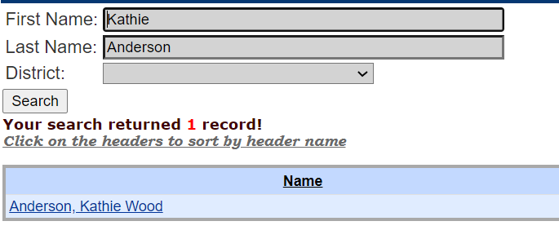
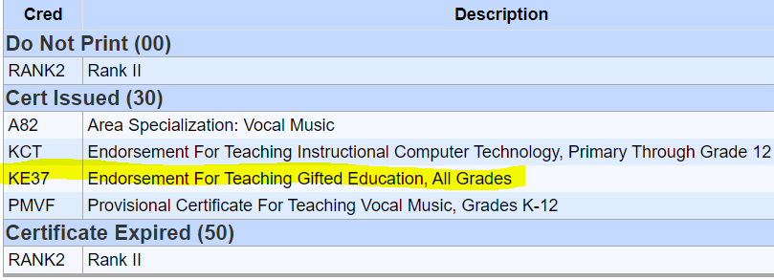
How to Check Credentials
EPSB webpage
How do I…
Check educator credentials
Type in name
Click search
Select correct person
Credentials

Slide 16
Certification Contact Information
Division of Educator Certification and Preparation
Phone: (502) 564-4606
Fax: (502) 564-7092
Email: KDELicensure@education.ky.gov

Slide 17
Gifted Regulation 704 KAR 3:285
Notes:
Drop “How well do you know gifted reg” form in Q and A

Slide 18
Gifted Regulation (704 KAR 3:285)
Introduction – covers the definition of gifted students and that district must have a gifted program. Gifted students are a category of exceptional children.
Sections:
1 - Definitions
2 – Policies and Procedures
3 – Identification and Diagnosis of Gifted Characteristics, Behaviors, and Talent and Determination of Eligibility for Services
4 – Procedure for Determining Eligibility for Services
5 – Program Evaluation
6 – Service Delivery Options
7 – Curriculum
8 – Personnel
9 – Budget; Funding
10 – Procedural Safeguards
Notes:
Review sections; clarify terms that are often questioned

Slide 19
Programs for the Gifted and Talented
Important Ideas:
5 Gifted Categories
GT students are a category of exceptional students
All districts must have a gifted program grades K-12
Creativity
General Intellectual Ability
Leadership
Specific Academic Aptitude
Math
ELA
Science
Social Studies
Visually and Performing Arts
Art
Dance
Drama
Music

Slide 20
Sections 1 & 2
Section 1 – Definitions
Section 2 – Policies and Procedures
Definitions cover many terms from Acceleration – Visual or performing arts abilities:
#3 - Cluster group
#4 - Collaborative teaching
#17 - GT Selection and Placement Committee
#19 - High Potential Learner
#33 - Underachieving
Available for public inspection
Locally board approved
Procedures that address each requirement

Slide 21
Section 3. Identification and Diagnosis of Gifted Characteristics, Behaviors, and Talent and Determination of Eligibility for Services
Districts must develop a system for selecting and identifying student in grades K-12:
Primary Talent Pool – informal selection
Grades 4-12 – formal and informal depending on the category
Diagnostic screening allows equal access for racial and ethnic minorities, disadvantaged and children with disabilities
A procedure must be developed for obtaining parent input related to a student’s interests, needs and abilities to determine appropriate services.
Parents must be notified of their student’s services annually through the gifted student service plan (GSSP).

Slide 22
Section 4. Procedure for Determining Eligibility for Services
Data Gathering – A district must develop a system for searching the entire school population on a continuous basis
Local or national norms may used to identify students
Local Norms Guidance on GT Resources webpage
GT Selection and Placement Committee (definition #17)
Special Considerations
Guidance on GT Resources webpage
Exceptions to the regulation criteria
Disabling conditions which may mask abilities
Environmental, cultural, disabling conditions
Student with an IEP
Disadvantaged
Underachieving

Slide 23
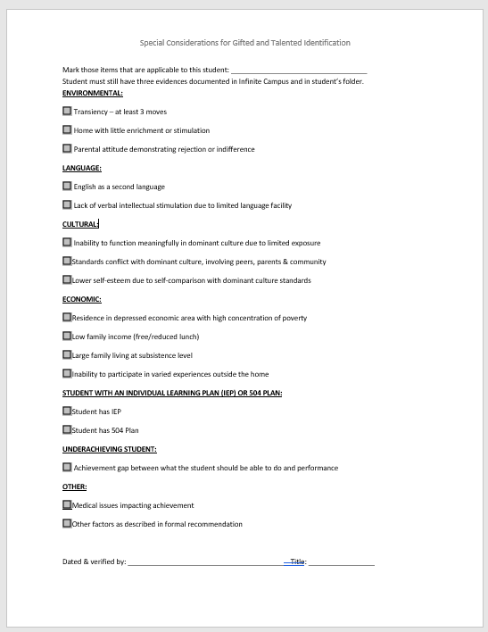
Special Considerations Form – page 67 of GT Coordinator Sample Handbook

Slide 24
Section 5. Program Evaluation
District must have a process for annually conducting a program evaluation
Overall student progress
Student, parent and faculty attitudes
Community involvement
Cost effectiveness
Incorporation of gifted education into the regular school program
Overall quality of instruction and program personnel credentials
Future program directions and modifications
Data collected in the annual program evaluation must be used in the school and district instructional planning process
Student progress as it relates to the GSSP must be reported once each semester
Notes:
What would be some good questions to ask on a student, parent or faculty survey?

Slide 25
Section 6. Service Delivery Options
Main Ideas:
Services Listed
Student grades K-12 must have a minimum of 2 service options
Services must meet students interests, needs and abilities
Services must be offered during the regular school day except for academic competitions or extra-curricular activities
(a) Various acceleration options (e.g., early exit from primary, grade skipping, content and curriculum in one (1) or more subjects from a higher-grade level);
(b) Advanced placement and honors courses;
(c) Collaborative teaching and consultation services;
(d) Special counseling services;
(e) Differentiated study experiences for individuals and cluster groups in the regular classroom;
(f) Distance learning;
(g) Enrichment services during the school day (not extracurricular);
(h) Independent study;
(i) Mentorships;
(j) Resource services delivered in a pull-out classroom or other appropriate instructional setting;
(k) Seminars;
(l) Travel study options; or
(m) Special schools or self-contained classrooms, grades four (4) through twelve (12) only.

Slide 26
Sections 7 & 8
Section 7. Curriculum
Section 8. Personnel
Curriculum must be:
Differentiated
Supplemented or
Modified
Replaced
Curriculum must meet students':
Needs
Abilities
Interest
District must hire GT certified staff to provide direct services to identified students
Staff must be GT certified when working directly with students in addition to the regularly assigned classroom teacher or
Staff must be GT certified if at least ½ of the day staff are working with only identified students
All other personnel who work with GT students must be prepared through professional development to address the needs, interests and abilities of identified students

Slide 27
Section 9. Budget, Funding
State funds must be used for direct service to identified students
Direct services must be provided by GT certified staff (16 KAR 2:110)
75% of the GT state funds must be expended to hire GT certified personnel to provide direct instructional services
The district must designate a gifted education coordinator
State funding is contingent upon:
Employing GT certified staff to administer and teach in the program
Submission of end of year reports and summative evaluation
Complying with the gifted regulation

Slide 28
Section 10. Procedural Safeguards
District must have grievance procedures for parents, guardians or students to resolve a concern regarding services of PTP or formally identified student’s GSSP.
The procedures must address:
How and by whom the grievance is started
Process for determining the need to evaluate or reevaluate the student for services
Criteria for determining if placement needs revision
Procedures for ensuring services are provided to all identified students
The procedures must include the participation of the parent/guardian, regular education teacher of the student, GT teacher or coordinator, administrator and counselor in addressing the grievance.

Slide 29
GT Coordinator Sample Handbook

Slide 30
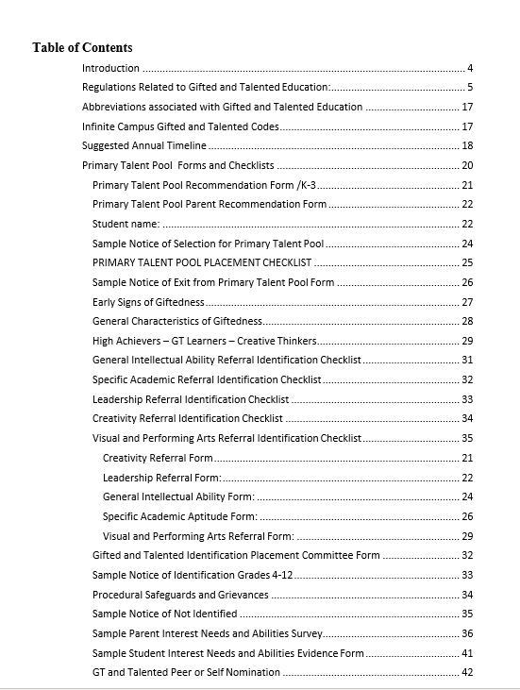
GT Coordinator Sample Handbook
Briefly review handout sent to participants, also posted on GT Resources webpage
Sample documents and forms
Calendar of events
GT forms
Referral
Checklists
Characteristics of gifted students
Assessment suggestions

Slide 31
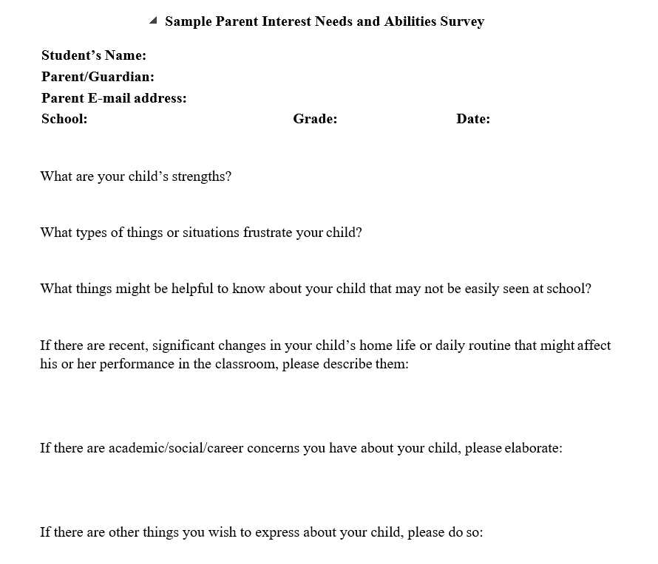
Parent Input Form

Slide 32
Infinite Campus

Slide 33
Infinite Campus Rights and Reports
Rights/permissions obtained from KSIS contact
GT participation tool
Reports you will need access to:
Ad hocs under State Reporting
Student G&T – Invalid Start Date – Year End Cleanup
Student G&T – Validation Roster for State Testing
Student G&T – Invalid gifted category
Student G&T – Invalid Primary Talent Pool
Student G&T – Invalid Specific Academic Aptitude
Student G&T student list
KY State Reporting / QA Gifted and Talented Report
System Admin rights for Customs forms/Parent Portal

Slide 34
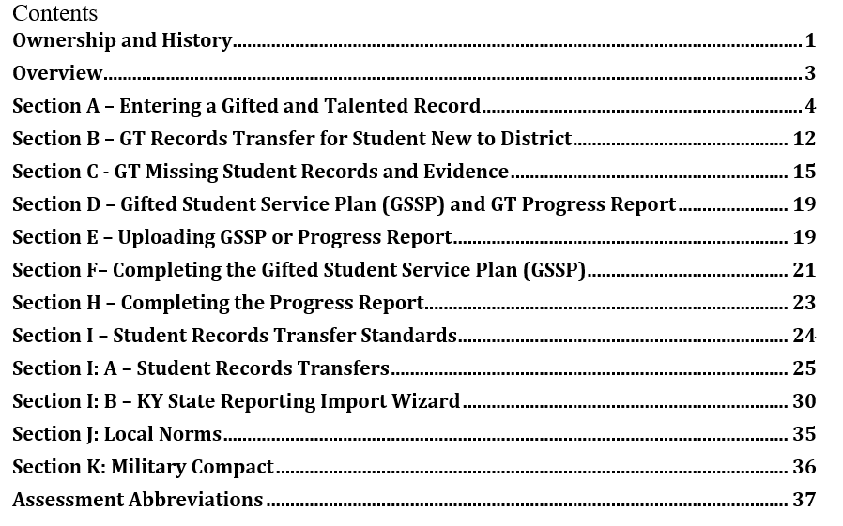
Data Standards
GT records
Missing records and evidence
GSSP
Progress Report
Publishing forms to Parent Portal
Notes:
Correct way to enter information into Infinite Campus (IC)
How to correct/update missing records and records that are missing important information
How to complete the Gifted Student Service Plan (GSSP) and Progress Report in IC
How to publish the GSSP and Progress Report to the Parent Portal
Briefly review Data Standards – bring up Data Standards document (participants can refer to handout sent in email)– we will review in more detail in a separate training

Slide 35
Missing Records/Data
GT records do NOT automatically transfer with student
Enrollment personnel must import record and forms of transfer students
When missed, enrollment personnel request records transfer through IC (covered in detail in GT Data Standards)
Broken Chain – happens when a student moves to a new district; district does not import record; student moves to another district; district cannot import record because previous district did not import; record must be entered manually and must look exactly like the original record or creates a new record for the student
District should create a process to ensure transfer student records are imported – suggest a training with enrollment staff at the beginning of each school year

Slide 36
Missing Records/Data Continued
Contact the GT Consultant for assistance with entering manual records
consultant can see all records ever created for student and enrollment history
GT Consultant will contact the district with missing records:
records need to be imported/corrected ASAP
GT Selection and Placement Committee must meet to discuss services/placement
Missing data/information on record:
usually the 9th stanine for GIA and SAA students

Slide 37
Questions

Slide 38
Funding

Slide 39
Funding
Each year, districts receive a GT grant from state funds
Funds are regulated by the General Assembly
Funding formula is based on a tiered system of general student population
Currently the GT State Grant is approximately $6.2 million
In order to receive the grant, districts must be in compliance with gifted regulation
75% must be spent to hire GT personnel to provide direct services to students
State Funding Matrix lists allowable expenses (review handout)
Grant for each district posted on the State Grant webpage

Slide 40
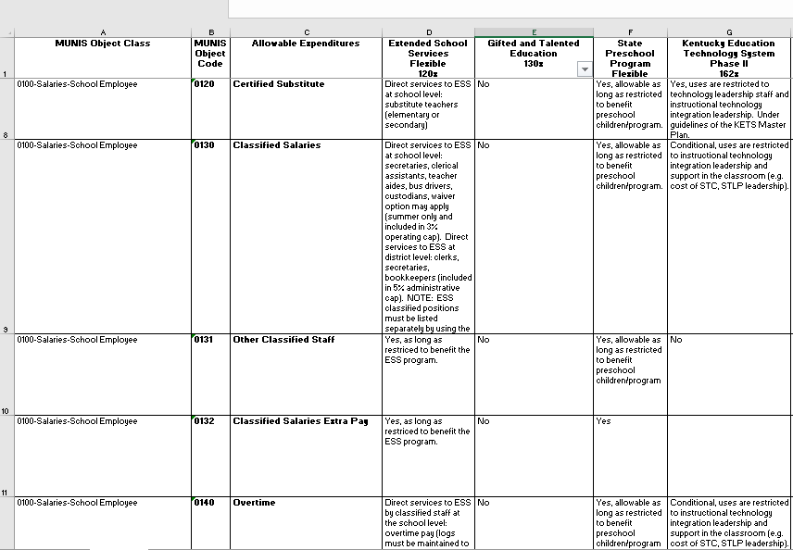
Non-Competitive Funding Matrix

Slide 41
Resources and Support

Slide 42
Webpages
KDE Gifted and Talented Resources webpage: regulation, training presentations and videos, guidance documents, data standards, brochures
KDE COVID-19 webpage: guidance, news releases, links to other agency information
Kentucky Association for Gifted Education: advocacy group, professional development
National Association for Gifted Children : advocacy group, GT program standards, many resources for teachers and parents
Hoagies Gifted Education Page : many links and resources for students, parents and teachers
Gatton and Craft Academies

Slide 43
GT Cadre Leaders Regional Support
Central Kentucky area – Leann Pickerill at leann.pickerill@paris.kyschool.us
Green River Regional area – Jennifer Sheffield at jennifer.sheffield@simpson.kychools.us
Jefferson County Public Schools – Staci Eddleman at staci.eddleman@Jefferson.kyschools.us
Kentucky Educational Development area (KEDC) – Genny Jenkins at genny.jenkins@rowan.kyschools.us
Kentucky Valley Education area – jeanne.lee@harlan.kyschools.us
Lake Cumberland Regional Cadre – Beth Patrick at beth.patrick@pulaski.kyschools.us
Northern Kentucky Association for Gifted Education – Shannon Gubser at shannon.gubser@newport.kyschools.us
Ohio Valley Educational area – Janet Fraser at janet.fraser@oldham.kyschools.us
Western Kentucky area – Toddie Adams at tatiana.adams@marshall.kyschools.us

Slide 44
New GT Coordinator Cadre
Support group for new coordinators and anyone else who would like to join
Pair with a mentor
Training on GT topics: data standards, assessments
Discuss member questions
Notes:
Drop link to new cadre in Q and A

Slide 45
Contact Information
Kathie Anderson, GT Program Consultant
Phone (direct line): 502-892-6560
Email: kathie.anderson@education.ky.gov

