Slide 1
Introduction to Serving English Learner (EL) and Immigrant Students
KDE Office of Continuous Improvement and Support
Division of School and Program Improvement

Slide 2
Goals
Participants in this training will gain an understanding of …
English learner and immigrant definitions
Legal background related to serving EL and immigrant students
The district Lau Plan
Kentucky’s membership in the WIDA consortium
EL and immigrant data collection and reporting

Slide 3
Definitions
English Learner
Individuals aged 3 through 21:
Represent countless language backgrounds and nationalities (including many born in the U.S.)
May be from any grade, academic proficiency, socioeconomic level, etc.
Whose primary language is a language other than English
Immigrant
Individuals aged 3 through 21 who:
Were not born in any state (including the 50 states, District of Columbia and Puerto Rico); and
Have not been attending one or more schools in any one or more states for more than 3 full academic years.
The term immigrant is not related to an individual’s legal status in the United States.
Notes:
For the full definition of an English learner see ESSA 8101(20). For the full definition of an immigrant student see ESSA 3201(5).
Some other terms you'll hear a lot when working with ELs are "former EL" and "never EL". A former EL is a student who was an English learner at one point but has met the proficiency standards and exited the program; you might also hear these students referred to as "exited ELs". A "never EL" refers to a student who has never been identified as an English learner. You might also hear the term "non-EL" referring to a student who is not an English Learner.
The immigration/citizenship status of the student, parent/guardian, or sponsor has no bearing on whether or not the student meets the definition of an immigrant student (See USED Fact Sheet II – Questions and Answers on Enrolling New Immigrant Students question B-3) https://www2.ed.gov/policy/rights/guid/unaccompanied-children-2.pdf.
It should be noted that immigrant students placed in Health and Human Services shelters after crossing the border are not enrolled in local schools but do receive educational services and other care from providers who run HHS shelters. Time spent in HHS shelters does not count as time spent in a U.S. school. KDE verified this with USED via email in November 2019.
See: Educational Services for Immigrant Children and Those Recently Arrived to the United States Fact Sheet (https://www2.ed.gov/policy/rights/guid/unaccompanied-children.pdf)

Slide 4
Legal Background
Federal Legislation | Significance
Title VI of the Civil Rights Act of 1964 | Prohibits discrimination on the basis of race, color or national origin in programs receiving federal funding. Affirmed to include language minority children in the May 1970 Memorandum.
Equal Educational Opportunities Act (EEOA) of 1974 | Prohibits states from denying equal educational opportunity by the failure to take appropriate action to overcome language barriers that impede equal participation by students.
Lau v. Nichols (1974) | Students cannot be denied access in or participation in an educational program due to an inability to speak or understand English.
Castañeda v. Pickard (1981) | Sets the criteria for examining EL programs and established a three-part test to evaluate the adequacy of a district’s EL program: Qualified teachers implementing sound theory (includes training of staff) Soundness of educational approach (effective teaching methods, including resources and personnel) School districts must evaluate their programs and make adjustments where needed to ensure language barriers are actually being overcome.
Plyler v. Doe (1982) | Public schools may not require Social Security numbers or original birth certificates from students for enrollment. Schools are required to provide equal access to a basic public education to all students regardless of immigration status.
Notes:
This isn’t an exhaustive list, just a brief overview of some of the most important federal laws and court cases related to serving English learners.
The May 1970 Memorandum affirmed the application of the Civil Rights Act (https://www.govinfo.gov/content/pkg/USCODE-2010-title42/pdf/USCODE-2010-title42-chap21-subchapV.pdf) to language minority children as language is intertwined with national origin. (https://www2.ed.gov/about/offices/list/ocr/docs/lau1970.html)
Congress passed the EEOA to encode in legislation the requirement that SEAs and LEAs take affirmative action to ensure that all students have access to the full range of opportunities a school district offers. (https://www.govinfo.gov/content/pkg/USCODE-2010-title20/pdf/USCODE-2010-title20-chap39-subchapI-part2-sec1703.pdf)
Lau is one of the most influential cases related to ELs. The San Francisco Unified School District was requiring English proficiency in order to graduate but was not providing language assistance to Chinese American students. The district had a number of services in place for Spanish-speaking students, however they are required to help all of their language-minority students. This is important as we often think of the term "EL" as synonymous with "Hispanic students," but ELs come from a variety of linguistic and cultural backgrounds. Remember, in school districts where the number of ELs in small, EL students must still receive language assistance services whether the district receives Title III funds or not. (https://www2.ed.gov/about/offices/list/ocr/ell/lau.html)
Castañeda is the first instance in which any authoritative body attempted to define what made language minority instruction "appropriate.“ (http://web.stanford.edu/~hakuta/www/LAU/IAPolicy/IA1bCastanedaFullText.htm)
In Plyler v. Doe, a Texas school district was attempting to charge a tuition to children whose U.S. citizenship could not be confirmed. The Supreme Court found it unacceptable to both fully deny education to any group or subgroup of children, and to penalize minors for "crimes" committed by their parents over which they had no control. The district had alleged it was unfair to children who were citizens and legal residents to have to share their resources with children who were not legal residents. In their ruling, the Supreme Court explains that any resources which might be saved from excluding undocumented children from public schools were far outweighed by the harms imposed on society at large from denying them an education. The basis of this ruling is what's known as the "Equal Protection Clause" of the 14th Amendment of the Constitution which states, "no state shall deny to any person within its jurisdiction the equal protection of the laws.“ (Plyler v. Doe https://www.law.cornell.edu/supremecourt/text/457/202; Equal Protection Clause https://www.law.cornell.edu/constitution/amendmentxiv)

Slide 5
Civil Rights Obligations
Identifying and assessing all potential EL students
Providing EL students with a language assistance program
Staffing and supporting an EL program
Providing meaningful access to all curricular and extracurricular programs
Avoiding unnecessary segregation of EL students
Evaluating EL students for special education services and providing special education and English language services
Meeting the needs of EL students who opt out of EL programs or particular EL services
Monitoring and exiting EL students from EL programs and services
Evaluating the effectiveness of the district’s EL program
Ensuring meaningful communication with limited English proficient parents
Notes:
All districts and schools have an obligation to provide appropriate services under Title VI of the Civil Rights Act of 1964 and the EEOA of 1974. These services constitute the district’s core EL program. It’s important to note that civil rights and EEOA required EL services cannot be paid for with federal funds. The January 2015 Dear Colleague Letter issued jointly by the Department of Education and the Department of Justice is a great resource regarding these obligations.
We will take an in-depth look at each of these obligations in the two-part video series Civil Rights Requirements parts one and two.
Sources
Dear Colleague Letter https://www2.ed.gov/about/offices/list/ocr/letters/colleague-el-201501.pdf
Non-Regulatory Guidance A-3 https://www2.ed.gov/policy/elsec/leg/essa/essatitleiiiguidenglishlearners92016.pdf
USED Fact Sheet https://www2.ed.gov/about/offices/list/ocr/docs/dcl-factsheet-el-students-201501.pdf

Slide 6
District EL Program
All districts are required to develop and maintain an up-to-date EL program plan to meet Civil Rights and EEOA requirements.
This includes districts with no ELs currently enrolled.
To ensure ELs, including immigrant children and youth, attain English language proficiency (ELP), develop high levels of academic achievement in English, and meet the same challenging state academic achievement standards as all children are expected to meet.
District EL Program Purpose
Notes:
Under Castañeda, an acceptable EL program includes:
A curriculum recognized by experts in the field
The programs/methods used are effective in carrying out the curriculum
The program proves successful in helping overcome language barriers

Slide 7
Lau Plan
Designed to meet district obligations under Title VI of the Civil Rights Act and the EEOA
Designed by a team through consultation with stakeholders
A working document that should be regularly reviewed and revised
Notes:
The district plan is commonly referred to as a Lau Plan, referring to the Lau v. Nichols Supreme Court case. It may also be referred to as the district EL plan, EL program plan, etc.

Slide 8
Lau Plan Contents
Lau Plan Team
Names of the Lau Plan team members responsible for its development
Guiding Principles
The goals the plan is designed to achieve
Enrollment, Identification, Placement
The process for identifying and placing students in the EL program
Program Description
The type of Language Instruction Educational Program (LIEP) provided by the district
Meaningful Access
The process to ensure EL students have meaningful access to all programs and activities
Professional Development
Description of the professional development provided to staff who deliver instruction or support the LIEP
Exit Criteria and Procedures
The process for exiting students from the EL program
Monitoring Procedures
The process for monitoring students who have exited the EL program
Program Evaluation
ELP Assessment
The process for annually assessing EL students’ English language proficiency
How the district will evaluate the effectiveness of the EL program and make revisions when necessary
Notes:
Each district’s Lau Plan must contain the following information.
Districts may include additional information at their discretion. The Lau Plan should be readily accessible to the public, such as posted on the district website. The Lau Plan is one of the documents reviewed by KDE during Consolidated Monitoring.
OCR’s EL Program Plan Development page provides additional guidance: https://www2.ed.gov/about/offices/list/ocr/ell/plandev.html

Slide 9
WIDA Consortium
Member-based organization made up of U.S. states, territories, federal agencies and international schools worldwide.
Dedicated to the research, design and implementation of a high-quality, standards-based system for ELs in grades K-12.
Notes:
Source: WIDA website

Slide 10
WIDA Consortium Membership
Kentucky joined WIDA in 2006
As a consortium member state, Kentucky utilizes the following WIDA resources:
English Language Development (ELD) Standards
English Language Proficiency (ELP) Screener
English Language Proficiency Assessment
Professional learning opportunities
Notes:
These resources help member states to remain in compliance with ESSA requirements such as adopting statewide English Language Proficiency standards, annually assessing English Language Proficiency, and the adoption of standardized entrance and exit procedures. WIDA also provides its members with professional learning opportunities including self-paced online modules, guided webinars, and face-to-face trainings.

Slide 11
English Language Development Standards
English Language Development Standards
Standard 1 – Social and Instructional Language
Standard 2 – Language of Language Arts
ELs communicate for social and instructional purposes within the school setting
ELs communicate information, ideas and concepts necessary for academic success in the content area of language arts
Standard 3 – Language of Mathematics
ELs communicate information, ideas and concepts necessary for academic success in the content area of mathematics
Standard 4 – Language of Science
ELs communicate information, ideas and concepts necessary for academic success in the content area of science
Standard 5 – Language of Social Studies
ELs communicate information, ideas and concepts necessary for academic success in the content area of social studies
Notes:
The WIDA English Language Development Standards represent the social, instructional, and academic language students use to engage with peers, educators, and the curriculum in schools. The standards highlight the language needed to meet academic expectations as described by state, college and career readiness standards, and other content standards such as Next Generation Science Standards.
You may have heard about the WIDA ELD Standards 2020 Edition. The 2020 Edition illuminates a vision where all students can develop language and learn content across educational settings. The 5 ELD standards listed on this slide are not changing; neither are the performance definitions or the Can Do Philosophy. The 2020 Edition will feature clear language expectations, short-hand reference codes, and reorganized content. The latest updates and information on the ELD Standards 2020 Edition can be found on the WIDA website under the “teach” heading. https://wida.wisc.edu/teach/standards/eld/2020
Source: https://wida.wisc.edu/teach/standards/eld

Slide 12
Using the WIDA English Language Development Standards for Instruction
Educators can use the standards to:
Promote and guide students’ English language development.
Aid in the development of curriculum, instruction and assessment.
Encourage and maximize the use of multiple language resources in the classroom.
Support and frame the collaboration among educators of multilingual learners and instructional teams who serve them to ensure educational equity for all students.
Notes:
The standards serve as a resource for planning and implementing language instruction and assessment for multilingual learners as they learn academic content.
The standards work along with content standards to ensure students engage in the learning of content standards as they continue to develop English.

Slide 13
Levels of Language Proficiency
WIDA divides the second language acquisition continuum into 6 stages describing the process of language development:
Level 1 – Entering
Level 2 – Emerging
Level 3 – Developing
Level 4 – Expanding
Level 5 – Bridging
Level 6 – Reaching

Slide 14
WIDA’s Can Do Descriptors
Notes:
In addition to the ELD standards, WIDA also provides us with the Can Do Descriptors. These grade specific charts provide examples of what ELs can do at various stages of English language development in listening, speaking, reading, and writing.
ELs bring a unique set of assets to the education community. By focusing on what these students can do, as opposed to what they cannot, we send a powerful message on how their experiences contribute and enhance the experiences of all learners and educators.
Source: https://wida.wisc.edu/teach/can-do/descriptors

Slide 15
Data Collection
October 1 count
U.S. Department of Education (USED) requires a count of all EL students enrolled on 10/1 of each year
Infinite Campus (IC) EL extract date range: Start and end date of Oct. 1 of current year
KDE will pull the data from IC
Districts should run extract on a regular basis and check student list
Correct critical errors
Ensure all ELs being served
Notes:
Reminder: The EL extract was formerly known as the LEP extract.

Slide 16
Annual Performance Report (APR)
Required for federal reporting for Title III
Completed in GMAP under Consolidated State Performance Report Details and Professional Development Details
Types of EL instructional services provided by district/consortium
EL-specific PD provided and number of participants

Slide 17
Data Quality
Annual data cleanup and verification period begins May 1.
Districts should periodically run EL extracts and immigrant reports to check for critical errors.
Critical errors. Students will not count as EL if:
No EL service type
No instructional accommodations
Home language is English

Slide 18
Data Updates
Program exit date of 6/30 of current school year if exited during that year.
Do not end-date EL services when a student transfers from your district, unless:
They have exited the EL program by obtaining English language proficiency on ACCESS, with an end date of 6/30 of current school year; or
Their service types have changed due to changes on the PSP.

Slide 19
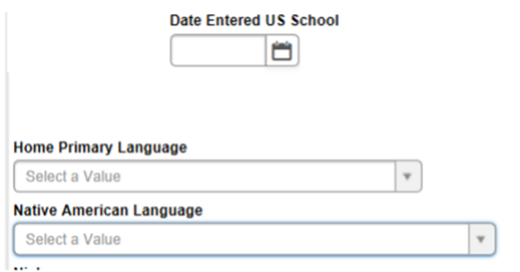
Data Entry: Demographics Tab
Campus Path: Census | People Demographics Tab
Enter the date in which the student first enrolled in a U.S. school.
Select the Home Primary Language from the drop list that was provided on the Home Language Survey.
If the student’s Home Primary Language is Native American (1025), then select the Native American Language from the drop list. If the language is not listed, then select other (N0000).
In the instance a foreign-born student is living in an English-speaking home, select the Home Primary Language based on the student’s native language.

Slide 20
Data Entry: Entering WIDA Screener/K W-APT Scores
Campus Path: Student Information | General | Assessment Tab
To enter WIDA Online Screener scores for ELs in grades 1-12, click the New button.
Select the appropriate WIDA Screener from the drop down.

Slide 21
Data Entry: Entering WIDA Screener Scores for Grades 1-12
Enter the date in which the assessment was taken.
Select the proficiency level from the drop list.
Select overall screener results from the drop list.
For each domain and composite, enter the date in which the assessment was taken and select the result from the drop down.
Save the data.

Slide 22
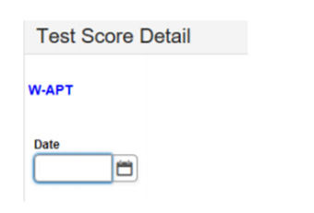
Data Entry: Entering WIDA Scores for Kindergarten W-APT
Click New button:
Select W-APT from the drop list:
Enter the date in which the assessment was taken.
No other elements are required for Kindergarten W-APT.

Slide 23
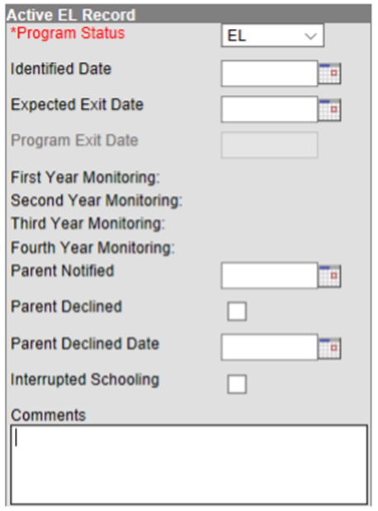
Data Entry: Program Status
Campus Path: Student Information | Program Participation | English Learners (EL) | EL Tab
Select the Program Status from the drop down.
Enter the date of eligibility based on an Initial Determination Test (WIDA Screener or K W-APT).
Enter the date in which the student is expected to exit the EL program.
The Program Exit Date should be entered as 6/30 of the year the student obtains ELP on the annual ACCESS. This should be entered as an end of year process (reference Reporting Timeline in Section F of the EL data standards).

Slide 24
Data Entry: Program Status (Cont.)
Enter the date on which the parents or guardian(s) were notified of their child’s eligibility for the EL program.
Only select the Parents Declined indicator and enter Parent Declined Date if EL services were refused and the waiver to refuse services was signed (enter the date the waiver was signed).
Select the indicator for Interrupted Schooling if the student missed school for a continuous month or more of the school year.

Slide 25
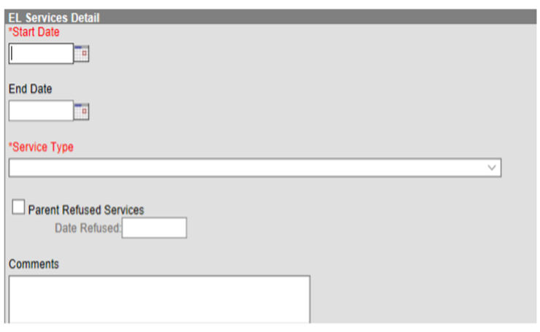
Data Entry: EL Services
Campus Path: Student Information | Program Participation | EL | EL Services
Must have at least one EL service type for reporting purposes.
Enter the date service started.
EL services should only be end-dated if a student exits EL Program Status or the student no longer needs the service based on an update to the student’s learning plan. The end date should be 6/30 of the reporting year in which the student exits the program.
Select the Service Type provided from the drop list.
Select the Parent Refused indicator if the parent/guardian(s) refused service and enter the date in which the parent refused.

Slide 26
Data Entry: EL Accommodations
Campus Path: Student Information | Program Participation | EL | EL Accommodations
Must have at least one EL Instructional Accommodation for reporting purposes.
Enter the date the accommodation starts.
EL accommodations should only be end dated if a student exits EL Program Status or the student no longer needs the accommodation based on an update to the student’s learning plan. The end date should be 6/30 of the reporting year in which the student exits the program.
Select the instructional or assessment accommodation from the drop list.

Slide 27
Student Records Transfer
Former (Originating) District: Preparing for transfer
The former (originating) district must end-date the enrollment of the student before releasing the record for all transfer functionality to work correctly.
Receiving District (Obtaining EL records from originating district):
Import Wizards
Assessment Import Wizard
English Learners (EL) Import Wizard
Extended Census Import Wizard
Transfer Documents
English Learners (EL)
EL Services
EL Accommodations
For expanded guidance, refer to the Student Records Transfer Data Standard.

Slide 28
Contact Information
Office of Continuous Improvement and Support
Division of School and Program Improvement
English Learners, Migrant, and Neglected Students Branch
(502) 564-3791
Kentucky Department of Education’s English Learners Contact Guide

Slide 29
Resources
Basic Information
English Learner and Immigrant Students webpage (KDE)
English Learner and Immigrant Resources webpage (KDE)
District Guide for the English Learners Program
Developing Programs for English Language Learners
Programs for English Language Learners
Migration Policy Institute (MPI) ELL Information Center
A Matter of Design: English Learner Program Models in K-12 Education (MPI)
Funding an Equitable Education for English Learners in the United States (MPI)
English Learner Resources (USED)
Legal Obligations and Guidance
2015 Dear Colleague Letter
English Learner Toolkit (USED’s Office of English Language Acquisition)
Memoranda on Schools’ Obligations Toward National Minority Students who are Limited English Proficient
Schools’ Civil Rights Obligations to English Learner Students and Limited English Proficient Parents
703 KAR 5:070
Legal Protections for K-12 English Learner and Immigrant Background Students (MPI)
Resources from the Migration Policy Institute are provided for informational purposes and are not endorsed by KDE.

Slide 30
Resources (Cont.)
Assessment
ACCESS for ELLs
ACCESS for ELLs Checklist
ACCESS for ELLs State-Specific Directions
Inclusion of Special Populations in State-Required Assessment and Accountability Programs 703 KAR 5:070 Guidance
Inclusion of Special Populations Training 703 KAR 5:070 Webinar
WIDA
WIDA Homepage
Kentucky Consortium Profile
English Language Development Standards
Teaching with WIDA’s ELD Standards
WIDA Resource Library
Data Collection
English Learner and Immigrant Data Collection and Reporting
Infinite Campus LEP Extract
English Learner Data Standards
Immigrant Data Standards
Student Records Transfer Data Standard
Kentucky Student Information System (KSIS) Data Standards
KSIS District Points of Contact
A Guide to Finding and Understanding English Learner Data (MPI)
Resources from the Migration Policy Institute are provided for informational purposes and are not endorsed by KDE.

