Slide 1
2022 Stilwell Awardees
Region 3

Slide 2
2022 Stilwell Awardee Kevin Brown with David Couch
Notes:
2022 Stilwell Awardee Kevin Brown with David Couch

Slide 3
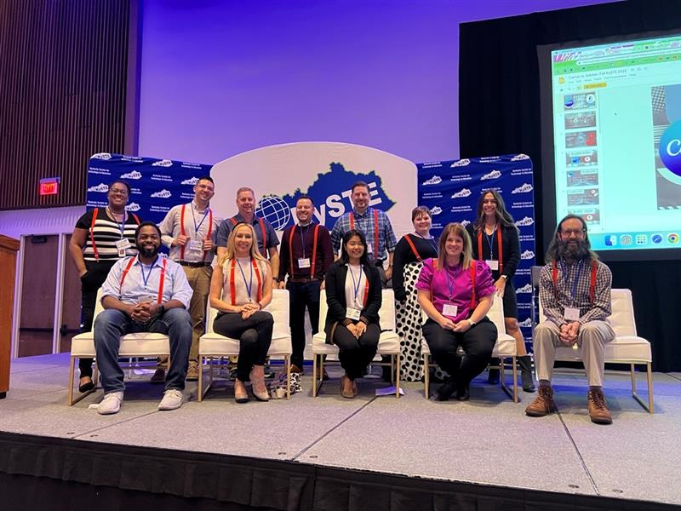
Jefferson County Stilwell Awardee
Notes:
Jefferson County Stilwell Awardee

