Slide 1
2022 Stilwell Awardees
Region 7

Slide 2
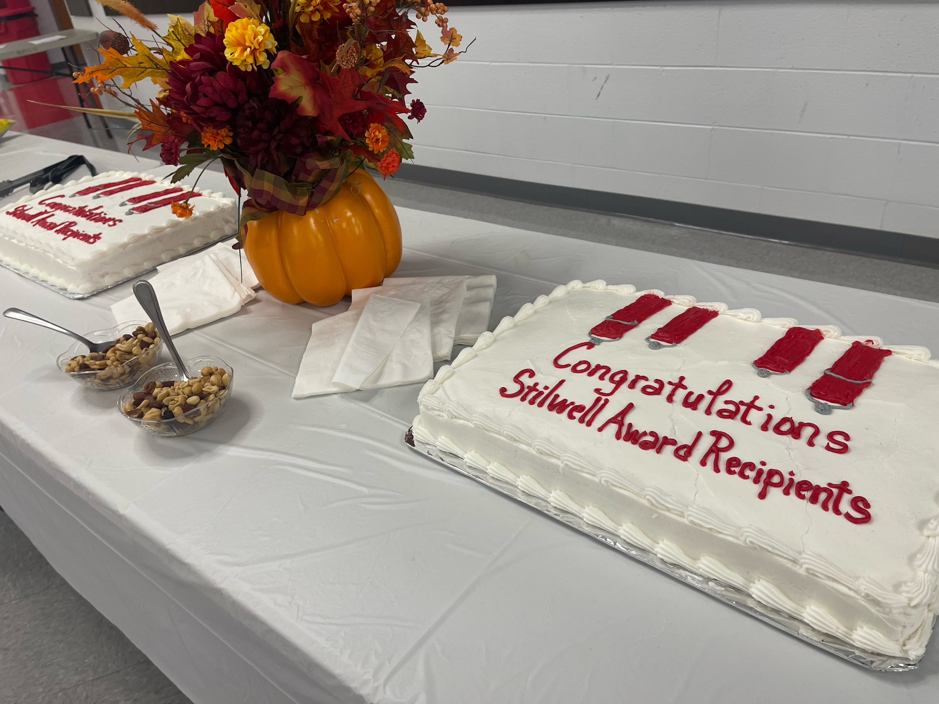
Stilwell Awardee Celebration Cake from Bath County
Notes:
Stilwell Awardee Celebration Cake from Bath County

Slide 3
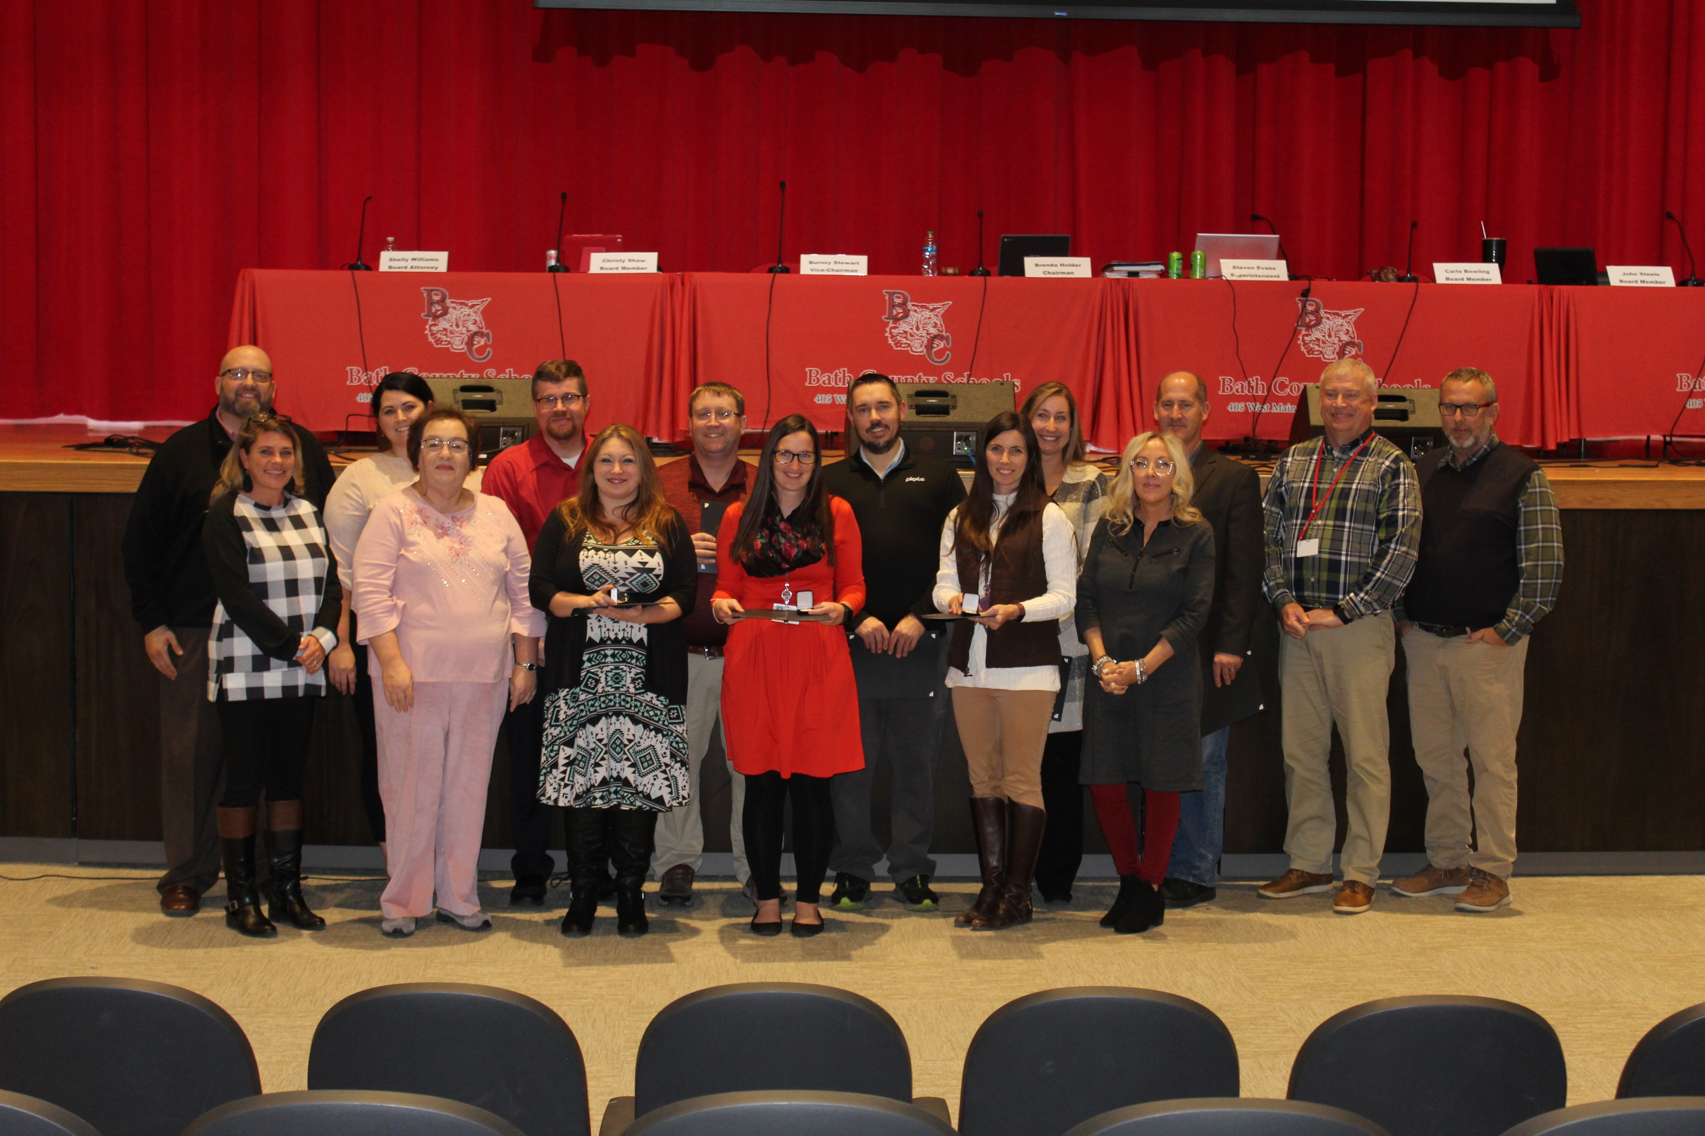
2022 Bath County Stilwell Awardees with Matt Jury
Notes:
2022 Bath County Stilwell Awardees with Matt Jury

Slide 4

2022 Bracken County Stilwell Awardees with Matt Jury
Notes:
2022 Bracken County Stilwell Awardees with Matt Jury

Slide 5
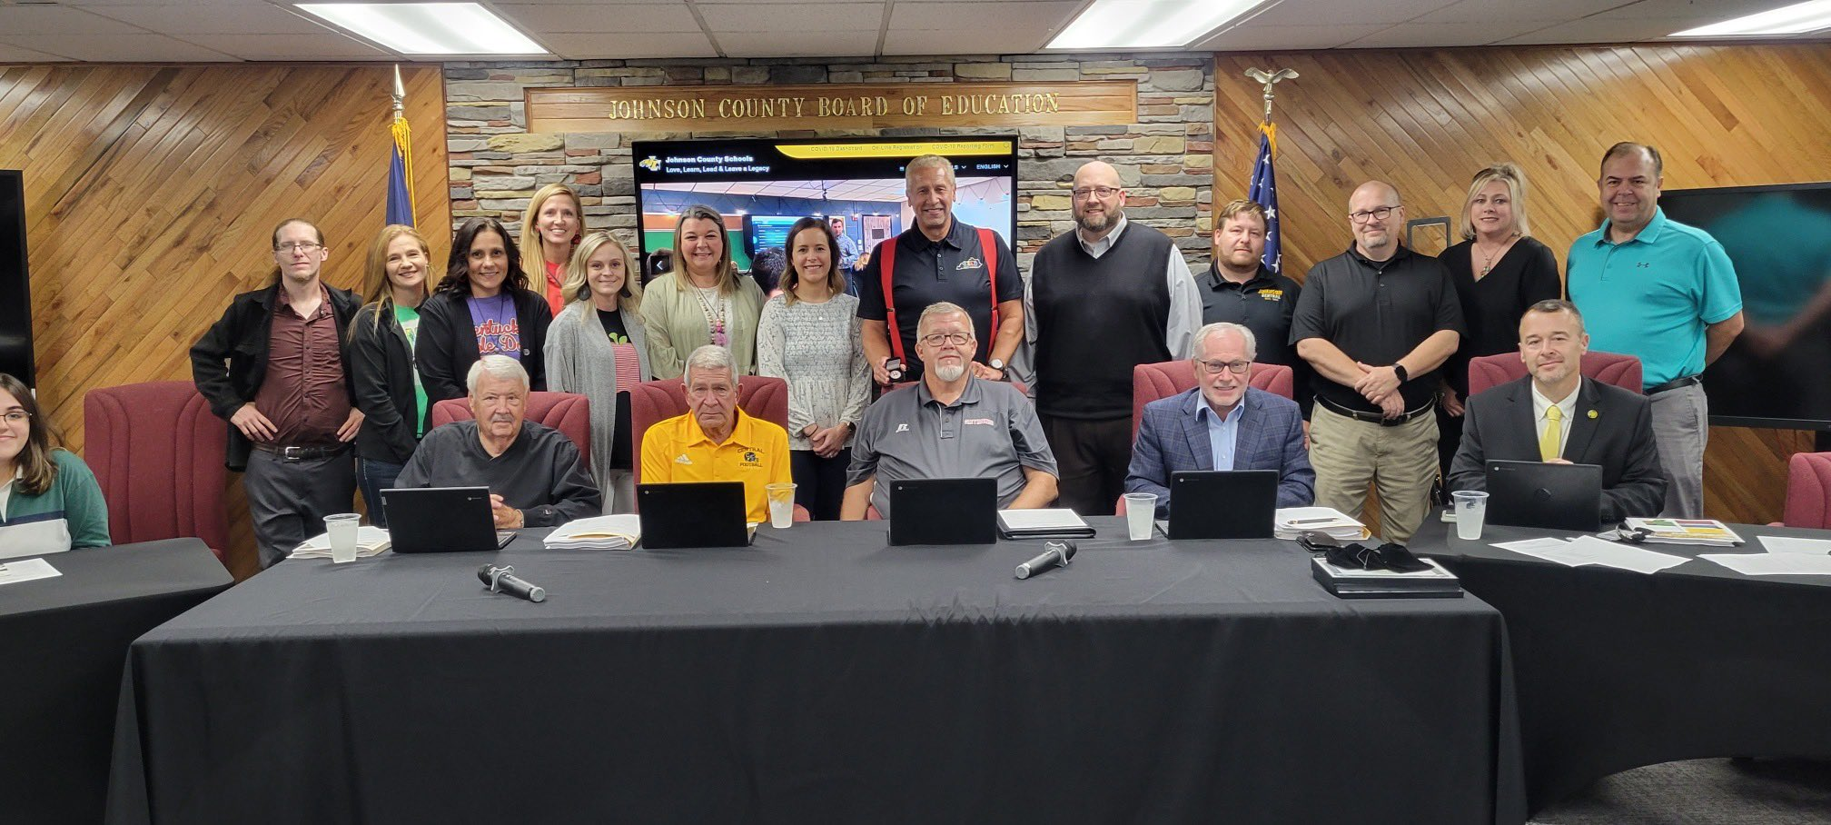
2022 Johnson County Stilwell Awardees with David Couch and Matt Jury
Notes:
2022 Johnson County Stilwell Awardees with David Couch and Matt Jury

Slide 6
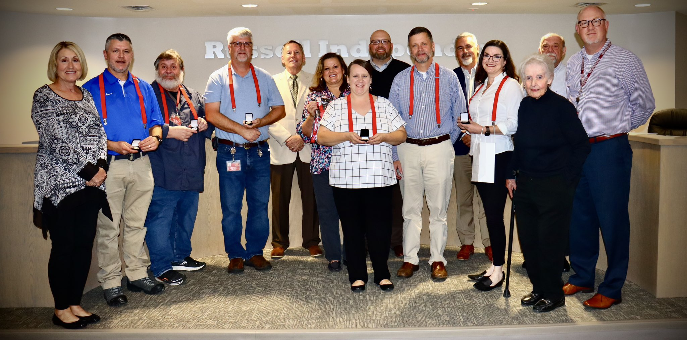
2022 Russell Independent Stilwell Awardees with Matt Jury
Notes:
2022 Russell Independent Stilwell Awardees with Matt Jury

Slide 7
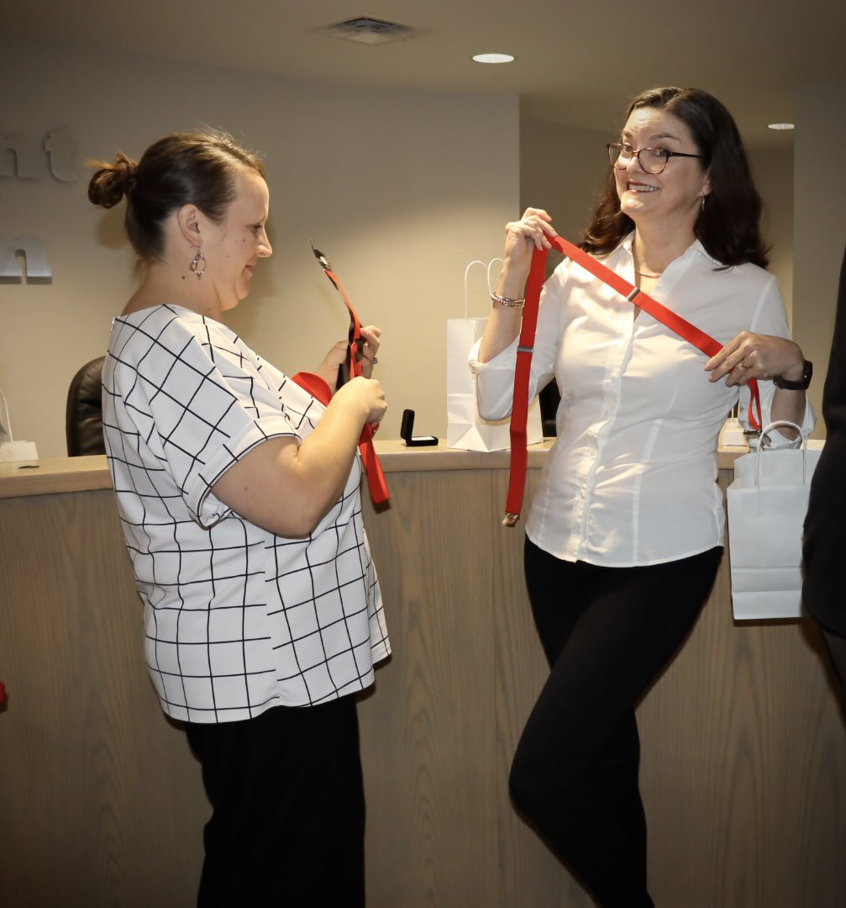
2022 Russell Independent Stilwell Awardees No. 2
Notes:
2022 Russell Independent Stilwell Awardees No. 2

