Slide 1
2022 Stilwell Awardees
Region 6

Slide 2
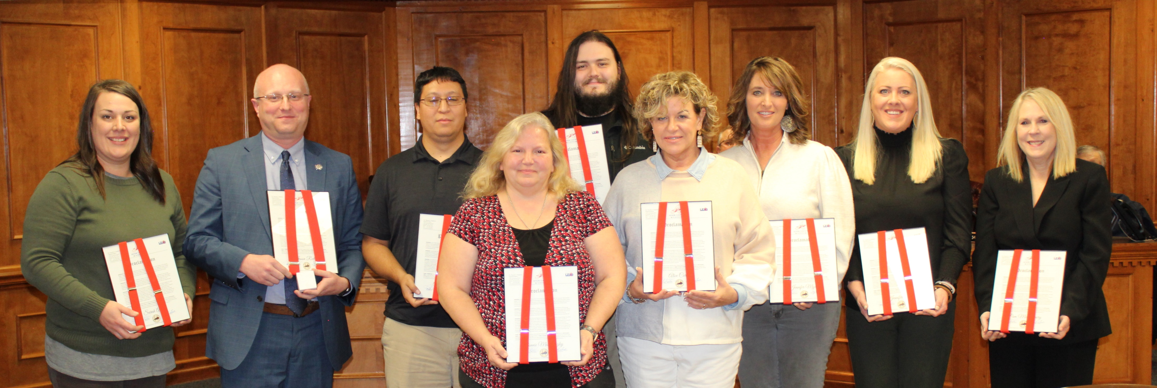
2022 Adair County Stilwell Awardees
Notes:
2022 Adair County Stilwell Awardees

Slide 3
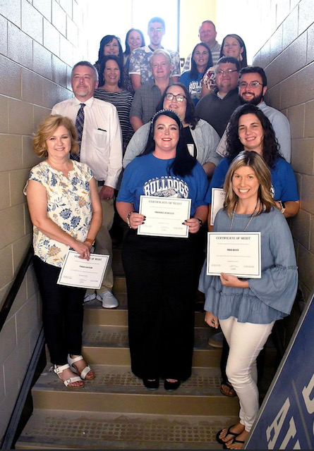
2022 Bell County Stilwell Awardees
Notes:
2022 Bell County Stilwell Awardees

Slide 4
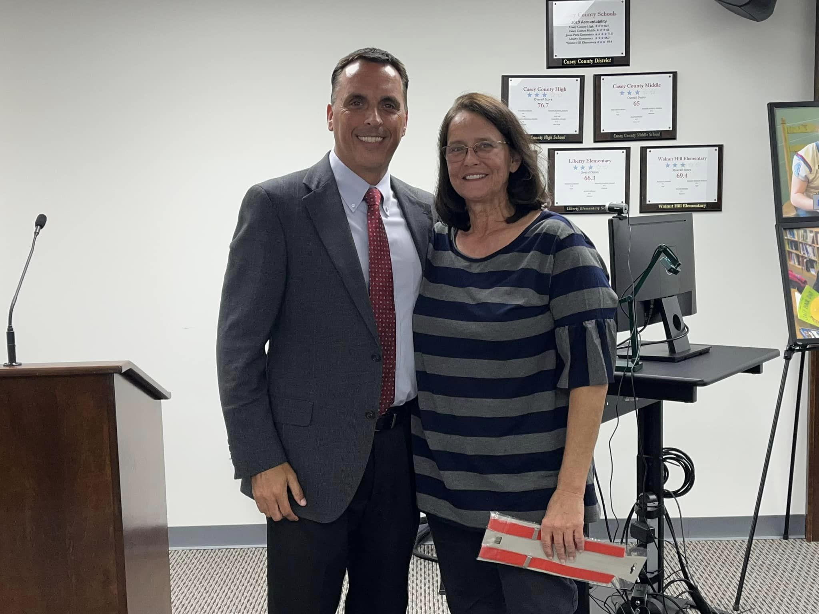
Casey County Stilwell Awardee No. 1
Notes:
2022 Casey County Stilwell Awardee No. 2

Slide 5
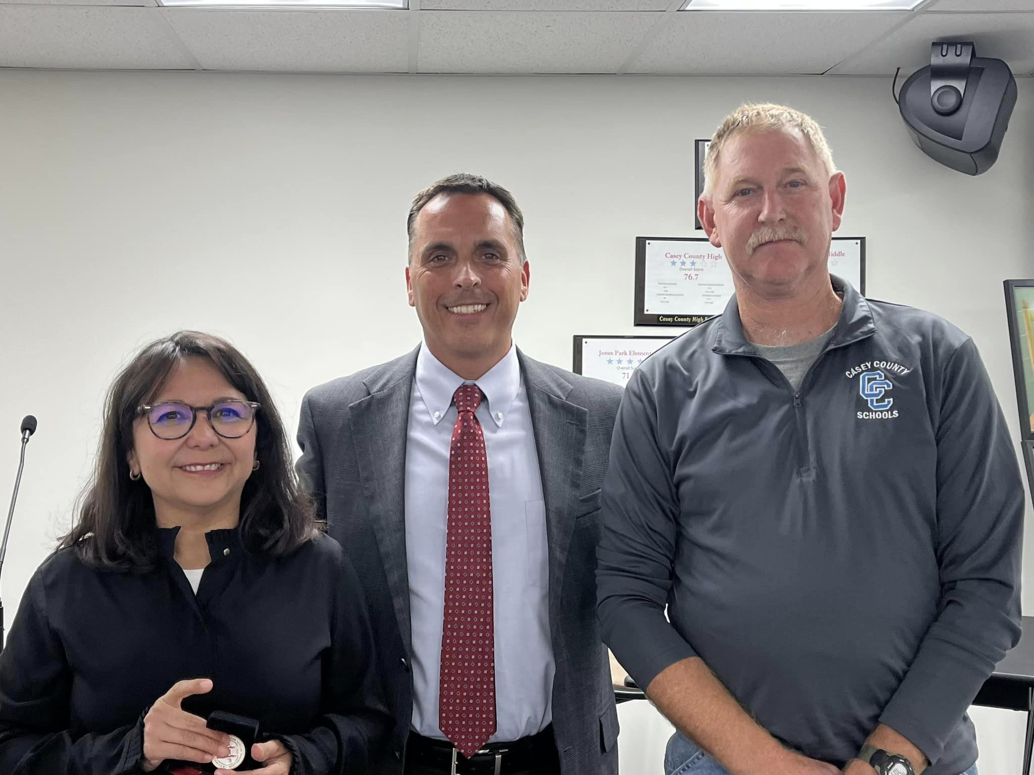
2022 Casey County Stilwell Awardees No. 2
Notes:
2022 Casey County Stilwell Awardee No. 4

Slide 6
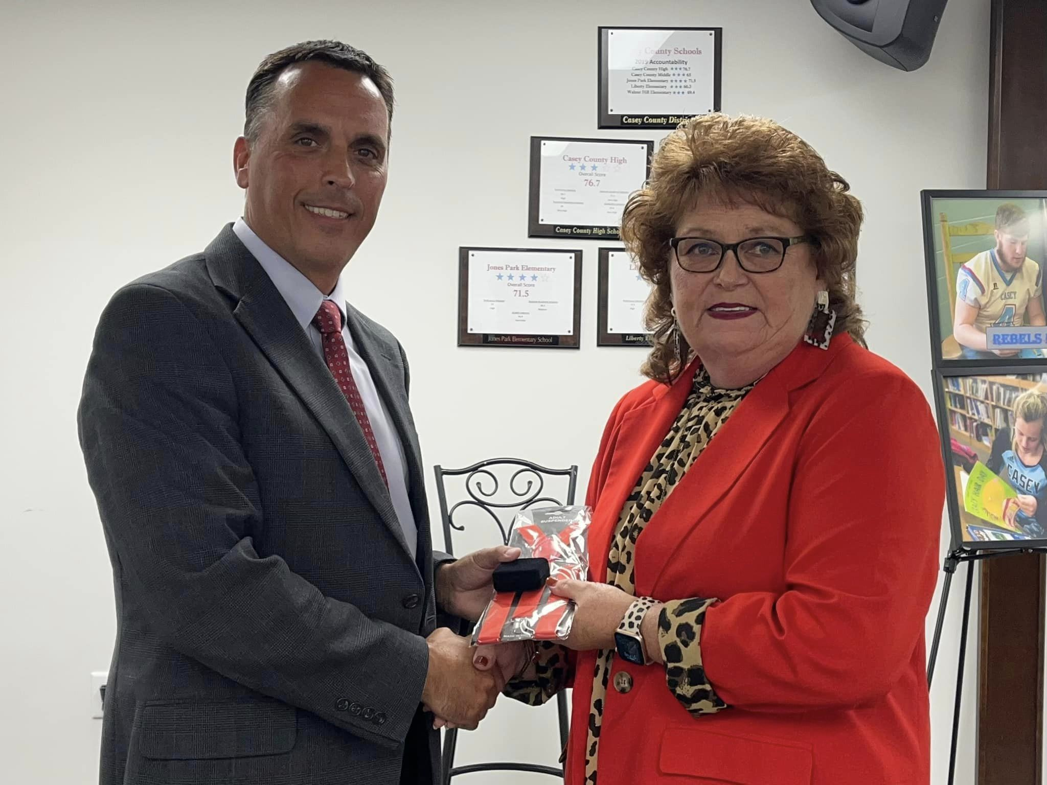
2022 Casey County Stilwell Awardee No. 3
Notes:
2022 Casey County Stilwell Awardee No. 3

Slide 7
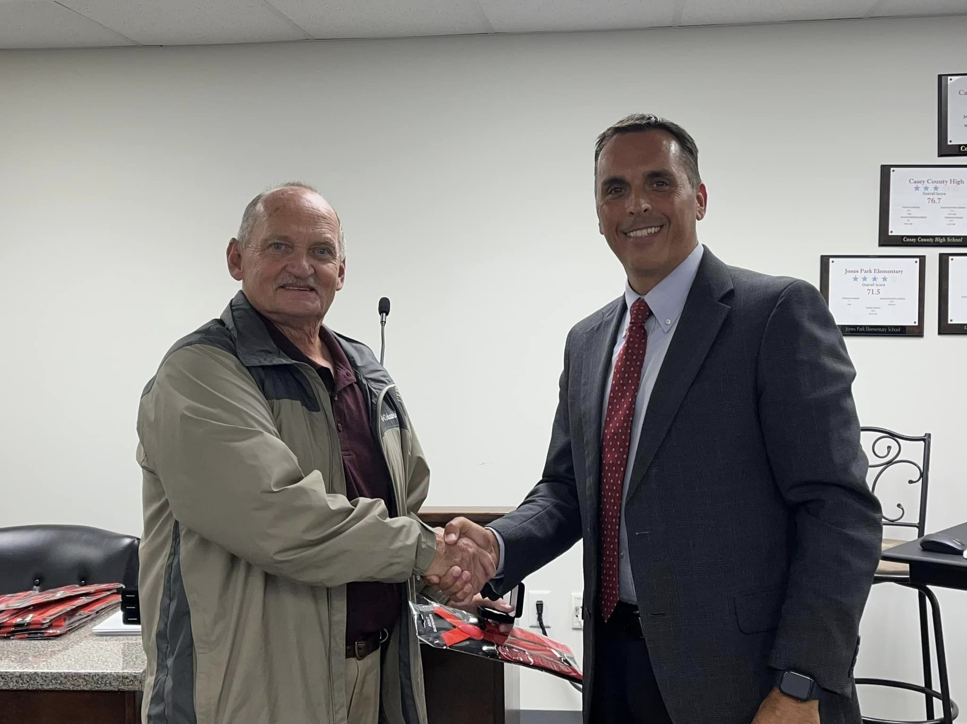
2022 Casey County Stilwell Awardee No. 4
Notes:
2022 Casey County Stilwell Awardee No. 4

Slide 8
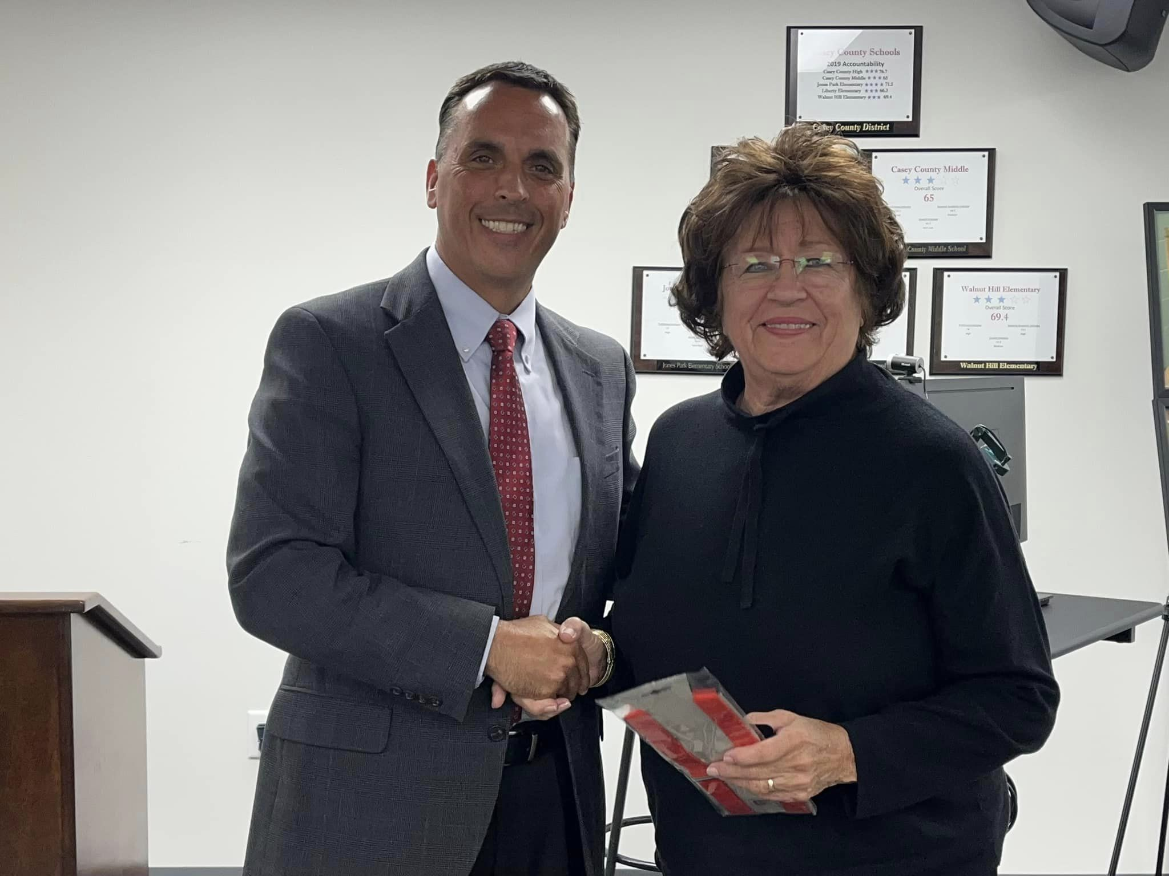
2022 Casey County Stilwell Awardee No. 5

Slide 9
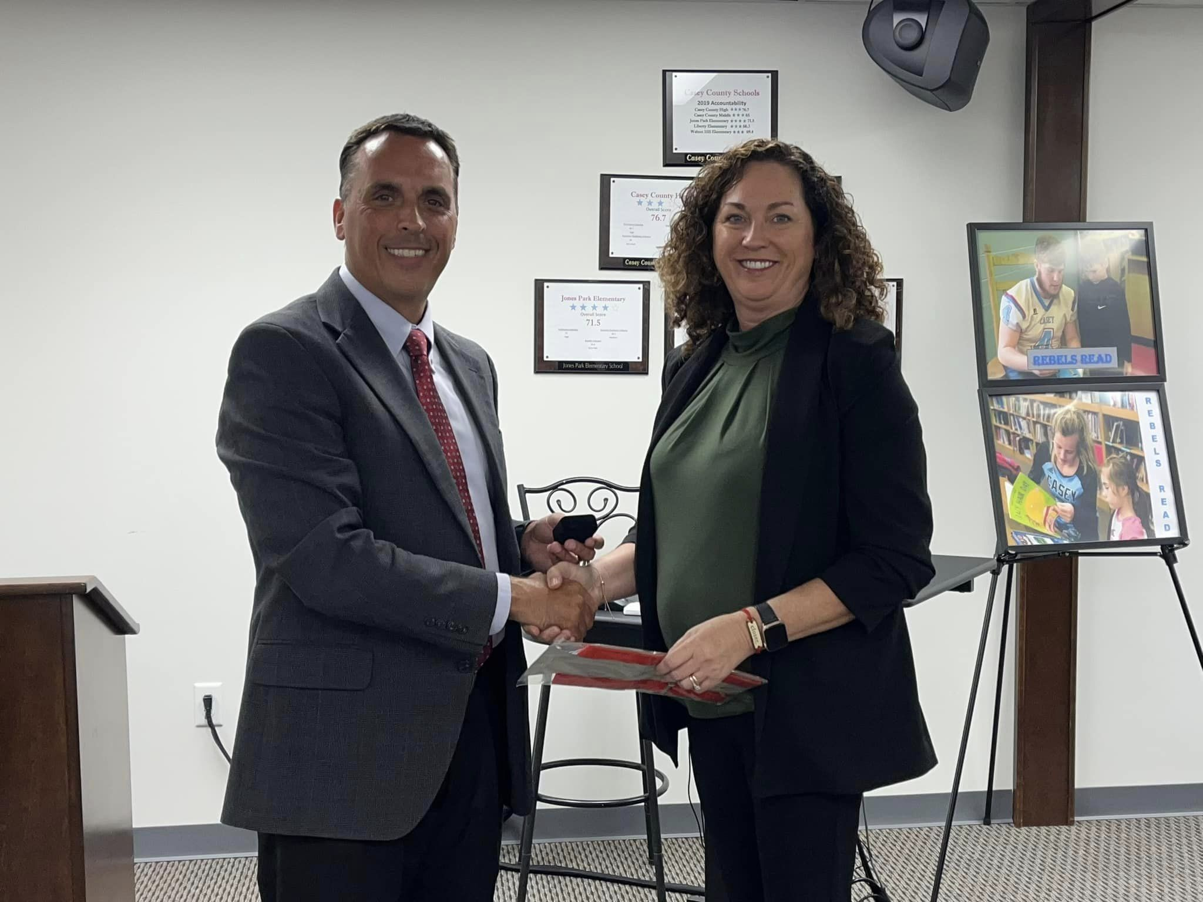
2022 Casey County Stilwell Awardee No. 6

Slide 10
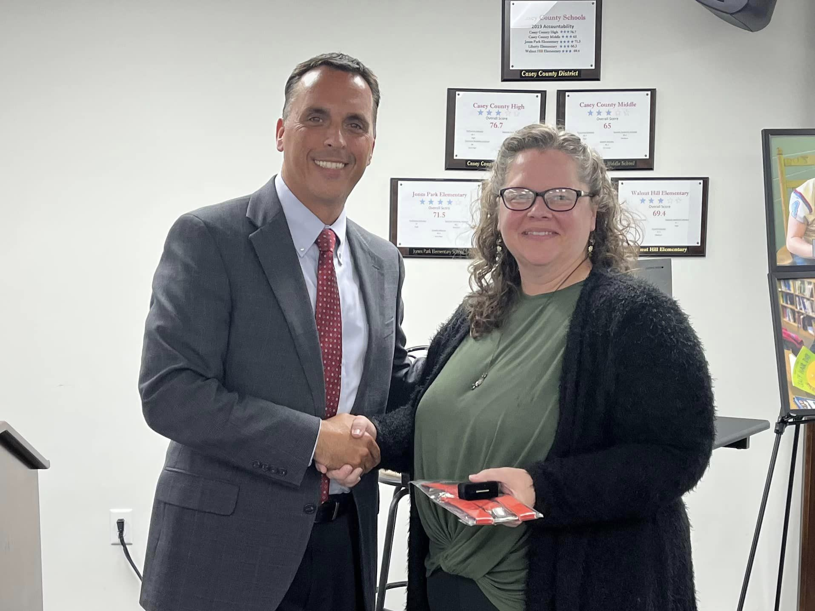
2022 Casey County Stilwell Awardee No. 7

Slide 11
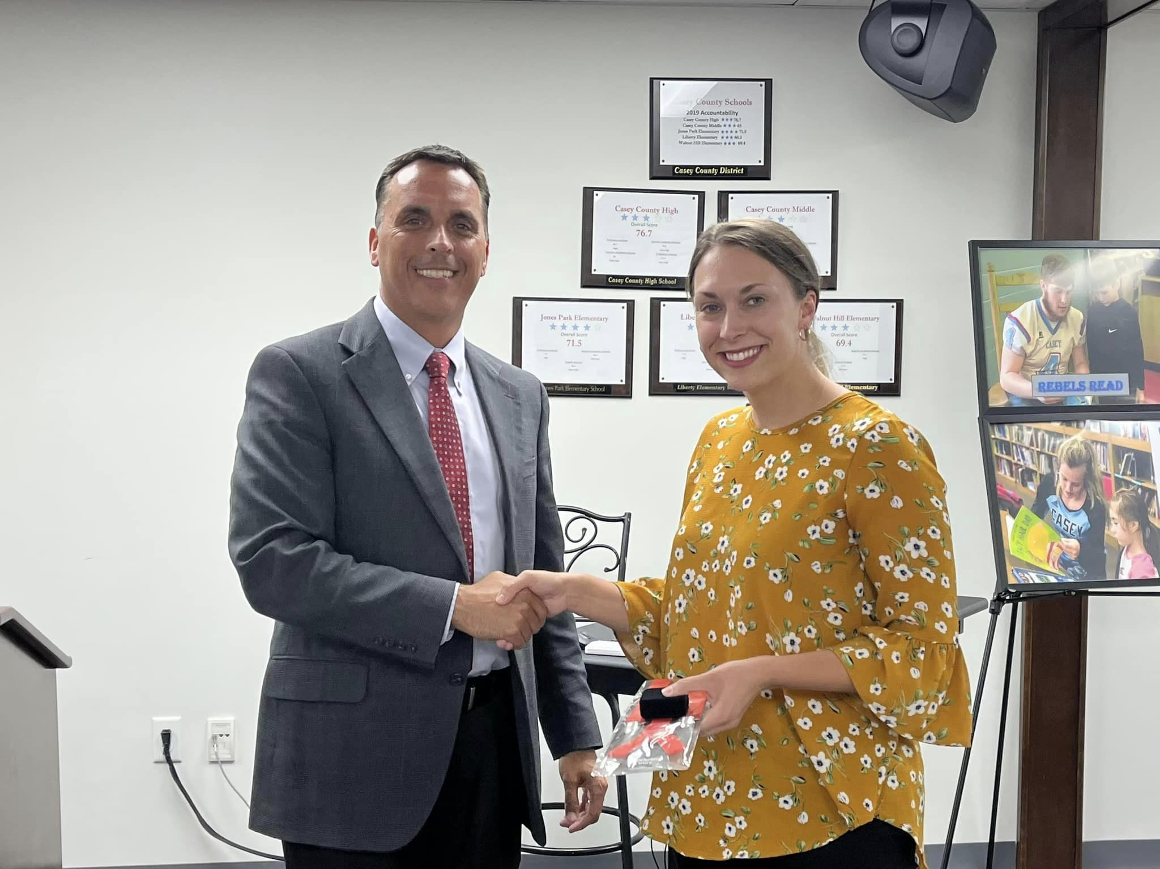
2022 Casey County Stilwell Awardee No. 8

Slide 12
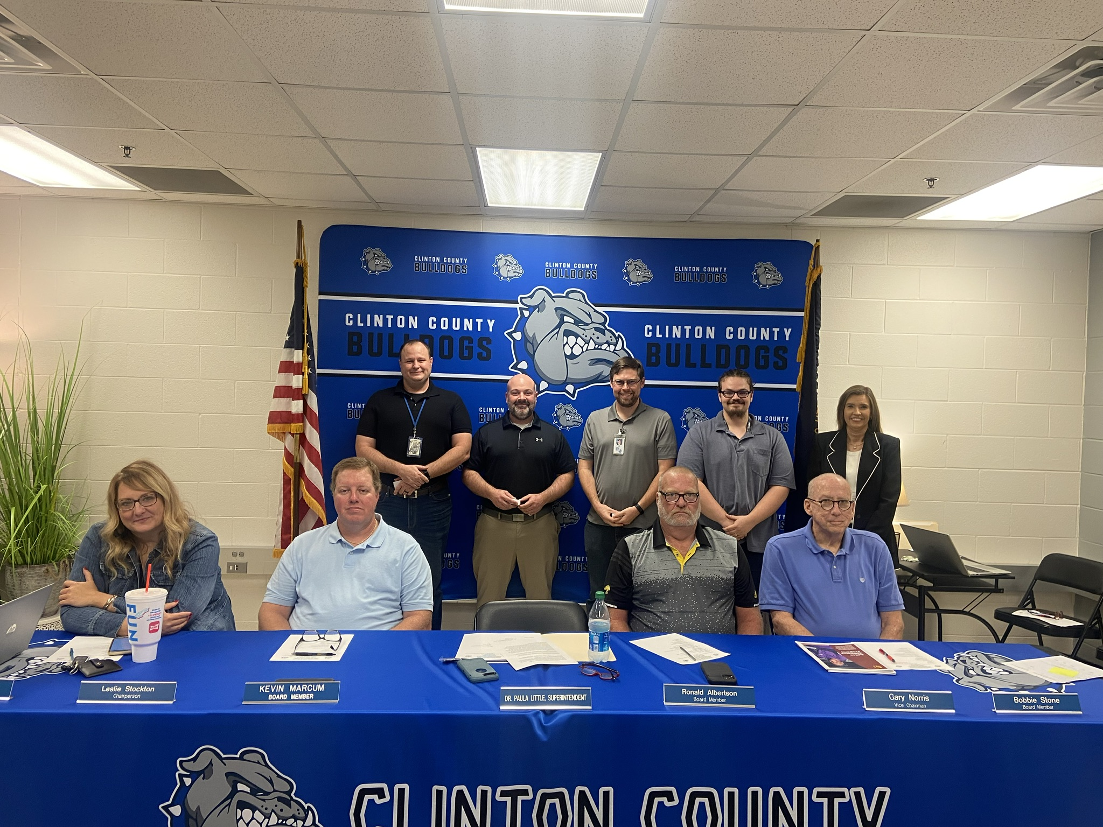
2022 Clinton County Stilwell Awardees
Notes:
2022 Clinton County Stilwell Awardees

Slide 13
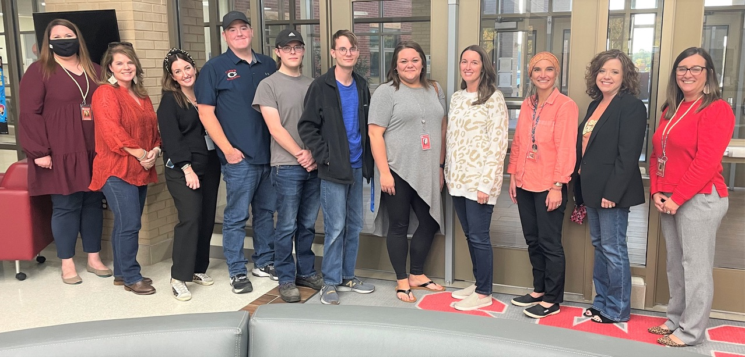
2022 Corban Independent Stilwell Awardees
Notes:
2022 Corban Independent Stilwell Awardees

Slide 14
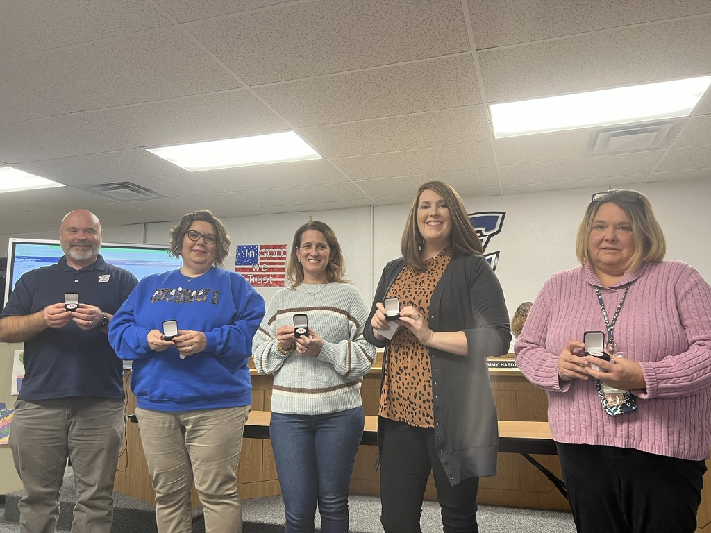
2022 Estill County Stilwell Awardees
Notes:
2022 Estill County Stilwell Awardees

Slide 15
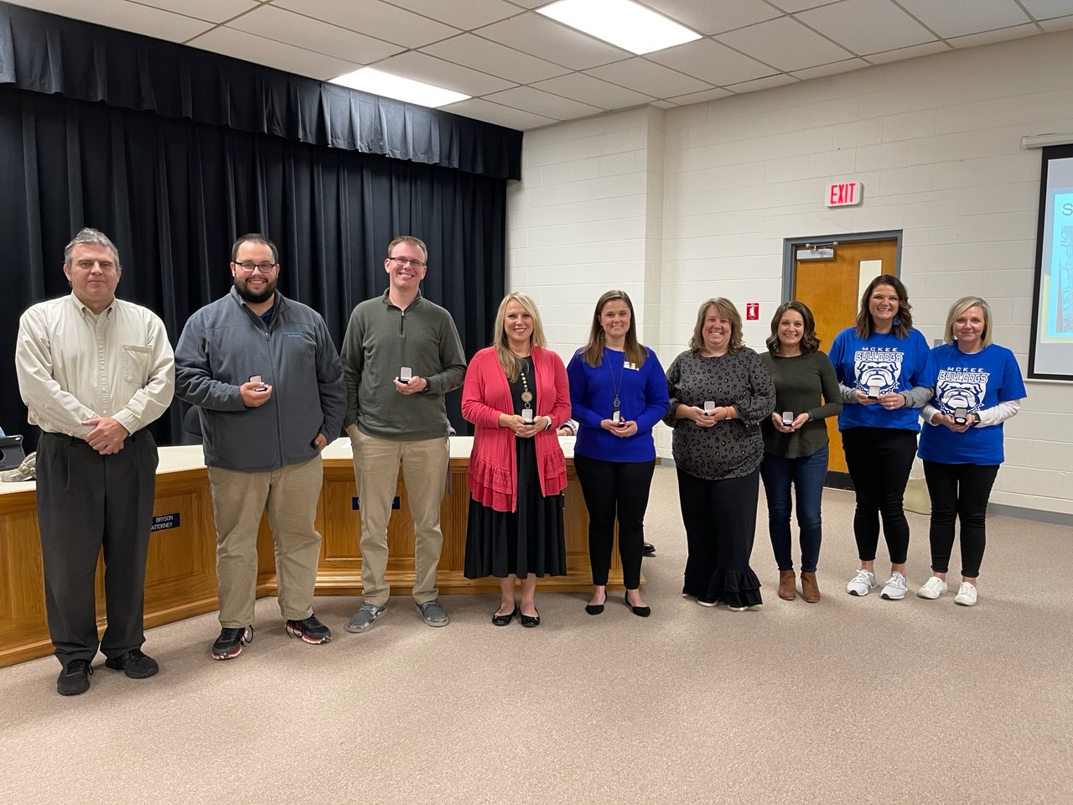
2022 Jackson County Stilwell Awardees

Slide 16
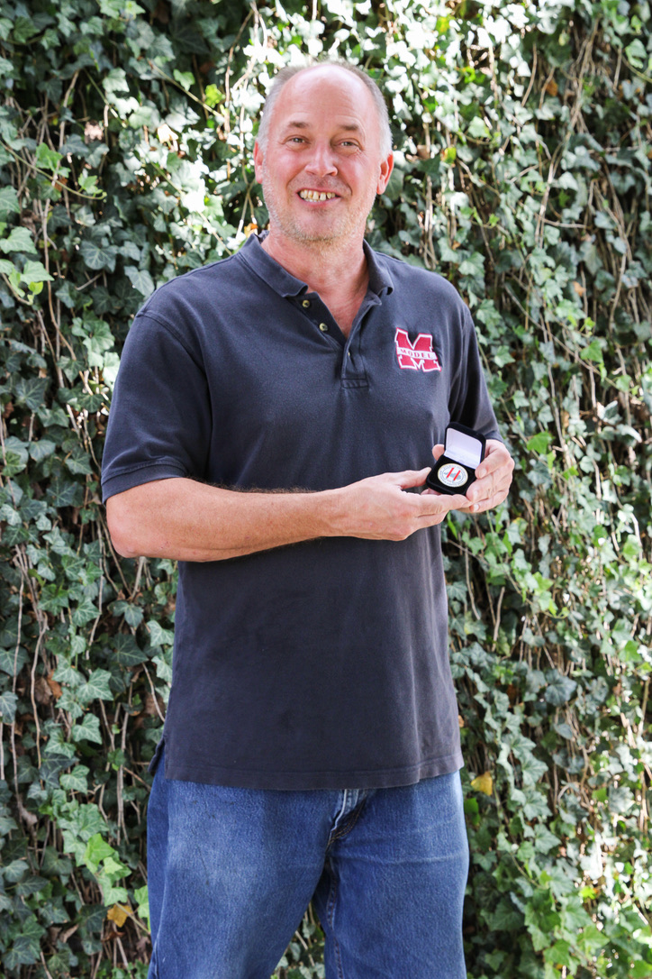
2022 Model Lab Stilwell Awardee
Notes:
2022 Model Lab Stilwell Awardee

Slide 17
2022 Pulaski County Stilwell Awardees
Notes:
2022 Pulaski County Stilwell Awardees

Slide 18
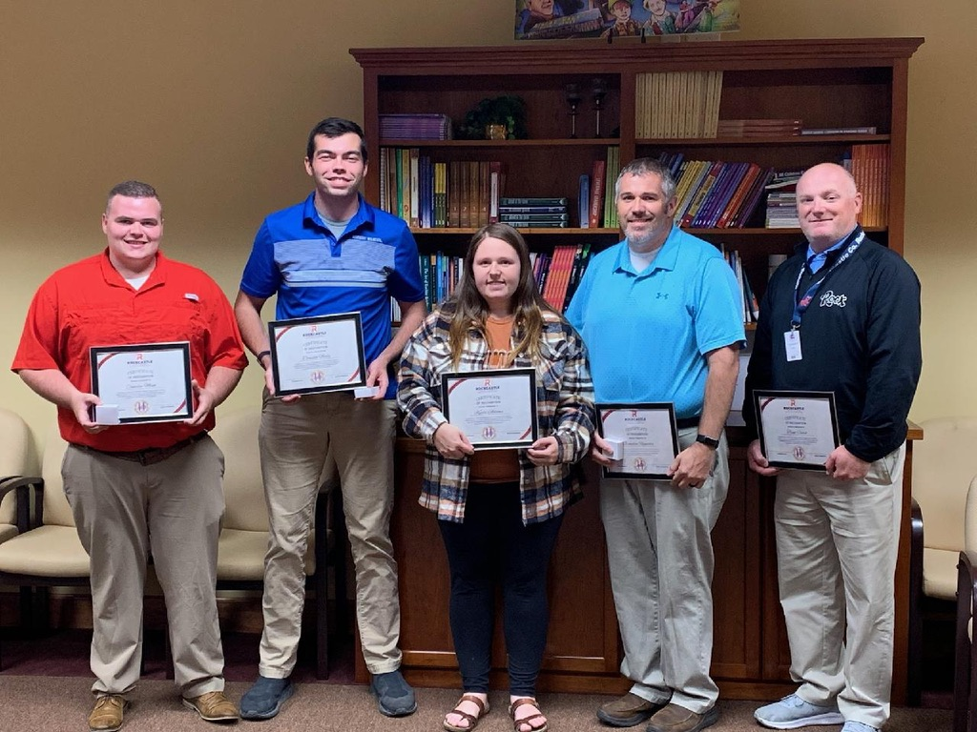
2022 Rockcastle County Stilwell Awardees
Notes:
2022 Rockcastle County Stilwell Awardees

Slide 19
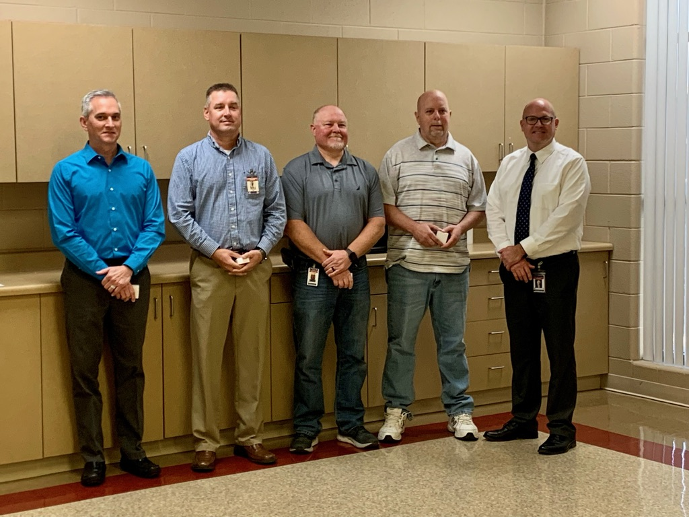
2022 Russell County Stilwell Awardees
Notes:
2022 Russell County Stilwell Awardees

Slide 20
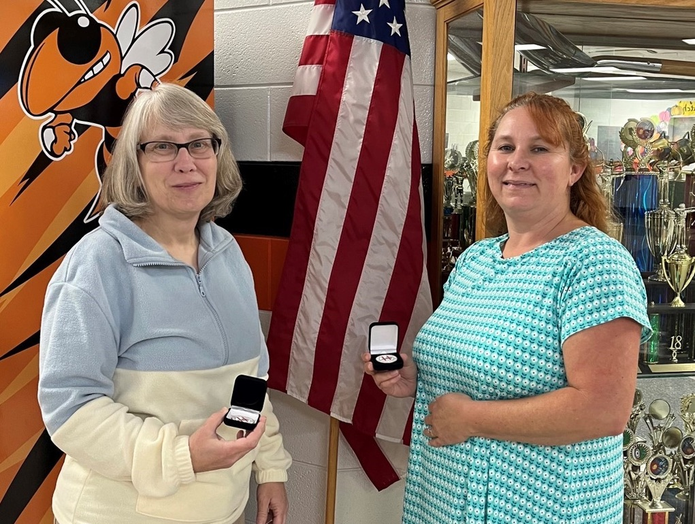
2022 Science Hill Stilwell Awardees
Notes:
2022 Science Hill Stilwell Awardees

Slide 21
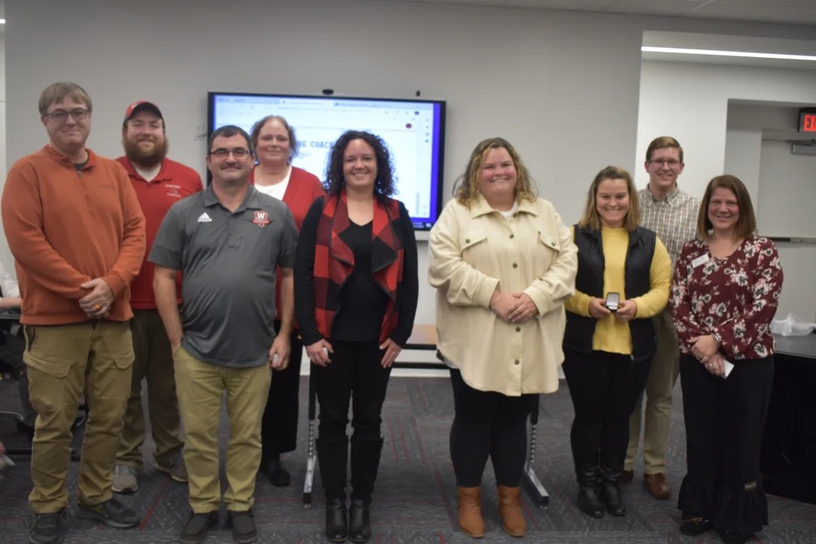
2022 Wayne County Stilwell Awardees
Notes:
2022 Wayne County Stilwell Awardees

Slide 22
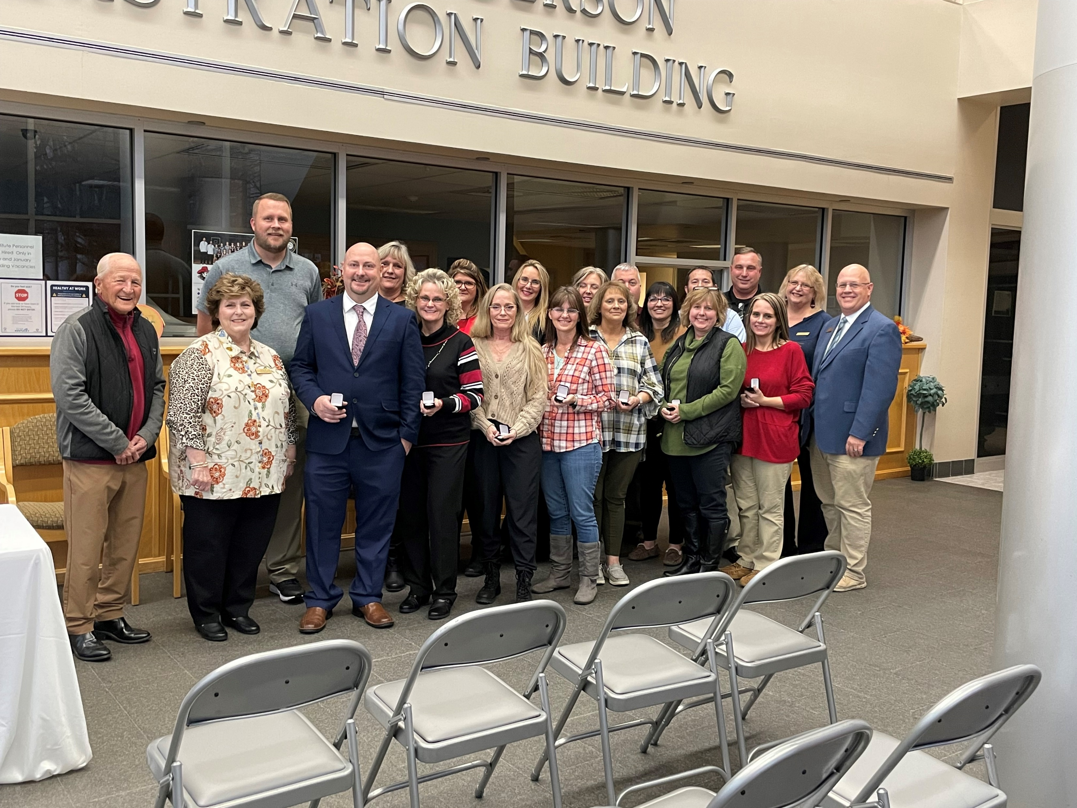
2022 Whitley County Stilwell Awardees
Notes:
2022 Whitley County Stilwell Awardees

