Slide 1
2022 Stilwell Awardees
Region 5

Slide 2
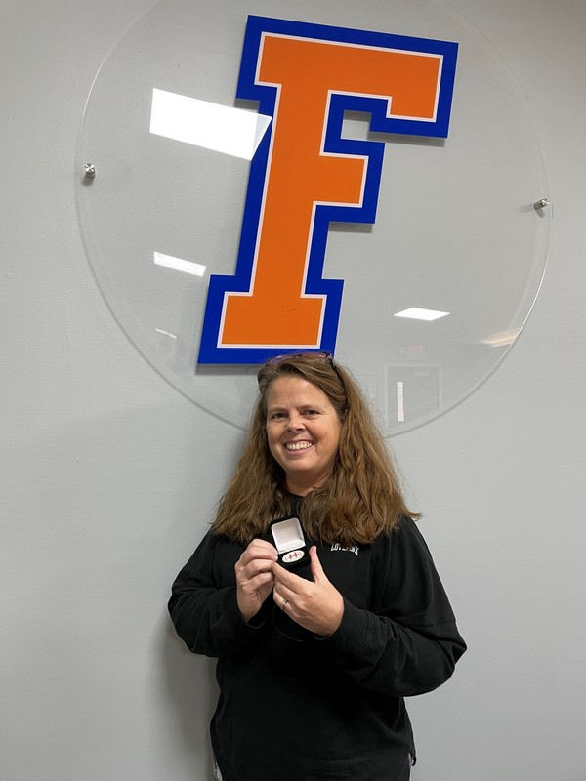
2022 Frankfort Ind (FIS) Stilwell Awardee Arlene Crabtree
Notes:
2022 Frankfort Independent (FIS) Stilwell Awardee Arlene Crabtree

Slide 3
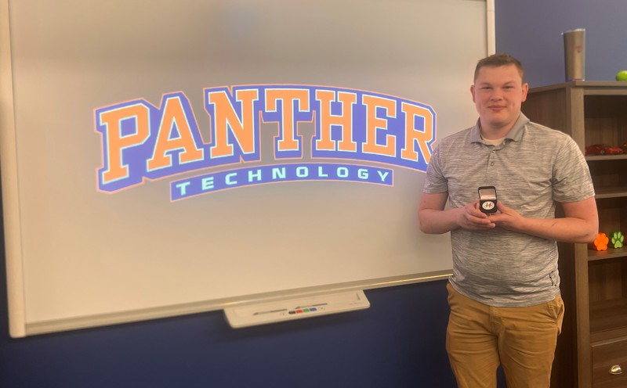
2022 Frankfort Ind (FIS) Stilwell Awardee Christopher Payne
Notes:
2022 Frankfort Ind (FIS) Stilwell Awardee Christopher Payne

Slide 4
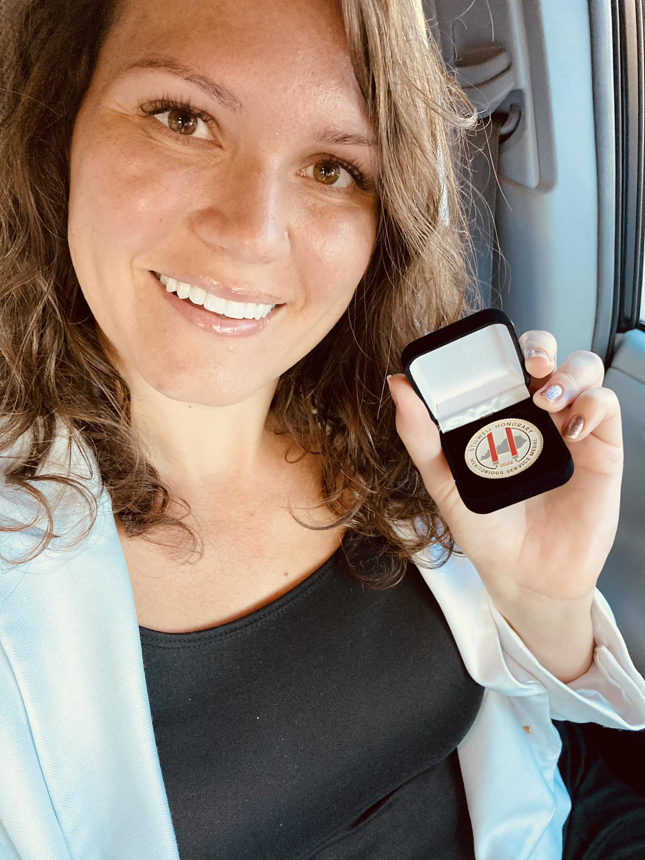
2022 Paris Independent Stilwell Awardee Brittany Palus
Notes:
2022 Paris Independent Stilwell Awardee Brittany Palus

