Slide 1
2022 Stilwell Awardees
Region 4

Slide 2
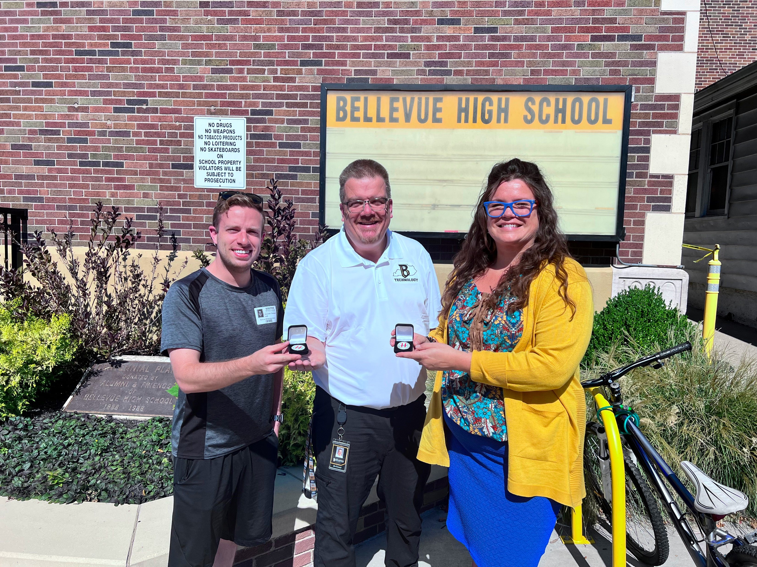
2022 Bellevue Stilwell Awardees
Notes:
2022 Bellevue Stilwell Awardees

Slide 3
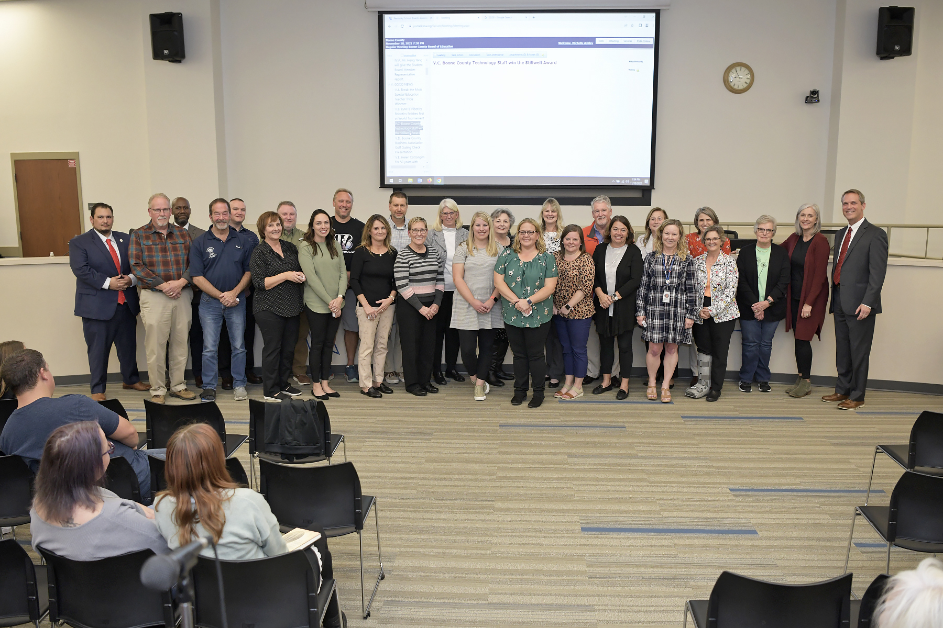
2022 Boone County Stilwell Awardees
Notes:
Boone County Stilwell Awardees

Slide 4
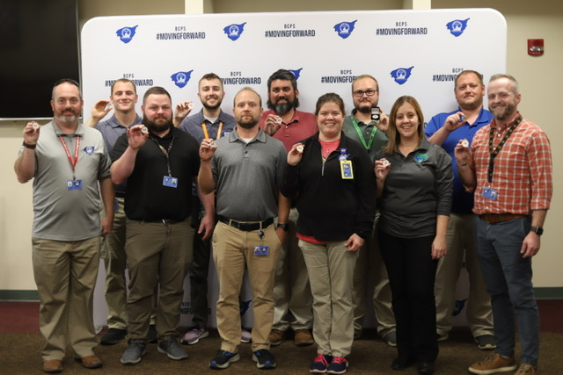
2022 Bullitt County Stilwell Awardees
Notes:
2022 Bullitt County Stilwell Awardees

Slide 5
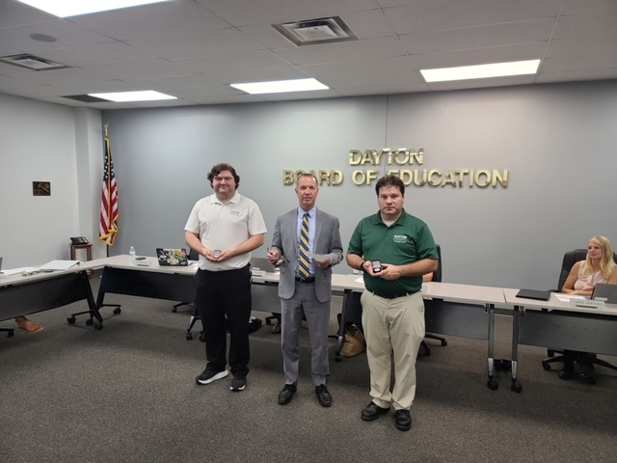
2022 Dayton Stilwell Awardees
Notes:
2022 Dayton Stilwell Awardees

Slide 6
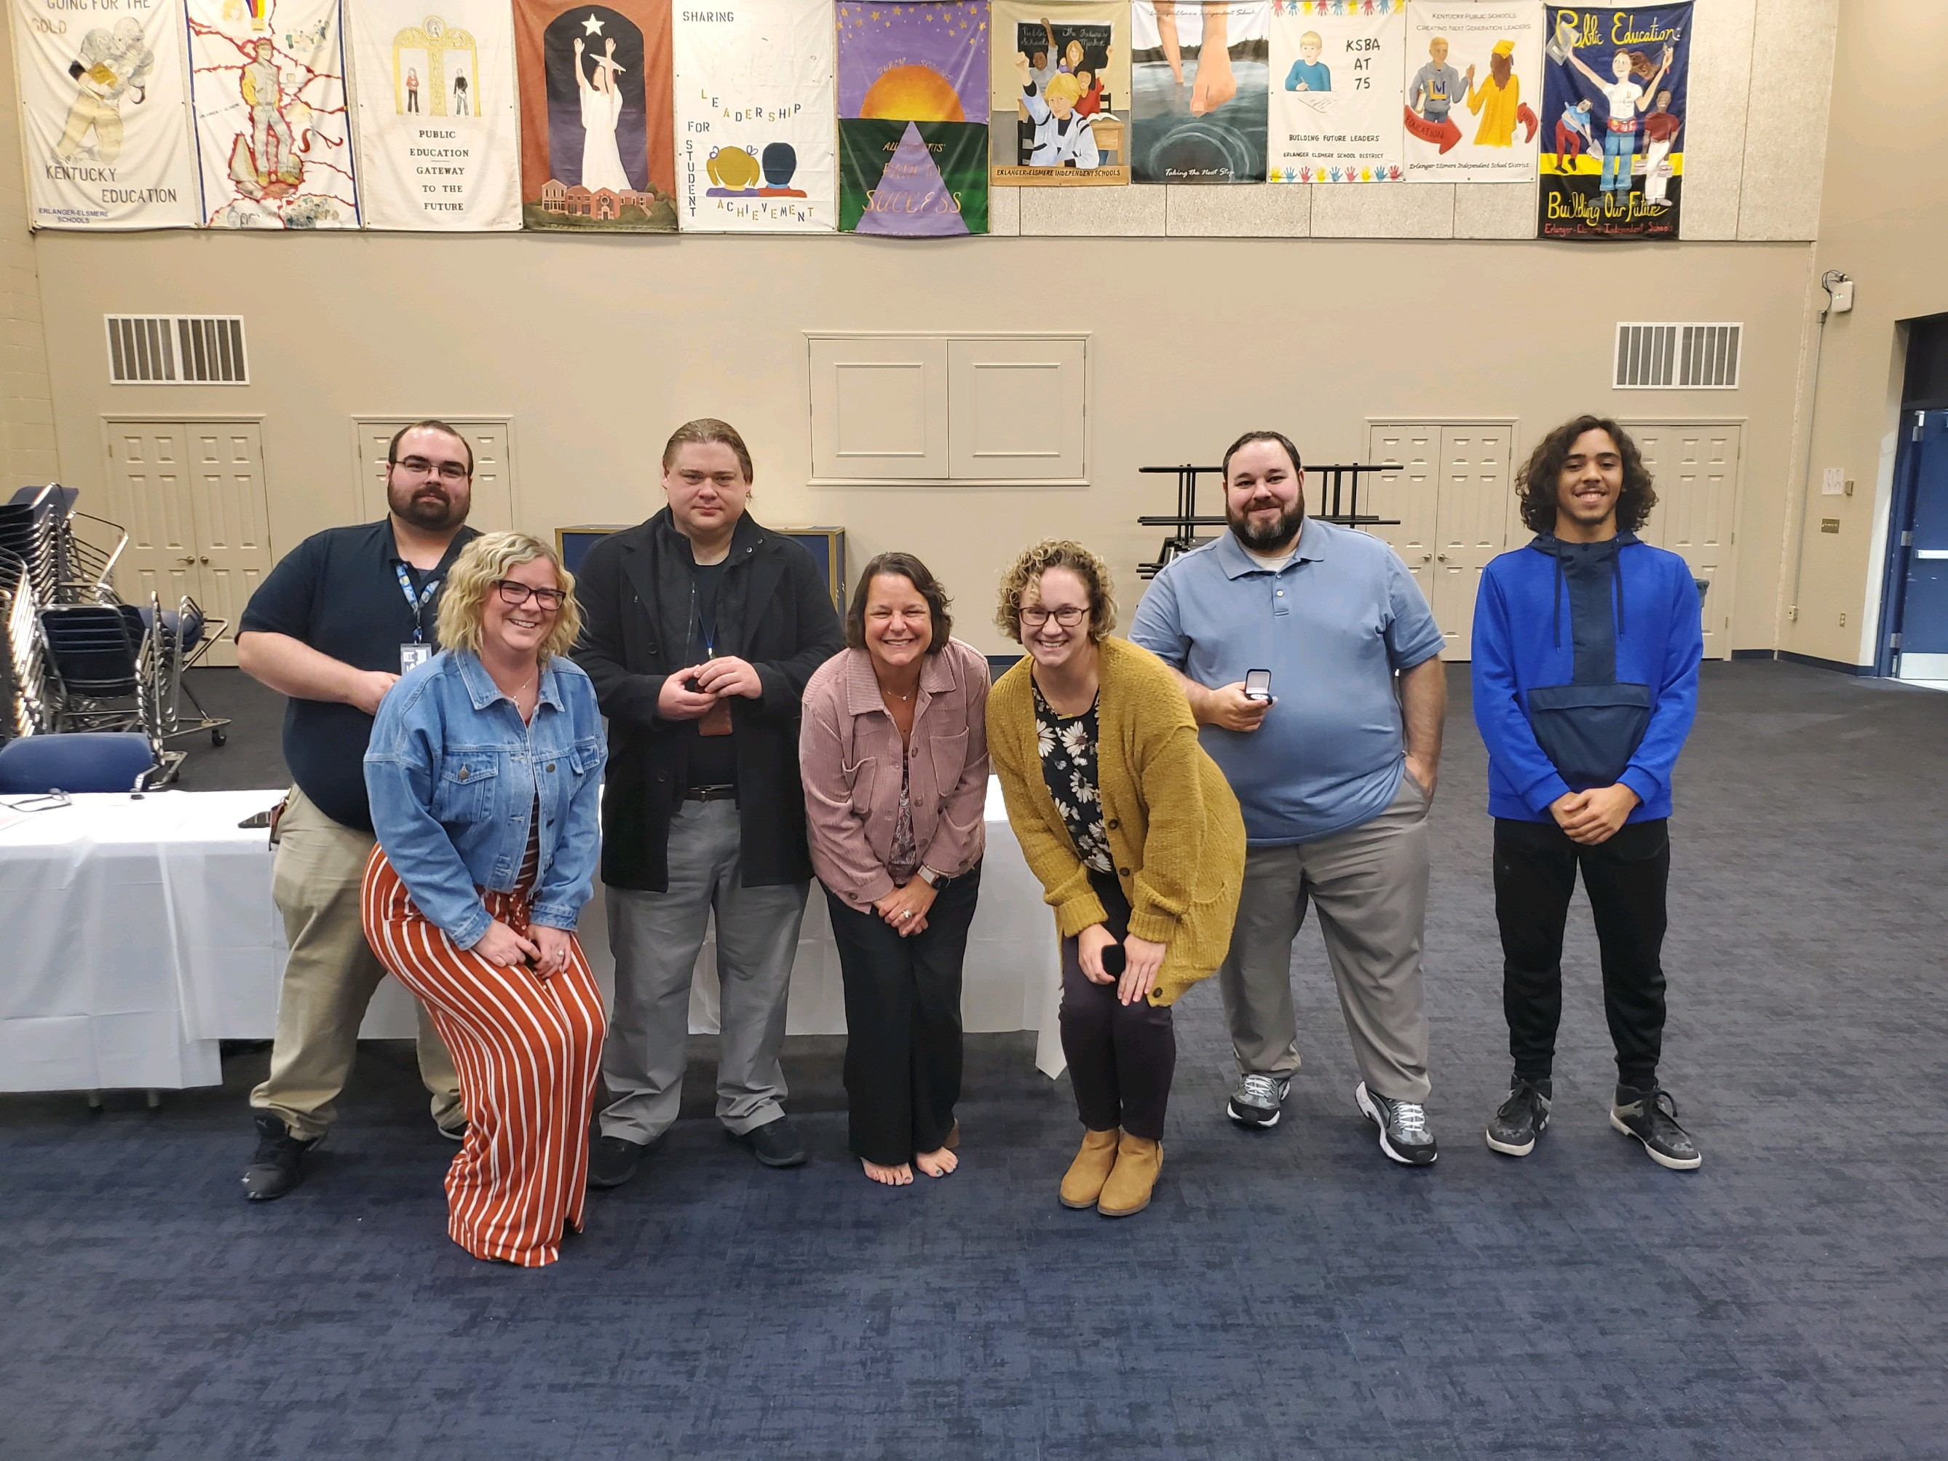
2022 Erlanger Elsmere Stilwell Awardees
Notes:
2022 Erlanger Elsmere Stilwell Awardees

Slide 7
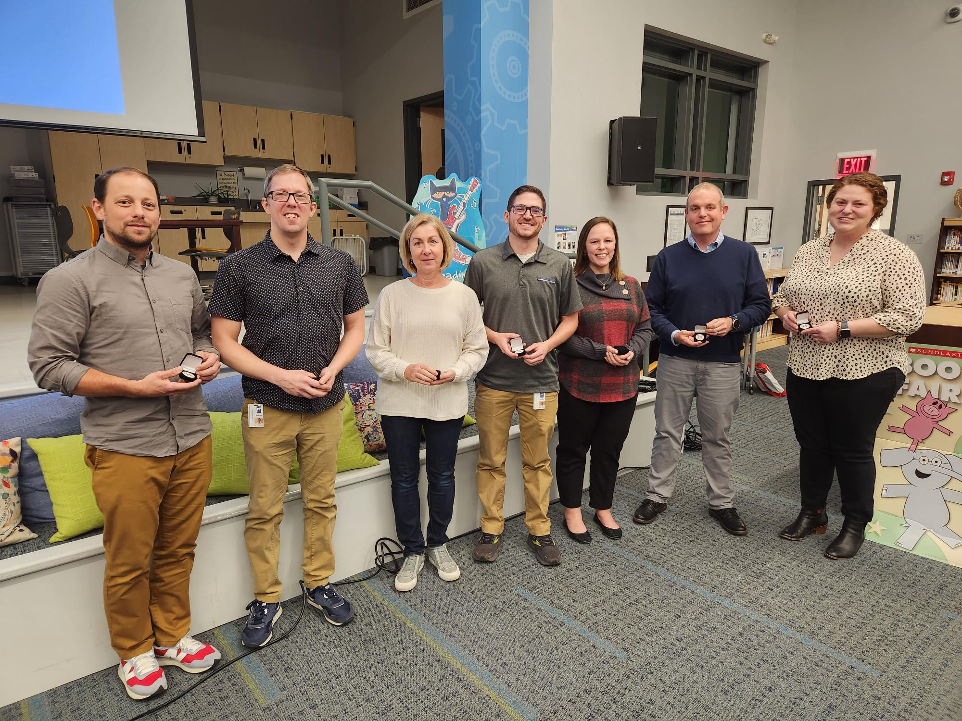
2022 Fort Thomas Stilwell Awardees
Notes:
2022 Fort Thomas Stilwell Awardees

Slide 8
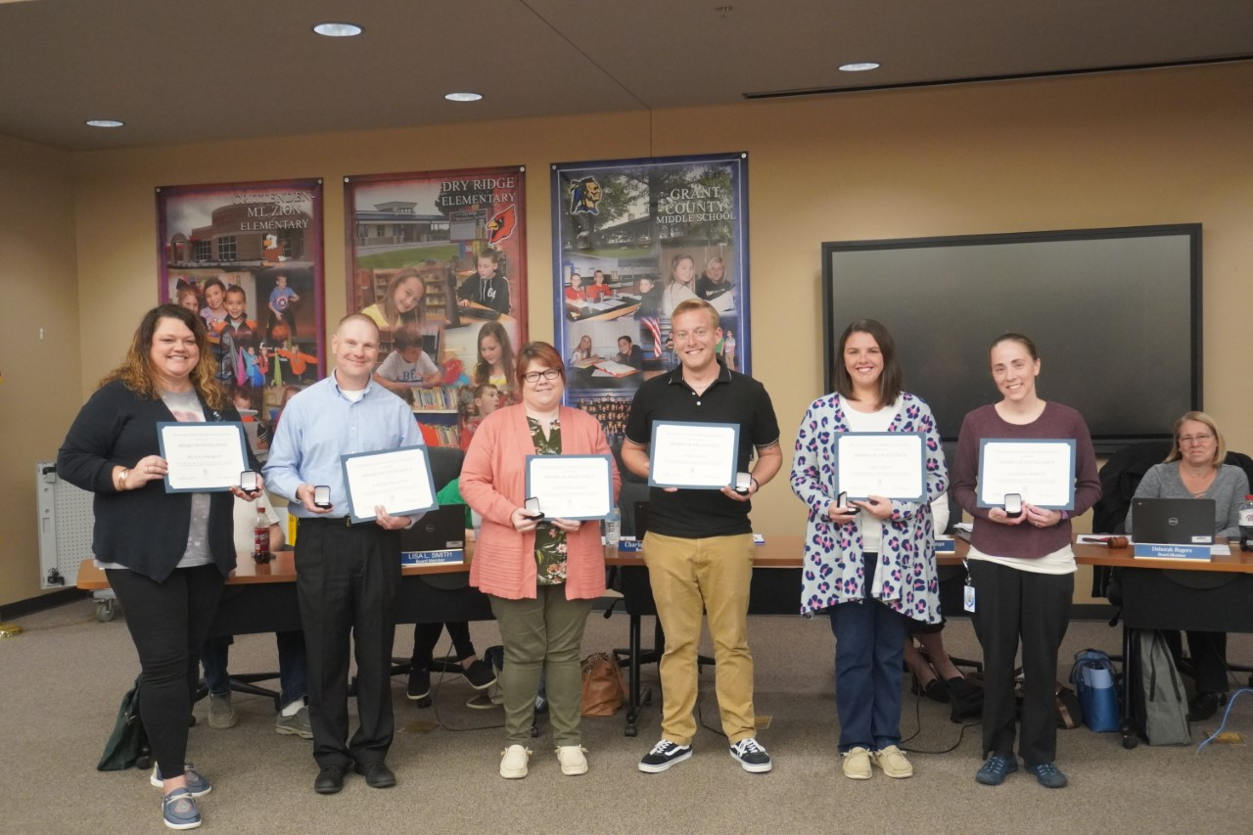
2022 Grant County Stilwell Awardees
Notes:
2022 Grant County Stilwell Awardees

Slide 9
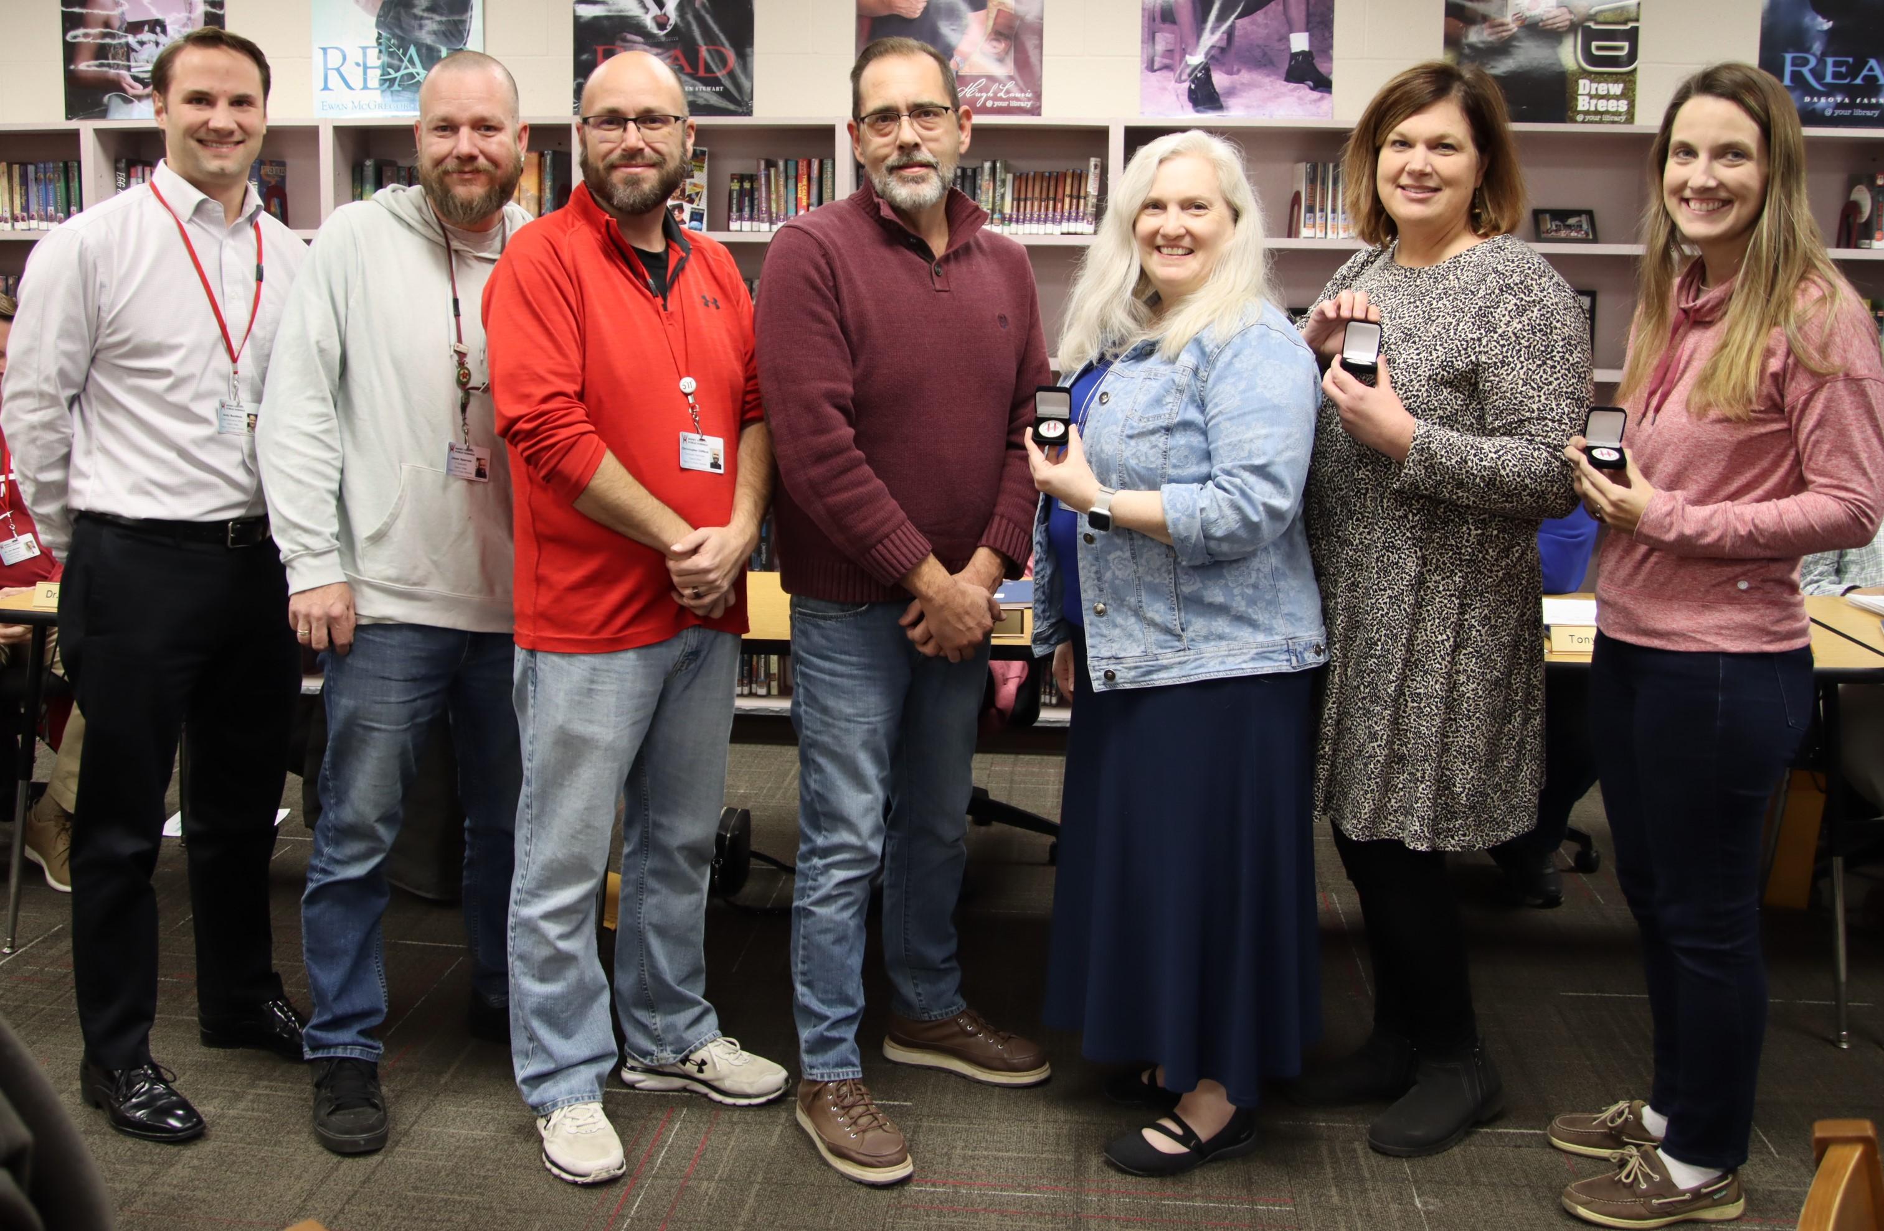
2022 Henry County Stilwell Awardees
Notes:
2022 Henry County Stilwell Awardees

Slide 10
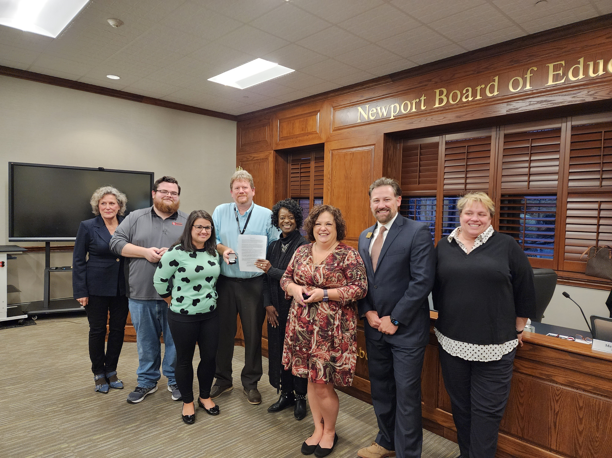
2022 Newport Independent Stilwell Awardees
Notes:
2022 Newport Independent Stilwell Awardees

Slide 11
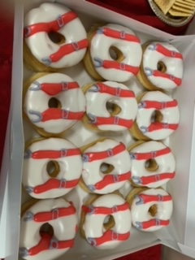
Oldham County Stilwell Cupcakes
Notes:
Oldham Co. Stilwell Cupcakes

Slide 12
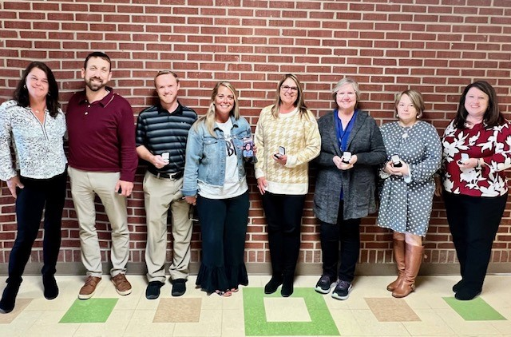
2022 Owen County Stilwell Awardees
Notes:
2022 Owen County Stilwell Awardees

Slide 13
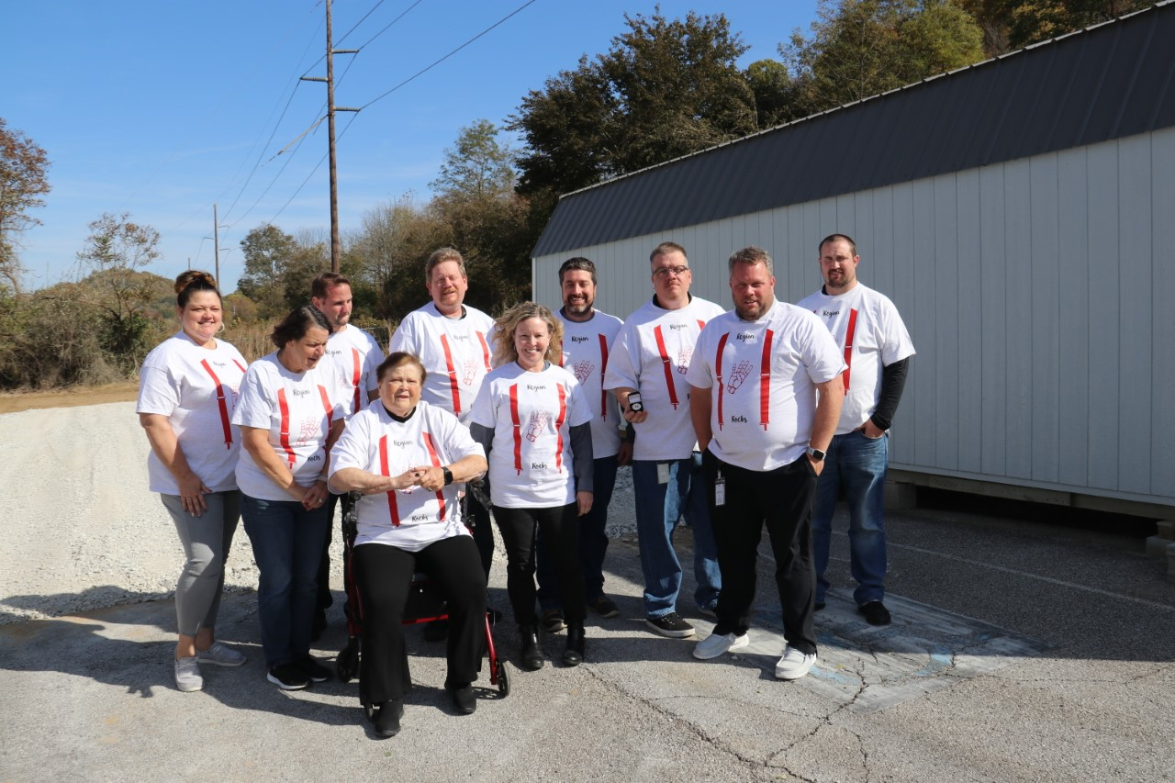
2022 Stilwell Awardees of Region 4 with Charlotte Chowning in their T-Shirts
Notes:
2022 Stilwell Awardees of Region 4 with Charlotte Chowning in their T-Shirts

Slide 14
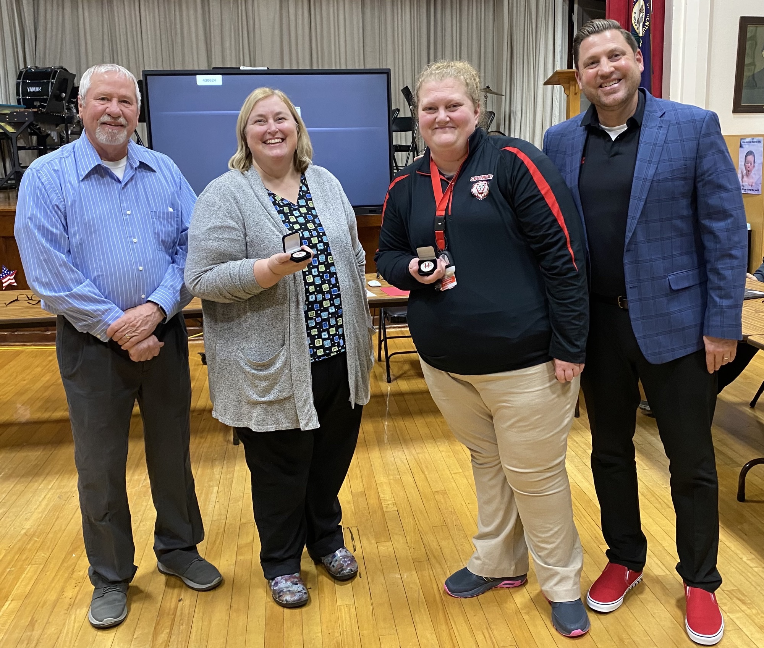
2022 Southgate Stilwell Awardees
Notes:
2022 Southgate Stilwell Awardees

Slide 15
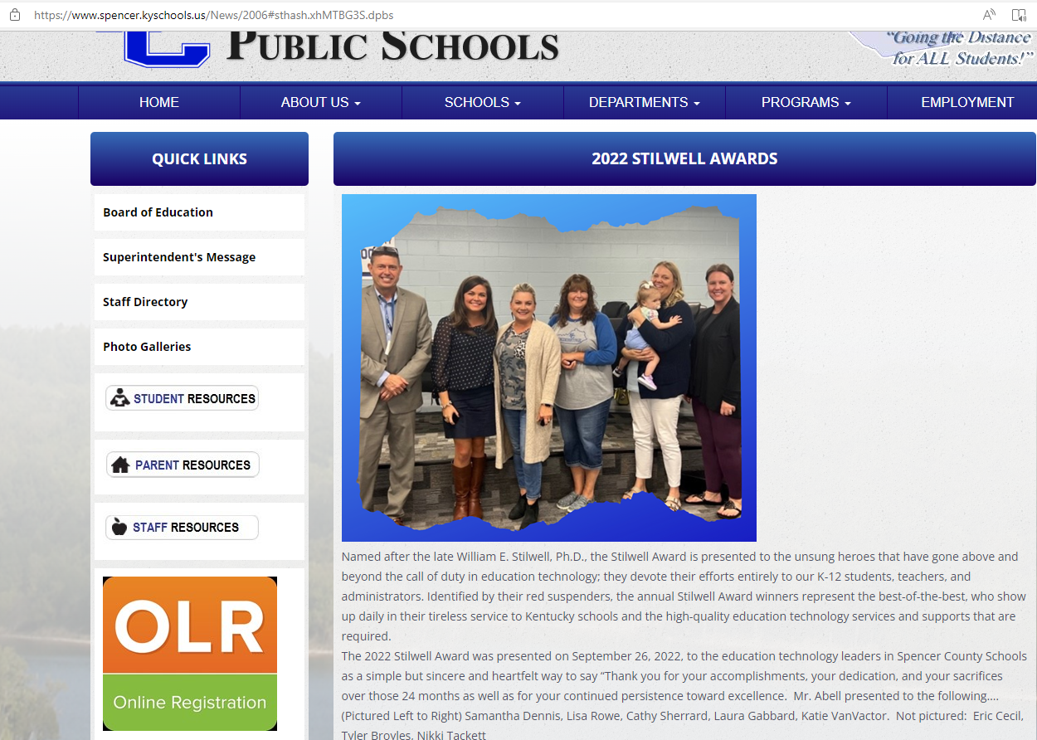
2022 Spencer County Stilwell Awardees Samantha Dennis, Lisa Rowe, Cathy Sherrard, Laura Gabbard, and Katie VanVactor
Notes:
2022 Spencer County Stilwell Awardees Samantha Dennis, Lisa Rowe, Cathy Sherrard, Laura Gabbard, and Katie VanVactor

Slide 16
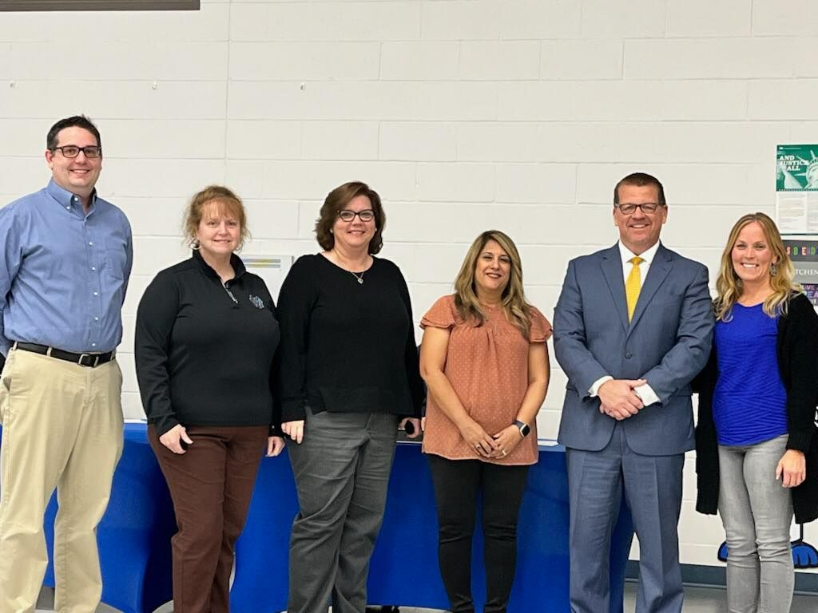
2022 Walton Verona Stilwell Awardees
Notes:
2022 Walton Verona Stilwell Awardees

