Slide 1
Webinar #2: District Facilities Planning (DFP) & Local Planning Committee (LPC)
702 KAR 4:180
Kentucky Department of Education (KDE)
Office of Finance and Operations (OFO)
Division of District Support (DDS)
District Facilities Branch (DFB)
September 25, 2025

Slide 2
Presentation Summary
Introductions
Why do we create a DFP? – Statutes and Regulations
When do we draft a DFP? – Status and Notifications
Who drafts a DFP? – Local Planning Committee
What is the process? – General Overview
How does the DFP work for your district?
Q&A

Slide 3
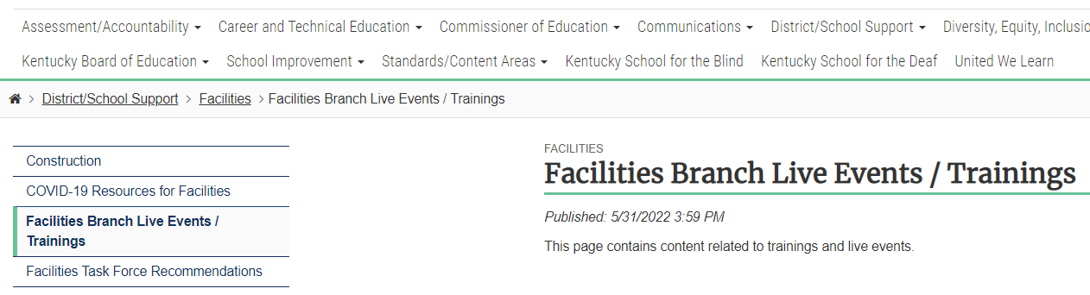
Presentation Located on KDE Website at
Facilities Branch Live Events / Trainings - Kentucky Department of Education
Partial image of the KDE website for “Facilities Branch Live Events.”
On the KDE website select: District/School Support > Facilities > Facilities Branch Live Events / Trainings

Slide 4
Introductions

Slide 5
Division of District Support
(DDS)
Division Director
Chay Ritter
Assistant Division Director
Marshall Smith

Slide 6
District Facilities Branch
(DFB)
Branch Manager
Greg Dunbar, AIA, MBA
greg.dunbar@education.ky.gov

Slide 7
District Facilities Branch Staff
(DFB) Part 1
Project Management/District Liaison
Gary Leist, AIA, LEED AP
gary.leist@education.ky.gov
Teresa Hester, NCID
teresa.hester@education.ky.gov
Marcus Highland, AIA
marcus.highland@education.ky.gov
John C. Gilbert, AIA, LEED AP
john.gilbert@education.ky.gov

Slide 8
District Facilities Branch Staff
(DFB) Part 2
Administrative and Resource Assistance
Tanesha Keene
tanesha.keene@education.ky.gov

Slide 9
Why do we create a DFP? Statutes and Regulations
Kentucky Revised Statutes (KRS)
Kentucky Administrative Regulations (KAR)

Slide 10
Kentucky Revised Statutes (KRS) Part 1
School Facilities Construction Commission (SFCC)
  KRS 157.620(3) SFCC funds are restricted to priority order on the approved school facilities plan.
  KRS 157.622 sets forth certain requirements for school facility plans relative to participation in funding by SFCC.
  Contact SFCC (Kristi Russell) for use of any SFCC funds concerning HB 678 (2022 RS) / HB 727 (2024 RS).

Slide 11
Kentucky Revised Statutes (KRS) Part 2
Facility Support Program of Kentucky (FSPK)
  KRS 157.440 FSPK funds are to be used to address categorized priorities listed in approved Facility Plans pursuant to KRS 157.420.
  Contact Sheila Miller in District Funding and Financial Reporting Branch with any questions related to this fund source.

Slide 12
Kentucky Revised Statutes (KRS) Part 3
Capital Outlay
  KRS 157.420(4) requires capital outlay be used for capital outlay projects approved by the Commissioner of Education in accordance with the administrative regulations (KDE 702 KAR 4:180).
  HB 678 (2022 RS) / HB 727 (2024 RS) allows local Boards to approve under the same requirements in lieu of KDE/Commissioner.
  For Capital Outlay fund use for work not on a DFP, a Capital Funds Request (CFR) Form is required to be approved by your local board.
  Contact Sheila Miller in District Funding and Financial Reporting Branch with any questions related to this fund source.

Slide 13
Kentucky Revised Statutes (KRS) Part 4
Kentucky Facilities Inventory Classification System (KFICS)
  KRS 157.420(9) Beginning 2011-12, KDE shall standardize the process for evaluation the overall quality and condition of all school buildings across the state - KFICS.
  AssetPlanner software by Ameresco serves this requirement and may also be used as an assessment tool for DFP work.

Slide 14
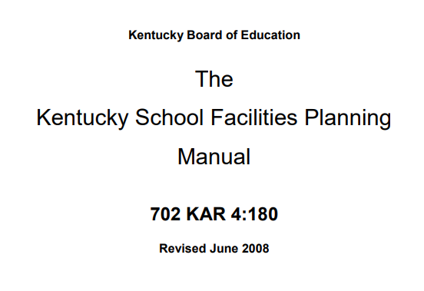
Kentucky Administrative Regulation (KAR)
The Kentucky School Facilities Planning Manual
  The Planning Manual is incorporated by reference through 702 KAR 4:180. The requirements for the development of a District Facility Plan (DFP) are outlined in this manual.
  Contact your DFB project manager on requirements.
Image of The KY School Facilities Planning Manual title page.

Slide 15
When do we draft a DFP?
DFP Status
KDE Notifications

Slide 16
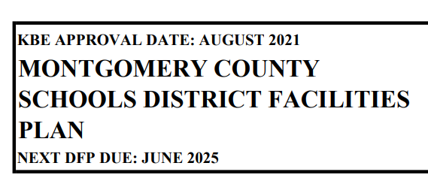
DFP Status – When is the next DFP due?
Current DFP will have “Next DFP Due” Date
  This information may be found on the current DFP which may be found on the KDE website, or the local district may already have their own copy.
  Information is found at the top left-hand side of each DFP.
  Find all approved DFP’s at:
    Facility Planning - Kentucky Department of Education
Sample image of text on top left-hand side of a DFP (page 1).
On the KDE website select: District/School Support > Facilities > Facility Planning

Slide 17
KDE Notifications
KDE will send automated notifications.
  KDE sends out monthly notifications to all districts’ listed superintendent, finance officer, and facilities director as updated by districts to DFB. Your specific district will receive notifications at the following intervals:
  District superintendents receive email notifications at the 18, 12, 6, and 1-month intervals prior to your DFP due date.
  A notice the month your DFP is due and one late notice will go out one month after the deadline. No further notifications occur past one month.
On the KDE website select: District/School Support > Facilities > Facility Planning

Slide 18
KDE Notifications – Email Content
Sample KDE Email
  Email sent to district superintendent, finance officer, and facilities director.
  Check your junk/spam email folders.
  Subject line will always start with “District Facility Plan (DFP) Status”
  Once you receive this notice, contact your DFB Project Manager to get started!

Slide 19
Who drafts your DFP?
Local Planning Committee (LPC)
Assembling - Section 101 of The Planning Manual
The LPC Roster Membership Form

Slide 20
Assembling your LPC Part 1
Highlights of Section 101:
  101.1 – The superintendent manages the selection process.
  101.2 – Determines the number of LPC members needed based on number of school centers (Table 101.2).
    The LPC is intended to provide a cross section of stakeholders – parents, teachers, administrators and community members. Requirements for each type of member is called out in Section 101.

Slide 21
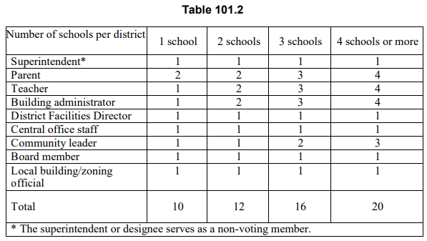
Assembling your LPC Table 101.2

Slide 22
Assembling your LPC Part 2
Highlights of Section 101:
  101.3 is important to remember for the following considerations: “All schools shall be represented before multiple representation of a school occurs. The maximum number of representatives on the LPC from a school shall not be in excess of one greater than the number of representatives from any other school.”
  101.4 – 101.12 provides guidance to the superintendent on how to instruct stakeholder groups on how to select their representatives.

Slide 23
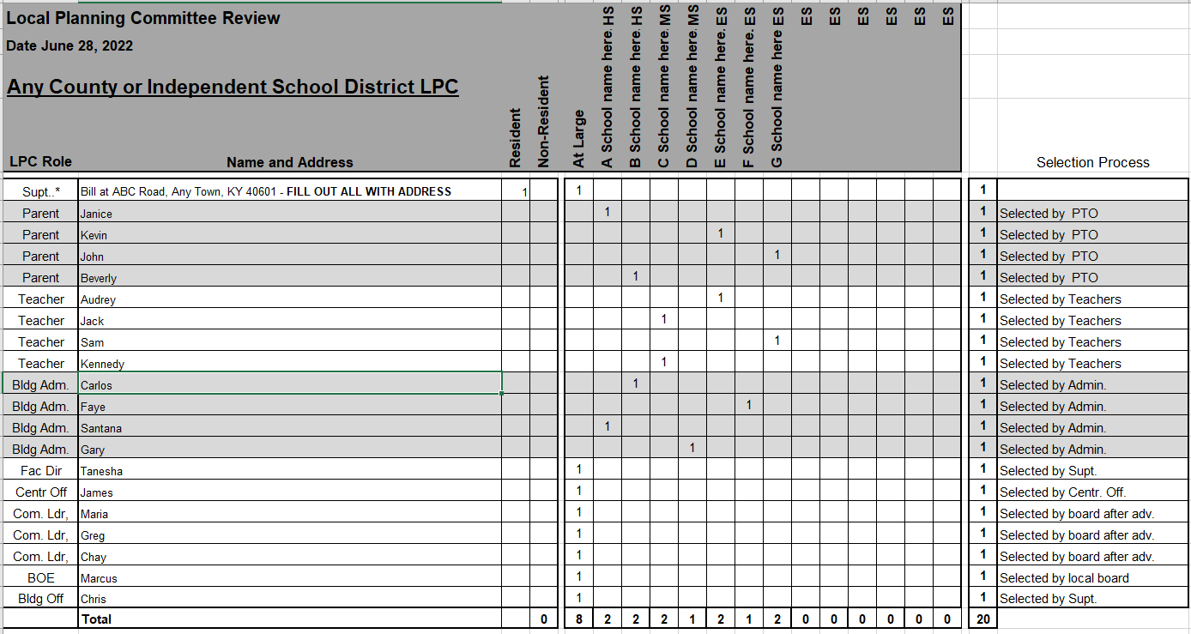
Sample LPC membership form

Slide 24
The LPC Membership Form – In-District
LPC Roster (all members living in-district):
  Fill LPC Roster out completely.
  Adhere to Section 101.3 and have no one school exceed any other by one person.
    Remember to designate School-Based Decision-Making Council (SBDM) members on the roster.
  Have your superintendent sign the roster.
  Submit full roster to KDE.
  KDE will review and send the superintendent an approval/denial letter.

Slide 25
The LPC Membership Form – Out-of-District 1
LPC Roster (any members living out-of-district):
  Fill LPC Roster out completely.
  Adhere to Section 101.3 and have no one school exceed any other by one person.
    Remember to designate SBDM members on the roster.
  Have your superintendent sign the roster.

Slide 26
The LPC Membership Form – Out-of-District 2
LPC Roster (any members living out-of-district):
  Submit full roster to DFB and notify your project manager that you will be sending a request to the commissioner’s office for out-of-district approvals.
    When submitting to DFB, highlight which members live out-of-district.
    Provide reasons / rationale for out-of-district membership needs.
    DFB will send you a determination letter for the in-district membership.
  (Section 101.1) Submit a formal request to the Commissioner’s office with the same information you sent to DFB after in-district membership review.
    A designee from the Commissioner’s office will provide a determination letter for out-of-district members.
    Copy your project manager on the correspondence you send to the Commissioner.

Slide 27
What is the Process?
A general overview

Slide 28
District: Request start up of DFP
Supt. Manages LPC selection process. Submit for approval LPC roster to KDE.
*LPC #1 mtg / forum to select chair/vice chair & view orientation
*Hold LPC #2 mtg / forum (min) to develop DFP
Send draft DFP to KDE for review/comments
*Final LPC #3 mtg (or later) / public forum. Vote to accept. Required after KDE review.
Return LPC approved draft to KDE for “spot check”.
Local Board votes to accept draft DFP / hold Public Hearing
Public Hearing (PH)
Local Board votes to accept PH report and Final DFP.
Send DFP & supporting docs to KDE for final approval. New plan in 4 years.
DFP Process General Overview
*Regulation has a 3-meeting minimum requirement. The LPC may decide to meet more.

Slide 29
How does the DFP work for your district?

Slide 30
The DFP…
aids in prioritizing District Need – not a “wish list.”
can communicate to your community.
provides eligibility to restricted fund sources that are used only for capital construction efforts.
communicates the total District Need to KDE who in turn reports this information to SFCC affecting offers made. This information is also reported to the General Assembly during the budget sessions.
  DFP’s updated by June 30th of the odd year prior to the budget session will be in official reports.
may even be a requirement to receive special offers.
may show evidence of community involvement for federal funding requirements (will vary dependent upon fund source).

Slide 31
Q & A
Questions and Answers
If you have any questions, you may call District Facilities Branch at (502) 564-4326 or email your assigned project manager.
If you are uncertain who to contact, reach out to Tanesha Keene at tanesha.keene@education.ky.gov.

Slide 32
Thank you for your interest and participation!
Kentucky Department of Education (KDE)
Office of Finance and Operations (OFO)
Division of District Support (DDS)
District Facilities Branch (DFB)
September 25, 2025

