Slide 1
Webinar #3:
Facilities Branch: Property – Part I
Kentucky Department of Education (KDE)
Office of Finance and Operations (OFO)
Division of District Support (DDS)
District Facilities Branch (DFB)
October 23, 2025

Slide 2
Presentation Summary – Property Part I
Introductions
Definitions
Constitution of Kentucky
Statutes
Legal Acts
Regulation – 702 KAR 4:050 Building sites; inspection, approval.
​
Tentative Approval/Disapproval
Required Documents (KDE Review for Final Approval​)
Best Practices​
Frequent Issues ​
Q & A

Slide 3
Office of Finance and Operations
(OFO)
Associate Commissioner
Matt Ross
Division of District Support
(DDS)
Division Director
Chay Ritter
Assistant Director
Marshall Smith

Slide 4
DFB – Personnel Introductions – Branch Manager
Name: Gregory C. Dunbar, AIA, MBA
Position: Capital Construction Project Manager (aka Branch Manager)
KDE Experience: 16 years

Slide 5
DFB – Personnel Introductions – Project Manager
Name: Gary T. Leist, AIA, LEED AP
Position: Capital Construction Project Administrator (aka Project Manager)
KDE Experience: 16 years
Augusta Ind.
Bardstown Ind. Beechwood Ind. Bellevue Ind.
Boone Co.
Bowling Green Ind. Bracken Co.
Caldwell Co.
Campbell Co.
Covington Ind.
Dawson Springs Ind. Dayton Ind.
Edmonson Co.
Erlanger - Elsmere Ind.
Fort Thomas Ind.
Garrard Co.
Grant Co.
Grayson Co.,
Hopkins Co.
Jackson Co.
Kenton Co.
Lewis Co.
Livingston Co.
Ludlow Ind.
Martin Co.
Mason Co.
Meade Co.
Muhlenberg Co.
Nelson Co.
Newport Ind.
Oldham Co.
Owen Co.
Pendleton Co.
Pike Co.
Pikeville Ind.
Scott Co.
Southgate Ind.
Trigg Co.
Trimble Co.
Walton - Verona Ind. Warren Co.
Williamstown Ind. Woodford Co.

Slide 6
DFB – Personnel Introductions – Project Manager
Name: Marcus Highland, AIA
Position: Capital Construction Project Administrator (aka Project Manager)
KDE Experience: 9 years
Barbourville Ind.
Berea Ind.
Boyle Co.
Breckinridge Co. Calloway Co.
Carroll Co.
Carter Co.
Clinton Co.
Cloverport Ind. Crittenden Co. Danville Ind.
Eminence Ind.
Floyd Co.
Frankfort Ind.
Franklin Co.
Graves Co.
Harrison Co.
Hazard Ind. Henderson Co.
Henry Co.
Knox Co.
LaRue Co.
Lee Co.
Leslie Co.
Logan Co.
Madison Co.
Magoffin Co.
Mayfield Ind.
McCreary Co.
McLean Co.
Menifee Co.
Morgan Co.
Murray Ind.
Perry Co.
Rockcastle Co. Russell Co. Russellville Ind. Shelby Co.
Todd Co.
Union Co.
Washington Co.
Wolfe Co.

Slide 7
DFB – Personnel Introductions – Project Manager
Name: John C. Gilbert, AIA, LEED AP
Position: Capital Construction Project Administrator (aka Project Manager)
KDE Experience: 6 years
Adair Co.
Allen Co.
Anderson Co.
Ashland Ind.
Boyd Co.
Breathitt Co.
Burgin Ind.
Casey Co.
Christian Co.
Clay Co.
Cumberland Co.
Elizabethtown Ind.
Elliott Co.
Estill Co.
Fairview Ind.
Fayette Co.
Fulton Co.
Fulton Ind.
Gallatin Co.
Green Co.
Greenup Co.
Hancock Co.
Hardin Co.
Hickman Co.
Jackson Ind.
Jenkins Ind.
Johnson Co.
Lawrence Co.
Letcher Co.
Lincoln Co.
Lyon Co.
Marion Co.
McCracken Co.
Mercer Co.
Metcalfe Co.
Monroe Co.
Montgomery Co.
Paducah Ind.
Paintsville Ind.
Powell Co.
Raceland-Worthington Ind. Russell Ind.
Webster Co.

Slide 8
DFB – Personnel Introductions – Project Manager
Name: Teresa Hester, NCIDQ, KYCID
Position: Capital Construction Project Administrator (aka Project Manager)
KDE Experience: 3 years plus other government agency experience
Anchorage Ind.
Ballard Co.
Barren Co.
Bath Co.
Bell Co.
Bourbon Co.
Bullitt Co.
Butler Co.
Campbellsville Ind. Carlisle Co.
Caverna Ind.
Clark Co.
Corbin Ind.
Daviess Co.
East Bernstadt Ind.
Fleming Co.
Glasgow Ind.
Harlan Co.
Harlan Ind.
Hart Co.
Jefferson Co.
Jessamine Co.
Knott Co.
Laurel Co.
Marshall Co.
Middlesboro Ind. Nicholas Co.
Ohio Co.
Owensboro Ind.
Owsley Co.
Paris Ind.
Pineville Ind.
Pulaski Co.
Robertson Co.
Rowan Co.
Science Hill Ind. Simpson Co.
Somerset Ind.
Spencer Co.
Taylor Co.
Wayne Co.
Whitley Co.
Williamsburg Ind.

Slide 9
DFB – Personnel Introductions – Analyst
Name: Tanesha Keene
KDE Experience: 4 years plus other government agency experience. Tanesha is your primary contact for all technical issues concerning FACPAC (Facilities Planning and Construction program in SharePoint).

Slide 10
Definitions
Real Property: Land and anything permanently attached to it such as buildings and fixed equipment, the natural resources within the subsurface (like minerals), and the airspace above it
Fee simple title: the most extensive form of property ownership granting the owner complete and unrestricted rights. Fee simple title requires that mineral rights have not been severed from the surface rights
Easement: a property right granting a limited legal right to cross or otherwise use someone else’s land for a specified purpose often involving compensation.
Fair market value (FMV): the value of a real property based on an appraisal performed by a real property appraiser licensed to practice in the Commonwealth of Kentucky under KRS 324A.
Appraisal: an assessment of the fair market value of a property by an authorized person having a designation from a regulatory body governing the appraiser’s jurisdiction.
FACPAC: FACilities Planning And Construction
DFP: District Facilities Plan

Slide 11
Constitution of Kentucky
Sections 180, 184, and 186 address the use of taxes levied and collected for the benefit of public education.
Multiple Opinions of the Attorney General (OAG) establish a fair market value criterion regarding the purchase and disposal of real property related to school funds.
Statutes, Opinions of the Attorney General (OAGs), and case law can be found in the Kentucky School Law Book on the KDE website.

Slide 12
Statutes
KRS 162.010 Title to school property
The title to all property owned by a school district is vested in the Commonwealth for the benefit of the district board of education.
Requires that fee simple title be obtained whether by purchase or condemnation, or otherwise.
Land received from the federal government or any agency thereof can be received in other than fee simple with the approval of the Attorney General.
KRS 162.030 Condemnation of property for school purposes.
Each board of education may, when unable to make a contract satisfactory to the board with the owner for the purchase of real estate to be used for school purposes, initiate condemnation proceedings pursuant to the Eminent Domain Act of Kentucky (KRS 416.540 to 416.670), and the title to land so obtained shall be vested in fee simple.
Eminent domain is administered at the local level. Property will have to comply with the requirements of 702 KAR 4:050.

Slide 13
Statutes Cont...
KRS 177.057 Required consultation on highway access prior to purchase of property for school facility.
Requires a local public school district to consult with KYTC before purchasing property for the construction of a school facility. KRS 162.010 Title to school property.
KRS 160.160(8)
Addresses the ability of a BOE to transfer or sell real or personal property without KDE approval to another governmental or quasi-governmental agency in exchange for money or a similar type of property that equals or exceeds the fair market value of the district’s property as determined by an independent appraisal conducted by:
(a) An individual or organization not affiliated with the district or its officers or employees, using a generally accepted national or professional standard; or
(b) A district's officers or employees using a nationally published valuation of property based on the most recent edition of the publication.
702 KAR 4:090 Section 4 requires that KDE receive documents (via FACPAC) when disposing of surplus property for recordkeeping purposes.

Slide 14
Statutes Cont...
KRS 61.878 Certain public records exempted from inspection except on order of court
Real estate appraisals, engineering or feasibility estimates and evaluations made by or for a public agency relative to acquisition of property, until such time as all of the property has been acquired.
The law of eminent domain shall not be affected by this provision.

Slide 15
Legal Acts
HB 678 (2022 RS) extended to June 30, 2027, by HB 727 (2024 RS)
A local board of education that submits a request for approval of a complete district facility plan, a request for acquisition of property, or a request for disposal of surplus property shall submit the request to the commissioner of education or designee who shall approve or disapprove the request within 30 business days. An approved request shall be reported to the Kentucky Board of Education. A denied request may be appealed to the board.

Slide 16
Regulation: 702 KAR 4:050 Building sites; inspection, approval
A two-step process is initiated by a written request by a BOE to KDE for a site inspection. The written request should include:
  Purpose of the proposed acquisition (District Facilities Plan Priority).
  Owner
  Address
  Acreage
Upon receipt of a written request, KDE will conduct an in-person inspection of a site proposed for a new school and coordinate the inspection with KYTC and the district. KDE may at its discretion, conduct a virtual site inspection for “minor” or other acquisitions.

Slide 17
Tentative Approval/ Disapproval
Following the site inspection, KDE will issue a tentative approval letter or disapprove the site.
A tentative approval letter will provide a brief description of the site and contain the following:
  A request for a discussion regarding the proposed funds and the DFP related to the BG-1.
  A statement that KDE cannot approve a purchase price that exceeds a de minimis amount above fair market value established by the appraisal.
  A statement regarding KDE review, identification of issues, and possible additional steps required.
A tentative approval letter will also have the following attachments:
  Property Acquisition Checklist – the items required for final approval.
  FACPAC Submission Process – required items are to be uploaded via SharePoint.
  Template Letters for the district’s use regarding roadway adequacy and funding commitment for improvements in public rights of way.
See example images at end of PowerPoint

Slide 18
Required Documents
The following items are required for Final Approval
  Item 1: Title Opinion
    Letter from attorney starting that fee simple title to the property to be obtained
    Title opinion shall be for a minimum of sixty (60) years.
    If mineral rights are not acquired, a forbearance agreement shall
  Item 2: Commitment for Title Insurance
    For the current appraised value of the property
  Item 3: Plat (Survey)
    Current within twenty-four (24) months of the proposed transaction.
    Performed by a professional land surveyor licensed in the Commonwealth of Kentucky with the following:
      Seal
      Signature
      Date
      Certification that the property is above the 100-year flood plain as determined by the current FEMA map.
      Current owner
      Property boundaries
      Acreage
      Access to and identification of public right(s) of way (state maintained or locally maintained)

Slide 19
Required Documents Cont...
  Item 4: Utility Assurance Letters from professional engineer and/or municipal government agency providing assurance of adequate site utilities:
    Water – Adequate water supply for both domestic and fire suppression shall be available. This shall require both an adequate volume, flow and pressure.
    Power – Adequate electrical service shall be available with normal voltages of 120V/240V, and three (3) Phase.
    Sanitary Sewage – Either municipal sewer system shall be available, or the site shall be equipped with a package sewage treatment plan with the effluent piped to an acceptable blue-line stream.
  Item 5: Roadway Adequacy and Funding Commitment Letters
    Providing a funding commitment for any improvements required in the impacted right of way. State maintained (KYTC).
    Proposed sites are subject to KYTC “School Site Process” which may include a requirement for traffic volume counts or an engineering study performed by the district and the design and estimated cost of proposed improvements. Locally maintained (city or county).
    KDE provides templates to the district to send to the appropriate parties.

Slide 20
Required Documents Cont...
  Item 6: Potential Environmental or Safety Hazards Letter:
  Letter from an architect or engineer regarding the presence of any potential environmental or safety hazards in the vicinity of the proposed site. Within the vicinity of a selected site, there shall not be any hazards to health or environment as so deemed by state agencies having jurisdiction. KDE may require a Phase I Environment Site Assessment (ESA).

Slide 21
Required Documents Cont...
  Item 7: Schematic Site Plan – demonstrate that the site can support the proposed facility by the following inclusion:
Proposed location of the school
Roadway ingress/egress, interior vehicular circulation, and parking
Required play areas, any extracurricular athletic fields or other proposed development
Confirmation that car traffic will not stack on a public right of way at peak times of student drop off/pick up.
Comply with 702 KAR 4:170 Part 2 Programming – 2a Site Plan
  Prioritize student safety and accessibility by the physically handicapped
  Separate bus loading/unloading driveway from all other vehicular circulation.
  Provide outdoor play areas directly accessible from preschool classrooms.
  Provide outdoor physical education area equivalent in size and graded like a soccer field.
  Locate utilities and physical plant components to avoid conflict with student and vehicular traffic, future growth of play areas, building expansions, etc.
  Provide separation between the facility and any source of air and water contamination and high-pressure gas lines (200’ min.).

Slide 22
Required Documents Cont...
  Item 8: Site Development Cost Analysis
    Geotechnical investigation (drilling a minimum of four (4) holes for subsurface conditions) and additional if required.
    Mass excavation includes all earth and rock removal and fill. Cost to be informed by the geotechnical investigation.
    Cost of bringing utilities to the site.
    Cost of hazardous condition cleanup (as indicated in Item 6).
    Acquisition cost.
    Maximum project budget.
    Should the site development costs plus the acquisition costs exceed ten (10) percent of the maximum project budget, approval by the Kentucky Board of Education (KBE)shall be required.

Slide 23
Required Documents Cont...
Item 9: Certification
  Written certification by the BOE that all reasonable sites within the approvable area have been reviewed and a decision has been made by the local board not to pursue acquisition of those sites. This certification shall provide the following:
  List of the sites reviewed and
  Reasons that each reviewed site was not acceptable.
Item 10: Appraisal
  Performed by a certified general real property appraiser.
  Commissioned by the district.
  Current - performed or updated within twenty-four months of the proposed acquisition.
  If SFCC funds will be used for the purchase or reimbursement, SFCC shall be contacted for a list of approved appraisers.

Slide 24
Required Documents Cont...
Item 11: Proposed Purchase Agreement
  Identify the local board of education as the buyer.
  Note: KDE cannot approve a property acquisition when the proposed purchase price exceeds the fair market value as determined by a certified appraisal by more than a de minimis amount - this is not subject to waiver.

Slide 25
KDE Review
Submission of the required documents (if compliant with stated requirements) represents a “Complete Submittal.”
  Pursuant to HB 727 (2024 reg), KDE has thirty (30) business days to approve or disapprove a complete request for acquisition of property. This does not include the following actions by KBE required for final approval.
    Waiver request to the regulation.
    Approval of a site acquisition for which the acquisition cost and the site development costs are more than 10% of the maximum project budget.

Slide 26
Final Approval
  KDE will issue final approval after all the required documents have been submitted, reviewed for substantial compliance with the regulation and the KBE has approved any waiver approvals and/or required approvals.
    BG-1 & BG-5

Slide 27
Best Practices
Designate a person in the district responsible for administering the process. Update FACPAC USER access when necessary.
Engage consultants (attorney, surveyor, appraiser, and others as needed) early in the process.
Periodically check the progress of the district’s consultants.
Evaluate documents for compliance using the Site Acquisition Checklist before submitting them to KDE.
Consult with the KDE project manager assigned to your district if you have any questions.

Slide 28
Best Practices Cont...
Manage the districts and the seller’s expectations regarding the length of the approval process based on:
    Site specific issues.
    Time required for the district’s consultants to provide the required documents.
    Time needed to resolve any issues that the district’s and/or KDE’s review may identify.
    Time needed to modify the district’s DFP to access restricted funds for the purchase.
    Time needed for KDE review – up to thirty (30) business days.
    Actions that may be required by KBE. KBE meets every 2 months – waiver requests and approval requests are due 45 days prior to the KBE meeting.

Slide 29
Frequent Issues
General Compliance
  Failing to comply with the regulation – specifically executing a purchase agreement without KDE knowledge or approval.
  Site Acquisition Checklist requirements not reviewed before submitting documents to KDE.
  FACPAC Submission Process not followed:
    Documents not numbered and/or titled
    sending documents via email.
    Representing that submittals are complete when they aren’t

Slide 30
Frequent Issues Cont...
Time – the time required to compete the site acquisition process can vary widely and is dependent of how efficiently the district administers the process at the local level and if KBE actions are involved.
    Options to purchase not long enough.
    Scheduling closing before KDE has had time to review. Remember KDE has up to 30 business days to approve/disapprove.
    Waivers and approvals that require KBE action impact the approval process.
    Requests to waive regulations require approval by KBE (traversing easements are frequent).
    KDE has a new waiver process – districts can find more information and relevant forms on the KDE Kentucky Laws and Regulations webpage. Forms should be submitted to the KDE waiver requests inbox.
    Site acquisition cost plus site development cost exceeding ten percent of project budget require approval.

Slide 31
Frequent Issues with Required Documents
Item 1: Title Opinion
  Attorney letters not explicitly stating that fee simple title is available.
  Length of title opinion – must be 60 years (not 30).
  Title Abstracts, Ownership History, etc. are not acceptable.
  Relying on the commitment for title insurance in lieu of acceptable fee simple opinion letter.
  Not addressing exceptions identified in the Commitment for Title Insurance.
  Include statements such as the following:
    “You should plot the property described in Item No. 1 of Exhibit A, verify and take any other steps deemed appropriate to verity that the properties described in Item No. 1 of Exhibit A does, in fact, embrace all of the Subject Property.”
Item 2: Commitments for Title Insurance
  Not in the amount of the appraisal.
  Excepting mineral rights.

Slide 32
Frequent Issues with Required Documents Cont...
Item 3: Plat/Survey
Noted as “Preliminary”
Not providing the current owner.
Not sealed (stamped), or not signed, or not dated.
Not providing certification regarding the 100-year flood plain.
Not providing acreage.
Not indicating access to and identification of public right(s) of way.
Statements such as the following:
“The property shown hereon is subject to: any and all legal easements and rights-of-ways recorded and unrecorded, including but not limited to those shown hereon; and any and all facts that may be disclosed by a full and accurate title search.”

Slide 33
Frequent Issues with Required Documents Cont...
Items 1, 2, and 3: Title opinions, commitments for title insurance, and surveys
  Not providing consistent information.
  Attorney and surveyor not communicating with each other.
  Not administered by the district for coordination/consistency.

Slide 34
Frequent Issues with Required Documents Cont...
Item 4: Utility Assurance Letters
  Not addressing the specific requirements - adequate water supply for domestic and fire protection with both having adequate volume, flow, and pressure.
Item 5: Funding for Right of Way Improvements
  Districts are constitutionally prohibited to pay for improvements in public rights of way.
  State maintained roads - the KYTC Secretary’s Discretionary Fund has a maximum limit for a school project. If the estimated cost of the work is above this limit, the district may need to seek funding from the legislature.
  City and/or county governments may balk at making a commitment. Districts need to work with local leaders.

Slide 35
Frequent Issues with Required Documents Cont...
Item 6: Environmental Issues
Existing buildings and/or sites that have been developed or previously developed (potential brownfields) may have environmental concerns.
Geotechnical investigations not informed by the schematic site plan (borings not within the building footprint).
Cost opinions not informed by the geotechnical investigation or cost of hazardous material remediation.
Appraisals do not address the presence of hazardous materials or factor in the cost of remediation. If remediation is required, hazardous materials must be remediated prior to purchase or the estimated cost of remediation must be considered in the purchase price.
Board certifications not providing reasons sites were not acceptable.
Certificates of Title Insurance not matching the appraisal amount.
Districts not submitting the executed deed and Certificate of Title Insurance in a timely manner (thirty days after closing).

Slide 36
Frequent Issues with Required Documents Cont...
Follow Up
  Districts not submitting the executed deed and Certificate of Title Insurance in a timely manner (thirty days after closing).
  Districts not notifying KDE when deciding not to pursue a site acquisition.

Slide 37
Property Image Examples
Site Acquisition Submittal Process
Site Acquisition Checklist
Acquisition Tentative Approval Letter
FACPAC Homepage – My Document Submissions

Slide 38
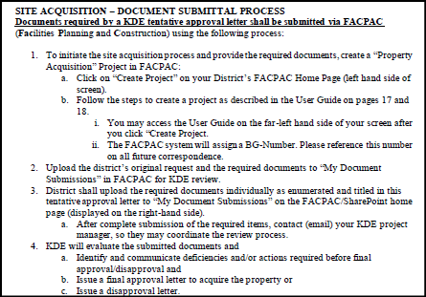
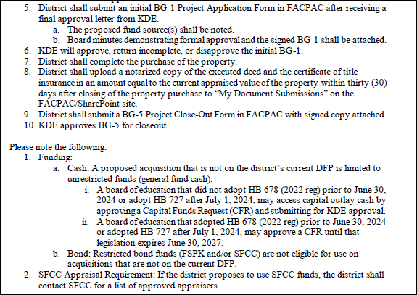
Site Acquisition Submittal Process
(Example of Acquisition Submittal Process, top half & bottom half) Image1

Slide 39
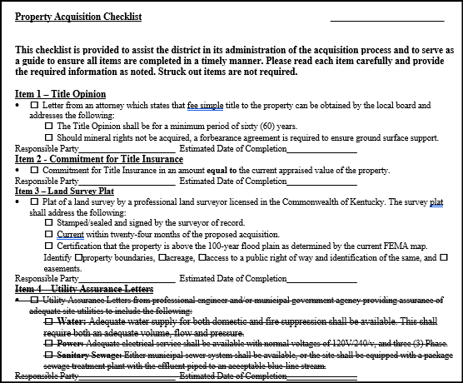
Site Acquisition Checklist
(Partial Example of Checklist ) Image1

Slide 40
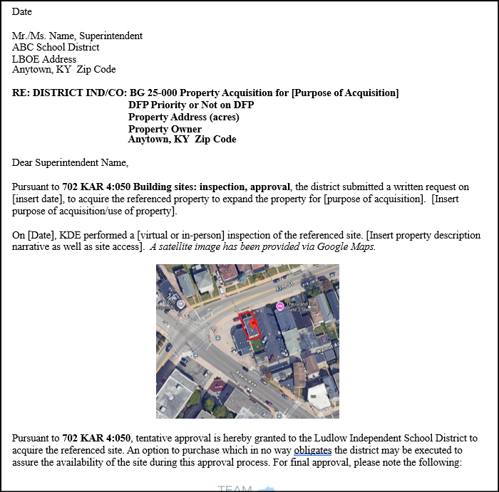
Acquisition Tentative Approval Letter
(Partial Example of tentative approval letter) Image2

Slide 41
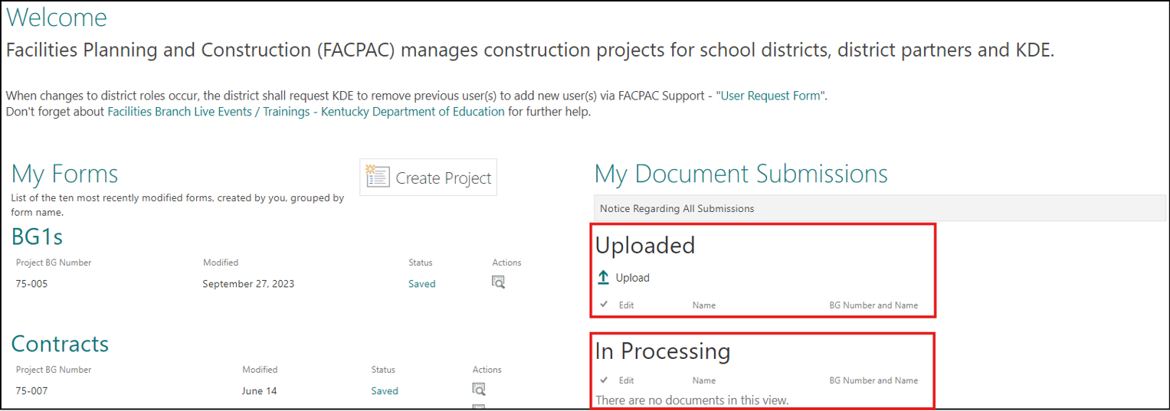
Document Uploads “My Document Submissions”
(View of FACPAC Homepage where documents are uploaded) Image3

Slide 42
Q & A
Questions
If you have any further questions, you may call District Facilities Branch at (502) 564-4326 or email your assigned project manager.
If you are uncertain who to contact, reach out to Tanesha Keene at tanesha.keene@education.ky.gov.

Slide 43
Thank you for your interest and participation!
Please join us for Property Part II on November 20th
Kentucky Department of Education (KDE)
Office of Finance and Operations (OFO)
Division of District Support (DDS)
District Facilities Branch (DFB)
October 23, 2025

