Slide 1
Webinar #5 Facilities Branch: FACPAC “Construction Projects”
Kentucky Department of Education (KDE)
Office of Finance and Operations (OFO)
Division of District Support (DDS)
District Facilities Branch (DFB)
www.education.ky.gov
December 11, 2025
Notes:
We are the Facilities Branch here at KY Dept of Education
A Few Items to Know
- There is a Q & A tab at the top of your screen that you can select to submit a question. All questions will be answered at the end.
My plan is for this slide show to last about 30 minutes – we will see if I can keep that goal.
There will be a survey emailed to you after the webinar. Please take the time to let us know how we did. Surveys are available for one week
We are the Facilities Branch, and this is our 5th Webinar. We started doing these in August and if you missed any they are uploaded to our Facilities webpage on KDE’s website.

Slide 2
Introductions

Slide 3
Kentucky Department of Education (KDE)
Commissioner of Education
Dr. Robbie Fletcher

Slide 4
Office of Finance and Operations (OFO)
Associate Commissioner
Matt Ross
Division of District Support (DDS)
Division Director
Chay Ritter
Assistant Director
Marshall Smith

Slide 5
District Facilities Branch (DFB) Part 1
Branch Manager
VACANT
Project Management / District Liaison
Gary Leist, AIA, LEED AP
gary.leist@education.ky.gov
Marcus Highland, AIA
marcus.highland@education.ky.gov
Notes:
Greg Dunbar is retiring as of 12/31/25, last day 11/26/25.
Marshall Smith is acting Branch Manager.

Slide 6
District Facilities Branch (DFB) Part 2
Project Management / District Liaison
Teresa Hester, NCIDQ, KYCID
teresa.hester@education.ky.gov
John C. Gilbert, AIA, LEED AP
john.gilbert@education.ky.gov

Slide 7
District Facilities Branch (DFB) Part 3
Tanesha Keene – FACPAC Contact
tanesha.keene@education.ky.gov

Slide 8
DFB – Personnel Introductions – Project Manager
Name: Gary T. Leist, AIA, LEED AP
Position: Capital Construction Project Administrator (aka Project Manager)
KDE Experience: 16 years
Augusta Ind.
Bardstown Ind. Beechwood Ind. Bellevue Ind.
Boone Co.
Bowling Green Ind. Bracken Co.
Caldwell Co.
Campbell Co.
Covington Ind.
Dawson Springs Ind. Dayton Ind.
Edmonson Co.
Erlanger - Elsmere Ind.
Fort Thomas Ind.
Garrard Co.
Grant Co.
Grayson Co.,
Hopkins Co.
Jackson Co.
Kenton Co.
Lewis Co.
Livingston Co.
Ludlow Ind.
Martin Co.
Mason Co.
Meade Co.
Muhlenberg Co.
Nelson Co.
Newport Ind.
Oldham Co.
Owen Co.
Pendleton Co.
Pike Co.
Pikeville Ind.
Scott Co.
Southgate Ind.
Trigg Co.
Trimble Co.
Walton - Verona Ind. Warren Co.
Williamstown Ind. Woodford Co.

Slide 9
DFB – Personnel Introductions – Project Manager
Name: Marcus Highland, AIA
Position: Capital Construction Project Administrator (aka Project Manager)
KDE Experience: 9 years
Barbourville Ind.
Berea Ind.
Boyle Co.
Breckinridge Co. Calloway Co.
Carroll Co.
Carter Co.
Clinton Co.
Cloverport Ind. Crittenden Co. Danville Ind.
Eminence Ind.
Floyd Co.
Frankfort Ind.
Franklin Co.
Graves Co.
Harrison Co.
Hazard Ind. Henderson Co.
Henry Co.
Knox Co.
LaRue Co.
Lee Co.
Leslie Co.
Logan Co.
Madison Co.
Magoffin Co.
Mayfield Ind.
McCreary Co.
McLean Co.
Menifee Co.
Morgan Co.
Murray Ind.
Perry Co.
Rockcastle Co. Russell Co. Russellville Ind. Shelby Co.
Todd Co.
Union Co.
Washington Co.
Wolfe Co.

Slide 10
DFB – Personnel Introductions – Project Manager
Name: Teresa Hester, NCIDQ, KYCID
Position: Capital Construction Project Administrator (aka Project Manager)
KDE Experience: 3 years plus other government agency experience
Anchorage Ind.
Ballard Co.
Barren Co.
Bath Co.
Bell Co.
Bourbon Co.
Bullitt Co.
Butler Co.
Campbellsville Ind. Carlisle Co.
Caverna Ind.
Clark Co.
Corbin Ind.
Daviess Co.
East Bernstadt Ind.
Fleming Co.
Glasgow Ind.
Harlan Co.
Harlan Ind.
Hart Co.
Jefferson Co.
Jessamine Co.
Knott Co.
Laurel Co.
Marshall Co.
Middlesboro Ind. Nicholas Co.
Ohio Co.
Owensboro Ind.
Owsley Co.
Paris Ind.
Pineville Ind.
Pulaski Co.
Robertson Co.
Rowan Co.
Science Hill Ind. Simpson Co.
Somerset Ind.
Spencer Co.
Taylor Co.
Wayne Co.
Whitley Co.
Williamsburg Ind.

Slide 11
DFB – Personnel Introductions – Project Manager
Name: John C. Gilbert, AIA, LEED AP
Position: Capital Construction Project Administrator (aka Project Manager)
KDE Experience: 6 years
Adair Co.
Allen Co.
Anderson Co.
Ashland Ind.
Boyd Co.
Breathitt Co.
Burgin Ind.
Casey Co.
Christian Co.
Clay Co.
Cumberland Co.
Elizabethtown Ind.
Elliott Co.
Estill Co.
Fairview Ind.
Fayette Co.
Fulton Co.
Fulton Ind.
Gallatin Co.
Green Co.
Greenup Co.
Hancock Co.
Hardin Co.
Hickman Co.
Jackson Ind.
Jenkins Ind.
Johnson Co.
Lawrence Co.
Letcher Co.
Lincoln Co.
Lyon Co.
Marion Co.
McCracken Co.
Mercer Co.
Metcalfe Co.
Monroe Co.
Montgomery Co.
Paducah Ind.
Paintsville Ind.
Powell Co.
Raceland-Worthington Ind. Russell Ind.
Webster Co.

Slide 12
Presentation Summary (1)
Does your project require a BG-1? (Is it time to use FACPAC?)
FACPAC – What is it?
FACPAC Access
FACPAC Welcome Page: FACPAC Support, User Guide, My Forms, Document Uploads, Create Project.
FACPAC Project Creation.
BG-1 (Editing and Attachments)
BG-2: Lists materials and energy estimates to detail energy target goal. (Form is not created in FACPAC)
Notes:
I have BG2 and BG3 listed just for order of operation we will not be discussing in detail today. John may make brief statement.

Slide 13
Presentation Summary (2)
BG-3 Lists the construction cost estimates. (Form is not created in FACPAC)
Contract
Purchase Order
Change Order Supplemental Information
BG-4 Documents that the contractor/construction manager completed the work.
BG-5 Documents final project costs and actual funds used to close project out.
Questions?

Slide 14
Does my project require a BG-1?

Slide 15
Does my project require a BG-1? (Is it time for FACPAC?)
If you can say yes to any of the following reasons, then it is time to create a project in FACPAC:
When the job requires a design professional.
When removing “Need” from the District Facilities Plan (DFP).
When there is a physical change to the space of an existing building.
When utilizing restricted funds.
When doing property transactions.
Contact your Project Manager is you are not sure.
Notes:
This presentation focuses on Construction so we will not be discussing property today.
We may reference some things but that is it.

Slide 16
What is FACPAC?

Slide 17
What is FACPAC?
FACPAC is the Facilities Planning and Construction software application within the Microsoft, SharePoint system.
This is where local districts (and third-party vendors) may formally submit property, design and construction-related materials to KDE's District Facilities Branch (DFB) for reviews and assistance.
FACPAC Forms for construction projects: ​
FACPAC Project Form (project home page)
BG-1 Initial and Revised
Contract (contract summary)
Purchase Order (purchase order summary)
Change Order Supplemental Information
BG-4 Contract Close-Out
BG-5 Project Close-Out
Notes:
We will be going over these forms in a high-level review.
A project may use all of these forms. Most will use just a few. Again, we will only be going over the Construction side of FACPAC today!

Slide 18
FACPAC Access

Slide 19
FACPAC Access
FACPAC access is granted based on requests received from district users & third-party groups to KDE through FACPAC Support. ​
District roles include the superintendent, finance officer, facility director and their assigned staff. It is important to provide individual roles when requesting access.
Third party roles include architects, construction managers, fiscal agents, qualified providers and their assigned staff. Districts may select third-party groups preloaded in the FACPAC system to provide them access to their projects.
Notes:
When changes occur, the district or third-party should contact KDE.

Slide 20
FACPAC Welcome Page
FACPAC Support, User Guide, Create a Project, Document Uploads, My Forms.

Slide 21
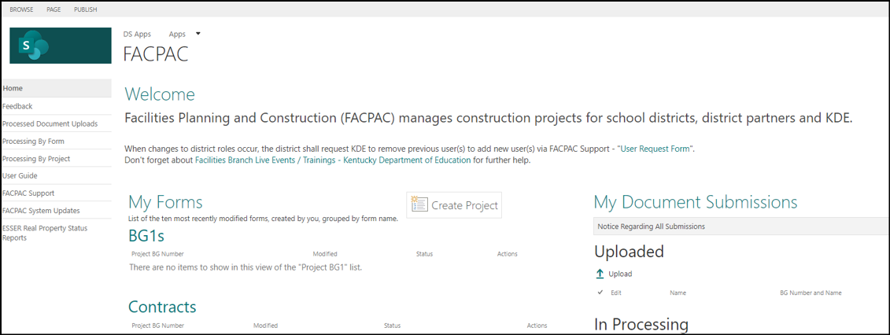
FACPAC Welcome Page – FACPAC Support (1)
Image: FACPAC Welcome Page
Notes:
Need FACPAC Help?
User Guide gives step by step process for FACPAC. Must have access to see
Click on the FACPAC support tab to open the User Request Form.
User Request form – you may need to scroll down

Slide 22
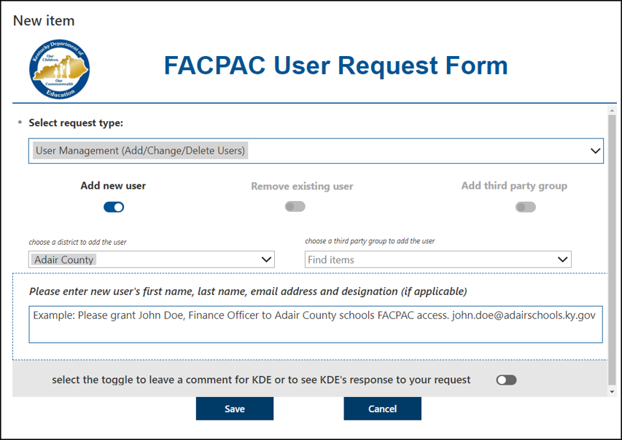
User Request Form– FACPAC Support (2)
Image: User Request Form
Notes:
Need FACPAC Help?
Click on the FACPAC support tab to open the User Request Form.

Slide 23
User Request Types - FACPAC Support (3)
General Inquiry – leave detailed explanation of issue or concern. (Remember, if not enough information is provided (i.e. name, BG#, district, requestor information) KDE may not be able to properly answer the request.
Inventory Management – gives the user the ability to add, change or remove a facility. Remember to provide facility information or KDE cannot complete the request.
User Management – gives the user the ability to add, change or remove another user. Remember to provide the user’s district or third-party information or KDE cannot complete the request.
Notes:
Users can use FACAPC Support to submit a questions or concern to KDE. Submit a request for each separate issue and provide a detailed description. I cannot express how important to detail your request. I get them without: BG#, name, email address, or no information at all.

Slide 24
FACPAC Project Creation

Slide 25
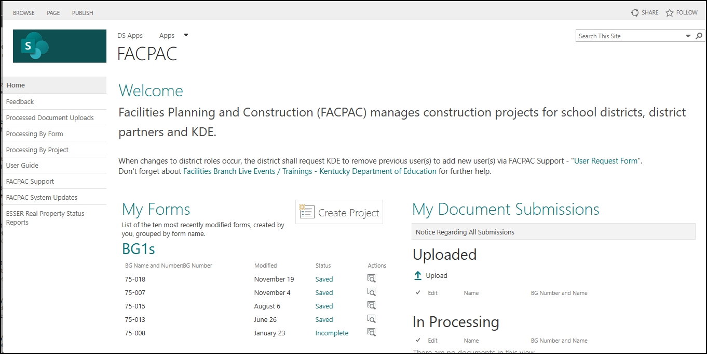
FACPAC Project Creation (1)
Image: FACPAC Welcome Page
Notes:
My Forms
My Document Submissions
Focus on Project Creation

Slide 26
FAPCAC Project Creation (My Document Submissions) (2)
Frequently, districts will have third parties (Design Professionals or Construction Managers) upload documents after the approval of the Initial BG-1. See below for a sample list of forms to be uploaded. Online forms do not get uploaded here. Please contact your Project Manager with any questions
Letters of agreement
Architect Contract
BG-2
BG-3
Board Order
Certificate of Title Insurance
Drawings
Inventory
Property related materials
Post Bid documents
And Others…
Notes:
I added this slide for a visual – Do not go over

Slide 27
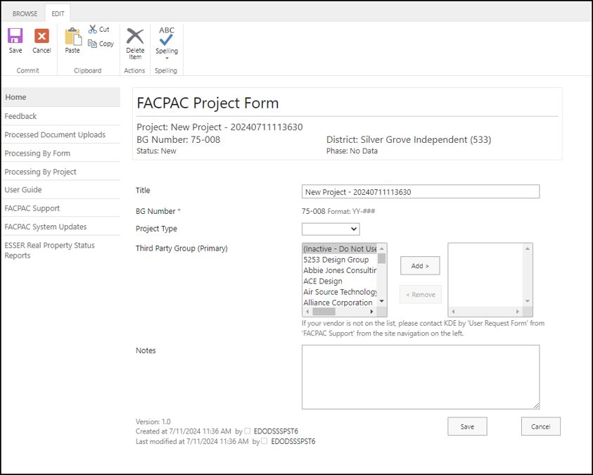

FACPAC Project Creation (3)
Title is generic at the time it is created “New Project YYYMMDDTTTTSS.”
CHANGE TITLE TO DESCRIBE THE PROJECT
BG number is automated.
Project Type provides two choices:
Construction
Delivery Method
Third Party Group
Add/Remove primary
vendor assisting with design/construction.
Save your data!
Image: FACPAC Project Form
Notes:
You have a new Project!! This is the FACPAC Project Form which is your Project Homepage
Districts may select third-party groups preloaded in the FACPAC system to provide them access to their projects.
Reiterate Third Party Roles is necessary for selections here. (FACPAC Support UNNECESSARY)
If 3rd party is not showing in the preloaded menu FACPAC Support NECESSARY!!! Business Name, Type, location and number plus the user, their title and their email

Slide 28
FACPAC Project Creation (4)
Each project created is identified by the BG number and the title. The system assigns the BG number upon creation. Please make sure the district user assigns a title to the project. To add the title, click on the system generated title and replace it with the correct title of your project. The project title can always be changed later if necessary.
When selecting a construction project, the district must decide their Construction Delivery Method by using the following drop-down menu choices:
General Contractor
Construction Manager
Guaranteed Energy Savings Contract
Cooperative Purchase
Notes:
Once the BG-1 is approved – you cannot change the Construction Delivery Method – This is very important if you will need to create a contract in FACPAC.

Slide 29
FACPAC Project Creation (5)
Select the “Third Party Group (Primary)” drop-down menu to choose a third-party organization to add to the project. Third-party users will not be able to access the project in FACPAC until this step is complete. This can always be changed or added later if necessary.
If the third-party organization, your district is using, is not showing in the drop-down menu please submit a request through FACPAC Support to have them added.
Include business name, business type, location and telephone number.
Also include the individual user(s) name, title and email account within the organization
Notes:
I chose to go a bit further in depth with the Project Creation Process.

Slide 30
BG-1
Details project type, lists jobs, location, cost and funding of the project.

Slide 31
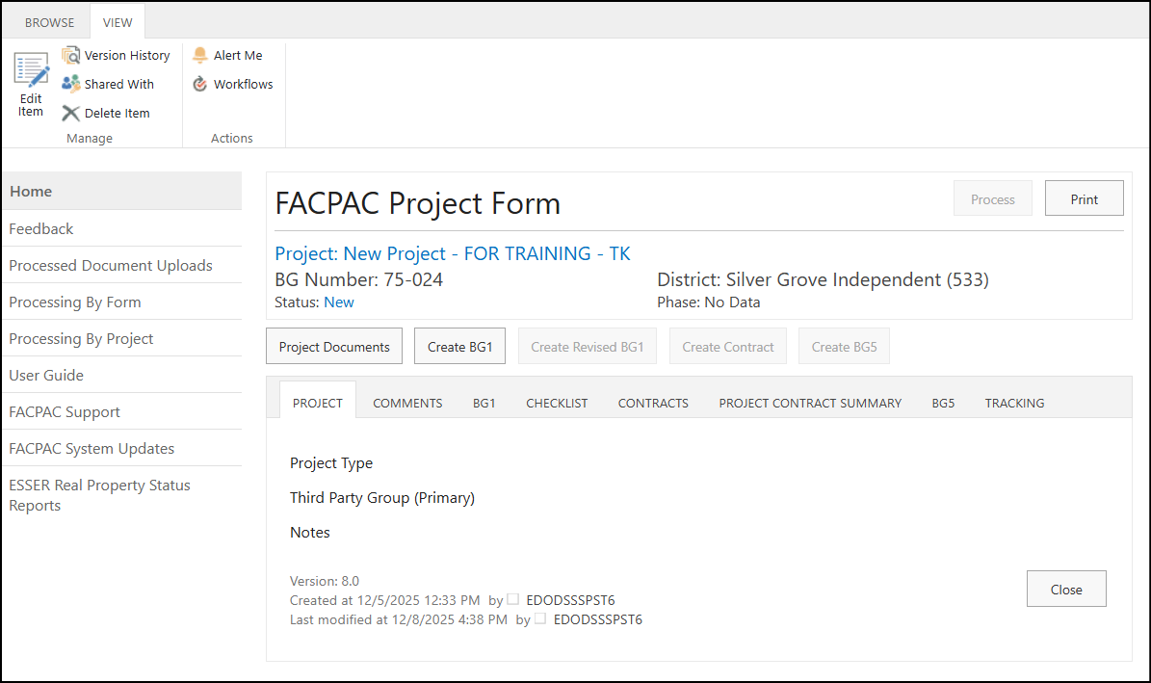
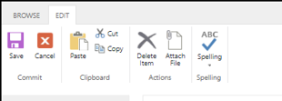
BG-1 (1)
Create BG-1
Editing (Attachments)
Create BG-1 (Image)
Image: FACPAC Project Form
Notes:
Project Form homepage
Project Information will populate based on your last save.
Create BG-1 when you are ready – Only district staff can complete Initial
Tabs
Edit Item – Delete Forms or Attachments

Slide 32
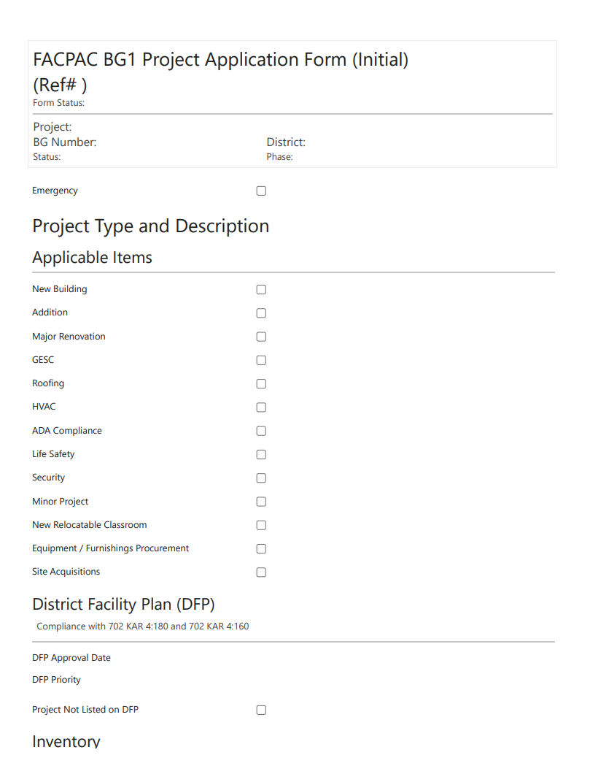


BG-1 (2)
Project Information carries over
Emergency?
Project Type
Image1: Initial BG-1 Form
Notes:
Project information carries over from Project Form to BG-1.
Make your selections, you can always save and come back.

Slide 33
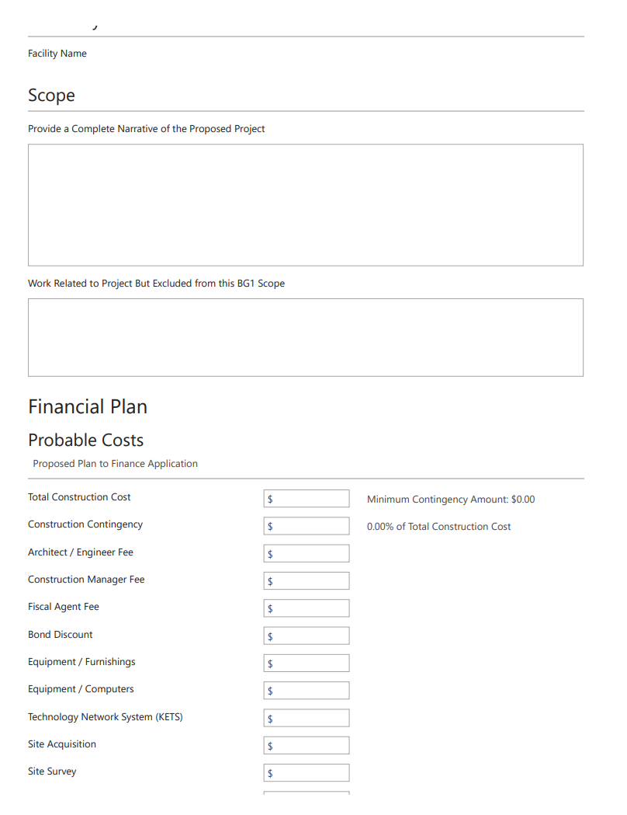
BG-1 (3)
DFP (Needs Being Met)
Inventory
Scope (General Description)
Image2: Initial BG-1 Form (continued)
Notes:
Scope – detailed narrative of the project

Slide 34
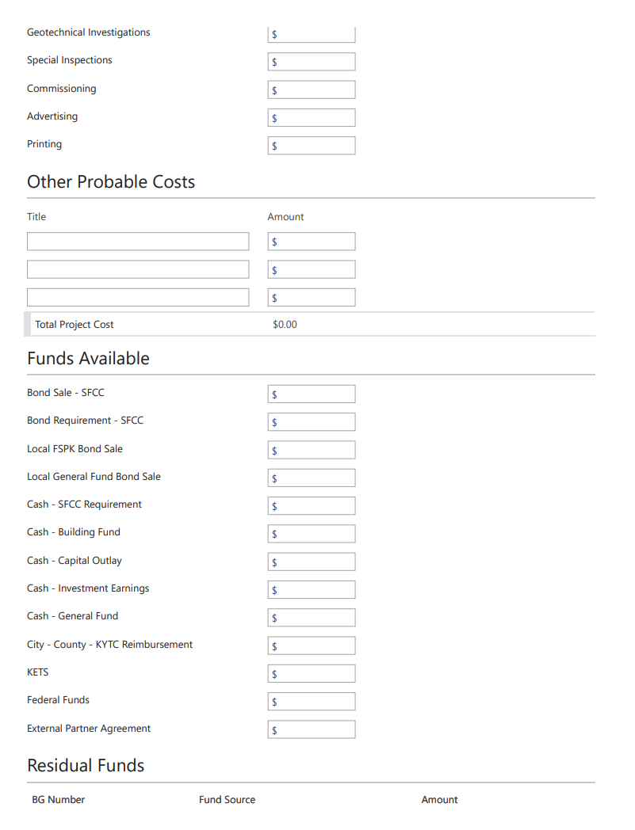
BG-1 (4)
Financial Plan – Probable Costs
Image3: Initial BG-1 Form (continued)
Notes:
Financial Plan – starting with Probable Costs

Slide 35
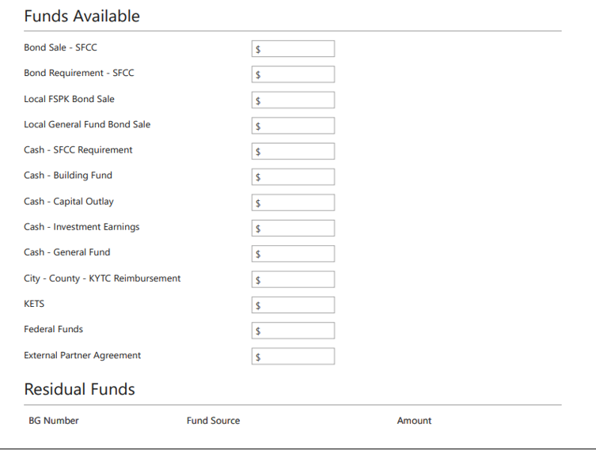
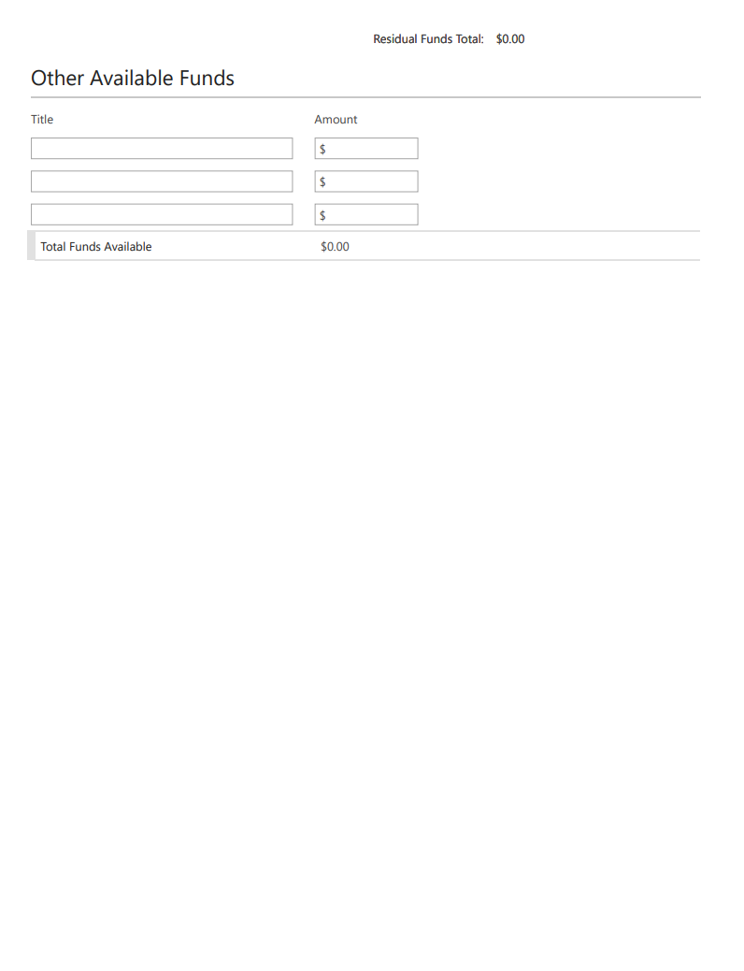
BG-1 (5)
Financial Plan – Funds Available
Define Other Available Funds!
Remember to save your data!
Signature page will populate when you print the form.
Image4: Initial BG-1 Form (continued)
Notes:
Financial Plan _ Funds Available
Signature page populates later
Define “Other Available Funds”
Make sure to use the drop-down menu to add Residual Funds from an old project………. If you have technical issues please let me know

Slide 36
BG-1 (6)
After a Project Form is created in FACPAC, the next step is to create a BG-1 when applicable. Contact the district’s KDE provided Project Manager (PM) if there are questions or concerns about the time to create a BG-1.
Only district staff can create the Initial BG-1 form and submit it to KDE.
On the FACPAC Project Form, select the “Create BG-1” button to start the process.
Add district data to complete the form.
Print form to get board signatures then attach and submit to KDE.
Notes:
Can edit later
Cannot edit if approved

Slide 37
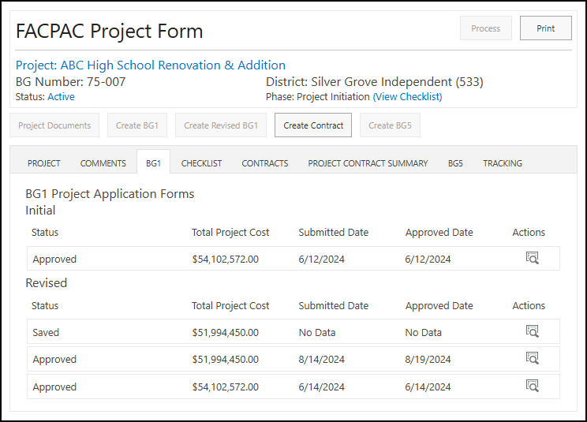
BG-1 (7)
BG-1 tab view
Image: FACPAC Project Form BG-1 Dashboard
Notes:
I wanted to show this screen because it is important. This screen is what hangs up most districts. The saved BG-1!
If it is a new project and you see NO DATA then your attention is needed. This does not apply to old projects as they are imported to FACPAC.
A project can have multiple BG-1s

Slide 38
BG-2 & BG-3
BG-2: Lists materials and energy estimates to detail energy target goal.
BG-3 Lists the construction cost estimates.
Notes:
JOHN, WOULD YOU LIKE TO GIVE A BRIEF EXPLANATION OF THESE?

Slide 39
BG-2 and BG-3
These forms are not in FACPAC
Performed by design professionals and construction managers.
Please see the User Guide for assistance.
Notes:
JOHN, WOULD YOU LIKE TO GIVE A BRIEF EXPLANATION OF THESE?

Slide 40
Contract

Slide 41
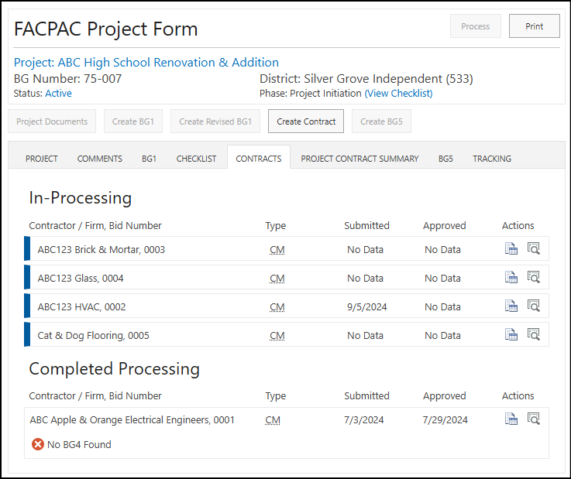
Contract (1)
Create Contract
Image: Create Contract View
Notes:
Contract View
JOHN, CAN YOU EXPLAIN THE ALL OR NOTHING APPROACH WITH CONTRACTS? – Reference question received from Codell’s Teresa Carpenter
No contract, means you skip this process and can go straight the BG-5.

Slide 42
Contract (2)
Generally, before construction begins on a project the post bid information is put into FACPAC.
A contract cannot be created until an Initial BG-1 has been approved.
Click on the “Create Contract” button to start the process.
Upon completion of the construction contract, including all change orders, and purchase orders, each contract must be closed out by a BG-4 Contract Closeout Form.

Slide 43
Contract (3)
In-Processing (contract pending)
Completed Processing (contract approved)
Image: Contract Processing View
Notes:
Contract View
Most question that I get from districts – Why are the buttons greyed out???
Not ready for a BG-5
CO, PO & BG4 comes from here

Slide 44
Contract (Approval Process) (4)
Contracts have a two-step submission process.
STEP 1
The Initial Contract (online version) should be completed with an attached copy (paper version) in PDF format of the proposal. When all necessary forms are attached, process the contract to submit the proposal to KDE. KDE will process accordingly.
The contract will show a status of “Approved – Proposed”.

Slide 45
Contract (Approval Process) (5)
Step 2
The final step involves printing the completed FACPAC Contract (online version) and the Executed Contract (paper version). Both copies should be presented to the Local Board of Education for approval then signed and dated by all appropriate parties. Attach both forms in PDF format to the online FACPAC contract with all other relevant attachments then process the contract to submit to KDE. After this final step is complete, the contract will show a status of “Approved – Signed”.

Slide 46
Purchase Order

Slide 47
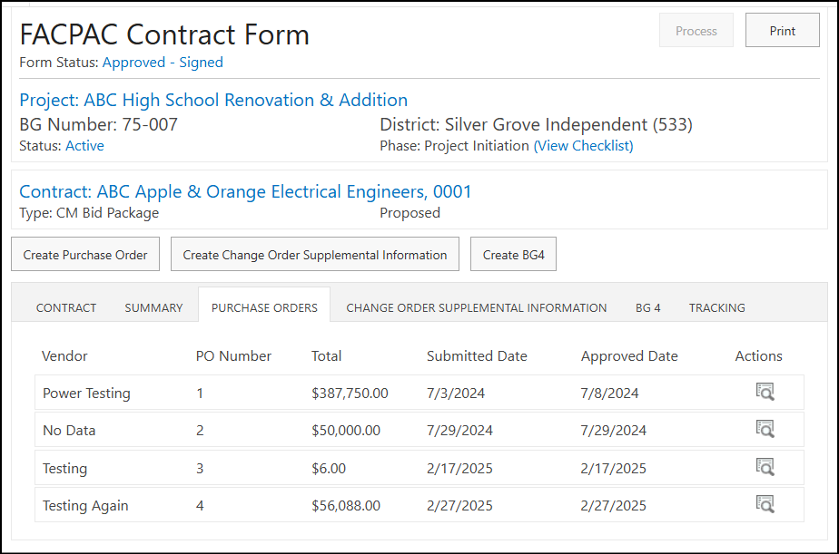
Purchase Order (1)
Create Purchase Order
Image1: Create Purchase Order View
FACPAC Project Form - Create PO (Image)
Notes:
Generally, your consultants complete these forms. I am not going into detail but showing you for reference.
Create Purchase Order – you can skip if unnecessary - This should be an all or nothing approach
The system will not allow you start a BG-4 if these are pending.
JOHN, WOULD YOU LIKE TO GIVE A BRIEF EXPLANATION OF THESE?

Slide 48
Purchase Order (2)
Purchase Order View
Image2: Purchase Order Processing View
Notes:
Purchase Order View
This example shows that all purchased orders are processed.

Slide 49
Purchase Order (3)(Extra Tidbits)
No further edits can be made to the Purchase Order after completion of the approval process.
Once the BG-4 process is started for a contract, no further purchase orders can be created. As long as the BG-4 is saved, it can be deleted to start that process if necessary.
Click the “Add Item” button to include the Item Description, Item Number, Quantity, and Unit Price. Be sure to click the “Add Item” button again to make the total populate for that entry. This does not require another entry and can be deleted if unnecessary however, it will correct the figures.

Slide 50
Change Order Supplemental Information
Notes:
JOHN, WOULD YOU LIKE TO GIVE A BRIEF EXPLANATION OF THESE?

Slide 51
Change Order Supplemental Information (1)
Create Change Order
Image1: Create Change Order View
Notes:
Changes to contracts agreements (post bid) are done by creating a change order.
John, anything to add
Create Change Order

Slide 52
Change Order Supplemental Information (2)
Changes to contracts/agreements (post bid) are done by creating a Change Order (AIA document). This information is what gets put into FACPAC and all accompanied information that supports this information.

Slide 53
Change Order Supplemental Information (3)
Changes to purchase orders (post bid) are done by creating a Change Order (AIA document). Same as stated previously for contracts, this information being put into FACPAC will result in a change order supplemental information form for a purchase order. Make sure to not confuse a Change Order to a contract with a Change Order to a purchase order. These may have common numeric values.

Slide 54
BG-4

Slide 55
BG-4 (1)
BG-4’s can be created and processed by third parties or the district.
Image1: Contract View for “No BG4 Found”
Notes:
You cannot click on the “X” t create the BG-4 This is just informational letting you know it is still needed
You will need to open the contract to create a BG-4. Double click on the action button to get there.
Must delete to go back to create CO or PO
JOHN, WOULD YOU LIKE TO GIVE A BRIEF EXPLANATION OF THESE?

Slide 56
BG-4 (2)
Image1: Create BG-4 View
Notes:
Create a BG-4 for all contracts

Slide 57
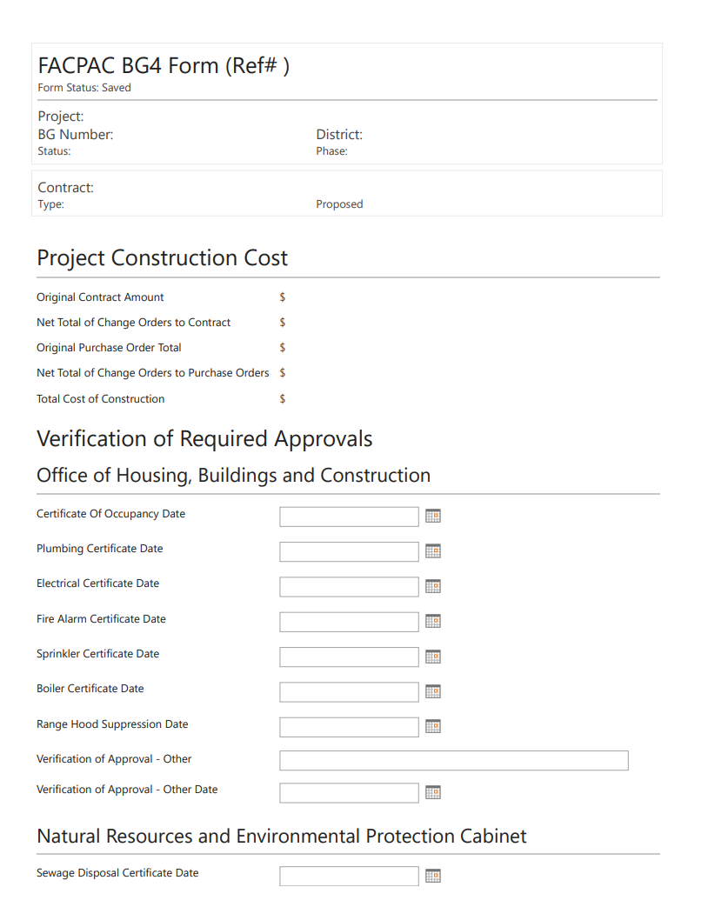
BG-4 (3)
BG-4 Construction Costs are summarized and automated from contract information in the FACPAC system.
Verification of Required Approvals provides dates of all official closeout requirements like building code, environmental, etc.
Closeout information provides documentation on warranties, trainings, record drawings, lien releases, etc.
Image2: BG-4 Form Project Costs
Notes:
Tanesha Read!

Slide 58
BG-5

Slide 59
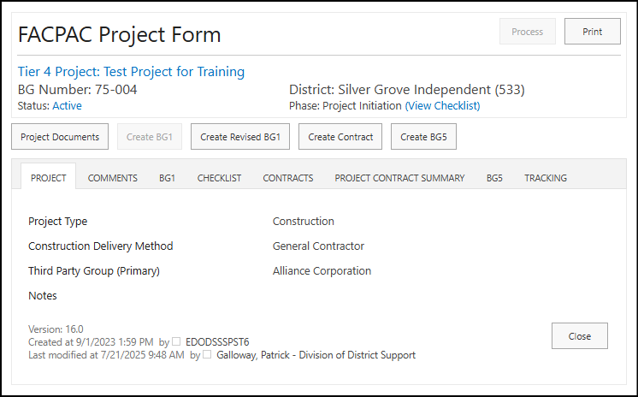
BG-5 (1)
Image1: Create BG-5 View
Notes:
All previous forms must be approved to begin BG-5 process
To go back, must delete any pending BG-5 since this is the close out process
For closing out older projects the same rules apply.
Keep in mind KDE can only assist with the information provided on older projects.
Any project with an approved BG-1 on file will require a BG-5 to close it out.
It is totally the district’s discretion on how they handle their projects. KDE will advise you in regards to any questions you may have.

Slide 60
BG-5 (2)
Who completes a BG-5?
Only district personnel may complete this form.
When do you complete a BG-5?
This is the final act to formally close the entire project. All contracts are completed which includes design professionals, construction management companies, fiscal agent and other soft cost related items.

Slide 61

BG-5 (3)
Remember to update your building inventory through Kentucky Facilities Inventory and Classification System (KFICS).
The Local Board of Education designee must sign and date the printed BG-5, then it should be attached to the online form itself.
PLEASE MAKE SURE ALL FIGURES ARE CORRECT BECAUSE NO FURTHER EDITS CAN BE DONE AFTER THE BG-5 IS APPROVED!
Notes:
Make sure to Print and get the BG-5 signed.

Slide 62
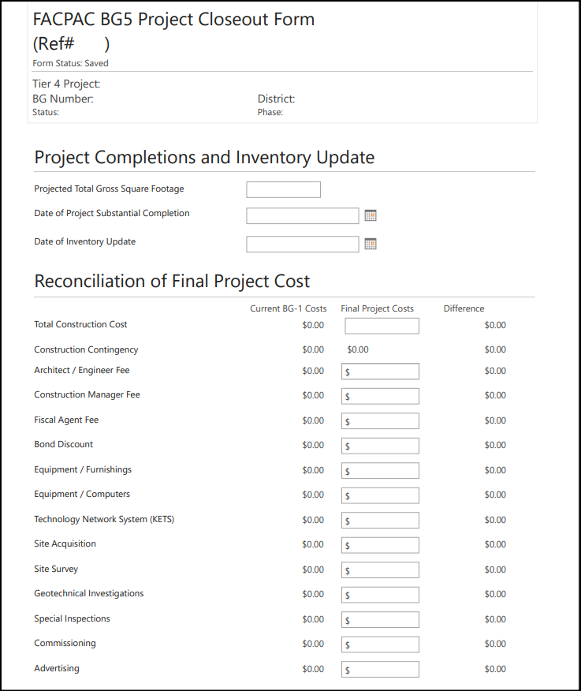
BG-5 (4)(Image 1)
Image1: BG-5 Form View
Notes:
JOHN, WOULD YOU LIKE TO GIVE A BRIEF EXPLANATION OF THESE?

Slide 63
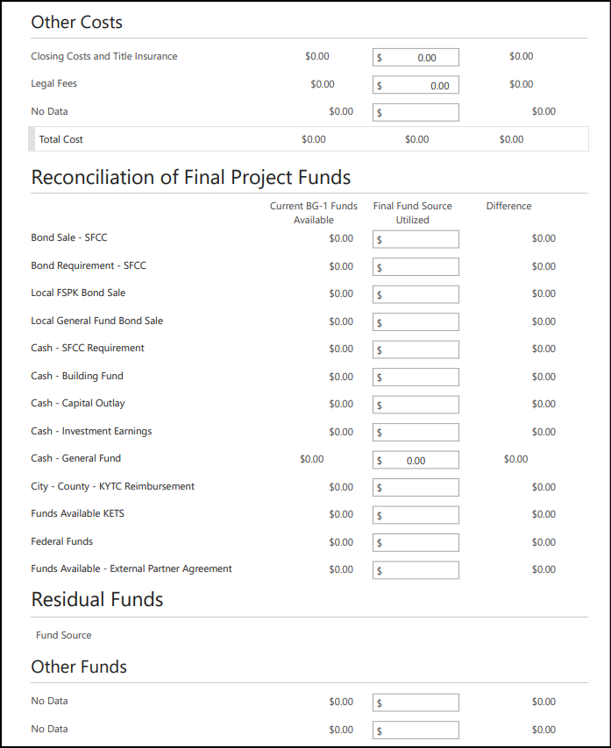
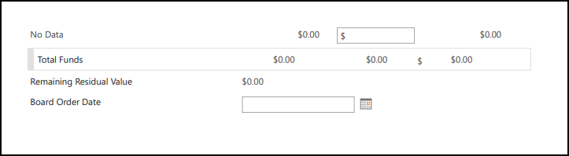
BG-5 (5)(Image 2)
Image2: BG-5 Form View

Slide 64
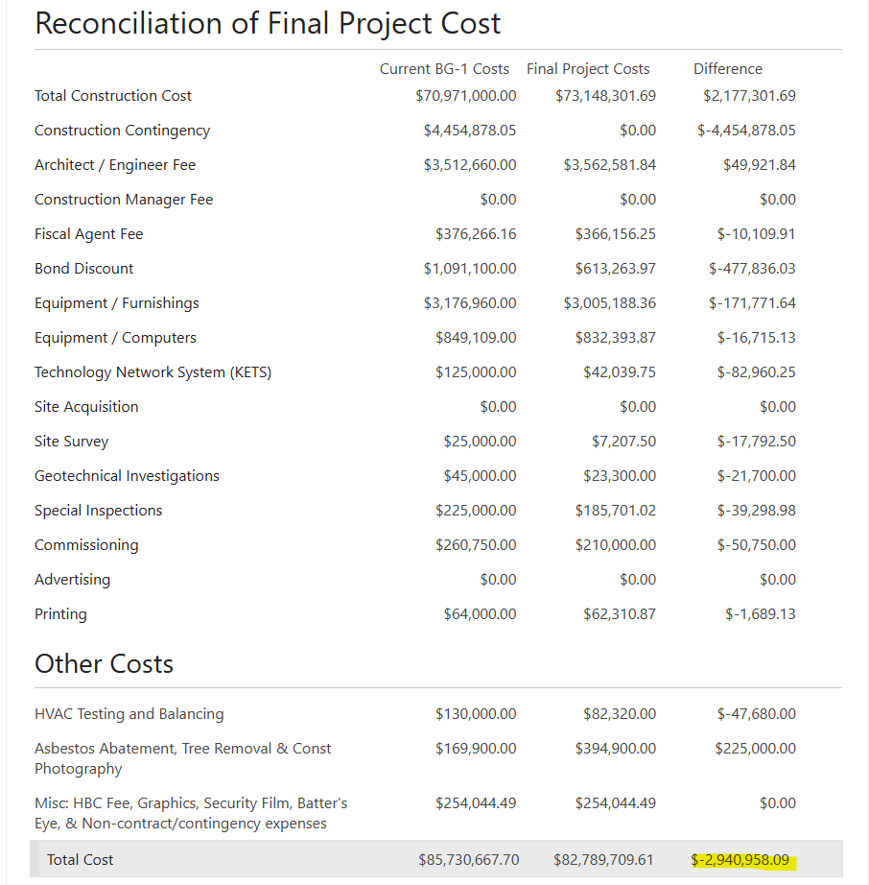
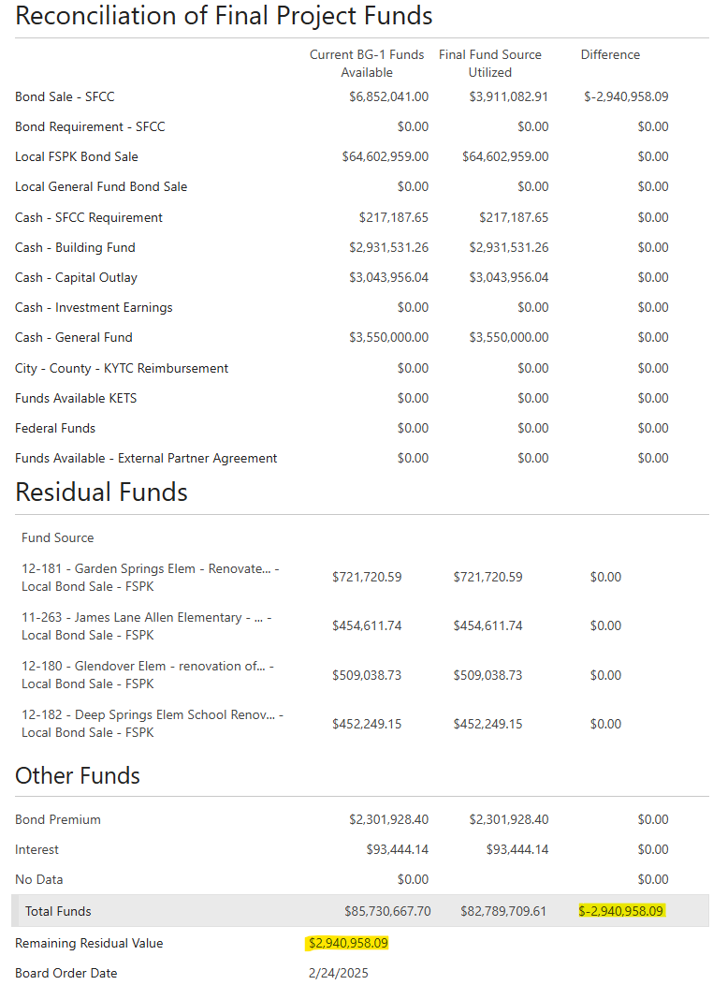
BG-5 Example (6)
Project Completions and Inventory Update (KFICS)
Reconciliation of Final Project Costs
Reconciliation of Final Project Funds and Residual Funds
The Difference for Costs, Funds, and Remaining Residual Value should all equal the same number.
For this to occur, the other totals for costs and funds shall match too.
EQUALS
Images focused on BG-5 Project Closeout Form totals and their need to match,
(credit Fayette County)
Notes:
JOHN, WOULD YOU LIKE TO GIVE A BRIEF EXPLANATION OF THESE?

Slide 65
Early Question #1
Should District’s, Architects, GC’s, and CM’s continue to utilize the construction documents/templates/ and fee guidelines available on the KDE website, despite the changes that have taken place related to HB 678 and the fact that the KAR 4:160 is designated as expired?
Additionally, we noted from a recently published RFP from a district which included a statement that there was no predetermined fee scheduled provided by KDE for CM as Constructor services, stating that the district allowed for negotiation of fee amount.

Slide 66
Any Questions?

Slide 67
Follow–Up Questions
If you have any further questions, you may call District Facilities Branch at (502) 564-4326 or email your assigned project manager.
If you are uncertain who to contact, reach out to Tanesha Keene at tanesha.keene@education.ky.gov.

Slide 68
Thank you for your interest and participation!
Kentucky Department of Education (KDE)
Office of Finance and Operations (OFO)
Division of District Support (DDS)
District Facilities Branch (DFB)
December 11, 2025

