Slide 2
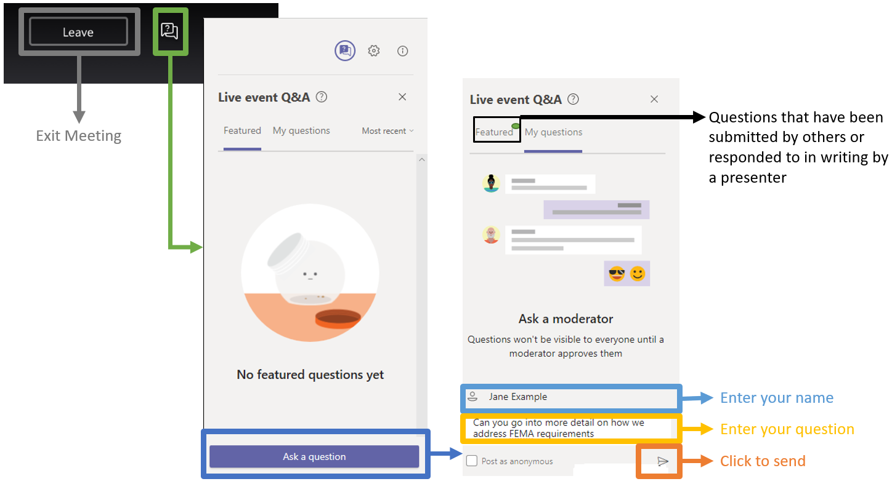
Questions & Answers Feature

Slide 3
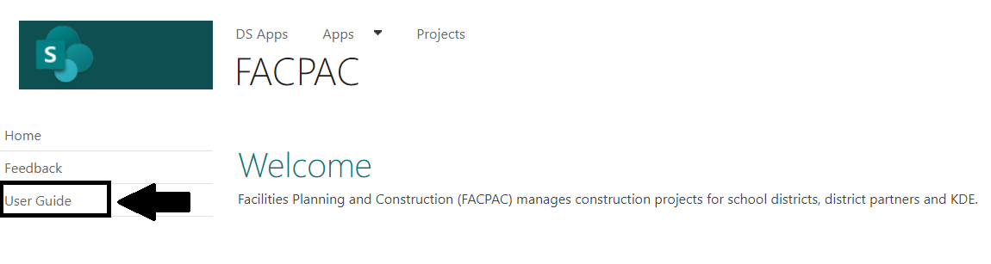
FACPAC Home Page
Select the User Guide in the left navigation site

Slide 4
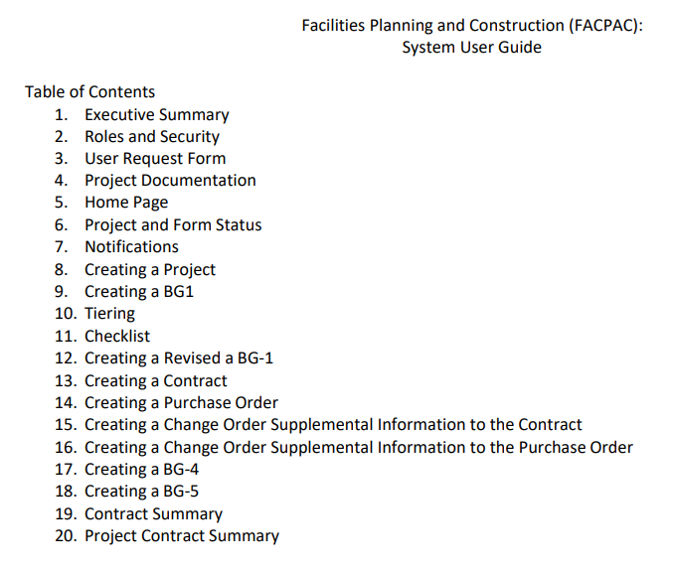
FACPAC User Guide
Table of contents

Slide 5
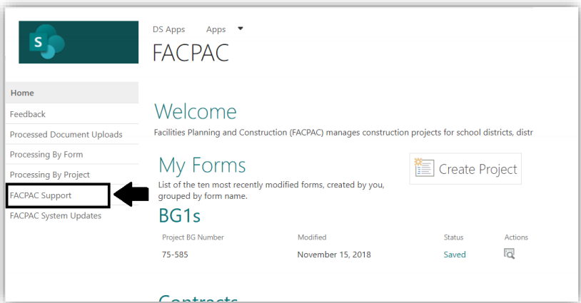
FACPAC Site Navigation
User opens the FACPAC Maintenance Requests using the FACPAC Support link from FACPAC site navigation.

Slide 6
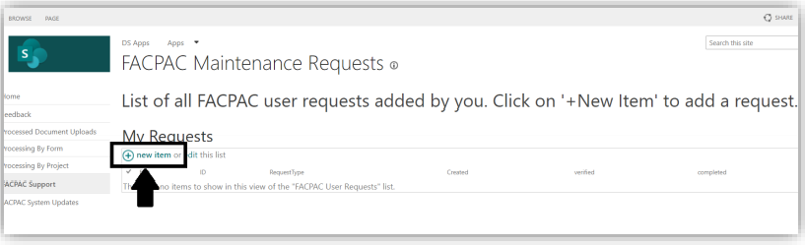
FACPAC Maintenance Requests
User clicks on ’new item’ to add a new request
Users can only view requests added by them

Slide 7
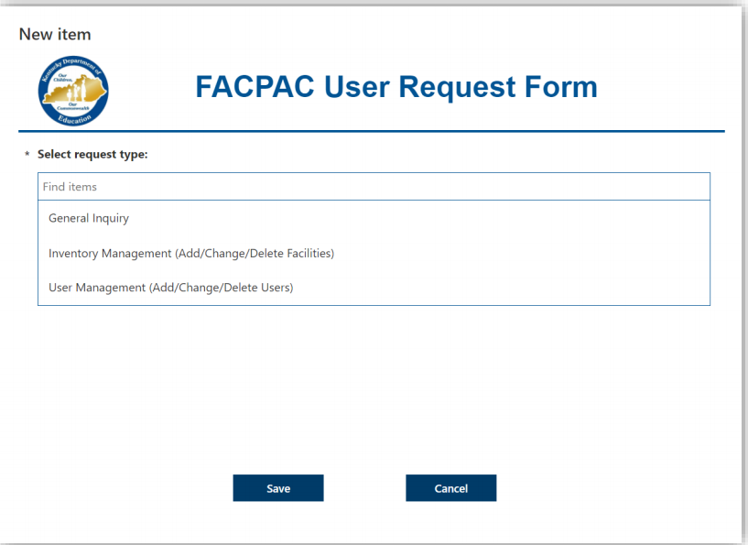
FACPAC User Request Form
Page with the User request form opens
User chooses a request type, fills out the request form and clicks on save

Slide 8
FACPAC User Request Form (continued)
The FACPAC Request Form has three request types to choose from:
General Inquiry: For general questions
Inventory Management (Add/Change/Delete Facilities): For adding, modifying, removing school buildings from KDE districts
User Management (Add/Change/Delete Users): For adding, removing people to KDE districts or third-party groups; adding new third-party groups
The User uses the options provided on the form to fill in and provide information like email address, building name, etc.
The users can also leave a brief comment about the request by selecting the toggle ‘select the toggle to leave a comment for KDE

Slide 9
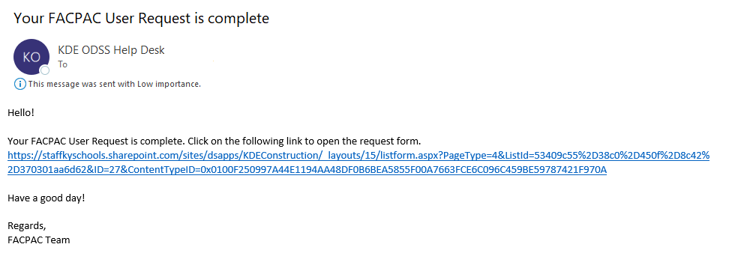
FACPAC User Request Completion
The User is notified about the completion of the request with a link. If the user has submitted a General Inquiry the Inquiry Response will be displayed from the link.

Slide 10
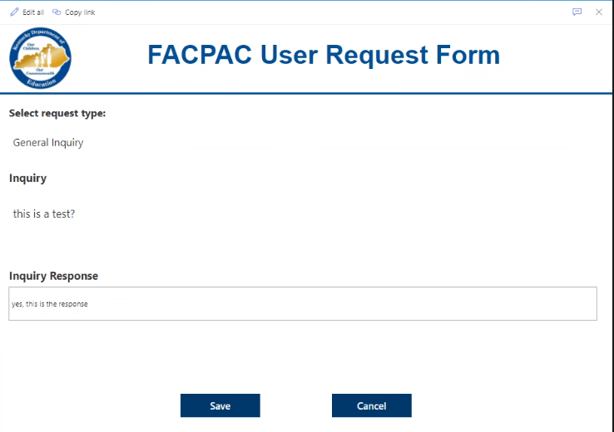
FACPAC User Request Completion (continued)
Please open the link to review the response

Slide 11
KDE Contact Information
District Facilities Branch
  James Bauman, Project Manager
  james.bauman@education.ky.gov
  John Gilbert, Project Manager
  john.gilbert@education.ky.gov
  Marcus Highland, Project Manager
  marcus.highland@education.ky.gov
  Gary Leist, Project Manager
  gary.leist@education.ky.gov

Slide 12
Q&A
This presentation will be available on the KDE Facilities website.

