Slide 1
Notes:
Greg

Slide 2
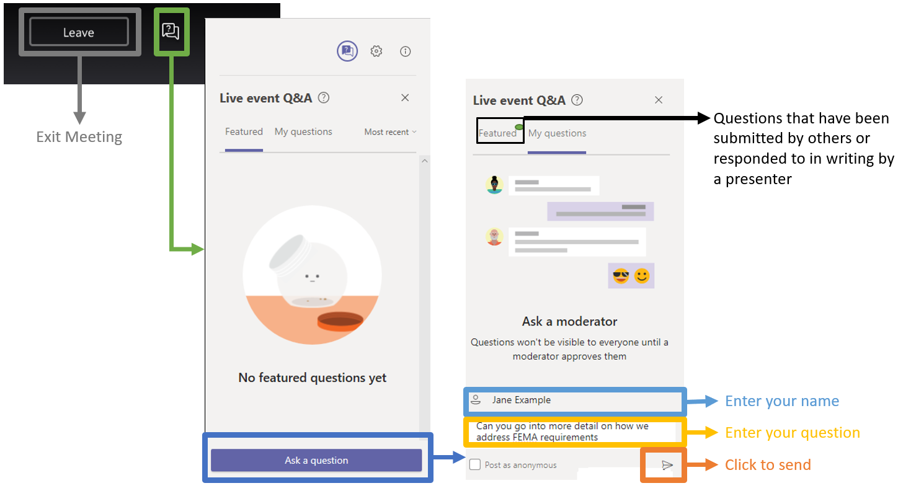
Questions & Answers Feature

Slide 3
702 KAR Capital Construction Process
Session 1
FACPAC (Phase 1) Part 2
Questions will be addressed at the end of the presentation.
3
Notes:
Greg

Slide 4
KRS 162.060
KRS 162.060 requires that all plans and specifications for new public-school buildings contemplated by boards of education, and for all additions to or alterations of old buildings, be approved or disapproved in accordance with the rules and regulations of the Kentucky Board of Education.
4
Notes:
Greg

Slide 5
KRS 162.060
KDE’s District Facilities Branch (DFB) is responsible for administering 702 KAR 4:160, Capital Construction Process, which promulgates this statute. No board of education may award a contract for the erection of a new building, or contract for an addition to or alteration of an old building, until the plan has been approved.
DFB also administers regulations regarding district facility planning and real property.
5
Notes:
Greg

Slide 6
Communicating with DFB
When corresponding with DFB via email, please
  IDENTIFY THE DISTRICT IN THE REFERENCE LINE.
  DO NOT simply say “question” or “call.”

Slide 7
FACPAC Notice
After an initial BG-1 is approved by KDE, a FACPAC System generated notice is sent by e-mail to whoever has access to that project.
The notice gives:
  A link to the form
  The most recent comments
  A link to the checklist
  The assigned tier
7
Notes:
Denise

Slide 8
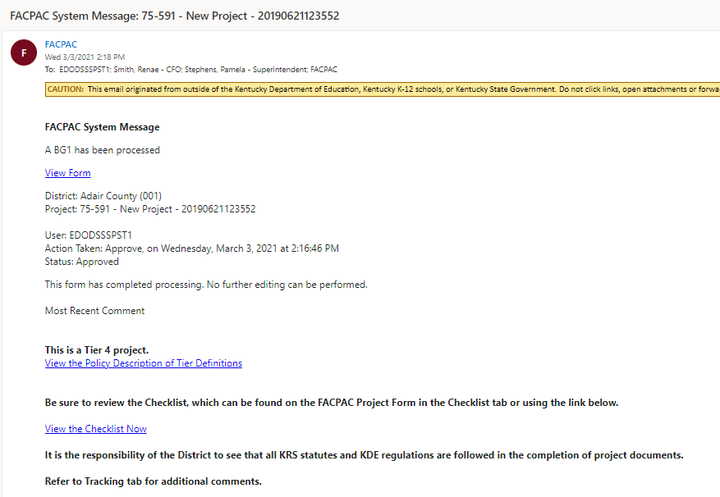
FACPAC System Message Example

Slide 9
FACPAC Checklist
The BG-1 approval process includes a system-generated checklist. All parties that have FACPAC access to the project can view the checklist.
The checklist includes items required for this project.
The checklist is accessed from the FACPAC Project Form screen.

Slide 10
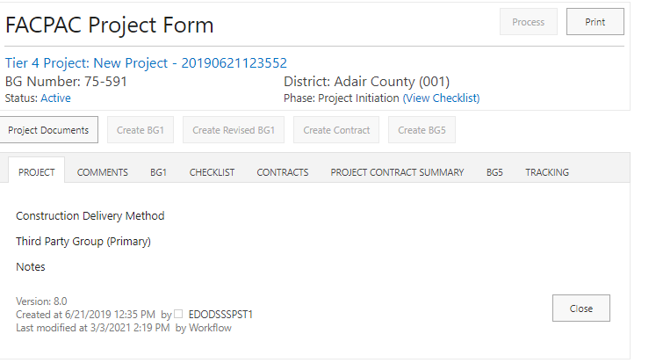
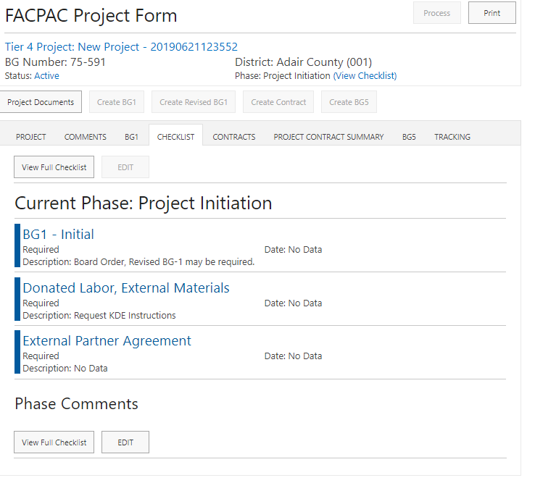

Slide 11
Where are Required Documents
Submitted?
Documents are submitted in FACPAC in two ways, either attached to a FACPAC form or uploaded to My Document Submissions. Examples are
listed below:
FACPAC Form My Document Submissions
Signed FACPAC Form AIA Owner/Architect Agreement
AIA Owner/Contractor Agreement AIA Owner/Construction Manager Agreement
Board Order (If required) BG-2
Certificate of Insurance BG-3
KDE Form of Proposal Site Plan
Tabulation of Bids Drawings
Copy of Advertisement Surveys
GESC Contract Project Manual
AIA Change Order Documentation Addenda

Slide 12
Tiering
Tiering is the automated evaluation of project criteria, developed by KDE, based on funding sources, project scope, program complexity and cost.
Tiering was developed to streamline project submittals and reviews.
A project is assigned the tier at the approval of the Initial BG-1.
A project tier can change with a Revised BG-1.
12
Notes:
Denise

Slide 13
Tier Definitions
Tier 1 This tier typically will require all reviews and approvals, including Schematic, Design Development and Construction Documents, post bid and construction submittals and approvals, as well as BG-1 through 5 submittals.
Tier 2 Similar to above but deleting one design submittal. The BG-2 will be required at Construction Document submittal.
Tier 3 Tier 3 reviews require BG-1 through 5, Construction Documents and Post Bid submittals.
Tier 4 BG-1, 4 and 5 and Owner-Contractor Agreement are required.

Slide 14
Tier Definitions
GESC - GESC projects will continue to be reviewed per the existing GESC checklist.
Cooperative Purchase Agreement (Price Contract), Emergency - Price contract work and emergency projects will have their own checklists incorporated into the appropriate tier based on scope, funding, etc., as above.

Slide 15
Document Submission Process
After the online FACPAC form is completed, it is:
  Printed
  Presented to the board for approval
  Signed and dated by all appropriate parties
  Scanned and saved as a PDF and attached to the online FACPAC form with all other relevant attachments
The FACPAC form with attachments is then processed to submit to KDE.

Slide 16
FACPAC Form Status
The FACPAC form status is on the Tracking Tab of every FACPAC form:
  Saved - Created but not submitted
  Submitted Financial Review - In financial review dashboard
  Submitted Project Manager - In the districts project manager dashboard
  Submitted Branch Manager – In the branch manager dashboard
  Submitted Director – In the director dashboard

Slide 17
Do
Verify the following before submission to KDE:
  When communicating with KDE, identify the district in the subject line.
  Verify FACPAC system-generated notices are not going to junk mail or clutter.
  View the checklist.
  Verify your project has been submitted to KDE.

Slide 18
Don’t
Don’t use old forms.
Don’t submit project documents until after an initial BG-1 has been approved by KDE.

Slide 19
Future Training Sessions
Future presentations will discuss:
  Document uploads during design phases
  Post-bid revised BG-1’s and related submissions
  Submissions during the construction phase
  BG-4 construction closeout
  BG-5 project closeout
  Site acquisitions

Slide 20
KDE Contact Information
District Facilities Branch
  Greg Dunbar, Manager
  greg.dunbar@education.ky.gov
  Denise Hartsfield, FACPAC Administrator
  denise.hartsfield@education.ky.gov

Slide 21
KDE Contact Information
District Facilities Branch
  James Bauman, Project Manager
  james.bauman@education.ky.gov
  John Gilbert, Project Manager
  john.gilbert@education.ky.gov
  Marcus Highland, Project Manager
  marcus.highland@education.ky.gov
  Gary Leist, Project Manager
  gary.leist@education.ky.gov

Slide 22
KDE Contact Information
Division of District Support
  Jeff Coulter
  jeffrey.coulter@education.ky.gov

Slide 23
Q&A
This presentation will be available
on the KDE Facilities webpage.

