Slide 1
DFP Startup and HB 678
Kentucky Department of Education (KDE)
Office of Finance and Operations (OFO)
Division of District Support (DDS)
District Facilities Branch (DFB)
July 14, 2022

Slide 2
Introductions

Slide 3
Office of Finance and Operations (OFO)
Associate Commissioner
Robin Fields Kinney
robin.kinney@education.ky.gov

Slide 4
Division of District Support (DDS)
Division Director
Chay Ritter
chay.ritter@education.ky.gov

Slide 5
District Facilities Branch (DFB)
Branch Manager
Greg Dunbar, AIA, MBA
greg.dunbar@education.ky.gov

Slide 6
District Facilities Branch Staff (DFB) Part 1
Project Management/District Liaison
Gary Leist, AIA, LEED AP
gary.leist@education.ky.gov
James A. Bauman, Architect
james.bauman@education.ky.gov
Marcus Highland, AIA
marcus.highland@education.ky.gov
John C. Gilbert, AIA, LEED AP
john.gilbert@education.ky.gov

Slide 7
District Facilities Branch Staff (DFB) Part 2
Resource Management Analyst II
Tanesha Keene
tanesha.keene@education.ky.gov

Slide 8
Presentation Located on KDE Website at
Facilities Branch Live Events / Trainings - Kentucky Department of Education
Partial image of the KDE website for “Facilities Branch Live Events.”
On the KDE website select: District/School Support > Facilities > Facilities Branch Live Events / Trainings

Slide 9
Presentation Summary
Introductions (Done!)
Statutes and Regulations “Why do we do a DFP?”
Status and Notifications – Getting Started
Start Up Packet
Assembling your Local Planning Committee (LPC)
Assessments – General Overview
HB 678 – General Notes
Q&A

Slide 10
Statutes and Regulations
Why do we do a DFP?
Kentucky Revised Statutes (KRS)
Kentucky Administrative Regulations (KAR)

Slide 11
Kentucky Revised Statutes (KRS) Part 1
Capital Outlay
KRS 157.420(4) requires capital outlay be used for capital outlay projects approved by the Commissioner of Education in accordance with the administrative regulations (KDE 702 KAR 4:180).
Facility Support Program of Kentucky (FSPK)
KRS 157.440 FSPK funds are to be used to address categorized priorities listed in approved Facility Plans pursuant to KRS 157.420.

Slide 12
Kentucky Revised Statutes (KRS) Part 2
School Facilities Construction Commission (SFCC)
KRS 157.620(3) SFCC funds are restricted to priority order on the approved school facilities plan
KRS 157.622 sets forth certain requirements for school facility plans relative to participation in funding by SFCC.
Kentucky Facilities Inventory Classification System (KFICS)
KRS 157.420(9) Beginning 2011-12, KDE shall standardize the process for evaluation the overall quality and condition of all school buildings across the state - KFICS.

Slide 13
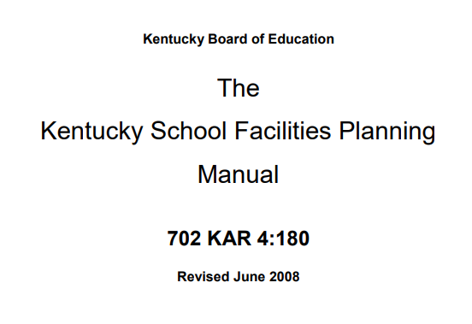
Kentucky Administrative Regulation (KAR)
The Kentucky School Facilities Planning Manual
The Planning Manual is incorporated by reference through 702 KAR 4:180. The requirements for the development of a District Facility Plan (DFP) are outlined in this manual.
Image of The KY School Facilities Planning Manual title page.

Slide 14
Status and Notifications
Getting Started

Slide 15
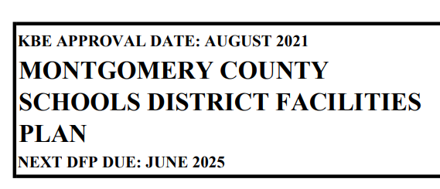
Status – When is the next DFP due?
Current DFP will have “Next DFP Due” Date
This information may be found on the current DFP which may be found on the KDE website, or the local district may already have their own copy.
Information is found at the top left-hand side of the plan.
Find all approved DFP’s at:
Facility Planning - Kentucky Department of Education
Sample image of text on top left-hand side of a DFP (page 1).
On the KDE website select: District/School Support > Facilities > Facility Planning

Slide 16
Notifications – KDE
KDE will send automated notifications.
KDE sends out monthly notifications to districts.
District superintendents and facility directors receive email notifications at the 18, 12 and 6-month intervals prior to your DFP due date.
Late notices will go out the month your DFP is due and one month after the deadline. No further notifications occur past one month.
On the KDE website select: District/School Support > Facilities > Facility Planning

Slide 17
Notifications
Sample KDE Email
Email sent to district superintendent.
Check your junk/spam email folders.
Subject line will always start with “District Facility Plan (DFP) Status”
Once you receive this notice, contact your DFB Project Manager to get started!

Slide 18
Start-Up Packet
Three (3) Files to Help You Get Started!

Slide 19
Start-Up Packet Details
Starting the Process
Following notification, the district should notify KDE that the district is ready to begin with an email to your project manager.
KDE will send start-up email response containing three attachments.
Start-Up Packet includes:
Section 101 of the Kentucky School Facilities Planning Manual – the Local Planning Committee (LPC) selection process.
LPC Roster Spreadsheet (Excel file)
DFP Process Checklist
Information is not on the KDE website. You are required to contact DFB to receive start-up packet.

Slide 20
Assembling your LPC
Section 101 of The Planning Manual
The LPC Roster Spreadsheet (Excel file)

Slide 21
Assembling your LPC Part 1
Highlights of Section 101:
101.1 – The superintendent manages the selection process.
101.2 – Determines the number of LPC members needed based on number of school centers (Table 101.2).
The LPC is intended to provide a cross section of stakeholders – parents, teachers, administrators and community members. Requirements for each type of member is called out in Section 101.

Slide 22
Assembling your LPC Part 2
Highlights of Section 101:
101.3 is important to remember for the following considerations: “All schools shall be represented before multiple representation of a school occurs. The maximum number of representatives on the LPC from a school shall not be in excess of one greater than the number of representatives from any other school.”
101.4 – 101.12 provides guidance to the superintendent on how to instruct stakeholder groups on how to select their representatives.

Slide 23
Assembling your LPC Part 3
LPC Roster (all members living in-district):
Fill LPC Roster out completely.
Adhere to Section 101.3 and have no one school exceed any other by one person.
Remember to designate School-Based Decision-Making Council (SBDM) members on the roster.
Have your superintendent sign the roster.
Submit full roster to KDE.
KDE will review and send the superintendent a determination letter.
Districts receive Orientation Part 1 Presentation with their LPC approval letters and begin meeting or may begin with the completion of their Orientation Part 2 Presentation – These presentations will be discussed at a future live event.

Slide 24
Assembling your LPC Part 4
LPC Roster (any members living out-of-district):
Fill LPC Roster out completely.
Adhere to Section 101.3 and have no one school exceed any other by one person.
Remember to designate SBDM members on the roster.
Have your superintendent sign the roster.

Slide 25
Assembling your LPC Part 5
LPC Roster (any members living out-of-district):
Submit full roster to DFB and notify your project manager that you will be sending a request to the commissioner’s office for out-of-district approvals.
When submitting to DFB, highlight which members live out-of-district.
Provide reasons / rationale for out-of-district membership needs.
DFB will send you a determination letter for the in-district membership.
(Section 101.1) Submit a formal request to the Commissioner’s office with the same information you sent to DFB after in-district membership review.
A designee from the Commissioner’s office will provide a determination letter for out-of-district members.

Slide 26
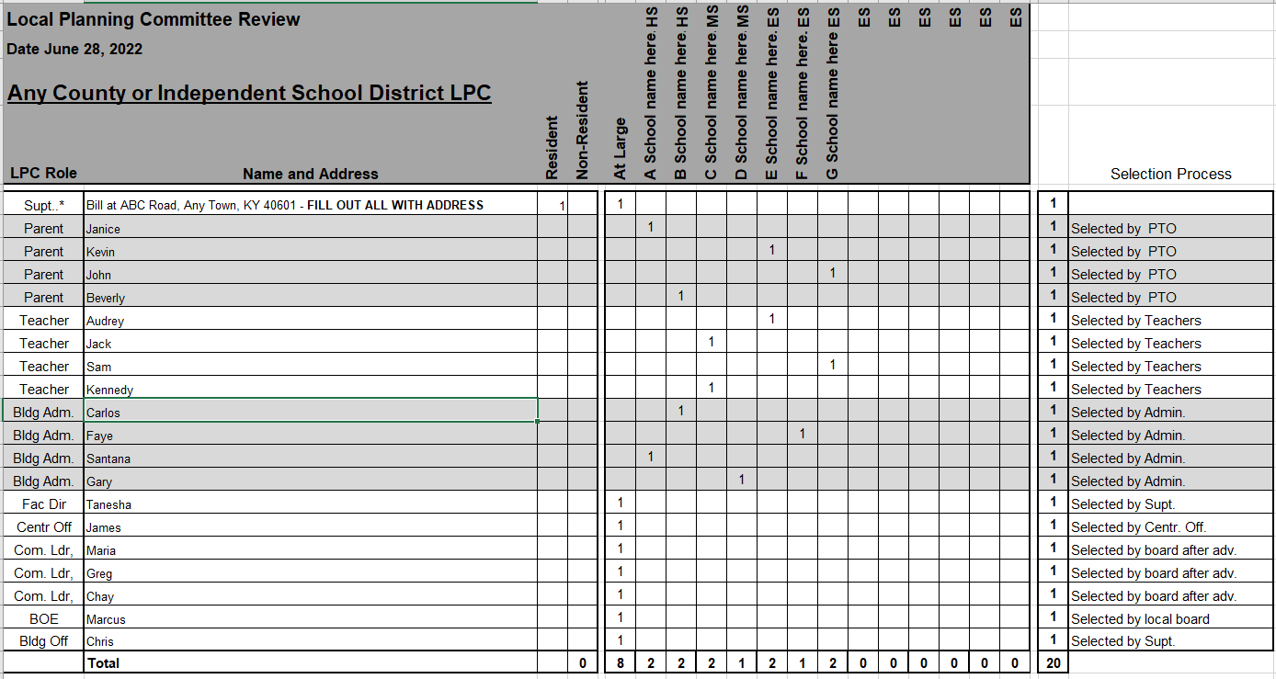
Sample LPC membership form

Slide 27
Assessments
Design Professional Assessments

Slide 28
Assessments Details
District facilities are assessed by registered Architects and Engineers as outlined in Chapter 2 of The Planning Manual.
Physical condition assessment: Use the KFICS audit process to:
Ensure uniform analysis
Provide consistent cost estimates
Eliminate duplicated efforts related to planning and KFICS requirements
Program Areas: Use the KFICS space planner function.
Contact your project manager if you choose to not use the KFICS audit process before you begin assessments.

Slide 29
HB 678 (2022) Impact

Slide 30
HB 678 Part 1
HB 678 is effective through June 30, 2024.
Districts are still required to comply with all aspects of The Planning Manual.
HB 678 requires the commissioner or his designee to provide approval or disapproval of a complete DFP within 30 business days from receipt. A complete DFP submittals includes:
Complete, final DFP (Excel format)
Public Hearing Agenda
Public Hearing Report
Public Hearing Sign-In Sheet
Public Hearing Audio Recording
Board minutes approving the Public Hearing Report and DFP
DFP Submittal Form (received by our office prior to the hearing)
Disapproved DFP’s may be appealed to the Kentucky Board of Education.

Slide 31
HB 678 Part 2
Capital Outlay - HB 678: KDE approval of the use for capital outlay for non-DFP items is not required at this time.

Slide 32
Q & A
Questions and Answers

Slide 33
Thank you for your interest and participation!
Kentucky Department of Education (KDE)
Office of Finance and Operations (OFO)
Division of District Support (DDS)
District Facilities Branch (DFB)
July 14, 2022

