Slide 1
Webinar #7 Facilities Branch: LPC Orientation and Other Key Updates (Memorandum 56)
Kentucky Department of Education (KDE)
Office of Finance and Operations (OFO)
Division of District Support (DDS)
District Facilities Branch (DFB)
February 26, 2026

Slide 2
Presentation Summary
Introductions
Memoranda
Regulation
Memorandum 56 – Orientation Requirements
Other Updates
Q&A

Slide 3
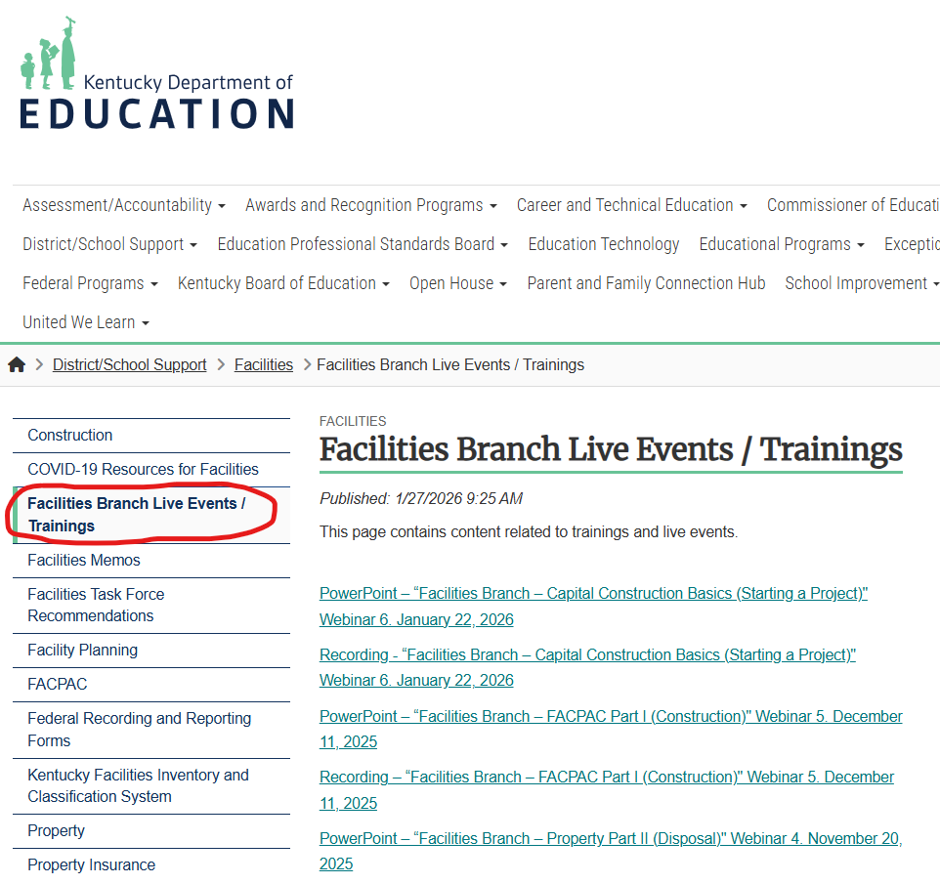
Facilities Branch Live Events / Trainings
Image of Facilities Branch Live Events / Trainings located on the KDE website.

Slide 4
Introductions

Slide 5
Division of District Support (DDS)
Division Director
Chay Ritter
Assistant Division Director
Marshall Smith

Slide 6
District Facilities Branch (DFB)
Branch Manager
Vacant Position

Slide 7
District Facilities Branch Staff (DFB) Part 1
Project Management/District Liaison
Gary Leist, AIA, LEED AP
gary.leist@education.ky.gov
Teresa Hester, NCID
teresa.hester@education.ky.gov
Marcus Highland, AIA
marcus.highland@education.ky.gov
John C. Gilbert, AIA, LEED AP
john.gilbert@education.ky.gov

Slide 8
District Facilities Branch Staff (DFB) Part 2
Administrative and Resource Assistance
Tanesha Keene
tanesha.keene@education.ky.gov

Slide 9
Memoranda
Before we discuss the main topic of this webinar, let’s explain what Memoranda are.

Slide 10
Memoranda
Memoranda issued on behalf of District Facilities Branch are generally intended to formally alert school districts and their consultants of clarifications and adjustments to processes or documents DFB oversees regarding compliance to regulations and statutes.

Slide 11
Memoranda
Memoranda issued on behalf of District Facilities Branch are generally intended to formally alert school districts and their consultants of clarifications and adjustments to processes or documents DFB oversees regarding compliance to regulations and statutes.
This process began around 2009 and originally sent only to design professionals as Architect Memoranda.

Slide 12
Memoranda
Memoranda issued on behalf of District Facilities Branch are generally intended to formally alert school districts and their consultants of clarifications and adjustments to processes or documents DFB oversees regarding compliance to regulations and statutes.
This process began around 2009 and originally sent only to design professionals as Architect Memoranda.
Recent history has expanded to more school district officials included in these circulations.

Slide 13
Memoranda
Memoranda issued on behalf of District Facilities Branch are generally intended to formally alert school districts and their consultants of clarifications and adjustments to processes or documents DFB oversees regarding compliance to regulations and statutes.
This process began around 2009 and originally sent only to design professionals as Architect Memoranda.
Recent history has expanded to more school district officials included in these circulations.
Memos address a broad range of topics addressed by DFB and school districts (Planning, Design, Capital Construction, Assessment, Real Property).

Slide 14
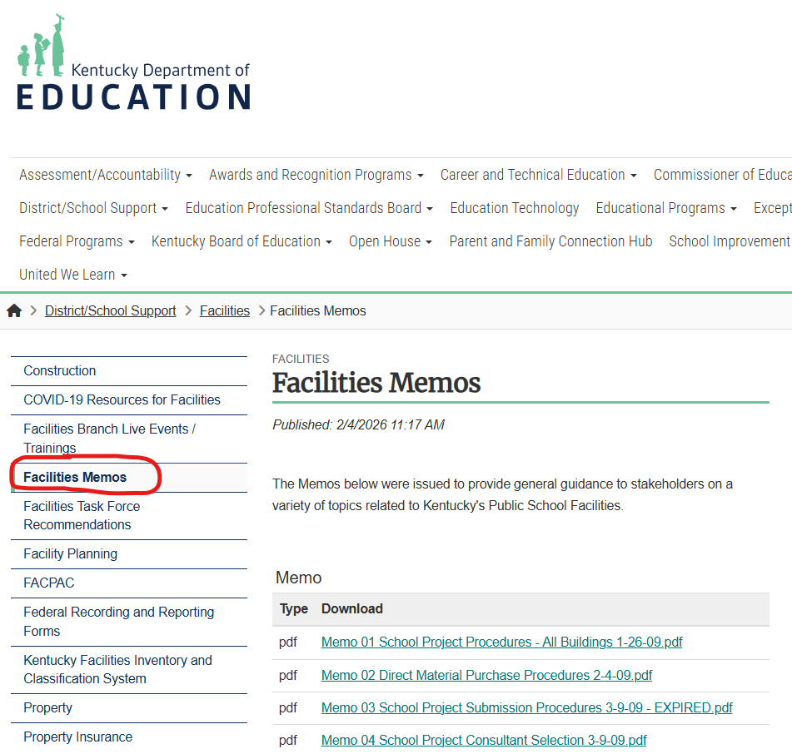
Memoranda
Facilities Memos Location
Image of Facilities Memos located on the KDE website.

Slide 15
Memoranda
General Information
A total of 58 memoranda are on the KDE website.

Slide 16
Memoranda
General Information
A total of 58 memoranda are on the KDE website.
57 have been officially released for use.
1 was drafted but not officially released (still on website as a reference).

Slide 17
Memoranda
General Information
A total of 58 memoranda are on the KDE website.
57 have been officially released for use.
1 was drafted but not officially released (still on website as a reference).
24 have since expired and labeled as such on the website (for reference only).

Slide 18
Memoranda
General Information
A total of 58 memoranda are on the KDE website.
57 have been officially released for use.
1 was drafted but not officially released (still on website as a reference).
24 have since expired and labeled as such on the website (for reference only).
The current format (headers, footers, etc.) was adjusted with Memorandum 51 and continues today.

Slide 19
Memoranda
General Information
A total of 58 memoranda are on the KDE website.
57 have been officially released for use.
1 was drafted but not officially released (still on website as a reference).
24 have since expired and labeled as such on the website (for reference only).
The current format (headers, footers, etc.) was adjusted with Memorandum 51 and continues today.
Memorandum 56 is released after numbers 57 and 58.

Slide 20
Regulation

Slide 21
Regulation
(702 KAR 4:180, The Planning Manual, Page 8, Definitions)
ORIENTATION MEETING means the first meeting of the Local Planning Committee held after the Architectural and Engineering analysis is complete. This meeting shall be conducted by KDE staff to layout the procedures and process for the LPC and to discuss research developed by KDE staff and to outline the roles and responsibilities of those involved in the DFP development.

Slide 22
Memorandum 56 Orientation Requirements
Issued February 3, 2026

Slide 23
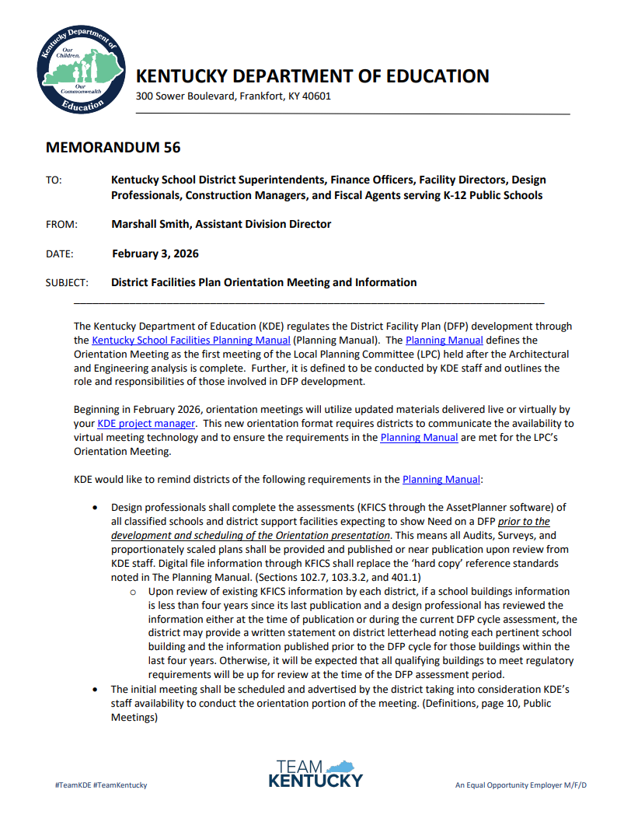
Memorandum 56
Image of Memorandum 56 (page 1) from KDE website.

Slide 24
Memorandum 56
Memorandum 56 alerts to school districts and their consultants a shift in how the orientation process will occur to comply with the current regulation. Adjustments are:

Slide 25
Memorandum 56
Memorandum 56 alerts to school districts and their consultants a shift in how the orientation process will occur to comply with the current regulation. Adjustments are:
Requiring complete assessments (AssetPlanner) before the orientation can be presented.

Slide 26
Memorandum 56
Memorandum 56 alerts to school districts and their consultants a shift in how the orientation process will occur to comply with the current regulation. Adjustments are:
Requiring complete assessments (AssetPlanner) before the orientation can be presented.
Adjusting from a Two-Part Orientation format to a one Orientation presentation.

Slide 27
Memorandum 56
Memorandum 56 alerts to school districts and their consultants a shift in how the orientation process will occur to comply with the current regulation. Adjustments are:
Requiring complete assessments (AssetPlanner) before the orientation can be presented.
Adjusting from a Two-Part Orientation format to a one Orientation presentation.
Requiring DFB Project Managers to present the orientation to LPC’s at the first part of the first LPC meeting.

Slide 28
Memorandum 56 - Assessments

Slide 29
Memorandum 56 - Assessments
It is highly advised that the district and their consultants sit down and determine what buildings need assessment before actual assessment begins.

Slide 30
Memorandum 56 - Assessments
It is highly advised that the district and their consultants sit down and determine what buildings need assessment before actual assessment begins.
If you have questions on what buildings require assessment in greater detail feel free to call us at KDE.

Slide 31
Memorandum 56 - Assessments
DFP assessments require:

Slide 32
Memorandum 56 - Assessments
DFP assessments require:
Assessment through AssetPlanner

Slide 33
Memorandum 56 - Assessments
DFP assessments require:
Assessment through AssetPlanner
Reviewed by a design professional

Slide 34
Memorandum 56 - Assessments
DFP assessments require:
Assessment through AssetPlanner
Reviewed by a design professional
All qualifying school centers reported to KDE (having a school classification)
Include all facilities housing these school centers whole or in part

Slide 35
Memorandum 56 - Assessments
DFP assessments require:
Assessment through AssetPlanner
Reviewed by a design professional
All qualifying school centers reported to KDE (having a school classification)
Include all facilities housing these school centers whole or in part
All qualifying support facilities (central office, bus garage, storage, maintenance)

Slide 36
Memorandum 56 - Assessments
DFP assessments are not required for:

Slide 37
Memorandum 56 - Assessments
DFP assessments are not required for:
Newer schools less than 15 years and not receiving repurposing or ADA related updates (capacity and listing as a school center on the DFP still required).
Exception: KFICS requires building assessment regardless of age and at all times.

Slide 38
Memorandum 56 - Assessments
DFP assessments are not required for:
Newer schools less than 15 years and not receiving repurposing or ADA related updates (capacity and listing as a school center on the DFP still required).
Exception: KFICS requires building assessment regardless of age and at all times.
Unclassified schools in facilities not qualifying to be on a DFP (examples: building solely used for adult education or a local school program not reported to KDE).

Slide 39
Memorandum 56 - Assessments
DFP assessments are not required for:
Newer schools less than 15 years and not receiving repurposing or ADA related updates (capacity and listing as a school center on the DFP still required).
Exception: KFICS requires building assessment regardless of age and at all times.
Unclassified schools in facilities not qualifying to be on a DFP (examples: building solely used for adult education or a local school program not reported to KDE).
Support buildings not planning or qualifying to be on a DFP.

Slide 40
Memorandum 56 - Assessments
DFP assessments are not required for:
Newer schools less than 15 years and not receiving repurposing or ADA related updates (capacity and listing as a school center on the DFP still required).
Exception: KFICS requires building assessment regardless of age and at all times.
Unclassified schools in facilities not qualifying to be on a DFP (examples: building solely used for adult education or a local school program not reported to KDE).
Support buildings not planning or qualifying to be on a DFP.
Athletic Facilities (local assessment only) (temporary DFP listing per HB 727)

Slide 41
Memorandum 56
KDE Orientation Presentation

Slide 42
Memorandum 56
KDE Orientation Presentation
KDE will present the orientation (virtually) at the start of your first meeting.

Slide 43
Memorandum 56
KDE Orientation Presentation
KDE will present the orientation virtually at the start of your first meeting.
Coordinate with your project manager dates, times and A/V capabilities prior to the presentation.

Slide 44
Memorandum 56
KDE Orientation Presentation
KDE will present the orientation virtually at the start of your first meeting.
Coordinate with your project manager dates, times and A/V capabilities prior to the presentation.
Presentation lasts approximately 40-60 minutes dependent upon many variables.

Slide 45
Memorandum 56
KDE Orientation Presentation
Topics will include:

Slide 46
Memorandum 56
KDE Orientation Presentation
Topics will include:
Introductions

Slide 47
Memorandum 56
KDE Orientation Presentation
Topics will include:
Introductions
Local Planning Committee

Slide 48
Memorandum 56
KDE Orientation Presentation
Topics will include:
Introductions
Local Planning Committee
Process Overview

Slide 49
Memorandum 56
KDE Orientation Presentation
Topics will include:
Introductions
Local Planning Committee
Process Overview
District Facilities Plan

Slide 50
Memorandum 56
KDE Orientation Presentation
Topics will include:
Introductions
Local Planning Committee
Process Overview
District Facilities Plan
Existing Conditions / Assessment

Slide 51
Memorandum 56
KDE Orientation Presentation
Topics will include:
Introductions
Local Planning Committee
Process Overview
District Facilities Plan
Existing Conditions / Assessment
Enrollment / Demographic Projections

Slide 52
Memorandum 56
KDE Orientation Presentation
Topics will include:
Introductions
Local Planning Committee
Process Overview
District Facilities Plan
Existing Conditions / Assessment
Enrollment / Demographic Projections
Restricted Funding Streams

Slide 53
Memorandum 56
KDE Orientation Presentation
Topics will include:
Introductions
Local Planning Committee
Process Overview
District Facilities Plan
Existing Conditions / Assessment
Enrollment / Demographic Projections
Restricted Funding Streams
Resources for your LPC

Slide 54
Memorandum 56
KDE Orientation Presentation
Topics will include:
Introductions
Local Planning Committee
Process Overview
District Facilities Plan
Existing Conditions / Assessment
Enrollment / Demographic Projections
Restricted Funding Streams
Resources for your LPC
Final Thoughts

Slide 55
Memorandum 56
KDE Orientation Presentation
Topics will include:
Introductions
Local Planning Committee
Process Overview
District Facilities Plan
Existing Conditions / Assessment
Enrollment / Demographic Projections
Restricted Funding Streams
Resources for your LPC
Final Thoughts
Q&A

Slide 56
Other Updates

Slide 57
Other Updates
Insurance Replacement Values were released February 5, 2026, and available on the KDE website.

Slide 58
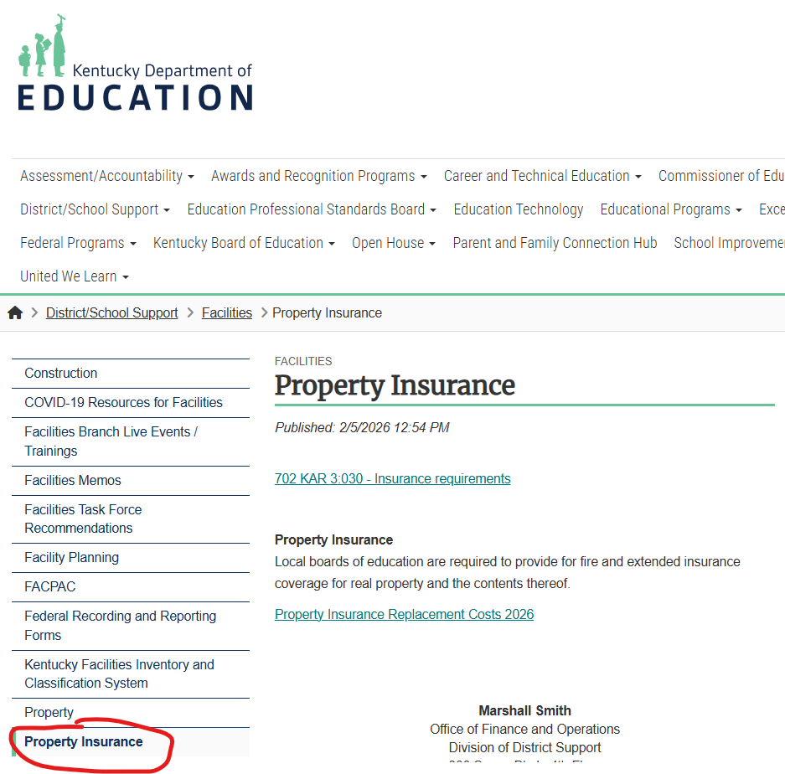
Other Updates
Property Insurance Location
Image of Property Insurance located on the KDE website.

Slide 59
Other Updates
Insurance Replacement Values were released February 5, 2026, and available on the KDE website.
DFP Start Up Packet Information Updated
LPC Rosters with improved instructions will be sent out with start up packets.
A DFP Checklist has been updated and will also be added to the start up packet information for district use.

Slide 60
Other Updates
Insurance Replacement Values were released February 5, 2026, and available on the KDE website.
DFP Start Up Packet Information Updated
LPC Rosters with improved instructions will be sent out with start up packets.
A DFP Checklist has been updated and will also be added to the start up packet information for district use.
The current/updated DFP format will be distributed with the DFP Start Up Packet to the school districts.

Slide 61
Q & A
Questions and Answers
If you have any questions, you may call District Facilities Branch at (502) 564-4326 or email your assigned project manager.
If you are uncertain who to contact, reach out to Tanesha Keene at tanesha.keene@education.ky.gov.

Slide 62
Thank you for your interest and participation!
Kentucky Department of Education (KDE)
Office of Finance and Operations (OFO)
Division of District Support (DDS)
District Facilities Branch (DFB)
February 26, 2026

