Slide 1
Capital Construction:
Starting a Project
for:
Webinar #6 for the 2025/26 Season
By:
Kentucky Department of Education (KDE)
Office of Finance and Operations (OFO)
Division of District Support (DDS)
District Facilities Branch (DFB)
January 22, 2026

Slide 2
Introductions

Slide 3
Kentucky Department of Education
(KDE)
Commissioner of Education
Dr. Robbie Fletcher

Slide 4
Office of Finance and Operations
(OFO)
Associate Commissioner
Matt Ross
Division of District Support
(DDS)
Division Director
Chay Ritter
Assistant Director
Marshall Smith

Slide 5
District Facilities Branch
(DFB) Part 1
Branch Manager
VACANT! – Greg Dunbar has retired! Congratulations!
Marshall Smith is the interim contact.
Project Management / District Liaison
Gary Leist, AIA, LEED AP
gary.leist@education.ky.gov
Marcus Highland, AIA
marcus.highland@education.ky.gov

Slide 6
District Facilities Branch
(DFB) Part 2
Project Management / District Liaison
Teresa Hester, NCIDQ, KYCID
teresa.hester@education.ky.gov
John C. Gilbert, AIA, LEED AP
john.gilbert@education.ky.gov

Slide 7
District Facilities Branch
(DFB) Part 3
Tanesha Keene
tanesha.keene@education.ky.gov

Slide 8
Presentation Summary
Introductions – Done!
Disclaimer (or two)
Acronyms
Capital Construction: Starting a Project
  Does My Project Require A BG-1?
  Do I Need a Design Professional?
  What Is My Fund Source?
  What Is My Construction Delivery Method?
  What If I Need To Buy Property?
Questions and Answers

Slide 9
Before we begin, a disclaimer or two…
This presentation provides a general overview of consideration related to initiating a capital construction project and is not intended to address all project specific circumstances. School districts should address their individual needs and consult with legal counsel and appropriate professional consultants.
Portions of this presentation are adapted from a School Financial Management Institute (SFMI) training performed annually by this Branch. While adapted, it may contain different material through audio and visual presentation content to reach a broader audience.

Slide 10
Acronyms Part I
Americans with Disabilities Act – ADA (not Average Daily Attendance)
Building and Grounds Form – BG (includes BG-1, BG-2, BG-3, BG-4 and BG-5)
Capital Funds Request – CFR
Career and Technical Education - CTE
District Facilities Plan – DFP
Elementary and Secondary School Emergency Relief - ESSER
Facilities Support Program of Kentucky – FSPK
Guaranteed Energy Savings Contract – GESC
House Bill – HB 727 (RS 2024) (Formerly HB 678 (RS 2022))

Slide 11
Acronyms Part II
Kentucky Administrative Regulation – KAR
Kentucky Educational Technology System – KETS
Kentucky Facilities Inventory Classification System – KFICS
Kentucky Revised Statutes – KRS
Kentucky Transportation Cabinet – KYTC
Local Educational Agency - LEA
Office of Career and Technical Education – OCTE
State Educational Agency - SEA
School Facilities Construction Commission – SFCC
Support Educational Excellence in Kentucky – SEEK

Slide 12
Capital Construction: Starting a Project
  Does My Project Require A BG-1?
  Do I Need a Design Professional?
  Am I Meeting Needs On My Current DFP?
  What Are My Fund Sources?
  What Is My Construction Delivery Method?
  What If I Need To Buy Property?

Slide 13
Does My Project Require A BG-1? (1)
In general, a BG-1 shall be submitted for any project that requires any one or more of the following:
  Professional design services pursuant to KRS Chapter 322 (engineers) and KRS Chapter 323 (architects).
  When proposing to use a restricted fund source.
    State: SFCC, FSPK, Capital Outlay, etc.
    Federally funded projects, especially requiring SEA approval (like ESSER).
  When the project includes “Need” identified on a district’s current DFP.
  When Model Program Areas are modified in a school (including changes not listed on a DFP).
If in doubt, please call your project manager! A preliminary conversation is always a good idea!

Slide 14
Does My Project Require A BG-1? (2)
All capital construction projects start with an initial BG-1 project application form.
  A district must understand a clear scope of work, review their DFP, and understand their funding before submission.
HB 727 (RS 2024) does not require KDE approval but still requires BG reporting to KDE. LEA approval is final approval and review for compliance with statutes and regulations is important at the local level when KDE is not factored as part of the review process. Other HB 727 considerations include:
  Federally funded projects requiring SEA approval (ESSER expired Fall of 2024).
  SFCC – Contact SFCC if you are unsure of SFCC acceptance for a project utilizing SFCC funds.
    Work must be on a DFP to qualify for use.
  HB 727 is scheduled to expire June 30, 2027.

Slide 15

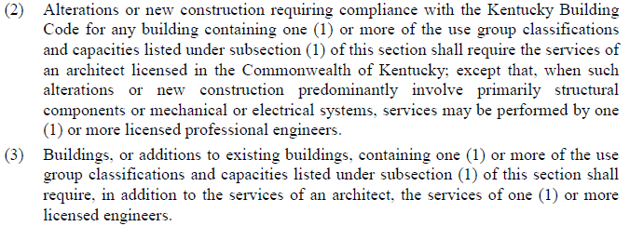
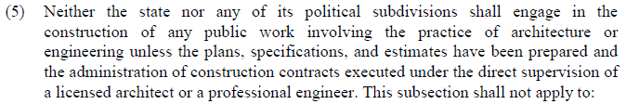

Do I Need A Design Professional?
Excerpts from KRS 323.033 for reference. Pay particular attention to Section (1)(f) noting, “Educational use groups regardless of capacity;” and Section (5)(a) mentioning maintenance or repair.
KRS 322 addresses engineers if your project does not consider architects.

Slide 16
An Architect / Design Professional…
is charged with adhering to building codes and preserving life safety.
may be required for repair and maintenance… there can be gray areas.
  Call a design professional or DFB if there’s a question.
  Roofs and mechanical replacements are the most common.
Fund sources are not exceptions or exemptions to code requirements.
Procurement of Services are professional through advertising for Letters of Interest / Requests for Proposals.
Owner-Architect Agreement samples and comparatives are available on the KDE website.
  A Letter of Agreement for small projects may be sufficient.
should provide a complete professional review for ANY security/life safety construction work relative to the scope of work provided, even if it appears minor.
may be required for state price contracts or cooperative purchase agreements.
  Neither procurement method is exempt from requirement.
Districts that implement work without professional consultation or review may be increasing their risks and liabilities.

Slide 17
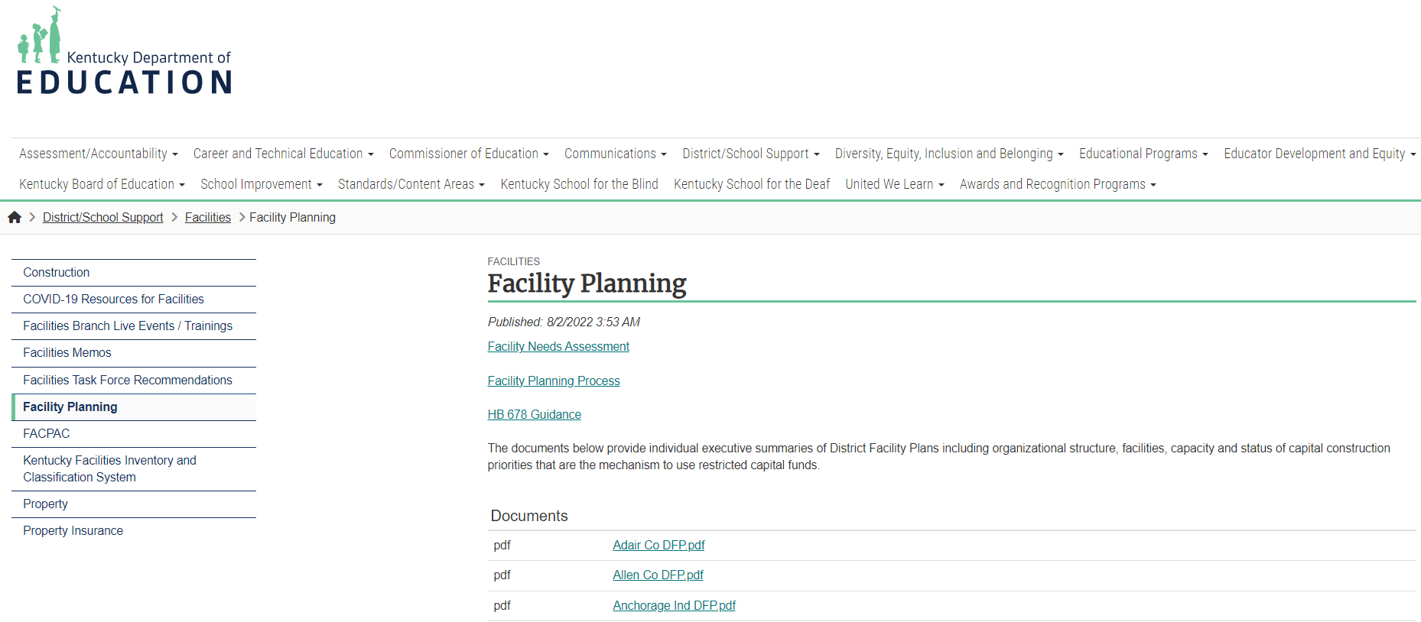
Am I Meeting Needs On My Current DFP? (1)
Every time you complete an initial BG-1 or attempt to revise scope through a revised BG-1, check its correlation to your DFP.
Scroll down to find your district.
Image of Facility Planning homepage on KDE website.

Slide 18
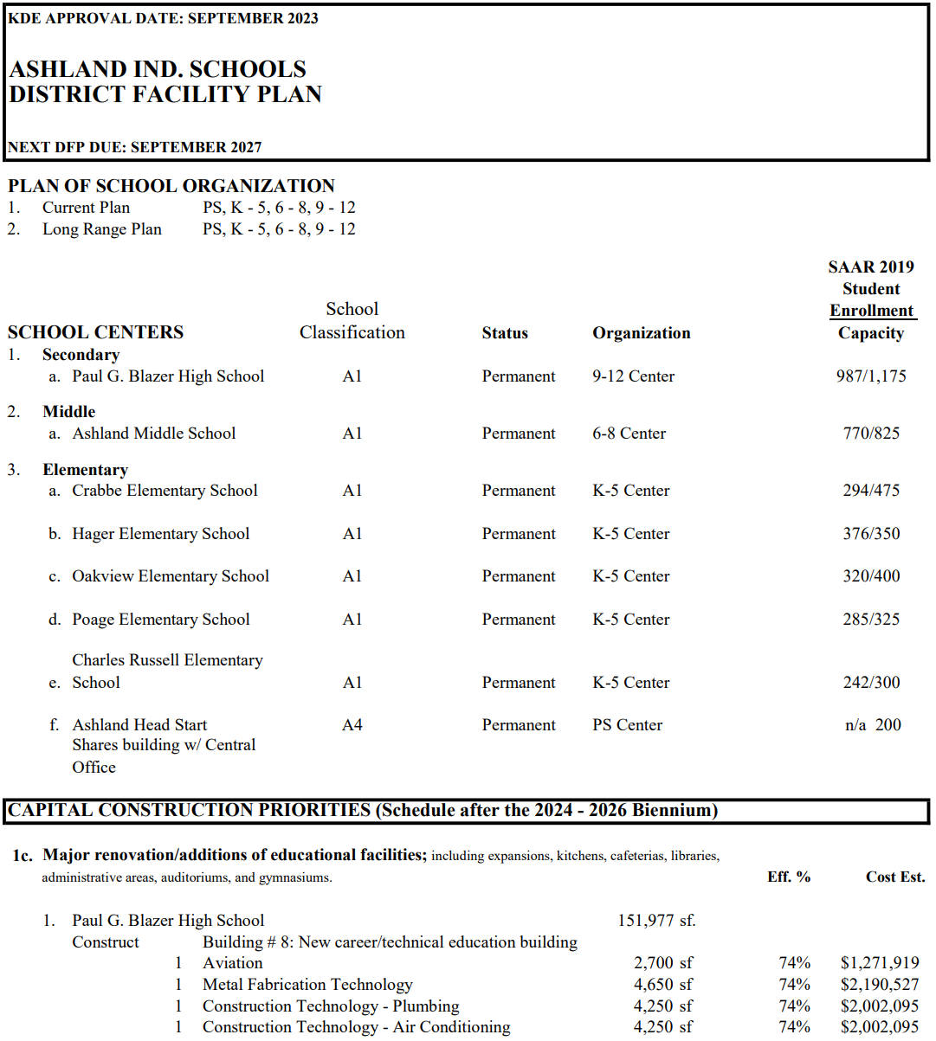
Am I Meeting Needs On My Current DFP? (2)
Image is a sample DFP from Ashland Independent

Slide 19
What Are My Fund Sources?
Certain fund sources require work to be listed on a DFP as a priority project to qualify for use of funds. Carefully review the requirements when initiating the project.
HB 727(RS 2024) allows for extracurricular projects to be listed in any priority.
  Extracurricular is “athletic” in nature as defined in regulation. Specifically, a program acknowledged by KDE through organizations like the Kentucky High School Athletic Association (KHSAA) or others. Unsanctioned programs are not typically considered.
  Refer to HB 678 Guidance found on the KDE website for more information. In general, HB 727 extended the original allowance of HB 678.
Any SFCC use of funds related to extracurricular should be calling SFCC direct for a ruling for fund use prior to starting a project. SFCC, not KDE approves the use of SFCC funds.

Slide 20
Types of Restricted Funding for School Construction
Monies used for capital construction or major renovation comes from multiple sources which include:
*Student Population Based Funds – KRS 157.420
  Capital Outlay Funds
*Property Assessment Based Funds – KRS 157.440
  Building Funds and Growth Levies
  Facilities Support Program of KY (FSPK)
Qualified Needs Based Funds – KRS 157.611
  KY School Facilities Construction Commission (SFCC)
  SFCC Offers of Assistance
  Urgent-Needs Grants
* Funds through population and property assessment are considered through the Supporting Educational Excellence in Kentucky (SEEK) program.

Slide 21
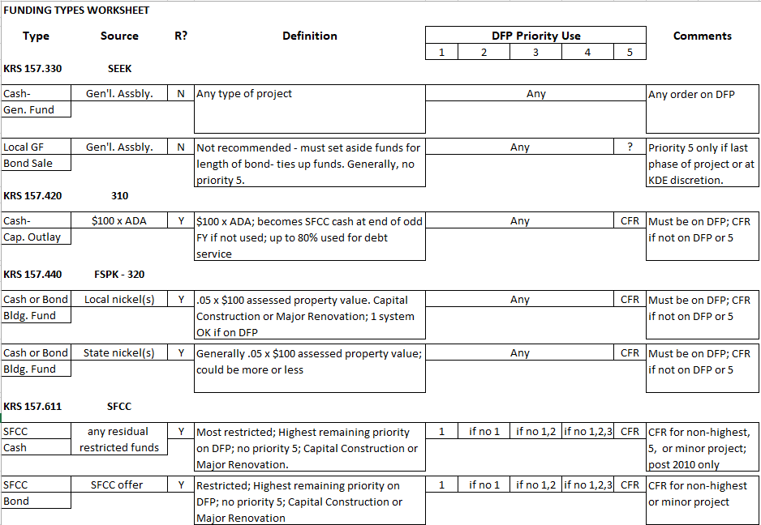
Notes:
FSPK (320) Local nickel(s) references the “1 system OK if on DFP” as exceptions related HVAC and/or roofing more than 15 years old, and ADA and/or Life Safety projects regardless of age. A CFR may/may not be needed. Ask if uncertain of requirements specific to your project. This exception is in reference to citations in 702 KAR 4:180’s Planning Manual which is incorporated by reference.
HB 727 relating to Priority 5 access is not applied to this chart. This affects Cap. Outlay and FSPK.
*Image of a chart relating funding to DFP Priorities.

Slide 22
Notes:
FSPK (320) Local nickel(s) references the “1 system OK if on DFP” as exceptions related HVAC and/or roofing more than 15 years old, and ADA and/or Life Safety projects regardless of age. A CFR may/may not be needed. Ask if uncertain of requirements specific to your project. This exception is in reference to citations in 702 KAR 4:180’s Planning Manual which is incorporated by reference.
HB 727 relating to Priority 5 access is not applied to this chart. This affects Cap. Outlay and FSPK.
*Image of a chart relating funding to DFP Priorities. Highlight field over fund source.

Slide 23
Notes:
FSPK (320) Local nickel(s) references the “1 system OK if on DFP” as exceptions related HVAC and/or roofing more than 15 years old, and ADA and/or Life Safety projects regardless of age. A CFR may/may not be needed. Ask if uncertain of requirements specific to your project. This exception is in reference to citations in 702 KAR 4:180’s Planning Manual which is incorporated by reference.
HB 727 relating to Priority 5 access is not applied to this chart. This affects Cap. Outlay and FSPK.
*Image of a chart relating funding to DFP Priorities. Highlight field over Definition.

Slide 24
Notes:
FSPK (320) Local nickel(s) references the “1 system OK if on DFP” as exceptions related HVAC and/or roofing more than 15 years old, and ADA and/or Life Safety projects regardless of age. A CFR may/may not be needed. Ask if uncertain of requirements specific to your project. This exception is in reference to citations in 702 KAR 4:180’s Planning Manual which is incorporated by reference.
HB 727 relating to Priority 5 access is not applied to this chart. This affects Cap. Outlay and FSPK.
*Image of a chart relating funding to DFP Priorities. Highlight field over DFP Priority Use.

Slide 25
What Is My Construction Delivery Method?
FACPAC / KDE website lists below which are recognized as compliant options through statutory and regulatory processes. Review your project and its needs accordingly.
General Contractor (AIA Document A101-2007)
Construction Manager as Adviser (AIA Document C132-2009)
  Involve the CM as early in the project as possible.
Cooperative Purchasing (KDE Purchase Orders in FACPAC and/or appropriate GC or CM agreement when applicable)
GESC (Only Design-Builder Agreement acknowledged – AIA Document A141-2004)
* A district considering any other avenue for a capital construction project should seek the advice of their legal counsel and applicable consultants. See also Architectural Memo #57 found on the KDE website.

Slide 26
What If I Need To Buy Property?
General notes on Real Property as you begin a construction process. See webinars #3 and #4 for additional information.
Property governed by different regulations than construction.
  702 KAR 4:050, 4:090, 4:005, etc.
  HB 727 does not impact property requirements. KDE maintains land acquisition and disposal approval requirements.
Real Property transactions are separate projects in our FACPAC system. You must own a property or have agreements secured for a property before you can construct on a property.
  Considering road access with KYTC or the local authorities having jurisdiction is an important part of this process.
Temporary construction easements are performed at the local level. KDE approval is not required.

Slide 27
Q & A
Questions
If you have any questions, you may call District Facilities Branch at (502) 564-4326 or email your assigned project manager.
If you are uncertain who to contact, reach out to Tanesha Keene at tanesha.keene@education.ky.gov.

Slide 28
Thank you for your interest and participation!
Kentucky Department of Education (KDE)
Office of Finance and Operations (OFO)
Division of District Support (DDS)
District Facilities Branch (DFB)
January 22, 2026

