Slide 1
Webinar #2: District Facilities Planning (DFP) & Updates
702 KAR 4:180
Kentucky Department of Education (KDE)
Office of Finance and Operations (OFO)
Division of District Support (DDS)
District Facilities Branch (DFB)
September 24, 2026

Slide 2
Before we begin…
This presentation is a general overview of work occurring related to or occurring within the District Facilities Branch (DFB). It does not cover all details related to statutes, legal actions, regulations, and processes. Please direct any specific questions that are not addressed today to the Branch Manager or the DFB project manager assigned to your district.

Slide 3
Presentation Summary
Introductions
Why do we create a DFP? – Statutes and Regulations
When do we draft a DFP? – Status and Notifications
What is the process? – General Overview
Who drafts a DFP? – Local Planning Committee
DFP Season 2026/27
Q&A

Slide 4
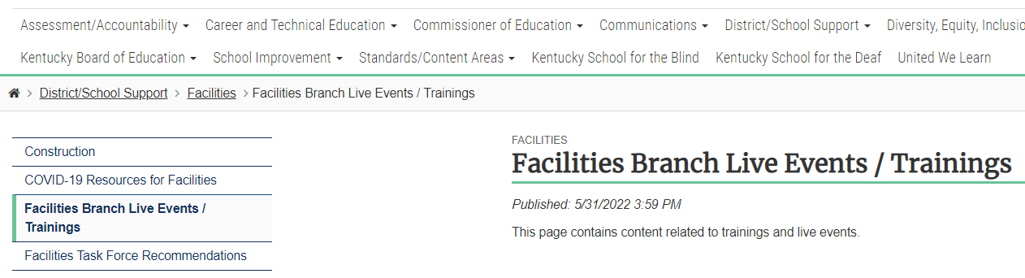
Presentation Located on KDE Website at
Facilities Branch Live Events / Trainings - Kentucky Department of Education
Partial image of the KDE website for “Facilities Branch Live Events.”
On the KDE website select: District/School Support > Facilities > Facilities Branch Live Events / Trainings

Slide 5
Introductions

Slide 6
Division of District Support
(DDS)
Division Director
Chay Ritter
Assistant Division Director
Marshall Smith

Slide 7
District Facilities Branch
(DFB)
Branch Manager
John C. Gilbert, AIA, LEED AP
john.gilbert@education.ky.gov

Slide 8
District Facilities Branch Staff
(DFB) Part 1
Project Management/District Liaison
Gary Leist, AIA, LEED AP
gary.leist@education.ky.gov
Marcus Highland, AIA
marcus.highland@education.ky.gov
Currently advertising for a third project manager!

Slide 9
District Facilities Branch Staff
(DFB) Part 2
FACPAC Administrative Specialist Senior
Tanesha Keene
tanesha.keene@education.ky.gov

Slide 10
Why do we create a DFP? Statutes and Regulations
Kentucky Revised Statutes (KRS)
Kentucky Administrative Regulations (KAR)

Slide 11
District Facilities Planning (DFP) – 702 KAR 4:180
Every Kentucky school district is required to develop a DFP
  A review is required every four years.
A DFP is created in accordance with The Planning Manual
  The Kentucky School Facilities Planning Manual is incorporated by reference in the regulation and outlines standards and requirements for the DFP and the process.
The DFP is a process requiring local and state approval
  The DFP is subject to Local Planning Committee (LPC) review, public forums, a public hearing, local board approval, and final approval by KBE or their designee. The process is intended to ensure transparency and stakeholder input.
The DFP provides access to funding for improvements
  Projects on the plan provide access to funds restricted to capital construction improvements. Fund sources include but are not limited to the School Facilities Construction Commission (SFCC) and the Facility Support Program of Kentucky (FSPK).

Slide 12
DFP provides the Capital Construction Projects Qualifying for Restricted Funds
Monies used for capital construction or major renovation comes from multiple sources which include:
*Student Population Based Funds – KRS 157.420
  Capital Outlay Funds
*Property Assessment Based Funds – KRS 157.440
  Building Funds and Growth Levies
  Facilities Support Program of KY (FSPK)
Qualified Needs Based Funds – KRS 157.611
  KY School Facilities Construction Commission (SFCC)
  Urgent-Needs Grants
* Funds through population and property assessment are considered through the Supporting Educational Excellence in Kentucky (SEEK) program.

Slide 13
Kentucky Revised Statutes (KRS) Part 1
School Facilities Construction Commission (SFCC)
  KRS 157.620(3) SFCC funds are restricted to priority order on the approved school facilities plan.
  KRS 157.622 sets forth certain requirements for school facility plans relative to participation in funding by SFCC.
  Contact SFCC (Kristi Russell) for use of any SFCC funds concerning HB 678 (2022 RS) / HB 727 (2024 RS).

Slide 14
Kentucky Revised Statutes (KRS) Part 2
Facility Support Program of Kentucky (FSPK)
  KRS 157.440 FSPK funds are to be used to address categorized priorities listed in approved Facility Plans pursuant to KRS 157.420.
  Contact Sheila Miller in District Funding and Financial Reporting Branch with any questions related to this fund source.

Slide 15
Kentucky Revised Statutes (KRS) Part 3
Capital Outlay
  KRS 157.420(4) requires capital outlay be used for capital outlay projects approved by the Commissioner of Education in accordance with the administrative regulations (KDE 702 KAR 4:180).
  HB 678 (2022 RS) / HB 727 (2024 RS) allows local Boards to approve under the same requirements in lieu of KDE/Commissioner.
  For Capital Outlay fund use for work not on a DFP, a Capital Funds Request (CFR) Form is required to be approved by your local board.
  Contact Sheila Miller in District Funding and Financial Reporting Branch with any questions related to this fund source.

Slide 16
Kentucky Revised Statutes (KRS)
Kentucky Facilities Inventory Classification System (KFICS)
  KRS 157.420(9) Beginning 2011-12, KDE shall standardize the process for evaluation the overall quality and condition of all school buildings across the state - KFICS.
  AssetPlanner software by Ameresco serves this requirement and may also be used as an assessment tool for DFP work.

Slide 17
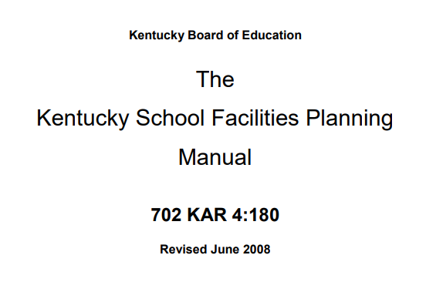
Kentucky Administrative Regulation (KAR)
The Kentucky School Facilities Planning Manual
  The Planning Manual is incorporated by reference through 702 KAR 4:180. The requirements for the development of a District Facility Plan (DFP) are outlined in this manual.
  Contact your DFB project manager on requirements.
Image of The KY School Facilities Planning Manual title page.

Slide 18
When do we draft a DFP?
DFP Status
KDE Notifications

Slide 19
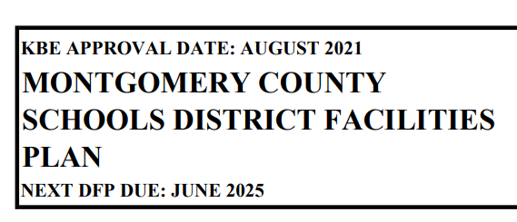
DFP Status – When is the next DFP due?
Current DFP will have “Next DFP Due” Date
  This information may be found on the current DFP which may be found on the KDE website, or the local district may already have their own copy.
  Information is found at the top left-hand side of each DFP.
  Find all approved DFP’s at:
    Facility Planning - Kentucky Department of Education
Sample image of text on top left-hand side of a DFP (page 1).
On the KDE website select: District/School Support > Facilities > Facility Planning

Slide 20
KDE Notifications
KDE will send automated notifications.
  KDE sends out monthly notifications to all districts’ listed superintendent, finance officer, and facilities director as updated by districts to DFB. Your specific district will receive notifications at the following intervals:
  District superintendents receive email notifications at the 18, 12, 6, and 1-month intervals prior to your DFP due date.
  A notice the month your DFP is due and one late notice will go out one month after the deadline. No further notifications occur past one month.
On the KDE website select: District/School Support > Facilities > Facility Planning

Slide 21
KDE Notifications – Email Content
Sample KDE Email
  Email sent to district superintendent, finance officer, and facilities director.
  Check your junk/spam email folders.
  Subject line will always start with “District Facility Plan (DFP) Status”
  Once you receive this notice, contact your DFB Project Manager to get started!

Slide 22
What is the Process?
A general overview

Slide 23
District: Request start up of DFP
LPC selections and Assessments completed
LPC Meeting / Public Forum #1 to select chair/vice chair & view orientation
LPC Meeting / Public Forum #2 to draft a DFP
Send approved draft DFP to KDE for review/comments
Review KDE comments in final LPC meeting /public forum #3. Vote to accept”
Return LPC approved draft to KDE for “spot check”
Local Board reviews Draft DFP and votes to hold a public hearing (assign hearing officer)
Public Hearing (PH)
Local Board votes to accept PH report and Final DFP
Send DFP & complete final submittal to KDE for final approval
*The LPC may hold more than the minimum 3-LPC meetings and 3-public forums shown.
*Process shown considers no disapprovals at any step in the process. Contact KDE if disapprovals occur at any level.
DFP Process Overview
Image: Circular graphic DFP Process Overview.

Slide 24
Who drafts your DFP?
Local Planning Committee (LPC)
Assembling - Section 101 of The Planning Manual
The LPC Roster Membership Form

Slide 25
Assembling your LPC Part 1
Highlights of Section 101:
  101.1 – The superintendent manages the selection process.
  101.2 – Determines the number of LPC members needed based on number of school centers (Table 101.2).

Slide 26
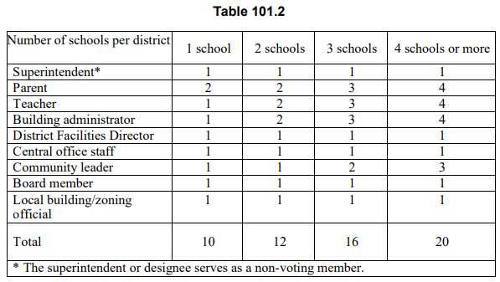
Assembling your LPC Table 101.2

Slide 27
Assembling your LPC Part 2
Highlights of Section 101:
  101.3 is important to remember for the following considerations: “All schools shall be represented before multiple representation of a school occurs. The maximum number of representatives on the LPC from a school shall not be in excess of one greater than the number of representatives from any other school.”
  101.4 – 101.12 provides guidance to the superintendent on how to instruct stakeholder groups on how to select their representatives.

Slide 28
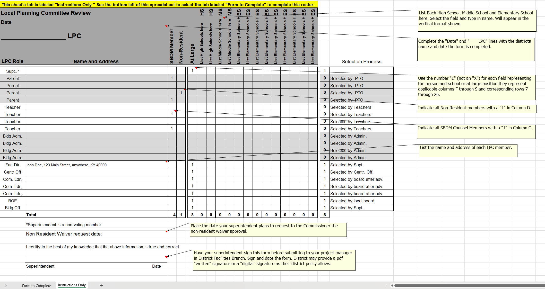
DFP – Local Planning Committee (LPC) Rosters
Image: Sample LPC Roster with instructions.

Slide 29
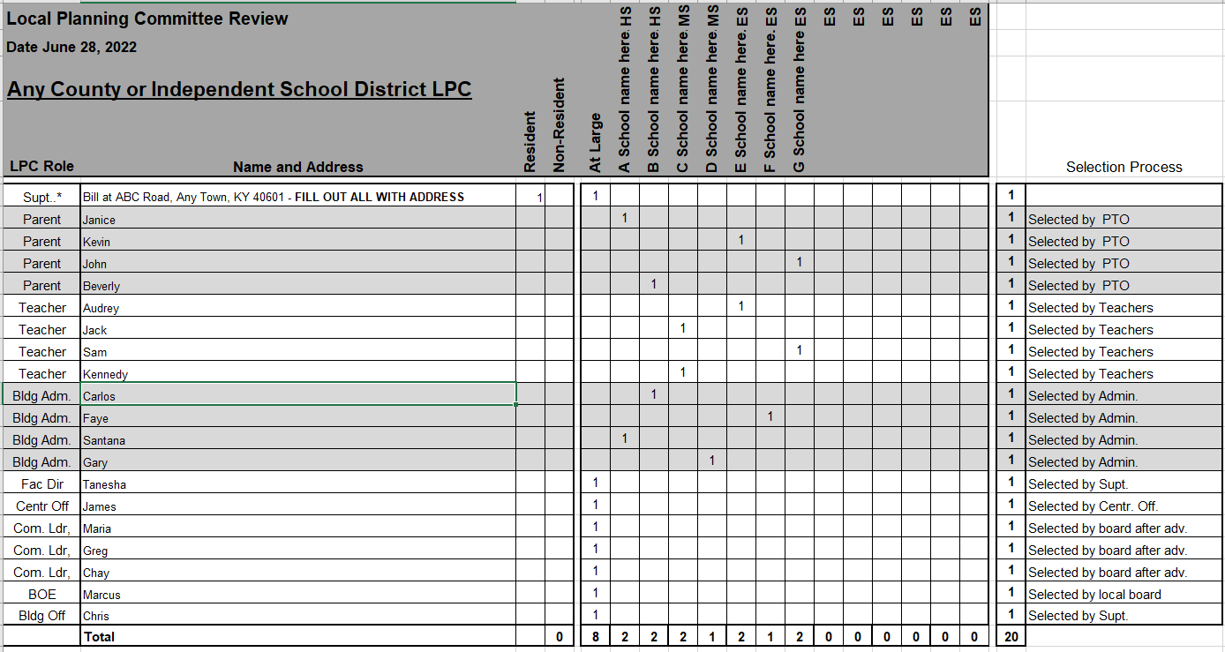
Example LPC membership form (7 schools)

Slide 30
DFP – Local Planning Committee (LPC) Rosters
LPC Rosters – to expedite approvals
  Excel file provided with your start-up packet.
    Fill out completely and have your superintendent sign.
  Select members in accordance with Section 101
  Submit the roster to your project manager to receive LPC approval from DFB before you send a non-resident waiver request to Commissioner Fletcher.
    Copy your project manager on your request to the Commissioner.

Slide 31
The LPC Membership Form – In-District
LPC Roster (all members living in-district):
  Fill LPC Roster out completely.
  Adhere to Section 101.3 and have no one school exceed any other by one person.
    Remember to designate School-Based Decision-Making Council (SBDM) members on the roster.
  Have your superintendent sign the roster.
  Submit full roster to KDE.
  KDE will review and send the superintendent an approval/denial letter.

Slide 32
The LPC Membership Form – Out-of-District 1
LPC Roster (any members living out-of-district):
  Fill LPC Roster out completely.
  Adhere to Section 101.3 and have no one school exceed any other by one person.
    Remember to designate SBDM members on the roster.
  Have your superintendent sign the roster.

Slide 33
The LPC Membership Form – Out-of-District 2
LPC Roster (any members living out-of-district):
  Submit full roster to DFB and notify your project manager that you will be sending a request to the commissioner’s office for out-of-district approvals.
    When submitting to DFB, highlight which members live out-of-district.
    Provide reasons / rationale for out-of-district membership needs.
    DFB will send you a determination letter for the in-district membership.
  (Section 101.1) Submit a formal request to the Commissioner’s office with the same information you sent to DFB after in-district membership review.
    A designee from the Commissioner’s office will provide a determination letter for out-of-district members.
    Copy your project manager on the correspondence you send to the Commissioner.

Slide 34
How does the DFP work for your district?

Slide 35
The DFP…
aids in prioritizing District Need – not a “wish list.”
can communicate to your community.
provides eligibility to restricted fund sources that are used only for capital construction efforts.
communicates the total District Need to KDE who in turn reports this information to SFCC affecting offers made. This information is also reported to the General Assembly during the budget sessions.
  DFP’s updated by June 30th of the odd year prior to the budget session will be in official reports.
may even be a requirement to receive special offers.
may show evidence of community involvement for federal funding requirements (will vary dependent upon fund source).

Slide 36
DFP Season 2026/27
General thoughts and information to know when drafting a compliant DFP.

Slide 37
DFP – What you Need To Know (1)
Draft DFP’s – KDE Comments
  We officially only provide one formal “KDE Comments” review after the first official LPC vote (required).
    Spot checks are intended to see a ‘final’ format and LPC decisions made based on comments.
    Significant changes may require added LPC Meetings.
  DFB happy to discuss in a phone call or virtual meeting general content of drafts not yet reviewed by an LPC when available (not required and unofficial). Do not record.

Slide 38
DFP – What you Need To Know (2)
Draft DFP’s – KDE Comments
  Schools and their facilities are reviewed for the number of students served (primary) and not the capacity (secondary) the building.

Slide 39
DFP – What you Need To Know (3)
Draft DFP’s – KDE Comments
  Schools and their facilities are reviewed for the number of students served (primary) and not the capacity (secondary) the building.
    School buildings serving School Centers with populations under KDE minimums will have a note “Reviewed per Section 305.4.1….”
      Preschool = 100 students
      Elementary = 300 students
      Middle School = 400 students
      High School = 500 students

Slide 40
DFP – What you Need To Know (4)
Draft DFP’s – KDE Comments
  A School Center cannot show existing school buildings total area including additions exceeding 125% of the gross area for a school’s model program per Section 305 as it relates to the number of students served.

Slide 41
DFP – What you Need To Know (5)
Draft DFP’s – KDE Comments
  A School Center cannot show existing school buildings total area including additions exceeding 125% of the gross area for a school’s model program per Section 305 as it relates to the number of students served.
    An existing school already exceeding 125% in area would not be able to take on any more addition considerations without descriptions demolishing enough area to remain at or under 125% in total for any described addition work.

Slide 42
DFP – What you Need To Know (6)
Draft DFP’s – KDE Comments
  School Center Information – If a school changes its Plan of Organization, list (or communicate in writing) what each affected school is “to become” and list any projected, proportionate changes in student population to inform DFB prior to our review of the Priority projects.

Slide 43
DFP – Cost Opinions (1)
All additions and new structures utilize the Insurance Replacement Values published on the KDE website.

Slide 44
DFP – Cost Opinions (2)
Renovation costs are compared to KFICS, Ranked Reports from recently published assessments if no supporting documentation or cost opinion is provided.

Slide 45
DFP – Cost Opinions (3)
Renovation costs are compared to KFICS, Ranked Reports from recently published assessments if no supporting documentation or cost opinion is provided.
  Design professionals may still provide:
    Independent cost opinions for renovations
    Supplemental costs plus KFICS information
    Illustrate numbers used in KFICS to arrive at costs in the draft DFP

Slide 46
DFP – Cost Opinions (4)
Totals for renovation/additions shall not exceed 80% the value of a new school for the number of students served (not the capacity of the building).
  80% is not a mandate to build a new school.
  80% is a mandate to consider
    A commitment to renovation/addition considerations where costs listed on the DFP do not exceed the 80%; or
    A new school and render the current building transitional or repurposed as a different use.

Slide 47
Q & A
Questions and Answers
If you have any questions, you may call District Facilities Branch at (502) 564-4326 or email your assigned project manager.
If you are uncertain who to contact, reach out to Tanesha Keene at tanesha.keene@education.ky.gov.

Slide 48
Thank you for your interest and participation!
Kentucky Department of Education (KDE)
Office of Finance and Operations (OFO)
Division of District Support (DDS)
District Facilities Branch (DFB)
September 24, 2025

