Slide 1
Kentucky Department of Education (KDE) Capital Construction Process Review
702 KAR 4:160
Federally Funded Projects
Post Bid Processes
School Security Issues
March 17, 2022

Slide 2
Presented by
KDE District Facilities Branch
Greg Dunbar, AIA, Branch Manager
James Bauman, KDE
Jeff Coulter, KDE
and
Ben Wilcox,
State School Security Marshals Office
assisted by
Tanesha Keene, KDE
Oxana Lopetegui-Pineda, KDE

Slide 3
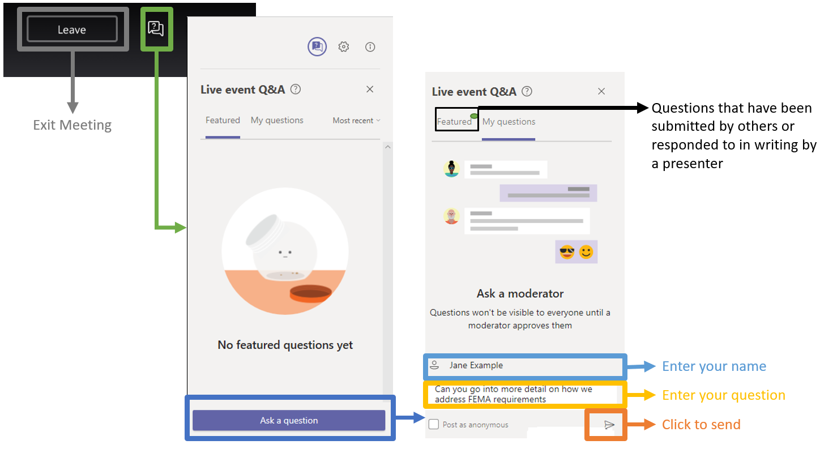
Before we start-
Questions and Answers

Slide 4
Topics for Review
Projects using Federal Funds- Elementary and Secondary School Emergency Relief I, II and III (American Rescue Plan (ARP)/ESSER)
Davis-Bacon Act requirements
Post Bid Submittal requirements
Bond Sale approval process
School Security Issues

Slide 5
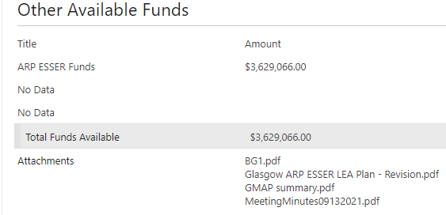
Projects using Federal Funds – BG-1
Projects using Federal Funds- ESSER I, II, and III (ARP/ESSER)
  Must comply with Uniform Grant Guidance requirements and US Department of Labor Electronic Document Gathering Analysis and Retrieval regulation (34 CFR Sect. 76.600).
  Must identify ESSER Funds by name as “Other Available Funds” and attach Grant Management Application Process (GMAP) documents:

Slide 6
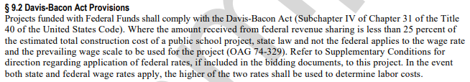
Projects using Federal Funds, Part 1
Bidding Documents – Project Manual
  KDE/AIA A701-1997 Instructions to Bidders, incorporated by reference in 702 KAR 4:160:
  Regulation effective 2013; Kentucky Prevailing Wage abolished 2017.
  Davis-Bacon requirements combine basic hourly wage and fringe benefits. https://www.dol.gov/sites/dolgov/files/WHD/davis-bacon/Conformance.pdf.
  Wage determinations are tied to specific geographic areas and construction trades.

Slide 7
Projects using Federal Funds, Part 2
Bidding Documents – Project Manual
  General Davis-Bacon wage determinations are at www.sam.gov and are available for incorporation into bidding documents and posting on job sites. FAQs:
  https://www.dol.gov/agencies/whd/government-contracts/construction/faq
  Immediately following the KDE/AIA A701, provide a Section titled “Supplementary Instructions to Bidders,” and include the following:
    9.2 Davis-Bacon Act Provisions: Projects funded with federal funds shall comply with the Davis-Bacon Act (Subchapter IV of Chapter 31 of the Title 40 of the United States Code). This project utilizes federal funds. Refer to Section titled “Available Information” for the “Wage Rates” applicable to this project (determination).”

Slide 8
Projects using Federal Funds, Part 3
Bidding Documents – Project Manual
  Provide a Section titled “Available Information” and include:
    This project is subject to Davis Bacon wage rates provided in this section. The contractor shall be responsible for compliance with federal requirements. Payroll records shall be transmitted to the owner’s designated representative weekly, using Form WH347 or similar.
    The wage rate determination for the area in which the project is located and sample reporting forms.
  KDE recommends review of the project scope relative to the wage rate determination to confirm that all the trades needed have been included in the determination. If not, contact the U. S. Department of Labor for a supplemental wage determination.

Slide 9
Projects using Federal Funds, Part 4
Bidding Documents – Project Manual
  KDE recommends discussion with the district any specific processes or forms that are needed for reporting purposes and include them.
  General guidance, fact sheets, e-tools, posters, forms and additional information can be found at:
  https://www.dol.gov/agencies/whd/government-contracts/construction/faq
  Other Recommendations
  KDE also recommends stating in the Advertisement for Bids that federal wage rates are applicable.
  Davis-Bacon wage rates should be a point of emphasis during the pre-bid meeting.

Slide 10
Post Bid Submittals – FACPAC, Part 1
Each proposed Owner-Contractor Agreement (AIA/KDE A101-2007) submitted via FACPAC, shall include the following:
  Bid Tabulation.
  KDE Form of Proposal including Bid Security.
  Written recommendation of the design professional (and Construction Manager if used) regarding award of the contract.
  Written rationale for additional cost if accepted bid exceeds the construction cost estimate by greater than 10%.
  Completed/Signed KDE Purchase Order Summary, if used. Summary serves to verify Purchase Orders until signed Purchase Orders can be submitted.
  Post Bid revised BG-1 to conform to contract(s) amount.

Slide 11
Post Bid Submittals - FACPAC, Part 2
Contract(s) and Purchase Order Summary Form are recommended to be submitted 25 working days prior to scheduled bond sale for KDE review, approval and correction as needed.
Revised post bid BG-1s cannot be approved without approved contract submittals and delays run the risk of Bond Sale postponement.
Following KDE approval of the proposed contract, the Board shall submit:
  A signed copy of each contract and Purchase Order.
  Certificate of Insurance with coverages as required by law.
  Copy of 100% Payment and Performance Bonds as required by 45A.435

Slide 12
KDE Bond Sale Approval Process
The Fiscal Agent shall upload to the Bond Sale system a minimum of 10 working days prior to a scheduled bond sale date:
  KDE approved revised post bid BG-1
  Notice of Revenue Bond Sale
  Official Terms and Conditions
  Plans of Financing
  Preliminary Official Statement
The KDE Bond Sale system will provide electronic approval to the Bond Sale.
Late submittals run the risk of Bond Sale postponement.

Slide 13
School Security, Part 1
KRS 158.162 (3)(d): Develop and adhere to practices to control the access to each school building. Practices shall include but not be limited to:
  1. Controlling outside access to exterior doors during the school day;
  2. Controlling the main entrance of the school with electronically locking doors, a camera and an intercom system;
  3. Controlling access to individual classrooms;
  4. Requiring classroom doors to be equipped with hardware that allows the door to be locked from the outside but opened from the inside;
  5. Requiring classroom doors to remain closed and locked during instructional time, except:
a. In instances in which only one student and one adult are in the classroom; or
b. When approved in writing by the state school security marshal;

Slide 14
School Security, Part 2
KRS 158.162 (3)(d): Develop and adhere to practices to control the access to each school building. Practices shall include but not be limited to:
  6. Requiring classroom doors with windows to be equipped with material to quickly cover the window during a building lockdown;
  7. Requiring all visitors to report to the front office of the building, provide valid identification, and state the purpose of the visit;
  8. Providing a visitor's badge to be visibly displayed on a visitor's outer garment.

Slide 15
School Security, Part 3
KRS 158.162 (7):
A district with a school not in compliance with the requirements of subsection (3)(d) of this section by July 1, 2022, shall not be eligible for approval by the Kentucky Department of Education for new building construction or expansion in the 2022-2023 school year and any subsequent year without verification of compliance, except for facility improvements that specifically address the school safety and security requirements of this section, when deemed necessary for the protection of student or staff health and safety, or to comply with other legal requirements or orders.

Slide 16
School Security, Part 4
State School Security Marshal- Ben Wilcox

Slide 17
Presentation Conclusion
Concluding remarks- Greg Dunbar
Question recap- Tanesha Keene
Participant comments

