Slide 1
General Review
of the
KDE Capital Construction Process
702 KAR 4:160
A Series of Flow Charts
February 10, 2022

Slide 2
Presented by
KDE District Facilities Branch
Greg Dunbar, AIA, Manager
James Bauman, KDE
assisted by
Tanesha Keene, KDE
Oxana Lopetegui-Pineda, KDE

Slide 3
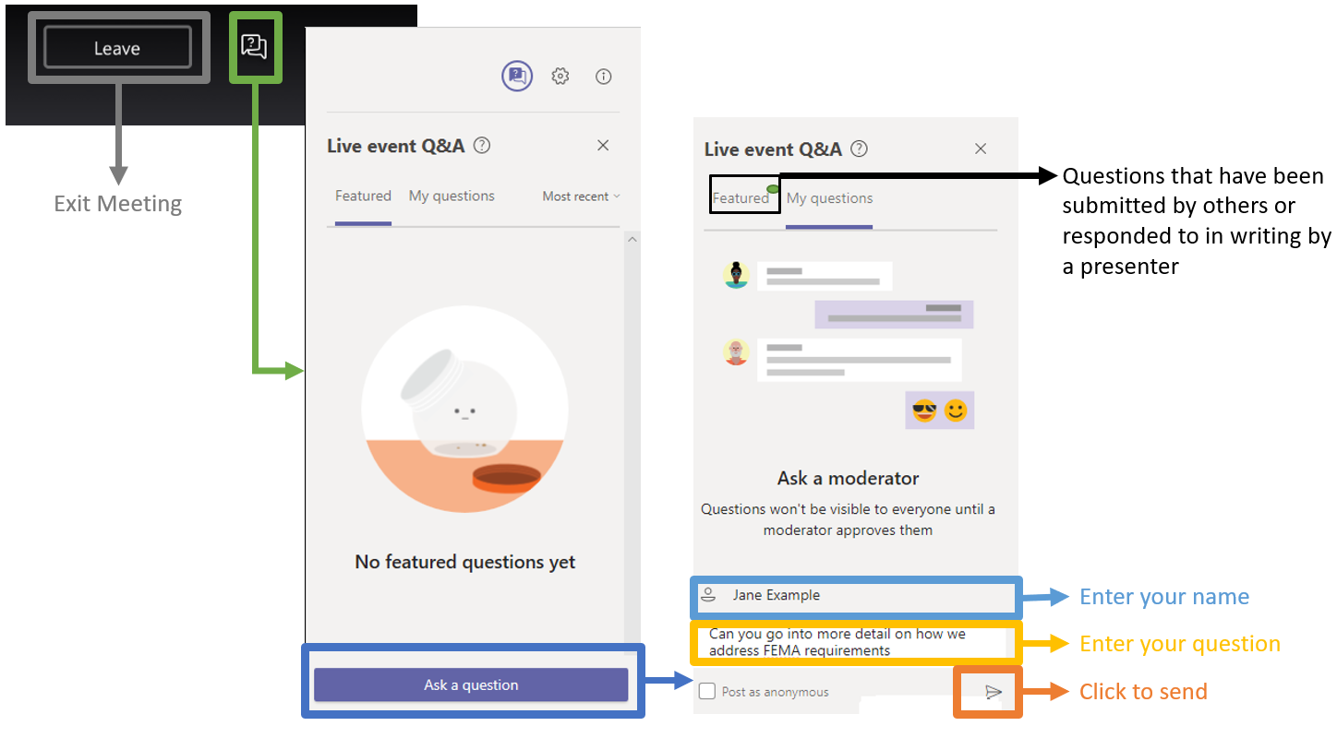
Before we start-
Questions & Answers

Slide 4
Statutes and Regulations
KDE processes are established by statute and applied by regulation:
702 KAR 4:160 – Capital Construction Process
The basic regulation that outlines the submittal, review, and approval of project documentation. This will be the subject of today’s session.
702 KAR 4:170 – Facility Programming and Construction Criteria Prescribes various construction specifications to ensure functional, safe, and economical facilities.
702 KAR 4:180 – Implements the Kentucky Schools Facilities Planning Manual

Slide 5
Statutes and Regulations - continued
Statutes include requirements for:
Project Funding including Bond Sales, and Local Board responsibilities
Design professionals (Architects/Engineers) including building code requirements, and Construction Managers
Procurement of services and materials including public notice and Bidding
Insurance of various kinds including Payment and Performance Bonds
KDE responsibilities
KDE regulations are designed to provide compliant paths related to these statutory requirements.

Slide 6
Capital Construction Processes
Capital Construction is organized in three delivery models:
General Contract
  One prime contractor with multiple subcontractors.
Construction Manager as Adviser
  Multiple prime contractors which may or may not have subcontractors.
Design/Build
  Contracts utilized exclusively for Guaranteed Energy Savings Contracts. A future session will address this process.
  KDE uses contract documents developed by the American Institute of Architects (AIA) as revised to match these specific delivery models and KDE requirements.

Slide 7
Capital Construction Processes – continued
Today’s session focuses on General Contractor and Construction Manager construction projects from initial BG-1 submittal through BG-5 Project Closeout, using the 702 KAR 4:160 framework as established in FACPAC.
FACPAC is a phased, linear process in that each phase must be completed (approved by KDE) before moving to the next phase.
If in doubt, call your KDE Project Manager for clarification. A phone call can help speed the process.

Slide 8
Capital Construction Processes – continued
The phases in today’s session are:
  Initial BG-1 submittal and approval.
  Consultant contract review and approval.
  Design document review and approval.
  Post bid review and approval of revised BG-1 and construction contracts.
  Review and approval of construction change orders.
  Review and approval of BG-4 & 5 construction contract and project closeout.

Slide 9
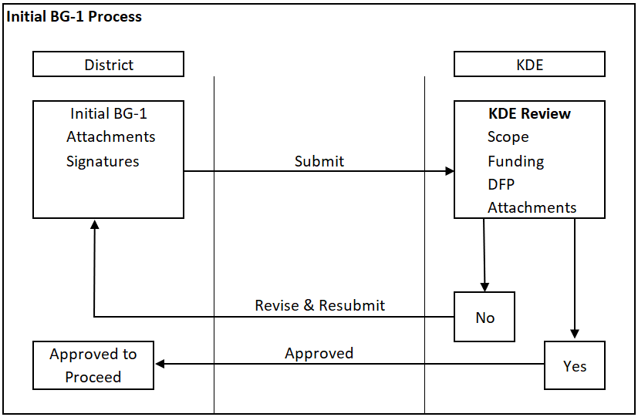
Beginning the Process
After the Initial BG-1 is approved by KDE, third parties may be given access to the system allowing them to submit and upload documents.

Slide 10
Tiering
Tiering is the automated evaluation of project criteria, developed by KDE, based on funding sources, project scope, program complexity and cost.
Tiering was developed to streamline project submittals and reviews.
A project is assigned the Tier at the approval of the Initial BG-1. A project requirement checklist is determined based on the assigned Tier. Tier may change upon BG-1 revision.
Depending on the Tier, Schematic, Design Development, or Construction Document reviews may be waived.
A project tier can change with a Revised BG-1.

Slide 11
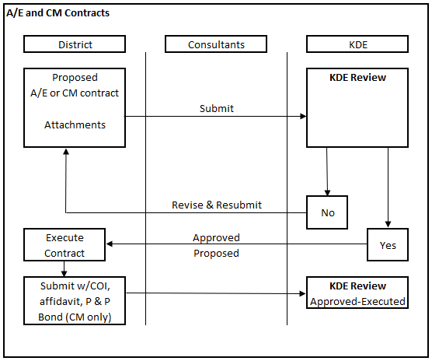
A/E and CM Contracts
All contracts have a two-step approval process.

Slide 12
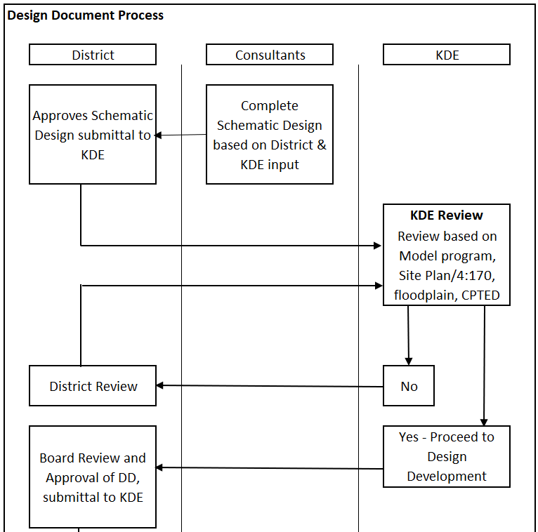
Design Document Process

Slide 13
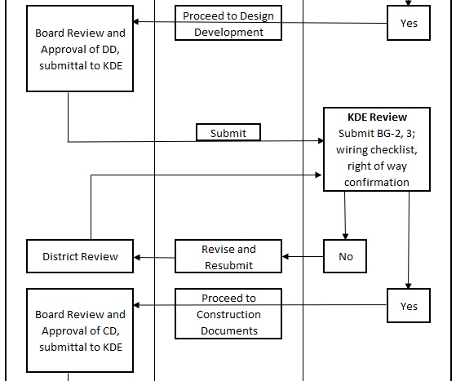
Design Document Process - continued

Slide 14
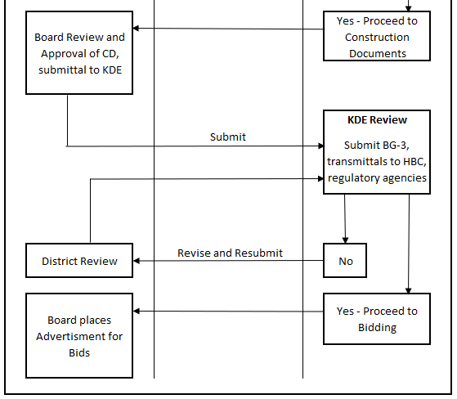
Design Document Process - continued

Slide 15
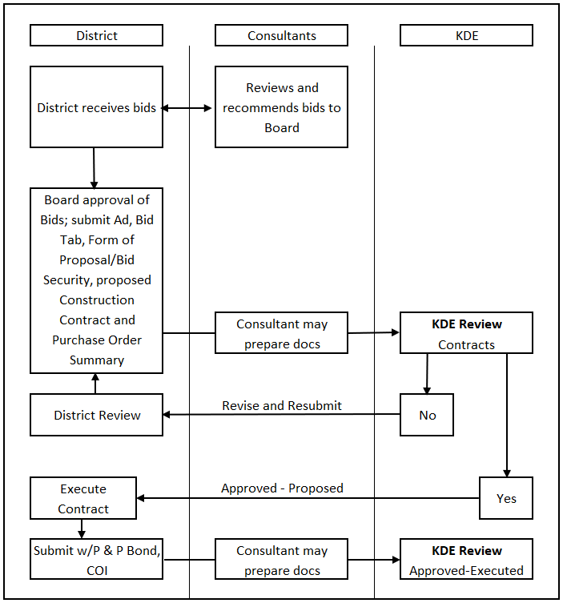
Bidding and Construction Contract Approval

Slide 16
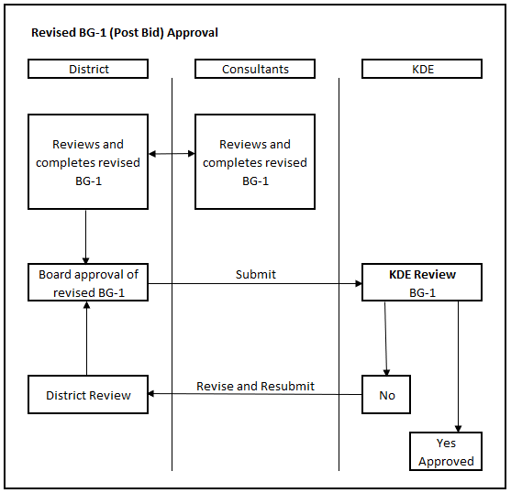
Revised BG-1 (Post Bid) Approval
Following the approval of the revised BG-1 the process leading to a Bond Sale may begin.

Slide 17
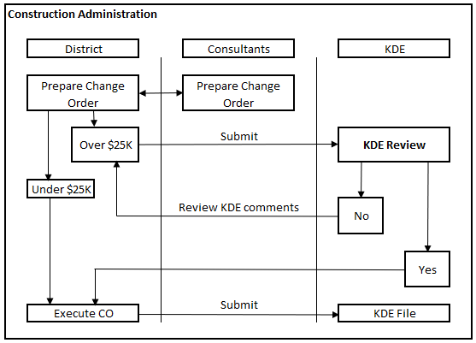
Construction Administration
KDE is required where necessary to review and approve construction change orders using a two-step process.

Slide 18
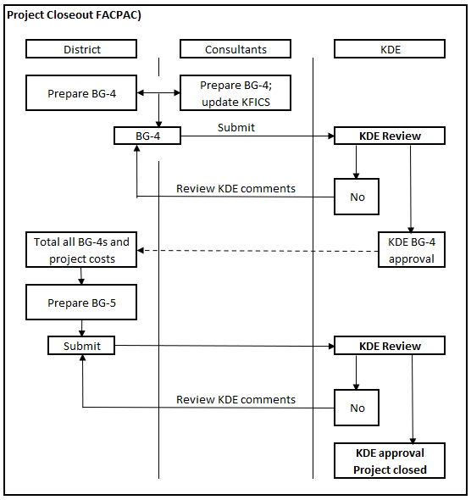
Project Closeout
The BG-4 closes out construction contracts; the BG-5 closes out the project.

Slide 19
Presentation Conclusion
Concluding remarks – Greg Dunbar
Question recap- Tanesha Keene
Participant comments

