Slide 1
BG (Building & Grounds) Forms 1-5
Kentucky Department of Education (KDE)
Office of Finance and Operations (OFO)
Division of District Support (DDS)
District Facilities Branch (DFB)
Kentucky School Plant Managers Association (KSPMA) - March 18, 2025

Slide 2
Introductions

Slide 3
Kentucky Department of Education (KDE)
Commissioner
Dr. Robbie Fletcher
robbie.fletcher@education.ky.gov

Slide 4
Office of Finance and Operations (OFO)
Associate Commissioner
Matt Ross
matt.ross@education.ky.gov
Division of District Support (DDS)
Division Director
Chay Ritter
chay.ritter@education.ky.gov

Slide 5
District Facilities Branch (DFB) Part 1
Phone Number
(502) 564-4326 plus extension

Slide 6
District Facilities Branch (DFB) Part 2
Branch Manager
Greg Dunbar, AIA, MBA (ext. 4429)
greg.dunbar@education.ky.gov
Project Management/District Liaison
Gary Leist, AIA, LEED AP (ext. 4404)
gary.leist@education.ky.gov
Marcus Highland, AIA (ext. 4408)
marcus.highland@education.ky.gov

Slide 7
District Facilities Branch DFB Part 3
Project Management/District Liaison
John C. Gilbert, AIA, LEED AP (ext. 4452)
john.gilbert@education.ky.gov
Teresa Hester, NCIDQ, KCID (ext. 4427)
teresa.hester@education.ky.gov
Resource Management Analyst II
Tanesha Keene (ext. 4401)
tanesha.keene@education.ky.gov

Slide 8
Presentation Summary
FACPAC 101 – Getting Started, General Information
Initial BG-1 (and revisions)
BG-2
BG-3
BG-4
BG-5

Slide 9
FACPAC 101 (FACilities Planning And Construction)
Defining FACPAC and other points of interest
FACPAC Homepage – User Guide
FACPAC Homepage – FACPAC Support
FACPAC Homepage – Create Project - BG Project (Form)

Slide 10
Defining FACPAC (and other acronymic definers)
FACPAC is the FACilities Planning And Construction software application used in the SharePoint system where local districts (and third-party vendors) may formally submit property, design and construction-related materials to KDE's District Facilities Branch (DFB) for reviews and assistance. Local districts create Building and Grounds (BG) projects to report to KDE for showing evidence meeting District Facilities Planning (DFP) Needs and reporting corresponding financial allocations to defined capital construction and property projects as approved by your local board.

Slide 11
Defining FACPAC (other points of interest)
FACPAC access is granted based on requests received from districts & third-party groups to KDE through FACPAC Support.
It is important to provide individual roles when requesting this access. District roles include the superintendent, finance officer, facility director and their assigned staff. Third party roles include architects, construction managers, fiscal agents, qualified providers and their assigned staff. District may select vendors preloaded in the system for access to projects. Contact Tanesha Keene if you have issues with access.
FACPAC as an application in SharePoint, provides districts and their third-party design professionals with online data entry forms for construction projects such as:
BG-1 Project Application, Contract, Contract Summary, Purchase Orders, Purchase Order Summary, Change Orders, BG-4 Contract Close-Out and BG-5 Project Close-Out forms and data.

Slide 12
Defining FACPAC (other points of interest continued)
Your FACPAC (SharePoint) homepage is also a place to upload (as an option to HB678 (2022)/HB727(2024) districts) design-related materials.
Examples: Design drawings, project manuals, BG-2, BG-3, design professional agreements, and construction manager agreements.
FACPAC (SharePoint) is also used for creating projects and uploading information through My Document Submissions for property related materials.
Acquisitions and Dispositions are now both processed in FACPAC. Contact your KDE Project Manager for all property disposal projects.
Examples: Fee simple title, title insurance, surveys, environmental assessments, appraisals, etc. This includes final submittals of executed deeds for acquisition and disposition.

Slide 13
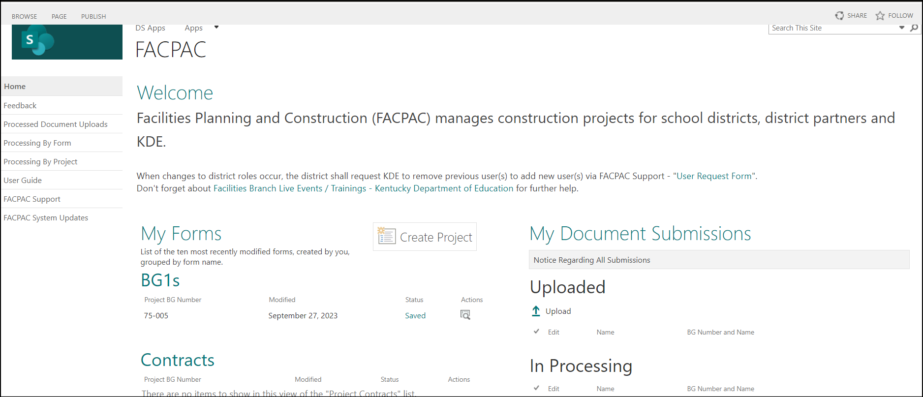
FACPAC Homepage - User Guide
Image: District’s FACPAC homepage

Slide 14
FACPAC Homepage – FACPAC Support
Image: District’s FACPAC homepage

Slide 15
My Document Submissions - Upload Documents
Image: District’s FACPAC homepage
Discussed in later slides

Slide 16
FACPAC Homepage - Create Project
Image: District’s FACPAC homepage

Slide 17
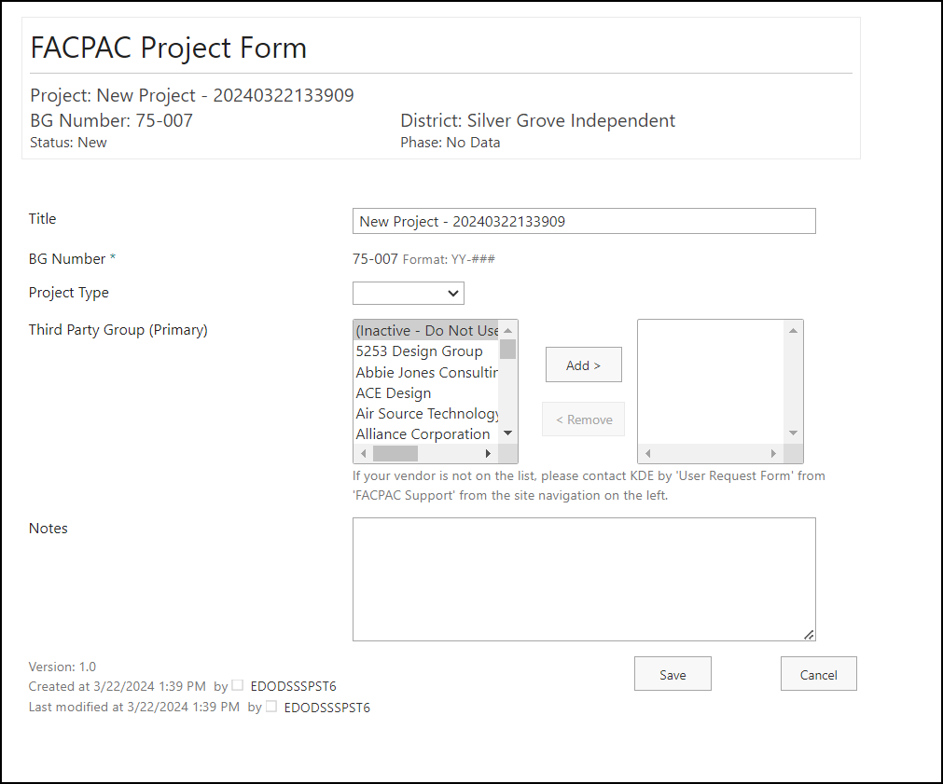
Each project created is identified by the BG number and the title.
Title is generic at the time it is created "New Project YYYMMDDTTTTSS."
CHANGE TITLE TO DESCRIBE THE PROJECT.
BG number is automated.
Project Type provides two choices:
Construction
Property
Third Party Group
Add/Remove primary vendor assisting with design / construction
Image: FACPAC Project Form page

Slide 18
Each project created is identified by the BG number and the title.
Title is generic at the time it is created "New Project YYYMMDDTTTTSS."
CHANGE TITLE TO DESCRIBE THE PROJECT.
BG number is automated.
Project Type provides two choices:
Construction
Property
Third Party Group
Add/Remove primary vendor assisting with design / construction
Image: FACPAC Project Form page

Slide 19
Each project created is identified by the BG number and the title.
Title is generic at the time it is created "New Project YYYMMDDTTTTSS."
CHANGE TITLE TO DESCRIBE THE PROJECT.
BG number is automated.
Project Type provides two choices:
Construction
Property
Third Party Group
Add/Remove primary vendor assisting with design / construction
Image: FACPAC Project Form page

Slide 20
Each project created is identified by the BG number and the title.
Title is generic at the time it is created "New Project YYYMMDDTTTTSS."
CHANGE TITLE TO DESCRIBE THE PROJECT.
BG number is automated.
Project Type provides two choices:
Construction
Property
Third Party Group
Add/Remove primary vendor assisting with design / construction
Image: FACPAC Project Form page

Slide 21
Project Type Breakdown:
Construction
Construction Manager
General Contractor
GESC
Cooperative Purchase
Property
Site Acquisition
Disposition by Sale
Disposition by Easement
Disposition by Lease
Disposition by Sale to Government (Gov’t) Agency
Image: FACPAC Project Form page

Slide 22
Each project created is identified by the BG number and the title.
Title is generic at the time it is created "New Project YYYMMDDTTTTSS."
CHANGE TITLE TO DESCRIBE THE PROJECT.
BG number is automated.
Project Type provides two choices:
Construction
Property
Third Party Group
Add/Remove primary vendor assisting with design / construction
Image: FACPAC Project Form page

Slide 23
FACPAC Document Attachments
Image: Top of Initial BG1 Project Application Form
All attachments submitted to FACPAC by districts must be in PDF format and all pages need to be attached, not just the signature page. The district cannot attach documents to FACPAC forms that are approved. This must be completed PRIOR to KDE submission.

Slide 24
My Document Submissions - Upload Documents
Image: District’s FACPAC homepage
Document Uploads.

Slide 25
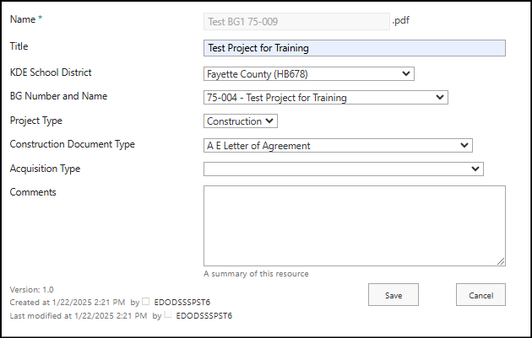
Image: “My Document Submissions” Entry Field Display (Example: Fayette County)
Construction type selection for document uploads.
All submittals for property shall be uploaded.
All submittals for design documentation shall be uploaded. However, BG forms, contracts and change orders shall be attached to each FACPAC form.

Slide 26
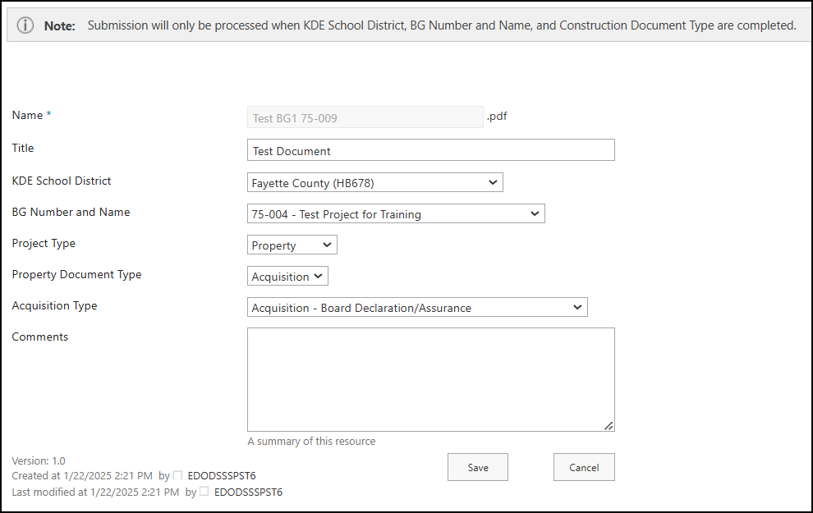
Image: “My Document Submissions” Entry Field Display (Example: Fayette County)
Property type selection for document uploads.
All submittals for property shall be uploaded.
All submittals for design documentation shall be uploaded. However, BG forms, contracts and change orders shall be attached to each FACPAC form.

Slide 27
Initial BG-1
Who, What, When, Where, Why, How...

Slide 28
Initial BG-1 – Who, What, When...
Who completes an initial BG-1?
Only school district representatives may complete the initial BG-1 in the FACPAC system. Others should assist in informing the district on information (design professionals, fiscal agents, construction managers, external partners (donations), etc.)
Revised – Consultants assigned to the project may complete revised BG-1's.
What is an initial BG-1 for?
A form that officially kicks off by formal board approval a construction project for a district primarily identifying the type of project, District Facilities Plan Needs being met, general scope of the project, costs to achieve the project, and all fund sources (restricted and unrestricted) allocated for the project.
When do you complete an initial BG-1?
The BG-1 should be approved by your Board to begin a project. This form is turned into KDE for "record keeping and data collection" in accordance with HB 678 (2022 reg) and will continue through HB 727 (2024 reg).
Revisions for financial adjustments and post-bid documentation.

Slide 29
Initial BG-1 – ...Where, Why, and...
Where do you complete an Initial (or Revised) BG-1?
Through the FACPAC system after you have created a project.
Why do we complete BG-1's?
This form is turned into KDE for "record keeping and data collection" - HB727 (2024 reg).
It is also the primary source for all districts requiring to report their Needs being met from projects noted on a DFP. KDE prepares that report every biennium in October 1 prior to the applicable budget session.
For federally funded capital construction projects requiring State Educational Agency (SEA) approval for a major project, this form may serve as that approval. (ESSER funding and others)
For local board to approve scope and funding for a project.
Initial BG-1’s are the only time you can report DFP Priority Needs being met. Revisions will not allow adjustments and may require the district to “start over” by creating a new BG-1 project to appropriately report Need.

Slide 30
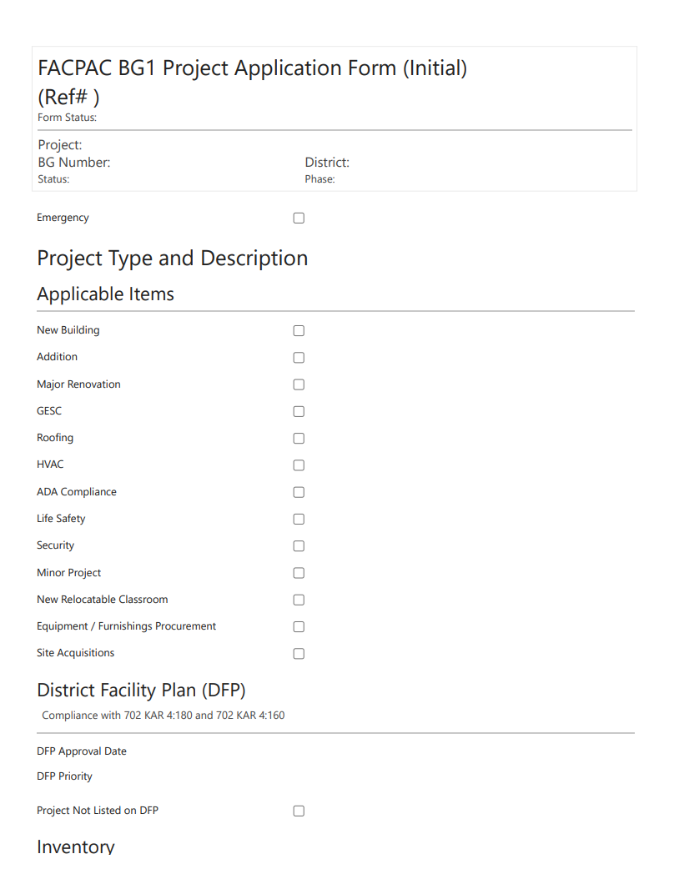
Initial BG-1 – How?
Project Information
Emergency?
Project Type
DFP (Needs Being Met)
Inventory
Scope (General Description)
Financial Plan – Probable Costs
Financial Plan – Funds Available
Image: Initial BG-1 Form

Slide 31
Initial BG-1 – How?
Project Information
Emergency?
Project Type
DFP (Needs Being Met)
Inventory
Scope (General Description)
Financial Plan – Probable Costs
Financial Plan – Funds Available
Image: Initial BG-1 Form (continued)

Slide 32
Initial BG-1 – How?
Project Information
Emergency?
Project Type
DFP (Needs Being Met)
Inventory
Scope (General Description)
Financial Plan – Probable Costs
Financial Plan – Funds Available
Image: Initial BG-1 Form (continued)

Slide 33
Initial BG-1 – How?
Project Information
Emergency?
Project Type (Property – Site Disposal coming soon…)
DFP (Needs Being Met)
Inventory
Scope (General Description)
Financial Plan – Probable Costs
Financial Plan – Funds Available
Image: Initial BG-1 Form (continued)

Slide 34
Initial BG-1 – How?
Project Information
Emergency?
Project Type (Property – Site Disposal coming soon…)
DFP (Needs Being Met)
Inventory
Scope (General Description)
Financial Plan – Probable Costs
Financial Plan – Funds Available
Image: Initial BG-1 Form (continued)

Slide 35
Initial BG-1 – How?
Project Information
Emergency?
Project Type (Property – Site Disposal coming soon…)
DFP (Needs Being Met)
Inventory
Scope (General Description)
Financial Plan – Probable Costs
Financial Plan – Funds Available
Image: Initial BG-1 Form (continued)

Slide 36
Initial BG-1 – How?
Project Information
Emergency?
Project Type (Property – Site Disposal coming soon…)
DFP (Needs Being Met)
Inventory
Scope (General Description)
Financial Plan – Probable Costs
Financial Plan – Funds Available
Image: Initial BG-1 Form (continued)

Slide 37
Initial BG-1 – How?
Project Information
Emergency?
Project Type (Property – Site Disposal coming soon…)
DFP (Needs Being Met)
Inventory
Scope (General Description)
Financial Plan – Probable Costs
Contact Project Manager for Property Disposal.
Financial Plan – Funds Available
Image: Initial BG-1 Form (continued)

Slide 38
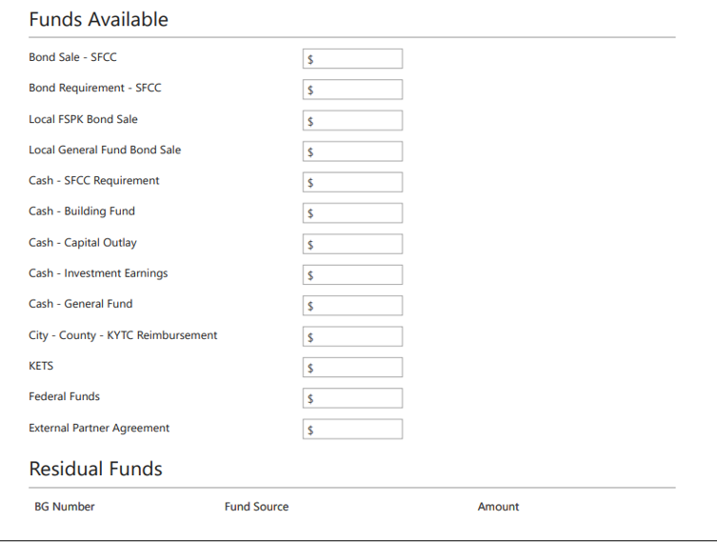
Initial BG-1 – How?
Project Information
Emergency?
Project Type (Property – Site Disposal coming soon…)
DFP (Needs Being Met)
Inventory
Scope (General Description)
Financial Plan – Probable Costs
Financial Plan – Funds Available
Contact Project Manager for Property Disposal.
Signature page populates when page complete in FACPAC.
Image: Initial BG-1 Form (continued)

Slide 39
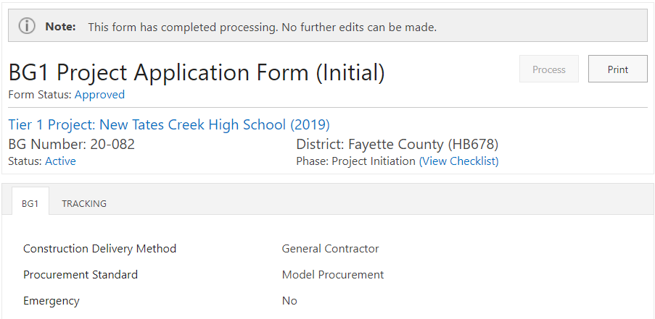
Initial BG-1
Example: Fayette County
Image: Initial BG-1 Fayette County. Top of page

Slide 40
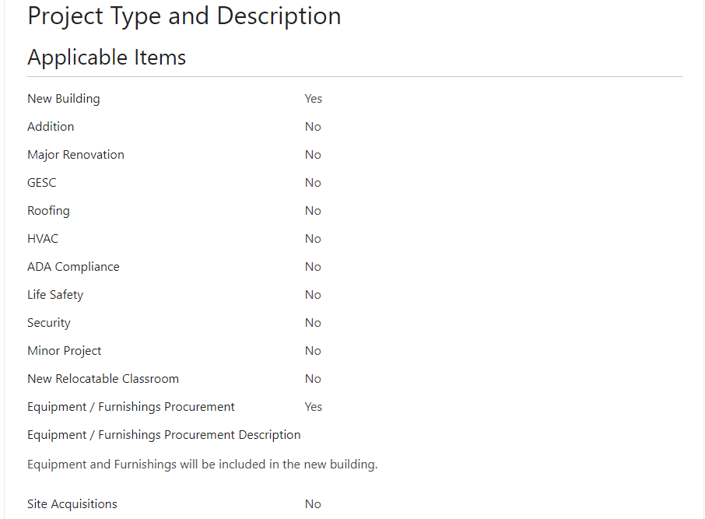
Initial BG-1
Example: Fayette County
Image: Initial BG-1 Fayette County. Project Type

Slide 41
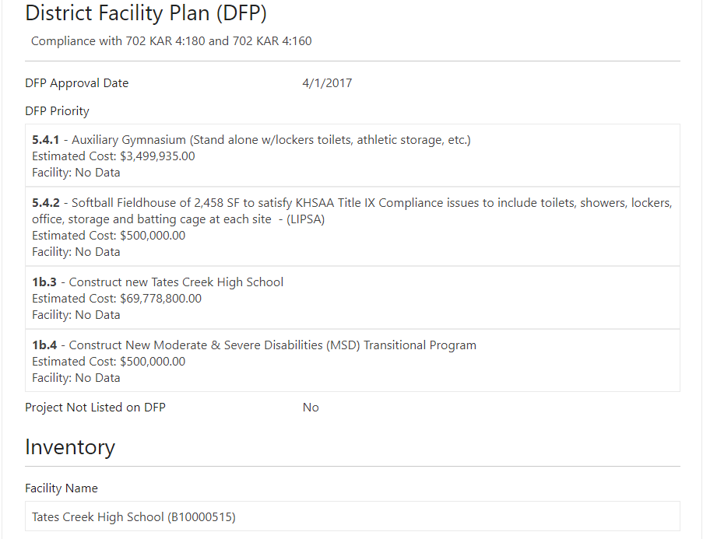
Initial BG-1
Example: Fayette County
Image: Initial BG-1 Fayette County. DFP Priority

Slide 42
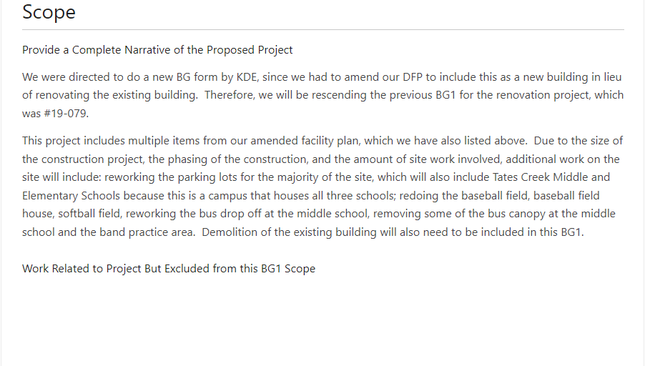
Initial BG-1
Example: Fayette County
Image: Initial BG-1 Fayette County. Scope

Slide 43
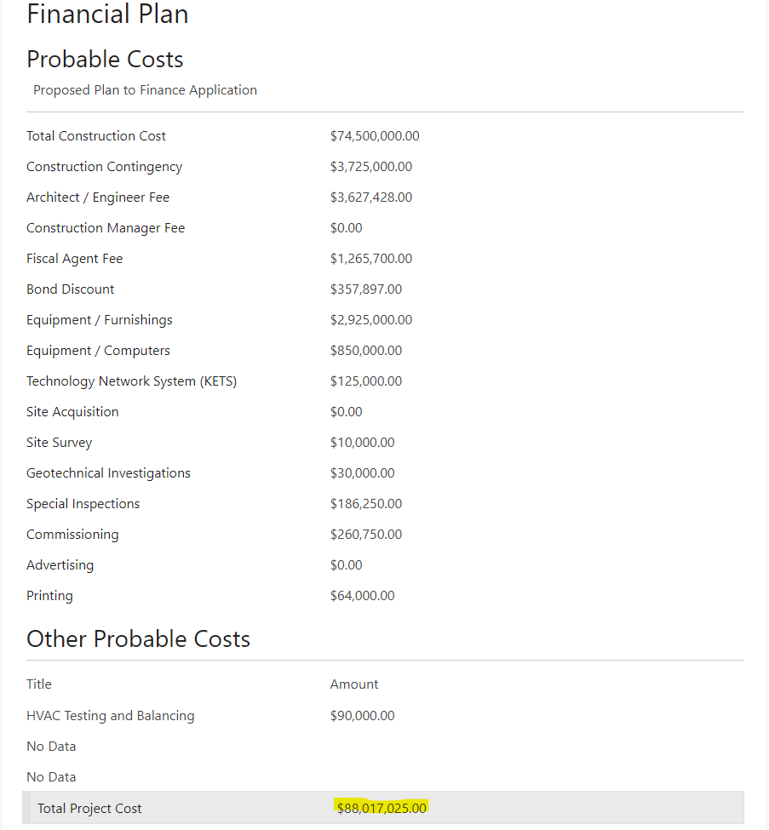
Initial BG-1
Example: Fayette County
Image: Initial BG-1 Fayette County. Probable Costs

Slide 44
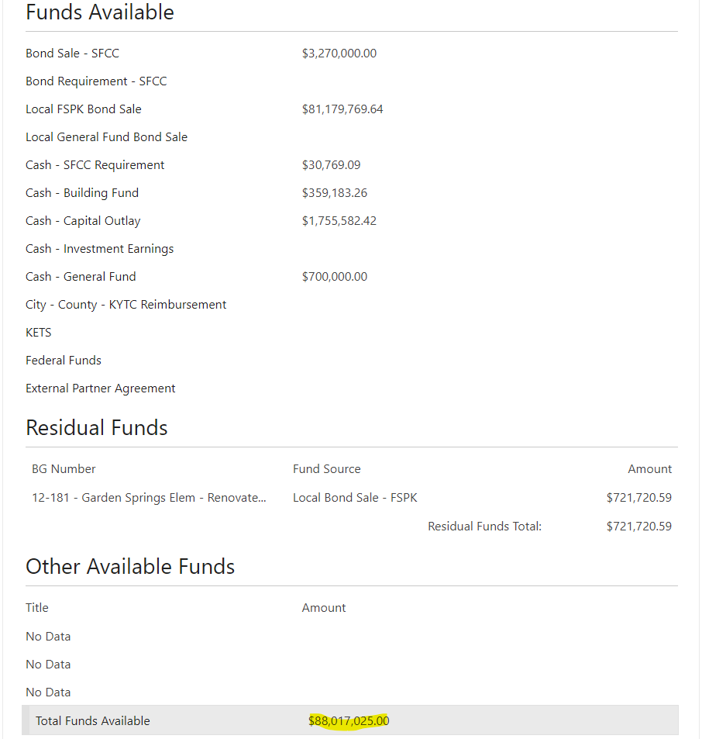
Initial BG-1
Example: Fayette County
Image: Initial BG-1 Fayette County. Funds Available

Slide 45
BG-2
Who, What, When, Where, Why, How

Slide 46
BG-2 – Who, What, When...
Who completes a BG-2?
Design Professionals complete a BG-2 outside the FACPAC system. Others should assist in informing the design professionals in what goes into the project (district admin., school board, construction managers, etc.)
What is a BG-2 for?
A BG-2 is called an Outline Specifications Design Criteria Form that provides design accountability by providing important design information in a concise way. Information includes everything from alternate bid options, to energy efficiency goals, to materiality (roofing, flooring, ceilings, etc.) and facility infrastructure (HVAC, electric, structure, etc.).
When do you complete a BG-2?
The BG-2 should be approved by your Board primarily during Design Development (DD) phases or when any major design changes occur that the district feels is important for a board to act on.

Slide 47
BG-2 – ...Where, Why, and...
Where do you find a BG-2?
The KDE website has an Excel form available. Most design professionals will already have working templates to fill this form out.
Why do a BG-2?
A design professional is typically required to provide and present design information to their clients (school districts) to meet the terms of their agreement. The form was established as a baseline of information to provide consistent information to local boards (and by extension KDE) for review and approval stemming from 702 KAR 4:160 requirements.

Slide 48
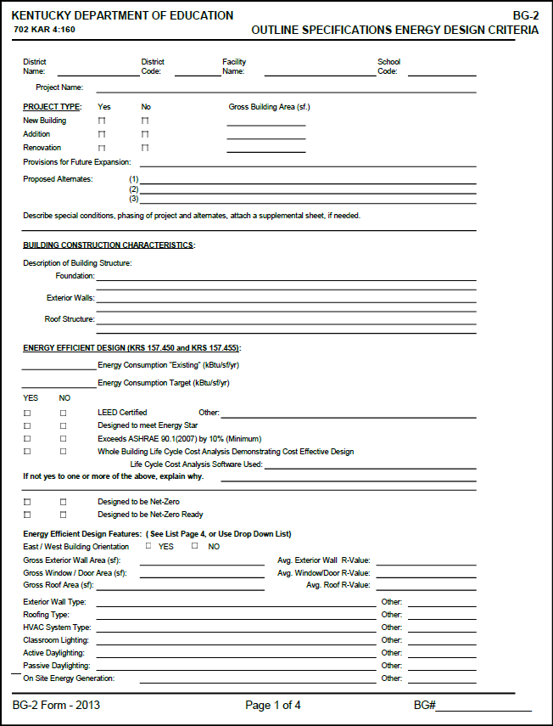
BG-2 Form
Image: Blank BG-2 Form Page 1

Slide 49
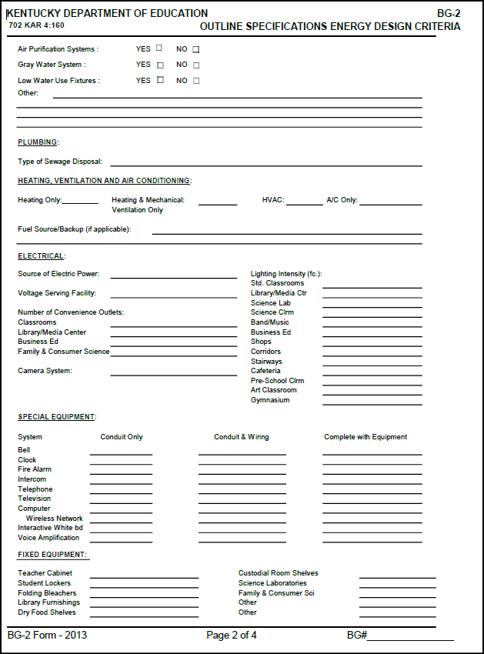
BG-2 Form
Image: Blank BG-2 Form Page 2

Slide 50
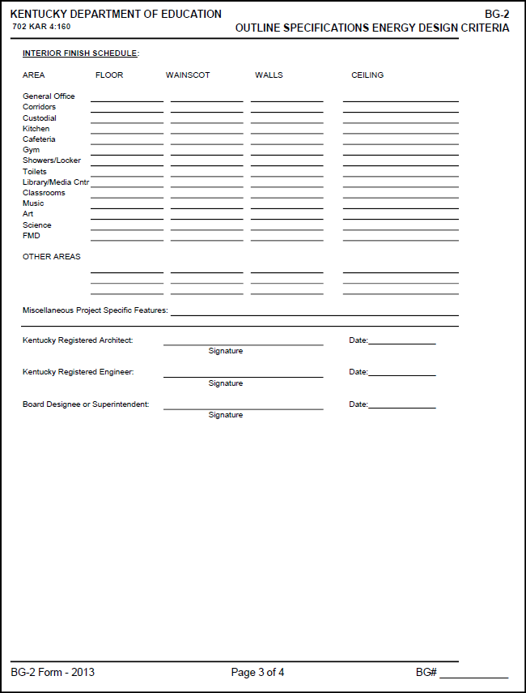
BG-2 Form
Note: Page 4 covers instructions only (not shown)
Image: Blank BG-2 Form Page 3

Slide 51
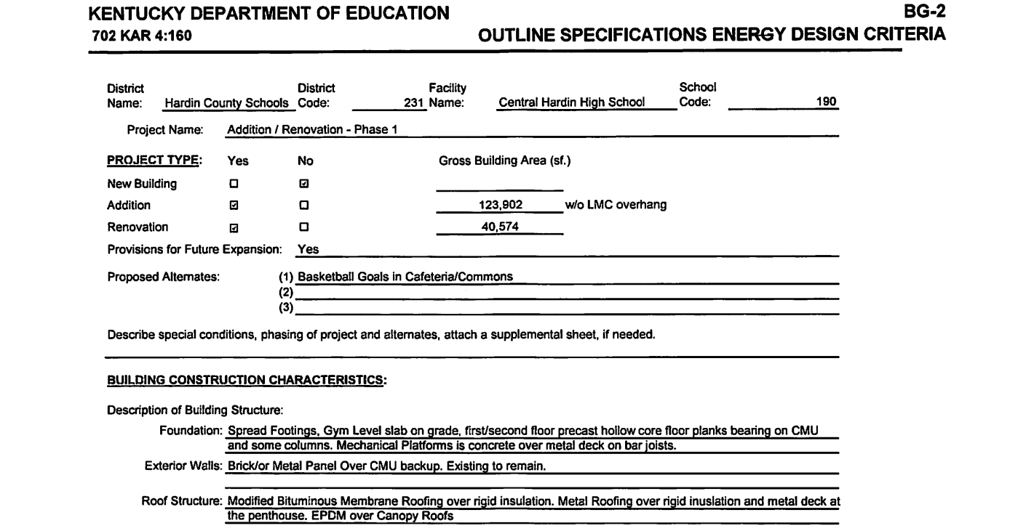
BG-2 – How?
Project Type
Building Construction -Characteristics
Energy Efficiencies
Plumbing
HVAC
Electrical
Special Equipment
Fixed Equipment
Interior Finishes
Image: BG-2 Form Hardin County.

Slide 52
BG-2 – How?
Project Type
Building Construction -Characteristics
Energy Efficiencies
Plumbing
HVAC
Electrical
Special Equipment
Fixed Equipment
Interior Finishes
Image: BG-2 Form Hardin County.
Building Construction

Slide 53
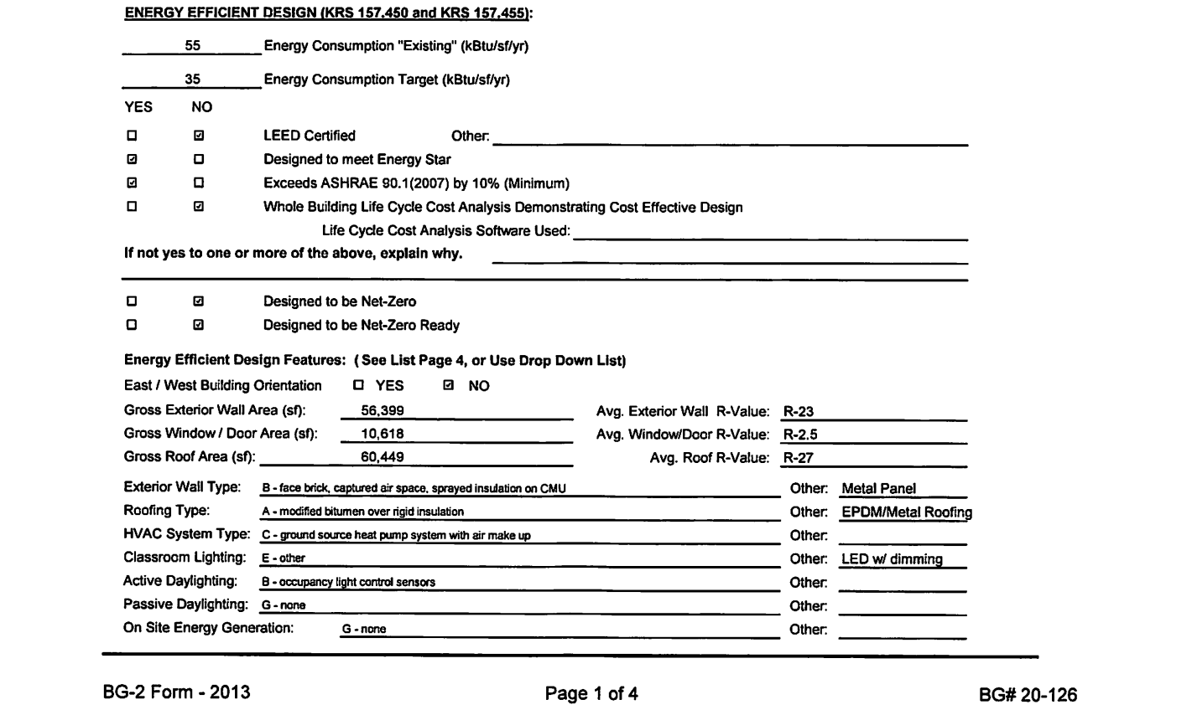
BG-2 – How?
Project Type
Building Construction -Characteristics
Energy Efficiencies
Plumbing
HVAC
Electrical
Special Equipment
Fixed Equipment
Interior Finishes
Image: BG-2 Form Hardin County.
Energy Criteria

Slide 54
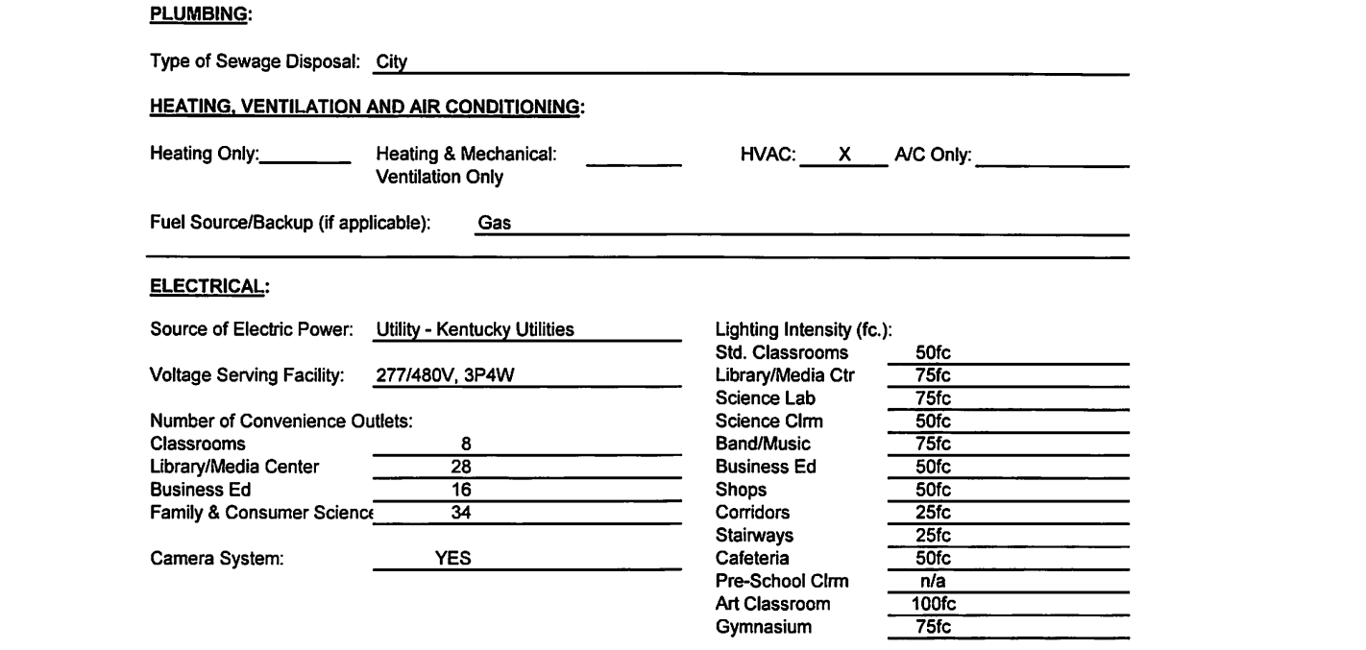
BG-2 – How?
Project Type
Building Construction - Characteristics
Energy Efficiencies
Plumbing
HVAC
Electrical
Special Equipment
Fixed Equipment
Interior Finishes
Image: BG-2 Form Hardin County.
Plumbing, HVAC, Electrical

Slide 55
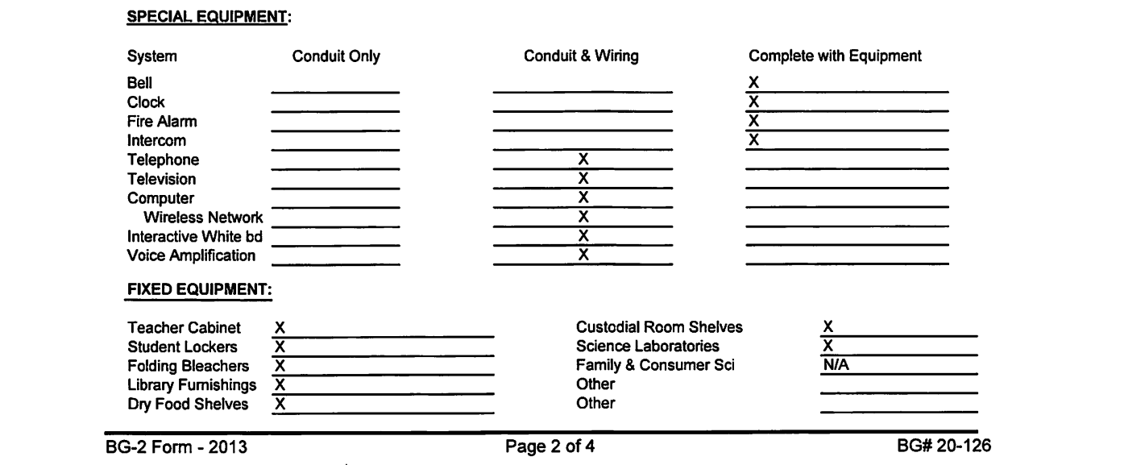
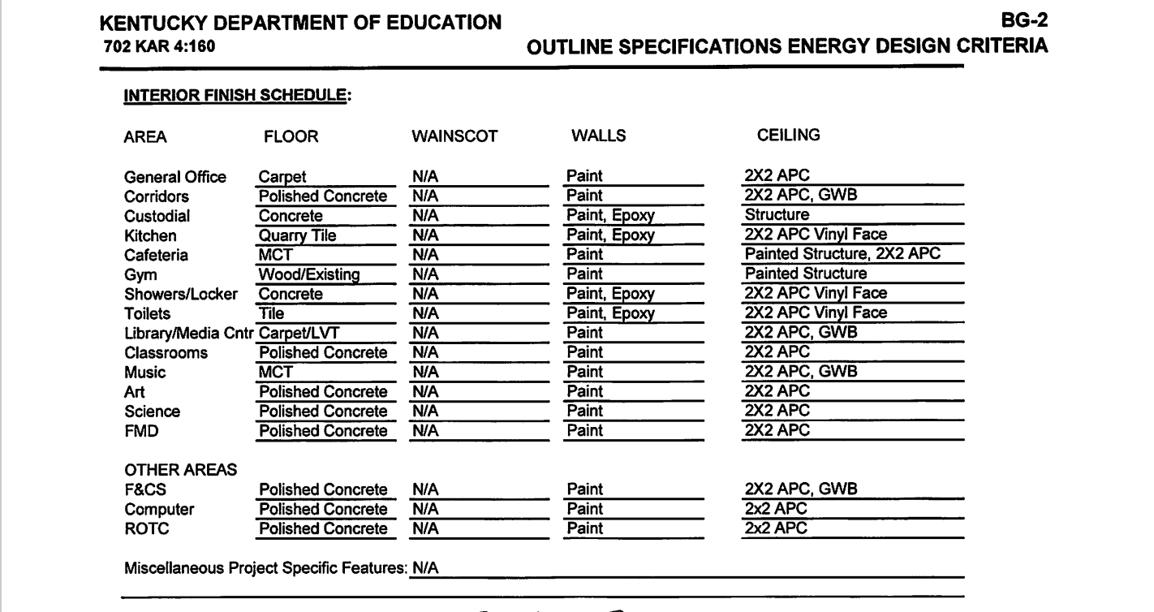
BG-2 – How?
Project Type
Building Construction - Characteristics
Energy Efficiencies
Plumbing
HVAC
Electrical
Special Equipment
Fixed Equipment
Interior Finishes
Image: BG-2 Form Hardin County.
Plumbing, HVAC, Electrical

Slide 56
BG-3
Who, What, When, Where, Why, How

Slide 57
BG-3 – Who, What, When...
Who completes a BG-3?
Design Professionals and Construction Managers complete a BG-3 outside the FACPAC system. Districts sign off after board approvals.
What is a BG-3 for?
The opportunity for a design teams and construction management company to report and alert districts on cost opinion adjustments. This was a requirement of 702 KAR 4:160 and is still a requirement that may be in your AIA Owner-Architect and AIA Owner-Construction Manager as Advisor agreements.
When do you complete a BG-3?
A BG-3 could be done at any design phase, but the most common and typical as a requirement would be at the Design Development and Construction Document phases. Traditionally, if costs were within 10% of the current BG-1 you would not revise a BG-1.

Slide 58
BG-3 – ...Where, Why, and...
Where do you find a BG-3?
The KDE website has an Excel form available. Most design professionals and construction management companies will already have working templates to fill this form out.
Why do a BG-3?
A design professional is typically required to provide and present design information to their clients (school districts) to meet the terms of their agreement. The same is true for adjusting cost opinions at applicable phases. The form was established as a baseline of information to provide consistent information to local boards (and by extension KDE) for review and approval stemming from 702 KAR 4:160 requirements.

Slide 59
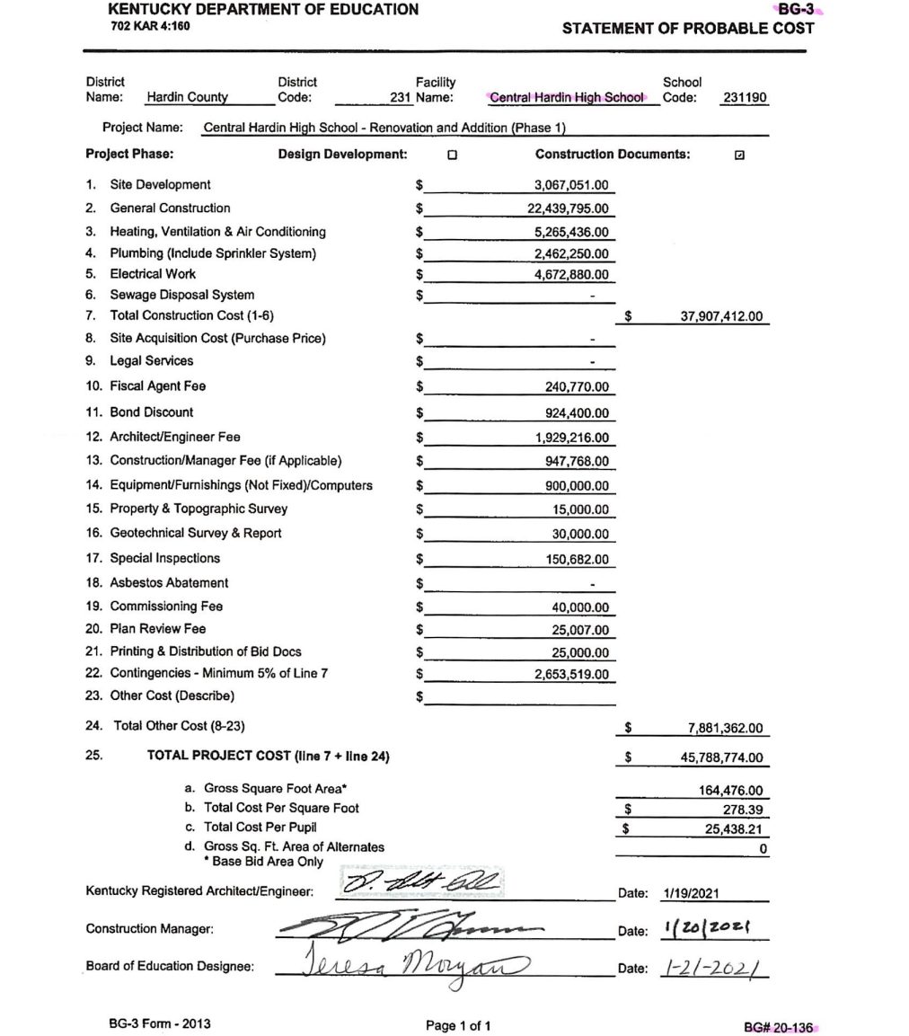
BG-3 – How?
BG-3 Cost Opinions nearly match the Probable Cost section of a BG-1 except for three distinct features breaking down costs:
Hard Costs for construction.
Soft Costs for design fees, bond sales, subsurface investigations, etc.
Totals including analysis of costs per square foot and per pupil.
This informs the district and allows important cost information to be considered by Finance Officers when monitoring fund source allocations.
Hard Costs
Soft Costs
Totals
Image: BG-3 Form Hardin County

Slide 60
BG-3 – How?
BG-3 Cost Opinions nearly match the Probable Cost section of a BG-1 except for three distinct features breaking down costs:
Hard Costs for construction.
Soft Costs for design fees, bond sales, subsurface investigations, etc.
Totals including analysis of costs per square foot and per pupil.
This informs the district and allows important cost information to be considered by Finance Officers when monitoring fund source allocations.
Hard Costs
Soft Costs
Totals
Image: BG-3 Form Hardin County

Slide 61
BG-3 – How?
BG-3 Cost Opinions nearly match the Probable Cost section of a BG-1 except for three distinct features breaking down costs:
Hard Costs for construction.
Soft Costs for design fees, bond sales, subsurface investigations, etc.
Totals including analysis of costs per square foot and per pupil.
This informs the district and allows important cost information to be considered by Finance Officers when monitoring fund source allocations.
Hard Costs
Soft Costs
Totals
Image: BG-3 Form Hardin County

Slide 62
BG-3 – How?
BG-3 Cost Opinions nearly match the Probable Cost section of a BG-1 except for three distinct features breaking down costs:
Hard Costs for construction.
Soft Costs for design fees, bond sales, subsurface investigations, etc.
Totals including analysis of costs per square foot and per pupil.
This informs the district and allows important cost information to be considered by Finance Officers when monitoring fund source allocations.
Hard Costs
Soft Costs
Totals
Image: BG-3 Form Hardin County

Slide 63
BG-4
Who, What, When, Where, Why, How

Slide 64
BG-4 – Who, What, When...
Who completes a BG-4?
Districts, Design Professionals or Construction Managers may complete a BG-4 at the final completion of a construction contract (within the FACPAC system).
What is a BG-4 for and what does it include?
A form that acknowledges final completion of their contract with a contractor for each contract. It includes a summary of the financial contract totals, related DPO's, and applicable change orders. It also acknowledges formal receipt of closeout documents like certificates of occupancy, release of liens, record drawings and other documents.
Property contracts do not require BG-4s
When do you complete a BG-4?
When achieving final completion on a contract. (Ideally) Board approves alongside the final retainage payment to contractor (consider Construction and Fairness Act).

Slide 65
BG-4 – ...Where, Why, and...
Where do you find a BG-4?
If you submit your contracts through FACPAC, you will be able to generate a BG-4 within the system for construction accountability purposes. If you adopted HB 727 (2024 reg) and choose not to submit to KDE in the FACPAC system, the district may need to use an older version of the form, create their own version, or create a process to effectively close a project out for board approval. The KDE website does not have a version of the BG-4 form.
Why do a BG-4?
A BG-4 intends to concisely acknowledge all key items on one form necessary for pertinent contract closeout. A board may review and formally approve signifying contract closeout.

Slide 66
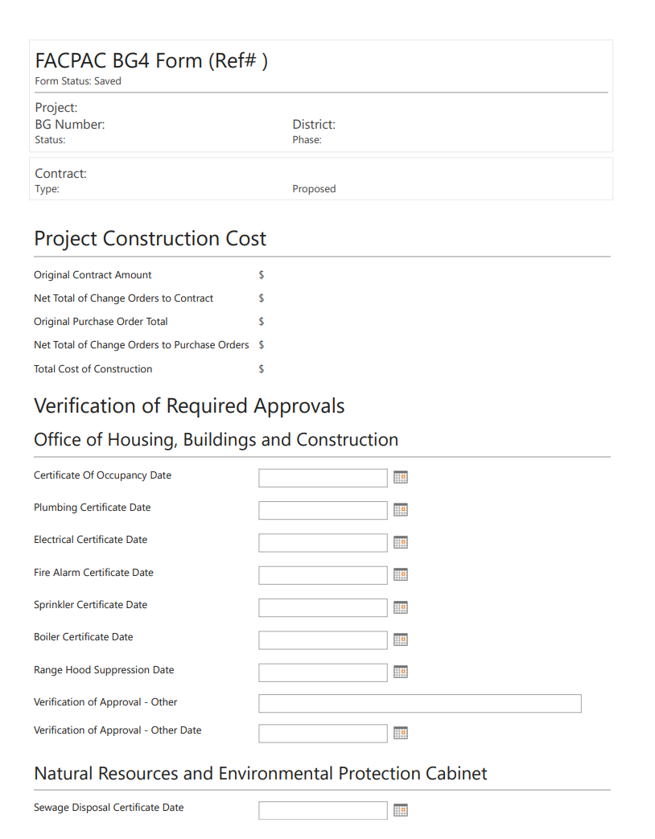
BG-4 – How?
BG-4 Construction Costs are summarized and automated from contract information in the FACPAC system.
Best Practice would cross check this information to your MUNIS systems.
Verification of Required Approvals provides dates of all official closeout requirements like building code, environmental, etc.
Closeout information provides documentation on warranties, trainings, record drawings, lien releases, etc.
Image: BG-4 Form Project Costs

Slide 67
BG-4 – How?
BG-4 Construction Costs are summarized and automated from contract information in the FACPAC system.
Best Practice would cross check this information to your MUNIS systems.
Verification of Required Approvals provides dates of all official closeout requirements like building code, environmental, etc.
Closeout information provides documentation on warranties, trainings, record drawings, lien releases, etc.
Image: BG-4 Form Approvals

Slide 68
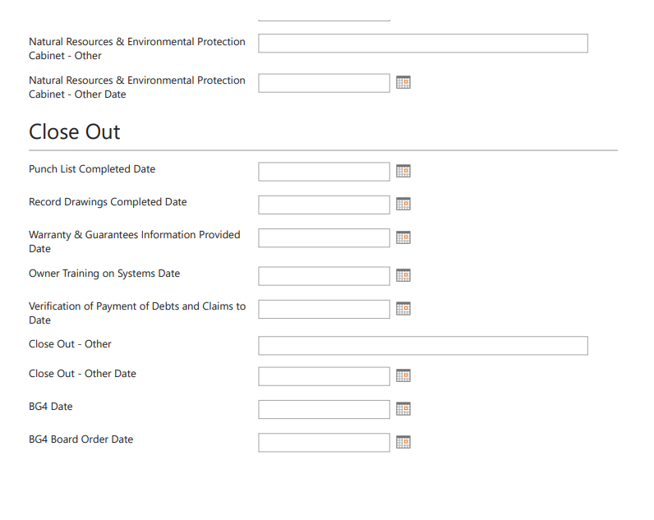
BG-4 – How?
BG-4 Construction Costs are summarized and automated from contract information in the FACPAC system.
Best Practice would cross check this information to your MUNIS systems.
Verification of Required Approvals provides dates of all official closeout requirements like building code, environmental, etc.
Closeout information provides documentation on warranties, trainings, record drawings, lien releases, etc.
Image: BG-4 Form Closeout

Slide 69
BG-5
Who, What, When, Where, Why, How

Slide 70
BG-5 – Who, What, When...
Who completes a BG-5?
Only district personnel may complete this form.
What is a BG-5 for and what does it include?
A form that acknowledges three (3) things at final completion of the full project:
A summary of the financial totals comparing the last approved BG-1 in the system to final expenditures. This will determine residual funds for the project.
The final area of the facility (new, additions, renovated area, etc.) and a verification the district updated their inventory in the Kentucky Facilities Inventory and Classification System (KFICS).
Property (Contact your Project Manager for disposal)
When do you complete a BG-5?
This is the final act to formally close the entire project. All contracts are completed which includes design professionals, construction management companies, fiscal agent and other soft cost related items.

Slide 71
BG-5 – ...Where, Why, and...
Where do you find a BG-5?
If you have an approved BG-1 through FACPAC; or, you have contracts fully completed in the FACPAC system, you will be able to generate a BG-5 within the system for construction accountability purposes. If you adopted HB 727 (2024 reg) and choose not to submit to KDE in the FACPAC system contracts, you can still create a BG-5 provided the BG-1 is up-to-date (may require a revision).
Note: If you place any contract information in the system, consider it an "all or nothing" approach, meaning you place all contracts and their applicable purchase orders and change orders in the system.
Why do a BG-5?
A board may review and formally approve signifying project closeout. A BG-5 intends to formally signify the closure of a project and no more intent to expend any further funds related to the project at that time. Any residuals are identified for potential use on other construction related matters (typical).

Slide 72
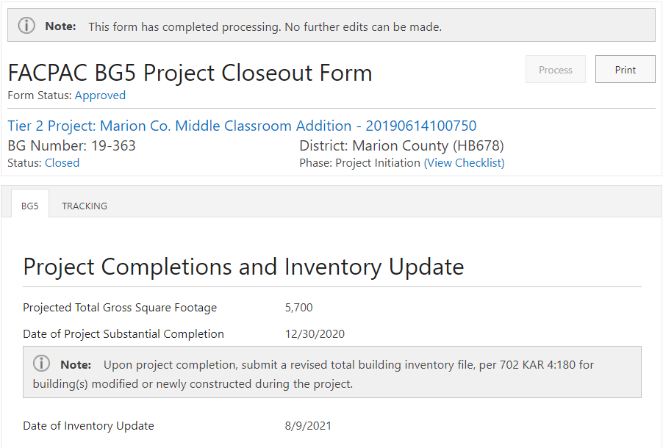
BG-5 – How?
Project Completions and Inventory Update (KFICS)
Reconciliation of Final Project Costs
Reconciliation of Final Project Funds and Residual Funds
Note: Contract Project Manager for all property disposal formwork.
Image: BG-5 Form Marion County. Inventory

Slide 73
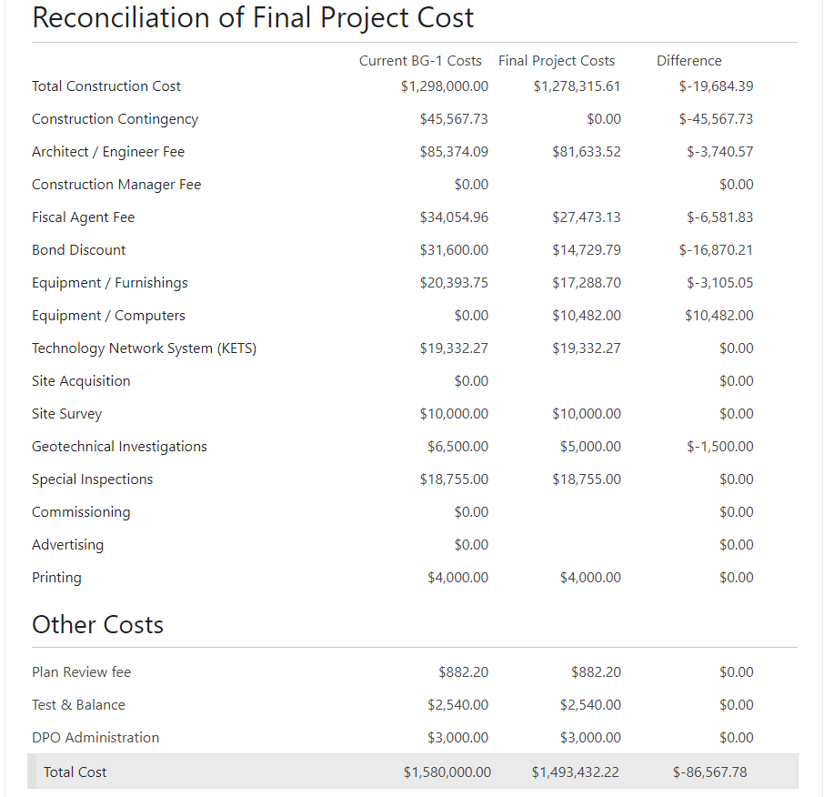
BG-5 – How?
Project Completions and Inventory Update (KFICS)
Reconciliation of Final Project Costs
Reconciliation of Final Project Funds and Residual Funds
Image: BG-5 Form Marion County.
Costs

Slide 74
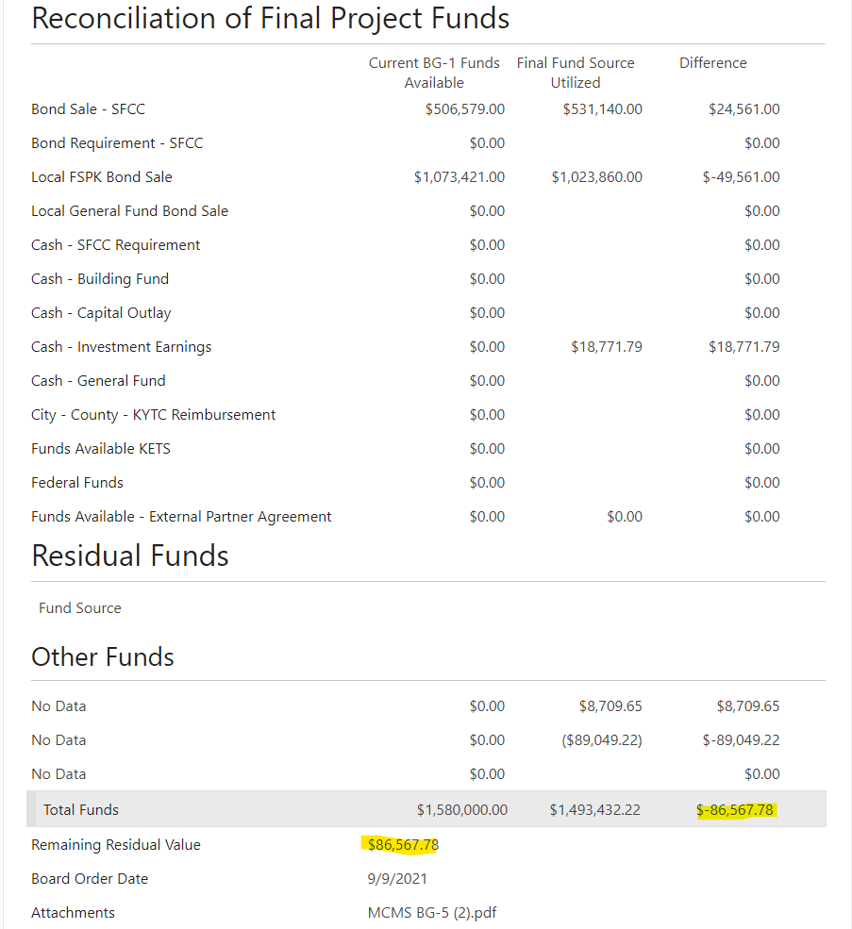
BG-5 – How?
Project Completions and Inventory Update (KFICS)
Reconciliation of Final Project Costs
Reconciliation of Final Project Funds and Residual Funds
Image: BG-5 Form Marion County. Funds

Slide 75
BG-5 – How?
Project Completions and Inventory Update (KFICS)
Reconciliation of Final Project Costs
Reconciliation of Final Project Funds and Residual Funds
The Difference for Costs, Funds, and Remaining Residual Value should all equal the same number.
Image: BG-5 Form Marion County. Residual

Slide 76
Questions?

Slide 77
Thank you KSPMA for your interest and participation!
Kentucky Department of Education (KDE)
Office of Finance and Operations (OFO)
Division of District Support (DDS)
District Facilities Branch (DFB)
March 18, 2025

