Slide 1
Whole School,
Whole Community,
Whole Child (WSCC)
Angie McDonald ADN, RN, NASSNC
KDE State School Nurse Consultant
Michelle Malicote BSN, RN, NASSNC
KDPH School Health Branch Manager
2022

Slide 2
Objectives:
Understands what the WSCC Model is and can identify the 10 components
Can explain how schools use the WSCC model
Understands how the WSCC model helps to improve learning and health
Understands what role families and community agencies play in the WSCC approach

Slide 3

Slide 3
HEALTH AND EDUCATION AFFECTS INDIVIDUALS, SOCIETY, AND THE ECONOMY AND, AS SUCH, MUST WORK TOGETHER WHENEVER POSSIBLE.
SCHOOLS ARE A PERFECT SETTING FOR THIS COLLABORATION.

Slide 4
Slide 4
It is time to truly align the sectors and place the child at the center. Both public health and education serve the same students, often in the same settings.
We must do more to work together and collaborate.
----------------------------------------------------------------------------------------------------------------------------------------
WAYNE H. GILES, DIRECTOR, DIVISION OF POPULATION HEALTH,
NATIONAL CENTER FOR CHRONIC DISEASE
PREVENTION AND HEALTH PROMOTION, CDC

Slide 5
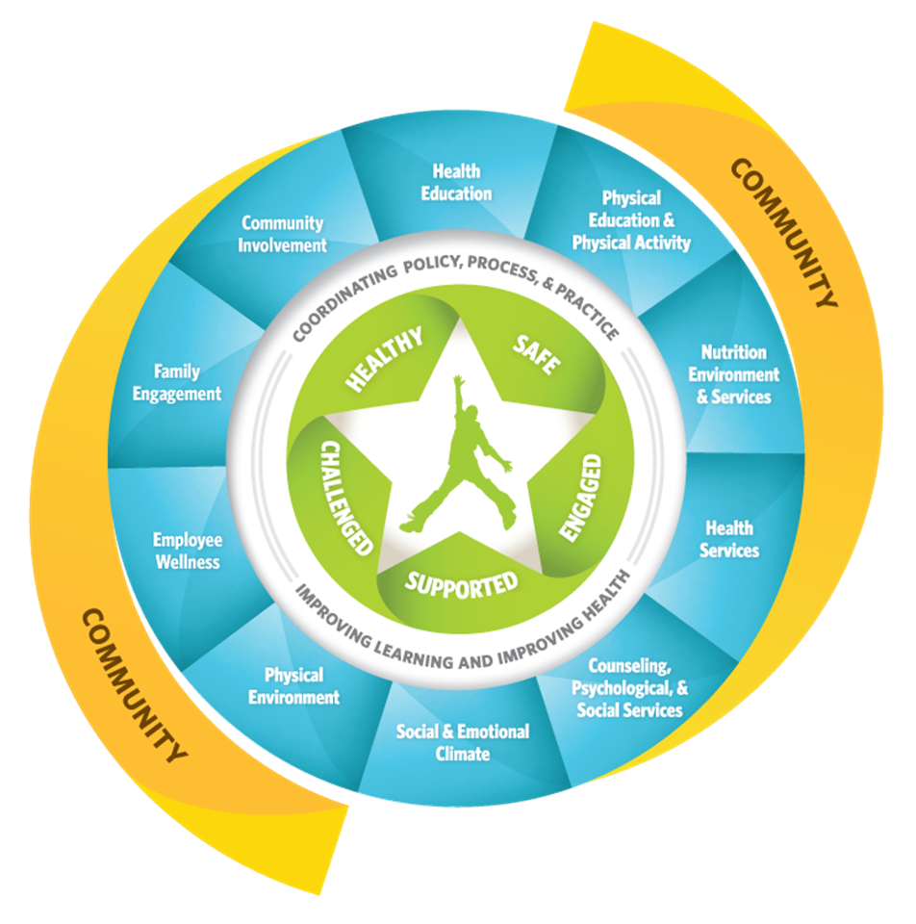
Whole School, Whole Community, Whole Child
The Whole School, Whole Community, Whole Child (WSCC) model focuses on the child to align the common goals of both sectors to put into action a whole child approach to education.
The education, public health, and school health sectors have each called for greater alignment that includes integration and collaboration between education leaders and health sectors to improve each child’s cognitive, physical, social, and emotional development.
Public health and education serve the same children, often in the same setting.
To view a short video of the WSCC Framework, click here

Slide 6
What is the WSCC model?
Physical education and physical activity
Nutrition environment and services
Health education
Social and emotional climate
Physical environment and health services
7. Counseling, psychological and social services
8. Employee wellness
9. Community involvement
10. Family engagement
Learn more about each of the 10 components

Slide 7
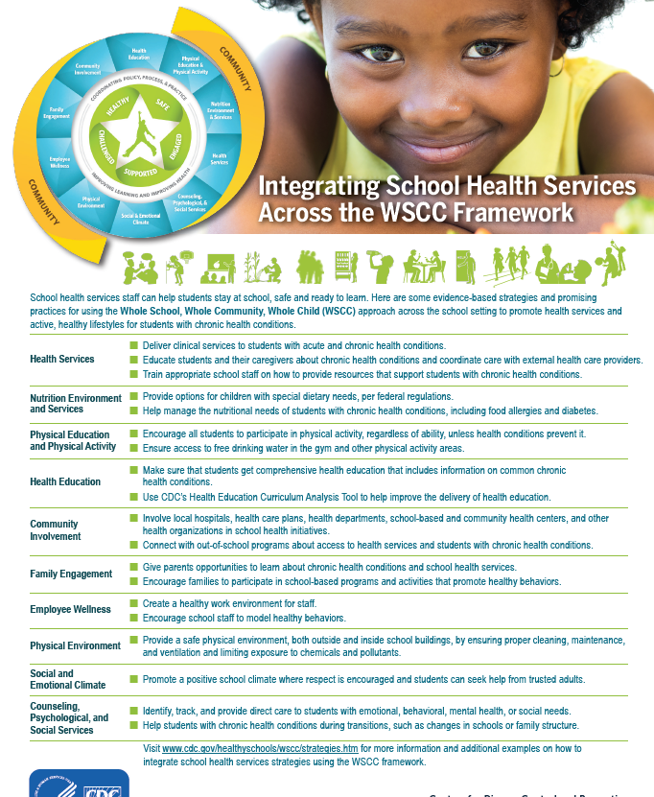
WSCC IN ACTION
Health Services, one of the WSCC components, play a vital role of ensuring student and staff well-being. This resource highlights the interconnectedness of each of the components.

Slide 8
How can Schools use the WSCC Model?
Establishing healthy behaviors during childhood is easier and more effective than trying to change unhealthy behaviors during adulthood
Schools play a critical role in promoting the health and safety of young people and helping them establish lifelong healthy behaviors
Every school has a unique set of needs
To better serve their students, school leaders and staff can incorporate the WSCC model components as they see fit
To see the WSCC model in action, visit our Virtual Healthy School

Slide 9
How does the WSCC model help to improve learning and health?
The WSCC model meets the need for greater emphasis on both the psychosocial and physical environment, as well as the increasing roles that community agencies and families play in improving childhood health behaviors and development

Slide 10
How does the WSCC model help to improve learning and health? (continued)
The WSCC model also addresses the need to engage students as active participants in their learning and health. CDC and the Association for Supervision and Curriculum (ASCD) external icon developed the WSCC model—in collaboration with key leaders from the fields of health, public health, education, and school health—to strengthen a unified and collaborative approach designed to improve learning and health in our nation’s schools

Slide 11
What Role do Families and Community Agencies Play in the WSCC Approach?
Family and community involvement in schools is important to the learning, development and health of students
When schools engage families in meaningful ways to improve student health and learning, families can support and reinforce healthy behaviors in multiple settings — at home, in school, in out-of-school programs and in the community

Slide 12

What Role do Families and Community Agencies Play in the WSCC Approach? (Cont.)
With help from school leaders, community agencies and groups can collaborate with schools to provide valuable resources for student health and learning
In turn, schools, students and their families can contribute to the community through service-learning opportunities and by sharing school facilities with community members (e.g., school-based community health centers and fitness facilities

Slide 13
References:
CDC Whole School, Whole Community, Whole Child (WSCC)
CDC WHOLE SCHOOL WHOLE COMMUNITY WHOLE CHILD Summary Document

Slide 14
Contact Information for WSCC :
Jim Tackett
Project Director
Jim.tackett@education.ky.gov
Stephanie Bunge
School Health Consultant
Stephanie.bunge@education.ky.gov
Nicole Barber-Culp
School Health Administrator
Mary.barber-culp@ky.gov

Slide 15
Contact Information:
Angie McDonald ADN, RN, NASSNC
KDE State School Nurse Consultant
Angela.Mcdonald@education.ky.gov
Michelle Malicote BSN, RN, NASSNC
KDPH School Health Branch Manager
Michelle.Malicote@ky.gov

Slide 16


