Slide 1
School Health Services Documentation
Angie McDonald, ADN, RN, NASSNC
KDE State School Nurse Consultant
Michelle Malicote, BSN, RN, NASSNC
KDPH School Health Branch Manager
2022

Slide 2

Student Confidentiality:
Student health records are part of the student’s education records Protected by FERPA What is FERPA? ed.gov
Access permitted on a “need to know basis”
Only electronic billing for school health services submitted electronically to Medicaid is subject to HIPPA What is HIPAA? CDC.GOV

Slide 3
Educational Records:
Health records maintained by school employees or contracted employees who provide “school health services”
Health services may include:
  Health acute care office visits
  Health chronic care office visits
  Health promotion
  Health maintenance
  Related or supportive services
    Medication or treatment records
    Phone calls and emails

Slide 4
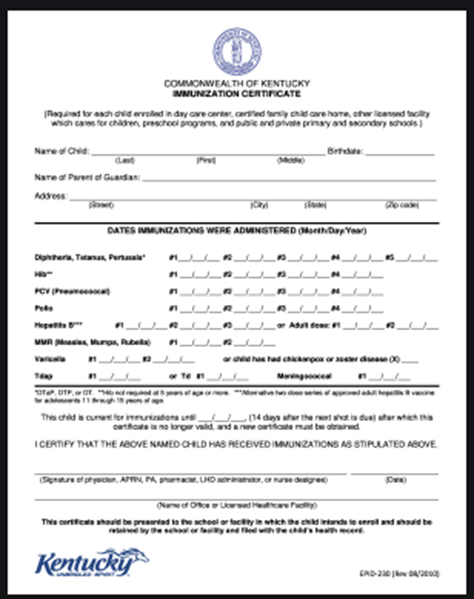
Required Health Documents:
Immunization certificate
Vision exam
Physical exams
Dental exams/screening
Kentucky High School Athletic Association (KHSAA) sports physical form

Slide 5
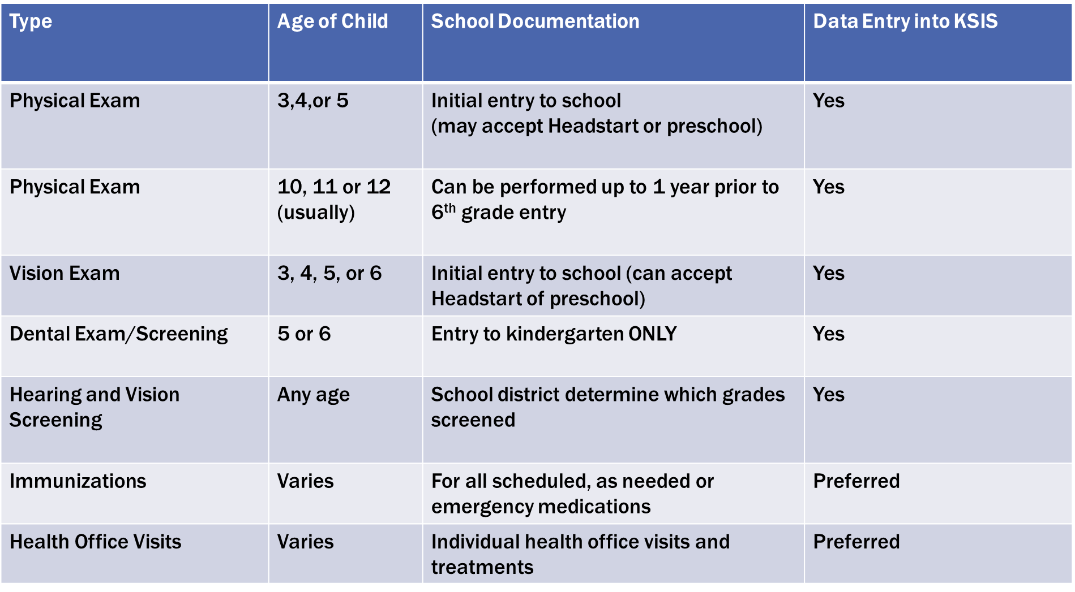
Blank
Notes:
Per 702 KAR 1:160, schools may extend the deadline for completing the physical exam by two months (up to and including October 15th)
Dental Exam/screening must be between Jan 1 and December 31 of year enrolls in Grade 00 (Child may be 4 years old at time of Dental exam or screening, but must be at least 5 years old by Dec 31 of year enrolled in Grade 00)
Both Vision and Dental Exam must be turned into school before January 1st to be considered valid

Slide 6
Keeping School Health Records:
Cumulative Health Documents
  Required school health documents
  Medication Information
  Other health services documentation
    Health office visits
    Documentation of physician or parent communication

Slide 7
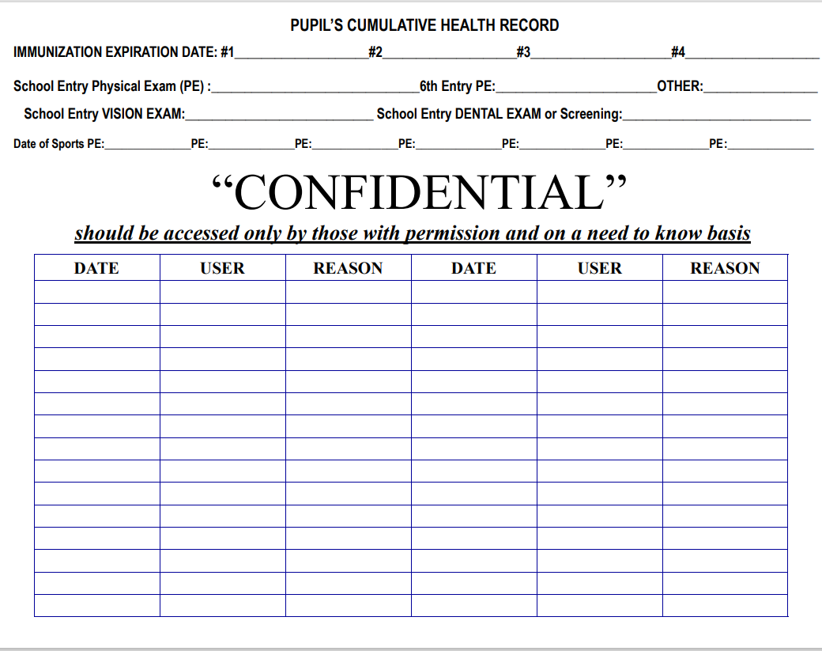
Record Retention:
Kentucky Records Retention Schedule, 2019 page 120
Electronic record in Kentucky Student Information System (KSIS) (preferred) or
Hard copy folder/chart

Slide 8
Data Entry for End of Year Reporting:
All health data must be entered into the Kentucky Student Information System (KSIS) before June 1 of each year to be included in end-of-year reports Health Data Entry for EOY Reports
All school health data will be extracted by KDE on June 1
Health data now included in Kentucky Department of Education (KDE) OPENHOUSE Data Website

Slide 9

Guidance on Health Data Entry:
Multiple guidance documents regarding the use of KSIS for school health found on KDE’s Student Health Services Infinite Campus Information webpage

Slide 10
Contact Information:
Angie McDonald, ADN, RN, NASSNC
KDE State School Nurse Consultant
Angela.Mcdonald@education.ky.gov
Michelle Malicote, BSN, RN, NASSNC
KDPH School Health Branch Manager
Michelle.Malicote@ky.gov

Slide 11


