Slide 1
School Health Screening Programs
Angie McDonald, ADN, RN, NASSNC
KDE State School Nurse Consultant
Michelle Malicote, BSN, RN, NASSNC
KDPH School Health Branch Manager
2022

Slide 2
Objectives:
Understands initial school entry requirements
Identifies school screening programs
Understands etiology of hearing loss
Can implement hearing screening program including referral
Understands vision screening process including referral
Can identify conditions that may cause decrease in visual acuity
Identifies what BMI is and how to accurately calculate in students

Slide 3
Initial Entry Requirements:
1. A valid Kentucky Immunization Certificate
2. A physical examination done within one year prior to entering school
3. Eye examination performed by ophthalmologist or optometrist by Jan. 1 of the year of enrollment
4. Proof of a dental screening or examination by a dentist, dental hygienist, physician, registered nurse, advanced registered nurse practitioner or physician assistant. This evidence shall be presented to the school no later than Jan. 1 of the first year that a 5 or 6-year-old is enrolled in public school

Slide 4
Basic School Health Requirements:
702 KAR 1:160 School Health Services:
A local board of education may extend the deadline by which to obtain a preventive student health care examination, not to exceed two months, (up to and including Oct. 15).

Slide 5
Basic School Health Requirements Part 2:
Type | Age of child | School Documentation | Data Entry into IC?
Physical exam* | 3,4 or 5 | Initial entry to school (may accept Headstart or Preschool if they are in district) | Yes
Physical exam** | 10, 11 or 12 (usually) | Performed up to one year prior to 6th-grade entry | Yes
Vision exam | 3,4,5 or 6 | Initial entry to school (can accept Headstart or Preschool) | Yes
Dental exam/screening | 5 or 6** | Entry to grade 00 - ONLY | Yes
Hearing and vision screening | Any age | School district determine which grades screened | Yes
Immunizations | Varies | Immunization certificate for Grades 00 and 6th,7th, 11th | Yes
Medication administration | Varies | Medication administration for scheduled, PRN and ER | Preferred
Health office visits | Varies | Individual health office visits and treatments | Preferred

Slide 6
Screening Programs:
702 KAR 1:160 Section 2 (10) (a) (b).
The Board of Education shall adopt a program of continuous health supervision for all enrollees. Supervision shall include scheduled, appropriate screening tests for vision and hearing.​ The specific scheduling (grades) for vision and hearing is at the local district’s discretion.

Slide 7
Hearing:

Slide 8
Hearing Screen:
Identifies children with hearing impairment​
Aids in planning for medical referral, treatment and educational programs​
Five to 10 percent of school age children do not pass audiometric tests​
Approximately 2% of children will show permanent hearing loss and require special educational services

Slide 9
Pure tone screening:
1. Perform biological check on pure tone screening equipment prior to daily screening.
2. Screen populations age 3 (chronologically and developmentally) and older using pure tone screening.
3. Perform a pure tone sweep at 1000, 2000 and 4000 Hz at 20 dB HL.
4. Present a tone more than once but no more than four times if a child fails to respond.
5. Only screen in an acoustically appropriate screening environment.
6. Lack of response at any frequency in either ear constitutes a failure.
7. Rescreen immediately.
8. Screen for high frequency hearing loss where efforts to provide education on hearing loss
prevention exist.
9. Suggested minimum grades to be screened: preschool, kindergarten and grades 1, 3, 5 and either 7 or 9.

Slide 10
Hearing Loss:
Interferes with normal speech and language development​
Development of abnormal social growth and behavior​
Interference with education human potential​
Isolation in a hearing world

Slide 11
Hearing Loss Continued:
Mild loss – 15-30db, difficulty hearing faint or distant speech​
Moderate hearing loss - 30-50db, difficulty hearing distant speech​
Moderate - Severe loss – 50-70db difficulty hearing conversations unless loud​
Severe/loss - 70-90db, may hear loud voice close to ear

Slide 12
Types of hearing loss:
Minimal Sensorineural Hearing Loss: The most common form of permanent hearing loss. It is defined as a hearing loss of at least 30 decibles within 3 days. SNHL results from damage to the hair cells in the inner ear or to the nerve pathways between the inner ear and the brain.
Unilateral Hearing Loss: Approximately one out of every 1,000 children is born with UHL, and nearly 3% of school-age children have UHL.
High Frequency Hearing Loss: One of the most common types of hearing loss is known as high-frequency hearing loss. Can be caused by exposure to loud noises.
Hearing Loss due to Otitis Media with Effusion:

Slide 13
High Frequency Hearing Loss:
One of the most common types of hearing loss is known as high-frequency hearing loss.
Can be caused by exposure to loud noises.

Slide 14
Otitis media with effusion (OME):
OME is characterized by a non-purulent effusion of the middle ear that may be either mucoid or serous.
Symptoms usually involve hearing loss or aural fullness but typically do not involve pain or fever.
In children, hearing loss is generally mild and is often detected only with an audiogram.

Slide 15
Hearing Screening Testing Procedure:
Hearing is assessed in children 3 years and older​
Room should be as quiet as possible​
Tester may test him/herself to assure noise level in the room will not interfere with testing​
Room should be large enough to accommodate a table, audiometer and chairs ​
Student chair should be positioned so the student cannot see the audiometer
Testing frequencies: 1000, 2000, 4000 Hz @ 20 dB HL

Slide 16
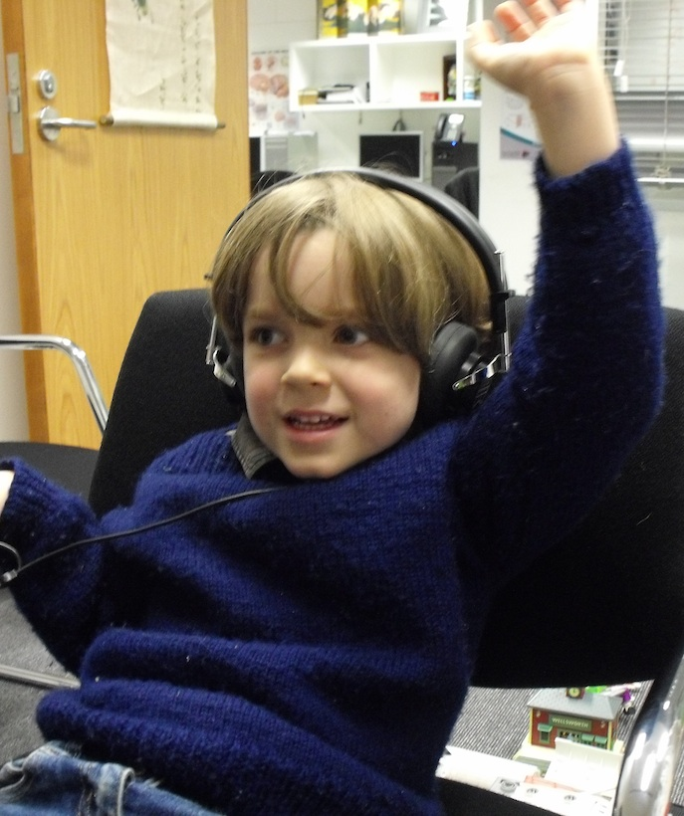
Hearing Screening Testing Procedure (Cont.):
Follow manufactures instructions ​
Give verbal instructions for student to raise a hand when a tone is heard​
For children 6 and below may hand or drop a block when tone is heard​
Without wearing the headset, demonstrate by turning the tone to 90dB, raise your hand when you hear the tone

Slide 17
Audiometer:
Check the audiometer and headphones for proper functioning​
Calibration and any needed repairs to be completed annually​
If unit has batteries, remove when unit is stored​
Turn off unit when not in use

Slide 18
Pass/Fail Criteria:
Screening test is failed if the student fails to hear any one tone, in either ear​.
Rescreen in two weeks; if second screening is failed, student should be referred for proper follow-up​.
Document results on the appropriate forms.

Slide 19
Vision Screening
KRS 156.160
A vision examination by an optometrist or ophthalmologist that shall be required by the Kentucky Board of Education (KBE). The administrative regulations shall require evidence that a vision examination that meets the criteria prescribed by the KBE has been performed. This evidence shall be submitted to the school no later than Jan. 1 of the first year that a 3, 4, 5 or 6-year-old child is enrolled in a public school, public preschool or Head Start program.

Slide 20
Vision Screening:
Screening for distance is the single most important test of visual ability​
Children/parents are often unaware of vision problems​
Detect and prevent serious lifelong and irreversible vision problems​
Educationally significant due to relationship to learning

Slide 21
Instructions for students receiving a vision screen:
If you wear glasses, bring them.
If you don’t have them, tell me.
Quietly wait your turn.
When you get back into your classroom, send the next person right away.

Slide 22
Common Eye Problems: Myopia (nearsightedness):
Inability to see distant objects​
Thought to be hereditary​
The most common refractive error affecting 1% of 6-year-olds
In infancy, may be more severe than in school-age children​
Tends to worsen with age

Slide 23
Strabismus:
Results from eye muscles not working together​
Difficult to detect - may be constant, come and go, or alternate from one eye to the other​
One may remain straight and the other eye turn slightly inward (may score 20/20 on eye chart)​
Affects 30% of children​
If uncorrected, strabismus can result in amblyopia (loss of vision)

Slide 24
Amblyopia (Lazy Eye):
Reduced visual acuity in an eye, not adequately used during early childhood (often caused by strabismus)​
Is NOT OBSERVABLE, must screen both eyes to find this condition​
Affects 2-5% of general population​
If untreated by age 6, permanent vision loss is likely​
Treatment involves patching the good eye to re-train the brain to accept images from the affected eye

Slide 25
Other Common Vision Anomalies:
Astigmatism - light cannot focus clearly on the retina, often causing blurred vision​
Hyperopia - farsightedness, inability to focus on nearby objects
Ptosis - when the upper eyelid droops over the eye

Slide 26
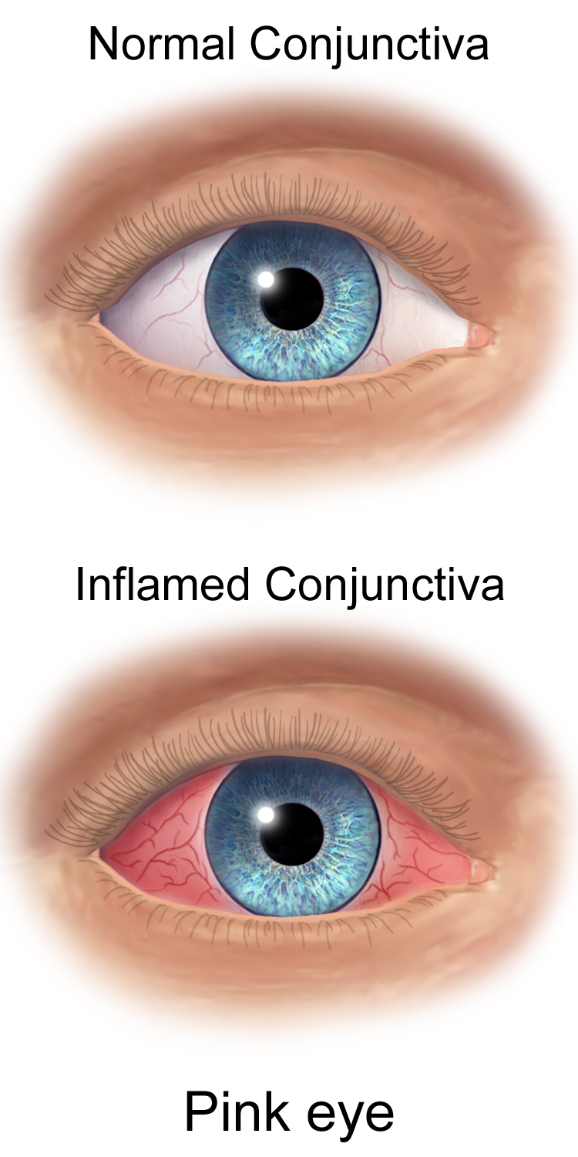
Problem Indicators:
Eye redness or discharge​
Swelling/crusting of the eyelids​
Haziness or clouding of the eye​
Eye crossing or misalignment (strabismus)​
Eyes “jiggle” (nystagmus)​
Protruding eyes (proptosis)​
Dropping eyelids (ptosis)​
Alignment of the eyes​
Non-round pupils/pupil size

Slide 27
Behavior Indicators:
Constant head tilt or face turn​
Squinting​
Rubbing eyes excessively​
Closing or covering one eye​
Holding objects close to the eyes​
Blinking excessively

Slide 28
Student Complaints:

Slide 29
Vision Assessment/Acuity:
Vision acuity is assessed in the school age by chart or vision instrument tester​
AAP recommends LEA Symbols, HOVT letter charts or Sloan letter charts​
Screen same procedure for both eyes​
Begin testing at the top of chart and progress down​
If student wears glasses, TEST with glasses​
Record last line which three of five symbols identified correctly

Slide 30
Vision Screening:
Supplies - eye chart, tape, INDIVIDUAL eye covers and vision logs​
Location - quiet and free from distractions, good lighting, light colored walls and no glare or shadows​
Attach chart to wall, with passing line at student’s eye level​
Mark 20 feet (or 10, according to chart used) of distance from chart

Slide 31
Vision Screening Continued:
Test both eyes first, then right and left​
Test with glasses (if applicable)​
When testing one eye, occlude the other eye​
Begun at the top of chart, if line read correctly, proceed to the next line​
When one line is missed, move back up until most letters/symbols are correctly identified
Move according to the speed of the student​
It may be necessary to use a pointer to indicate the letter​
To pass, more than half of the symbols/letters on a line (three out of five must be identified​)
Observe for eye problems (head tilt or peeking)​
Record visual acuity (the last successful line read, both eyes, right and left eye)

Slide 32
Documentation:
Record the results as a fraction – i.e., 20/30, 20/40​
The numerator (top) represents the distance from the chart to the student’s eye​
The denominator (bottom) represents the last/smallest line read​
A reading of 20/50:​
20 = testing distance from student eyes to chart​
50 = smallest line student could clearly identify​
The larger the denominator, worse the eyesight​
Record screening results on flow sheets, cumulative/individual health records and other appropriate forms

Slide 33
Referral Criteria – Ages 3-5:
Refer if visual acuity is poorer that 20/40 in both or either eye​
Refer if there is a two-line difference between the eyes even in passing range (examples 20/25, 20/40)​
Refer if possible signs of visual disturbance are present

Slide 34
Referral Criteria for Ages 6-Adult:
Refer if visual acuity is poorer than 20/30 in both or either eyes​
Refer if there is two-line difference between the eyes, even in the passing range (examples 20/20, 20/30)​
Refer if possible signs of visual disturbance are present​
Avoid using the word fail in front of the student or parent

Slide 35
Body Mass Index – BMI:
Screening for BMI is optional
Produced by CDC as a screening tool to determine obesity​
BMI can be plotted for children after age 2
BMI is the ratio of weight to height squared​
Height and weight screening is used to identify children who may be at risk for abnormal growth patterns for age, weight and/or heredity

Slide 36
Weight Measurement:
Balance beam or digital scales (all scales should be zero balanced and calibrated annually) ​
Weigh without outer clothing and shoes​
Place student in the middle of scale​
Weight is recorded to the nearest 0.1 Kg or ¼ pound​
Read and record measurements​
Do not use bathroom or spring balance scales​
Always provide privacy

Slide 37
BMI:
Is on the KDE school physical form but is not a requirement​
If BMI is listed on the physical form, this should be entered into Infinite Campus​
Web sites:​
CDC Body Mass Index (BMI)​
BMI Percentile Calculator for Child and Teen

Slide 38
Documentation:
Kentucky Student Information System (KSIS), Infinite Campus (IC)
All screening results must be entered and reported at end of each school year​
Data Entry Information in KSIS Health Data Entry Document in Student Health Services Health Coordinator’s Briefcase (Webpage)

Slide 39
Reference:
American Academy of Audiology Childhood Hearing Screening Guidelines

Slide 40
Contact Information:
​Angie McDonald, ADN, RN, NASSNC​
KDE State School Nurse Consultant​
angela.mcdonald@education.ky.gov​
​
Michelle Malicote, BSN, RN, NASSNC​
KDPH School Health Branch Manager
michelle.malicote@ky.gov

