Slide 1
Researching Vaccine Records
MADE EASY:
A Guide for the KY School Nurse
Angie McDonald, ADN, RN, NASSNC
KDE State School Nurse Consultant
Michelle Malicote, BSN, RN, NASSNC
KDPH School Health Branch Manager
2022

Slide 2
Objectives
Participants will:
Understand the relevant Kentucky Revised Statutes (KRS) or Kentucky Administrative Regulations regarding immunizations
Understand how to utilize the Kentucky Immunization Registry (KYIR)
Understand how to run immunization reports from Infinite Campus (IC)
Understand the process for review, prioritization of follow-up, outreach and ongoing documentation of immunizations
How to use immunization reports available in IC
Understand immunization documents found in student’s cumulative health record

Slide 3
Kentucky Revised Statutes and Regulations
KRS 158.035 - Certificate of Immunization
KRS 214:034 - Immunization of Children
902 KAR 2:060 - Immunization Schedules for Attending
902 KAR 2:055 - Immunization and Data Exchange

Slide 4
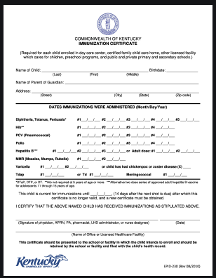
KRS 158.035
Certificate of Immunization
No child shall be eligible to enroll as a student in any public or private elementary or secondary school without first presenting a certificate.

Slide 5
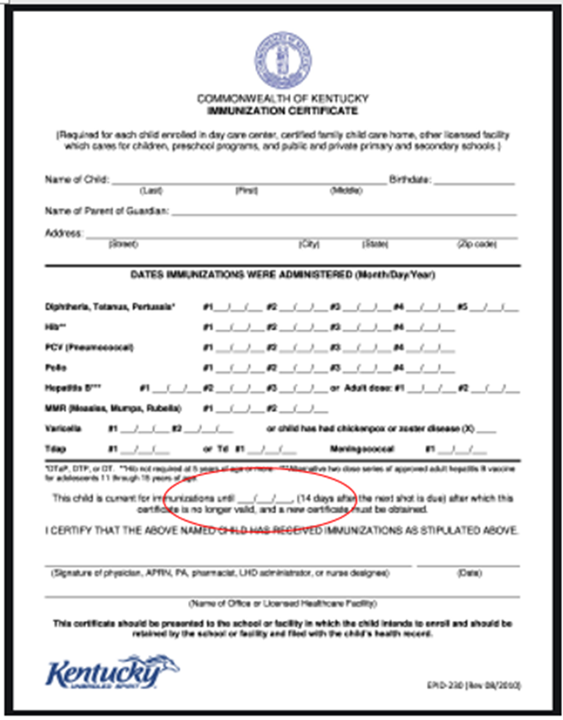
KRS 214:034
Immunization Of Children
All public or private primary or secondary schools and preschool programs:
Shall require a current immunization certificate for any child enrolled as a regular attendee, as provided by administrative regulation of the Cabinet for Health and Family Services, promulgated under KRS Chapter 13A, to be on file within two weeks of the child's attendance.

Slide 6
902 KAR 2:060
Immunization Schedules for Attending
This administrative regulation establishes the mandatory immunization schedule for attendance at
  child day care centers
  certified family childcare homes
  other licensed facilities which care for children
  preschool programs
  public and private primary and secondary schools
A completed immunization certificate shall:
  Be on file for a child enrolled in a public or private primary or secondary school or preschool program

Slide 7
902 KAR 2:055
Immunization And Data Exchange
This administrative regulation establishes requirements for reporting immunization results in schools by the public health immunization reporting entity, which includes public or private elementary and secondary schools and permits recording and exchange of immunization data.
Immunization Data Exchange:
  A public health immunization reporting entity (aka: Health Care Provider) may record and exchange immunization data if the person requesting the data (aka: School Nurse) provides health related or educational services on behalf of the patient or has a public health interest in compliance with the Health Insurance Portability and Accountability Act (HIPAA), Pub. L. 104-191

Slide 8
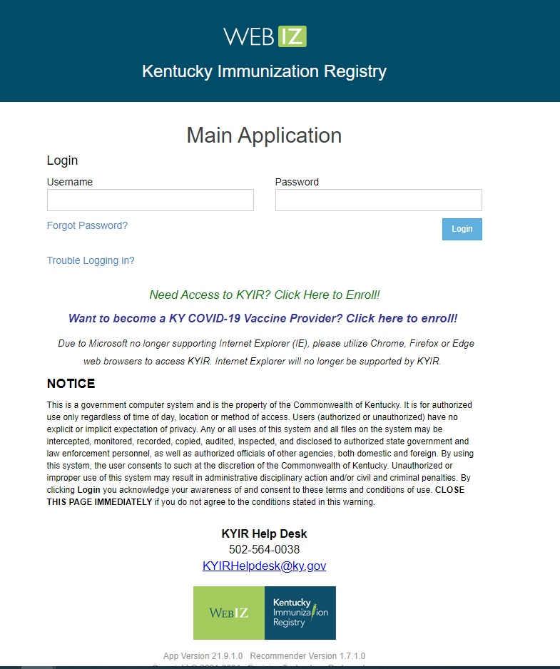
Kentucky Immunization Registry (KYIR)
What is KYIR?
The Kentucky Immunization Registry (KYIR) is a Web-Based, statewide system that collects and reports immunization data across a variety of metrics.
The system protects data quality and combines individual immunization information into a single, accurate record.
KYIR can receive and send data securely to ensure privacy, confidentiality and accuracy.

Slide 9
Kentucky Immunization Registry (KYIR) (Cont.)
Schools who enroll will initially only be given READ access to KYIR to be able to search and print Immunization Certificates.
Access can be modified if the school indicates they collect parent consent to update data.
Parental consent IS required to be able to edit patient demographic, immunization data or to add historical or newly administered vaccines to their students record.
Due to the high volume of enrollment forms, there is a seven to 10-day turnaround for new clinic/school enrollments to KYIR.

Slide 10
Web link for the KYIR:
Immunization Registry (KYIR) - Cabinet for Health and Family Services

Slide 11
KYIR Resources:
Printing Certificates and Immunization Records and COVID-19 Records
KYIR LOG IN PAGE
Authorization for Release of Patient Immunization Record

Slide 12
NEW KYIR COVID record ready for PRINTING
This COVID-19 Vaccination Record does NOT replace official card, just official vaccine administration record.
KYIR is implementing a new feature that grants users the ability to access and print a patient’s Covid-19 immunization record specifically, independent of their full record. It will be available to anyone with a user account and can be accessed in the same location as the Official Immunization Record. Please see the attached, updated user guide to learn more about this.

Slide 13
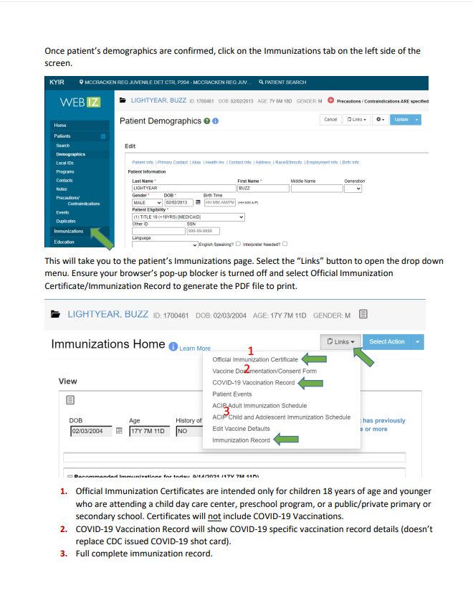
Slide 13

Slide 14
KYIR School Enrollment Forms
Schools that want access to the Kentucky Immunization Registry should complete the enrollment forms below and fax them to the Kentucky Immunization Branch: Fax: (502) 564-4760
Immunization Registry (KYIR)
2021 School Site Enrollment Form(complete one per school location)
2021 School Participation Agreement(complete one per school district for public schools/one per facility for private schools)
KYIR User Account Confidentially Agreement(complete one per log in user)

Slide 15
KYIR Training Materials
Training materials, including videos and quick guides, are in the KYIR Training and Information Resources
Updated videos are available that show how to log into KYIR and how to print the new certificate from KYIR.
  Tips on Logging in to the KYIR "YOUTUBE VIDEO"
  How to Print a Certificate from the KYIR

Slide 16
KYIR Contact Information
Available:
Monday - Thursday 8 a.m. - 4 p.m. Eastern time
Friday 8 a.m. - noon. Eastern time
Phone: (502) 564-0038
Fax: (502) 564-4760
Email: KYIRHelpdesk@ky.gov

Slide 17
Immunization Report - Infinite Campus (IC)
To run an IC immunization report:
HEALTH Index > Reports > Immunization certificate
Check the box for NO CERTIFICATE, Standard, Provisional
Medical, Religious (I run NO CERTIFICATE on a separate report and work this one first)
Generate report
Print report

Slide 18
Immunization Report - Checking DATES
Do a VISUAL SCAN and check to be sure all dates look correct
NO CERTIFICATE will be blank all the way across the report
PROVISIONAL should be expired or expiring soon (within 1 year)
STANDARD should be expiring either 4th, 11th, or 16th birthday
IC was developed based upon guidelines established by the American Academy of Pediatrics
  Kentucky has more restrictive guidelines, so some immunizations may be required on a different schedule. Kentucky schools must follow Kentucky laws.

Slide 19
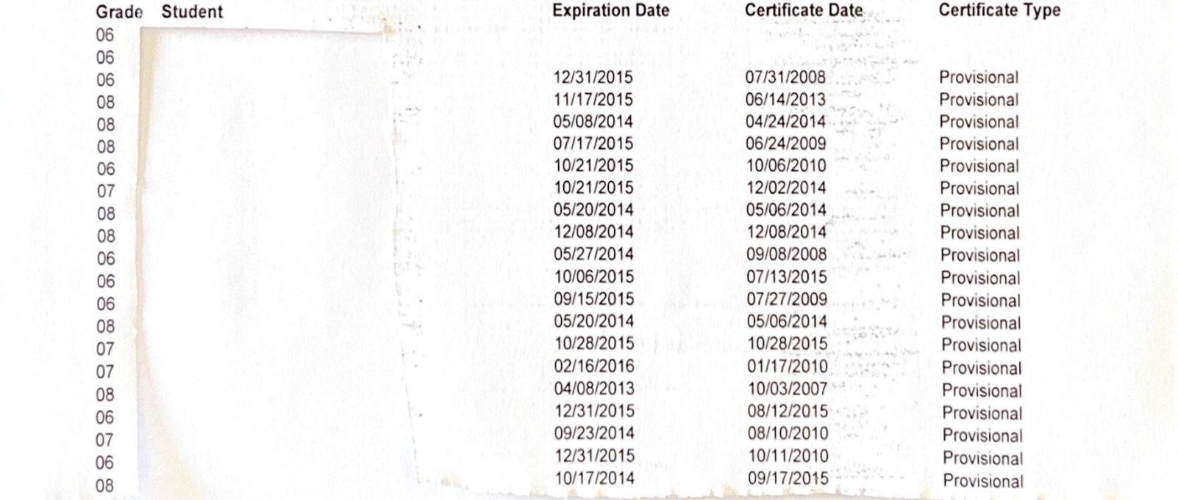

Immunization Certificate Report (IC)
Student Names Listed Here
Notes:
Ovals represent missing information

Slide 20
No Certificate
Check the KYIR - If you find the record, note the vendor PIN so you can call the provider to request any missing Physical Exams (PE) needed
Check the cumulative health folder for certificate, look through the whole folder; can be stapled to other documents
Check the cumulative health folder for Physical Exam and record date as well as where exam was administered. If PE available, but immunization certificate is missing:
  Call PE provider to request immunization certificate
  Script: “I am Nurse Malicote, I see CHILD came to your office on DATE and received his/her PE. I am sure they also received their immunization update, but the record never made it here to the school.”
    Ask them to give you the dates over the phone, if possible. Provide them with an email address or fax number to send the report to the school.

Slide 21
Provisional Status:
Child is not-up-to-date at this time.
Check the KYIR for missing immunization dates and print a new certificate if one is available
Check the cumulative health record, double check to be sure is not stapled to other documents
Add any missing dates for vaccines administration to IC
If certificate is now compliant, change certificate expiration date in IC to two weeks after 11th birthday or on 17th birthday

Slide 22
IC Contact Log - Documentation
Contact may be:
KYIR (if applicable)
Specific provider office
Blank if recording health folder checked
What to document if no new records found:
Health Folder/Cumulative Record checked
Contacted Provider of Record to request document
  Document contact at the provider office
Deficiency Letter sent to parent
  Document route letter was sent – mail or via student
  If records were found and IC updated, no documentation is required in the IC contact log
Notes:
These contacts should be entered as health office visits to give the school nurse credit for the time they worked on this student matter. This will show in the day’s health office calendar.

Slide 23
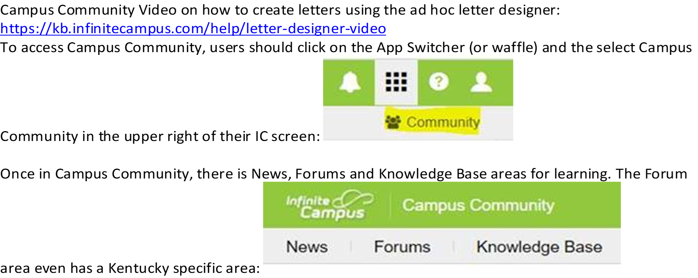
Campus Community Provides Written Instruction and Videos on all IC Functionality

Slide 24
Search Letter Builder for Non-Compliant Immunization Status and it will Discuss Creating Ad Hocs and Letters
Every district user has access to Campus Community with their Infinite Campus access. Campus Community includes forums, tutorials, videos and simulations that explain all aspects of IC. It includes guidance on how to create letters and ad hocs that can be used with those letters.
Because each district creates their own processes for collecting immunizations and contacting guardians, KDE does not create a standardized letter in IC that must be used.
Contact District Support (Samantha Engstrom) samantha.engstrom@education.ky.gov or their district KSIS contact who can put in a ticket with IC requesting help

Slide 25
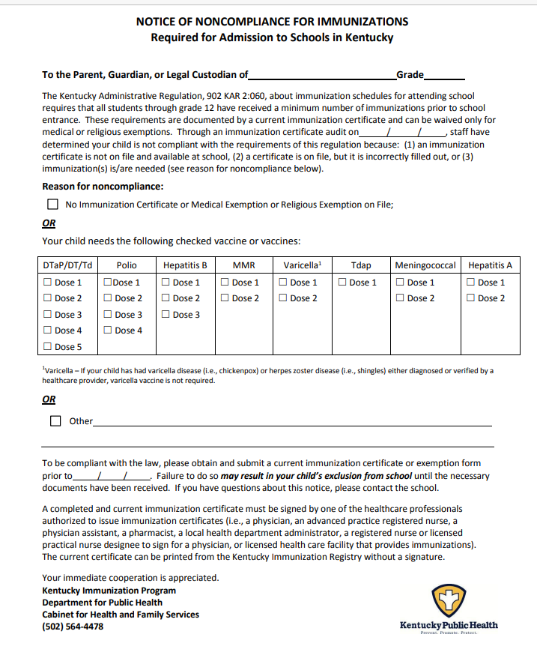
Deficiency letter
Index - General - on left hand column
Click ADHOC letter if applicable, developed for this specific notice, on overhead tabs
Click immunization letter – print - change to custom because may print extra second page
Fill out with specific requirements missing
Chart in KSIS that deficiency letter sent

Slide 26
Contact Information:
Angie McDonald ADN, RN, NASSNC
KDE State School Nurse Consultant
Angela.Mcdonald@education.ky.gov
Michelle Malicote BSN, RN, NASSNC
KDPH School Health Branch Manager
Michelle.Malicote@ky.gov

Slide 27


