Slide 1
Providing Health Services on Out of State Field Trips
Angie McDonald ADN, RN, NASSNC
KDE State School Nurse Consultant
Michelle Malicote BSN, RN, NASSNC
KDPH School Health Branch Manager
2022

Slide 2
Objectives:
To understand the federal laws that protect students with disabilities
To learn about out-of-state regulation of nursing practice
To learn about how the nurse licensure compact relates to nursing practice
Can plan and prepare for out-of-state field trips for all students

Slide 3
The Issue:
The numbers of children attending school with special healthcare needs and complex medical conditions continue to increase
Students who require health services may not be excluded or denied access to activities
Not all school children have access to a registered professional school nurse
Field trips may occur locally, within a state, out-of-state or even out-of- country
Federal laws mandate schools to provide ALL students equal opportunity to participate in academic, nonacademic and extracurricular activities (including school-sponsored field trips)
Notes:
Healthcare needs include - 86% prescribed med’s, 52% specialty medical care, 33% vision care, 25% mental health services, 23% specialty therapies & 11% use of medical equipment (US Dept. of Health & Human Services, 2008)

Slide 4
Assurance:
Schools must assure that medications administered to students are done so in a way that assures safety and compliance with the school policies and procedures and each state’s law
The nurse is responsible for knowing the scope of practice for nurses in the state they will be traveling into plus their home state

Slide 5
What are the Federal Laws that protect students with disabilities?
Individuals with Disabilities Education Act (IDEA) IDEA – 34 CFR 300.34 (13)
Section 504, Rehabilitation Act of 1973 | U.S. Department of Labor (dol.gov)
Title II Americans with Disabilities Act 1970 (ADA)
Notes:
IDEA_
1975 landmark legislation assuring all students (including those with disabilities) receive a free and appropriate public education and the related services and support the students need to achieve.
What Is Section 504?
Section 504 of the Rehabilitation Act of 1973 is a civil rights law that prohibits discrimination on the basis of disability in programs and activities, public or private, that receive federal financial assistance. This law conforms to the definition of disability under the Americans with Disabilities Act Amendments Act (ADAAA). Section 504 does not provide funding for special education or related services, but it does permit the federal government to take funding away from programs that do not comply with the law.
KRS 156.502 defines what school health services are, who may train and delegate school health services, and describes process for liability protection
KRS 314.021 gives the Kentucky Board of Nursing the authority to regulate nursing in order to safeguard the health and safety of the Kentucky public
KRS 158.838 each public and private school shall have at least one school employee who has met the requirements of KRS 156.502 on duty during the entire school day to administer or assist with the self-administration of glucagon, insulin and seizure rescue medication or medication prescribed to treat seizure disorder symptoms approved by the FDA. Also, parents/guardians of students with seizures are required to collaborate with school personnel to develop of seizure action plan.

Slide 6
Discrimination on the Basis of Disability:
As they apply to entities under the jurisdiction of the Office for Civil Rights (OCR), OCR enforces:
Section 504 of the Rehabilitation Act of 1973, including programs and activities that are conducted by HHS or receiving Federal financial assistance from HHS
Section 508 of the Rehabilitation Act of 1973, covering access to electronic and information technology provided by HHS
Title II of the Americans with Disabilities Act (ADA) of 1990, covering all health care and social services programs and activities of public entities
Section 1557 of the Patient Protection and Affordable Care Act (ACA), ensuring that an individual is not excluded from participating in, denied benefits because of, or subjected to discrimination as prohibited under Section 504 of the Rehabilitation Act of 1973 (disability), under any health program or activity, any part of which is receiving federal financial assistance, or under any program or activity that is administered by an Executive Agency or any entity established under Title I

Slide 7
School Nursing Practice:
Scope of practice varies from state to state
Be especially aware of the scope of licensed practical nursing practice. Varies greatly across the U.S.

Slide 8
Out of State Regulation of Nursing Practice:
Nursing Scope of Practice “Nurse Practice Act” regulated by individual State Boards of Nursing
Standards of Practice are developed by National Nursing Organizations, i.e., National Association of School Nurses (NASN) and American Nurses Association (ANA)

Slide 9
Delegation:
KBN Guidance Related to Delegation
Delegation of Nursing Tasks is discussed in 201 KAR 20:400;
Advisory Opinion Statement (AOS) #15 Supervision and Delegation of Nursing Tasks to Unlicensed Personnel, found in the Document Library; and
The Decision Tree for Delegation to UAP (Unlicensed Assistive Personnel), found in the Document Library.

Slide 10
NASN Position Paper on Delegation:
NASN Nursing Delegation in the School Setting
Nurses are accountable to:
state laws, rules and regulations
employer/agency regulations
standards of professional school nursing
practice, including those pertaining to
delegation (NASN, 2019)

Slide 11
Nurse Licensure Compact States (NLC):
The Nurse Licensure Compact is a modern licensure solution for the 21st century. As leaders in public protection, State Boards of Nursing developed and adopted the Nurse Licensure Compact in 2015. The Nurse Licensure Compact allows for nurses to have one multistate license with the ability to practice in all compact states
Allows nurses from NLC states to practice in another NLC state without a second license
Like a driver’s license

Slide 12
Nurse Licensure Compact:
Currently 34 NLC states
Applies to RNs and in some states, LPNs
Does not apply to unlicensed personnel or APRNs
Enacted in 38 Jurisdictions
The National Council of State Boards of Nursing has a current listing of each state’s board of nursing contact information: Click Here

Slide 13
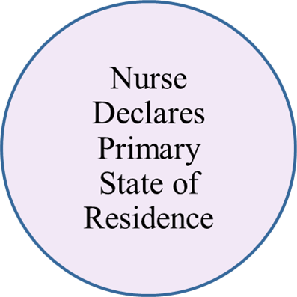
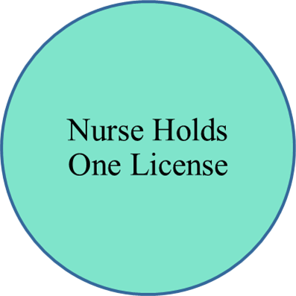
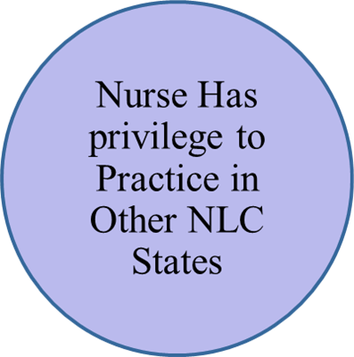
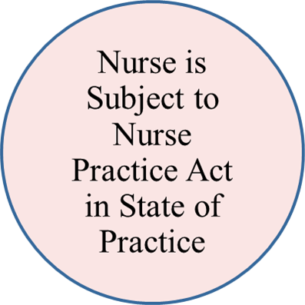
Mutual Recognition:
Notes:
The MSL follows the mutual recognition model of licensure. This is the same model as the driver’s license. The driver’s license is also a compact. The multistate nurse license is like your driver's license. It is issued by your state of residence but provides a privilege to practice in other member states. Similarly, You can drive from state to state with one license. The compact license allows nurses to work in other compact states without having to get another license. While driving in other states, a driver is required to be aware of and follow the driving laws in that state. The nurse is required to follow the NPA in the state of practice

Slide 14
Member States:
Nurse Licensure Compact | NLC (nursecompact.com) 2021

Slide 15
NLC States

Slide 16
NCSBN’s National Council of State Boards of Nursing Position:
NASN’s Executive Director, Donna Mazyck, met with NCSBN (July 2012) and requested a clarification on medication administration for students on school trips that occur in states outside the student’ home state. NCSBN’s response was:
“…the school nurse will need to contact the boards of nursing in the states where the field trips occur in order to determine the practice allowances for the licensed nurse related to delegation of nursing functions.”
The National Council of State Boards of Nursing has a current listing of each state’s board of nursing contact information

Slide 17
Applicable Statutory/Administrative Provisions:
(a) The practice of any currently licensed nurse of another state practicing in this state during an emergency occurring in this state or any other state declared by the President of the United States or the Governor of Kentucky. The duration and conditions of the practice shall be determined by the board;”
KRS 314.101(1)(a, e) 314.101 Excepted activities and practices -- Work permits and the Good Samaritan Act of 2007, KRS 39A.350-366, authorize APRNs licensed to practice in other states to provide medical care to patients in Kentucky during the current state of emergency.”
Executive Order 2020-215 STATE OF EMERGENCY: March 6 2020
3.31.20 Order Executive Order: Declaring a State of Emergency March 31 2020

Slide 18
Out of State Field Trips:
Nurse is responsible for knowing the scope of practice for nurses in the state they will be traveling into plus their home state
Areas of particular importance:
Delegation
Medication administration
Emergency care

Slide 19
Plan:
Student Considerations:
Use of the Nursing Assessment
Accommodations as specified in the IHP, IEP or 504 Plan
Emergency Action Plans
Determine needed health services, frequency of service need, the level of care required
Legal and safe delegation of nursing services if allowed in state to be visited
Availability of trained staff to provide healthcare services

Slide 20
Plan Ahead:
Documentation and confidentiality of student information
Reasonable accommodations for students with special health care needs
Options for cancellation or alteration of the trip if all students cannot be reasonably accommodated
Invite parents to accompany the student on the field trip. Parents cannot be required to attend.

Slide 21
Health Services Considerations:
Is the state you are visiting or traveling through a member of the Nurse Licensure Compact?
Do you know the scope of practice in those states?
Do you know if delegation to unlicensed personnel is permitted in the state you are visiting or traveling through
If delegation is allowed, are there limitations on delegation?
If delegation allowed, is training and competency verification required for unlicensed personnel?
Are there restrictions regarding proximity of supervising RN?

Slide 22
Summary:
School sponsored field trips enhance a student’s educational experience
Review of state laws, regulations and nursing scope of practice for school health services is critical when planning and problem solving for students requiring health services on out of state field trips.

Slide 23
References:
https://www.hhs.gov/civil-rights/for-individuals/disability/index.html
https://nursecompact.com/index.htm
https://www.ncsbn.org/State_COVID-19_Response.pdf

Slide 24
Contact Information:
Angie McDonald ADN, RN, NASSNC
KDE State School Nurse Consultant
Angela.Mcdonald@education.ky.gov
Michelle Malicote BSN, RN, NASSNC
KDPH School Health Branch Manager
Michelle.Malicote@ky.gov

