Slide 1
Virtual & Performance Based Course Setup
Josh Whitlow, Resource Management Analyst III
Office of Finance and Operations
Division of District Support

Slide 2
Virtual or Performance Based
Kentucky Law
702 KAR 7:125, Section 1 (4) (c); 704 KAR 3:305 Section (4) (3.) states that a virtual course must be off campus.

Slide 3
Virtual Performance Facts
Infinite Campus should reflect as closely as possible what actually happened in the school.
Students can not be checked out in Infinite Campus during the time they are in a non-attendance class
Virtual or performance based attendance does not count on the Growth Factor to show growth
Seat time classes must contain a Carnegie unit of time (120 hours)
Virtual or performance-based classes can be set up to earn a Carnegie unit of attendance even if the course is completed in less time

Slide 4
Virtual or Performance Based
Gatton Academy and Craft Academy
Dual credit college classes
Online classes
Credit recovery
Classes where credit is given upon completion of a predefined criteria
Innovative scheduling
Notes:
All of these types of classes can be either Virtual or Performance Based, or a district option.

Slide 5
Do these HAVE to be V/PB?
Gatton Academy and Craft Academy
Yes, required to be performance based
Gatton Academy and Craft Academy should always be set up as performance based
There is no attendance taken for these classes
They will earn all of their attendance when they pass the class
Other college classes can not be set up for all day

Slide 6
Do these HAVE to be V/PB?
Dual credit college classes
District option
Dual Credit College Classes that are off campus should be set up as Performance Based
Dual Credit College Classes can be on school grounds and meet than less than 120 hours should be set up as Performance Based
A Dual Credit Base holder course can be set up to take attendance if students are on campus every day
Notes:
Dual Credit Base holder should be 950001

Slide 7
Do these HAVE to be V/PB?
Virtual Classes
Can only be Virtual if the class is completely off campus
Students must not be in the school for a Virtual Class
On-line classes taken on campus should be marked for attendance
Notes:
Students may come on campus to take tests or end of course assessments. Classes are outside of the school.

Slide 8
Do these HAVE to be V/PB?
Credit Recovery
District option
If classes are less than 120 hours, they need to be Performance Based
Credit Recovery classes taken off campus should be set up as Virtual
A Credit Recovery place holder can be set up to take attendance on students in Performance Based Classes who are expected to be there every day
Notes:
Credit Recovery Place Holder should be 960001

Slide 9
Do these HAVE to be V/PB?
Classes where credit is given upon completion of a pre-defined criteria
Yes, required to be Performance Based

Slide 10
Pros and Cons of V/PB classes
Pro
100% attendance when they pass the class
Does not require 120 hours
Allows students to work at their own pace
Con
No attendance if they do not pass
Cannot check in or out students without seat time attendance
No V/PB attendance on the Growth Factor report

Slide 11
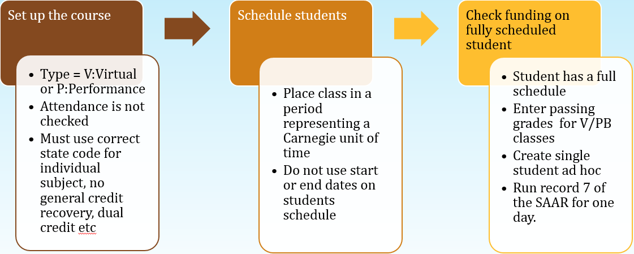
Virtual/Performance Based

Slide 12
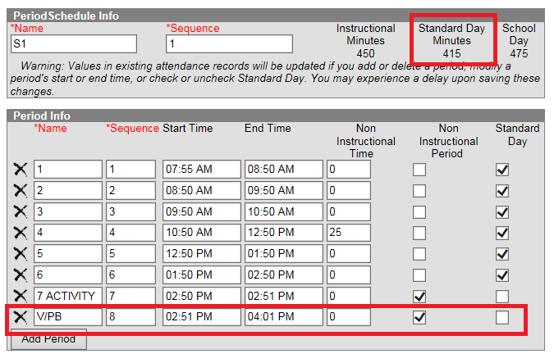
Make sure you have a period outside the standard day that is a Carnegie unit of time
Virtual/Performance Based
Notes:
Period has been added to the end of the day called V/PB.
In order to generate a Carnegie unit of time on the SAAR, the length of the period must be calculated. In the example above, there are 415 minutes in one school day. There are six classes per day.
Divide the number of periods in the standard day into the number of standard day minutes. The example above would be calculated as (415/6=69.1). Round up to 70 minutes to assure a full-day funding.
This gives a student 1/6 of the day or 70 minutes of possible attendance credit for any V/PB class they are scheduled to take.

Slide 13
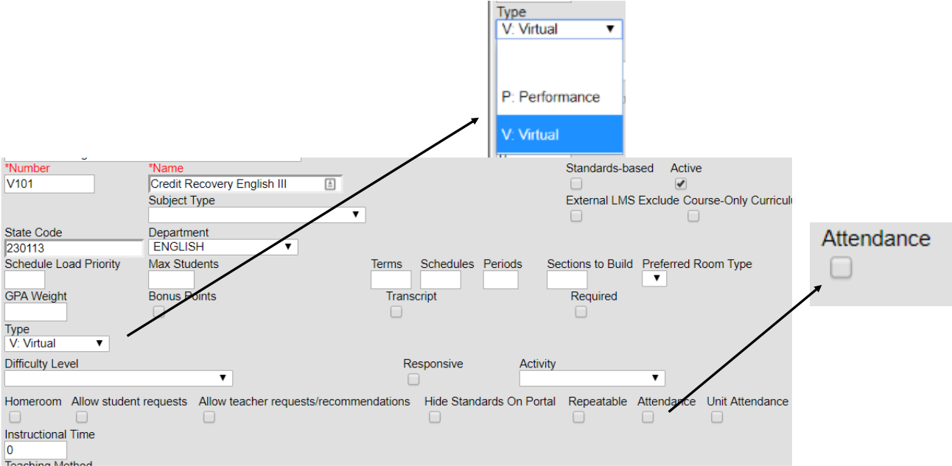
Course Setup
Virtual/Performance Based
Notes:
In order to get attendance credit based on passing the course the type must be Virtual or Performance and attendance must be unchecked

Slide 14
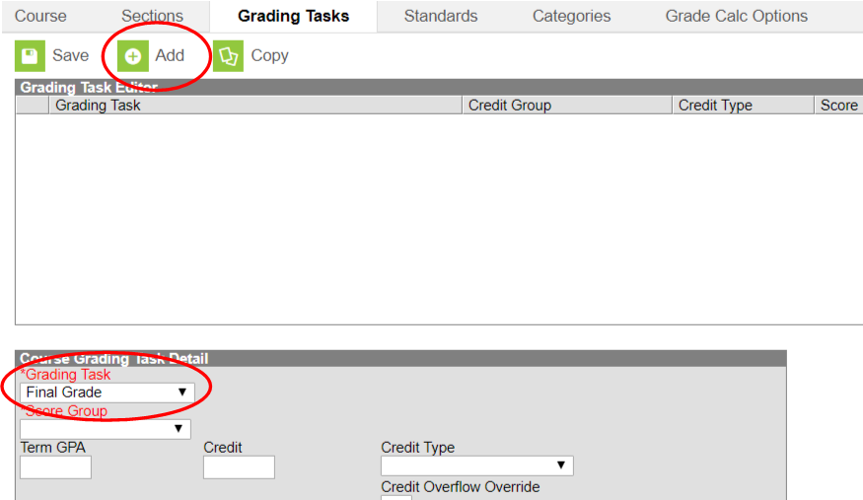
Grading Task
Virtual/Performance Based
Notes:
Note: Final Grade should only be selected for one term on the Term Mask — the final term where the grade will be awarded. If other terms are marked and have left the final term blank, no attendance will be given for the course. Attendance is pulled from the final term for attendance reporting on SAAR.

Slide 15
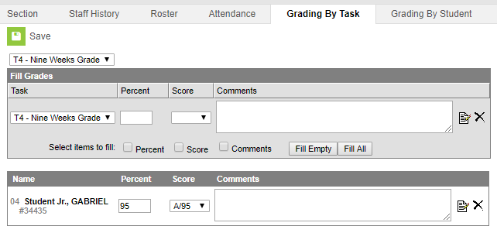
Virtual Performance Based
Select a score for each student from the dropdown score list
Notes:
Select the actual grade the student received as long as the correct grades are indicated as a passing grade on the Grading Scale. This allows you to post the actual grade directly to the transcript rather than entering the grade manually on the transcript.

Slide 16
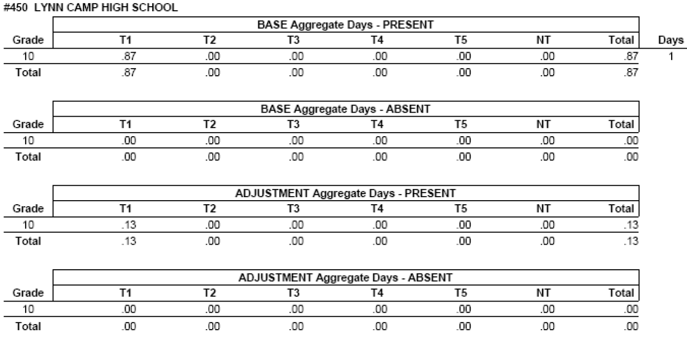
SAAR Record 7 one day combined seat time and V/PB
Virtual/Performance Based

Slide 17
Sometimes attendance need to be taken but all classes are performance based
Virtual/Performance Based
Examples
Alternative school
Expelled with services

Slide 18
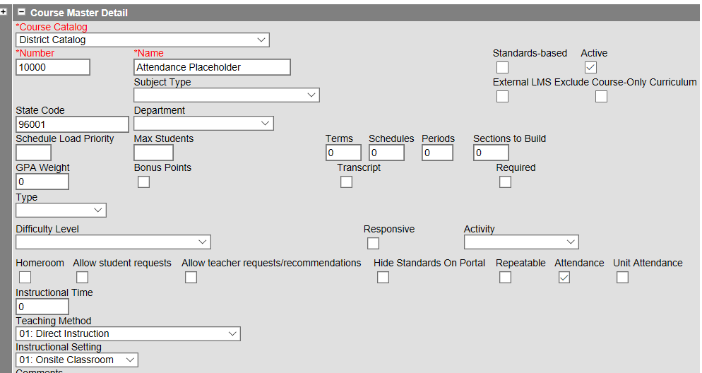
Virtual/Performance Based
Create a Attendance Placeholder Course
Notes:
When students are taking Performance Based classes as part of their daily schedule, you can put an attendance placeholder into their schedule to take attendance. The attendance will override Performance Base classes and will cap attendance so they only earn one day of attendance each day

Slide 19
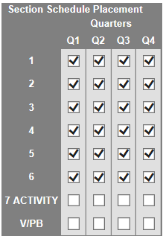
All periods where the student will attend
Virtual/Performance Based

Slide 20
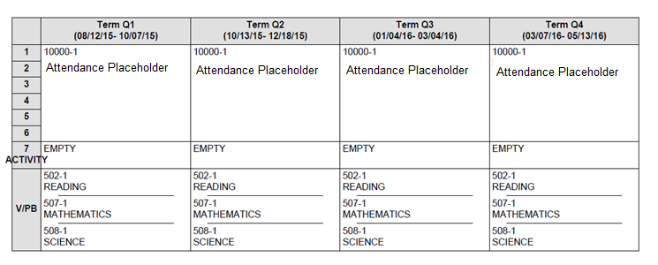
Sample alternative school student schedule
Virtual/Performance Based

Slide 21
Seat Time Attendance
Student is expected to attend full day and attendance is taken
PB classes are scheduled into the V/PB period
The SAAR report calculates the seat time attendance first and caps the V/PB attendance so a student never generates over one day of attendance per day.
NOTE: Do not schedule students into a seat time class if you are not really taking attendance.
Notes:
A student’s attendance credit can never be more than 1.0 for each day. So, the highest possible attendance credit a student can receive for virtual courses can only be equal to the difference between the standard school day and the student’s seat time in regularly scheduled classes.

Slide 22
Record 7 all year example student
Performance Based/Seat Time

Slide 23
SAAR Record V Detail
Performance Based/Seat Time

Slide 24
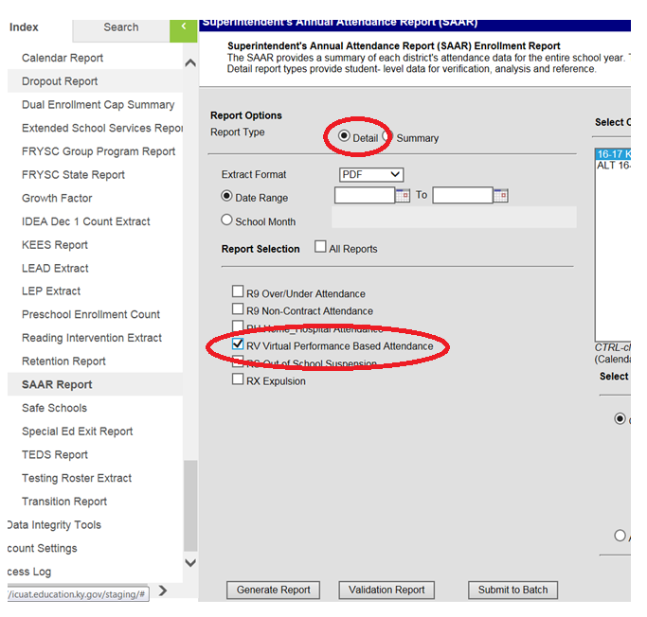
Verify Virtual/Performance Credit
Verify Data Entry SAAR Report Record V
Calendars: Select the calendars you want to verify
Report Type: Detail
Report Selection: Check only RV Virtual Performance Based Attendance
Generate the report.

Slide 25
Verify Virtual/Performance Credit
After a passing grade is entered, the amount of attendance credit per student will show on the report.
Notes:
If a student does not have a final grade or does not have a passing grade, they will show on the report with zero days.

Slide 26
Verify Virtual/Performance Credit
Student with Seat-Time and Virtual Classes
A student would also be over scheduled if they had a partial day seat-time schedule and excess V/PB classes
A student will generate AT MOST one day of Aggregate Daily Attendance (ADA) per each day they are enrolled
The Capped V/P Proficient Days is the sum of the Uncapped Performance Proficient Days plus the Uncapped V Proficient days. If the student is overscheduled, the Capped V/P will be capped to only allow one day’s attendance per day per student.
Notes:
The SAAR report can be used to verify full day’s attendance is being generated. In order to verify this you must have the following things:
A student has a full schedule. This can be either V/PB or Seat-Time and V/PB
A student has passing grades entered on the V/PB classes

Slide 27
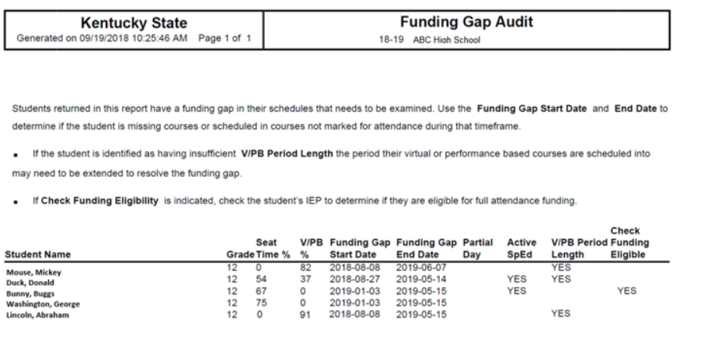
Funding Gap Audit Report
Path: KY State Reporting/Funding Gap Audit
Report is to produce a list of students that potentially have funding gaps in their schedules
The report is designed to look at a student’s schedule and display the percentage of attendance used to calculate funding for seat time attendance classes and virtual/performance-based classes
This report is not designed to be “cleared”. It is an auditing tool to help identify potential issues with student schedules that could result in a loss of funding
Notes:
The purpose of this report is to produce a list of students that potentially have funding gaps in their schedules. The report is designed to look at a student’s schedule and display the percentage of attendance used to calculate funding for seat time attendance classes and virtual/performance-based classes. Students with a combined total of less than 100% in these two class types will be returned on the report. Schedules for these students should be examined to determine whether there is a funding gap that needs to be addressed. This report is not designed to be “cleared”. It is an auditing tool to help identify potential issues with student schedules that could result in a loss of funding. For more information, see the Funding Gap Audit Report Quick Reference Card

Slide 28
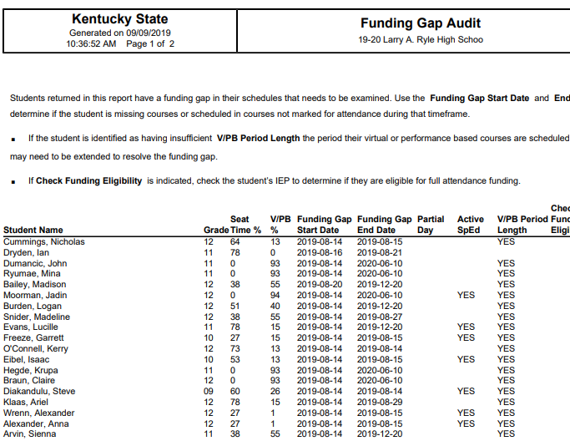
Funding Gap Audit Report
Notes:
The first line you see Seat Time % 64 and V/PB% 13 add those two together equals = 77. This student does not have enough time OR error in their schedule.
Second Line 78% Seat time 0% in V/PB – First thing I would do is look that student schedule, then look at each class to make sure the set-up is correct.
Third Line – 0% in Seat Time and 93% in V/PB – This is student is good to go. Our magic number for this report is 93% and above. This report does not include passing time or lunch times.

Slide 29
Dual Credit
Dual Credit means a student can take a class and get a high school credit and college credit for the same class.
Dual Credit classes are usually set up as Performance Based with a few rare exceptions. They are most often performance based for the following two reasons:
Any course used for high school credit that meets less than 120 hours must be set up as a performance based class.
Any classes that are held off campus where a certified person is not there taking attendance should also be performance based classes.
Note: If the dual credit class is offered on campus attendance should be taken on the student. This can be accomplished with the placeholder course.

Slide 30
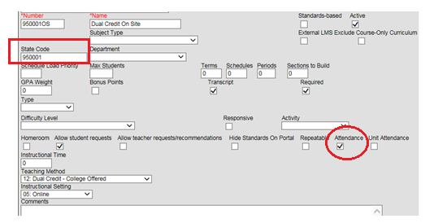
Dual Credit
Place holder Set-Up
Students doing dual credit both on campus and off campus, you will need two different placeholders. The place holder for on campus should be marked for attendance
Make sections of the course for any periods when students will be working on dual credit classes on campus. These could be online, college classes the student will work on in a computer lab each day

Slide 31
Resources
KDE Resources
Josh Whitlow (Josh.Whitlow@education.ky.gov)
Ronda Devine(Ronda.Devine@education.ky.gov)
Sheila Harned(Sheila.Harned@education.ky.gov)
Ruth Wilkes(Ruth.Wilkes@education.ky.gov)
Scott Rose(Scott.Rose@education.ky.gov)
Documentation on the Data Standards page
http://education.ky.gov/districts/tech/sis/Documents/VirtualandPerformanceTrainingDocument_.pdf

