Slide 1
Infinite Campus (IC) Health Overview
Angie McDonald, ADN, RN, NASSNC
KDE State School Nurse Consultant
Michelle Malicote, BSN, RN, NASSNC
KDPH School Health Branch Manager
2022

Slide 2
Objectives:
What is Infinite Campus (IC)?
To understand how to use IC to communicate to other staff members about student health and health conditions as needed
To learn how to enter immunization data and pull data for yearly CDC Immunization Survey
To understand how to enter screening data and medications
To understand how to enter health office visits and discharge data
To understand how to run health, screening and immunization reports

Slide 3
What is Infinite Campus?
The Kentucky Department of Education uses a national web-based software called Infinite Campus to manage student records in all school districts across the state
This single database houses all the records for a district including, but not limited to, health, enrollment, food service/meal balances and messaging students and parents
Families are encouraged to keep their household information up-to-date with the school office
The Campus Portal gives families access to students' attendance records, grades, class assignments and more. (Mozilla Firefox and Google Chrome are the recommended browsers.)
Note: Questions about a student's grades or attendance should be directed to the teachers or the school

Slide 4
District NURSE Assignment:
Districts will be asked to document school board hired nurses in the district assignments tab.
They will enter 07 Other for Type and then choose either LRN or RN/Advance Practice RN

Slide 5
This is the health home screen, you will find the student photo (if available) and demographics
Photo here, when available

Slide 6
Health Conditions Tab (part 1):
Health staff can add new student health conditions.
Current conditions are in blue, resolved conditions are in red.

Slide 7
Health Conditions Tab: (part 2)
Click on the “Conditions” tab
Click on “New Condition”

Slide 8
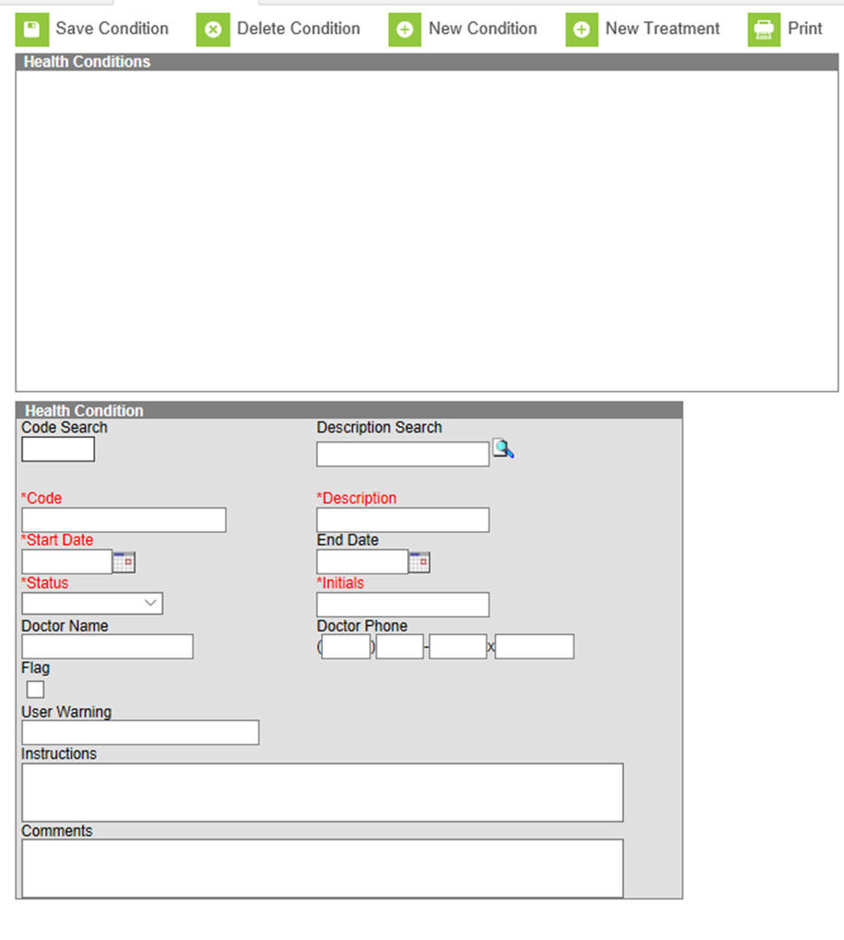
Health Conditions Tab: (part 3)
Type in the name of the condition you are looking for (Ex. Asthma)

Slide 9
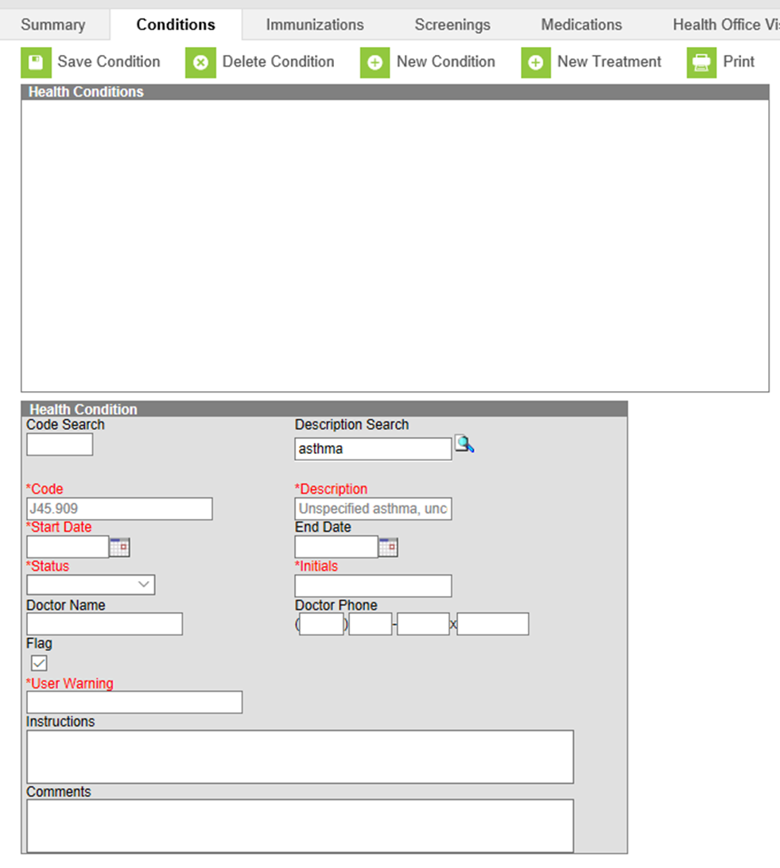
Health Conditions Tab: (part 4)
Complete the red, required boxes
User Warning box is what teachers will be able to see. (Ex. “carries inhaler”)
Also, check the flag box
Finally, click the “Save Condition” button

Slide 10
Health Conditions Tab: (part 5)
Once the health condition has been saved, a symbol and health condition alert will appear next to the student’s name. If a teacher or other staff member hovers over the words “health condition,” the user warning will appear. If they click on it, this box will open.
If, at any time you would like to review or change the health condition information, double click on the actual health condition and the box will open.

Slide 11
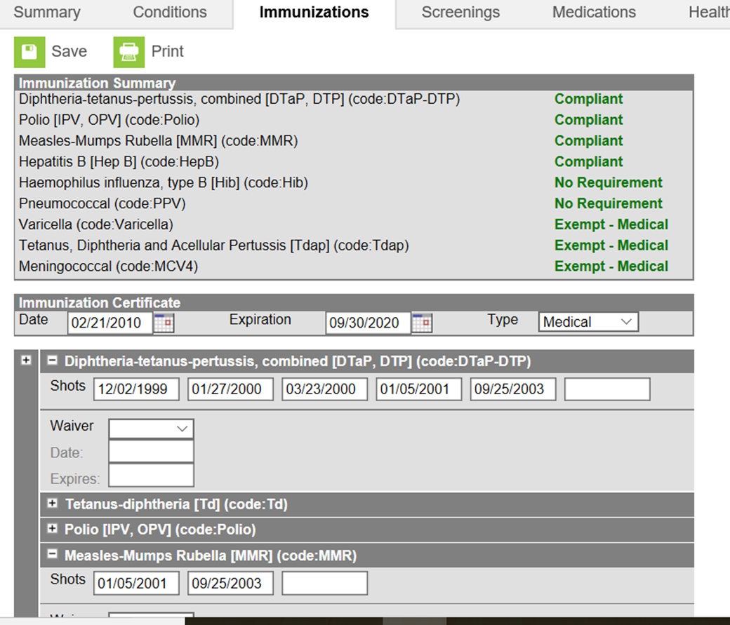
Immunization Tab:
Immunization information is entered here
All Kentucky schools complete an immunization survey each year to their local health departments and the Kentucky Department of Public Health (KRS 158.037 and 902 KAR 2:055)
Schools may use the expandable immunization boxes to enter the dates the immunizations were administered to student
This data will not be collected by KDE but will be useful to districts in completing the immunization survey from the Department for Public Health

Slide 12
Screenings Tab:
Student physical exams, dental and vision exams or screenings, as well as any other health screenings or exams are entered here.
There is a batch entry function to enter mass screenings in less than a minute.

Slide 13
Entering Screenings and Exams:
Data entry of screenings and exams take a minute or so and dropdown boxes allow users to choose the exam/screening type.
See how to enter exams and screenings PowerPoint on Student Health Services: Infinite Campus webpage

Slide 14
Medications Tab:
One of the most used aspects of IC health
Allows you to track student doses of medications
Schedule medication doses as well as track as needed (prn) medications
Allows staff to chart medication administration in a matter of a few clicks of the mouse

Slide 15
Medications (part 1):
Medications are grouped by school year so medications can be viewed briefly.
You can also track how many doses of medication are available.
Pill count 4 of 14 pills left

Slide 16
Medications (part 2)
“ “
Medication dosage, pharmacy and MD information is entered here.
You can also schedule appointments, cancel appointments and change dose count.

Slide 17
Medications (part 3)
After you click New, the Medication Detail box will appear
Enter the information requested in the boxes
Under Medication Name, many medications are already listed in the drop-down box
If the medication is not listed, it can be added in the system administration tab, but for now, let’s choose a medication that is already listed

Slide 18
Medications (part 4)
After you save the medication, the box should look like this
The school's name and school year should be listed in the area I have marked out with blue
Notice the medication and the number of doses you have are listed
Now that you have entered your medication, all you need to do is schedule your medications!

Slide 19
Medications (part 5)
To schedule a medication, click on the name of the medication and the following box should open.

Slide 20
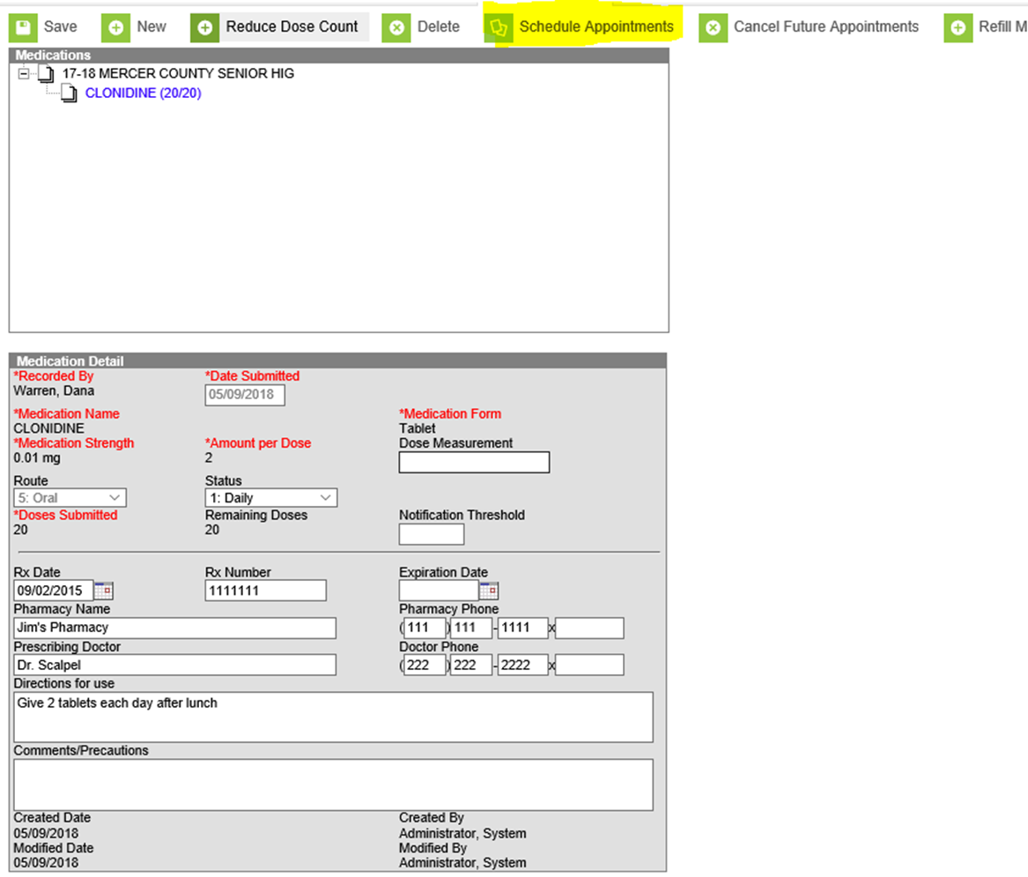
Medications (part 6)​
Click on the
Schedule Appointments tab above the boxes.

Slide 21
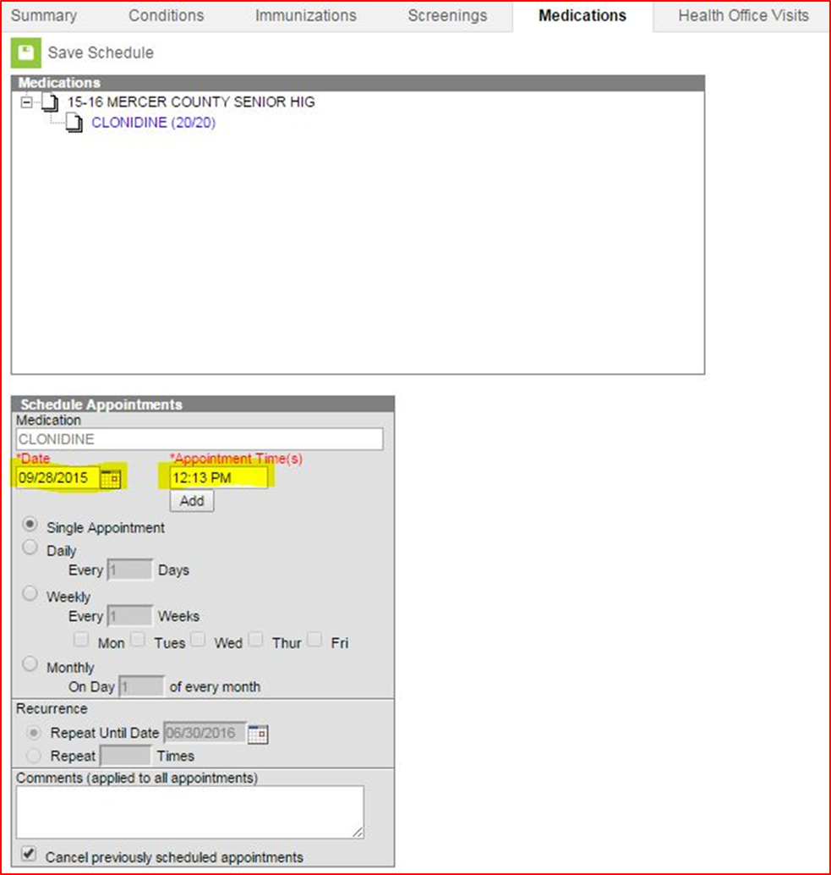
Medications (part 7)​
In the Date box, enter the date that you will begin entering the medication.
In the Appointment Time(s), enter what time you plan to administer the medication.
If you will be giving the same medication and dosage at multiple times of the day, click ADD under the appointment time box and you can enter an additional time.

Slide 22
Medications (part 8)​
In the Recurrence box, list the last day for which the medication is ordered -- usually the last day of the school year.
Once you enter the frequency and recurrence, click on Save Schedule.

Slide 23
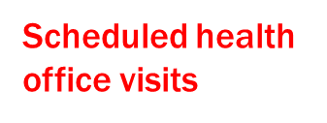
Medications (part 9)​
Now when you click on that student’s Health Office Visits Tab, you will see all the scheduled appointments listed in the upper box.
When that student comes for his medication, you click on the correct date and time and the lower box appears.

Slide 24
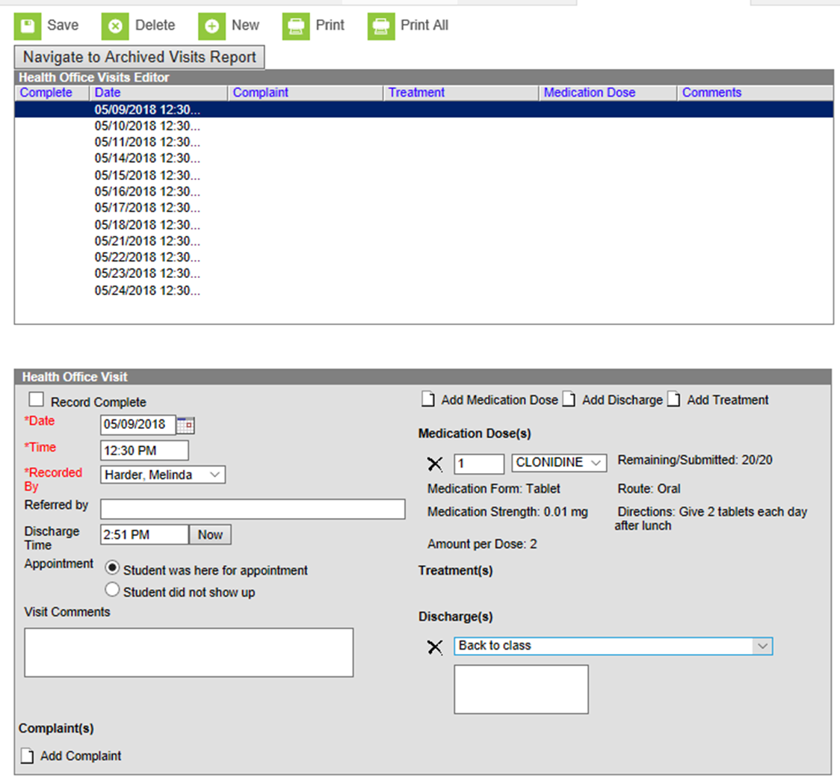
Medications (part 10)​
After you administer the medication, check the Record Complete box, enter the time they were discharged and that they were here for appointment.
Then, click Add Discharge, and choose from the drop-down box the appropriate response.
After you have finished entering this, click Save in the upper left-hand corner.

Slide 25
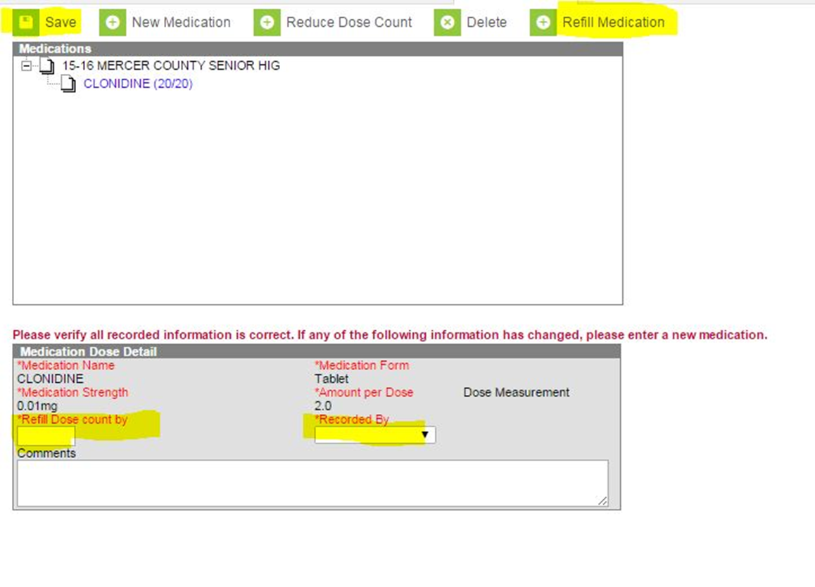
Medications (part 11)​
What do you do when you give all the medication and Mom brings in more?
Simply click on the Refill medication tab and the bottom box will pop up. Enter the number of doses sent in, not pills,
Recorded by, and then Save. This will reset your pill count.
If you need to reduce the dose count for any reason, click on the “reduce dose count” button. This box will appear, and you enter the correct number of pills in the reduce dose count by box, recorded by and finally save.

Slide 26
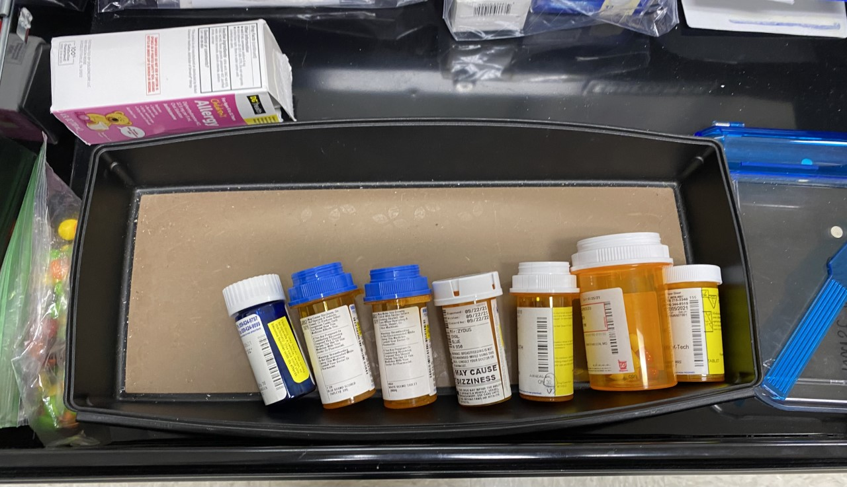
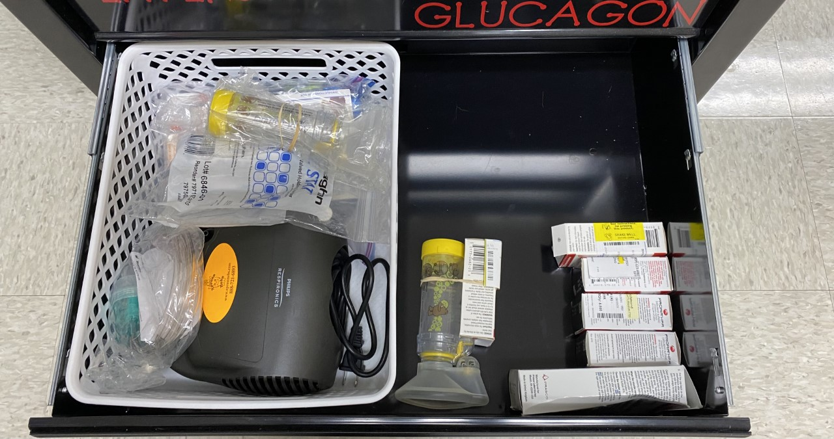
Medications (part 12)
Now, let's show what we do if you have a medication that is ordered and isn’t listed in the drop-down box of medication names

Slide 27
Medications (part 13)​
On the left-hand side, go to the Index tab, then scroll down toward the bottom of the page to:
System Administration
Health
Medication Name

Slide 28
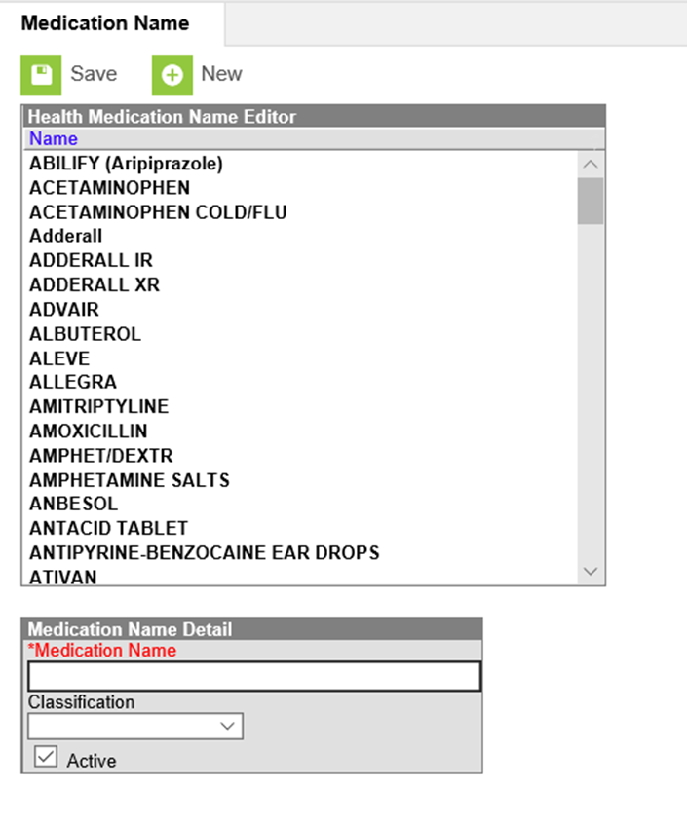
Medications (part 14)​
Type in the name of the new medication that you would like to add.
Choose the drug classification from the drop-down box and click “Save.”

Slide 29
Documenting Medications (part 1):
Now that the medication is entered and scheduled, how do I document it?
There are three ways to accomplish this; all are very simple.

Slide 30
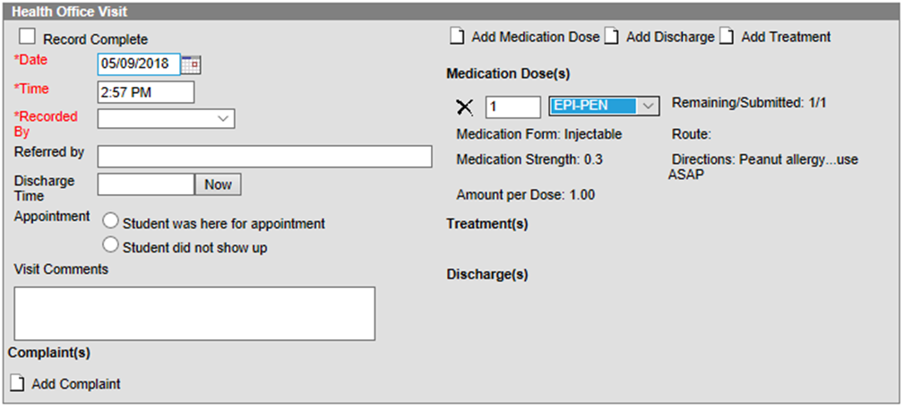
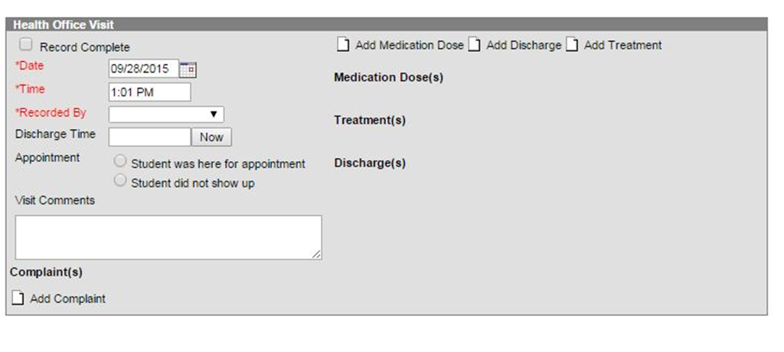
Documenting Medications: (part 2)
A drop-down box should appear, click on the drop-down box and click on the medication name. The form, strength and amount per dose should appear. Complete the health office visit record as usual and save.
Your medication has been documented!
Option 1:
Open a new health office visit box and click Add Medication Dose.

Slide 31
Documenting Medications: (part 3)
Option 2:
Pull up the student and go to the health office visits tab, all the scheduled visits are listed.
Choose the visit you would like to document and double click on it.
The most recent health office visit will be listed at the top.

Slide 32
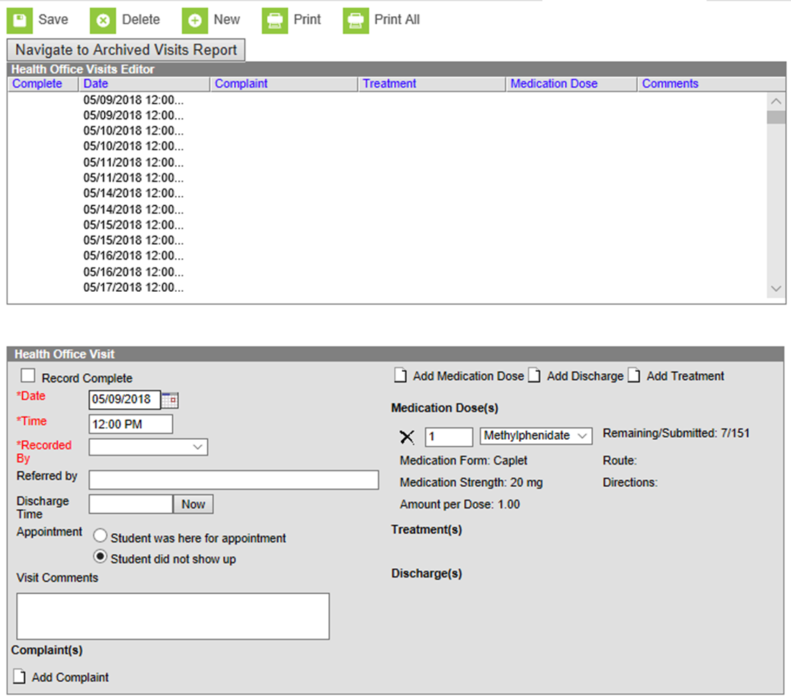
Documenting Medications: (part 4)
The health office visit box will open, complete the documentation and click the save button.

Slide 33
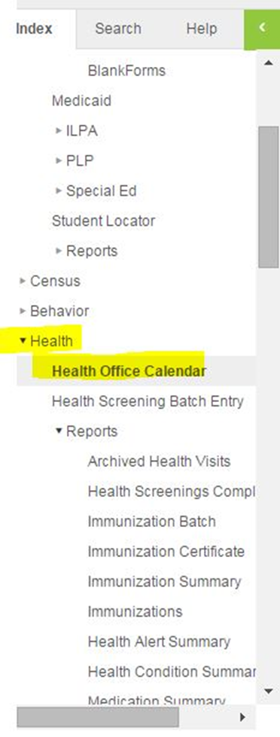
Documenting Medications: (part 5)
Option 3:
Use the Health Office Calendar.
Go to the index tab, then go to the second health tab Health Office Calendar.

Slide 34
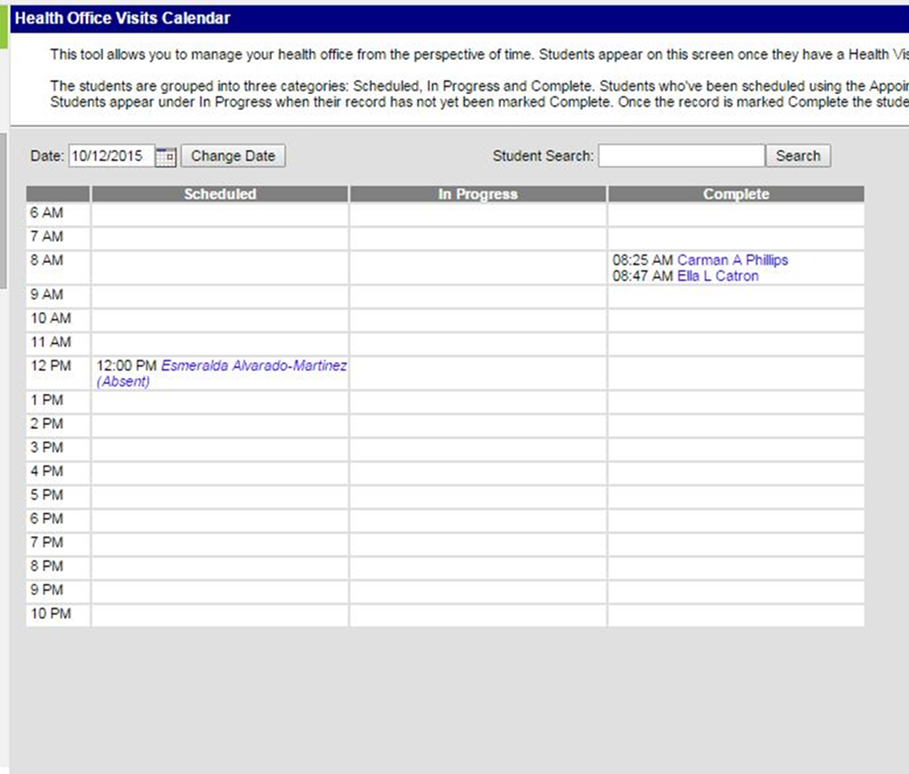
Documenting Medications: (part 6)
In the Health Office Visits Calendar, in the first column, named Scheduled, all students who have scheduled health office visits are listed.
Choose the student you need and double click on the name.
The correct health office visit will open, and you can finish your documentation.
Once you click save, the student’s name will move from the first column, Scheduled, to the last column listed Complete.

Slide 35
Health Office Visits (HOV):
At the HOV tab, you can see all student health office visits in a glance.
To start a new health office visit, click the “New” button.

Slide 36
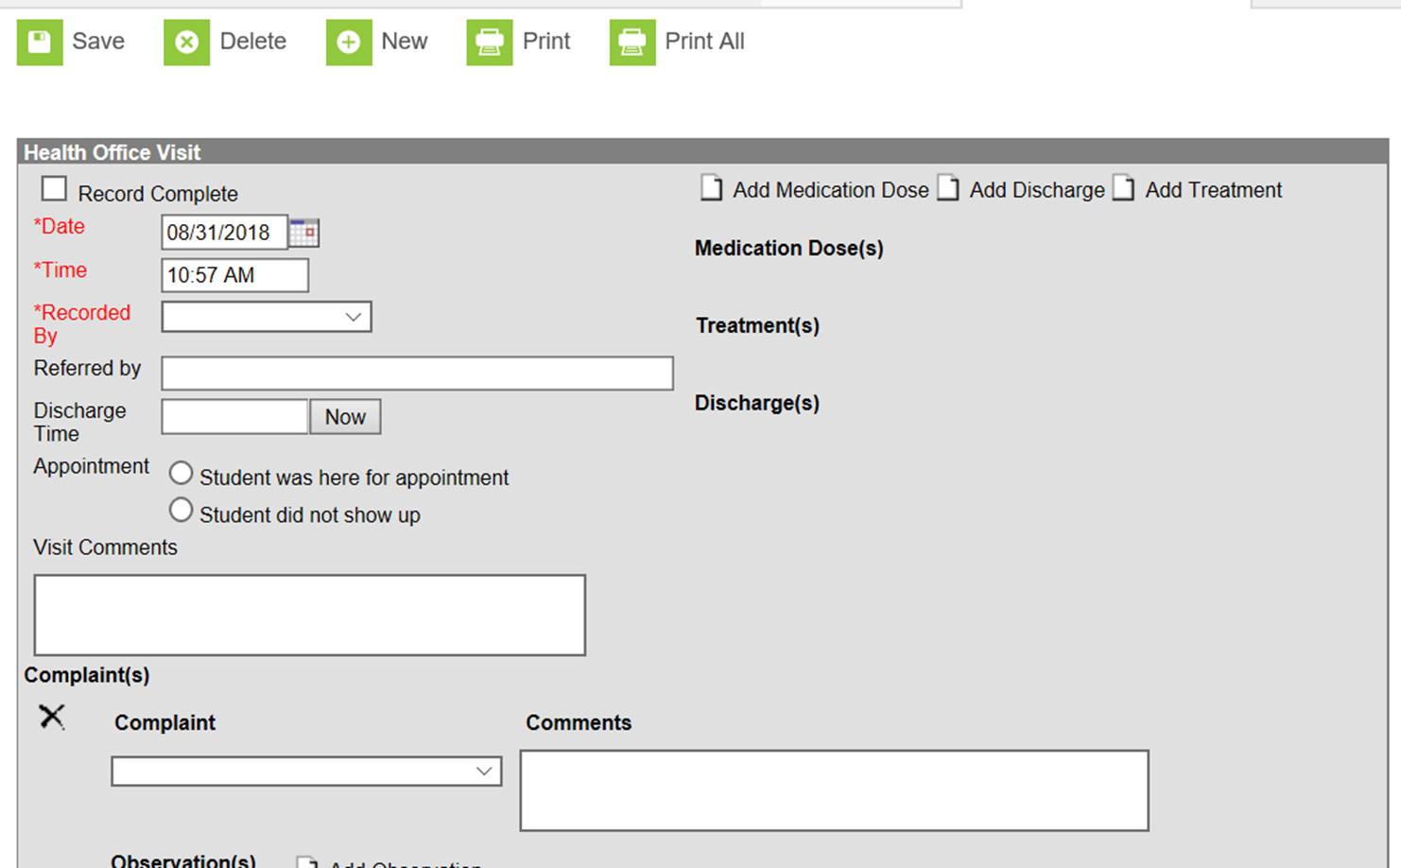
Office Visits (part 1):

Slide 37
Office Visits (part 2)
After clicking “add complaint,” a dropdown box will appear.
IC will allow you to add any listed complaint as a choice.

Slide 38
Office Visits (part 3)
Click the Observation button to add as many observations as needed.
Anything that you can’t use a dropdown box for such as a temperature, blood sugar, wound measurement or other description, should go in the “visit comments” box.

Slide 39
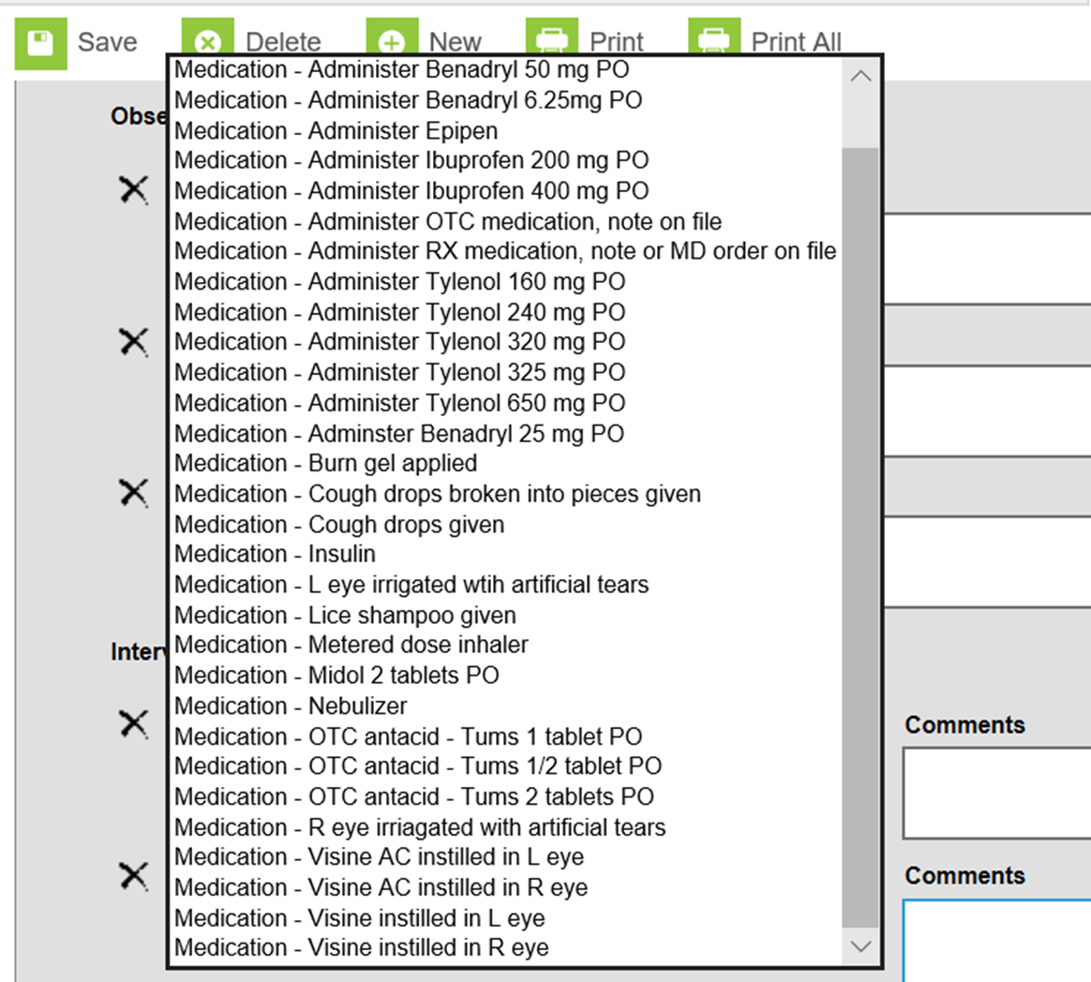
Office Visits (part 4)
Next, click the Interventions button and then choose the correct choice from the dropdown box.

Slide 40
Medications During HOV:
If scheduled or prn medications are administered, click the “add medication dose” button and a dropdown with all entered medications will appear and the dose and directions will appear.

Slide 41
Medications During HOV: (Cont.)
When you have finished documenting, click the add discharge button and choose from the dropdown list

Slide 42
Adding Discharges:
Note, you can add as many discharges as you need. Ex. Called parent, sent home

Slide 43
Adding STOCK RESCUE INHALER:
1. Go to Index
2. System Administration
3. Health
4. Intervention Type

Slide 44
Stock Rescue Inhaler in Infinite Campus:
1. Click on New Intervention Type, Enter
Stock Rescue Inhaler
2. Click on Add Intervention Type Item
3. Enter Stock Rescue Inhaler, dosage
and route as Intervention Type Item
4. Check active box so it will appear as a
choice in the drop-down box
5. Click “Save”

Slide 45
Example of How to Correctly Document Stock Rescue Inhaler Administration in Infinite Campus

Slide 46
Documents Tab:
Documents can be scanned and loaded into IC and are grouped by school year. To view the documents, click on the plus sign next to the year, then click next to the uploaded documents and a list of saved documents appear.
Double click on the name of the document and it will open to be read or printed.

Slide 47
Document Tab Uses:
Examples of documents include:
MD orders
Notes from parents
Individualized health care plans
Any other document that needs to be a part of the student health record

Slide 48
Health Reposts:
Several pre-built reports are already available in Campus health.

Slide 49
Student Health Immunization Report:

Slide 50
Student Health Screening Report:

Slide 51
Health Conditions Alert Report:
School Name
Date:
Time run:

Slide 52
Health Office Visit Report:
Gives a list of all student health office visits for a date or range of dates.
Includes all information from the health office visits.

Slide 53
Immunization Certificate Report:

Slide 54
Immunization Summary:

Slide 55
Ad Hoc Reporting:
Ad hoc reporting is also an option to build custom reports for data in Campus.
Examples include:
* number of students sent back to class
* number of students with head injuries
* who is sending students to the nurse

Slide 56
Resources:
Visit KDE’s the Student Health Services Infinite Campus Health webpage.

Slide 57
Contact Information:
Angie McDonald, ADN, RN, NASSNC
KDE State School Nurse Consultant
Angela.Mcdonald@education.ky.gov
Michelle Malicote, BSN, RN, NASSNC
KDPH School Health Branch Manager
Michelle.Malicote@ky.gov

