Slide 1
All things FRAM (FRAM=Free reduced application management)
Samantha Engstrom, Resource Management Analyst II
Kentucky Department of Education
Office of Finance and Operations

Slide 2
Overview
Reminders/Important dates
Coordinator tips
Direct Certification
Point of Sale/Data Sync
CEP setup
Entering HIFs
Electronic processing options

Slide 3
Meal Status Data reminders
Confidential and should be kept in a secure location.
Time sensitive- Household Income Forms (HIF) due in the system by OCTOBER 1.
Frequently changing, especially at the beginning of school.
Funding: eRATE, Seek At Risk and FRYSC.
Notes:
HIF data is confidential info and should be kept in a secure location. (Locking file cabinet)
It is time sensitive, October 1- This is due to eRATE funding.
If your district’s direct certifications are fairly consistent and you get your HIFs in by the last week in October, that would be enough time to have one of the days in October show as your highest day. By suggesting all HIFs be entered by October 1, that allows the most “chances”/days for getting the highest number possible.

Slide 4
How do I approach FRAM?
Determine process for distribution and collection of HIFs
Set up data Synchronization
Set up school or district as Community Eligibility Provision (CEP)
Set up FRAM Preferences
Process Household Income Forms (HIF)
Continue monthly Direct Certification (DC) import
Notes:
Develop a plan for distributing and collecting HIFS
Set up data sync
Set up School or District as CEP -Step 3 only needed if you’re a new CEP school or if your schools have changed
Set up FRAM Preferences… this has to be updated each year.
Enter your HIFS
Make sure your DC import happens monthly

Slide 5
FRAM Coordinator Tips
Get started early
Involve the FRYSC staff in collecting forms
Offer incentives
Include as part of registration packet or OLR
Emphasize importance to parents on qualifying for additional educational benefits for the school
Notes:
4. Or online registration

Slide 6
Direct Certification(DC)

Slide 7
Direct Certification
DC students are “free” automatically and are entered into FRAM by the Food Service Director (FSD)
FSDs are responsible for the record keeping requirements of DC students
FRAM Coordinator should also be checking to ensure that the DC import is working
Notes:
DC students are always going to automatically get a status of free. This is entered in FRAM by the Food Service Director.
Some districts have shared that their FSD will go through the HIF forms and pull out all HIFs for DC students to save you time when entering the forms, which is great. But if not, when you start entering them you will notice as soon as you pull a student up that they are directly certified and will be able to put that form to the side and not enter a status for that student.

Slide 8
Ways to Upload Direct Certification
Upload by either:
Directly into Infinite Campus (IC)
Point of Sale (POS) system
Either process is fine
If your POS is correctly syncing with IC then your DC will import nightly
Note: Some districts import into the POS and IC
Notes:
This is probably one of the areas where I get lots of questions. There is a couple ways you can do this…
There is a manual on the CEP page of the KDE website with instructions on retrieving your DC import and uploading to IC.

Slide 9
Point of Sale (POS) Data Synchronization

Slide 10
Steps for POS Data Synchronization
Proper setup of data synchronization
Monitor the process
Adjust to correct any errors
Notes:
The core steps for data synchronization include proper setup, monitoring the process and adjusting for any errors found after monitoring. The key challenge is knowing how to locate the error – and then correctly fix it.

Slide 11
Troubleshooting Import Process
Path: FRAM>Eligibility Import Wizard>Scheduled Imports
Directory Path – Check to see that your Directory path is correct, you have a shared folder on the POS…and your file is named IC_Eligibility
Test Connection – Use this to ensure you can connect to the POS
Test Import – Verify you can connect and pull in the data
Run Import – Run the import process manually and review the Eligibility Import report to locate and correct errors
Notes:
This screenshot shows the proper setup for data synchronization with your POS. Once you set it up you should always confirm the process is working by testing it.
Test Connection is used to ensure you can connect to the POS
Test Import is used to verify you can connect and pull in the data
And Run Import is used to run the import manually and review the eligibility Import report to locate and correct errors.

Slide 12
POS Data Sync: What could go wrong?
Shown below are common scenarios with data synchronization:
“The data sync has stopped working”
Confirm that the username and password are correct under Scheduled Imports
Verify that the file path/folder name has not changed
Consider changing the IC scheduled start time to a later time
Ensure that the school year is correct in the data mapping
Verify that the POS data extract has the current school year’s data
“My free/reduced percentage appears low in IC”
Verify all values are mapped in POS import mapping
Check when latest data sync was done under Scheduled Imports>Scheduled Import Log
Spot check a few students without a meal status against POS
(CEP districts) Verify that DC imports are being regularly done
Notes:
This is some common scenarios that show that to do if you data sync has stopped working or if your free/reduced percentages seem low.

Slide 13
Setting up CEP in Campus

Slide 14
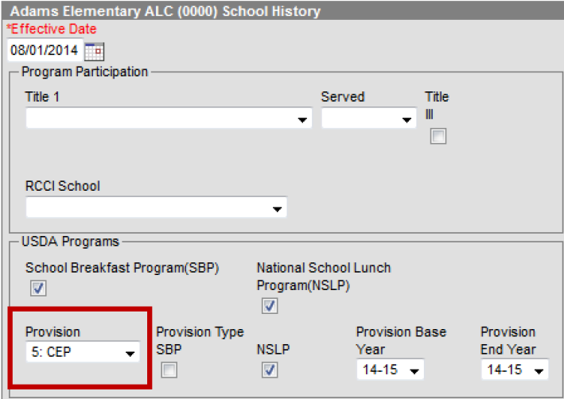
Setting up CEP approved schools
Add the CEP Provision to each CEP approved school
Path: System Administration>Resources>School
Notes:
This is the path for adding the CEP Provision to each CEP approved school. This is an important step If you are a new CEP district or have added new CEP schools since the previous year. Notice the school name at the top to ensure that you are adding the provision to the correct school. Typically, CEP will be approved for your school or districts for 4 years so you can update that under Provision End Year to prevent from having to do this every year, unless something changes.

Slide 15
FRAM Preferences

Slide 16
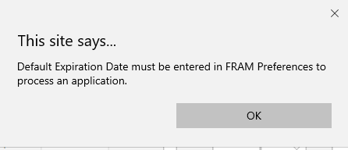
Before you enter HIFS:
Set up your default expiration date
Path: FRAM>FRAM Preferences
If you attempt to process a HIF prior to setting up your default expiration, the following error message will appear
Notes:
Before HIFs can be entered you MUST set up your default expiration date. The default expiration should be 6/30/2020 and this date does allow for the 30 day carry over period. You will get this error message if you attempt to process a HIF without setting up your default expiration, so it is not going to let you process the form until this has been done.

Slide 17
Provision Preferences
Mark the Educational Benefits Applications Processed Checkbox
Select whether CEP is approved for All Schools or Individual Schools in the district
Full CEP select All Schools
Partial CEP will select Individual Schools
Notes:
Provision preferences is also set up under FRAM preferences. This allows you to designate that the HIFs entered for CEP schools are for receiving Educational Benefits and not for determining a meal status. You will mark the Educational Benefits applications processed checkbox and select all schools or individual schools. This will separate your students status. Those entered as a Educational Benefit (CEP Schools) will show as SES and those non CEP will show as MEAL.

Slide 18
New Application Type
When you process HIFs select:
Educational Benefits Application
Notes:
When you go to process your first application, If you get to this screen and you do not see the EBA option then something isn’t set up correctly. First, go back and check to ensure that your all your CEP schools are marked as CEP in campus, if you this has been done, make sure you have checked the EBA processed checkbox like I just showed on the previous slide. If those have been done correctly, when you process an application, you should have both options to mark as either meal or educational.

Slide 19
IC Community Knowledge Base
Find more information about setting up FRAM Preferences in the IC Community Knowledge Base when you search CEP
Notes:
When in IC, Community is found in the upper right corner, Then click on Knowledge base, then search CEP.

Slide 20
Entering Household Income Forms

Slide 21
Important Dates
When do I send the HIFs to the households?
HIFs can be distributed in the student registration packets prior to July 1. (This applies to hard copies only)
If using electronic processing, HIFs should be processed after July 1.
Begin processing HIFs after July DC data has been imported
Income Eligibility Guidelines for the current school year need to be updated in Campus
Recommend waiting until after the update to begin processing the HIFs
Notes:
1. A lot of districts wait and distribute the HIFs at open house our during Online Registration and that is fine but you can distribute prior to July 1 if you would like.
2. I recommend waiting until you have processed your DC import for August before you start processing your HIFS.
3. The reason we recommend you waiting until August even if you are a district that starts getting HIFs back in July, is because you want the Income Eligibility Guidelines for the current school year to be updated before you start processing.

Slide 22
Entry of HIF Suggestions
Block out time to solely work on HIFs.
Ensure the HIF is complete and legible before entering into FRAM.
Enter HIFs into the FRAM module within 30 days of receiving.
Set goal to have all HIFs entered by October 1 for the most possible funding opportunities.
Notes:
Blocking out the time is important to meet the October 1 deadline. Having all HIFs entered by October 1 ensures the most possible funding opportunities.
Before entering you will want to make sure that the HIF is complete. (if missing signature or something like that go ahead and reach out to the family to complete it)
And just remember that the recommendation is that the HIFs are entered into the FRAM module within 30 days of receiving.

Slide 23
Options for Electronic processing

Slide 24
Electronic processing for full CEP districts
HIF processing can be completed electronically through FRAM Processing in IC if you are a full CEP district.
Email me for the instructions to setup.
Process is lengthy and sometimes requires a help desk ticket with campus to complete set up.

Slide 25
Partial CEP districts Electronic signature option 1:
Create an OLR form that mimics your current form with an electronic signature.
With this option it would require adding some extra text and moving around your pleat placements to make the signature look like it’s for the HIF form
You could add a custom tab in Campus to upload all the data or print forms for 10-year retention
Notes:
There is only one place for an electronic signature in the OLR

Slide 26
Partial CEP districts Electronic signature option 2:
You can create a Custom Form in Campus that you can send to all parents through Parent Portal where they can sign it electronically.
Use OLR to remind them to go to their parent portal to sign their HIF.
This option will take up space in your district’s campus storage capacity (digital repository) so you will have to check to see if you are close to limit at this point.

Slide 27
Partial CEP districts Electronic signature option 3:
Create an OLR page with a link where parents can upload the form themselves.
If you prefer copies with an actual signature, you can give them directions on where to send it back via mail.
Or print off copies that are uploaded.
Note: The electronic copy will need to be deleted or stored some place secure since it has personal/income information.

Slide 28
HIF Processing Checklist
Monthly DC imports
Process HIFs in Campus
Follow up with households who have not returned a HIF
Check DC and free/reduced percentages periodically
Notes:
POS sync, FRAM preferences and DC imports are all set up at the beginning of the years so once you are ready for HIF processing this is a good checklist to use.

Slide 29
HIF Sample form
The KY HIF sample form can be found of the KDE website
Form is available in Spanish as well
https://education.ky.gov/districts/Pages/Community-Eligibility-Provision-(CEP).aspx
Notes:
The HIF form is now a generic document that district can update each school year. We now have a Spanish version available on our website as well. We are unable to provide it in other languages at this time but we felt like the Spanish form was the most request/most pressing at the time. If you are full CEP I would recommend printing off your HIF forms in different colors. Helps keep track of what schools have returned forms.

Slide 30
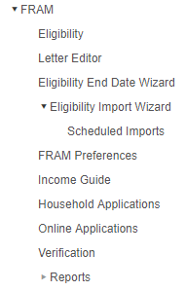
Processing HIF in Infinite Campus
FRAM coordinators will process the HIFs electronically within Infinite Campus using the FRAM module.
Notes:
There has been lots of confusion for people on this. HIF are entered under Household application and NOT eligibility.

Slide 31
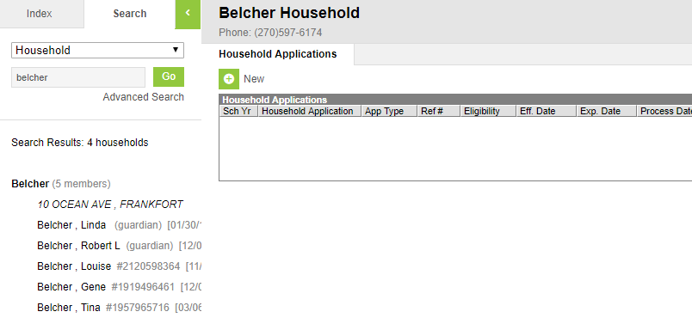
Household Application Forms
Select Household Applications (FRAM> Household Applications)
Search tab –Select Households from drop down
Search for Household name
Select Household Name
Click New
2
1
3
5
4
Notes:
For larger districts I recommend actually confirming the address for the household to confirm you are entering for the correct household.

Slide 32
Processing applications
Mark as Educational Benefits Application
Application Date – The date the application was signed by the parent/guardian
Effective Date – The eligibility effective date based on the approval of the application
Expiration Date- This will pull in from FRAM Preferences (should be 6/30/2020)
Notes:
If you don’t have the EBA option, then you need to go back and check that each CEP approved school is marked correctly and that the EBA processed check box is marked as well. If this isn’t done you will not have the new application type radio buttons available when processing and all applications will default to meal.

Slide 33
App Sign and Income
App Sign – This radio button indicates the household member who signed the application.
Mark the ‘Application Signed’ button as well
Enter income and frequency

Slide 34
Process the application
Once all information from HIF has been entered, you will process the application
This will prompt a screen that allows you to print a letter for the household

Slide 35
HIF Reference Number
Use this screen to confirm that the HIF was processed by looking for the eligibility status for the current school year
Write the generated reference number on the physical HIF
Some districts find it help helpful to file the HIFs by reference number

Slide 36
Completed HIFs
On a completed HIF, the FRAM coordinator must:
Indicate SES
Sign or initial the HIF
Indicate the approval date
Notes:
Not required but useful- As previously stated mark down the Reference number provided by the FRAM module

Slide 37
Amending a HIF
Amend: Can be used to make any necessary changes to the HIFs that have been entered

Slide 38
Incomplete HIFs
If SES status cannot be determined due to an incomplete HIF, the FRAM coordinator must:
Indicate this by marking “paid”
Indicate the reason
Sign or initial the HIF
Indicate the date
Notes:
I first recommend reaching out to the household to make an attempt to get whatever is missing from the parent. Most times, if they have taken time to complete the form and just missed a signature or something that would make it incomplete then chances are they will fix it but if not you will need to document the following this on the HIF form….

Slide 39
Process HIF for split CEP households
Student in the Non-CEP School can be removed
Process the Educational Benefit Application just for the student in the CEP School
Works the same way if you have one student who is DC and one who is not
The DC student can be removed

Slide 40
Comparison of Full CEP vs Partial CEP
Full CEP
Collect HIFs on all schools
Perform no data synchronization with POS system
Import DC file into Campus
Partial CEP
Collect HIFs for only CEP schools
Perform POS data synchronization with only non-CEP schools
Import DC file into Campus
Footnotes for Partial CEP
1. IC POS users have a special setup; please contact Infinite Campus for assistance.
2. Districts should collaborate with their POS vendor to include only the non-CEP school in the meal status data extract.
Notes:
Here is a comparison between full CEP and partial CEP districts – and the differing responsibilities/activities. The major differences are data synchronization and collection of the HIF forms.

Slide 41
Processing HIFS with Reported Household Income vs Case Numbers
Required information for processing with Reported Household Income
Names of all household members
Schools attended by children & grade level
Current income & frequency
Indication of “no income” (if applicable)
Signature of adult household member
Required information for processing with Case Numbers
Names of all household members
Schools attended by children & grade level
Name of household member who receives SNAP or KTAP and their case number
Signature of adult household member
Notes:
Here is a comparison for processing HIFs with Reported Household Income vs Case Numbers. I have highlighted the difference in Gold. NOTE: Valid Case Numbers are Social Security Numbers not EBT card numbers.

Slide 42
Eligible without Case Numbers
Homeless
Runaway
Migrant
Foster Child
An SES of free under these programs does not extend to other children in the household
State published ad hoc available to identify homeless students without a free meal status
Notes:
These are not processed as a HIF. Contact your food service director. All of these are Direct Certified. FSD will communicate with the program coordinator for their district to make a final determination on status for student.

Slide 43
Homeless/Migrant/Runaway
Required Information
Names of all household members
Schools attended by children & grade levels
Homeless, Migrant, or Runaway box checked
Signature of adult household member
Note: Do not process this as a HIF
Once the child’s status is confirmed with the signed and dated list from the district homeless/migrant/runaway coordinator, the child becomes DC (directly certified)

Slide 44
Manually Entering a Student as DC
PATH: FRAM>Eligibility
Locate the student
Mark the student as Direct
Mark the Certified Type
Notes:
If it is determined that the child is in fact Homeless, Migrant, Runaway or Foster you can follow this path to override the status. Certified type= what makes them certified
An example of this would be a student who is Homeless…. Didn’t come up on your DC list but they qualify bc of this. You can change their certified type to reflect what made them certified.

Slide 45
Missing HIF Forms

Slide 46
Locating Missing Forms
To locate students in Excel perform the following steps:
Path: FRAM>Reports>Eligibility
Select the settings for the current year
Choose to export as ‘CSV’
Choose the option under “Data” to filter the report
Choose to filter where ‘Source’ is blank
Notes:
There is a FRAM Eligibility report that you can pull to locate missing forms. You will export the file and filter where source is blank.

Slide 47
Contact Household Missing a HIF
Send home reminder with another HIF
Reach out to the household and explain the benefits of completing a HIF
Encourage Students
Ask for assistance from other school and district staff

Slide 48
Marking Students as “Paid” and “Did Not Apply” manually
For those who do not intend to return the HIF after repeated attempts, follow these steps:
Path: FRAM>Eligibility
Locate the student
Mark the student as “Paid” and “Did Not Apply”

Slide 49
Best Practices for Comparing and Monitoring
Import DC File each month
Homeless Student List
Any student on a signed and date
homeless/runaway/migrant list can be marked as “DC” and “Free”
Advanced Comparison of DC Students
Compare list of DC students in prior school year to current school year
Search current DC list to identify any who were DC last year that might need to be DC this year
Notes:
Shown above are the best practices for your district to obtain the highest free meal status percentage possible.

Slide 50
Resources
Several useful ad hoc reports have been placed under the “State Published” folder in IC
FRAM Transposed Meal Eligibility Dates
Locates records where the meal status data was imported in the wrong school year
FRAM Missing Meal Eligibility Records-District
FRAM Missing Meal Eligibility Records-School
KDE CEP Website
https://education.ky.gov/districts/SHS/Pages/Community-Eligibility-Provision-(CEP).aspx
Notes:
Here are several other resources for you. You can use the FRAM Missing Meal Eligibility Records – School along with the letter editor in Campus to send out reminder letters for households without a HIF form returned.
Review the KDE CEP website for additional tools on CEP.
Coordinator tips/acronyms, powerpoints, HIF form, DC tool manual (all can be found on the KDE website)

Slide 51
Campus Community
Training on FRAM Module
Campus offers training at no cost to all IC users. Check for FRAM training at http://community.infinitecampus.com
Search for FRAM in the Knowledge Base

Slide 52
Any Questions?

Slide 53
Contacts
Samantha Engstrom
Samantha.engstrom@education.ky.gov
(502) 564- 5279, ext. 4434
Ronda Devine
ronda.devine@education.ky.gov
(502) 564- 5279, ext. 4444

