Slide 2
FRAM: Understanding and Accurately Reporting Free Meal Status
Office of Finance and Operations
Division of District Support
Samantha Engstrom

Slide 3
What is FRAM?
F
R
A
M
ree
educed
pplication
anagement

Slide 4
Meal Status Data is….
  Confidential and should be kept in a secure location
  Time sensitive- Household Income Forms (HIF) due in the system by OCTOBER 1
  Frequently changing, especially at the beginning of school
Overall Goal: Accurate + Timely Data
Notes:
HIF data is confidential info and should be kept in a secure location. (Locking file cabinet)
October 1- This is due to eRATE funding.

Slide 5
Key Funding Purposes
Seek At Risk- funding is based on the average daily membership (ADM) of students in the district who are approved for free meals under the National School Lunch Program. The ADM is multiplied by 15% of the Guaranteed Base Per Pupil Funding amount to arrive at the additional funding for this add on.
eRate - provides discounts on telecommunications, Internet, and eligible internal connection technologies to elementary and secondary schools and public libraries. The data provided for eRate funding looks at every day in October and choses the date with the highest Free Reduced Lunch (FRL) count in that month.
FRYSC – Districts no longer provide FRL counts to CHFS for FRYSC funding. The data is provided by KDE as of December 1.
Notes:
If your district’s direct certifications are fairly consistent and you get your HIFs in by the last week in October, that would be enough time to have one of the days in October show as your highest day. By suggesting all HIFs be entered by October 1, that allows the most “chances”/days for getting the highest number possible.

Slide 6
How do I approach FRAM?
Devise process for distribution and collection of HIFs
Set up data Synchronization
Set up school or district as Community Eligibility Provision (CEP)
Set up FRAM Preferences
Process Household Income Forms (HIF)
Continue monthly Direct Certification (DC) import
Notes:
Develop a plan for distributing and collecting HIFS
Set up data sync
Set up School or District as CEP -Step 3 only needed if you’re a new CEP school or if your schools have changed
Set up FRAM Preferences… this has to be updated each year.
Enter your HIFS
Make sure your DC import happens monthly

Slide 7
Direct Certification(DC)

Slide 8
Direct Certification continued
DC students are “free” automatically and are entered into FRAM by the Food Service Director (FSD)
FSDs are responsible for the record keeping requirements of DC students
  FRAM Coordinator should also be checking to ensure that the DC import is working
Notes:
DC students are always going to automatically get a status of free. This is entered in FRAM by the Food Service Director.
Some districts have shared that their FSD will go through the HIF forms and pull out all HIFs for DC students to save you time when entering the forms, which is great. But if not, when you start entering them you will notice as soon as you pull a student up that they are directly certified and will be able to put that form to the side and not enter a status for that student.

Slide 9
Ways to Upload Direct Certification
Upload by either:
Directly into Infinite Campus (IC)
Point of Sale (POS) system
  Either process is fine
  If your POS is correctly syncing with IC then your DC will import nightly
Note: Some districts import into the POS and IC
Notes:
This is probably one of the areas where I get lots of questions. There is a couple ways you can do this…
There is a manual on the CEP page of the KDE website with instructions on retrieving your DC import and uploading to IC.

Slide 10
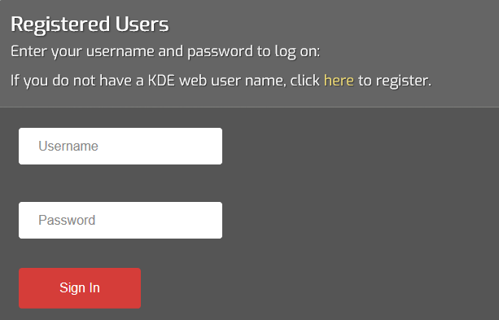
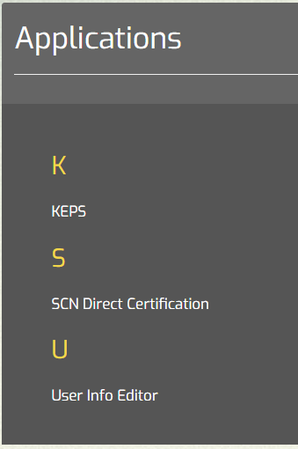
Retrieving DC list
https://applications.education.ky.gov/login
Notes:
This is the link where you can retrieve your DC list. You can find this link on the KDE website.

Slide 11
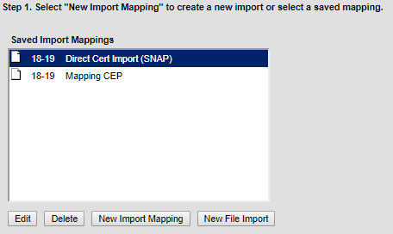
Data Import into Infinite Campus
Log in to IC
Ensure you have selected the current school year
Navigate to FRAM>Eligibility Import Wizard
Choose “new import mapping” to upload your DC file
https://education.ky.gov/districts/Pages/Community-Eligibility-Provision-(CEP).aspx
Notes:
Once you have obtained your DC list you will need to import that into IC. You will follow these steps to import. One reminder here is to always make sure that you have selected the current school year. I’m not going to walk you through all the steps of setting up your import because it is time consuming and a little confusing but there is a DC web download tool help manual on the KDE website that should assist you in downloading and uploading. And that link can be found on the bottom of this PowerPoint slide.

Slide 12
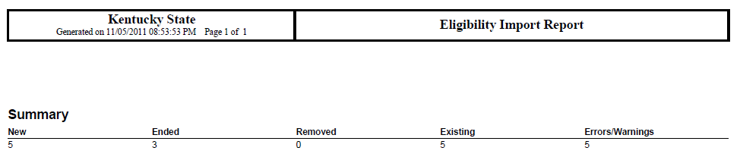
DC Import Report Review
Review the report
  Provides a summary description of import results (focus on “Errors/Warnings)
  Shows duplicate students were located in Campus > Run the Duplicate Student Search Report in IC to correct these
  If the student ID field (SSN or SSID) were not matched in IC:
    SSN is incorrect in the DC import file or Campus
    The child is not enrolled in your district/diocese
Notes:
This is your summary report. You will want to review this and confirm everything looks ok before importing. (Focus on the errors and warnings (like confirming you don’t have students duplicated) But keep in mind surrounding counties are now included in the DC file numbers on this report. So you will see a higher number of “error” but as long as you have confirmed that everything looks ok, the errors and warning are ok.

Slide 13
Point of Sale (POS) Data Synchronization

Slide 14
Steps for POS Data Synchronization
Proper setup of data synchronization
Monitor the process
Adjust to correct any errors
Notes:
The core steps for data synchronization include proper setup, monitoring the process and adjusting for any errors found after monitoring. The key challenge is knowing how to locate the error – and then correctly fix it.

Slide 15
POS Data Sync: What could go wrong?
Shown below are common scenarios with data synchronization:
“The data sync has stopped working”
Confirm that the username and password are correct under Scheduled Imports
Verify that the file path/folder name has not changed
Consider changing the IC scheduled start time to a later time
Ensure that the school year is correct in the data mapping
Verify that the POS data extract has the current school year’s data
“My free/reduced percentage appears low in IC”
Verify all values are mapped in POS import mapping
Check when latest data sync was done under Scheduled Imports>Scheduled Import Log
Spot check a few students without a meal status against POS
(CEP districts) Verify that DC imports are being regularly done
Notes:
When something appears awry, here are a few areas to check for a diagnosis. I would begin with the FRAM Scheduled Import Log. Look there to see when the last successful sync was done. If that has been unsuccessful, then you can look at what is wrong with the communication between the POS and IC. Presuming that it’s worked in the past- you want to check the configuration hasn’t changed; verify the username and password are correct; the folder name for the IC_Eligibility filed is still the same, a file is being produced since the rollover, and – if you have a new POS server- your IP address for the server is the same as before.
If you have low free/reduced percentages then look at your POS import mapping under the Eligibility Import Wizard: select your import mapping and import the most current IC_Eligibility file. Ensure that no values are missing from the mapping (homeless, migrant, etc.). Then you will want to verify the Scheduled Import Log as well for any errors that need to be resolved.

Slide 16
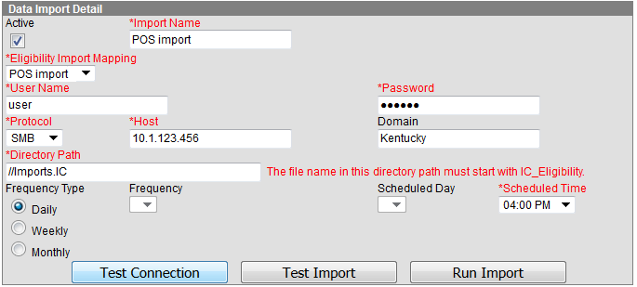
Troubleshooting Import Process
Path: FRAM>Eligibility Import Wizard>Scheduled Imports
Directory Path – Check to see that your Directory path is correct, you have a shared folder on the POS…and your file is named IC_Eligibility
Test Connection – Use this to ensure you can connect to the POS
Test Import – Verify you can connect and pull in the data
Run Import – Run the import process manually and review the Eligibility Import report to locate and correct errors
Notes:
This screenshot shows the proper setup for data synchronization with your POS. Once you set it up you should always confirm the process is working by testing it.
Test Connection is used to ensure you can connect to the POS
Test Import is used to verify you can connect and pull in the data
And Run Import is used to run the import manually and review the eligibility Import report to locate and correct errors.

Slide 17
Setting up CEP in Campus

Slide 18
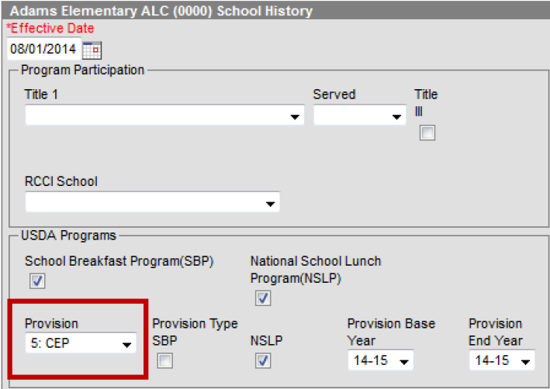
Setting up CEP
Add the CEP Provision to each CEP approved school Path: System Administration>Resources>School
Notes:
This is the path for adding the CEP Provision to each CEP approved school. This is an important step If you are a new CEP district or have added new CEP schools since the previous year. Notice the school name at the top to ensure that you are adding the provision to the correct school. Typically CEP will be approved for your school or districts for 4 years so you can update that under Provision End Year to prevent from having to do this every year, unless something changes.

Slide 19
FRAM Preferences

Slide 20

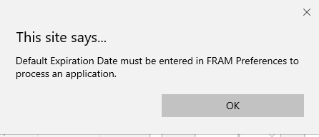
Before you enter HIFS:
Set up your default expiration date
Path: FRAM>FRAM Preferences
If you attempt to process a HIF prior to setting up your default expiration, the following error message will appear
Notes:
Before HIFs can be entered you MUST set up your default expiration date. The default expiration should be 6/30/2020 and this date does allow for the 30 day carry over period. You will get this error message if you attempt to process a HIF without setting up your default expiration so it is not going to let you process the form until this has been done.

Slide 21
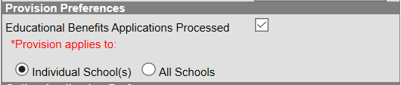
NEW! Provision Preferences
Mark the Educational Benefits Applications Processed Checkbox
Select whether CEP is approved for All Schools or Individual Schools in the district
  Full CEP select All Schools
  Partial CEP will select Individual Schools
Notes:
Provision preferences is also set up under FRAM preferences. This allows you to designate that the HIFs entered for CEP schools are for receiving Educational Benefits and not for determining a meal status. You will mark the Educational Benefits applications processed checkbox and select all schools or individual schools. This will separate your students status. Those entered as a Educational Benefit (CEP Schools) will show as SES and those non CEP will show as MEAL.

Slide 22
What are the benefits of this function?
More accurate data/reporting
Easily separates students who have been entered as SES/MEAL
GOOD NEWS! It doesn’t matter how you have done this in the past. The state pulls both SES and MEAL types for funding!
Notes:
The good news is that it doesn’t matter how you have done this in the past! The state pulls both SES and Meal types for funding.
So what are the benefits of this? This is a newer functionality that is available in the core product so we are encouraging as a best practice recommendation to use this feature because it will provide more accurate data and reporting and allows you to easily pull data for students with SES status or MEAL status.

Slide 23
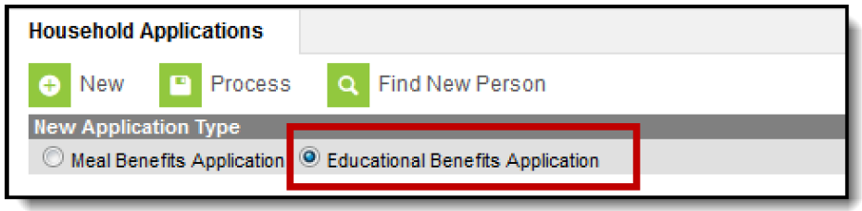
New Application Type
When you process HIFs select:
Educational Benefits Application
Notes:
Be sure to watch this so it doesn’t default to EBA after you have entered several application.

Slide 24
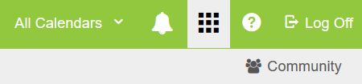
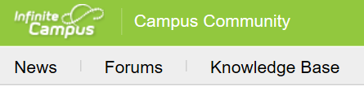
IC Community Knowledge Base
Find more information about setting up FRAM Preferences in the IC Community Knowledge Base when you search CEP
Notes:
When in IC, Community is found in the upper right corner, Then click on Knowledge base, then search CEP.

Slide 25
Household Income Forms

Slide 26
Before you start processing . . .
Plan how you will distribute and collect HIFs
  Who will help me?
  How will I file them?
  What incentives can be offered to increase the return rate?
  When will I be able to work on these?
Notes:
So now we are going to plan the Who, How, What and When. Who will help, How will file/store them? What Incentives can you offer to increase your return rate. (Elementary age loves a little extra recess time, stickers, bracelets) And when will you start processing them? Keep in mind we encourage that October 1 deadline so if you can process early to mid Sept you still have a couple weeks before the deadline to follow up with any household
When filing keep in mind that these need to be retained for 10 years. The reason for this is that the eRate program can audit FRL data for up to 10 years.

Slide 27
Important Dates
When do I send the HIFs to the households?
  HIFs can be distributed in the student registration packets prior to July 1. (This applies to hard copies only)
  If using electronic processing, HIFs should be processed after July 1.
Begin processing HIFs after July DC data has been imported
Income Eligibility Guidelines for the current school year need to be updated in Campus
  Recommend waiting until after the update to begin processing the HIFs
Notes:
1. A lot of districts wait and distribute the HIFs at open house our during Online Registration and that is fine but you can distribute prior to July 1 if you would like.
2. I recommend waiting until you have processed your DC import for August before you start processing your HIFS.
3. The reason we recommend you waiting until August even if you are a district that starts getting HIFs back in July, is because you want the Income Eligibility Guidelines for the current school year to be updated before you start processing.

Slide 28
Entry of HIF Suggestions
Steps to Data Entry
  Block out time to solely work on HIFs
  Ensure the HIF is complete and legible before entering into FRAM
  Enter HIFs into the FRAM module within 30 days of receiving

Slide 29
Options for Electronic processing

Slide 30
Electronic processing for full CEP districts
HIF processing can be completed electronically through FRAM Processing in IC if you are a full CEP district.
  You will need to contact Campus to put in a support ticket to complete setup for using FRAM Processing.

Slide 31
Partial CEP districts
Electronic signature option 1:
Create an OLR form that mimics your current form with an electronic signature.
  With this option it would require adding some extra text and moving around your pleat placements to make the signature look like it’s for the HIF form
  You could add a custom tab in Campus to upload all the data or print forms for 10 year retention
Notes:
There is only one place for an electronic signature in the OLR

Slide 32
Partial CEP districts
Electronic signature option 2:
You can create a Custom Form in Campus that you can send to all parents through Parent Portal where they can sign it electronically
  Use OLR to remind them to go to their parent portal to sign their HIF
  This option will take up space in your district’s campus storage capacity (digital repository) so you will have to check to see if you are close to limit at this point.

Slide 33
Partial CEP districts
Electronic signature option 3:
Create an OLR page with a link where parents can upload the form themselves
  If you prefer copies with an actual signature, you can give them directions on where to send it back via mail
  Or print off copies that are uploaded

Slide 34
HIF Processing Responsibilities
FRAM Coordinator | Food Service Director
Distribute, collect and process the HIF forms | N/A
Provide any HIFs marked as Homeless, Migrant or Runaway to FSD | Provide determination on runaway/migrant/homeless status in conjunction with program coordinator
Review DC list; no HIF processing necessary for any DC student | Import DC file on monthly basis
Notes:
This a comparison of responsibilities between the FRAM Coordinator and FSD.

Slide 35
HIF Processing Checklist
Monthly DC imports
Process HIFs in Campus
Follow up with households who have not returned a HIF
Check DC and free/reduced percentages periodically
Notes:
POS sync, FRAM preferences and DC imports are all set up at the beginning of the years so once you are ready for HIF processing this is a good checklist to use.

Slide 36
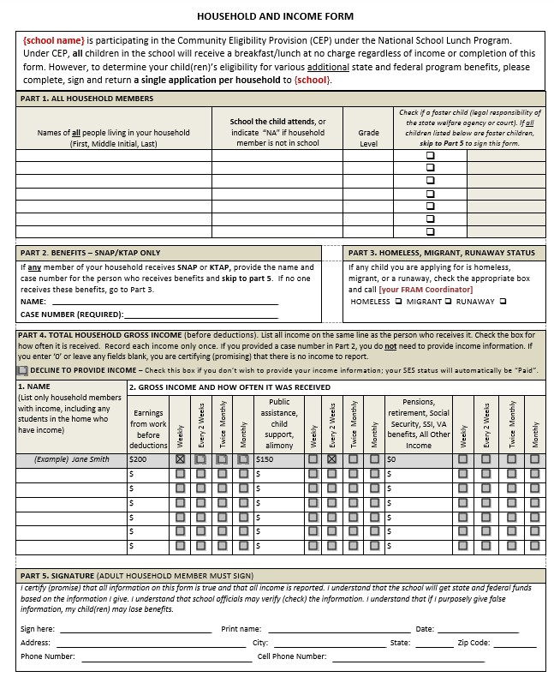
HIF Sample form
The KY HIF sample form can be found of the KDE website
We now have this form available in Spanish
https://education.ky.gov/districts/Pages/Community-Eligibility-Provision-(CEP).aspx
Notes:
The HIF form is now a generic document that district can update each school year. We now have a Spanish version available on our website as well. We are unable to provide it in other languages at this time but we felt like the Spanish form was the most request/most pressing at the time. If you are full CEP I would recommend printing off your HIF forms in different colors. Helps keep track of what schools have returned forms.

Slide 37
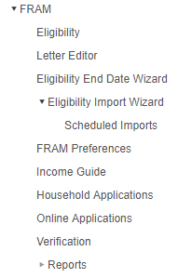
Processing HIF in Infinite Campus
FRAM coordinators will process the HIFs electronically within Infinite Campus using the FRAM module
Notes:
There has been lots of confusion for people on this. HIF are entered under Household application and NOT eligibility.

Slide 38
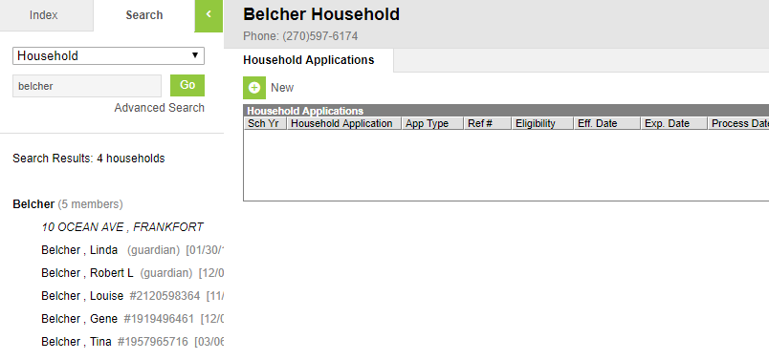
Household Application Forms
2
3
5
4
Select Household Applications (FRAM> Household Applications)
Search tab –Select Households from drop down
Search for Household name
Select Household Name
Click New
Notes:
For larger districts I recommend actually confirming the address for the household to confirm you are entering for the correct household.

Slide 39
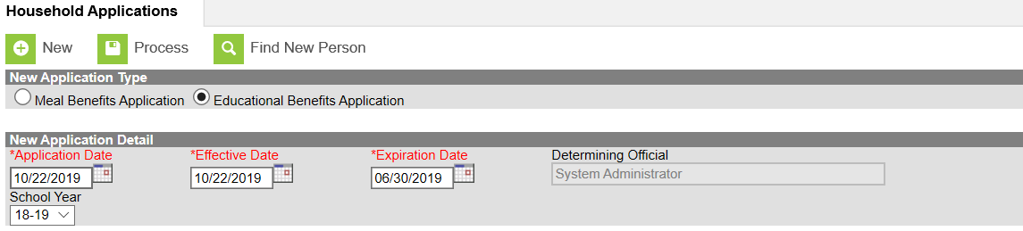
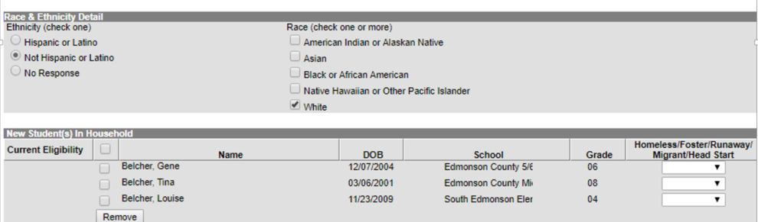
Blank4
Mark as Educational Benefits Application
Application Date – The date the application was signed by the parent/guardian
Effective Date – The eligibility effective date based on the approval of the application
Expiration Date- This will pull in from FRAM Preferences (should be 6/30/2020)

Slide 40
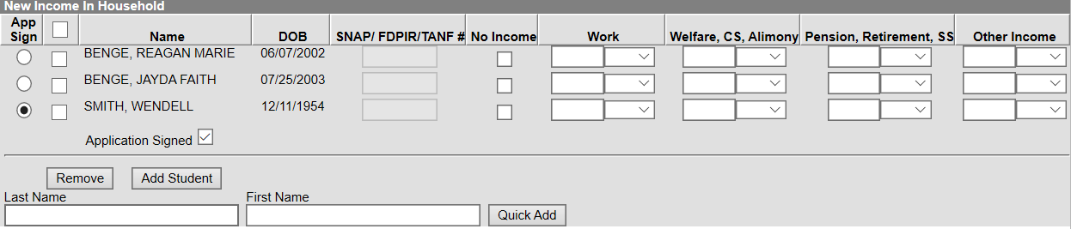
App Sign and Income
App Sign – This radio button indicates the household member who signed the application
  Mark the ‘Application Signed’ button as well!
Enter income and frequency

Slide 41

Process the application
Once all information from HIF has been entered, you will process the application
This will prompt a screen that allows you to print a letter for the household

Slide 42
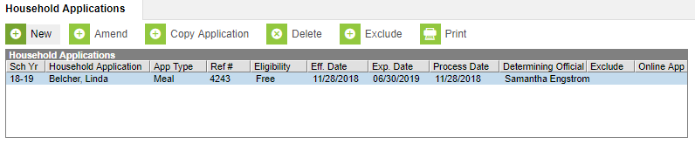
HIF Reference Number
Use this screen to confirm that the HIF was processed by looking for the eligibility status for the current school year
Write the generated reference number on the physical HIF
  Some districts find it help helpful to file the HIFs by reference number

Slide 43
Completed HIFs
On a completed HIF, the FRAM coordinator must:
  Indicate SES
  Sign or initial the HIF
  Indicate the approval date
Notes:
Not required but useful- As previously stated mark down the Reference number provided by the FRAM module

Slide 44
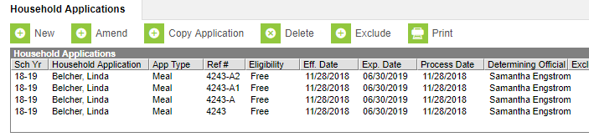
Amending a HIF
Amend: Can be used to make any necessary changes to the HIFs that have been entered

Slide 45
Incomplete HIFs
If SES status cannot be determined due to an incomplete HIF, the FRAM coordinator must:
  Indicate this by marking “paid”
  Indicate the reason
  Sign or initial the HIF
  Indicate the date
Notes:
I first recommend reaching out to the household to make an attempt to get whatever is missing from the parent. Most times, if they have taken time to complete the form and just missed a signature or something that would make it incomplete then chances are they will fix it but if not you will need to document the following this on the HIF form….

Slide 46
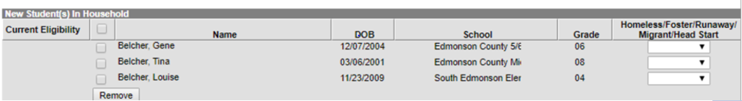
Process HIF for split CEP households
Student in the Non CEP School can be removed
  Process the Educational Benefit Application just for the student in the CEP School
Works the same way if you have one student who is DC and one who is not
  The DC student can be removed

Slide 47
Comparison of Full CEP vs Partial CEP
Full CEP
Partial CEP
Collect HIFs on all schools
Perform no data synchronization with POS system
Import DC file into Campus
Collect HIFs for only CEP schools
Perform POS data synchronization with only non-CEP schools
Import DC file into Campus
Footnotes for Partial CEP
1. IC POS users have a special setup; please contact Infinite Campus for assistance.
2. Districts should collaborate with their POS vendor to include only the non-CEP school in the meal status data extract
Notes:
Here is a comparison between full CEP and partial CEP districts – and the differing responsibilities/activities. The major differences are data synchronization and collection of the HIF forms.

Slide 48
Processing HIFS with Reported Household Income vs Case Numbers
Required information for processing with Reported Household Income
Required information for processing with Case Numbers
  Names of all household members
  Schools attended by children & grade level
  Current income & frequency
  Indication of “no income” (if applicable)
  Signature of adult household member
  Names of all household members
  Schools attended by children & grade level
  Name of household member who receives SNAP or KTAP and their case number
  Signature of adult household member
Notes:
Here is a comparison for processing HIFs with Reported Household Income vs Case Numbers. I have highlighted the difference in Gold. NOTE: Valid Case Numbers are Social Security Numbers not EBT card numbers.

Slide 49
Eligible without Case Numbers
Homeless
Runaway
Migrant
Foster Child
An SES of free under these programs does not extend to other children in the household
State published ad hoc available to identify homeless students without a free meal status
Notes:
These are not processed as a HIF. Contact your food service director. All of these are Direct Certified. FSD will communicate with the program coordinator for their district to make a final determination on status for student.

Slide 50
Homeless/Migrant/Runaway
Required Information
Names of all household members
Schools attended by children & grade levels
Homeless, Migrant, or Runaway box checked
Signature of adult household member
Note: Do not process this as a HIF
Once the child’s status is confirmed with the signed and dated list from the district homeless/migrant/runaway coordinator, the child becomes DC (directly certified)

Slide 51
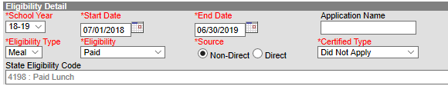
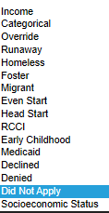
Manually Entering a Student as DC
PATH: FRAM>Eligibility
Locate the student
Mark the student as Direct
Mark the Certified Type
Notes:
If it is determined that the child is in fact Homeless, Migrant, Runaway or Foster you can follow this path to override the status. Certified type= what makes them certified
An example of this would be a student who is Homeless…. Didn’t come up on your DC list but they qualify bc of this. You can change their certified type to reflect what made them certified.

Slide 52
Missing HIF Forms

Slide 53
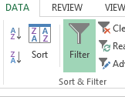

Locating Missing Forms
To locate students in Excel perform the following steps:
Path: FRAM>Reports>Eligibility
Select the settings for the current year
Choose to export as ‘CSV’
Choose the option under “Data” to filter the report
Intermediate
Choose to filter where ‘Source’ is blank
Notes:
There is a FRAM Eligibility report that you can pull to locate missing forms. You will export the file and filter where source is blank.

Slide 54
Contact Household Missing a HIF
Send home reminder with another HIF
Reach out to the household and explain the benefits of completing a HIF
Encourage Students
Ask for assistance from other school staff

Slide 55
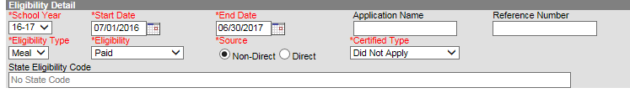
Marking Students as “Paid” and “Did Not Apply” manually
For those who do not intend to return the HIF after repeated attempts, follow these steps:
Path: FRAM>Eligibility
Locate the student
Mark the student as “Paid” and “Did Not Apply”
Notes:
Once you have made repeated attempts to reach out to the household you will have to decide when its time to move on. Once you feel pretty confident that you are not going to get a form returned… move on and manually mark as did not apply. You will follow these steps to do that.

Slide 56
FRAM Coordinator Tips
Get started early
Involve the FRYSC staff in collecting forms
Offer incentives
Include as part of registration packet
Emphasize importance to parents on qualifying for additional educational benefits for the school

Slide 57
Best Practices for Comparing and Monitoring
Import DC File each month
Homeless Student List
  Any student on a signed and dated homeless/runaway/migrant list can be marked as “DC” and “Free”
Advanced Comparison of DC Students
  Compare list of DC students in prior school year to current school year
  Search current DC list to identify any who were DC last year that might need to be DC this year
Notes:
Shown above are the best practices for your district to obtain the highest free meal status percentage possible.

Slide 58
Resources
Several useful ad hoc reports have been placed under the “State Published” folder in IC
FRAM Transposed Meal Eligibility Dates
  Locates records where the meal status data was imported in the wrong school year
FRAM Missing Meal Eligibility Records-District
FRAM Missing Meal Eligibility Records-School
KDE CEP Website
https://education.ky.gov/districts/SHS/Pages/Community-Eligibility-Provision-(CEP).aspx
Notes:
Here are several other resources for you. You can use the FRAM Missing Meal Eligibility Records – School along with the letter editor in Campus to send out reminder letters for households without a HIF form returned.
Review the KDE CEP website for additional tools on CEP.
Coordinator tips/acronyms, powerpoints, HIF form, DC tool manual (all can be found on the KDE website)

Slide 59

Campus Community
Training on FRAM Module
Campus offers training at no cost to all IC users. Check for FRAM training at http://community.infinitecampus.com
Search for FRAM in the Knowledge Base

Slide 60
Any Questions?

Slide 61
Contacts
Samantha Engstrom
Samantha.engstrom@education.ky.gov
        (502) 564- 5279, ext. 4434
Ronda Devine
ronda.devine@education.ky.gov
(502) 564- 5279, ext. 4444

