Slide 1
Entering Hearing Screenings into Infinite Campus
Angie McDonald ADN, RN, NASSNC
KDE State School Nurse Consultant
Michelle Malicote BSN, RN, NASSNC
KDPH School Health Branch Manager
2022

Slide 2
Objectives:
1. Understands steps needed to enter hearing screens into Infinite Campus
2. Can enter screening results either individually or by batch entry

Slide 3
Get Credit for Your Hard Work!
Documenting hearing screens into Infinite Campus (IC) is a simple process. However, if any of the needed information is omitted, the screening or exam will not be counted by IC.

Slide 4
How to Document a Hearing Screen
First:
Go to the Index tab on the left side
Click on Student Information
Health
General

Slide 5
Choose the Screenings tab in the main portion of the screen and select new
How to Document a Hearing Screen (cont.)

Slide 6
Choose the screening type (hearing)
In the first date box, enter the date of exam/screening

Slide 7
Your Screen Should Look Like This

Slide 8
Choose the status:
Passed
Failed
Refused

Slide 9
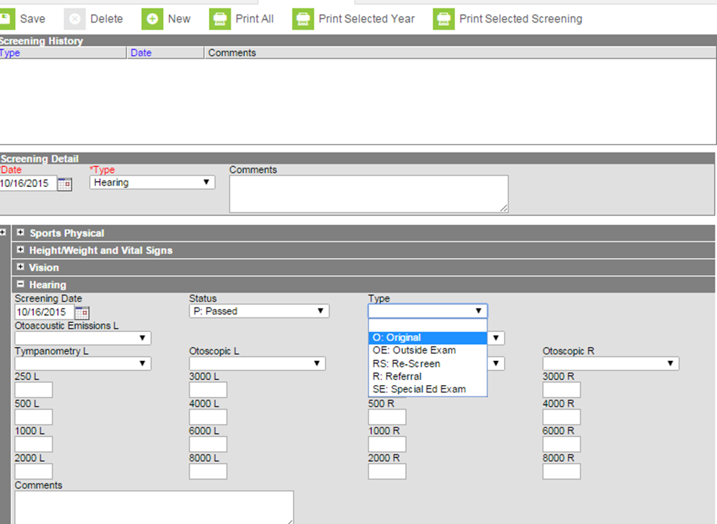
In the Type Box, choose: Screening Type
If it was a routine screening, choose original, then save

Slide 10
Batch Entries:
Batch entry is the quickest way to enter many screening results at one time

Slide 11
Batch Screening
To enter a batch screening:
Go to Index
Health
Health Screening Batch Entry
00

Slide 12
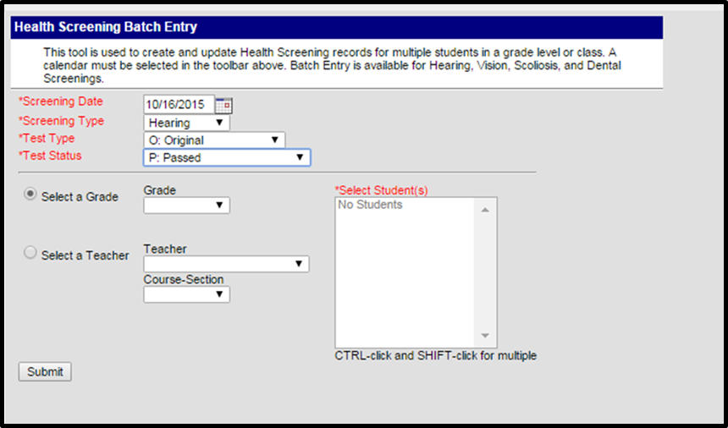
Choose the following items:
Screening date
Screening type (hearing)
Test type (original)
Test status (passed)

Slide 13
Batch Entry Continued
If you screened
a certain grade,
select it here.

Slide 14
Choosing Teacher and Course Section
If you screened a certain class,
choose the teacher’s name and the correct course-section

Slide 15
Finally,
Once you have chosen everything, click the submit
button.

Slide 16
Correcting Results from Pass to Fail (Referral):
If you have a student or group of students who need to be referred for further evaluation or if you were unable to screen a student due to absence, you can correct their screening results individually.

Slide 17
How to Edit Your Entry
Go to the Screenings tab of the student you want to edit:

Slide 18
How to Edit Your Entry (part 2)
Choose the entry from the list of screenings
It will have a “batch entry” listed in the comments section
Double click the entry

Slide 19
How to Edit Your Entry (part 3)
Go to the status box, change to referred
Enter any comments as needed
Click Save

Slide 20
How to Edit Your Entry (part 4)
If the student was not screened that day:
Double click on the screening history box.
Click delete

Slide 21
Contact Information:
Angie McDonald ADN, RN, NASSNC
KDE State School Nurse Consultant
Angela.McDonald@education.ky.gov
Michelle Malicote BSN, RN, NASSNC
KDPH School Health Branch Manager
Michelle.Malicote@ky.gov

Slide 22
This Photo by Unknown Author is licensed under CC BY-NC-ND

