Slide 1
Emergency Preparedness
School Crisis
Angie McDonald ADN, RN, NASSNC
KDE State School Nurse Consultant
Michelle Malicote BSN, RN, NASSNC
KDPH School Health Branch Manager
2022

Slide 2
Objectives:
Understand the role of the school nurses in emergency preparedness
Can implement programs considering the four phases of emergency management
Understands the emergency preparedness plan as it relates to school health
Can utilize tools included in this presentation to develop an emergency preparedness plan as it relates to school health

Slide 3
National Association of School Nurses (NASN) Position Statement:
“The school nurse is a leader and integral partner with school staff and outside agencies in developing comprehensive school plans/procedures for injury prevention and first aid, facilitating evacuation, caring for students with special needs, performing triage, educating and training staff, providing surveillance, and reporting” (NASN Emergency Preparedness Position Statement)
Notes:
The NASN websight has all kinds of resources worth looking at!

Slide 4
Four Phases of Emergency Management:
Prevention/Mitigation – establish/conduct school safety programs, participate in school committees, implement vaccination programs
Preparedness – assist in establishing standard ER response plans, participate in skills, drills and exercises to evaluate school response and effectiveness of the plan
Response – know your role, including triage; coordination of first aid response team; providing direct care; providing mental health support to students and staff
Recovery – after disaster serve as a liaison between community resources and those in need

Slide 5
Kentucky Legislation:
KRS 158.162 - Mandatory adoption of emergency management response plan in each public school
KRS 158.163 - Law for emergency drill requirements, reporting to KDE, and the collaboration with community first responders
KRS 158.164 - Building lockdown procedures

Slide 6
School Emergency Preparedness:
Natural Disasters and Other Emergencies
Earthquakes
Fires / Explosions
Tornados
Terroristic Threats and Active Shooter
Pandemic Illness
Injuries
School nurses should:
  Know your school/districts emergency and disaster plan
  Always keep an emergency kit prepared and available
  School nurses assess, plan, implement and evaluate current plans and adapt as needed
Notes:
School districts should have an employee who oversees school safety. At least one school nurse should be part of the district’s safety team.

Slide 7
Topics to Consider Including in
Emergency Procedure Guide:
ACCIDENTS AT SCHOOL / MEDICAL EMERGENCIES
ACTIVE SCHOOL SHOOTER
ASTHMA ATTACK
BOMB THREATS
BUS SAFETY
CHILD ABUSE
COPING WITH DEATH / LOSS AT SCHOOL
DIABETES (LOW BLOOD SUGAR)
DRUG-RELATED INCIDENT
EARTHQUAKE
EMERGENCY PREPAREDNESS AND RESPONSE / CRISIS PLANNING LINKS FOR SCHOOLS
FIRST RESPONSE IN CRISIS - CALL 911
HAZARDOUS MATERIALS
HOSTAGE SITUATION
SEIZURES
SEVERE ALLERGIC REACTIONS
STUDENT ABDUCTION / RUNAWAY
STUDENT DISRUPTIONS
STUDENT-ORIENTED BULLYING / HARRASSMENT GUIDELINES
SUICIDE COMPLETION (ON CAMPUS)
SUICIDE INTERVENTION
THREATS BY STUDENTS
TORNADO / WEATHER AND FIRE EMERGENCIES
VIOLENT BEHAVIOR
WHEN TO CALL EMERGENCY MEDICAL SERVICES (EMS)
Notes:
Emergency Procedure Guide could be a flip chart where procedures are reviewed at least every 5 years by gathering a community team CONSISTING OF BUT NOT LIMITED TO EMS, police, BOTH LOCAL AND STATE, local pharmacy representative, facility management staff, transportation representative as well as guidance counselor and school nurse.

Slide 8
Put a PLAN Together:
How will I receive emergency alerts and warnings?
How will I communicate with my other school health colleagues?
What is our school shelter plan?
What is our school evacuation route?
Do I need to update the emergency preparedness kit?
Check with the Centers for Disease Control (CDC) and update any emergency plans due to Coronavirus.
Get masks (for everyone over 2 years old), disinfectants and check any sheltering plan.
Notes:
Remember, phones may not be working, how will you communicate with others, radios, walkie talkies, etc.?
Very likely that Infinite Campus may not be available, how to access student health records and consents. What if some students are re-located to another school. How will you access their health records if needed?

Slide 9
Emergency Operations Plan:
Evacuation: For use when conditions on the outside are safer than on the inside
Reverse Evacuation: For use when conditions inside are safer than outside
Lockdown: For use to protect occupants from potential dangers outside the building
Shelter-In-Place: For use in external gas or chemical release
Drop, Cover and Hold: For use in earthquake or other immanent danger to building or immediate surroundings

Slide 10

Other Ways to Prepare:
Practice emergency drills
Test communication plan
Plan to account for all persons
How are you going to communicate? Cell phone, text, walkie-talkie, etc.
Family reunification plan
Recovery phase: debriefing for staff and students
Safeguard student rosters / documents
Plan with other school nurses in your district if applicable
Assemble or update supplies
Develop personal family / household communication plan
Seek professional development to address skills related to emergencies, triage and providing emergency care
Access to student health information in the event of power or internet outages

Slide 11

Consider specific needs of your school:
Different ages of members within your school
Responsibilities for assisting others
Locations frequented
Dietary needs
Languages spoken
Cultural and religious considerations
Medical needs including prescriptions and equipment
Disabilities or access and functional needs including devices and equipment
Pets or service animals
Notes:
What is the plan for relocation of students if needed? Who will need a handicapped bus? What supplies and/or medications will be needed for those students? Who needs to travel with or stay with those students?

Slide 12
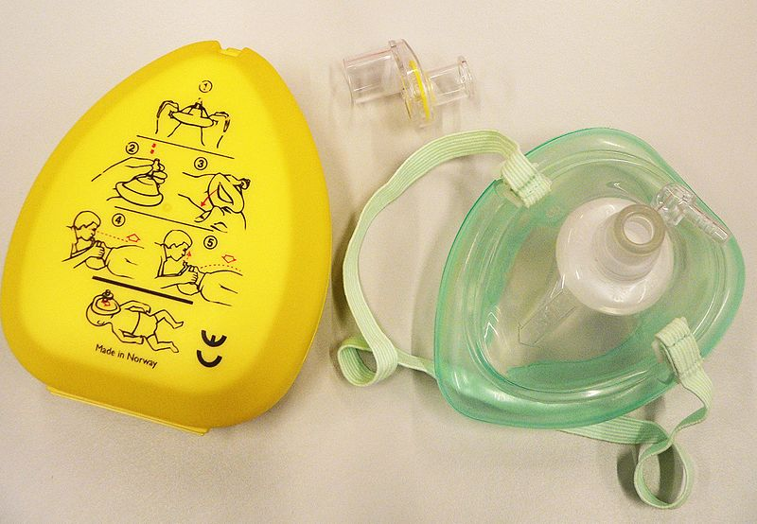
“Emergency Box” example of inventory:
• Two EPIPENS (one) 0.15mg and (one) 0.3mg with standing order in baggie
NARCAN (two) with standing order in baggie (if applicable)
• One flashlight with (two) D batteries and extra (two more) D batteries
• One stethoscope
• Eight ammonia inhalants
• One CPR mask
• One glucose gel
• One hand sanitizer
• Baggie with gloves
Notes:
Epinephrine and Narcan if approved by district policy

Slide 13
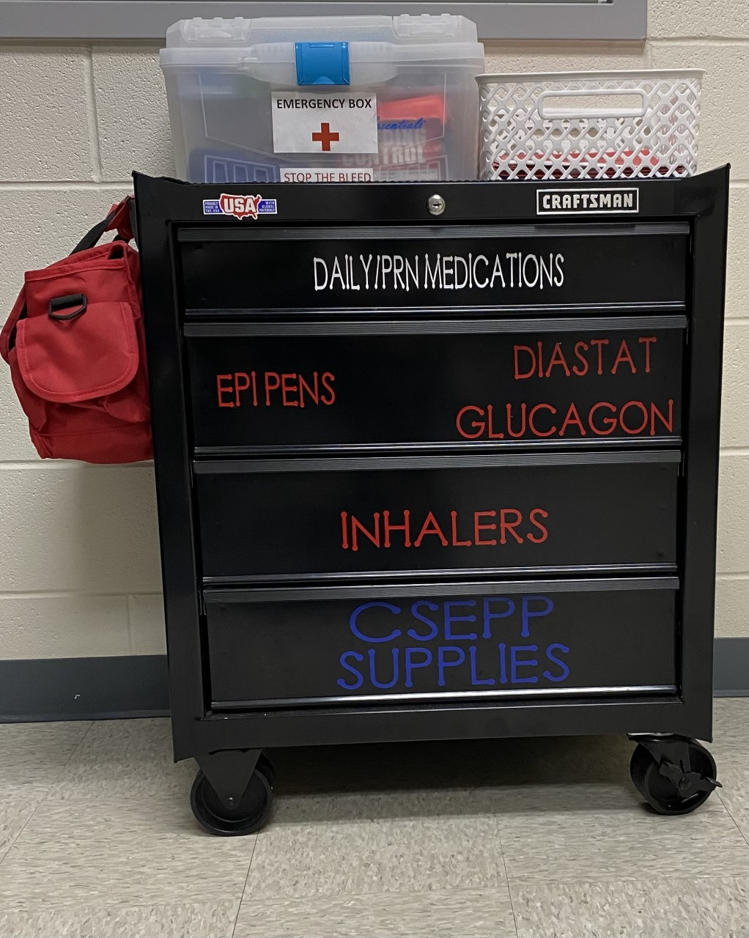
Emergency – Medication Cart:

Slide 14

“Emergency Box” example of inventory (cont.):
• Baggie with 1” Ace wrap and 2” Ace wrap, roll of tape, gauze
roll, pair of gloves, adhesive Telfa pads, gauze 4x4
• Band-Aids – big and small
• Alcohol pads
• Steri-strips
• Non-adherent Telfa pads
• Poison Control sticker on outside of box
• Emergency flow sheet in plastic slip with ink pen

Slide 15
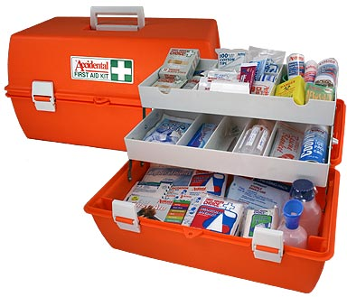
Sample Emergency Box Inventory Sheet:
Notes:
Sample “Emergency Box” Inventory Checklist

Slide 16
Resources:
Student Health Services - Kentucky Department of Education
CHFS Public Health Preparedness Program
CDC Children in Disasters: Teachers and Childcare
Kentucky Center for School Safety- Emergency Management Resource Guide
NASN Emergency Preparedness Position Statement

Slide 17
References:
Emergency Preparedness in School | Accredited Schools Online
Ready.gov Disasters and Emergencies
Readiness and Emergency Management for Schools

Slide 18
Contact Information:
Angie McDonald ADN, RN, NASSNC
KDE State School Nurse Consultant
Angela.Mcdonald@education.ky.gov
Michelle Malicote BSN, RN, NASSNC
KDPH School Health Branch Manager
Michelle.Malicote@ky.gov

Slide 19


