Slide 1
New SAAR Application
Laura Loman
Resource Management Analyst
Office of Finance and Operations
Student Tracking Data Branch

Slide 2
SAAR Application Submission
SAAR Application Link
SAAR Application Guidance Document (SAAR/Growth Factor/Jan GF)
New SAAR Application is a one stop shop:
SAAR
Growth Factor
January Growth Factor
Notes:
The SAAR Application Link one-stop shop for all of the Growth Factor, January Growth Factor and SAAR Reports.
We will walk through the entire application process, from the first steps of creating and generating a report from Infinite Campus, to sending the report through the SAAR Application Link. We will look at all of the tabs through the application, go through all of the stages of submission and the final verification process. We will also show users how to find historical reports that have already been uploaded in the application.
And then we will have plenty of time for Q and A at the end.

Slide 3
SAAR Application Dashboard
Home –Reports (SAAR/GF/JanGF)
District Information
Report Manager (SAAR/GF/JanGF)
Request New User

Slide 4
Home Tab
Notes:
A couple of quick notes regarding what you see on the HOME tab:
in the top right corner, you will see your basic info: your login, your school district
And you cant see it on this screenshot but from the home tab, you will see KDE contact info in the bottom right corner
by clicking View Reports here you can sort by school year to see historical reports from previous years.

Slide 5
District Information Tab
Notes:
The Details tab provides basic district information that is pulled in from SRIM.
The Users tab will be a list of all users and the roles these users fill.
Superintendent – needed to verify final reports
Finance Officer – can view only
District User – access to upload, edit files. This would include DPP and any other staff who needs access.
The Communication Activity tab provides an account of messages sent through the SAAR application and KDE.
The Submissions tab provides information on previous SAAR application submissions.

Slide 6
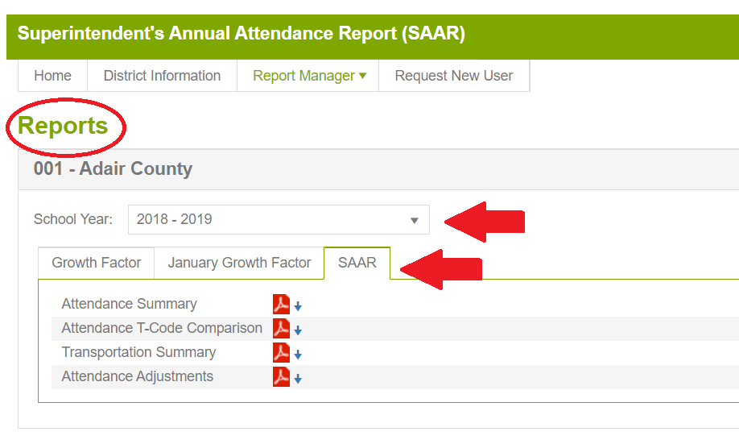
Report Manager Tab
Reports for all three types of Submissions– SAAR/GF/JanGF
Historical Reports Submitted by School Year
Notes:
There is a Report Manager's tab at the top of the screen.
This tab will bring up separate tabs for GF, Jan GF and SAAR. You can also sort here by school year to see historical reports.
And all historical reports have been uploaded in the system.

Slide 7
Request New User Tab
Names have been loaded from prior distribution list
Use this to request a new user
Notes:
This is the tab you will use to request a new user. You will fill in First and last name, email address and role ( Superintendent, Finance Officer and District User) You will then Click submit, which will trigger an email notification for KDE to add the person. Once the person is added, they will receive an email stating that they have been added to the SAAR application and can now log in using the Microsoft credentials.
If you have someone who has retired or left and needs to be removed, you can email me directly to have that person marked as inactive.

Slide 8
SAAR Basics
Purpose:
The Superintendent's Annual Attendance Report (SAAR) provides year-end attendance information used to calculate the school district's enrollment, membership, average daily membership (ADM), percent of attendance, home and hospital ADA, and adjusted average daily attendance (AADA). All information is reported by the school, grade level, and by transportation code.
Regarding AADA: SAAR for SY 2022- 23 will include full day Kindergarten AADA
Notes:
SAAR for SY 2022-23 will include full day Kindergarten AADA.

Slide 9
10 Focus Area Records for SAAR
Notes:
These are the 10 focus area records for SAAR. Note that records 1, 2 and 4 are different than they were for Growth Factor.

Slide 10
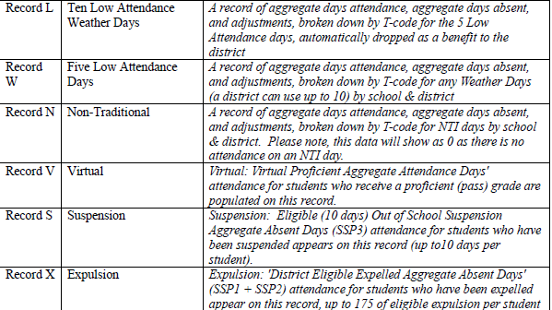
10 Focus Area Records for SAAR
Notes:
These are the 10 focus area records for SAAR. Not that records 1, 2 and 4 are different than they were for Growth Factor.

Slide 11
Data Cleanup
State Enrollment Overlap Report
Missing Enrollment End Status
Kindergarten Full-Day/Half-Day Indicator
ADA/ADM Report – Full Year
Student Schedule Gap
Overlapping T-Codes
Missing T-Codes
Period Schedule Gaps
Non-Resident-Out of State Students
Overage/Underage
Expulsion Attendance
Partial Day Students
Home Hospital Students
Funding Gap Audit Report
District Daily Attendance Report
Notes:
All of these reports help with data cleanup and should be done monthly AND before pulling your SAAR Files.

Slide 12
State Enrollment Overlap
Path: Student Information>Reports>State Enrollment Overlap
Description: Enrollment overlaps occur when the begin/end dates of one primary enrollment overlap with that of a second primary enrollment record for the same student
KDE will not process a district SAAR until all overlaps of more than one day are corrected
Action: Correct enrollment overlaps
Notes:
All enrollment overlaps must be corrected before KDE can verify your submission. We had a lot of issues with this one on Growth Factor and I can not verify on my end until this report is cleaned up. Only a 1-day overlap will be allowed. If the overlap is outside of your district, you will need to call that district to get that cleaned up.

Slide 13
Missing Enrollment End Status
Path: Ad Hoc Reporting>Filter Designer>State Published>Student ENR End Date With No End Status
Description: Identifies students who have an enrollment with an end date but no associated end status
Action: Add an end status to enrollment
Notes:
This was another one we had issues with during Growth Factor submission. If you have students who are end dated with no end status you will get a record 1 issue when submitting GF and this will be a record 5 issue when submitting SAAR.

Slide 14
Student Schedule Gaps
Path: Ky State Reporting>KDE Reports>Schedule Gap Report
Description: Used to locate student schedule gaps
Action: Correct any schedule gaps for any dates shown on this report. Perform this for any withdrawn students as well, since they do affect the attendance reports.
Notes:
This is the path to locate student schedule gaps. You will want tot correct any gap for any dates shown on this report. You will perform this for any withdrawn students as well.
And if you don’t set up placeholder for VPB courses it will show a gap in the schedule.
There could be a reason for the gap and that is fine. This report is just to show you the students with the gap incase it does need to be corrected.

Slide 15
Audit Overlapping T Codes
Path: Ad Hoc Reporting>Filter Designer>State Published
Description: Student records with overlapping transportation codes need to be corrected
Run this query for each school
Action: Correct any overlapping transportation records
Notes:
This is the path for finding overlapping t-codes. You can not have overlapping t-codes and all students need a t-code. If there is no tcode for the students, it will automatically mark as non transport and you will not get any funding for that student.

Slide 16
Missing End Dated Students/T Codes
Path: Ad Hoc Reporting>Filter Designer>State Published>Student Audit End-dated T-Code Record
Description: Locate Student who were enrolled, listed with t-codes and was a ‘no show’ or left and then came back for part of the year.
Action: Make sure these are correct to ensure you are getting full year of transportation,
Notes:
This is the path for locating students with an end dated tcode.
If you have a student who was enrolled, listed with a T-Code, but then was a ‘No Show’ or left and then came back for part of the year,
this ad hoc will help locate these students to ensure you are getting the full year of transportation for that student.

Slide 17
Audit Missing T-Codes
Path: Ad Hoc Reporting>Filter Designer>State Published>Missing T-code
Description: All students should have a T-Code associated with their school enrollment records.
Action: Run the Missing T-Code filter for each school. Assign a transportation code and enter a date segment for students.
Notes:
This is the report to run for missing t-codes. All student should have a t-code associated with their student enrollment record.

Slide 18
Overage/Underage
Path: KY State Reporting>Edit Reports>SAAR report> R9
Description: Identifies underage/overage students.
Action: Check for accuracy of Student DOB and that all students with waiver are correctly identified.
*You can no longer run the overage/underage report under KY state reporting>edit reports>Overage/Underage report.
Notes:
This is the path for identifying overage and underage students. If you have underage students with the waiver box checked you will get a Record 9 warning when submitting SAAR or a record 4 when submitting GF. You will be able a resolve this warning by explaining that you have an underage student with the waiver and proceed with your submission.

Slide 19
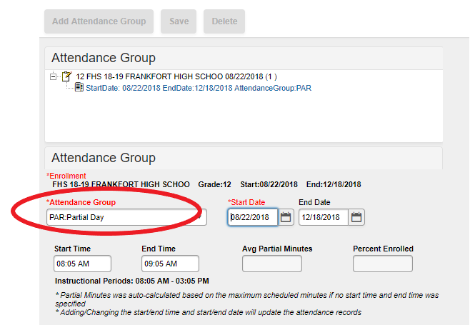
State Attendance Groups/Audit Partial Day
Path: Ad Hoc Reporting>Filter Designer>State Published>Student Audit Partial Day
Description: Identifies students with a Partial Day attendance group. (i.e., Students with IEPs whose LRE is partial day.)
Action: Ensure that the setup is correct for partial day students.
Verify start date, start time and end time match the student’s IEP (as applicable)
Notes:
This is the report for identifying students with partial day attendance groups. You will want to Make sure that they have those students marked in partial day attendance groups.
If they have an IEP and they are partial day, they must check wavier box to get full funding.

Slide 20
State Attendance Groups/Audit Home Hospital
Path: Ad Hoc Reporting>Filter Designer>State Published>Student Audit Home Hospital
Description: Identifies students in the HH attendance
Action: Ensure that attendance is marked properly
Any student eligible for HH must be put in the HH attendance group
*State date should be the date signed by the doctor.
Notes:
This is the path to identify students in HH.
HH must have the correct start and end date. Start date will be the date signed by doctor and end date would be when released.

Slide 21
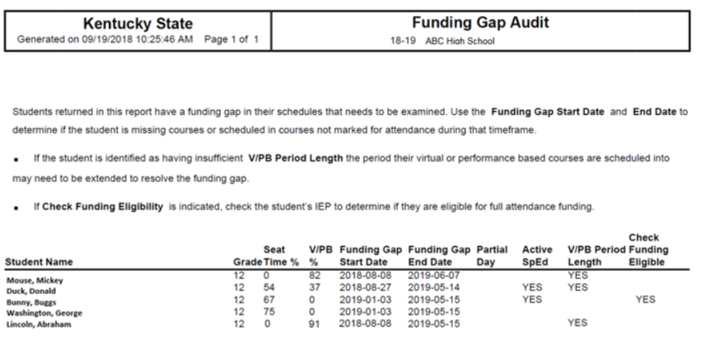
Funding Gap Audit Report
Path: KY State Reporting/Funding Gap Audit
Report is to produce a list of students that potentially have funding gaps in their schedules
The report is designed to look at a student’s schedule and display the percentage of attendance used to calculate funding for seat time attendance classes and virtual/performance-based classes
This report is not designed to be “cleared. It is an auditing tool to help identify potential issues with student schedules that could result in a loss of funding
Notes:
The purpose of this report is to produce a list of students that potentially have funding gaps in their schedules. The report is designed to look at a student’s schedule and display the percentage of attendance used to calculate funding for seat time attendance classes and virtual/performance-based classes. Students with a combined total of less than 100% in these two class types will be returned on the report. Schedules for these students should be examined to determine whether there is a funding gap that needs to be addressed. This report is not designed to be “cleared”. It is an auditing tool to help identify potential issues with student schedules that could result in a loss of funding. For more information, see the Funding Gap Audit Report Quick Reference Card

Slide 22
Notes:
The BLUE line you see Seat Time 64% and V/PB 13% add those two together equals = 77. This student does not have enough V/PB time OR error in their schedule.
RED Line 78% Seat time 0% in V/PB – First thing I would do is look that student schedule, then look at each class to make sure the set-up is correct.
GREEN Line – 0% in Seat Time and 93% in V/PB – This is student is good to go. Our magic number for this report is 93% and above. This report does not include passing time or lunch times.
REMINDER THIS REPORT DOES NOT HAVE TO BE CLEARED!!

Slide 23
Data Cleanup reports
Refer to the SAAR training document for additional details on all data cleanup reports.
You should be running these reports monthly, but we recommend checking all these reports prior to generating your SAAR file in Infinite Campus.
Notes:
You should refer to the SAAR training document for additional info on data cleanup reports.
Run these reports monthly.

Slide 24
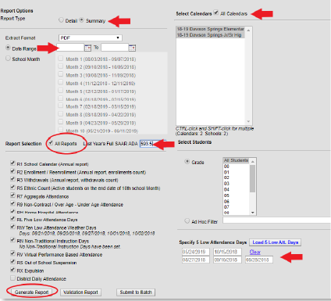
Creating Your SAAR File
Path: KY State Reporting > SAAR
Run the State Format Fixed Width for all Schools
Leave the date range blank
Select 'All Reports’
Select ‘All Calendars’
Generate Report
The file name should be saved as SAARXXX.YY (XXX = District Number, YY= School Year)
Example: SAAR011.23
Submit the file to SAAR Application
*You will select all calendars, unless you have a calendar covered by other districts
or a place holder calendar (such as a home school calendar)
Notes:
This is the path for creating for the SAAR File. KY State reporting, SAAR Report…..
…..
The file you submit will be “fixed width” but be sure to run and save the PDF version for your own records.

Slide 25
Creating PDF version for verification
You should follow the same steps on the previous slide to generate the SAAR PDF immediately following the SAAR State Format report.
If the SAAR PDF is completed later, the information on the two reports may not match

Slide 26
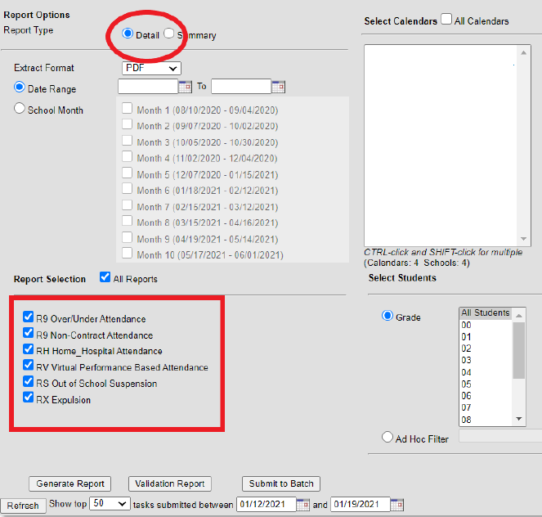
SAAR Detail Report
Several SAAR reports have detail reports that provide additional information.
Detail reports can be run by selecting “detail” in the report type.
Detail reports can be run for R9, RH, RV, RS and RX.
Notes:
The detail reports provide additional information like school level listings of students who appear on the SAAR records.

Slide 27
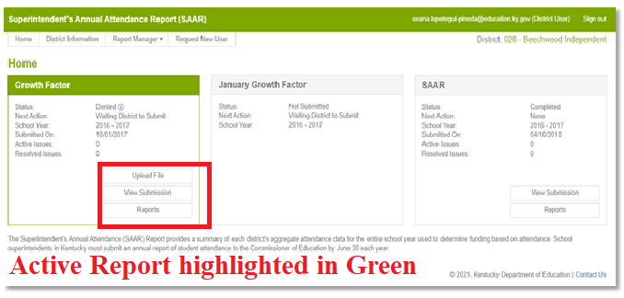
New SAAR Application
Access the new SAAR system by using the link found on the KDE Website: SAAR Application
Log in; this will be the same login credentials used to access your Microsoft Outlook
Notes:
Main Function of Home screen
Tabs for the three cycles of SAAR – Growth Factor, January GF, and SAAR
The three cycles on the home tab will reflect the current year
The tab that is highlighted in green is currently open

Slide 28
Submission Details Tabs
Notes:
This is what you will see on the submission details tabs. It will show your district, school year, report type, when it was submitted and if it has been verified or where it is in the approval process.
And highlighted in red you will see additional tabs and we will talk about each tab in more detail.

Slide 29
Details
Notes:
the DETAILS tab will import all of the following data.
Once you have imported your files, you will see data here under each tab.

Slide 30
Reports
Notes:
This is what the reports tab will look like and it shows the reports that have been submitted.

Slide 31
Messages
Notes:
This is the messages tab, this is going to show you any communication between the district or KDE. If anyone has a question it will show here.. If we have questions we will typically message you through the system instead of via email but it should notify you via email that someone has sent you a message.

Slide 32
Status Tracking
Notes:
The status tracking tab will show you where the submission is in the approval process and who has verified/who we are waiting on. For this specific example, you will see it was submitted 6/21. It will show you who submitted it. Then it was verified by KDE on 8/16. You will see who verified it and then as you can see this one is still waiting on district verification so once that has happened, that would show here as well.
Status: the status that the Infinite Campus file is in. Below you will find the different status categories:
Not Submitted – the district has not submitted a file yet.
Waiting KDE Review – Infinite Campus file submitted by the district, waiting for KDE review
Waiting District Review – has already been reviewed by KDE, no errors, now awaiting verification by the Superintendent
Waiting KDE to Complete – has been verified by Superintendent, now simply waiting on KDE to finalize
Complete – submission final, approved by all parties
Denied – the submission can be denied by the district superintendent or KDE at any point during the submission.
Withdrawn – The district has withdrawn submission

Slide 33
Things to Remember Submitting File
Your GF, Jan GF, and SAAR files will now be uploaded through this SAAR system instead of the KDE page you have used in years past
You will still format the file name the same as in years past; the file name should be saved as CYCLENAMEXXX.YY (XXX = District Number, YY= School Year)
Notes:
This system is where you will upload all your GF, Jan GF and SAAR files instead of through the KDE website like in the past.
Just a reminder that you will format the file just like you did in the past when you submit it. IE. Cycle (GF, JANGF or SAAR, 3 digit district number and then school year. IE: GF,district number,23.

Slide 34
Submitting File with no issues
If the file presents NO errors or warnings, it will submit without any additional steps, and the district user will see the screenshot below.
Notes:
If the file has no warnings or errors, you will see this confirmation. At this point, the District User and the Finance Officer roles are able to view submission.

Slide 35
Submitting File with errors/warnings
Note - The SAAR application will show what are the errors or warnings as seen above.
Withdraw submission – this button will allow the KDE user to withdraw the submission to make any adjustments.
Note – the Withdraw submission button will ONLY be available for files presenting any errors or warnings. Some files present hard stops, which means the district users will need to generate the file from Infinite Campus to correct the errors and resubmit the file in the SAAR application.
Notes:
This is what you will see if you submission has been submitted but there are errors or warnings that need to be fixed.
It will show you what the errors or warning are as seen in this screenshot.
Withdraw submission……
Note…….
Application has some “hard stops”, when this occurs the file has an error that can’t be accepted,
Others are just ‘warnings’ for which an explanation must be included. For example, 8th graders who take classes at the high school.

Slide 36
Resolving warnings
When a file is uploaded with warnings, school districts will need to explain what is causing the warning by selecting ‘Resolve’
Notes:
When a file is uploaded with a warning, you will select resolve, and then you will be able to explain what is causing this warning.

Slide 37
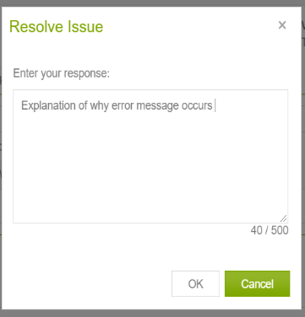
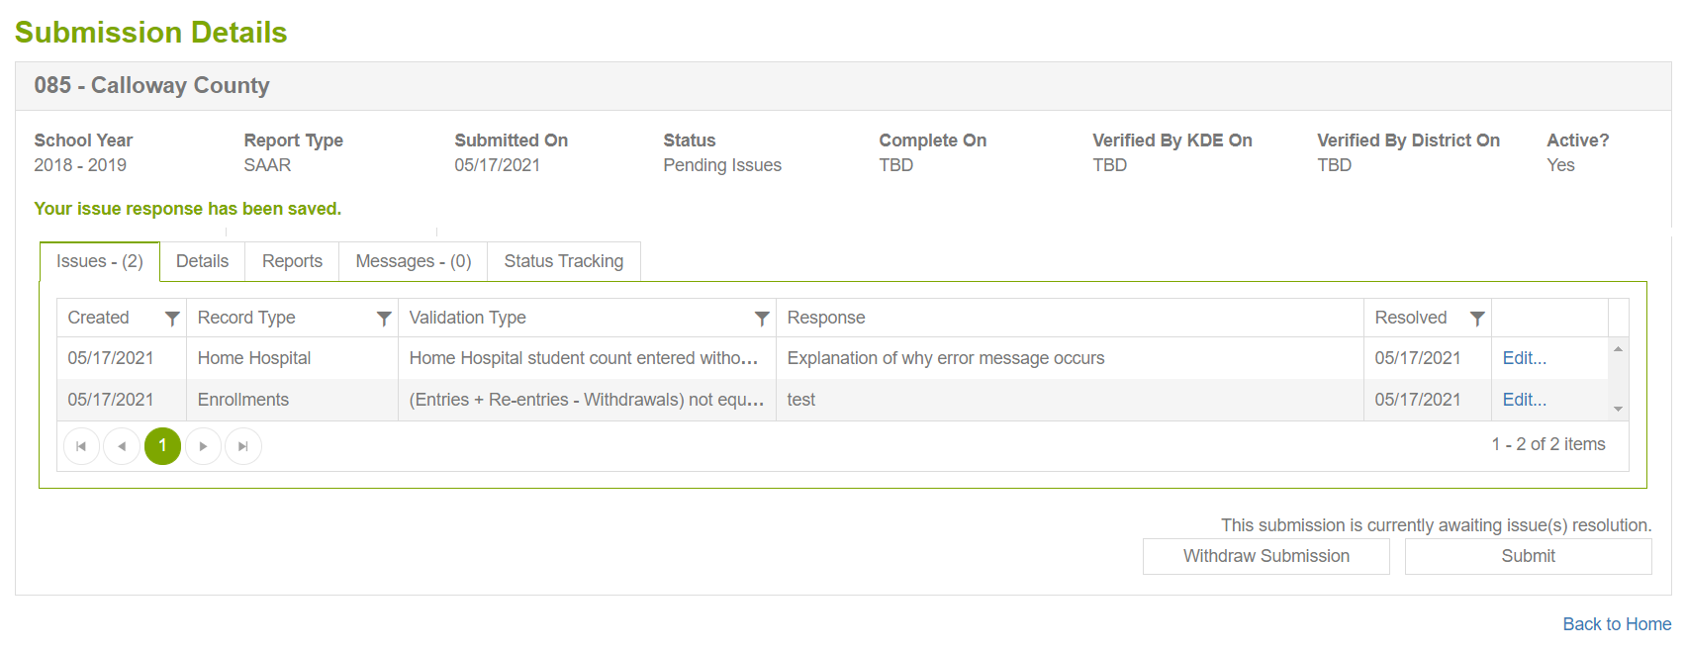
Resolve to submit
type the explanation for the error or warning (as shown below), then click Ok. After all the issues are resolved, the Submit button becomes active, and the District User can proceed with the file submission process by clicking on the "Submit" button.
Notes:
You will type the explanation for the error or warning and then click ok.
This is the same procedure as the old system, just explaining the warning via the new SAAR app instead of a separate email.
Once you have resolved the issues, the submit button will become active.

Slide 38
Submission Process
After the district submits the file, KDE reviews the submission and will "Approve" or "Deny" the file based on its validity.
If KDE denies the file – the file status changes to "Denied," and a response with a Deny explanation will be sent to the District User role.
If KDE approves the file – the file status changes to "Verified by KDE" and the Next Action for the district to be taken by the Superintendent.
Notes:
Once submitted, KDE will review and approve or deny the file.
if KDE denies the file, the status then changes to denied with a reason for why it was denied and then the district user role will be notified.
If KDE approves the file, the status will change to verified by KDE and it will then be ready for approval by the superintendent.

Slide 39
Verification Process
At this point, the Superintendent can Deny or Approve the file based on its validity.
If the Superintendent denies the file – the file status changes to "Denied," and a response with a Deny explanation will be sent to the District User role and KDE submission group.
If the Superintendent approves the file – the file status changes to "Verified by the District," which will complete all activities the district needs to perform during a file submission in the SAAR application.
Notes:
At this point, the superintendent will then be able to deny or approve the file.
The superintendent is notified via email when it is time for verification. The superintendent is the only person who can verify the submission at this point and is the only person notified when it is fine for them to verify.

Slide 40
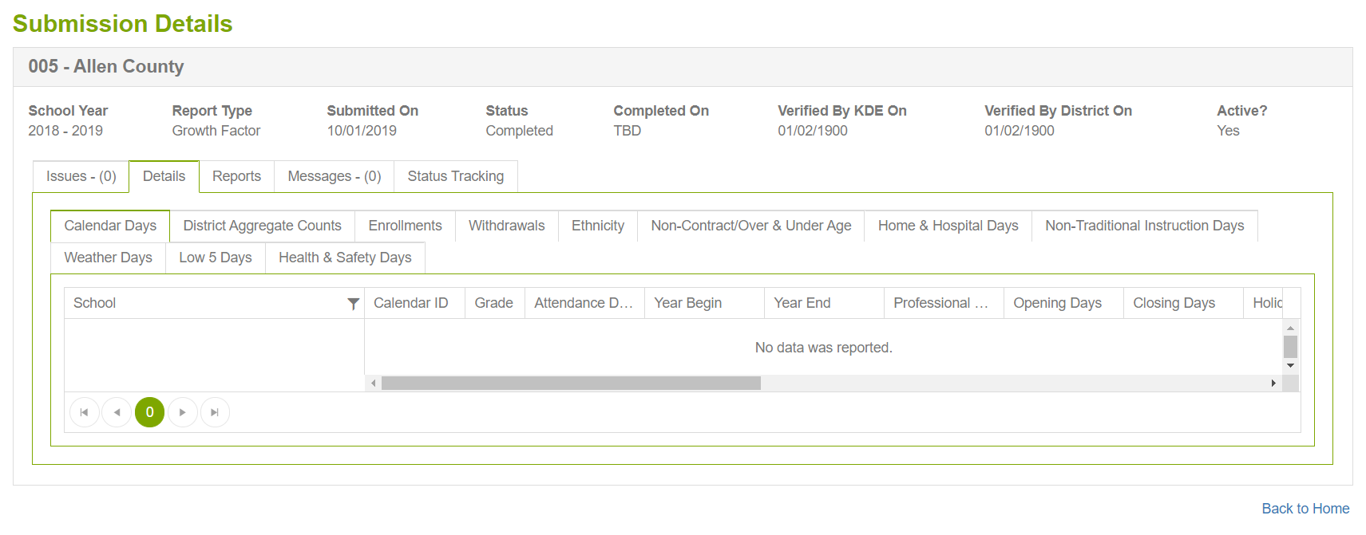
After a file is submitted
For reports already submitted, the View Submission button will be available.
Notes:
After the file is submitted the view submission button will become available and you will see this which will show you the details of your submission. So DPPs have mentioned that they do not have access to open the files when it is waiting on superintendent verification. These files do not become available to view on the District user end, until they have been verified by the Superintendent.
So you will see detailed reports for all records that were submitted.

Slide 41
Resources
SAAR Application Link
SAAR Application Guidance Document (SAAR/Growth Factor/Jan GF)
Superintendent's Annual Attendance Report (SAAR) - Kentucky Department of Education

Slide 42
Questions?
Notes:
Feedback on SAAR System?

Slide 43
Contact Info
Laura Loman- laura.loman@education.ky.gov
502-564-5279 ext. 4485
Ronda Devine- ronda.devine@education.ky.gov
502-564-5279 ext.4444

Slide 44
Attendance Summary Report
Notes:
Use the second page of the report to help verify each column. Run your SAAR Report as a pdf and check each calculation. The second page of this report explains the calculation for each line. ​
A1 K Reported Kindergarten Aggregate Days Present​
A2 1-12 Reported Grades 1-12 Aggregate Days Present​
C1 K Adjustments Total Adjustments for Kindergarten - five low attendance days, weather days, non-traditional days, non-contract and overage/underage​
C2 1-12 Adjustments Total Adjustments for 1-12 - five low attendance days, weather days, non-traditional days, non-contract and overage/underage​
D1 K Substituted Days Number of low weather days plus non-traditional days times last year's full AADA (You only have this if you claimed any low weather days in addition to the 5 low​
D2 1-12 Substituted Days Number of low weather days plus non-traditional days times last year's full AADA (You only have this if you claimed any low weather days in addition to the 5 low​
E1 K Adjusted Reported A1 - C1 (subtract C1 as a positive number)​
E2 1-12 Adjusted Reported A2 - C2 (subtract C2 as a positive number)​
F1 Full AADA K D1 + E1 divided (L-5) Substituted Days + K Adjusted/Number of Days Reported - 5​
F2 Full AADA 1-12 D2 + E2 divided (L-5) Substituted Days + K Adjusted/Number of Days Reported - 5​
F3 Adjusted AADA 1/2 K Full AADA 1-12 plus 1/2 Full Kindergarten​
G ADM Base Aggregate Days Present + Base Aggregate Days Absent divided by number of days taught​
H Enrollment District total of all E1's, E2's, and E3's​
I Membership District total count of Ethnic Count (Record 2 – Record 3 = Record 5) Enrollment plus re-enrollment minus withdrawals​
J Attendance Percentage District Aggregate Days Present divided by (District Aggregate Days Present) + (District Aggregate Days Absent)​
K H/H AADA District Aggregate Days Home & Hospital divided by Number of Days Taught​
L Number of Days Total Number of Days Taught

Slide 45
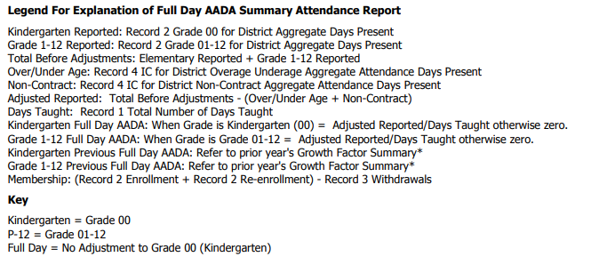
School Summary Report

Slide 46
Full Day Attendance Adjustment Report
Notes:
Grade 1-12 IC adjustment: Includes V/PB, suspension, expulsion

Slide 47
Attendance T-Code Comparison
T1: Twice Daily > Mile​
T2: Twice Daily < Mile​
T3: Once Daily > Mile ​
T4: Once Daily < Mile​
T5: Special Transport​
NT: Not Transported
Notes:
There is a lot of funding connected with transportation. Please review this carefully. In the example above, notice the drastic difference in T-1 Codes and NT from previous to current years. Remember, we do not pay for NT and this district may have lost funding due to errors in T-Coding. If a T-Code is left out, it automatically puts them into the NT Code.​ Check for accuracy, a large difference in T-codes from the previous year to current, may be a warning that something is wrong.
​
NT Not Transported​
T1 Twice Daily > Mile​
T2 Twice Daily < Mile​
T3 Once Daily > Mile ​
T4 Once Daily < Mile​
T5 Special Transport​
​

Slide 48
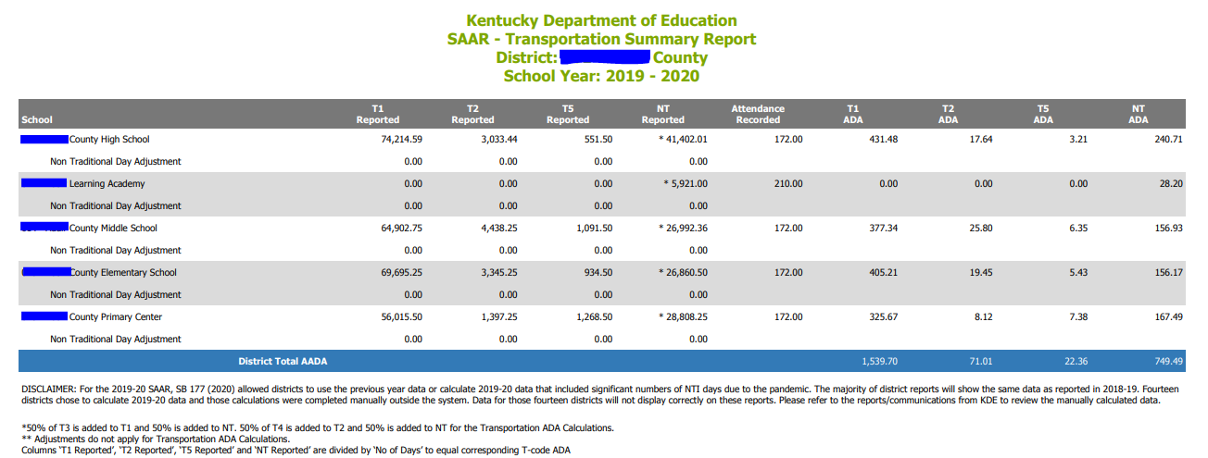
Transportation Summary Report
Notes:
*50% of T3 is added to T1 and 50% is added to NT. ​
50% of T4 is added to T2 and 50% is added to NT for the Transportation ADA Calculations.​
​
** Adjustments do not apply for Transportation ADA Calculations.​
Columns T1 Reported, T2 Reported, T5 Reported, and NT Reported are divided by Number of Days to equal corresponding T-code ADA​

