Slide 2
KY Comprehensive Literacy
Technical Assistance
KyCL General Information Technical Assistance
January 2020
Notes:
Jackie
GoSoapbox KAS

Slide 3
Kentucky Comprehensive Literacy (KyCL)
Comprehensive Literacy State Development (CLSD)
Notes:
Jackie

Slide 4
Grant’s Purpose
Support schools in improving the reading & writing achievement for all learners from birth to grade 12
Notes:
Jackie
Keeping in line with our 3 year plan, we are continuing this journey into systems and structures of support for standards implementation. We’ve looked at resources and practiced using an assignment alignment protocol. Now we are in the second phase of this series taking a closer look at the PLC structure and how it is essential in teaching and learning.

Slide 5
Comprehensive is Comprehensive
Birth to grade 12
Consider particularly the birth to age 3 children in your community
How will they be served?
Which partners will you need to accomplish this comprehensive piece?
Notes:
Misty
Can tie back to Opportunity Myth

Slide 6
Comprehensive & Integrated Literacy Plan
Birth – Grade 12
Internal & External Partners
Include characteristics of comprehensive literacy
Evidence from the Literacy PERKS needs assessment
Instructional strategies for at-risk students & those with disabilities

Slide 7
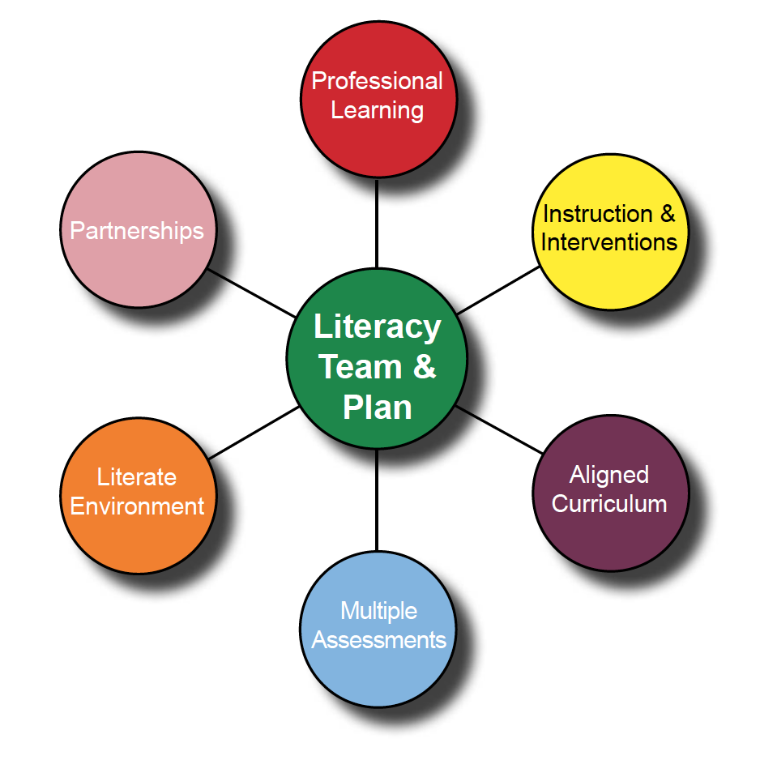
Literacy Needs Assessment
Literacy PERKS
Program Effectiveness Review for KY Schools
PERKS document
Notes:
Misty
not a program or a meeting

Slide 8
Literacy PERKS
Consider
Who will be a part of the needs assessment?
Timeline?
Compilation of information?
Find the Literacy PERKS document and Literacy Planning Booklet at https://education.ky.gov/curriculum/conpro/engla/Pages/striving_readers.aspx

Slide 9
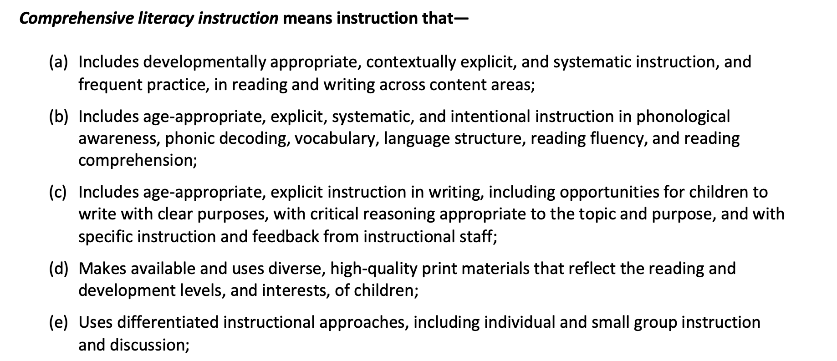
Characteristics of Comprehensive Literacy (p. 24 of RFA)

Slide 10
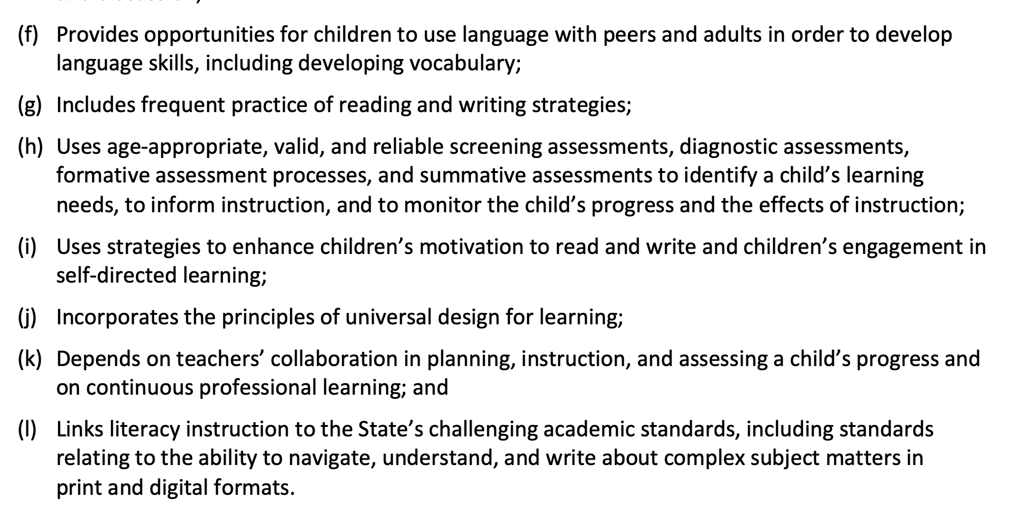

Slide 11
Comprehensive & Integrated Literacy Plan
Alignment to the Kentucky Academic Standards for Reading & Writing
Reading, Writing, Speaking & Listening
Professional Learning based on literacy needs
Assessment plan to screen, diagnose, monitor progress

Slide 12
Comprehensive & Integrated Literacy Plan: Assessment
Used to track and monitor literacy attainment
Used to inform instruction, intervention, accommodations, professional learning and program improvement

Slide 13
Comprehensive & Integrated Literacy Plan: Teacher Cohorts
Include a plan to select teachers for the three cohorts over the four-year life of the grant. 100% of teachers will be included by 2024.
2020-2023 | 2021-2024 | 2022-2024
Cohort 1 | Cohort 2 | Cohort 3
30% of teachers | additional 50% of teachers | remaining 20% of teachers

Slide 14
Professional Learning Requirements Number of Required Hours per Cohort
 | Cohort #1 | Cohort #2 | Cohort #3
2020-2021 | 60
2021-2022 | 40 | 40
2022-2023 | 24 | 40 | 24
2023-2024 |  | 24 | 24
Total | 124 | 104 | 48

Slide 15
Eligibility
Only Kentucky public school districts that include K-12 and do not have a current Striving Readers grant may apply for round 1
Use the 2018-2019 Qualifying Data to determine if the high school is at 65% or greater F/R lunch

Slide 16
Eligibility
Qualify as high poverty (65% f/r or greater)
Significant deficits in literacy in at least 3 of the 4 levels (birth to age 5, K-5, middle/high)
Agree that early education providers will be engaged as active members of the DLLT and participate in development & implementation of literacy plan

Slide 17
Feeder System
A feeder system is made up of all the schools that feed a particular high school.
All schools that feed into the eligible high school should be considered a part of the district’s plan for KyCL. If a district wishes to exclude certain schools from KyCL, clearly note in the grant for approval.
Project must serve the entire continuum, so partners that address birth to age 3 must clearly be included in the plan.

Slide 18
Endorsed Literacy Programs
To provide comprehensive literacy instruction, which includes interventions
Must choose at least one provider at each level (early childhood, elementary, middle/high) from KDE’s matrix

Slide 19
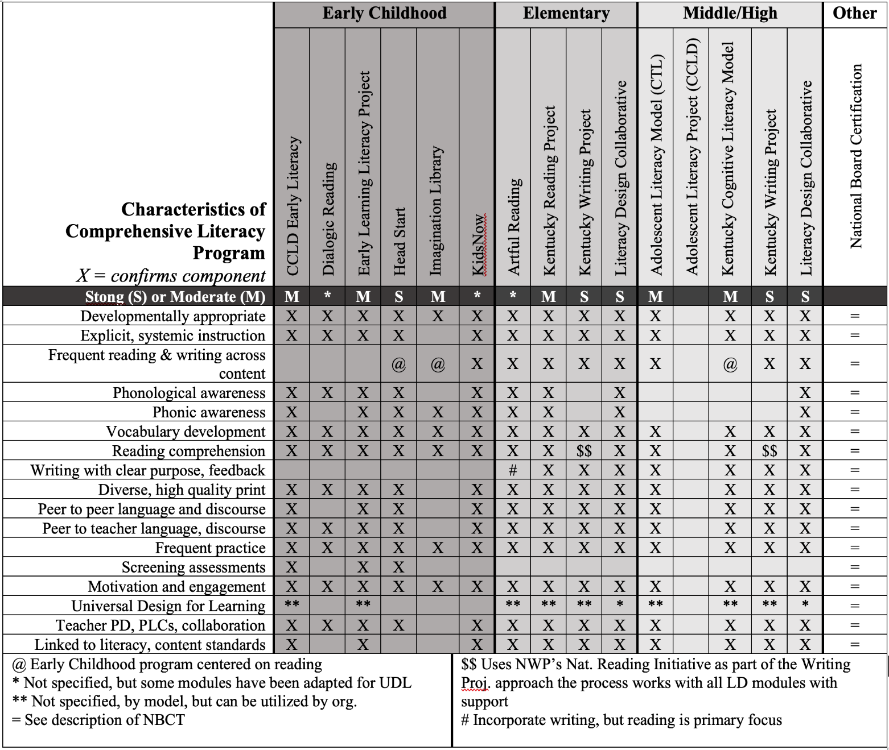

Slide 20
Additional Programs
Additional programs, outside the KDE matrix of programs, may be chosen, but those programs must be evidence-based and reviewed through the Elevating Evidence process guidance provided by the Office of Continuous Improvement and Support.

Slide 21
Evidence-based Practice Evaluation
Webinars for Evaluating Evidence
Elevating Evidence Overview
Using Databases & Clearinghouses

Slide 22
Professional Learning
Literacy focus, based on needs assessment
On-going, specialized adult learning
Not a one-time event
May occur before, during or after school
Outlined in your literacy plan
Approved by District and School Literacy Leadership Teams (DLLT & SLLT)

Slide 23
On-going Professional Learning in a Nutshell
Learn
Put into practice
Evaluating Results

Slide 24
Funding
Approximately $28 million total award
2 rounds of awards
Approximately 15 awards in the first round
Average award of the life of the grant: $1.1 million
Eligible districts may apply for 1 feeder system

Slide 25
Allocation of Funds
 | District Implementation Calendar
 | Year 1 (per feeder) July 1, 2020-Sept. 30, 2021 | Year 2 (per feeder) Oct. 1, 2021-Sept. 30, 2022 | Year 3 (per feeder) Oct. 1, 2022-Sept. 30, 2023 | Year 4 (per feeder) Oct. 1, 2023-Sept. 30, 2024 | Total (per feeder)
Small | 235,000 | 255,726 | 175,000 | 190,726 | $856,452
Medium | 300,000 | 323,726 | 230,000 | 248,726 | $1,102,452
Large | 350,000 | 376,726 | 270,000 | 291,726 | $1,288,452
See pages 25-27 of the RFA for Tier Classification Chart

Slide 26
Allocation of Funds
Birth to age 5 – 16% of funds
Kindergarten to grade 5 – 42% of funds
Middle and High School – 42% of funds

Slide 27
Literacy Intervention
Intervention is a part of comprehensive literacy instruction.
Reading intervention program or practices that address the needs of identified students reading at low levels
Program or practice must promote effective instruction and be based on trend data of the districts’ students

Slide 28
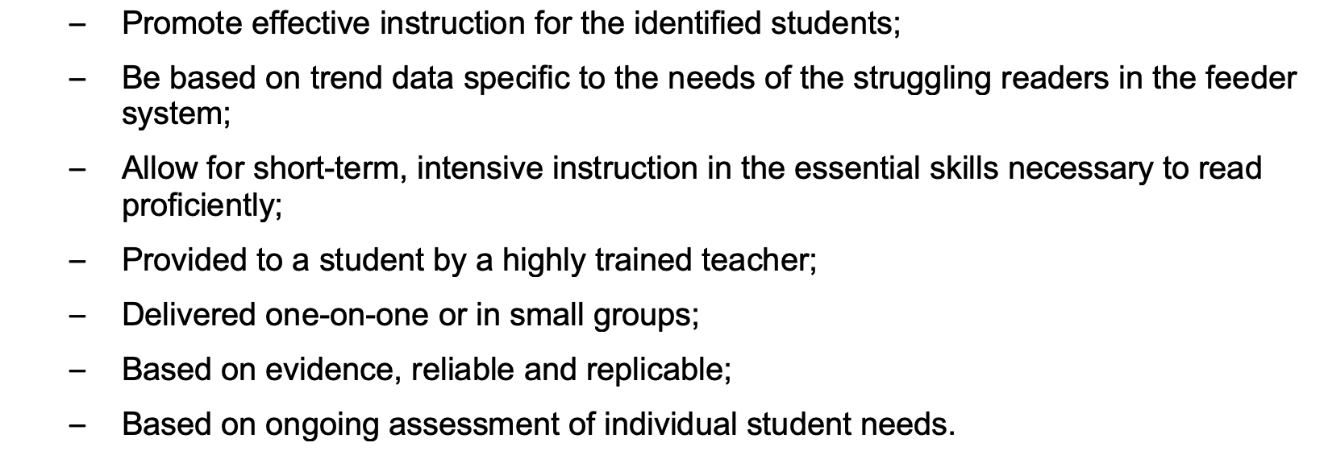
Literacy Intervention

Slide 29
School Commitment
Letter of interest from each school in the feeder
Support & commitment to improving literacy achievement for all learners
Need for school-community partnership relative to literacy and early literacy
Project alignment with other programs & funding sources having a literacy component
Current strategies to improve literacy outcomes in the community

Slide 30
Partners
Agencies (nonprofit & for-profit) the provide literacy and pre-literacy services
May include: independent, home-based, and faith-based childcare; preschool providers; Head Start centers; public school preschool; public libraries, afterschool programs, mentoring programs
Minimums: 3 for small feeder, 5 medium, 7 large systems

Slide 31
Partner Commitments
Letters Required
Relationship between the district and the partner
Reason for participating in the project
Description of the partner’s staff involvement with the district and/or school literacy leadership teams

Slide 32
Partner Commitments
Letters Required
Description of how parents (especially parents of children who are high poverty) will be involved
Types of support needed by the partner for professional learning & leadership capacity building
Partner’s commitment to the project, including their prior history of literacy work

Slide 33
Requirements for Funded Districts

Slide 34
Requirements for Funded Districts

Slide 35
Allowable & Required Activities

Slide 36
Allowable & Required Activities

Slide 37
Other Allowable Activities

Slide 38
Competitive Preference Priority (up to 5 points each)
#1 Serving Disadvantaged Children
#2 Alignment of Birth to 5th Grade
#3 Homelessness, Foster, Grandparenting

Slide 39
Competitive Preference Priority #1
Serving Disadvantaged Children
To meet Competitive Preference Priority #1 (Serving Disadvantaged Children), an applicant clearly identifies the numbers or percentages of disadvantaged children, including children living in poverty, English learners and children with disabilities (including Dyslexia), etc., as defined in this RFA. This competitive preference should be noted specifically in the pages of the narrative. The KDE will determine the application of points based on proposals submitted.

Slide 40
Competitive Preference Priority #2
Alignment of Birth to 5th Grade
To ensure alignment of birth to age 5 and Kindergarten to grade 5, the KDE will award up to an additional 5 points for applicants who have demonstrated in their proposals a significant focus on alignment to early learning. This may be demonstrated through the numbers and types of partnership with early learning providers, including but not limited to the proportional number of early learning partners to be included in this project, demonstrated through high quality Letters of Interest. This competitive preference should be noted specifically in the pages of the narrative. The KDE will award these competitive points based on the number and quality of early learning partners.

Slide 41
Competitive Preference Priority #3
Homelessness, Foster, Grandparenting
To meet Competitive Preference Priority #3, an applicant clearly identifies the numbers or percentages of school-aged children with high-mobility, including homelessness, foster and grand-parented students. For homelessness, districts must meet or exceed a level of 125% of the state’s rate. This competitive preference should be noted specifically in the pages of the narrative. The KDE will determine the application of points based on proposals submitted.

Slide 42
OPTIONAL Preference Priority #4
Impact Study Participation
Districts that indicate willingness to include four or more elementary schools in their CLSD subgrant and participate in the impact study, if awarded a CLSD subgrant, will receive the full additional three points on their application. Districts that include three elementary schools will receive two points and districts that include two elementary schools will receive one point. Districts that include only one or no elementary schools will not be eligible for additional points. However, this competitive preference area will not negatively impact any application that either does not qualify or does not choose to participate.

Slide 43
How Will the CLSD Impact Study Work?
(Video) https://www.youtube.com/watch?v=0pSLQ-nfuKY&feature=youtu.be
Questions about the Impact Study
Dr. Eleanor Flubeck: efulbeck@air.org or 650.350.9045
Dr. Jessica Heppen: jheppen@air.org or 202.403.5488

Slide 44
Applying
Review Proposal Components carefully
Assurances
GEPA 427 Statement
General Education Provisions Act
Requires a description of how applicant proposes to ensure equitable access to and participation in federally-assisted program for students, teachers, and other beneficiaries with special needs
Gender, race, national origin, color, disability, age
Google sample statement

Slide 45
Date | Event | Location | Participation
On or around January 9, 2020 | RFA Released | Online | NA
January 21, 2020 | Informational Sessions & Vendor Fair on Grant | Bowling Green GRREC | Attendance is encouraged for any potential applicants.
January 28, 2020 | Informational Sessions & Vendor Fair on Grant | Hazard KVEC
January 24, 2020 | Informational Sessions & Vendor Fair on Grant | Frankfort Admin Office of the Courts
January 27, 2020 | Informational Session about Process to Vet Additional Programs | Online | Attendance is encouraged for potential applicants.
February 20, 2020 | Submissions for Vetting of Any Additional Programs due | Send to KDERFP@education.ky.gov | Required
March 20, 2020 | Technical Assistance for grant proposal development | Frankfort Admin Office of the Courts | Attending one of the three technical assistance sessions is strongly recommended.
TBA | Technical Assistance for grant proposal development | Bowling Green
TBA | Technical Assistance for grant proposal development | Hazard
March 25, 2020 | Online Q&A Session #1 | Online
March 26, 2020 | Online Q&A Session #2
March 27, 2020 | FAQ posted online
April 13, 2020 | Proposal Deadline | Email to KDERFP@education.ky.gov | Required

Slide 46
Technical Assistance for Grant Preparation (Face-to-Face)
Friday March 20, 2020 | 9 a.m. – 3 p.m. ET | Administrative Office of the Courts 1001 Vandalay Dr, Frankfort
Thursday March 26, 2020 | 10 a.m. – 4 p.m. ET | Kentucky Valley Educational Cooperative 412 Roy Campbell Drive, Hazard
Tuesday March 24, 2020 | 10 a.m. – 4 p.m. ET | Green River Region Educational Cooperative 200 Technology Way, Bowling Green

Slide 47
Online Q&A Sessions
Wednesday March 25, 2020 | 1 p.m.—2 p.m. ET | Call-in instructions will be posted at http://education.ky.gov/ districts/business/Pages /Competitive%20Grants%20from%20KDE.aspx
Thursday March 26, 2020 | 10 a.m.—11 a.m. ET | Call-in instructions will be posted at http://education.ky.gov/ districts/business/Pages /Competitive%20Grants%20from%20KDE.aspx
Friday March 27, 2020 | By close of business | FAQ Posted

