Slide 1
Childhood and Adolescent Vaccination Update
Emily Messerli, DNP, APRN, FNP-C, Immunization Branch Manager
09/15/21

Slide 2
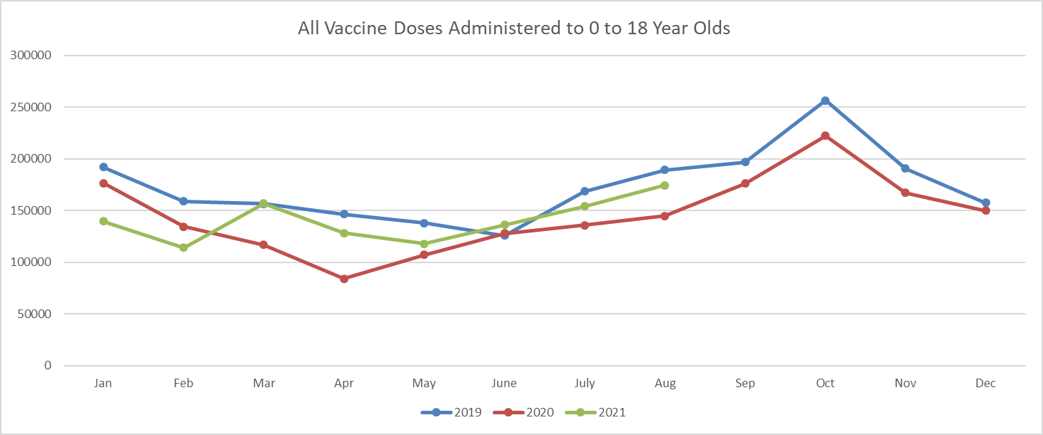
Blank
For doses administered to 0-18-year-olds, we are still below rates from 2019. However, we are currently doing better than 2020.
All data reflected is per the Kentucky Immunization Registry (KYIR).

Slide 3
Blank 1
There was a huge increase in April from last year, and some moderate increases through June-August. This is mainly because April 2020 was one of our hardest hit lowest vaccination months due to the pandemic. The example above is DtaP, TD, and Tdap.
All data reflected is per the Kentucky Immunization Registry (KYIR).

Slide 4
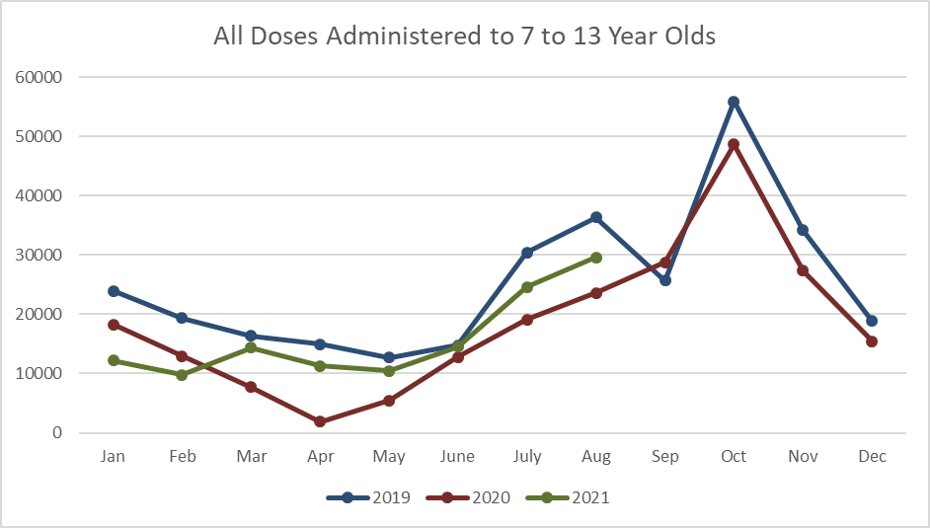
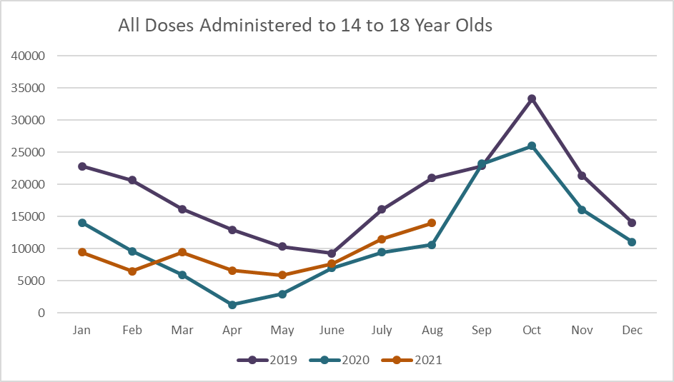
Blank 2
Where we are struggling the most to get back on track is with 7-18-year-olds.
All data reflected is per the Kentucky Immunization Registry (KYIR).

Slide 5
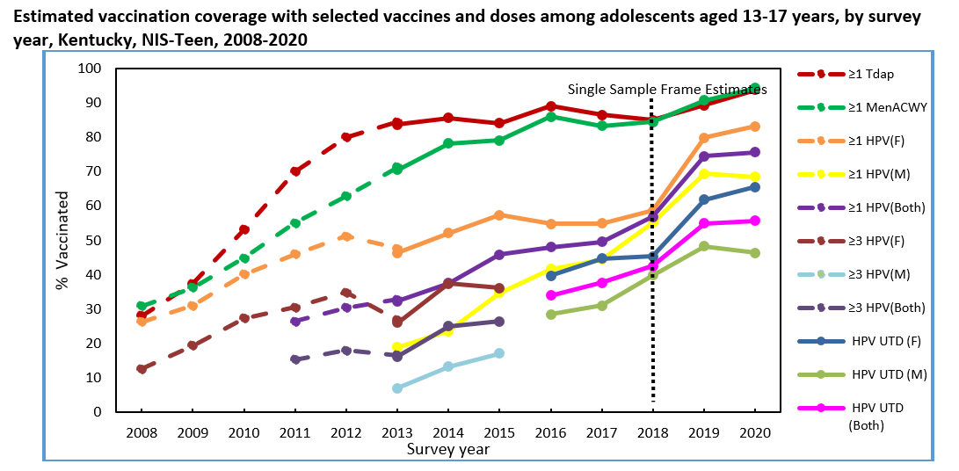
Blank 3
The good news is that the National Immunization Survey (NIS) data shows that we have increased in certain categories like HPV vaccination. This is significant since we are one of the lowest HPV vaccinated states and have one of the highest HPV-related cancer case rates.
Source: About the National Immunization Surveys | CDC

Slide 6
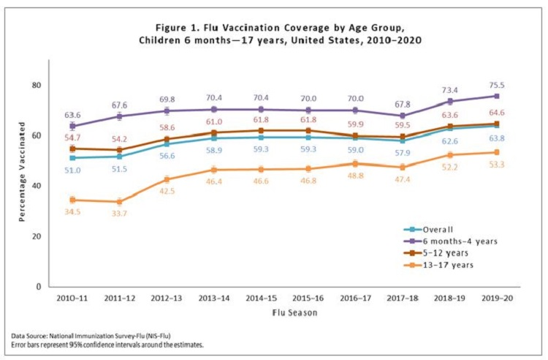
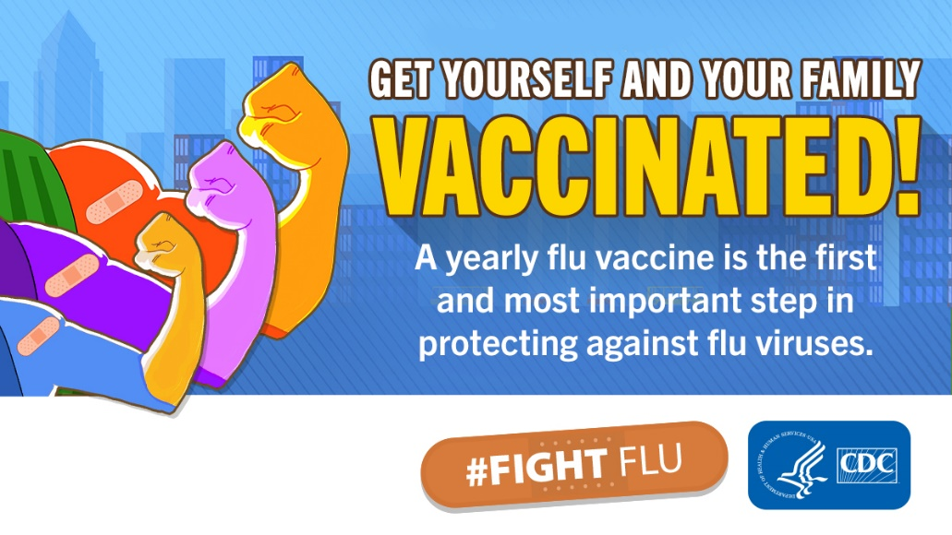
Blank 4
Reminder: Flu season starts in October. The best time to get vaccinated for this flu season is September-October.
CDC Digital Media Toolkit: 2020-21 Flu Season | CDC
Flu data from FluVax showing a steady increase of vaccination.
Source: Flu Vaccination Coverage, United States, 2019–20 Influenza Season | FluVaxView | Seasonal Influenza (Flu) | CDC

Slide 7
COVID19 Vaccine Rates 12-17
https://govstatus.egov.com/ky-covid-vaccine

Slide 8
Pfizer Locations in Kentucky for 12-17
https://www.vaccines.gov/search/

Slide 9
Blank 5
Additional Resources
Vaccine Education: ImmunizationHealthEducation@ky.gov
Kentucky Immunization Registry (KYIR) assistance: at KYIRHelpdesk@ky.gov or phone (502) 564-0038
Health Care Professional Kit – Help Fight Flu: HCP Fight Flu Toolkit | CDC
Routine Childhood Immunization Toolkit: Resources for Encouraging Routine Childhood Vaccinations | CDC
Vaccine Schedule: Vaccine Schedule | CDC
Thank you for all your hard work and helping to keep our kids safe from vaccine-preventable illnesses.

