Slide 1
Appropriate preparation of Intranasal Midazolam for Pediatric Patients
Robert Kuhn, PharmD
Kelsey Peterson, PharmD
Katie Landmesser, PharmD
September 11, 2019

Slide 2
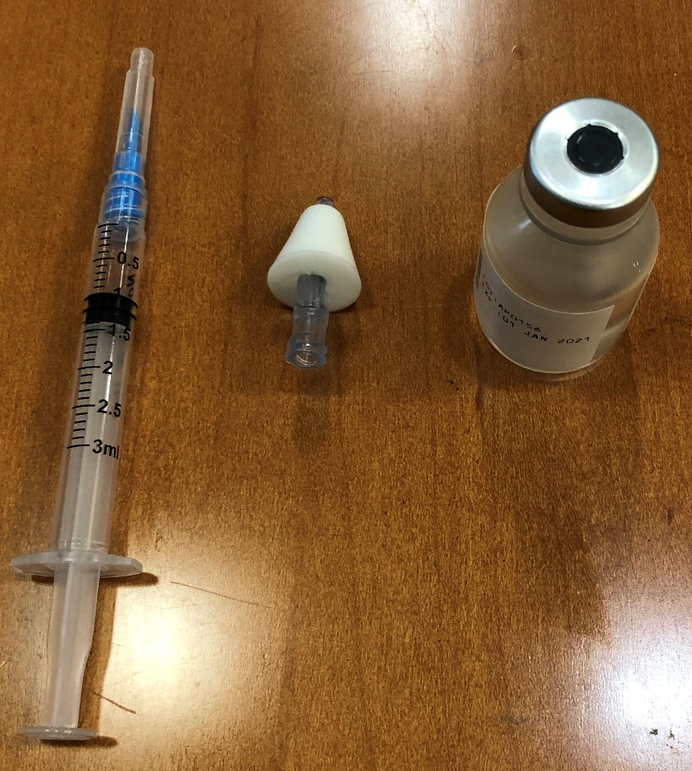
Preparation for administration
Draw the syringe plunger back to measured dose
Insert syringe into midazolam vial and inject measured volume of air into vial
Withdraw appropriate volume of midazolam from vial
    If directed on medication label, draw up an additional 0.1 mL of medication to allow for dead space in the atomizer.
Attach atomizer

Slide 3
Dosing from UK –Prefilled Syringe
Patient age | Weight | Total Volume* (0.1 mL overfill included) | Equivalent dose**
Neonate | 3-6 kg | 0.3 mL | 1 mg
1-5 years | 6-20 kg | 0.7 mL | 3 mg
5-10 years | 20-30 kg | 1.1 mL | 5 mg
Adolescent/Adult | >30 kg | 2.1 mL | 10 mg
*Midazolam vial: 5 mg/mL concentration
**Dose equals approximately 0.2-0.5 mg/kg

Slide 4
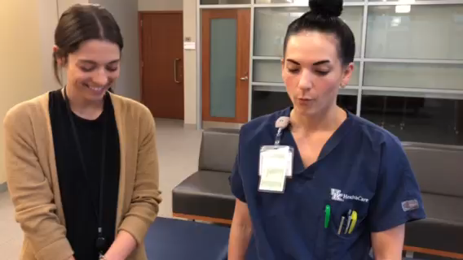

Slide 5
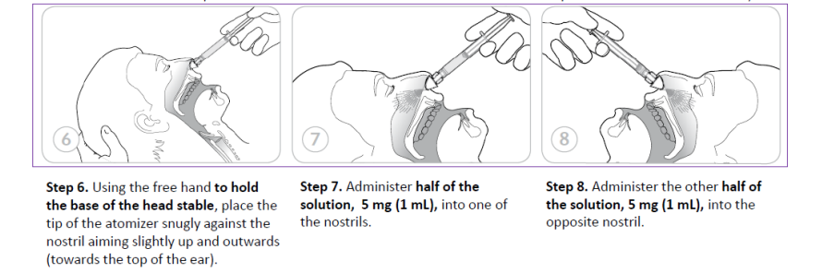
administration
  Inspect nostrils. If blood or mucous present, suction the nares prior to medication delivery. NOTE-Drug is absorbed by the mucous membranes, not via inhalation
  Insert tip of atomizer into left nostril & administer half of the dose, administer remaining half of dose into the right nostril (doubles the amount of mucosa available for drug absorption & increases rate & amount of absorption)
  Direct spray away from center of nose & spray directly up & back, or toward outside of nose
Reference: step-by-step guide adapted from 2013 Teleflex Inc. LMA MAD Nasal Device Instructions.
https://www.liveactionsafety.com/lma-nasal-mucosal-atomization-device-mad-syringe-vial-adapter/

Slide 6
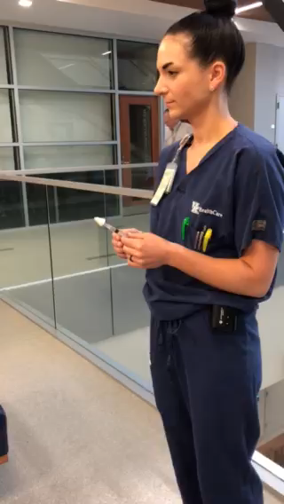

Slide 7
Clinical pearls
Intranasal midazolam easily & rapidly crosses the nasal mucosa & blood-brain barrier
Administration is less traumatic for patient
Onset of action: ~2-3 minutes (rapid)
Oral bioavailability of midazolam: ~30%

Slide 8
Safety Concerns and Side Effects
Sedation after administration
Common after a seizure
If swallowed- only 1/3 of the dose is absorbed so real risk
Activate the plan-calling nurse or activate 911 system depending on situation
Risk for diversion is almost nil
Store at room temperature

