Slide 1
Using Infinite Campus Health Office Visits
Angie McDonald, RN
Student Tracking and Data Branch
Office of Finance and Operations
Kentucky Department of Education

Slide 2
Slide 1
Since the passage of KRS 217.186 and 158.836, which allows Kentucky schools to stock and administer Epinephrine and Narcan (Naloxone), KDE has been asked to track the administration of these medications and to report the findings to the legislature.

Slide 3
Slide 2
Therefore, since documentation of all health services in Infinite Campus is considered best practice, beginning with the 2018 - 2019, KDE will be pulling health office visits data and publishing it in Open House.

Slide 4
Slide 4
Recording of health office visits into Infinite Campus is voluntary but recommended.
Documentation in Campus is not intended to put an additional burden on nurses and school districts. This is information that should already be collected by districts. The only difference is that it is in Campus and not on paper.

Slide 5
Slide 5
Once the health office visits, medications, treatments and Ad Hoc reports are set up, electronic documentation should make documentation and reporting much easier and less time consuming.

Slide 6
Why Should I Use Electronic Documentation for Health?
No more paper logs/charts to file or store
Easier case management of student needs
Quicker than writing notes
Records follow the student from school to school in the district
Ability to track health office visits and their outcome

Slide 7
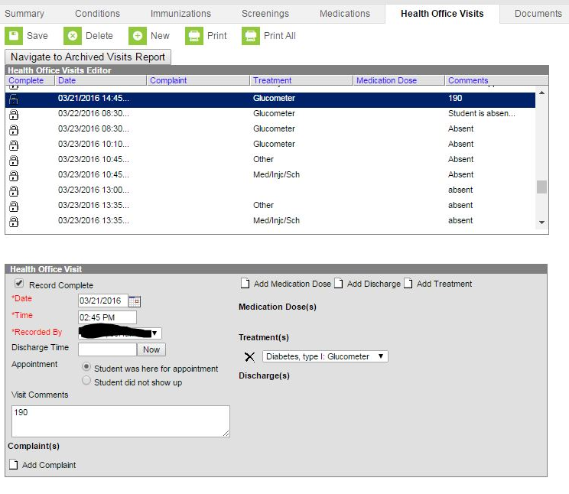
Example of Health Office Visit
This is a list of the student’s health office visits.
Here is where you chart the office visits

Slide 8
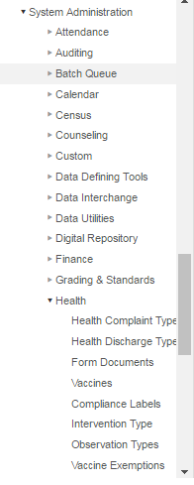
Slide 8
To edit or add to health office visits documentation options:
Go to System Administration
Health
Then, click on the area you choose to edit
Let’s start with, Health discharge type.
Set up is easier to start with discharge and work backwards.
8

Slide 9
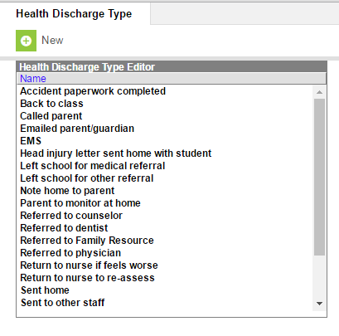
Slide 9
A few basic discharge
types are already listed in Campus.
Here are some suggested discharge types. You may customize them to suit your district needs.
However, remember the following 4 discharges MUST remain and be used.
Back to class
Sent home
EMS/911 Called
Sent to MD
You can have more than one discharge type.

Slide 10
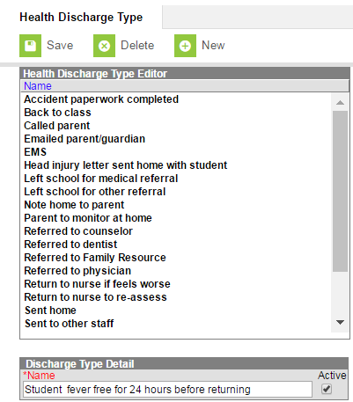
Slide 10
To add a new Health Discharge Type:
1. Click “New”
2. Add Discharge Type Detail
3. Check the “Active” box.
4. Click “Save”
C

Slide 11
Use your guide/handouts to review/add discharge types. Click Here

Slide 12
Slide 12
Now, to set up “Intervention Types”
Go to the “Index” tab
“System Administration”
“Health”
“Intervention Type”

Slide 13
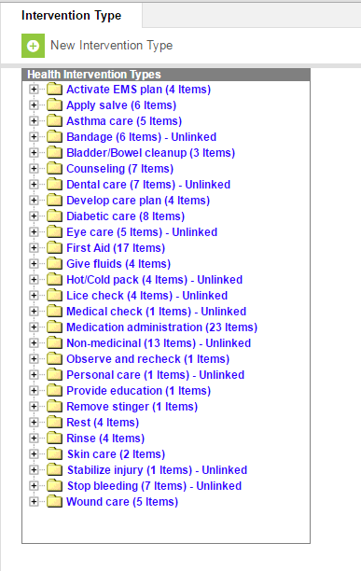
Slide 13
There are some basic intervention types already set up, however, you will need to add to them.
To edit an already existing intervention type, click on the name of the intervention type.

Slide 14
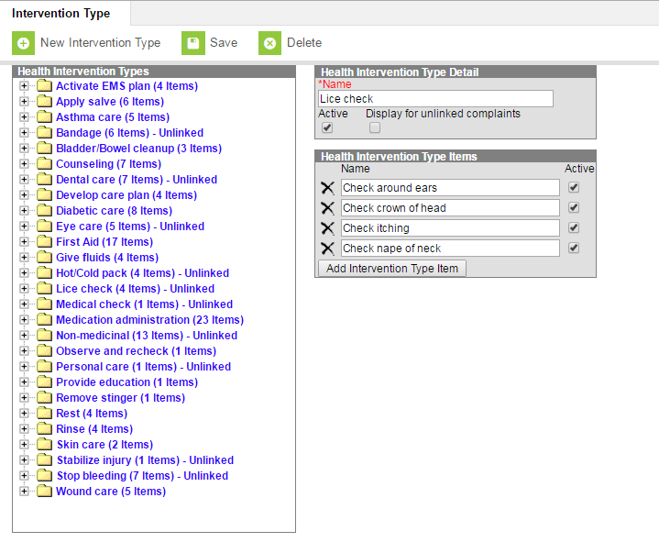
Slide 14
The health intervention type detail box will open.
To add a new intervention type item, click the “Add Intervention Type Item” button.

Slide 15
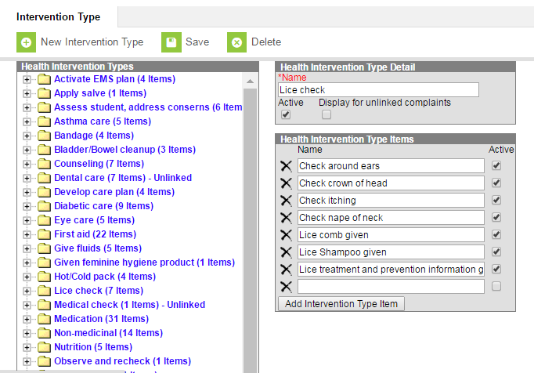
Slide 15
Add the new intervention
Type detail.
Check the active box. This will make the intervention visible in the drop down box.
Then click “Save”
Ov

Slide 16
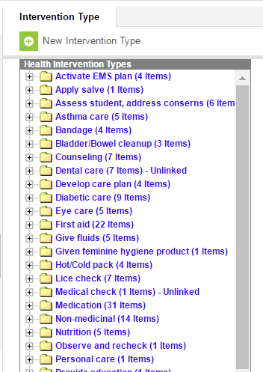
Slide 16
To add a new intervention type:
Click “New Intervention Type”

Slide 17
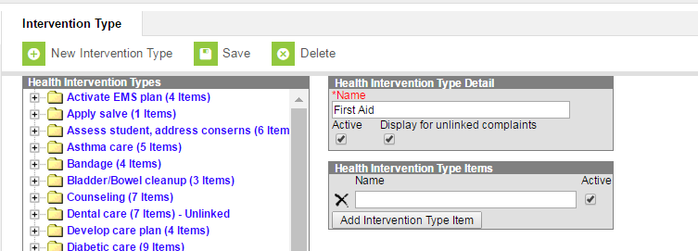
Slide 18
Enter the Health Intervention Type Detail as well as the specific interventions that go with it.
Finally, click “Save”

Slide 18
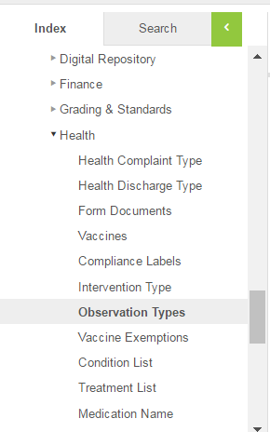
Slide 1 part28
Now, we can add Observation Types:
Go to Index,
System Administration,
Health,
Observation Types

Slide 19
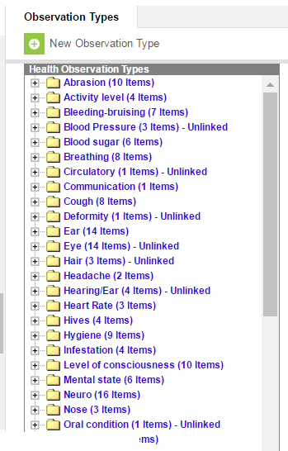
Slide 19
To create a new observation type, click, “New Observation Type”, OR, click on an existing observation type to add to it.

Slide 20
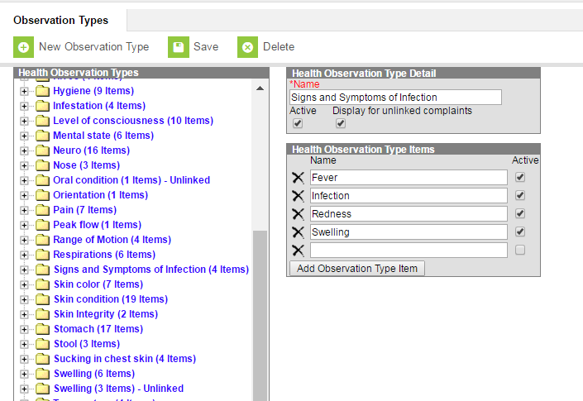
Slide 20
You can add as many observation types as necessary.
Check the “Active” box and then click the “Save” button.

Slide 21
Slide 21
Finally, let’s add Complaint Types:
Go to Index,
System Administration,
Health,
Health Complaint Type
Ov

Slide 22
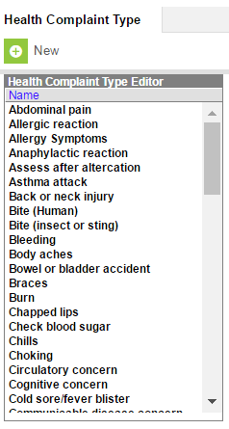
Slide 22
Here is the list of complaints students may have when they come to the nurse.
To add to this list, click “New”

Slide 23
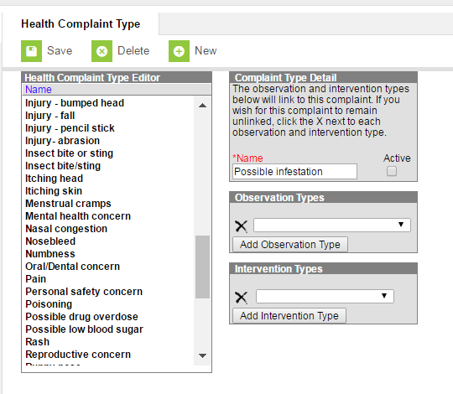
Slide 23
Leave these two boxes blank

Slide 24
Now you are ready to go paperless!

Slide 25
Entering Health Office Visits
With a little practice, you will be able to enter them in less than a minute.

Slide 26
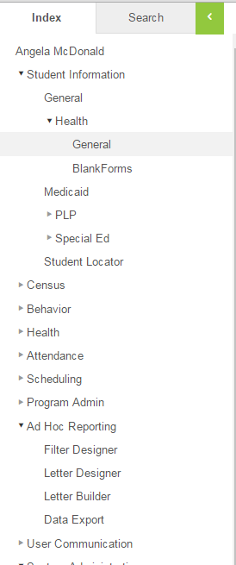
Slide 26
To enter a health office visit, do the following:
First look up student by either name or student ID, then:
● Index
● Student Information
● General
● Health
● General

Slide 27
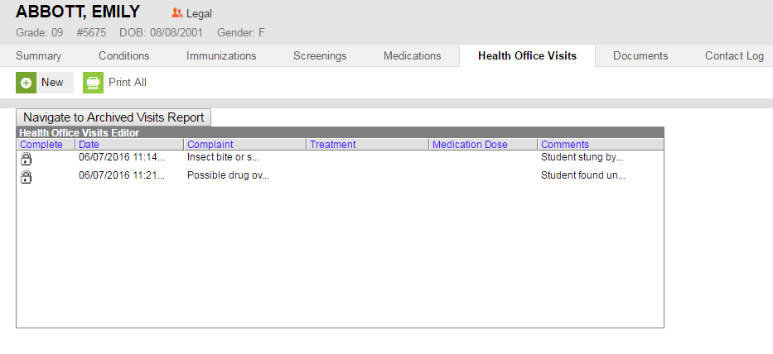
Slide 27
●Choose the Health Office Visits tab
● Click on “New”

Slide 28
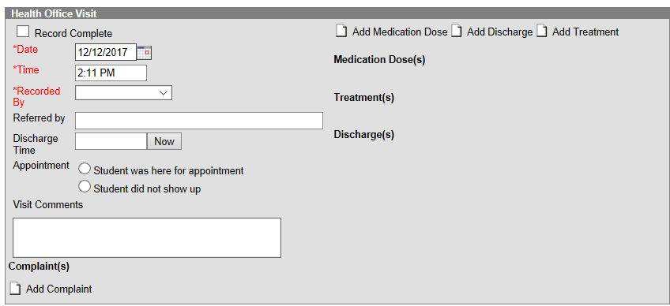
Slide 28
● Complete the information in the boxes
● In visit comments, enter anything not included in drop down boxes
● In the “Referred By” box, enter the last name of who sent child to nurse
● Click “Add Complaint”

Slide 29
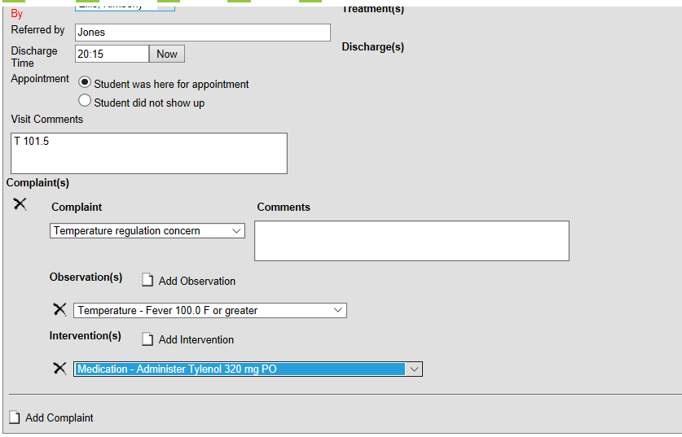
Slide 31
Choose the complaint in from extensive drop down list
Under observations, choose from drop down list, then proceed to observations and interventions. You may have more than one complaint, observation, or intervention.
Use “visit comments” box to enter all observations. Avoid using comments box below.
Use this box for comments.
Avoid using this comment box.

Slide 30
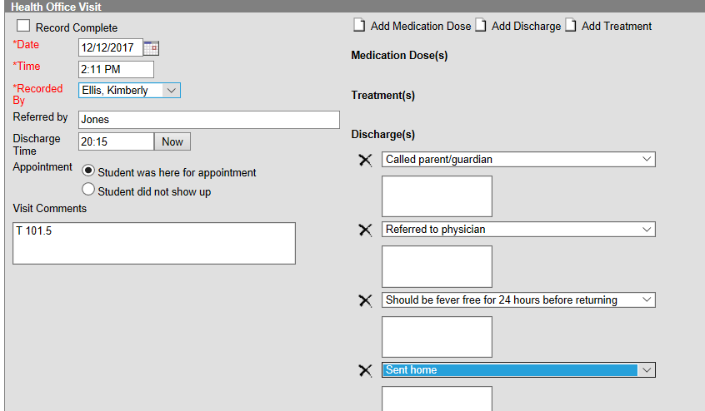
Slide 30
When you have finished charting, record the discharge time, check the box for record complete, and then click “Save”

Slide 31
Slide 31Slide 31 part 2
Click “Add Discharge”
Multiple discharges can be entered as long as one of the following are entered:
Back to class
Sent home
EMS called
Sent to MD

Slide 32
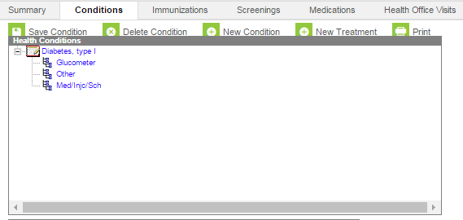
Slide 32
To add treatments such as glucometer checks, carb counting, etc.
Go to conditions, click on the health condition, then click on “New Treatment”
We are now going to set up for a diabetic student.

Slide 33
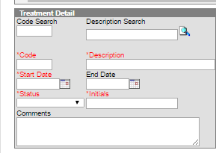
Slide 33
Type in the treatment, such as glucometer, then click on the magnifying glass, choices will pop up to choose from.
Then add the start date, status and your initials before clicking the save button.

Slide 34
Slide 34
Now, go back to the student health condition, then click on “New Treatment”

Slide 35
Slide 35
Type in the treatment, med/inj/sch, then click on the magnifying glass, choices will pop up to choose from.
Then add the start date, status and your initials before clicking the save button.

Slide 36
Slide 36
Now, go back to the student health condition, then click on “New Treatment”

Slide 37
Slide 37
Type in the treatment, other then click on the magnifying glass, choices will pop up to choose from. Choose other.
Under comments type carb counting.
Then add the start date, status and your initials before clicking the save button.

Slide 38
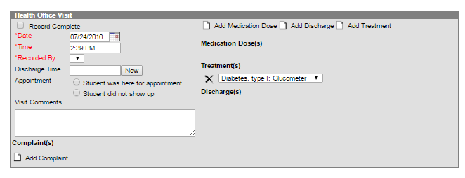
Slide 38
Now, when the student comes in for the treatment, click on the “add Treatment” box, and under the “Treatments” chose the treatment you want.
All three treatments are now listed as choices. In the visit comments box, you can enter blood sugar results, carb counting, insulin amounts, etc.

Slide 39
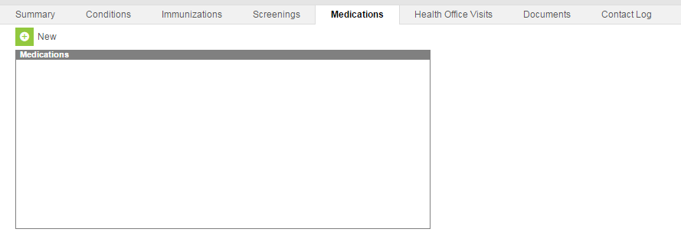
Slide 39
To enter a medication for a student, click on the Medications tab, then New

Slide 40
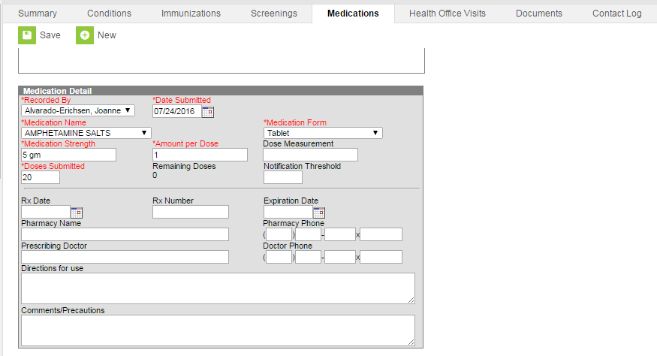
Slide 40
Use the drop down boxes to complete the boxes in red
This information is optional but may be beneficial.

Slide 41
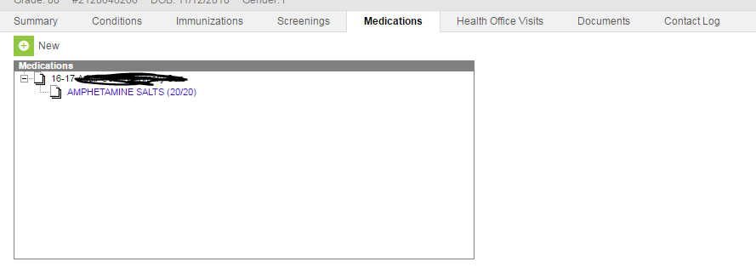
Slide 41
Now, the student’s medication will be listed under the medications tab. Now to schedule these medications, do the following:
Click on the name of the medication

Slide 42
Slide 42
Then click on the “Schedule Appointments” tab.

Slide 43
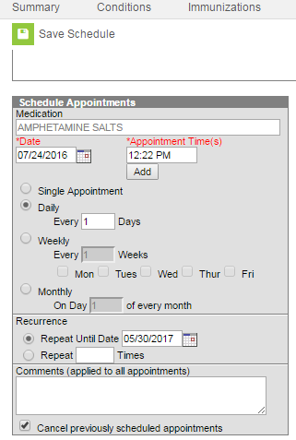
Slide 43
Choose the start date and the appointment times for the medication, as well as the frequency.
Choose the repeat until date (generally the last day of school unless it is ordered short term.
Then click, save schedule

Slide 44
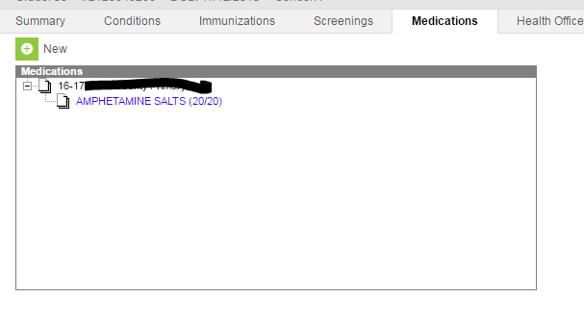
Slide 44
Notice the pill count next to medication name
When a parent sends in more medication, it can be entered into Campus like this:
● Click the medication name

Slide 45
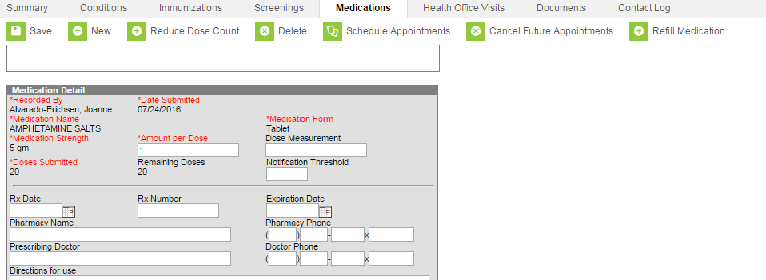
Slide 45
Click on the “Refill Medication” tab

Slide 46
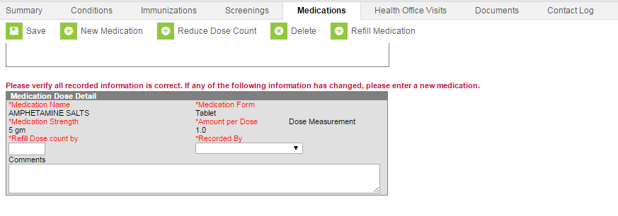
Slide 46
Complete below and click “Save”
You can also reduce the pill count by clicking “Reduce Dose Count”

Slide 47
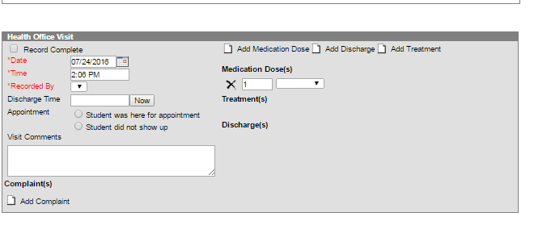
Slide 47
When a student comes to get his scheduled medication, open the health office visit, and click on the “Add Medication Dose” box. Then choose the Medication from the drop down box.

Slide 48
Slide 48
If a student is absent, or there is a snow day, open the health office visit, click on the “Add Medication Dose”. Then, click on the “X” next to the number under “Medication Dose(s)”. Check the “Record Complete Box” then save. This will adjust your pill count.

Slide 49
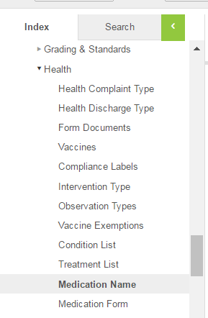
Slide 49
If you need to add a medication that isn’t in already in Campus, it can easily be added.
In the Index tab go to “System Administration”
Health
Medication Name

Slide 50
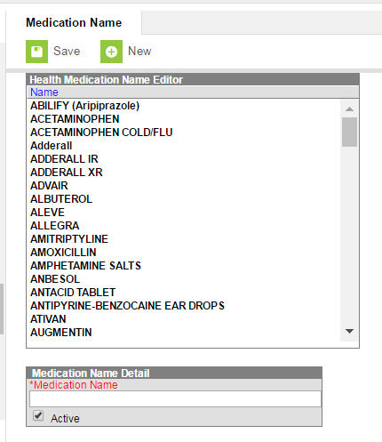
Slide 50
Click on “New” and the box will appear below.
Add the name of the medication, then click “Save” (Make sure the “Active” button is checked or it won’t appear as an option.

Slide 51
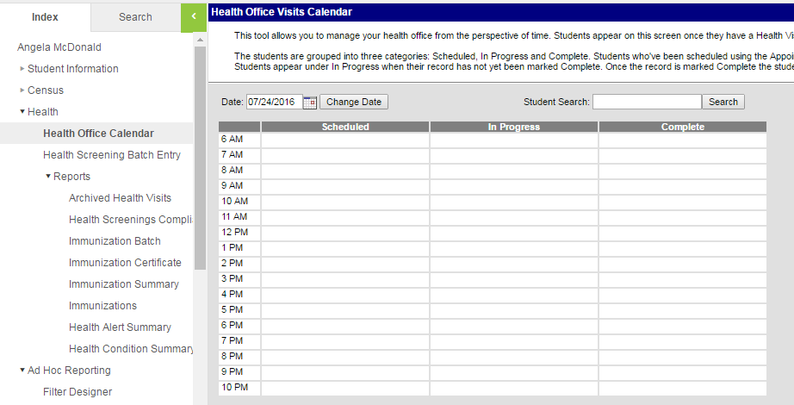
Slide 51
Marcum, Adam
To see your scheduled students or to see who you have seen for the day, Under index, go to the second health, then click “Health Office Calendar”
You can click on the name and it will take you to the scheduled health office visit to enter the information from the visit.

Slide 52
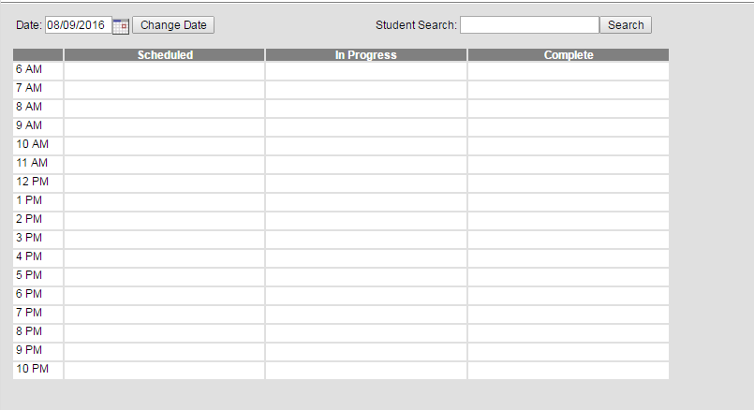
Slide 52
Once the record complete box is checked on the health office visit box, the name moves to the “Complete” column.
If you start entering information on the health office visit, and you forget to check the record complete box, the name will move to the “In Progress” box.
Abbott, Haley
Daniels, Abbie
Marcum, Adam
Sammons, Devonte

Slide 53
Slide 53
You can also upload documents such as MD orders or parent notes as well:
Click on the “Documents” tab
Then choose “Upload Document”

Slide 54
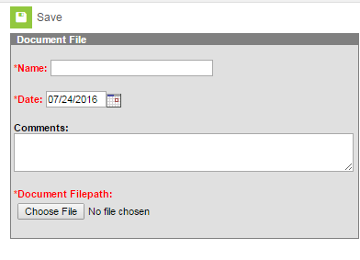
Slide 54
Name the document
Then click “Choose File” to search for the file you need. After you choose the file, click the “Save” button.

Slide 55
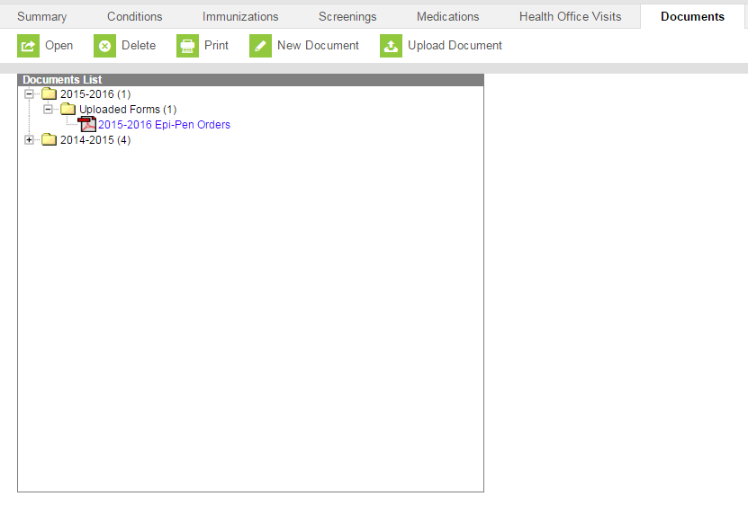
Slide 55
Once you have saved the document, this will be what you will see when you click on the “Documents” tab. All uploaded documents will be organized by school year.
Double click on the name of the document to view it.

Slide 56
Slide 76
Don’t panic out, we’re here to help!

Slide 57
Finally
Contact Information
Angie McDonald, RN
Phone: (502) 564-5279 Ext. 4430
Email: angela.mcdonald@education.ky.gov

