Slide 1
KDE Health Coordinator Conference KDPH Update
Michelle Malicote BSN, RN, NASSNC: School Health Consultant
Jan Bright BSN, RN: MCH Branch Manager
September 15, 2021

Slide 2
KDPH Updates include:
Official TEAM KENTUCKY: KDPH source for INFORMATION
TESTING information including the CDC guidance as well as KDPH ELC Testing
Masking
Contract tracing
Quarantine
Isolation
Promoting Vaccination

Slide 3
COVID-19 Information
The COVID-19 response in Kentucky involves stakeholders at every level of the community. The documents and links found on this web page reflect the most current guidance for healthcare providers, laboratories and local public health.
The one pagers are on the https://govstatus.egov.com/kycovid19
page under the KDPH Guidance tab.
All of the documents created by KDPH will be found on that page moving forward.

Slide 4
Blank
Guidance for COVID-19 One Pagers
COVID-19 Guidance for International Travel Updated 8/18/2021
COVID-19 Guidance for International Travel - Spanish Updated 8/18/2021
COVID-19 in Schools Updated 8/18/2021
COVID-19 in Schools Flowchart Updated 8/18/2021
Exposed Guidance - Fully Vaccinated Updated 8/18/2021
Exposed Guidance - Not Fully Vaccinated Updated 8/18/2021
Exposed Guidance - Fully Vaccinated - Spanish Updated 8/18/2021
Exposed Guidance - Not Fully Vaccinated - Spanish Updated 8/18/2021
Patient Guidance Updated 8/18/2021
Patient Guidance - Spanish Updated 8/18/2021
COVID-19 In The Workplace Updated 8/20/2021
COVID-19 In The Workplace - Spanish Updated 8/20/2021
Guidance for Communities
Have you been exposed to or tested positive for COVID-19? Updated 8/18/2021
Have you been exposed to or tested positive for COVID-19? - Spanish Updated 8/18/2021
LHD Guidance for Mask Use and Prevention Strategies Updated 7/29/2021
Healthy at Work - Recommended Minimum Guidance Updated 7/29/2021
Guidance for K-12 School Operations for In-Person Learning Updated 8/27/2021
Guidance for Operations in Early Care and Education and Child Care Programs Updated 8/30/2021

Slide 5
Blank1

Slide 6
Blank2

Slide 7
CDC School Testing for COVID-19
As schools go back to in-person learning, many offer free, regular COVID-19 testing for students and staff.
Regular testing, along with COVID-19 vaccination, helps protect students, staff, family members, and others who are not currently vaccinated against COVID-19 or are otherwise at risk for getting seriously sick from COVID-19.
Testing programs help keep students in the classroom and allow them to take part in the other activities they love.
Includes:
Communication Toolkit for Schools
Customizable Materials, including sample letters, and Q & A samples
Sample Social Media messages and Graphics
Printable Posters and Flyers
https://www.cdc.gov/coronavirus/2019-ncov/community/schools-childcare/school-testing.html?CDC_AA_refVal=https%3A%2F%2Fwww.cdc.gov%2Fcovid19-school-testing%2Findex.html

Slide 8
Blank 2

Slide 9
COVID-19 Screening Testing
Screening testing can be used to help evaluate and adjust prevention strategies and provide added protection for schools that are not able to provide optimal physical distance between students.
Schools may consider testing a random sample of at least 10% of the students who are not fully vaccinated, or conduct pooled testing of cohorts.
Testing in low-prevalence settings might produce false positive results, but testing can provide an important prevention strategy and safety net to support in-person education.

Slide 10
Blank3

Slide 11
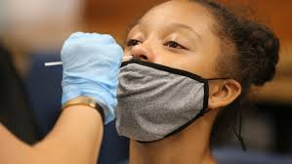
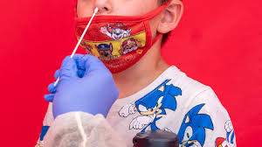
Blank 4

Slide 12
Masks
All persons 2 years of age or older should wear masks or face coverings while indoors in all classroom and non-classroom settings, including buses operated by public and private school systems, unless otherwise exempted (e.g., cannot wear a mask due to disability), regardless of COVID-19 vaccination status.
Masks should be required in compliance with federal, state, local, and organization regulations, including the CDC, the Kentucky Department for Education and the Kentucky Board of Education.
Operators of school buses should refer to the U.S. Department of Education’s COVID-19 Handbook for additional guidance. A driver does not need to wear a mask if they are the only person on the bus.
Notes:
>2 or >=2? CDC and AAP have different guidance here. KDPH has been using >=2

Slide 13
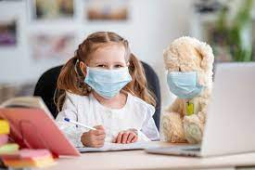
Consistent and Correct Mask Usage
• In general, people do not need to wear masks when outdoors, though mask use may be considered in outdoor settings that involve sustained close contact with other people who are not fully vaccinated.

Slide 14
Quarantine and Contact Tracing
In the K-12 indoor classroom setting, the close contact definition excludes students who were at least >3 feet away from an infected student if both students were engaged in consistent and correct use of masks and other K-12 prevention strategies were in place.
This exception does not apply to teachers, staff, or other adults in the indoor classroom setting.

Slide 15
Who is NOT a CLOSE CONTACT
INDOOR CLASSROOM:
1. Students K-12 who are greater than or equal to 3 feet apart for a
cumulative total of 15 minutes or more and were both wearing masks
This does not apply to teachers, staff, or other adults in the indoor classroom setting, where the less than 6 feet for cumulative 15 minutes rule applies.

Slide 16
Blank 5
ISOLATION:
Separates sick people with a contagious disease from people who are not sick
QUARANTINE:
Separates and restricts the movement of people who were exposed to a contagious disease to see if they become sick

Slide 17
Unvaccinated students teachers or staff
Unvaccinated students, teachers, or staff who are identified as close contacts should be instructed to self-quarantine regardless of whether the exposure occurred within or outside of the school setting. Quarantine may be discontinued when the local public health department determines the individual is safe to be around others or:
After day 7 (on day 8) if the individual is symptom-free and receives a negative COVID-19 test 5 days or later after the last date of exposure to the case. The last day of exposure is day 0.
After day 10 (on day 11) without testing if the individual is symptom-free.
Unvaccinated persons who have documented COVID-19 illness in the prior 3 months (with a positive COVID-19 PCR or antigen test) do not need to quarantine if they are symptom-free. Results from antibody testing should not be used to assess for infection or for determining need to quarantine.
Notes:
Modified quarantine “test to stay” option?

Slide 18
Fully-vaccinated persons *DO NOT NEED TO QUARANTINE*
Fully-vaccinated* persons do not need to quarantine following an exposure to a person diagnosed with COVID-19 if he/she is not experiencing symptoms, but are recommended to be tested 3-5 days after an exposure and wear a mask in public settings for 14 days or until a negative test is received.
*>14 days have passed since receipt of the Janssen (J&J) vaccine or the second dose of Pfizer or Moderna vaccine.

Slide 19
Promotion of COVID19 Vaccination
Achieving high levels of COVID-19 vaccination among eligible students as well as teachers, staff, and household members is one of the most critical strategies to help schools safely resume full operations.

Slide 20
Vaccination
Vaccination is currently the leading public health prevention strategy to end the COVID-19 pandemic. People who are fully vaccinated against COVID-19 are at low risk of symptomatic or severe infection.
A growing body of evidence suggests that people who are fully vaccinated against COVID-19 are less likely to have a symptomatic infection or transmit COVID-19 to others than people who are not fully vaccinated.
In most settings, people who are fully vaccinated can safely resume activities they did before the pandemic, except where prevention measures are required by federal, state, local, tribal, or territorial laws, rules, and regulations, including local business and workplace guidance.

Slide 21
Thank you

Slide 22
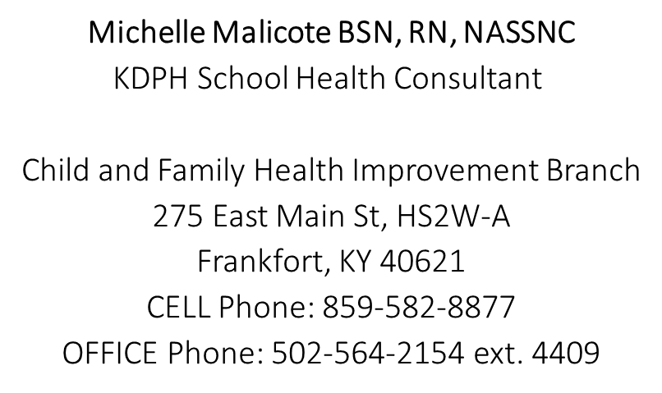
Blank 6
Michelle.Malicote@ky.gov

