Slide 1
Entering Vision Exams/Screenings into Infinite Campus Health
Angie McDonald, RN
Kentucky Department of Education

Slide 2
Objective
Today we are going to discuss how to correctly enter vision exams or screenings into IC.

Slide 3
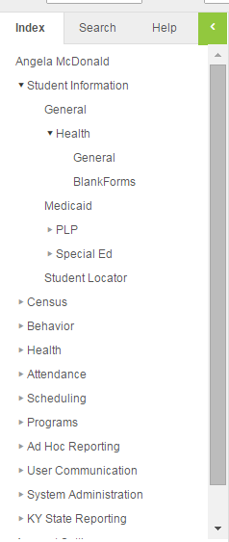
Let’s get started
First:
Choose the correct student
Go to the index tab
Student Information
Health
General

Slide 4
Screenings Tab
Click on the screenings tab
Choose new

Slide 5
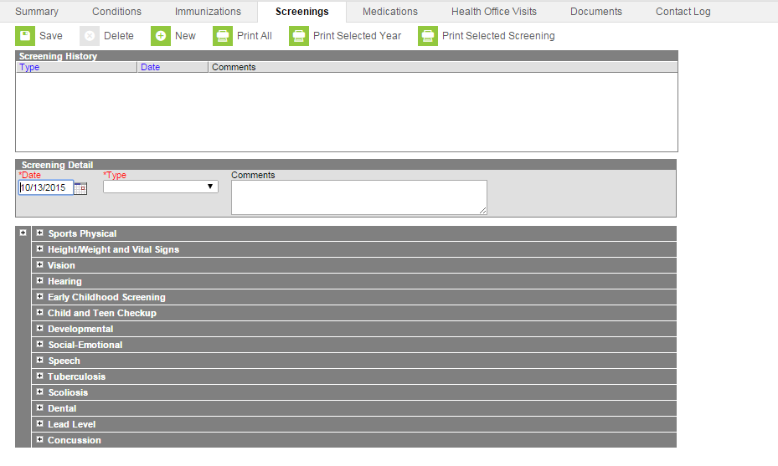
This Box Should Appear

Slide 6
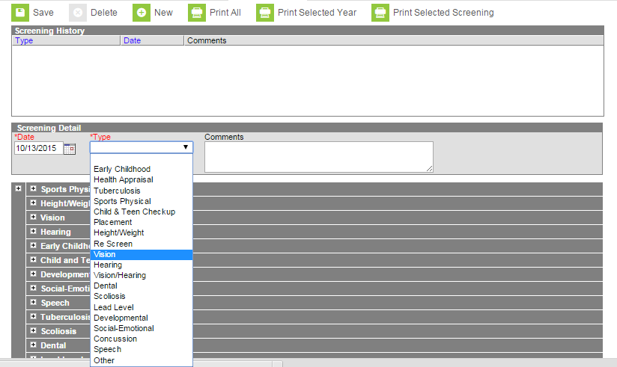
Screening Type
In the type box,
choose vision

Slide 7
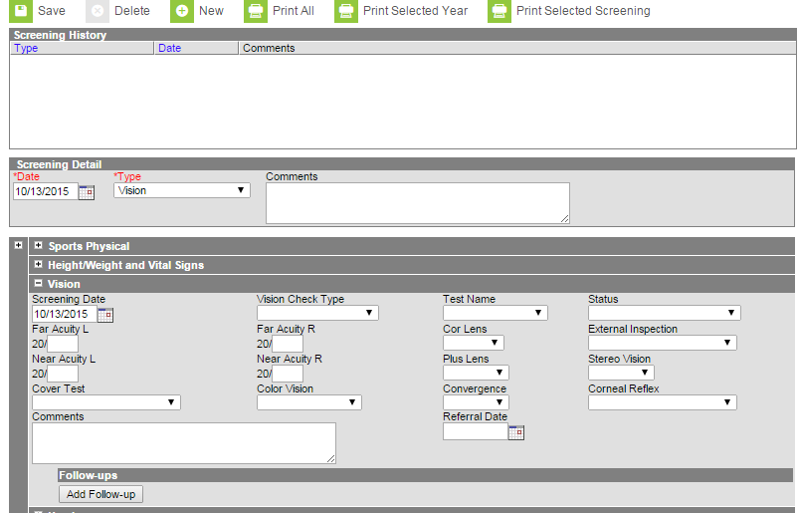
This Box Should Open

Slide 8
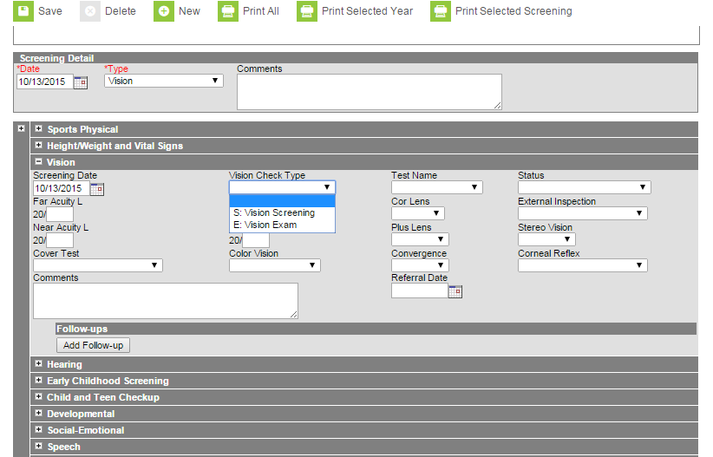
Vision Check Type
In the vision check
type box, enter the
screening type
(screening or exam)

Slide 9
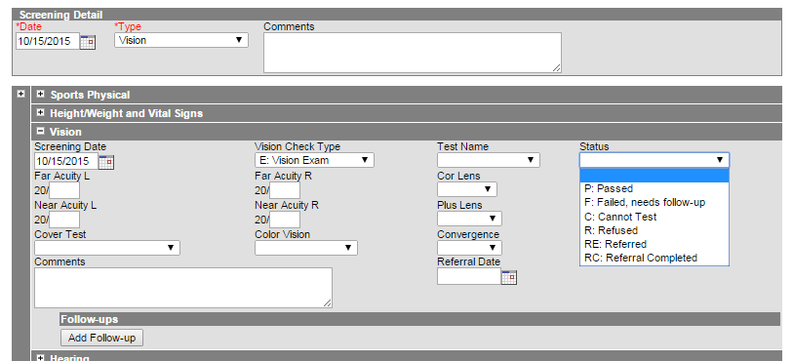
Status
In the status box,
choose the correct
result. (Passed,
failed, needs follow
up or cannot test).

Slide 10
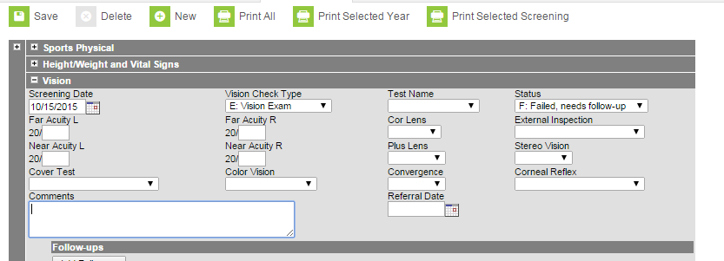
Referral and Comments
If the student needs follow up, enter the
referral date as well any comments and
click save.

Slide 11
Batch Entry
Batch entry will allow you to record a large group of screenings at one time. This is useful when performing mass screenings.

Slide 12
How to Enter a Batch Entry
- Go to the index tab
- Click on the second health listing
- Click on health screening batch entry

Slide 13
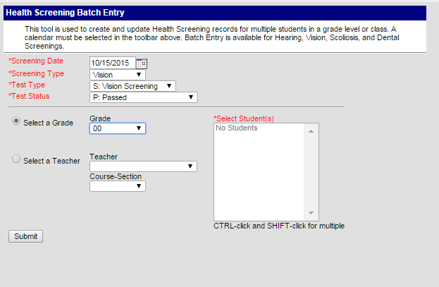
Filters
- If you screened
a certain grade,
choose the correct
grade here.

Slide 14
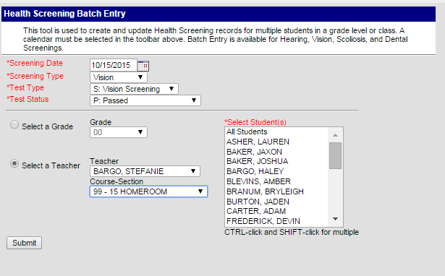
Filter by Teacher
- If you screened a
certain class, choose
the teacher’s name
and the correct course-
section
- Then, click submit

Slide 15
Note
This will record that every child in that class or grade had a particular screen or exam that day and had a passing result.

Slide 16
Correcting Results from Pass to Fail (Needs Follow-Up or Referral)
If you have a student or a particular group of students that need to be referred for further evaluation, you can correct their screening results individually.

Slide 17
Back to the screenings tab
Go to the Screenings tab to reach the results you want to edit.

Slide 18
No title
Choose the entry from the list of screenings. It will have “batch entry” listed in the comments section.

Slide 19
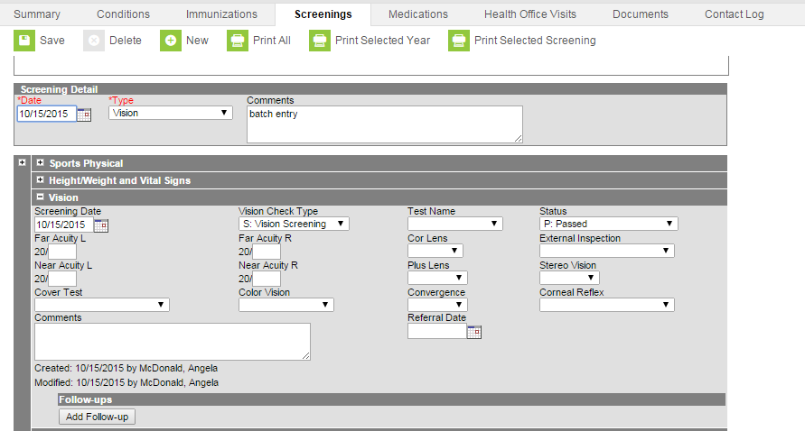
Changing Status
- Go to the status box,
change to failed, needs
follow up.
- Enter the referral date
and any comments as
needed and click save.

Slide 20
Questions
Angie McDonald, RN
Email: angela.mcdonald@education.ky.gov
Phone: (502) 564-5279 Ext. 4430

