Slide 1
Entering Physical Exams into Infinte Campus
Angie McDonald, RN
Kentucky Department of Education

Slide 2
Show How Hard You Work!!
Entering physicals is an easy process. Let’s take a moment to review how to correctly enter your data so that the exams are counted correctly on the end of the year reports.

Slide 3
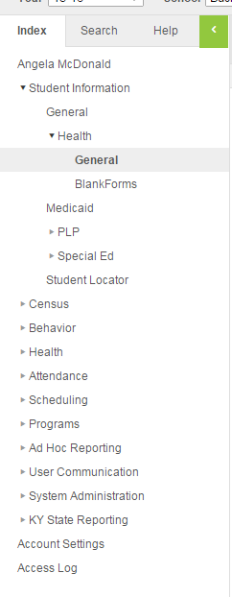
Let’s Get Started
First:
- Choose the correct
student.
- Go to Index
- Student Information
- Health
- General

Slide 4
Screenings Tab
Next, choose the “Screenings” tab.
The following box should appear.

Slide 5
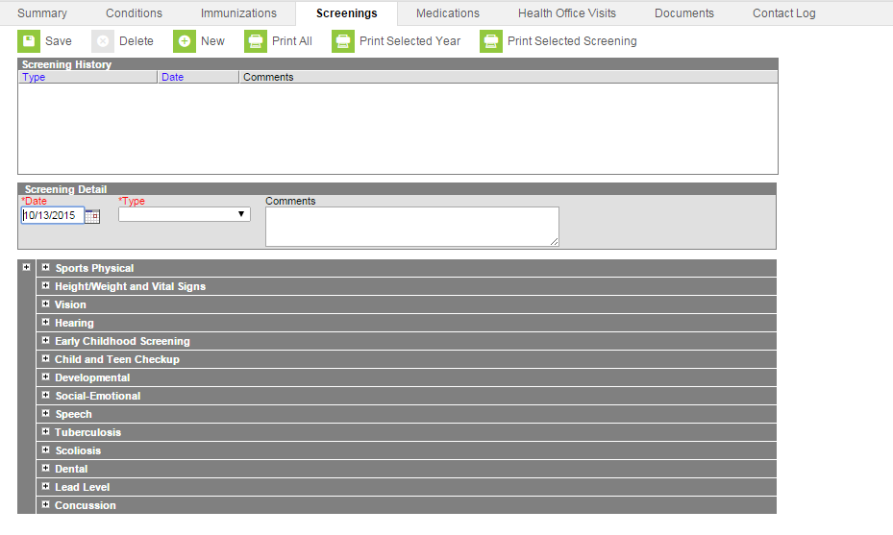
Screenings tab continued
Choose New
This box should appear

Slide 6
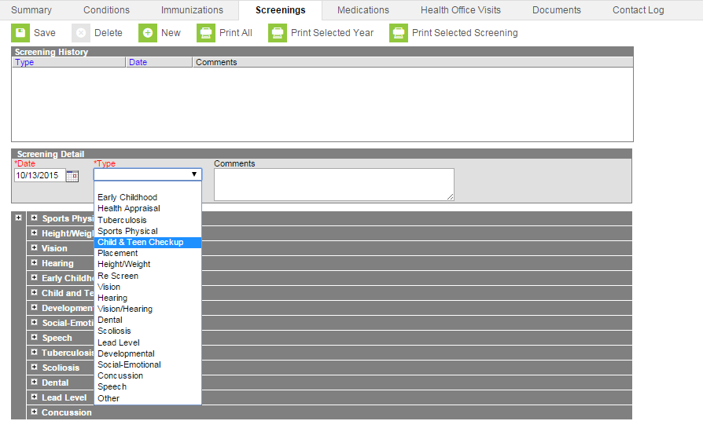
Entering Exam
Enter the date of exam
Choose the exam type
(Child and Teen Exam)

Slide 7
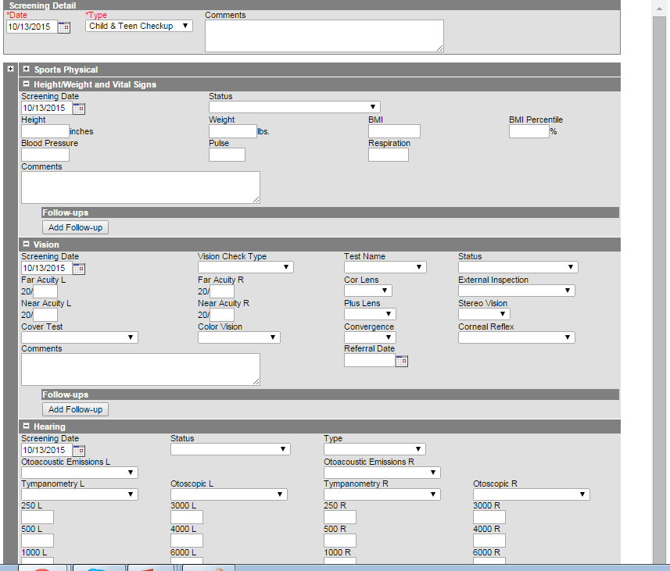
Now, Several Boxes Should Open

Slide 8
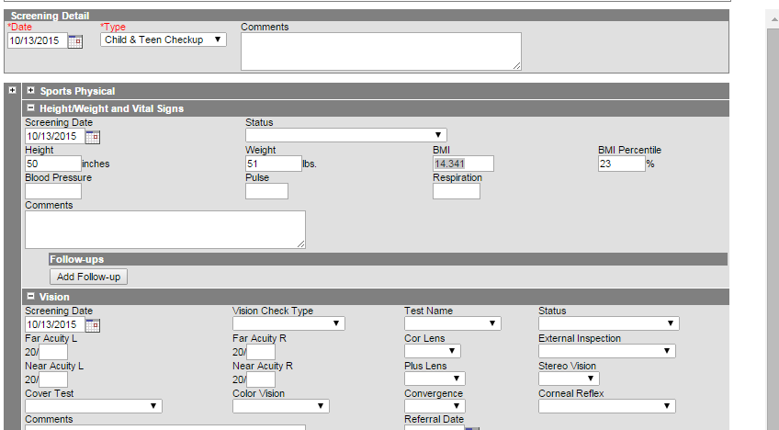
Physical Data
In the “Height/Weight
and Vital Signs box,
enter the information
from the child’s physical.

Slide 9
BMI Calculations
As you hit the tab
button when entering
the height and weight,
the BMI and BMI
percentile automatically
calculates.

Slide 10
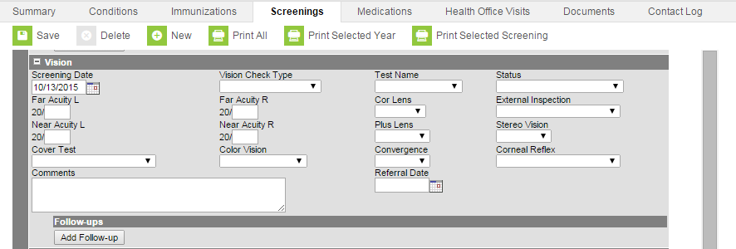
Remove vision date
- Scroll down to the
vision box.
- Remove the date
in the screening date
box.

Slide 11
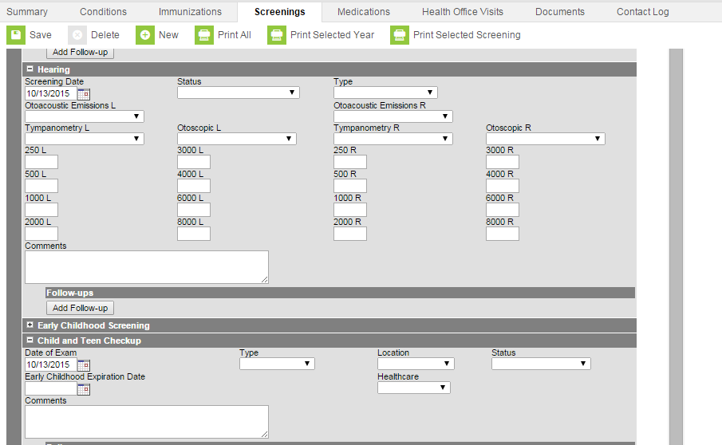
Remove hearing date
Scroll down to the hearing screening box
Remove the screening date

Slide 12
Remove Child and Teen Checkup Box
Scroll to the “Child and Teen Checkup” box.

Slide 13
Child and Teen Checkup
Scroll to the “Child and Teen Checkup box.

Slide 14
Exam Type
In the “Type” box,
choose either “Initial
Entry” or “6th Grade”
from the dropdown
box.

Slide 15
Location
In the “Location” box,
choose where the
exam was performed.
(Health Department
exams count as “Doctor”).

Slide 16
Status
In the “Status” box,
choose from either
normal, referred, or
known condition.

Slide 17
Don’t Forget to Save Your Work!!

Slide 18
Questions??
Angie McDonald, RN
Email: angela.mcdonald@education.ky.gov
Phone: (502) 564-5279 Ext. 4430

