Slide 1
Entering Hearing Screenings into Infinite Campus
Angie McDonald, RN
Kentucky Department of Education

Slide 2
Get Credit for Your Hard Work!
Documenting hearing screens into IC is a simple process. However, if any of the needed information is omitted, the screening or exam will not be counted by Infinite Campus.

Slide 3
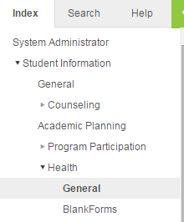
Let’s get started
First:
Go to the Index tab on
the left side.
- Click on Student
Information
- Health
- General

Slide 4
Screening tab
Choose the Screening tab in the main portion of the screen and select new.

Slide 5
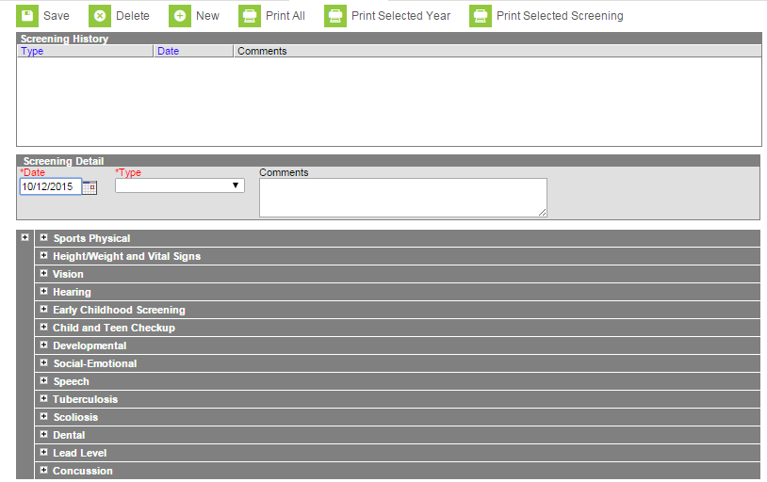
Your Screen Should Look Like this:

Slide 6
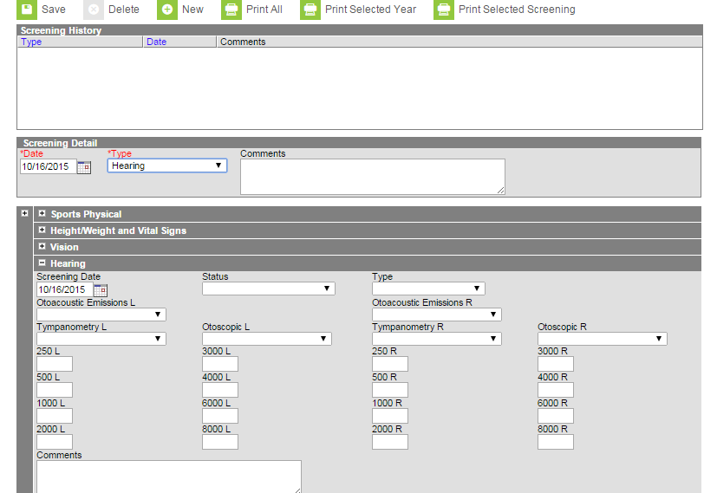
Hearing Screening Entry
Choose the screening type (Hearing)
In the first date box, enter the date of exam/screening.

Slide 7
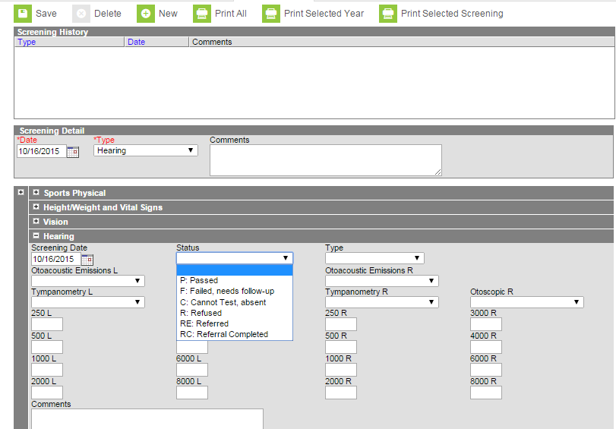
Screening Status
Choose the status,
(usually passed or failed:
needs follow up).

Slide 8
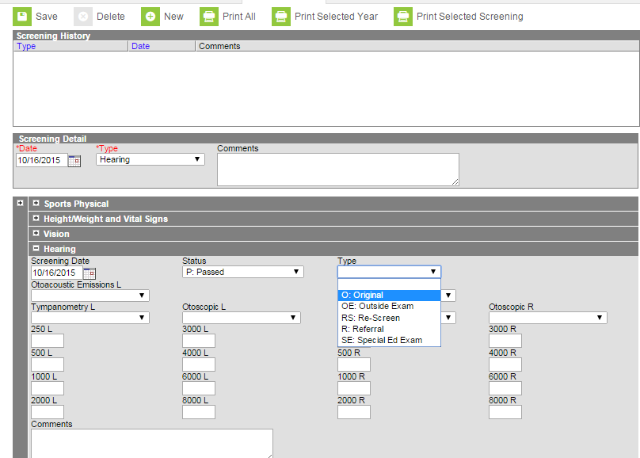
Screening Type
- In the type box,
choose screening
type.
- If it was a routine
screening, choose
original,
- Click Save

Slide 9
Batch Entries
Batch entry is the quickest way to enter a large number of screening results at one time.

Slide 10
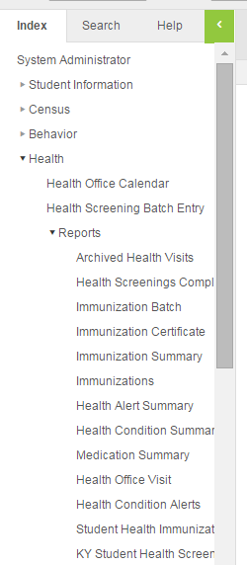
How to enter
To enter a batch screening,
complete the following steps:
- Go to Index
- Health
- Health Screening Batch Entry

Slide 11
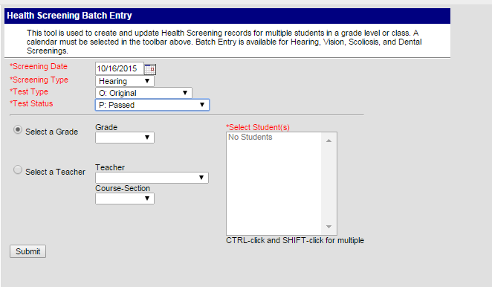
Batch Entry Box
Choose the following items:
Screening date
Screening type (hearing)
Test type (original)
Test status (passed)

Slide 12
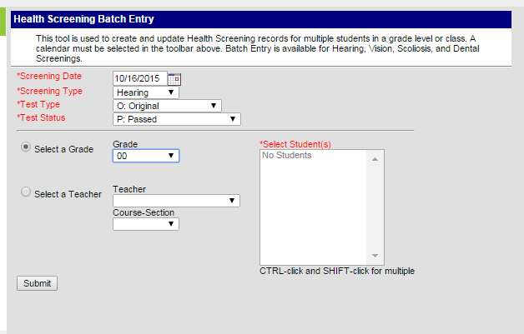
Filter your report
If you screened
a certain grade,
select it here.

Slide 13
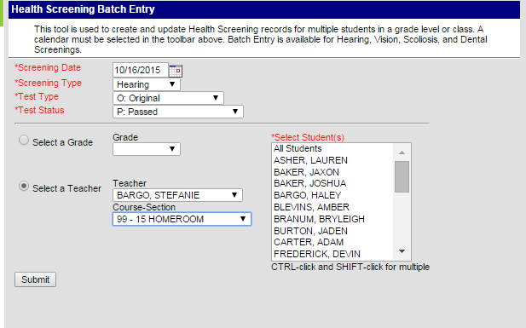
More filters
If you screened a
certain class,
choose the teacher’s
name and the correct
course-section

Slide 14
Submit the Entry
Once you have
chosen everything,
click the submit
button.

Slide 15
Correcting Results from Pass to Fail (Referral)
If you have a student or particular group of students that need to be referred for further evaluation, or if you were unable to screen a student due to absence, you can correct their screening results individually.

Slide 16
How to Edit Your Entry
Go to the Screenings tab on the student you want to edit.

Slide 17
Editing
Choose the entry from the list of screenings. It will have a “batch entry” listed in the comments section. Double click the entry.

Slide 18
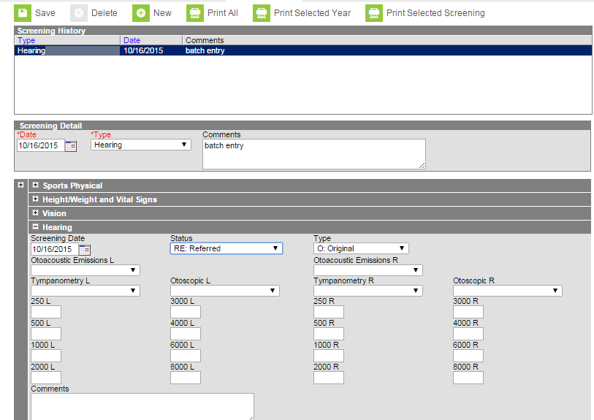
Finishing your entry
- Go to the status box,
changed to referred.
- Enter any comments
as needed and click
save

Slide 19
Finishing your entry continued
- If the student was
not screened that day,
double click on the
screening history box.
- Click delete

Slide 20
Questions????
Email: angela.mcdonald@education.ky.gov
Phone: (502) 564-5279 Ext. 4430

