Slide 1
Entering Dental Exams/Screenings into Infinite Campus
Angie McDonald, RN
Kentucky Department of Education

Slide 2
Get Credit for Your Hard Work!
Documenting dental screenings/exams into IC is a simple process. However, if any of the needed information is omitted, the screening or exam will not be counted by Infinite Campus.

Slide 3
Let’s Get Started
First:
Go to the Index tab on the left side.
- Click on Student Information
- General
- Health
- General

Slide 4
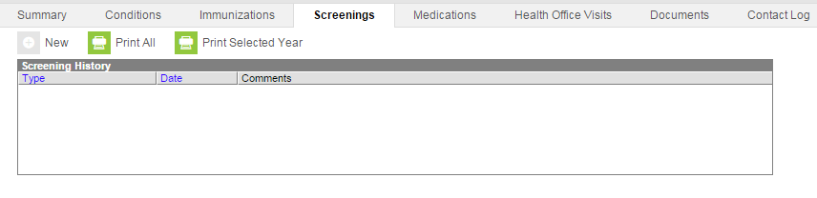
Screening Tab
Choose the screening tab in the main portion of the screen and select new.

Slide 5
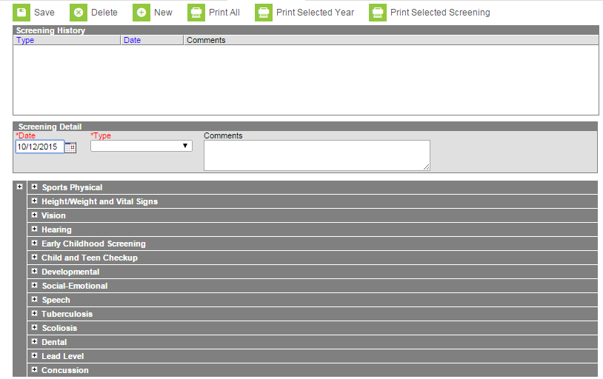
Now Your Screen Should Look Like This:

Slide 6
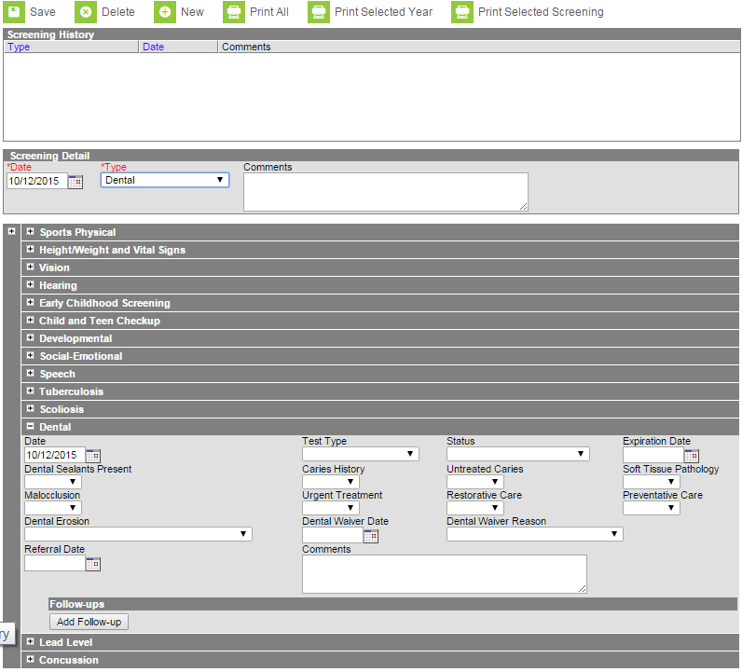
How to enter
In the first date box, enter the correct date.
Choose the screening type (Dental)
Your screen should now look like this:

Slide 7
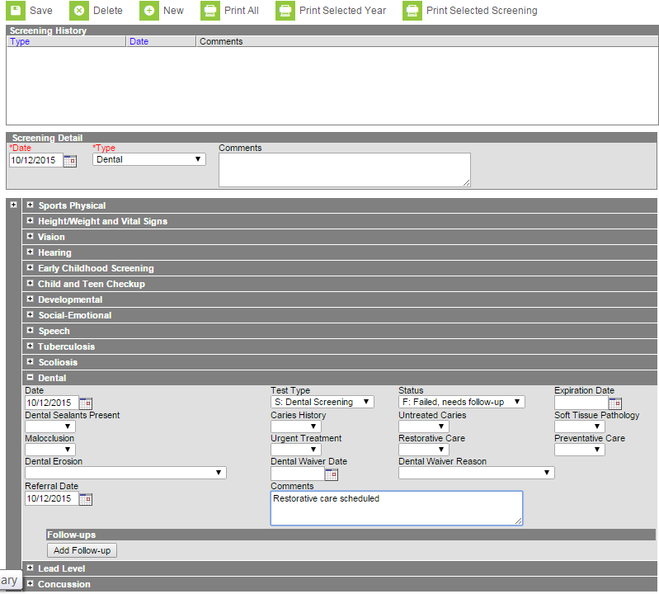
Completing the entry
In the date box, enter the date of the exam/screening.
Choose the test type, either exam or screening and finally choose the status (pass or failed: needs follow up).

Slide 8
Referrals
If it was a screening or if the child required follow up, choose fail and enter the referral date as the date of the exam or screening and any needed comments.

Slide 9
Save your entry
Click Save

Slide 10
How to Enter Batch Entry Screenings
Batch entry is the quickest way to enter a large number of screening results at one time.

Slide 11
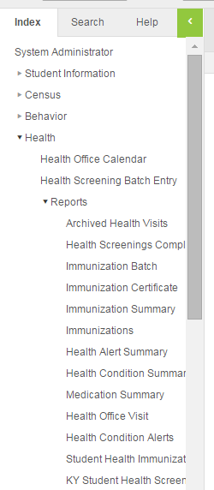
How to Find it
To enter a batch screening, complete the following steps:
- Go to index
- Health
- Health Screening Batch Entry

Slide 12
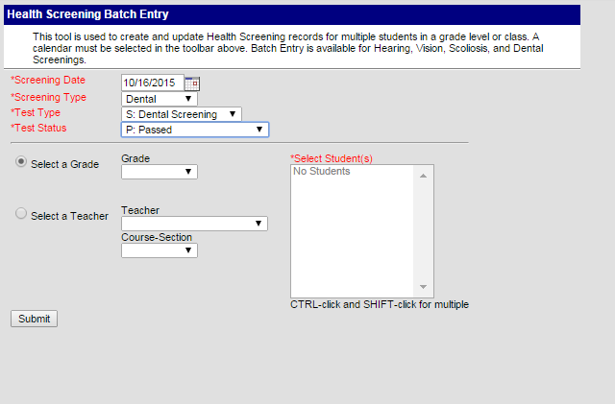
Health Screening Batch Entry Page
Choose the following items:
- screening date
- screening type
(Dental)
- Test type (Exam or
Screening)
- Test status (pass).

Slide 13
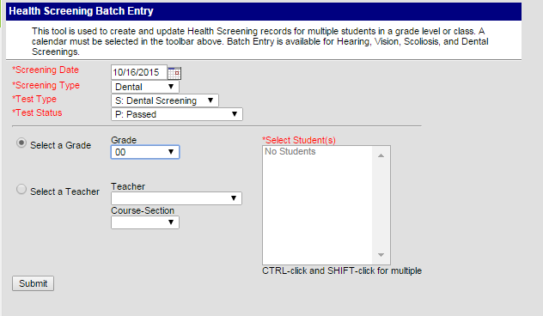
Finishing Your Entry
If you screened a certain grade, select it here:

Slide 14
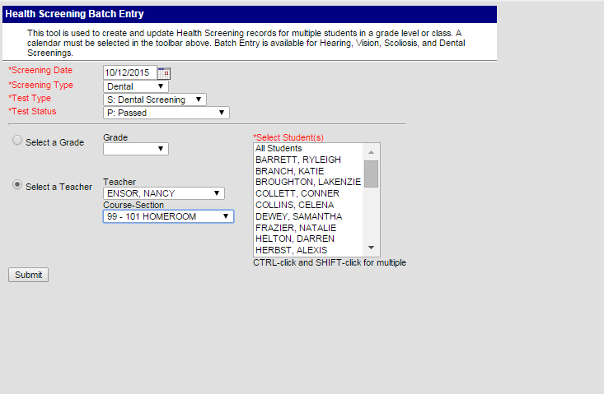
Filter by teacher
If you screened a certain class, choose the teacher’s name and the correct course-section.

Slide 15
Submitting your entry
Once you have chosen everything, chick the Submit button.
This will record that every child in that class or grade had a particular screen or exam that day and had a passing result.

Slide 16
Correcting Results from Pass to Fail (Referrals)
If you have a student or a particular group of students that needed to be referred for further evaluation, or if a student was not screened due to absence, you can correct their screening results individually.

Slide 17
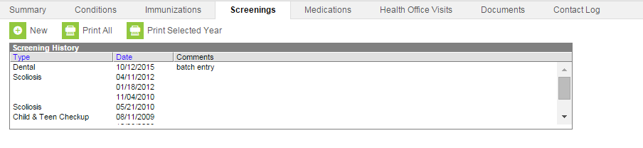
Step 1
Go to the screenings tab on the student you want to edit.

Slide 18
Step 2
Choose the entry from the list of screenings. It will have “batch entry” listed in the comments section.
Double click the entry.

Slide 19
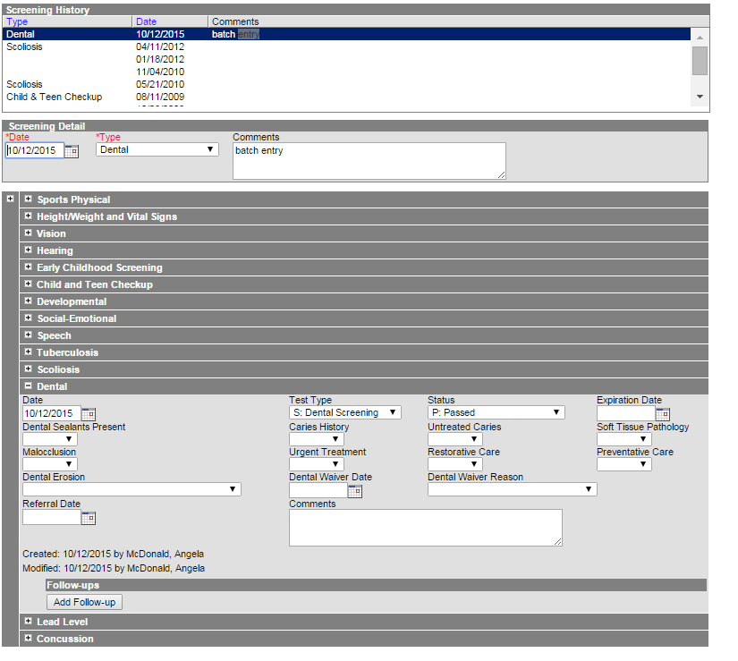
Step 3
Go to the status box, change to “Failed, needs follow-up”
Enter the referral date and any comments as needed and click “Save”.

Slide 20
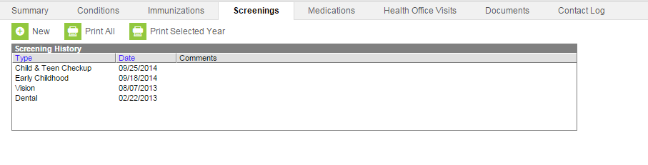
What if the student was absent?
If a student was not screened to due to absence, the screening can be deleted.
Double click on the screening you want to delete.

Slide 21
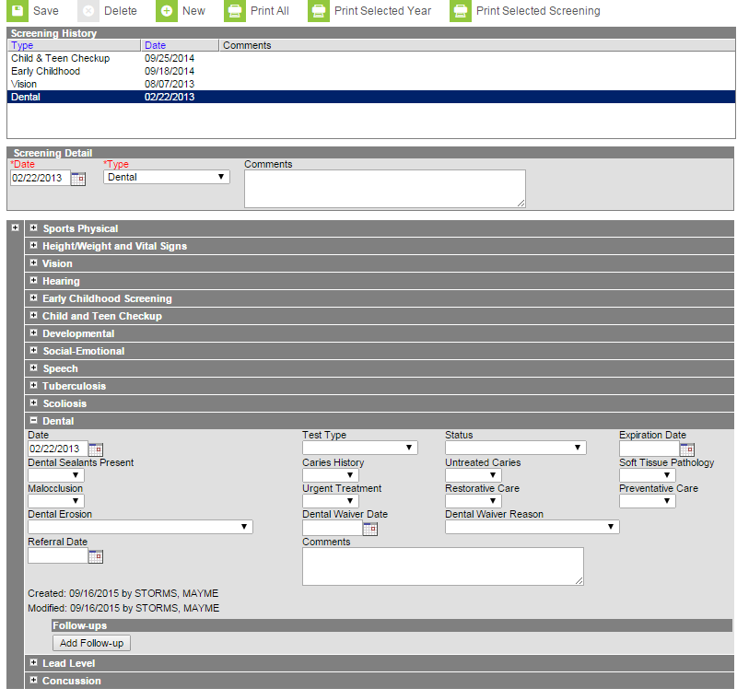
Now Delete It
Click delete

Slide 22

Questions????
Contact me by email: angela.mcdonald@education.ky.gov
Phone: (502) 564-5279 Ext. 4430

