Slide 1
PURCHASING RESOURCES
Tom Stratton, Procurement Manager
Kentucky Department of Education

Slide 2
Two Methods of Procurement for School Districts
Bid Law
KRS 424.260
Kentucky Model Procurement Code (KMPC)
KRS 45A.345 - 460

Slide 3
Bid Law
Under $20,000
Quotes– based on your district policy for dollar thresholds
Over $20,000 (IFB)
Invitation for Bids (IFB), local newspaper and/or Internet (district’s website)
Detailed specifications
Lowest price or lowest evaluated bid price (price, warranty, delivery, etc.)

Slide 4
Kentucky Model Procurement Code
Under $20,000
Quotes – based on your district policy for dollar thresholds
Over $20,000 (IFB and RFP)
Invitation for Bids (IFB)
Local newspaper and/or Internet (district’s website)
Detailed specifications
Lowest price or lowest evaluated bid price
  (evaluated bid price explained later in the presentation)

Slide 5
Kentucky Model Procurement Code
(continued)
Request for Proposals (RFP)
Local newspaper and/or Internet (district’s website)
Specifications are not detailed – need vendors to propose solutions
Best Value – based on evaluation factors in the RFP

Slide 6
Evaluated bid price
  The dollar amount of a bid after bid price adjustments are made pursuant to objective measurable criteria, set forth in the invitation for bids, which affect the economy and effectiveness in the operation or use of the product, such as reliability, maintainability, useful life, residual value, and time of delivery, performance, or completion.

Slide 7
Evaluated bid price
(continued)
  You can find helpful information on the KDE District Support Procurement Assistance page.
  http://education.ky.gov/districts/Proasst/Pages/Procurement-Lowest-Evaluated-Bid-Price.aspx.

Slide 8
NON-competitive negotiation
(1)
KRS 45A.380
Sole Source – ex: only provider within a reasonable geographical area (manufacturer has only one Kentucky distributor).
Not Feasible to Bid – ex: an attorney is working ongoing litigation, beyond the original contract end date.

Slide 9
NON-competitive negotiation
(2)
KRS 45A.380
Emergency
An emergency exists which will cause public harm as a result of the delay in competitive procedures.

Slide 10

NON-competitive negotiation
(3)
Customer:
We need 100 custom widgets.
Finance Office:
When do you need them?
Customer:
Tomorrow… it’s an emergency.

Slide 11
Small purchase process
(1)
  Couple ways to get what you need:
  Price quotes
  Cooperative purchasing agreements

Slide 12
Small purchase process
(2)
Local government, KRS 45A.385:
The local public agency may use small purchase procedures for any contract for which a determination is made that the aggregate amount of the contract does not exceed twenty thousand dollars ($20,000) if small purchase procedures are in writing and available to the public.

Slide 13
Small purchase process
(3)
Local government, KRS 45A.385:
Your district has established small purchase procedures, quote requirements, etc.

Slide 14
Small purchase process
(4)
Aggregate amount doesn’t exceed $20,000.
  State government = 1 fiscal year
  In general terms = 1 calendar year
  Your district may observe the fiscal year, calendar year, or school year (August - July).

Slide 15
Small purchase process
(5)
Cannot artificially split or divide purchases.
  This includes the same item from multiple vendors; related items from multiple vendors;
  and the same or related items from the same or multiple vendors over time.

Slide 16
Small purchase process
(6)
May require one quote or multiple quotes, depending on dollar thresholds established by local purchasing procedures.

Slide 17
Basic Small Purchase Procedure
Limits on Purchases – sample
1. $0 - $249.99 requires purchase order signed by the Superintendent.
2. $250 - $1,999.99 requires signed purchase order and documented three telephone quotes or three prices from competitive catalogs.

Slide 18
Basic Small Purchase Procedure
(continued)
Limits on Purchases – sample
3. $2,000 - $19,999.99 requires signed purchase order and three written quotes from competitive vendors or suppliers.
4. $20,000 and over requires formal bidding by the Office of the Superintendent.

Slide 19
Specifications
Use detailed specifications to compare “apples to apples.”
Brand Name or Approved Equal
Acceptable Brands List – If a system is already in place that requires particular brands. Ex: Building locking system. May require the maker of the system for replacements and upgrades.
“No Substitute” – BEWARE! – Competition Killer

Slide 20
Tips When Obtaining Quotes
From Vendors
(1)
If obtaining phone quotes, advise vendors you’re obtaining quotes from several vendors. You cannot share the names of other vendors from whom quotes are being obtained.
Ensure that all vendors receive the same information. One vendor cannot receive information not given to all.
Notes:
F.O.B. means FREE ON BOARD.

Slide 21
Tips When Obtaining Quotes
From Vendors
(2)
For email/fax quotes, have vendor email/fax his quote, terms, etc. to you complete with his/her signature.
Always give a complete address for the “Ship To” location. Don’t use PO Box Numbers.
Notes:
F.O.B. means FREE ON BOARD.

Slide 22
Tips When Obtaining Quotes
From Vendors
(3)
Have goods shipped FOB Destination, if possible.
FOB = Free On Board
FOB Origin – sale occurs at the shipping point
FOB Destination – sale occurs at the destination
Best choice
Seller assumes the risk while in transit
(damage, loss, insurance, freight charges)
Notes:
F.O.B. means FREE ON BOARD.

Slide 23
Reciprocal Preference, KRS 45A.494
Kentucky Preference Laws
(1)
KRS 45A.494
Price quotes and bid prices are subject to Reciprocal preference for Kentucky resident bidders.
200 KAR 5:410.
Preferences for Qualified Bidders the Department of Corrections, Division of Prison Industries.
Notes:
F.O.B. means FREE ON BOARD.

Slide 24
Reciprocal Preference, KRS 45A.494
Kentucky Preference Laws
(2)
KRS 45A.490 Definitions for KRS 45A.490 to 45A.494.
As used in KRS 45A.490 to 45A.494:
(1) "Contract" means any agreement of a public agency, including grants and orders, for the purchase or disposal of supplies, services, construction, or any other item; and
(2) "Public agency" has the same meaning as in KRS 61.805.
Notes:
F.O.B. means FREE ON BOARD.

Slide 25
Reciprocal Preference, KRS 45A.494
Kentucky Preference Laws
(3)
Prior to a contract being awarded to the lowest responsible and responsive bidder on a contract by a public agency, a resident bidder of the Commonwealth shall be given a preference against a nonresident bidder registered in any state that gives or requires a preference to bidders from that state. The preference shall be equal to the preference given or required by the state of the nonresident bidder.
Notes:
F.O.B. means FREE ON BOARD.

Slide 26
Reciprocal Preference, KRS 45A.494
Kentucky Preference Laws
(4)
Helpful information can be found on the Kentucky Finance & Administration Cabinet, eProcurement website.
http://finance.ky.gov/services/eprocurement/Pages/LawsPrefRegsPolicies.aspx
How to calculate it:
http://finance.ky.gov/services/eprocurement/Documents/FAQ%27s%20and%20Presentations/ReciprocalPreferenceLaw2411final1.pdf
Notes:
F.O.B. means FREE ON BOARD.

Slide 27
Small Purchase Process
Cooperative Purchasing
(going outside of cooperative agreements)
KRS 45A.300 (5) (Cooperative purchasing):
Nothing in this code shall limit or restrict the ability of local school districts to acquire supplies outside of the public purchasing agreements when the supplies and equipment meeting the same specifications as the contract items are available at a lower price elsewhere and the purchase does not exceed two thousand five hundred dollars ($2,500).

Slide 28
Cooperative purchasing
To be valid for use, cooperative contracts must have been posted for competitive bids.
Contracts awarded as a result of a bid process that does not use the lowest bid price or lowest evaluated bid price cannot be properly used by school districts that have adopted the Kentucky Model Procurement Code (KPMC).
        KRS 45A.365, which applies to the bid process in the Kentucky Model Procurement Code (KPMC), notes:

Slide 29
Cooperative purchasing
(continued)
(2) The invitation for bids shall state that the award shall be made on the basis of the lowest bid price or the lowest evaluated bid price. If the latter is used, the objective measurable criteria to be utilized shall be set forth in the invitation for bids.
In either case, bid price must be a basis of award.

Slide 30
Cooperative Purchasing
Master Agreement
“State Price Contract”
Price agreements with a particular vendor to supply specific items at a specific unit price for a specific period.
Bidding and awarding already done by the Finance Cabinet. Items and services are ready for purchase.
A listing of ALL STATE Agency Master Agreements is available at: http://finance.ky.gov/services/eprocurement/Pages/contractinginfo.aspx.

Slide 31
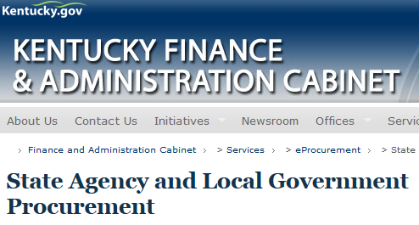
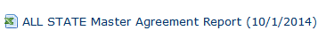
Cooperative Purchasing
Master Agreement
“State Price Contract”
(continued)

Slide 32
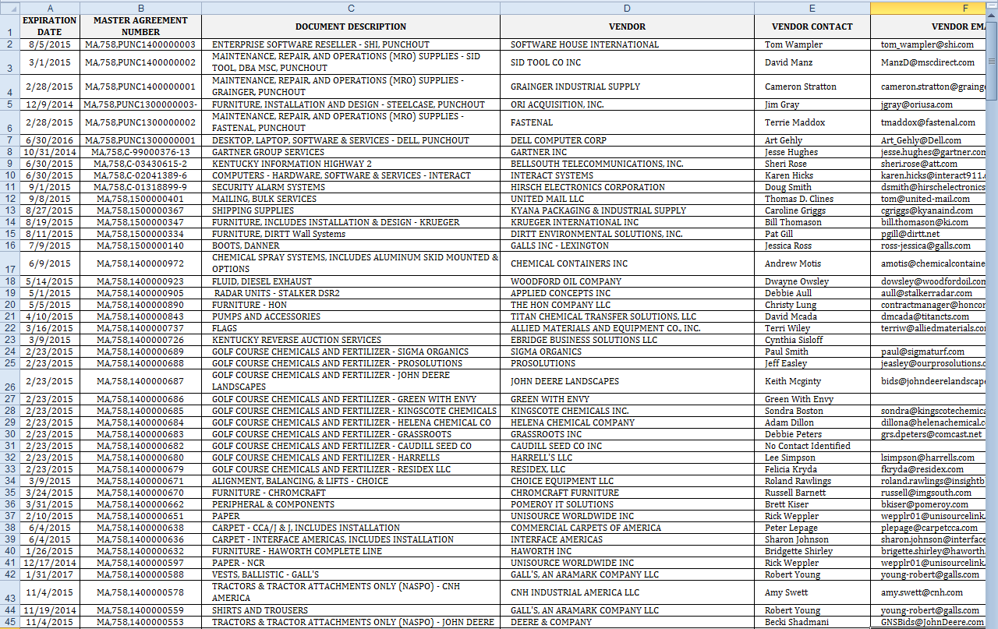
Currently 281 master agreements

Slide 33
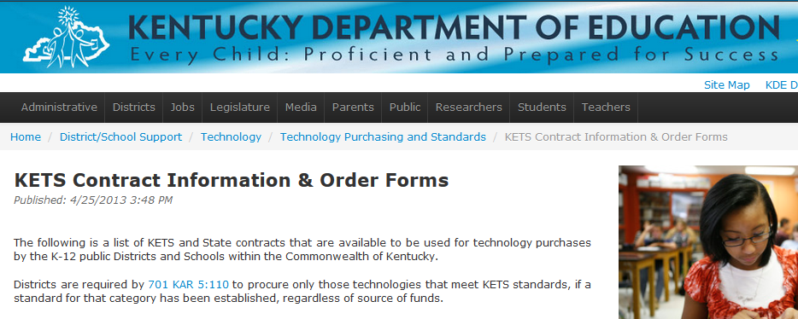
Cooperative Purchasing
Master Agreement
“State Price Contract”
(technology)
Technology purchases - KETS Contracts (Kentucky Education Technology System)
Several vendors have KETS Instructional Device contracts available for use by K-12 public districts with the Commonwealth of Kentucky. Link is on KDE’s website:
http://education.ky.gov/districts/tech/kpur/Pages/Instr-Device.aspx

Slide 34
ckec grrec
JCECES KEDC kpc KVEC
NKCES OVEC
SESC wkec http://education.ky.gov/comm/about/Pages/Kentucky-Education-and-Special-Education-Cooperatives.aspx
Cooperative Purchasing
Kentucky educational cooperatives

Slide 35
Cooperative purchasing
(1)
National and other co-ops:
Capitol Region Purchasing Council (CRPC)
Educational & Institutional Cooperative Purchasing (E & I)
Go Green Communities
H-GAC Cooperative Purchasing Program
HGAC Energy Purchasing Corporation
Kansas City Regional Purchasing Cooperative (KCRPC)
National Cooperative Purchasing Alliance (NCPA)
National Intergovernmental Purchasing Alliance (National IPA)

Slide 36
Cooperative purchasing
(2)
National and other co-ops:
Public Sourcing Solutions
Southeast Florida Governmental Purchasing Cooperative
The Cooperative Purchasing Network (TCPN)
Unified Purchasing Cooperative of the Ohio River Valley
U.S. Communities Purchasing Alliance
Washington School Information Processing Cooperative (WSIPC)
Western States Contracting Alliance (WSCA)

Slide 37

Cooperative purchasing
(3)
National and other co-ops:
http://www.nigp.org/eweb/StartPage.aspx?Site=NIGP&webcode=rsl_pc_links

Slide 38
ETHICS
KRS 45A.455 governs ethical standards for local government entities under the KMPC.
In essence, these statutes note that any state or local public employee should NOT participate in a procurement, if that individual has a conflict of interest in the process (ex: a financial interest in the outcome of the process).

Slide 39
ETHICS
(continued)
As a best practice, public employees who are involved in the public procurement process should always exercise vigilance and common sense to ensure impartiality and fairness throughout the process.
Perception is everything!

Slide 40
CONSEQUENCES OF VIOLATING KMPC
Penalties
KRS 45A.990 allows for criminal charges to be brought for violating the KMPC, which may result in criminal convictions ranging from Class A misdemeanors to Class C felonies.
KRS 45A.990(9) also clarifies that these penalties also apply to officials at local public entities which have adopted the KMPC.

Slide 41

If you are unsure if it’s ethical or legal, check with your local board attorney.

Slide 42
Terms and Acronyms
MA Master Agreement, Price Contract Prefix
PO “Guaranteed” Contract Prefix
RFQ Request for Quotes
IFB Invitation for Bids
RFP Request for Proposals
D&F Determination and Finding
45A Kentucky Model Procurement Law
Addendum Official changes to RFQs, IFBs, RFPs
BREACH Contractor is in default of contract requirement(s)
PROTEST Vendor formally protesting an award decision

Slide 43
VENDOR SELF SERVICE (VSS)
(1)
School districts can access additional information on state contracts, and state solicitations by accessing the “Vendor Self Service System” at https://emars.ky.gov/online/vss/AltSelfService .

Slide 44
VENDOR SELF SERVICE (VSS)
(2)
By clicking public access, a user can search for any current or past solicitations by keyword search. These may help a school district research specifications, or other information. In order to see which vendor received an award, click on the details button, and go to the Notice of Award tab.

Slide 45
VENDOR SELF SERVICE (VSS)
(3)
Also available at the “Vendor Self Service System” site is a tab for “Catalog Management”. District personnel can look up items to see if they are on an “All State Agency Master Agreement” by keyword, vendor name, supplier part number, or manufacturer.

Slide 46
USING VSS
Vendor Self Service (VSS)
Public Access
Catalog Management
Keyword Search
“and” is the wildcard that allows for the search of all words. Without it, the system finds only those contracts with phrases exactly as entered.

Slide 47
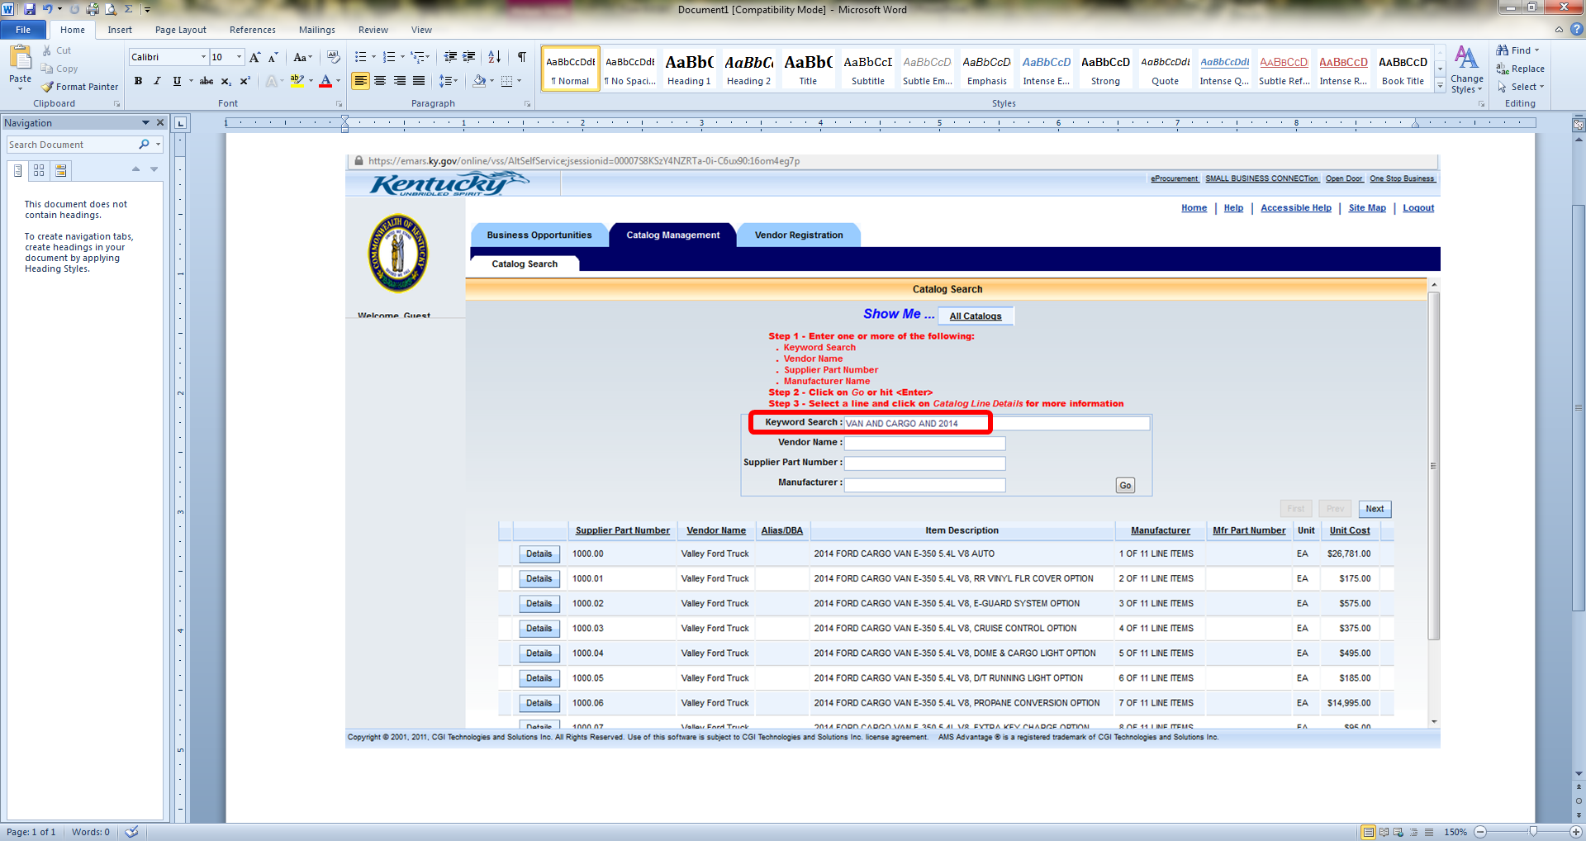
Vss screenshot
(1)
Notes:
“and”
Next = more options

Slide 48
Vss screenshot
(2)
Notes:
“and”
Next = more options

Slide 49

Want to LEARN MORE AND GET TO KNOW OTHER PROCUREMENT PROFESSIONALS?
There are numerous events, workshops, and seminars available to you - many FREE OF CHARGE.
  Kentucky Public Procurement Association (KPPA)
  The Institute for
  Public Procurement
  (NIGP)
Notes:
www.kppanigp.org
www.nigp.com

Slide 50
HELPFUL RESOURCES
IT Purchases, KETS contracts page (Kentucky Education Technology System)
http://education.ky.gov/districts/tech/kpur/pages/kets-contracts.aspx
Kentucky state government procurement
Office of Procurement Services
Finance and Administration Cabinet
502-564-4510
http://finance.ky.gov/business/procurementservices/
Procurement Assistance (“Procurement Tools”)
http://education.ky.gov/districts/Proasst/Pages/default.aspx

Slide 51
HELPFUL RESOURCES
(continued)
Kentucky Department of Education
Tom Stratton
Procurement Manager
tom.stratton@education.ky.gov
502-564-2351

Slide 52

QUESTIONS?

