Slide 1
What do the Kentucky Academic Standards (KAS) for Social Studies look like in practice?
A webinar designed to deepen social studies content knowledge and pedagogy.
Topic Focus: Grade 3 Kentucky Economics
Notes:
.

Slide 2
Webinar Goals
Learning Goal: to support your implementation of the KAS for Social Studies through experiencing a grade level example.
Success Criteria
I can analyze 3.E.KE.1 to understand what this standard requires students to know and be able to do.
I can improve my content knowledge and pedagogical skills after exploring a grade level sample.

Slide 3
What are Standards?
Standards define what students should know, understand and be able to do at the end of a grade level.
 | Definition
Know | Refers to facts, dates, places, people, definitions, rules or information
Understand | Refers to theories, generalizations or “big ideas”
Do | Refers to skills such as communication, reading, computation, application and transfer to new situations
Notes:
It is important to clearly understand and unpack each piece of a standard to be able to implement it with fidelity.

Slide 4
What Does it Mean to Unpack a Standard?
Breaking a standard into smaller, more explicit chunks for the purposes of curriculum development and/or unit and lesson planning.
3.E.KE.1 Explain how trade between people and groups can benefit Kentucky.
Economics (E)
Microeconomics (MI)
Macroeconomics (MA)
Specialization, Trade and Interdependence (ST)
Incentives, Choices and Decision Making (IC)
Kentucky Economics (KE)
Civics (C) | Economics (E) | Geography (G) | History (H)
Notes:
Unpacking a standard means to break a standard into smaller, more explicit chunks for the purposes of curriculum development and/or unit and lesson planning.

Slide 5
What Does it Mean to Unpack a Standard? (2)
Breaking a standard into smaller, more explicit chunks for the purposes of curriculum development and/or unit and lesson planning.
3.E.KE.1 Explain how trade between people and groups can benefit Kentucky.
What does explain mean in this standard?
Does it mean “make meaning of” or “transfer”?
Does it mean to “accurately state”? Or, does it mean to “support ideas with details and examples”?
What does the verb demand in terms of student learning?
Notes:
Unpacking a standard means to break a standard into smaller, more explicit chunks for the purposes of curriculum development and/or unit and lesson planning.

Slide 6
When Unpacking a Standard, Ask a Series of Questions:
What knowledge will students need to demonstrate the intended learning?
What understandings will they need to master?
What skills will they need to apply to demonstrate mastery?
How might students demonstrate the requisite skills through learning experiences?
Notes:
Review the questions that are necessary for educators to unpack the standards. Ask participants to reflect on the questions.

Slide 7
Tool to Unpack Standards
Step 2
Step 4
Step 1
Unpacking the Standard
Standard | What Knowledge/Concepts/ Vocabulary do students need to know to reach this standard? | What skills do students need to be able to do to reach this standard? | What level of proficiency do students need to be at in order to reach this standard?
Step 3
Notes:
If you are having trouble accessing the Tool to Unpack Standards, please copy and paste this URL into your browser and press the enter key to download.
https://education.ky.gov/curriculum/standards/kyacadstand/Documents/Tool_to_Unpack_Standards_and_Identify_Gaps.xlsx
The tool is a step by step process to begin to unpack a specific set of standards. Section B focuses on the first four steps of the tool:
Step 1: Identifying the standards you want to unpack
Step 2: What Knowledge/Concepts/ Vocabulary do students need to know to reach this standard?
Step 3: What skills do students need to be able to do to reach this standard?
Step 4: What level of proficiency do students need to be at in order to reach this standard?

Slide 8
Step 1: List the Standards for Your Grade/Course
Cut and paste the standards, including the inquiry practices, into the furthest left column of the spreadsheet
Unpacking the Standard
Standard | What Knowledge/Concepts/ Vocabulary do students need to know to reach this standard? | What skills do students need to be able to do to reach this standard? | What level of proficiency do students need to be at in order to reach this standard?
3.E.KE.1 Explain how trade between people and groups can benefit Kentucky.
Notes:
The first step is to list the standards. You can cut and paste the standards they want to work with in the far left column. Make sure they include the inquiry practices.

Slide 9
Step 2: What Knowledge, Concepts, Vocabulary will they need to Master? (1)
Closely look at each standard and identify the Knowledge/Concepts/Vocabulary
The “what” that students should learn
Unpacking the Standard
Standard | What Knowledge/Concepts/ Vocabulary do students need to know to reach this standard? | What skills do students need to be able to do to reach this standard? | What level of proficiency do students need to be at in order to reach this standard?
3.E.KE.1 Explain how trade between people and groups can benefit Kentucky. | Trade Benefit Kentucky
Notes:
The second step is to look at each individual standard and determine what knowledge, concepts and vocabulary students will need to understand in order to master the standards. Review the example on the slide.

Slide 10
Step 2: What Knowledge, Concepts, Vocabulary will they need to Master? (2)
Teachers can use the disciplinary clarifications to determine the Knowledge/Concepts/Vocabulary.
The disciplinary clarifications for Grade 3 begin on page 62 of the KAS for Social Studies.
Concepts and Practices | Standard | Disciplinary Clarifications
E: Kentucky Economics | 3.E.KE.1 Explain how trade between people and groups can benefit Kentucky. | People and groups in Kentucky benefit from trade for goods and services not available to them in their area, region or the state. Kentuckians also benefit by selling abundant or specialized items outside the state to those without as much access. For example, Kentucky’s specialization in horse breeding and racing means that people from across the world come to the state to access these goods and services, helping boost the economy. Kentucky’s natural access to coal also serves as an item of trade across borders to areas not as rich in this resource.
Notes:
One resource to identify the knowledge, concepts and vocabulary is the disciplinary clarifications for each grade. The disciplinary clarifications offer suggestions teachers can use to more clearly determine the knowledge, concepts and vocabulary. Review the example in the slide.

Slide 11
Step 2: What Knowledge, Concepts, Vocabulary will they need to Master? (3)
Unpacking the Standard
Standard | What Knowledge/Concepts/ Vocabulary do students need to know to reach this standard? | What skills do students need to be able to do to reach this standard? | What level of proficiency do students need to be in order to reach this standard?
3.E.KE.1 Explain how trade between people and groups can benefit Kentucky. | Trade Benefit Kentucky Goods and Services Area, region or Kentucky Specialization Abundant or Specialized items
Notes:
Review the example in the slide. The bolded text comes from the disciplinary clarification.
The disciplinary clarifications include sample ideas of content and concepts to help teachers better understand the expectations of the standards. The identified disciplinary clarifications are possible suggestions; however, they are not the only pathways and are not comprehensive to obtain mastery of the standards. Participants may add more to this column beyond what is listed in the Disciplinary Clarification provided.
Additionally, it is important to note that there are not Disciplinary Clarifications provided for the Inquiry Practices. Therefore, it is critical that participants complete this work with a partner, in their grade level teams or PLC when unpacking an Inquiry Practice standard. These collegial conversations will support educators in identifying all of the knowledge/concepts/vocabulary students will need to know in order to reach this standard.

Slide 12
Step 3: What Skills will they need to Master?
Closely look at the standard and identify the skills
Skills include the thinking skills and mental processes that require skillful application of the knowledge to solve problems, make a decision, etc.
Unpacking the Standard
Standard | What Knowledge/Concepts/ Vocabulary do students need to know to reach this standard? | What skills do students need to be able to do to reach this standard? | What level of proficiency do students need to be in order to reach this standard?
3.E.KE.1 Explain how trade between people and groups can benefit Kentucky. | Trade Benefit Kentucky Goods and Services Area, region or state Specialization Abundant or Specialized items | Explain
Notes:
The third step is to look at each individual standard and determine what skills students will need to engage in in order to master the standards. Review the example in the slide. Explain this usually starts and is determined by the verb at the start of the standards statement. However, do not limit the identification of the skills required to demonstrate master of the standard to just the verb as some standards, such as 2.G.GR.1, requires that students examine and use a variety of data. Using a variety of data is an additional skill students need to be able to do in order to demonstrate mastery of the standards.

Slide 13
Step 4: What Level of Proficiency do Students need to be in order to Reach this Standard?
Look at the standard and identify what level of proficiency students will need to be in order to reach this standard.
One way to determine answers to this question is to look at the Depth of Knowledge.
Unpacking the Standard
Standard | What Knowledge/Concepts/ Vocabulary do students need to know to reach this standard? | What skills do students need to be able to do to reach this standard? | What level of proficiency do students need to be in order to reach this standard?
3.E.KE.1 Explain how trade between people and groups can benefit Kentucky. | Trade Benefit Kentucky Goods and Services Area, region or state Specialization Abundant or Specialized items | Explain | Level 3
Notes:
The fourth step is to determine the level of proficiency students are required to be at for a particular grade. Most often this can be identified using Bloom’s taxonomy and/or Webbs Depth of Knowledge.
It is important to note that when determining the DOK of a standard, the verb, such as analyze, should not be separated from the rest of the standard as the content and skills outlined in the standard impact the level of rigor students need to engage in order to demonstrate mastery of the standards. For example, in the DOK handout provided, “analyze similarities and differences in issues and problems” is a DOK 3 while “analyzing and synthesizing information from multiple sources” is a DOK 4.

Slide 14
What do the KAS for Social Studies look like in practice?
Topic Focus: Grade 3 Kentucky Economics

Slide 15
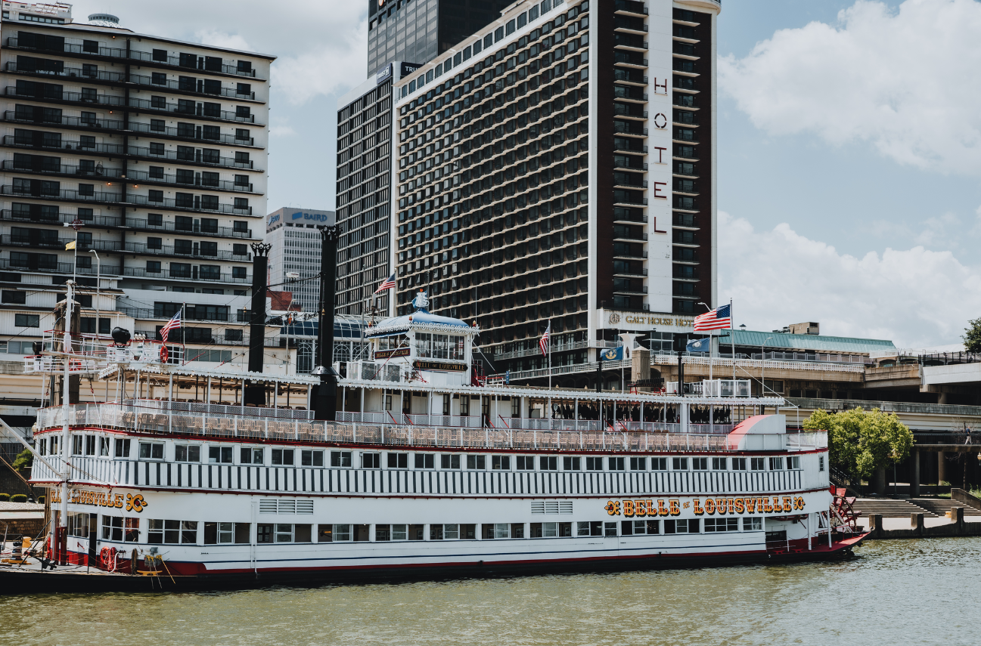
Belle of Louisville lesson introduction
Compelling Question: How have innovations in river watercraft impacted the lives of Americans?
Supporting Question: How have steamboats expanded travel and trade to benefit Kentucky?
401 W River RD
Louisville KY 40202

Slide 16
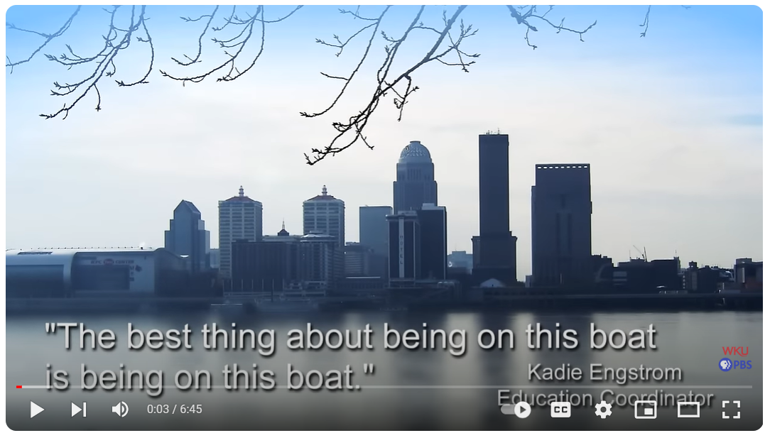
Main Street- Belle of Louisville
Notes:
Source:
WKU PBS. (2014, February 14). Main Street- Belle of Louisville [video]. https://www.youtube.com/watch?v=_hx_BkjUIsY

Slide 17
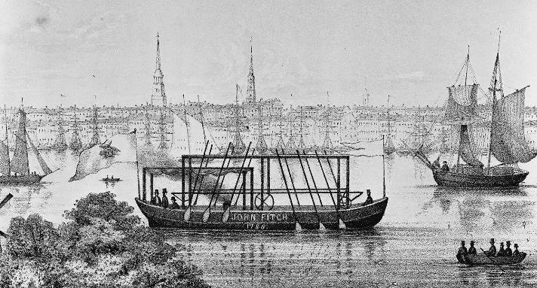
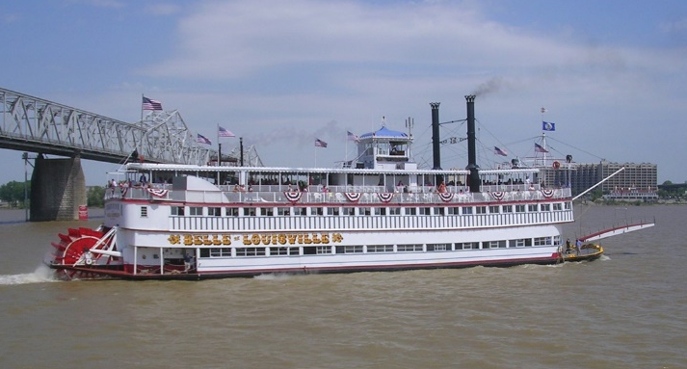
Comparing steamboats
Str John Fitch
Str Belle of Louisville
How are these boats similar?
How are they different?
What advantages might the Str Belle of Louisville have compared to the Str John Fitch?
401 W River RD
Louisville KY 40202
Notes:
Sources:
Library of Congress. (n.d.). John Fitch’s steamboat. Encyclopedia Britannica. https://www.britannica.com/technology/steamboat#/media/1/564552/101915
Str. Belle of Louisville – Belle of Louisville Archive

Slide 18
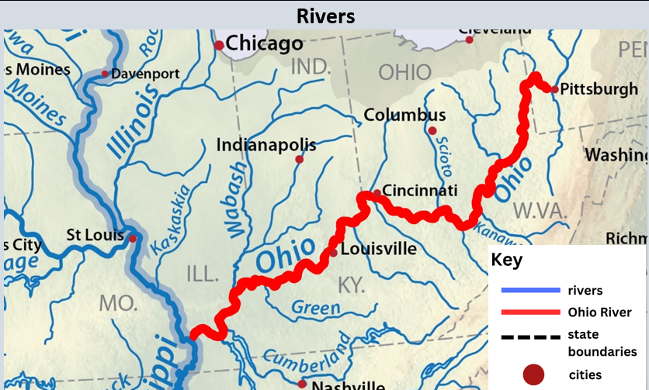
Rivers
Notes:
To support engagement with this source, access the Analyze a Map tool from the National Archives. For the purposes of this examination, students should only complete the “Meet the map” and the “Observe its parts” sections. This tool may be accessed using this link: https://www.archives.gov/education/lessons/worksheets/analyze-a-map-novice
Modified from:
Shannon1. (2016, February 26). Mississippiriver-new-01 [map]. https://en.wikipedia.org/wiki/List_of_longest_rivers_of_the_United_States_%28by_main_stem%29#/media/File:Mississippiriver-new-01.png

Slide 19
Meet the Map
What do you see?
Does the map have a title?
Notes:
Modified from:
Shannon1. (2016, February 26). Mississippiriver-new-01 [map]. https://en.wikipedia.org/wiki/List_of_longest_rivers_of_the_United_States_%28by_main_stem%29#/media/File:Mississippiriver-new-01.png

Slide 20
Observe the map
Notes:
Modified from:
National Archives. (n.d.). Meet the Map. https://www.archives.gov/education/lessons/worksheets/analyze-a-map-novice
Shannon1. (2016, February 26). Mississippiriver-new-01 [map]. https://en.wikipedia.org/wiki/List_of_longest_rivers_of_the_United_States_%28by_main_stem%29#/media/File:Mississippiriver-new-01.png

Slide 21
Discuss
Discuss
How many other rivers are connected to the Ohio River?
How can people benefit from living near rivers?
What questions do you have about the map?
Notes:
Modified from:
Shannon1. (2016, February 26). Mississippiriver-new-01 [map]. https://en.wikipedia.org/wiki/List_of_longest_rivers_of_the_United_States_%28by_main_stem%29#/media/File:Mississippiriver-new-01.png

Slide 22
Quick Write
Quick Write
How did the steamboat improve travel?
Cite evidence from what you have learned to support your answer.
Submit your responses in the chat when prompted.
Notes:
WKU PBS. (2014, February 14). Main Street- Belle of Louisville [video]. https://www.youtube.com/watch?v=_hx_BkjUIsY
Str. Belle of Louisville – Belle of Louisville Archive
Map modified from: Shannon1. (2016, February 26). Mississippiriver-new-01 [map]. https://en.wikipedia.org/wiki/List_of_longest_rivers_of_the_United_States_%28by_main_stem%29#/media/File:Mississippiriver-new-01.png

Slide 23
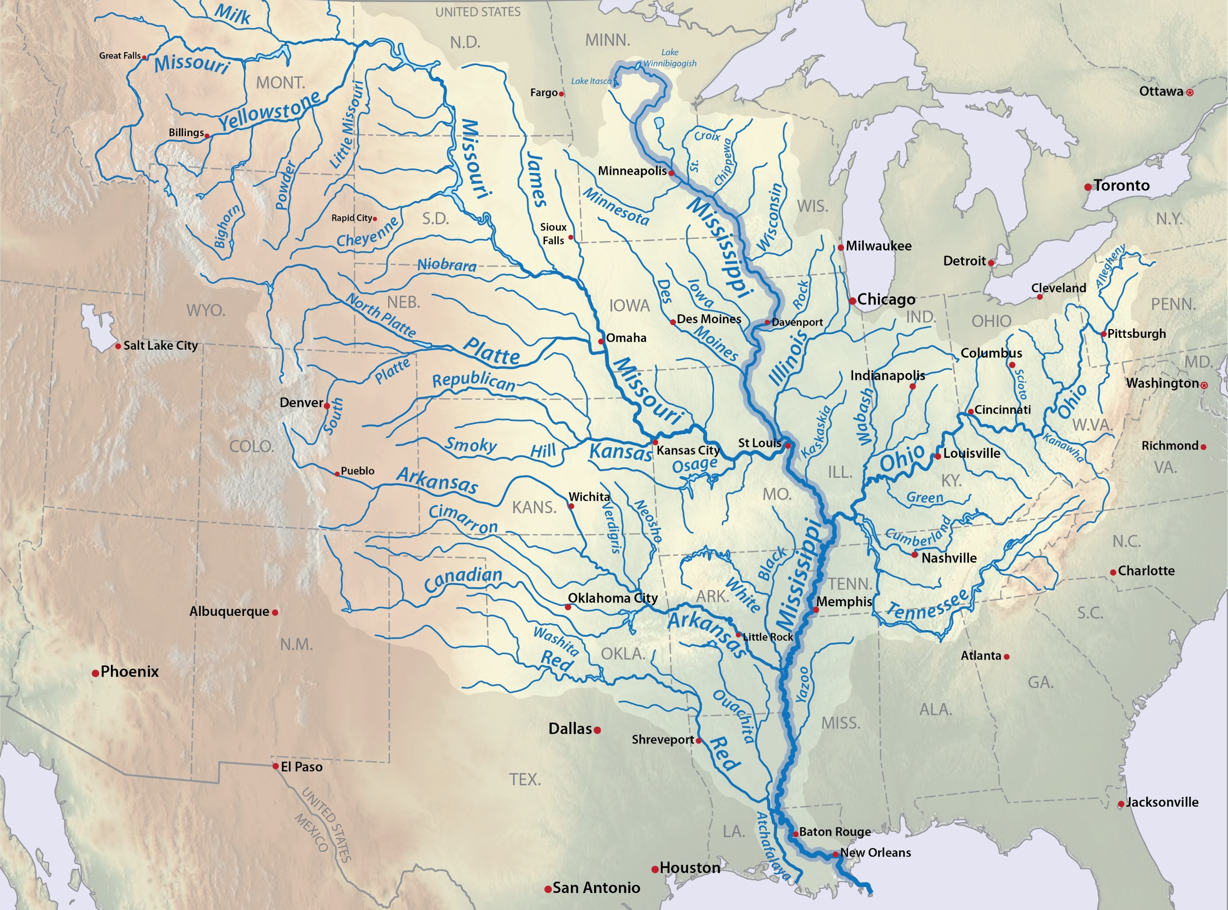
Major Rivers of the US
Missouri River – 2,546 Miles
Mississippi River – 2,350 Miles
Ohio River – 981 Miles
401 W River RD
Louisville KY 40202
Notes:
Modified from:
Shannon1. (2016, February 26). Mississippiriver-new-01 [map]. https://en.wikipedia.org/wiki/List_of_longest_rivers_of_the_United_States_%28by_main_stem%29#/media/File:Mississippiriver-new-01.png

Slide 24
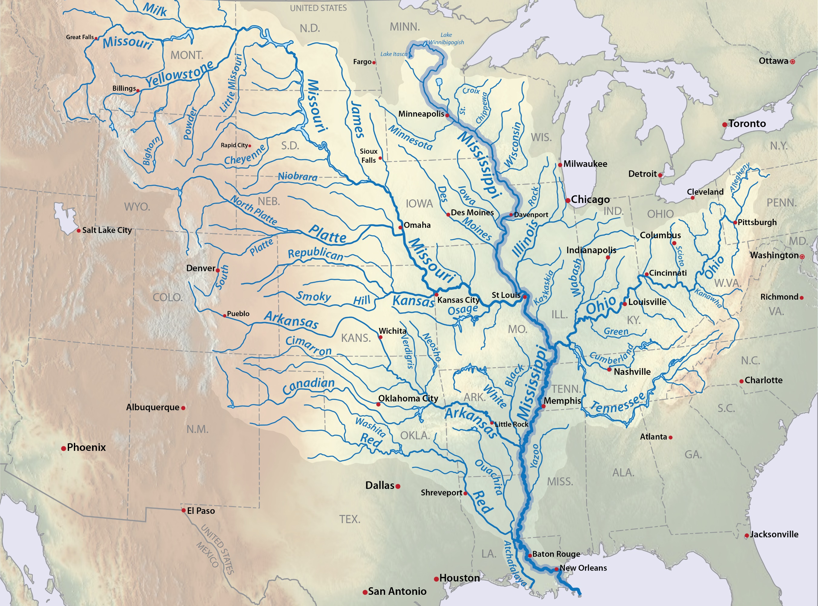
Major Rivers Flow Direction
Missouri River – 2,546 Miles
Mississippi River – 2,350 Miles
Ohio River – 981 Miles
401 W River RD
Louisville KY 40202
Notes:
Modified from:
Shannon1. (2016, February 26). Mississippiriver-new-01 [map]. https://en.wikipedia.org/wiki/List_of_longest_rivers_of_the_United_States_%28by_main_stem%29#/media/File:Mississippiriver-new-01.png

Slide 25
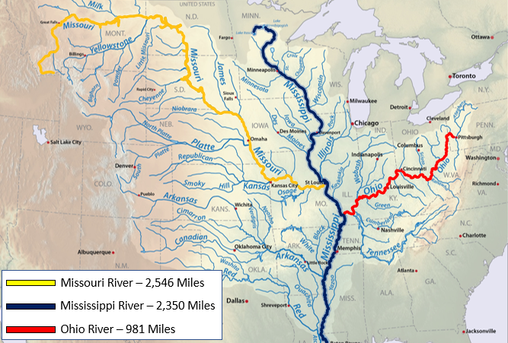
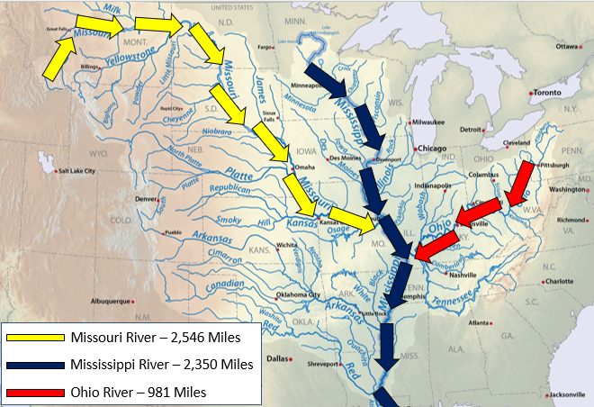
Discussion
Discuss
Why did steamboats have an advantage over other types of watercraft? Use evidence in your response.

Slide 26
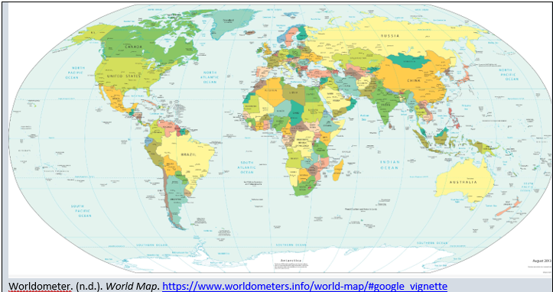
World Map
Notes:
Worldometer. (n.d.). World Map. https://www.worldometers.info/world-map/#google_vignette

Slide 27
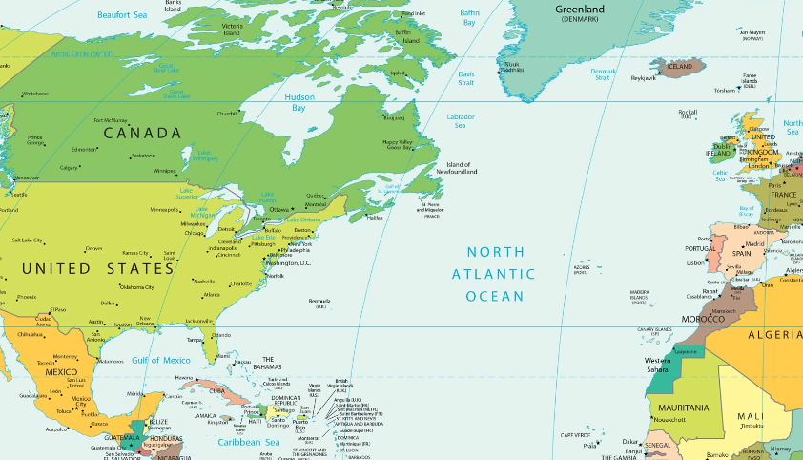
World Map showing trade with Louisville/New Orleans
Notes:
Modified from:
Worldometer. (n.d.). World Map. https://www.worldometers.info/world-map/#google_vignette

Slide 28
Buttons
401 W River RD
Louisville KY 40202
Notes:
The Arabia Steamboat Museum. (n.d.). The Arabia Steamboat Museum [webpage]. http://www.1865.com

Slide 29
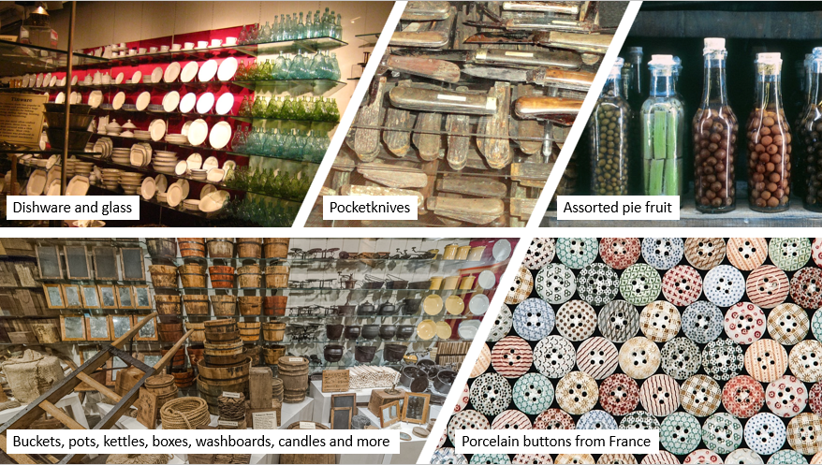
See, Think, Wonder
What do you see?
What do you think about that?
What does it make you wonder?
Notes:
Harvard Project Zero. (n.d.). See, Think, Wonder. https://pz.harvard.edu/resources/see-think-wonder
The Arabia Steamboat Museum. (n.d.). The Arabia Steamboat Museum [webpage]. http://www.1865.com

Slide 30
Try to make sense of the artifacts
Pick one artifact, and answer the following:
What do you think the artifact was used for?
Who do you think would have used the object?
Why do you think these items were traded?
What does the object tell us about the time period when it was made and used?
Do we still use this object today? If so, how it is different?
Notes:
The “Try to make sense of it” questions on this slide are from the National Archives’ Analyze an Artifact or Object tool: https://www.archives.gov/files/education/lessons/document-analysis/english/analyze-an-artifact-or-object-novice.pdf
The Arabia Steamboat Museum. (n.d.). The Arabia Steamboat Museum [webpage]. http://www.1865.com

Slide 31
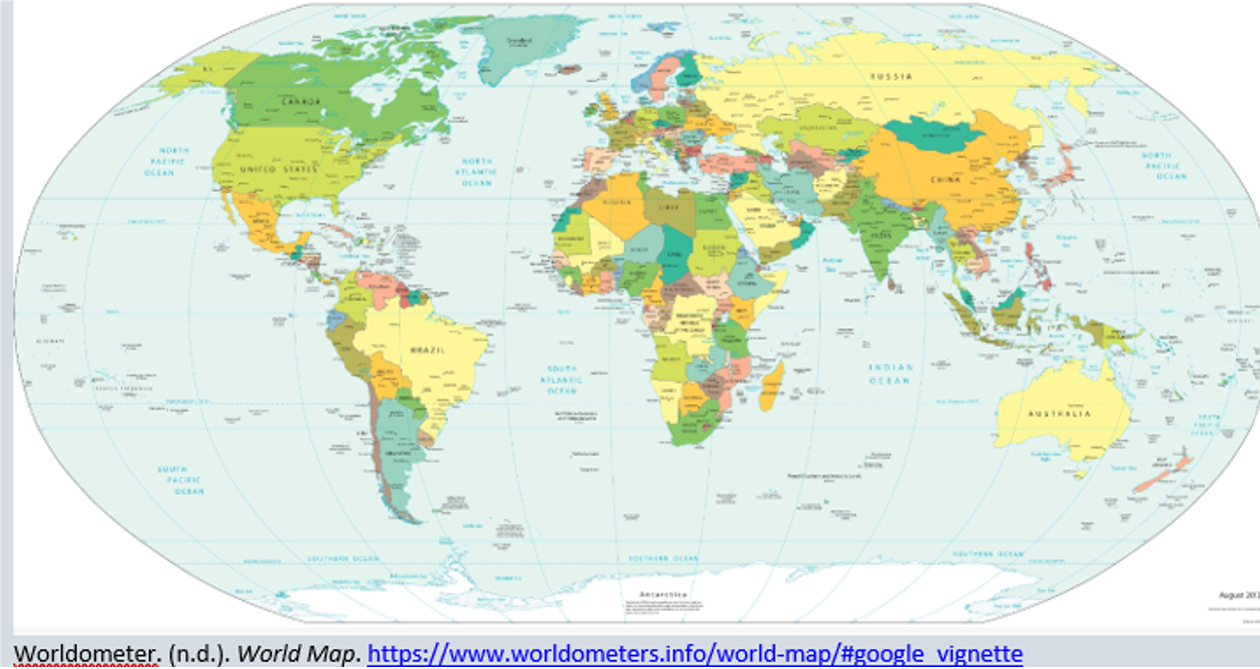
Claim, Support, Question
Claim, Support, Question
Write a claim that answers this question: “How did Kentucky benefit from the opportunities steamboats provided?”
Identify evidence from the sources to support your claim.
Ask a question related to your claim or the supports. What isn’t explained?
Notes:
The Arabia Steamboat Museum. (n.d.). The Arabia Steamboat Museum [webpage]. http://www.1865.com
Worldometer. (n.d.). World Map. https://www.worldometers.info/world-map/#google_vignette

Slide 32
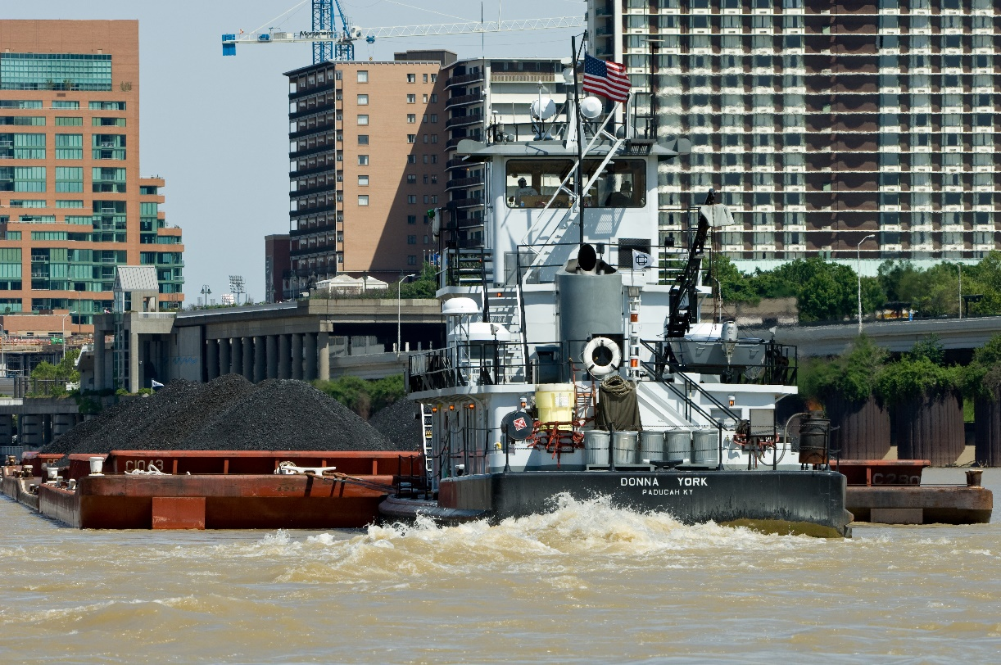
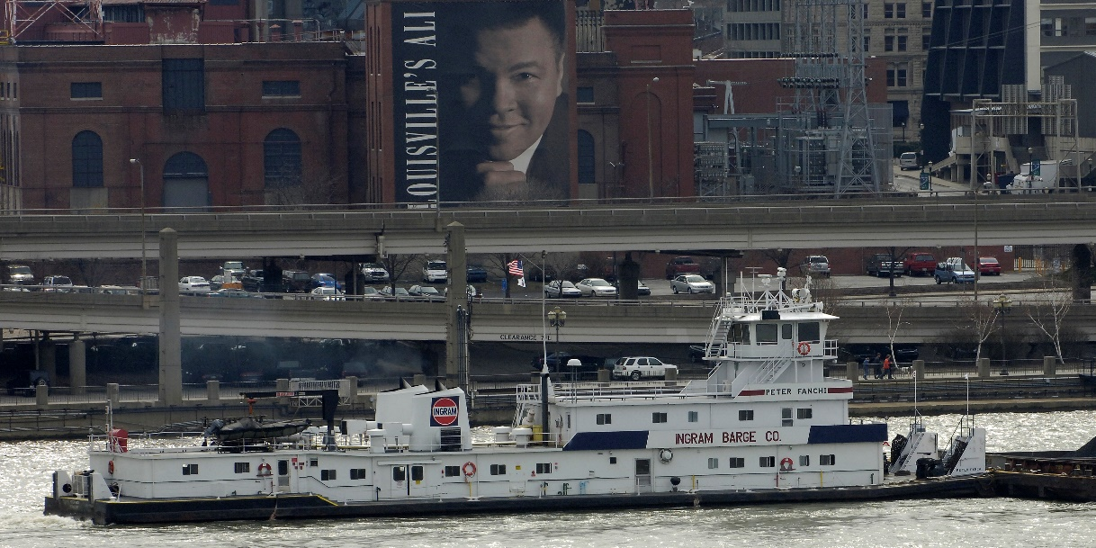
Analyze a Photograph
Meet the photo:
What do you see?
Is the photo black and white or color?
Is there a caption?
If so, what does the caption tell you?
Observe its parts:
Do you see people, objects, or both in the photo?
What are people doing in the photo?
What are the objects used for in the photo?
What are two wors that describe the photo?
Notes:
Peter Fanchi. (2006, February 25). The towboat Peter Fanchi down-bound on the Ohio river at Louisville, Kentucky. https://en.m.wikipedia.org/wiki/File:PeterFanchi.jpg
Schneid, Joe. (2009, May 24). The Donna York pushing barges of coal up the Ohio River at Louisville, Kentucky. https://en.wikipedia.org/wiki/Pusher_(boat)#/media/File:Donna_York.jpg

Slide 33
Discussion
How have the trade systems we use today changed over time?
Notes:
Peter Fanchi. (2006, February 25). The towboat Peter Fanchi down-bound on the Ohio river at Louisville, Kentucky. https://en.m.wikipedia.org/wiki/File:PeterFanchi.jpg
Schneid, Joe. (2009, May 24). The Donna York pushing barges of coal up the Ohio River at Louisville, Kentucky. https://en.wikipedia.org/wiki/Pusher_(boat)#/media/File:Donna_York.jpg

Slide 34
Task Aligned to the Supporting Question
Answer the supporting question:
How have steamboats expanded travel and trade to benefit Kentucky?
In your response, provide evidence from at least two different sources you investigated.
When directed, submit your responses in the chat.

Slide 35
Belle of Louisville conclusion
Compelling Question: How have innovations in river watercraft impacted the lives of Americans?
Supporting Question: How have steamboats expanded travel and trade to benefit Kentucky?
401 W River RD
Louisville KY 40202

Slide 36
Reflection
Concepts and Practices | Standard | Disciplinary Clarifications
E: Kentucky Economics | 3.E.KE.1 Explain how trade between people and groups can benefit Kentucky. | People and groups in Kentucky benefit from trade for goods and services not available to them in their area, region or the state. Kentuckians also benefit by selling abundant or specialized items outside the state to those without as much access. For example, Kentucky’s specialization in horse breeding and racing means that people from across the world come to the state to access these goods and services, helping boost the economy. Kentucky’s natural access to coal also serves as an item of trade across borders to areas not as rich in this resource.
Today’s webinar was designed to support you in experiencing what the KAS for Social Studies looks like in practice. Complete the Connect, Extend, Challenge strategy to reflect on how what you experienced will help students do social studies and demonstrate mastery of the standards.

Slide 37
Reflection (2)
Concepts and Practices | Standard | Disciplinary Clarifications
E: Kentucky Economics | 3.E.KE.1 Explain how trade between people and groups can benefit Kentucky. | People and groups in Kentucky benefit from trade for goods and services not available to them in their area, region or the state. Kentuckians also benefit by selling abundant or specialized items outside the state to those without as much access. For example, Kentucky’s specialization in horse breeding and racing means that people from across the world come to the state to access these goods and services, helping boost the economy. Kentucky’s natural access to coal also serves as an item of trade across borders to areas not as rich in this resource.
Consider what you have just read, seen, or heard, and then ask yourself:
How are the ideas and information connected to what you already know?
What new ideas did you get that broadened your thinking or extended it in different directions?
What challenges or puzzles emerge for you?

Slide 38
We need to hear from you!
Please complete the Elementary Webinar Series Feedback Form for April 24, 2024.
Your feedback is essential to helping us continue to offer learning experiences that best meet your needs moving forward.
Notes:
Please complete this survey to provide feedback on your experience this evening: https://forms.gle/Fyp25GY12S9cJQgy6

