Slide 1
What do the Kentucky Academic Standards (KAS) for Social Studies look like in practice?
A webinar designed to deepen social studies content knowledge and pedagogy.
Topic Focus: Grade 1 Kentucky History

Slide 2
Webinar Goals
Learning Goal to the KAS for Social Studies by engaging in a demonstration about Kentucky history.
Success Criteria
I can analyze 1.H.KH.1 to understand what this standard requires students to know and be able to do.
I can improve my content knowledge and pedagogical skills after exploring a grade level sample.

Slide 3
What are Standards?
Standards define what students should know, understand and be able to do at the end of a grade level.
 | Definition
Know | Refers to facts, dates, places, people, definitions, rules or information
Understand | Refers to theories, generalizations or “big ideas”
Do | Refers to skills such as communication, reading, computation, application and transfer to new situations
Notes:
It is important to clearly understand and unpack each piece of a standard in order to be able to implement it with fidelity.

Slide 4
What Does it Mean to Unpack a Standard?
Breaking a standard into smaller, more explicit chunks for the purposes of curriculum development and/or unit and lesson planning.
For example, analyze the verb in the following standard to determine its meaning in terms of instruction and assessment.
“...understand the development of important community traditions and events.”
What does understand mean in this standard?
Does it mean “make meaning of” or “transfer”?
Does it mean to “accurately state and explain”? Or, does it simply mean to “know”?
What does the verb demand in terms of student learning?
Notes:
Unpacking a standard means to break a standard into smaller, more explicit chunks for the purposes of curriculum development and/or unit and lesson planning. Explain that even determining the meaning of understand here, does not necessarily mean this specific definition of understand can be transferred to other grade levels. (i.e.: As students move up in grades, it must be determined at what level students need an understanding of, say, the causes and effects of the Civil War). Give teachers time to discuss grade alignment - what does understand look like at the grade level above and below?

Slide 5
Doing it Together
Breaking down the standards allows for collegial conversations that should result in a common agreement on the learning expectations.
Define the language of the standard
Determine the level of rigor indicated, in part, through the verb used and the grade level of the standard
Analyze and translate to better incorporate into curriculum, unit and lesson plans
Analysis is essential at the local level if the standards are to be validly and consistently taught among teachers
Notes:
Unpacking the standards should be done together – the ideas on the slide highlights why it is important to do this work as a team.

Slide 6
Tool to Unpack Standards
Step 2
Step 4
Step 1
Unpacking the Standard
Standard | What Knowledge/Concepts/ Vocabulary do students need to know to reach this standard? | What skills do students need to be able to do to reach this standard? | What level of proficiency do students need to be at in order to reach this standard?
Step 3
Notes:
If you are having trouble accessing the Tool to Unpack Standards, please copy and paste this URL into your browser and press the enter key to download.
https://education.ky.gov/curriculum/standards/kyacadstand/Documents/Tool_to_Unpack_Standards_and_Identify_Gaps.xlsx
The tool is a step by step process to begin to unpack a specific set of standards. Section B focuses on the first four steps of the tool:
Step 1: Identifying the standards you want to unpack
Step 2: What Knowledge/Concepts/ Vocabulary do students need to know to reach this standard?
Step 3: What skills do students need to be able to do to reach this standard?
Step 4: What level of proficiency do students need to be at in order to reach this standard?

Slide 7
Step 1: List the Standards for Your Grade/Course
Cut and paste the standards, including the inquiry practices, into the furthest left column of the spreadsheet
Unpacking the Standard
Standard | What Knowledge/Concepts/ Vocabulary do students need to know to reach this standard? | What skills do students need to be able to do to reach this standard? | What level of proficiency do students need to be at in order to reach this standard?
1.H.CH.1 Describe how events, people and innovation of the past affect their present lives, community and state.
Notes:
The first step is to list the standards. You can cut and paste the standards they want to work with in the far left column. Make sure they include the inquiry practices.

Slide 8
Step 2: What Knowledge, Concepts, Vocabulary will they need to Master? (1)
Closely look at each standard and identify the Knowledge/Concepts/Vocabulary
The “what” that students should learn
Unpacking the Standard
Standard | What Knowledge/Concepts/ Vocabulary do students need to know to reach this standard? | What skills do students need to be able to do to reach this standard? | What level of proficiency do students need to be at in order to reach this standard?
1.H.CH.1 Describe how events, people and innovation of the past affect their present lives, community and state. | Events of the past People of the past Innovation of the past Impacts on their lives, community and state
Notes:
The second step is to look at each individual standard and determine what knowledge, concepts and vocabulary students will need to understand in order to master the standards. Review the example on the slide.

Slide 9
Step 2: What Knowledge, Concepts, Vocabulary will they need to Master? (2)
Teachers can use the disciplinary clarifications to determine the Knowledge/Concepts/Vocabulary.
The disciplinary clarifications for Grade 1 begin on page 38 of the KAS for Social Studies.
Concepts and Practices | Standard | Disciplinary Clarifications
H: Change and Continuity | 1.H.CH.1 Describe how events, people and innovation of the past affect their present lives, community and state. | The past impacts the present through the cultures which exist in an area, the ways people interact and the technology which modern people use.
Notes:
One resource to identify the knowledge, concepts and vocabulary is the disciplinary clarifications for each grade. The disciplinary clarifications offer suggestions teachers can use to more clearly determine the knowledge, concepts and vocabulary. Review the example in the slide.

Slide 10
Step 2: What Knowledge, Concepts, Vocabulary will they need to Master? (3)
Unpacking the Standard
Standard | What Knowledge/Concepts/ Vocabulary do students need to know to reach this standard? | What skills do students need to be able to do to reach this standard? | What level of proficiency do students need to be in order to reach this standard?
1.H.CH.1 Describe how events, people and innovation of the past affect their present lives, community and state. | Events of the past People of the past Innovation of the past Impacts on their lives, community and state Impacts through culture Impacts through technology Impacts through interactions
Notes:
Review the example in the slide. The bolded text comes from the disciplinary clarification.
The disciplinary clarifications include sample ideas of content and concepts to help teachers better understand the expectations of the standards. The identified disciplinary clarifications are possible suggestions; however, they are not the only pathways and are not comprehensive to obtain mastery of the standards. Participants may add more to this column beyond what is listed in the Disciplinary Clarification provided.
Additionally, it is important to note that there are not Disciplinary Clarifications provided for the Inquiry Practices. Therefore, it is critical that participants complete this work with a partner, in their grade level teams or PLC when unpacking an Inquiry Practice standard. These collegial conversations will support educators in identifying all of the knowledge/concepts/vocabulary students will need to know in order to reach this standard.

Slide 11
Step 3: What Skills will they need to Master?
Closely look at the standard and identify the skills
Skills include the thinking skills and mental processes that require skillful application of the knowledge to solve problems, make a decision, etc.
Unpacking the Standard
Standard | What Knowledge/Concepts/ Vocabulary do students need to know to reach this standard? | What skills do students need to be able to do to reach this standard? | What level of proficiency do students need to be in order to reach this standard?
1.H.CH.1 Describe how events, people and innovation of the past affect their present lives, community and state. | Events of the past People of the past Innovation of the past Impacts on their lives, community and state Impacts through culture Impacts through technology Impacts through interactions | Describe
Notes:
The third step is to look at each individual standard and determine what skills students will need to engage in in order to master the standards. Review the example in the slide. Explain this usually starts and is determined by the verb at the start of the standards statement. However, do not limit the identification of the skills required to demonstrate master of the standard to just the verb as some standards, such as 2.G.GR.1, requires that students examine and use a variety of data. Using a variety of data is an additional skill students need to be able to do in order to demonstrate mastery of the standards.

Slide 12
Step 4: What Level of Proficiency do Students need to be in order to Reach this Standard?
Look at the standard and identify what level of proficiency students will need to be in order to reach this standard.
One way to determine answers to this question is to look at the Depth of Knowledge.
Unpacking the Standard
Standard | What Knowledge/Concepts/ Vocabulary do students need to know to reach this standard? | What skills do students need to be able to do to reach this standard? | What level of proficiency do students need to be in order to reach this standard?
1.H.CH.1 Describe how events, people and innovation of the past affect their present lives, community and state. | Events of the past People of the past Innovation of the past Impacts on their lives, community and state Impacts through culture Impacts through technology Impacts through interactions | Describe | Level 2
Notes:
The fourth step is to determine the level of proficiency students are required to be at for a particular grade. Most often this can be identified using Bloom’s taxonomy and/or Webbs Depth of Knowledge.
It is important to note that when determining the DOK of a standard, the verb, such as analyze, should not be separated from the rest of the standard as the content and skills outlined in the standard impact the level of rigor students need to engage in order to demonstrate mastery of the standards. For example, in the DOK handout provided, “analyze similarities and differences in issues and problems” is a DOK 3 while “analyzing and synthesizing information from multiple sources” is a DOK 4.

Slide 13
What do the KAS for Social Studies look like in practice?
Topic Focus: Grade 1 Kentucky History

Slide 14
Teacher Notes
Inventor Garrett Morgan

Slide 15
Let’s Explore Inventor Garrett Morgan
Overview:
Students will analyze a good invented by a Kentuckian in the early 20th century to determine the community impact.
Compelling Question:
How can an individual impact their community?
Supporting Question:
How does Garrett Morgan’s breathing device impact your community?
Standard Connection:
1.H.CH.1 Describe how events, people and innovation of the past affect their present lives, community and state.

Slide 16
Vocabulary
A patent is a government license to give the inventor the sole right to produce and sell their creation.
A good is a tangible item that can be seen, touched, and owned by a consumer or customer.

Slide 17
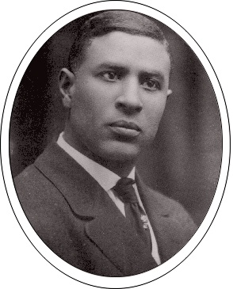
Garrett Morgan
Garrett A. Morgan, an African American, was born in Claysville, Kentucky on March 4, 1877. At the age of 14 he started working as a handyman and later opened his own repair shop. This experience taught Morgan how things worked and were made, which inspired him to become an inventor.

Slide 18
Creating a Breathing Device
Morgan also repaired and sold sewing machines. He used his skills to sew a hood that could be worn as a breathing device that would prevent the inhalation of smoke. Morgan sold this device to firefighters.
Notes:
Morgan also repaired and sold sewing machines. He used his skills to sew a hood that could be worn as a breathing device that would prevent the inhalation of smoke. Morgan sold this device to firefighters. To prevent others from stealing his design, he had to register a patent with the United States Patent and Trademark Office.

Slide 19
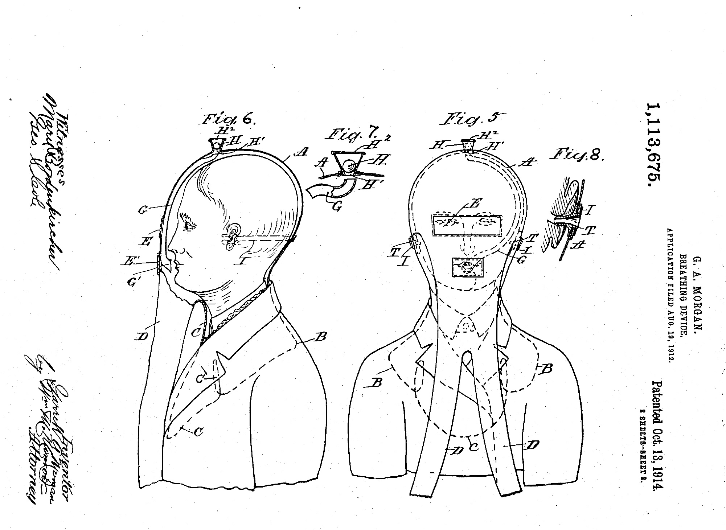
U.S. Patent
To prevent others from stealing his design, he had to register a patent with the United States Patent and Trademark Office.

Slide 20
Let’s Take a Closer Look!

Slide 21
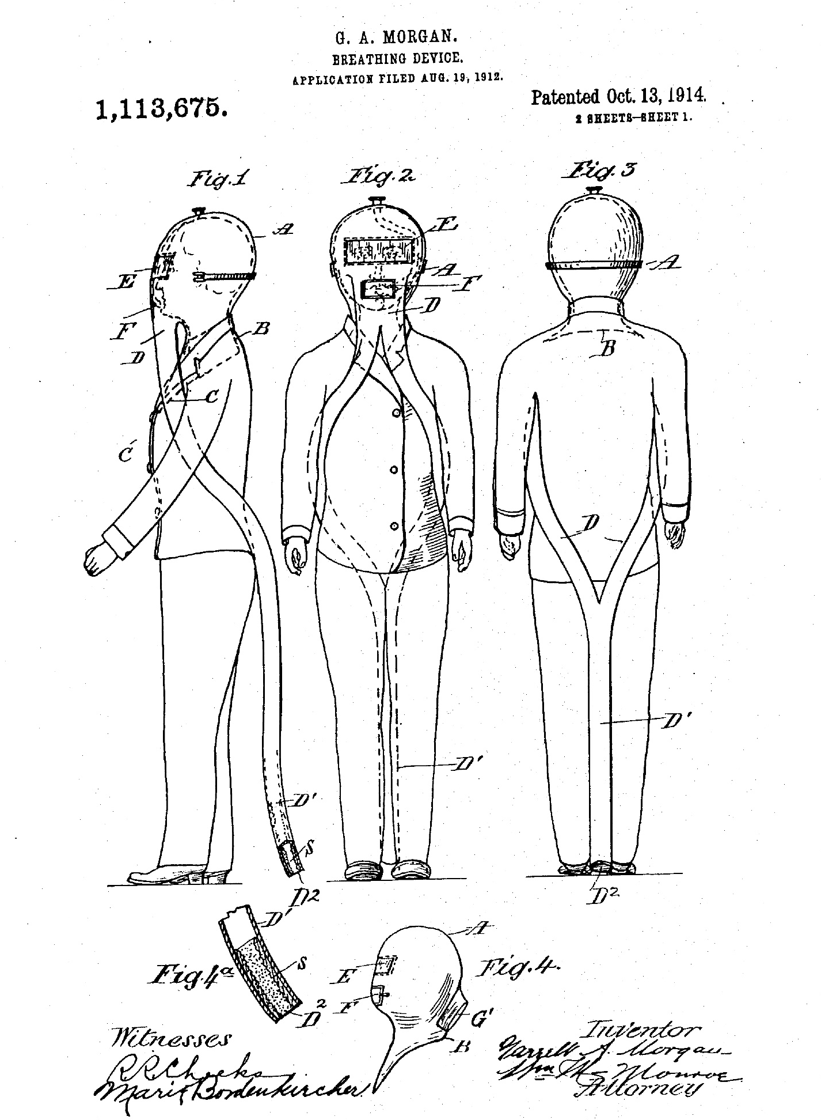
Patent
Notes:
Start an inquiry discussion: What’s going on in this image? What do you see that makes you say that? What more can you find?

Slide 22
Prototype
Notes:
Explain what a prototype is and how they are improved overtime based on design, material, manufacturing, and usage. This is currently at the National Museum of African American History and Culture in Washington D.C.

Slide 23
Let’s look at the text!
Through Smoke and Fumes with Safety
Advertising pamphlet
A modified version of the text included in this source adapted for Grade 1 students can be found below:
Modified text from Source 3:
The purposes of the fire hoods are to allow the person wearing it to enter a room that is filled with dangerous smokes and gases. This will help them save lives, stop whatever is causing the smoke and gases, and put out fires.
WRHS
Notes:
Examine another primary source from the Fire Hood Pamphlet (Source 3). Have the students investigate it to find the purpose of fire protectors, an estimated price, and the date.

Slide 24
Then and Now
Do you think the design has changed for firefighters today?
Do you think the material has changed?
Do you think they are cheaper or more expensive today?
Notes:
Has anyone seen a fire hood or mask used by firefighters today?

Slide 25
Firefighter Air Pack
Notes:
Discuss how the design has changed over time due to improvement of materials. Discuss what is the same about the current day air pack and Morgan’s breathing device, ending with the same community impact (i.e. save lives, protect the firefighter, and stop the fire to prevent more damage).

Slide 26
Let’s act like a Historian!
What’s going on in this image?
What do you see that makes you say that?
What more can you find?
Notes:
I’m going to pull up an image and want you to think about these three questions.

Slide 27
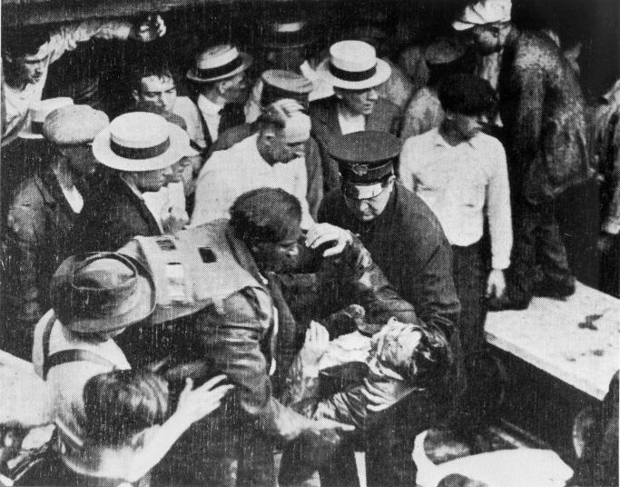
Waterworks Tunnel Disaster
Notes:
Pull up the photograph (Source 5) of the Waterworks Tunnel disaster rescue for the full class to see. Explain how Morgan wore his safety hood to enter a tunnel under Lake Erie to rescue workers that were in an explosion at Cleveland Waterworks in 1916. Discuss the importance of firefighters in the community.

Slide 28
Quick Write
How does Garrett Morgan’s invention of the firefighter breathing device impact your community?
In your response, use evidence from two or more sources.

Slide 29
Extension Activity
Notes:
Extension Activity: Think about the world you live in. Think about your home, your school, and the community. What could be improved or created to help people or animals complete a task? What would the product be made of? How much would it cost?

Slide 30
Act like an Inventor!
Think about your home, your school, and the community.
What could be improved or created to help people or animals complete a task?
What would the good be made of?
How much would it cost?
Notes:
Turn and Talk. Bring back the class's attention to have a brainstorming discussion on their ideas.

Slide 31
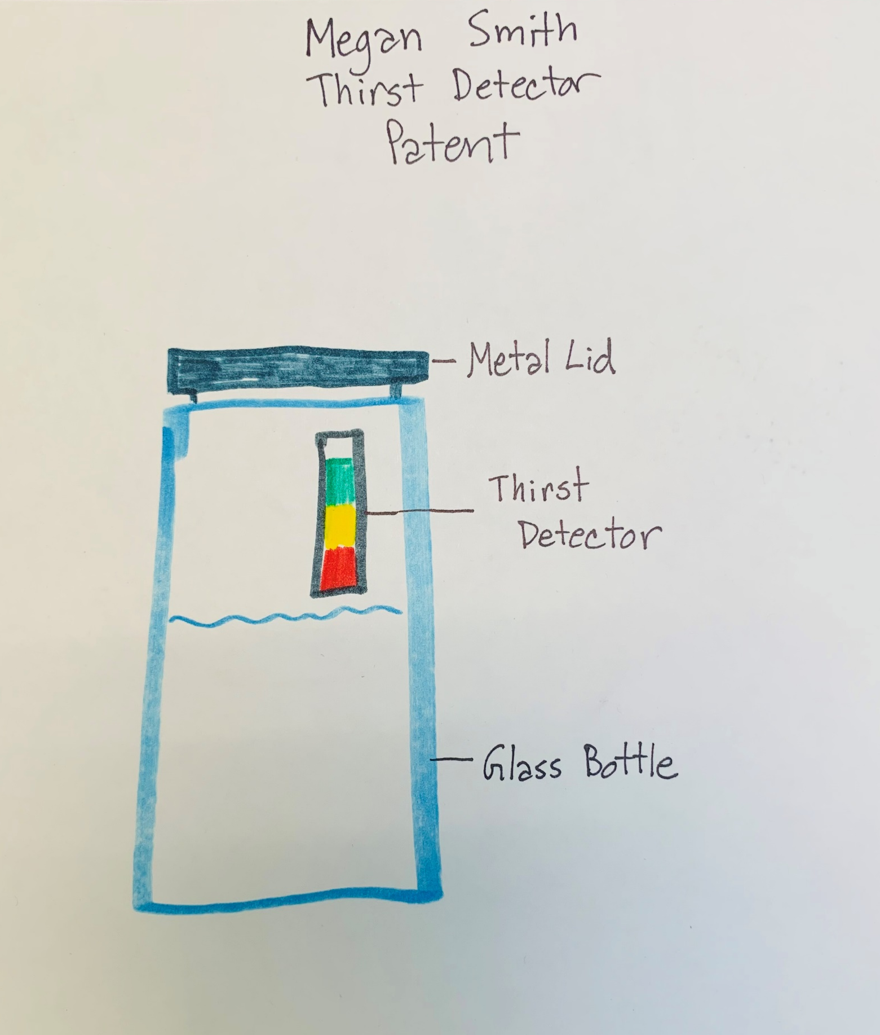
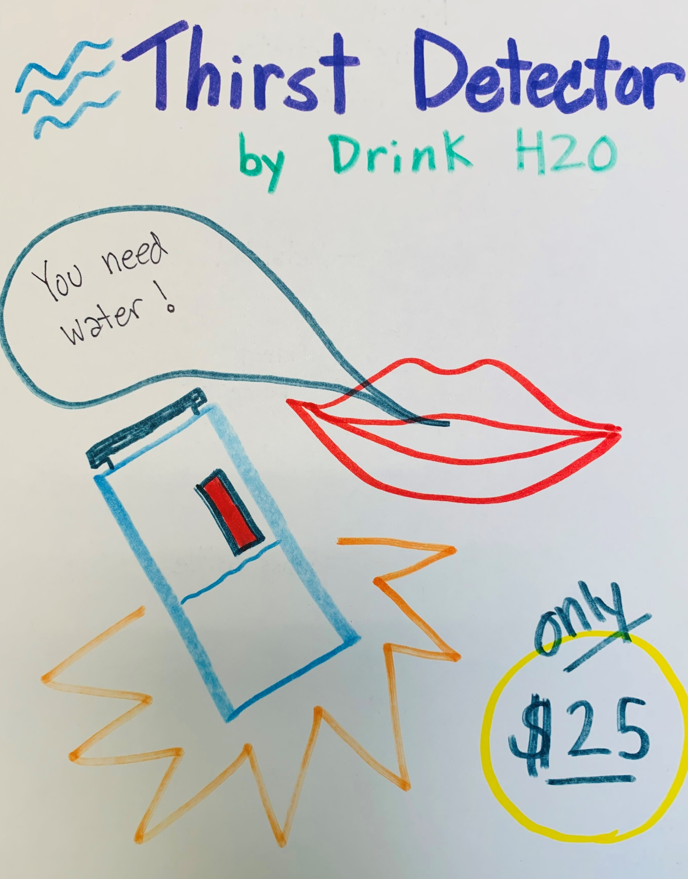
Let’s draw it!
Patent or Design
Advertisement

Slide 32
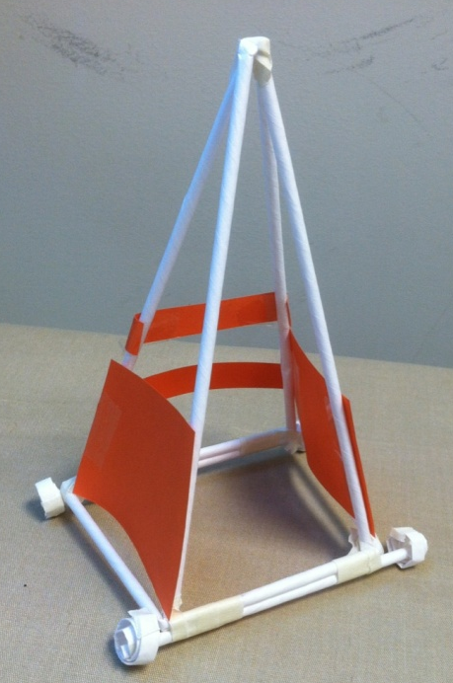
Let’s build it!

Slide 33
Let’s sell it!
Notes:
Time for presentation or to pitch your idea.

Slide 34
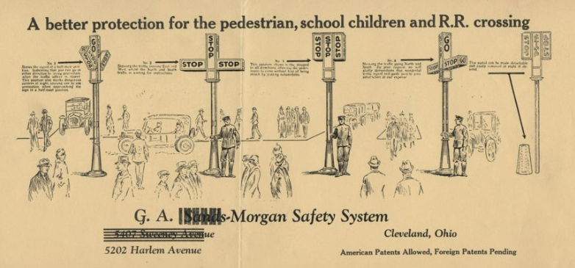
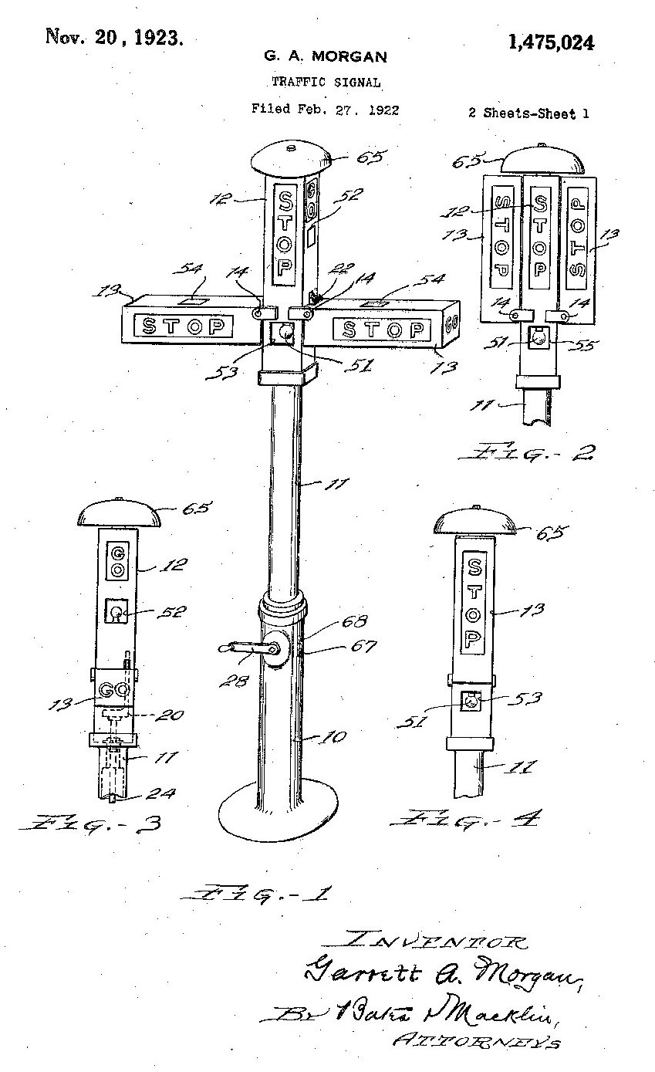
Morgan continued to impact the community:
Traffic Signal Patent 1475024 (uspto.gov)
Morgan’s Traffic Signal System Advertising sheet (WRHS)

Slide 35
Source Courtesy Rights
United States Patent and Trademark Office
Courtesy of the Smithsonian National Museum of African American History and Culture. Photograph by Josh Weilepp.
The Western Reserve Historical Society, Cleveland, Ohio
Fisher Scientific
Encyclopedia of Cleveland History, Case Western Reserve University
Kentucky Center for African American Heritage

Slide 36
Survey
Please take a moment to complete our quick survey to provide feedback on this session.
Thank you for attending!

