Slide 1
Professional Development Coordinators Annual Training
July 2025

Slide 2
Guiding Questions
What are the responsibilities of the district Professional Development Coordinator?
Which professional development experiences are required by law?
What resources are available from KDE to support professional learning in Kentucky school districts?

Slide 3
Professional Development Coordinator’s
Major Responsibilities…
Use data to plan, design, facilitate and/or evaluate professional learning
Connect professional learning with effective instructional practices based on student data
Provide professional learning data to councils, committees and staff
Collaborate with shareholders to develop a professional development plan and calendar
Foster capacity building of school leaders, staff and councils to plan and evaluate learning
Support and assist leaders, staff and councils with planning PL opportunities
Keep professional development records for certified and administrative staff

Slide 4
House Bill 48
Section 3(3) maintains the requirement of each local school district superintendent to appoint a certified school employee to fulfill the role and responsibilities of a professional development coordinator but allows the local board of education to determine the manner of appoint, qualifications, and other duties of the professional development coordinator instead of the Kentucky Board of Education.
While the KDE recommends that local district professional development coordinators continue to participate in annual trainings provided by the KDE, amendments provided under Section 3(3)(c) do not require participation. Annual training ensures that professional development coordinators receive essential, up-to-date information needed to ensure that the responsibilities of the coordinator, as provided in law, are maintained.

Slide 5

Legislative Responsibilities Review…
704 KAR 3:035 Annual Professional Development Plan
KRS 156.095 Professional Development Programs
KRS 158.070 Flexible Professional Development and School Calendar
KRS 160.345 SBDM Roles
KRS 156.101 Effective Instructional Leadership Act (EILA)
Legislative Research Commission - Legislative Research Commission

Slide 6
704 KAR 3:035 Professional Development Plan
Definition of a Professional Development Program
District process requirement, including a Needs Assessment
Elements of a Professional Development Plan
Definition of Professional Development
Professional Development Coordinator (PDC) Qualifications and Requirements

Slide 7
704 KAR 3:035 Designing the Annual PD Plan
Develop a Process…
Conduct district needs assessment using input from all shareholders
Analyze needs assessment data to develop district and school comprehensive improvement plans (CDIP and CSIPs)
Design professional development plans that directly align with district and school needs and integrate into improvement plans
Make plans available to the public prior to implementation
Plan, Implement and Evaluate Professional Learning Needs

Slide 8
PD Diagnostic Basics
Each district/school will use needs assessment data to select two (2) areas requiring professional development.
At least one (1) area should be aligned with the district/school plan if possible. Districts/schools should work together for a cohesive overall plan for supporting improvement district wide.
Ongoing communication between district/school leadership of plan effectiveness is necessary for cohesive overall improvement.
The PD Diagnostic can be revised throughout the year if needed.
The PD Diagnostics are not available for upload after June 30 each year.
Uploaded to Cognia by May 1.

Slide 9
Key Points
Due Date: District and school diagnostics are due by May 1 for the upcoming school year.
Revisions: Diagnostics can be updated as PD needs evolve.
Alignment: District and school diagnostics should complement each other.
Submission Issues: Some diagnostics were uploaded in the wrong sections this year (e.g., district diagnostics in school areas).
Template Feedback: We’ve used the same templates for several years. Feedback from PDCs is encouraged:
  Which questions are no longer useful?
  What additional questions could improve planning for High-Quality PD?
Desk Audits: Random desk audits will be conducted this fall to identify trends and ensure alignment between district and school diagnostics.
Questions? Please ask. Renee.yates@education.ky.gov

Slide 10
KRS 158.070 (3)(a) School Calendar (no change)
Each local board of education shall use four (4) days of the minimum school term for professional development and collegial planning activities for the professional staff without the presence of students pursuant to the requirements of KRS 156.095. At the discretion of the superintendent, one (1) day of professional development may be used for district-wide activities and for training that is mandated by federal or state law. The use of three (3) days shall be planned by each school council, except that the district is encouraged to provide technical assistance and leadership to school councils to maximize existing resources and to encourage shared planning.

Slide 11
KRS 158.070(3)(b) Flexible PD Plans
Flexible PD plans are options for certified and administrative staff using the following criteria:
approved by the local school board
includes professional learning that is aligned with the classroom assignment/administrative requirements of the individual
included in the CDIP/CSIP
approved by district administration
monitored for compliance by district administration

Slide 12
KRS 160.345 SBDM Councils
Provide professional learning data to councils, committees and staff
Foster capacity building of school leaders, staff and councils to plan and evaluate learning
Support and assist leaders, staff and councils with planning PL opportunities
The policies adopted by the local board to implement school-based decision making shall also address the following:…(d) Professional development plans developed pursuant to KRS 156.095
156.095: In planning the use of the four (4) days for professional development under KRS 158.070, school councils and districts shall give priority to programs that increase teachers' understanding of curriculum content and methods of instruction appropriate for each content area based on individual school plans.

Slide 13
704 KAR 3:325. Effective Instructional Leadership Act (EILA)
Required for certified instructional leaders
  21 hours for continuity
  42 hours for renewal
a local district shall keep on file documentation of compliance with KRS 156.101(4) for each instructional leader employed by the school district, including a copy of all training certificates…by August 30 each year thereafter, the local school district shall report to the Kentucky Department of Education the name of any instructional leader who fails to complete the twenty-one (21) hours of training required under KRS 156.101, the individual’s position title, Social Security number, and the number of hours which were completed.
All certificates shall be kept on file for three (3) years by each local district for each participant. If a participant becomes employed by another district, the original file shall be sent to the instructional leader and a duplicate copy to the new employing district.
Questions contact: pam.wininger@education.ky.gov

Slide 14
Required Professional Development
What is mandated by state or federal law?

Slide 15
Required Professional Development…
Active Shooter Training
Child Abuse and Neglect Training
Seizure Disorder Training
Suicide Prevention Training
Bloodborne Pathogens Training
Physical Restraint and Seclusion Training
First Aid/CPR

Slide 16
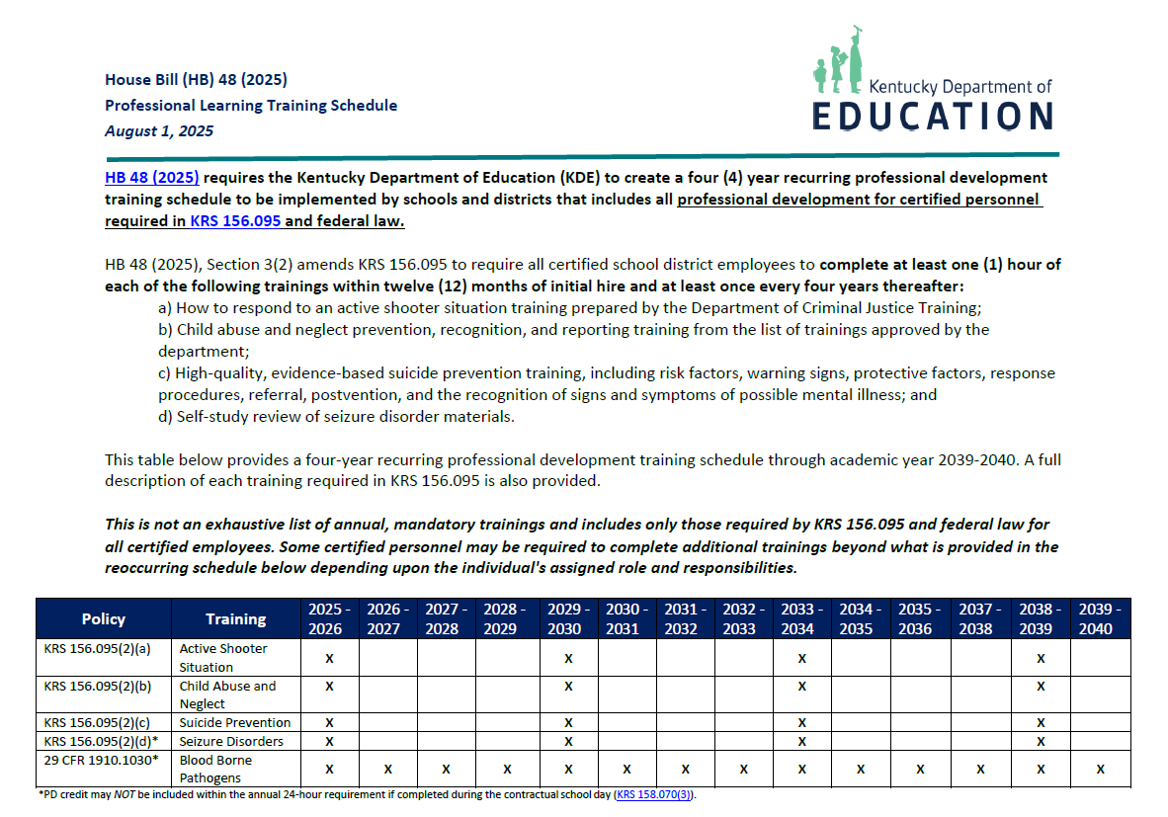
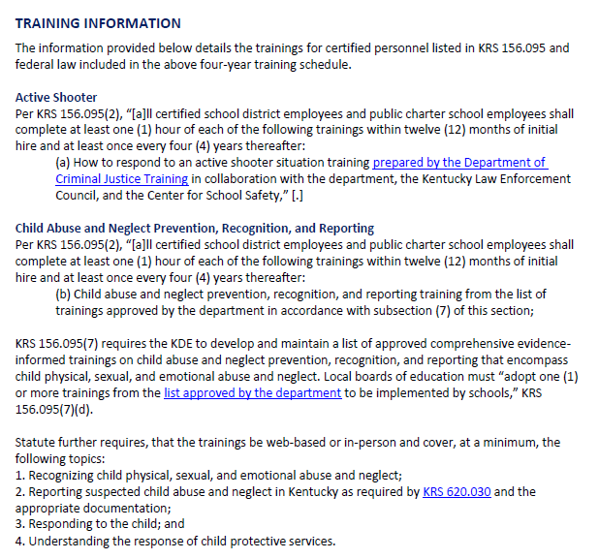
New Guidance Document

Slide 17
KRS 156.095 Professional Development Programs
Section 3(2) amends KRS 156.095 to require all certified school district employees to “complete at least one (1) hour of each of the following trainings within twelve (12) months of initial hire and at least once every four years thereafter.”
How to respond to an active shooter situation training prepared by the Department of Criminal Justice Training;
b) Child abuse and neglect prevention, recognition, and reporting training from the list of trainings approved by the department;
c) High-quality, evidence-based suicide prevention training, including risk factors, warning signs, protective factors, response procedures, referral, postvention, and the recognition of signs and symptoms of possible mental illness; and
d) Self-study review of seizure disorder materials.

Slide 18
Active Shooter Training – KRS 156.095 (2)(a)
Per KRS 156.095(2), “[a]ll certified school district employees and public charter school employees shall complete at least one (1) hour of each of the following trainings within twelve (12) months of initial hire and at least once every four (4) years thereafter:
(a) How to respond to an active shooter situation training prepared by the Department of Criminal Justice Training in collaboration with the department, the Kentucky Law Enforcement Council, and the Center for School Safety,”

Slide 19
Child Abuse and Neglect Training – KRS 156.095 (2)(b)
Per KRS 156.095(2), “[a]ll certified school district employees and public charter school employees shall complete at least one (1) hour of each of the following trainings within twelve (12) months of initial hire and at least once every four (4) years thereafter:
(b) Child abuse and neglect prevention, recognition, and reporting training from the list of trainings approved by the department in accordance with subsection (7) of this section;

Slide 20
Child Abuse and Neglect Training – KRS 156.095 (7)
KRS 156.095(7) requires the KDE to develop and maintain a list of approved comprehensive evidence informed trainings on child abuse and neglect prevention, recognition, and reporting that encompass child physical, sexual, and emotional abuse and neglect. Local boards of education must “adopt one (1) or more trainings from the list approved by the department to be implemented by schools,” KRS 156.095(7)(d).

Slide 21
Child Abuse and Neglect Training – KRS 156.095
Statute further requires, that the trainings be web-based or in-person and cover, at a minimum, the following topics:
1. Recognizing child physical, sexual, and emotional abuse and neglect;
2. Reporting suspected child abuse and neglect in Kentucky as required by KRS 620.030 and the appropriate documentation;
3. Responding to the child; and
4. Understanding the response of child protective services.
Trainings must also include a questionnaire or other basic assessment tool upon completion to document basic knowledge of training components. The list of available trainings may be accessed via the KDE’s Child Abuse and Neglect: Prevention, Recognition and Reporting webpage

Slide 22
Child Abuse and Neglect Training – KRS 156.095 (8)(a) Child Abuse and Neglect: Prevention, Recognition and Reporting - Kentucky Department of Education
The following trainings have been approved for district use. In accordance with SB119 and KRS 156.095, each local school board shall adopt one or more trainings for implementation within the schools. ​
​Face It: Recognizing and Reporting Child Abuse and Neglect
  ​​Free-of-charge. Developed by Kosair Charities Face It Movement in partnership with Kentucky Youth Advocates.
Recogni​zing and Reporting Child Abuse and Neglect
  Free-of-charge. Created by the Kentucky Cabinet for Health & Family Services
Child Abuse and Neglect: Recognition and Reporting
  Free-of charge. Developed by the Central Kentucky Educational Cooperative.
Child Abuse: Mandatory Reporting (KY)​​ (vectorsolutions.com)

Slide 23

Statewide Child Abuse and Neglect Hotline Information
Every public school shall prominently display the statewide child abuse hotline number administered by the Cabinet for Health and Family Services, and the National Human Trafficking Reporting Hotline number administered by the United States Department for Health and Human Services.

Slide 24
Suicide KRS 158.039(1)
KRS 158.039(1) requires the Kentucky Cabinet for Health and Family Services (KCHFS) to “post on its website high-quality, evidence-based suicide prevention awareness information, which shall include information on recognizing the warning signs of suicide crisis. The website shall include information related to suicide prevention training opportunities offered by the cabinet or an agency recognized by the cabinet as a training provider.”

Slide 25
Suicide Prevention Training – KRS 156.095 (2)
Per KRS 156.095(2), “[a]ll certified school district employees and public charter school employees shall complete at least one (1) hour of each of the following trainings within twelve (12) months of initial hire and at least once every four (4) years thereafter:
(c) 1. High-quality, evidence-based suicide prevention training, including risk factors, warning signs, protective factors, response procedures, referral, postvention, and the recognition of signs and symptoms of possible mental illness.
2. As used in this paragraph, "postvention" means a series of planned supports and interventions with persons affected by a suicide for the purpose of facilitating the grieving or adjustment process, stabilizing the environment, reducing the risk of negative behaviors, and limiting the risk of further suicides through contagion.”

Slide 26
Seizure Disorder Training
Per KRS 156.095(2), “[a]ll certified school district employees and public charter school employees shall complete at least one (1) hour of each of the following trainings within twelve (12) months of initial hire and at least once every four (4) years thereafter:
(d) Self-study review of seizure disorder materials."
This self- study review shall be in addition to the four days required in KRS 158.070(3).

Slide 27
Bloodborne Pathogens Training – OSHA/Department of Labor 29 CFR 1910.1030
School systems must identify personnel that could be exposed to blood or OPIM (other potentially infectious materials) and provide annual training on bloodborne pathogens
Training is a requirement for all employees and the control plan is part of the school’s annual health services program

Slide 28
Physical Restraint and Seclusion Training – 704 KAR 7:160 Section 6
Section 6(1)(a) All school personnel shall be trained in state administrative regulations and school district policies and procedures regarding physical restraint and seclusion.
(b) All school personnel shall be trained annually to use an array of positive behavioral supports and interventions to:
1. Increase appropriate student behaviors;
2. Decrease inappropriate or dangerous student behaviors; and
3. Respond to dangerous behavior.
(c) This training may be delivered utilizing web-based applications.

Slide 29
Physical Restraint and Seclusion Training
(d) This training shall include:
1. Appropriate procedures for preventing the need for physical restraint and seclusion, including positive behavioral supports and interventions;
2. State administrative regulations and school district policies and procedures regarding physical restraint and seclusion;
3. Proper use of positive reinforcement;
4. The continuum of use for alternative behavioral interventions;
5. Crisis prevention;
6. De-escalation strategies for responding to inappropriate or dangerous behavior, including verbal de-escalation, and relationship building; and
7. Proper use of seclusion as established in Section 4 of this administrative regulation, including instruction on monitoring physical signs of distress and obtaining medical assistance if necessary.

Slide 30
First Aid and CPR Training
Training is not required for all staff. However, 702 KAR 1:160 Section 2(10)(b) states that there shall be at least one adult present in the school who is certified in a standard first aid course which includes CPR for infants and children. Refer to district policy to determine local training requirements

Slide 31
Training Resources
https://kycss.org/training-and-compliance/active-shooter/
School Safety and Resiliency Act - Kentucky Department of Education
https://www.education.ky.gov/curriculum/ProfLern/Pages/Child-Abuse-and-Neglect-Prevention-Recognition-and-Reporting.aspx
https://www.education.ky.gov/school/sdfs/Pages/Suicide-Prevention-and-Awareness.aspx
https://www.education.ky.gov/districts/SHS/Pages/District-Health-Coordinators-Briefcase.aspx
https://dbhdid.ky.gov/mh/sp

Slide 32
Available PL Resources from the Kentucky Department of Education
Professional Learning Bulletin Board
Kentucky Academic Standards Resources
PDC Cohorts

Slide 33

PLBB
The Professional Learning Bulletin Board (PLBB) provides Kentucky educators access to post or search for professional learning opportunities offered by the Kentucky Department of Education or other education partners.

Slide 34

Kentucky Academic Standards

Slide 35
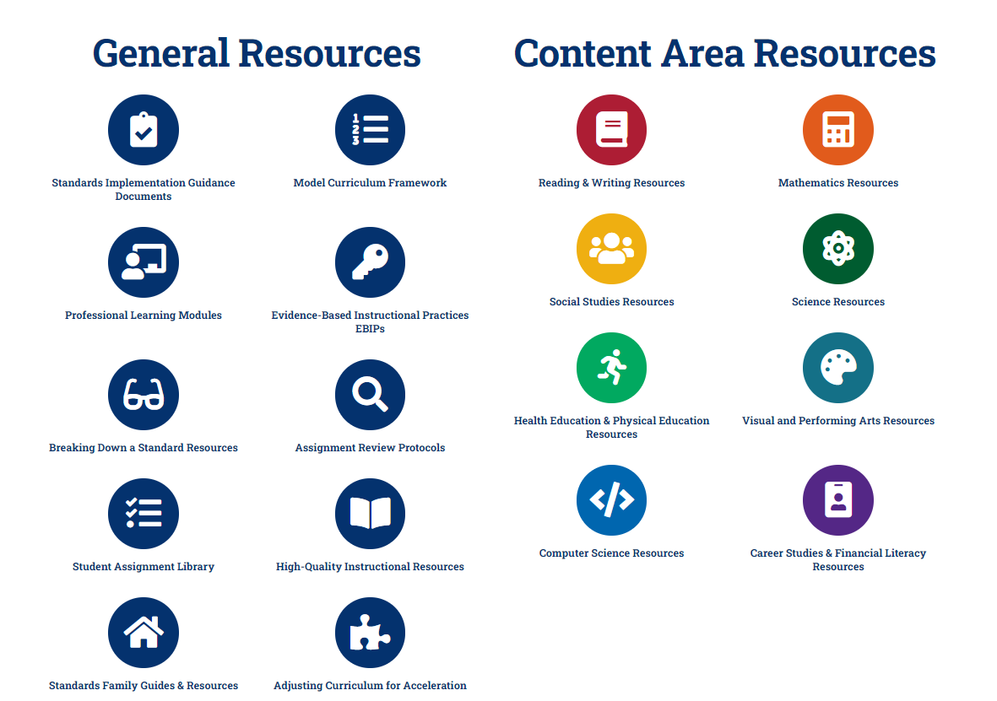
Kentucky Academic Standards

Slide 36

Foundational Implementation Resources
Curriculum Development Process (Phase 4)
Curriculum Implementation Framework
Curriculum-Based Professional Learning (CBPL) Guidance Document
Resources available on kystandards.org under Model Curriculum Framework.

Slide 37
Questions
Fox DeMoisey - Professional Learning Coordinator, DPS
fox.demoisey@education.ky.gov
Misty Higgins - Professional Learning Coordinator, DPS
misty.higgins@education.ky.gov

Slide 38
Evaluating Professional Development
If you are looking for ways to evaluate your current PD plan, here is a list of resources that you may find helpful:
https://learningforward.org/journal/evaluating-professional-learning/
Rivet Education
Measuring Implementation to Impact: A Guide to Evaluating Professional Development
Does It Make a Difference? Evaluating Professional Development

Slide 39
Related Resources
If you are looking for something to guide the needs assessment process to capture what PL needs are within the district:
2024-2025 CDIP Rubric
2024-2025 CDIP Rubric with TSI Addendum
https://www.education.ky.gov/school/csip/Pages/default.aspx

Slide 40
PDC Cohorts – 2025-2026
Began in winter of 2023
Meetings have been specific to PDC needs: federal funding and PL, comprehensive improvement planning and PL, and supporting new teachers through PL
Schedule TBD

Slide 41

Thank You
Any questions contact: dana.kelly@education.ky.gov

