Slide 1
Partitioning – Introduction
Kentucky Family Math Night Game
Partitioning
Recommended for Grades 2-3
This game will help your student partition rectangles in equal parts of a whole to develop foundations for fractions, area, volume and geometry in later grades.
Kentucky Academic Standards for Mathematics Connections:
Second Grade Geometry
KY.2.G.3 Partition circles and rectangles into two, three, or four equal shares; describe the shares using the words halves, thirds, half of, a third of, etc.; and describe the whole as two halves, three thirds, fourths. Recognize that equal shares of identical wholes need not have the same shape.
Third Grade Geometry
KY.3.G.2 Partition shapes into parts with equal areas. Express the area of each part as a unit fraction of the whole.
Standards for Mathematical Practice
MP.3 Construct viable arguments and critique the reasoning of others.
MP.6 Attend to precision.
MP.5 Use appropriate tools strategically.

Slide 2
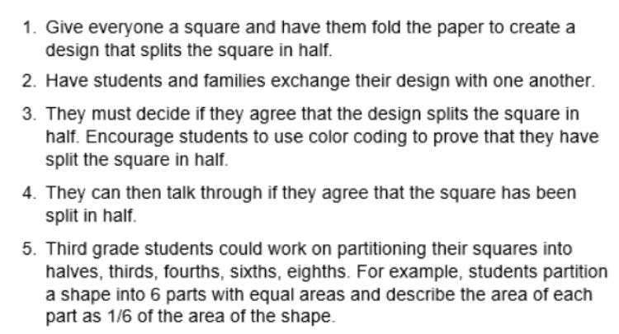
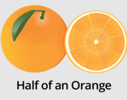
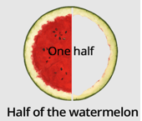
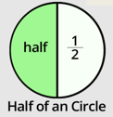
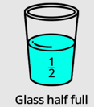
Partitioning - Instructions
Partitioning Instructions
Players: One or more players
Goal: Partition squares into halves, thirds, or fourths.
On-Line Activity Instructions
In-person Activity Instructions

Slide 3
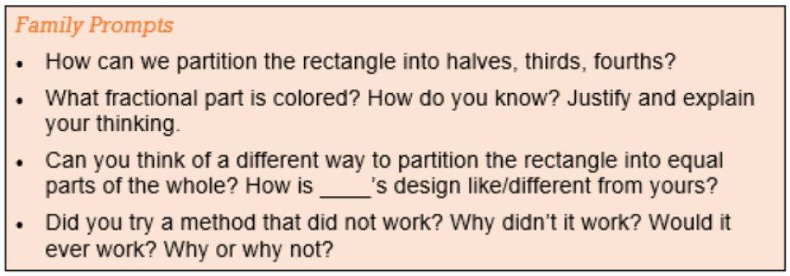
Partitioning – Family Prompts
Partitioning Family Prompts
Ask any of the following questions as you play the game.

Slide 4
Partitioning – Make Half Board 1
Partitioning – Make Half
Click on Draw in the top left toolbar and chose a pen in the drawing tools. Use the pen to create a design to divide the square in half. Explain your thinking.
Insert your name
Squares
Family Prompts
Can you think of a different way to partition the rectangle into equal parts of the whole?
How is____’s design like/different from yours?

Slide 5
Partitioning – Make Half Board 2
Partitioning – Make Half
Click on Draw in the top left toolbar and chose a pen in the drawing tools. Use the pen to create a design to divide the square in half. Explain your thinking.
Insert your name
Squares
Family Prompts
What fractional part is colored? How do you know?
Justify and explain your thinking.

Slide 6
Partitioning – Make Half Board 3
Partitioning – Make Half
Click on Draw in the top left toolbar and chose a pen in the drawing tools. Use the pen to create a design to divide the square in half. Explain your thinking.
Insert your name
Squares
Family Prompts
Can you think of a different way to partition the rectangle into equal parts of the whole?
How is____’s design like/different from yours?

Slide 7
Partitioning – Make Half Board 4
Partitioning – Make thirds, fourths, or sixths
Click on Draw in the top left toolbar and chose a pen in the drawing tools. Use the pen to create a design to divide the square in thirds, fourths, or sixths.
Explain your thinking.
Insert your name
Squares
Family Prompts
How can we partition the rectangle into halves, thirds, fourths?

Slide 8
Partitioning – Make Half Board 5
Partitioning – Make thirds, fourths, or sixths
Click on Draw in the top left toolbar and chose a pen in the drawing tools. Use the pen to create a design to divide the square in thirds, fourths, or sixths.
Explain your thinking.
Insert your name
Squares
Family Prompts
Can you think of a different way to partition the rectangle into equal parts of the whole?
How is____’s design like/different from yours?

Slide 9
Partitioning – Make Half Board 6
Partitioning – Make thirds, fourths, or sixths
Click on Draw in the top left toolbar and chose a pen in the drawing tools. Use the pen to create a design to divide the square in thirds, fourths, or sixths.
Explain your thinking.
Insert your name
Squares
Family Prompts
Did you try a method that did not work? Why didn’t it work?
Would it ever work? Why or why not?

Slide 10
Partitioning – Closing Slide
Kentucky Family Math Night Games
Partitioning
Thank you for playing!
Access more digital family math games at: https://www.education.ky.gov/curriculum/conpro/Pages/summer_support_math_resources.aspx

