Slide 1
Curriculum Development Process
Phase 3: Develop the Curriculum
Notes:
Hello and welcome to the Curriculum Development Process professional learning series. The focus in this module is Phase 3 of the CDP: Develop the Curriculum. There are four phases to the CDP and four corresponding modules. Before engaging Module 3, we suggest you access the Introduction to the Curriculum Development Process and Modules 1-2 to gain a context for the learning that follows.

Slide 2
Phase 3 Module Materials
For this session, you will need access to:
Curriculum Development Process (CDP)
Module 3 Participant Handout
CDP Self-Assessment Tool: Phase 3
Notes:
For this module, please make sure you have access to the following documents:
Curriculum Development Process from the Model Curriculum Framework
Copy of the participant handout to hold your thinking throughout the module
CDP Self-Assessment Tool which you will use at the end of the module to assess where your district may be in relation to the essential elements of Phase 3
All materials are hyperlinked on the slide for easy access.

Slide 3
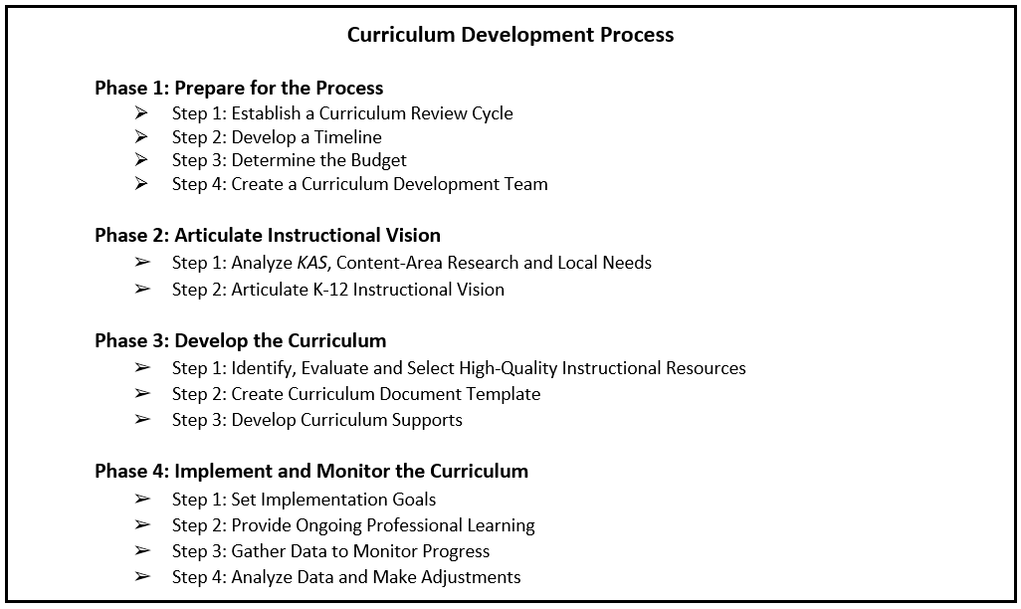
Phase 3: Develop the Curriculum
Learning Goal: We are learning about the importance of HQIRs and key curricular elements to consider when developing the local curriculum template
Notes:
Before we move into Phase 3 content, it will be helpful for you to establish a baseline level of understanding. Look briefly at the name Phase 3, “Develop the Curriculum,” and its three steps.
Next, consider our learning goal: “We are learning about the importance of HQIRs and key curricular elements to consider when developing the local curriculum template.”
This information will be helpful on the next slide when we activate background knowledge you might have about the third phase of curriculum process and is also available at the top of your participant handout.

Slide 4
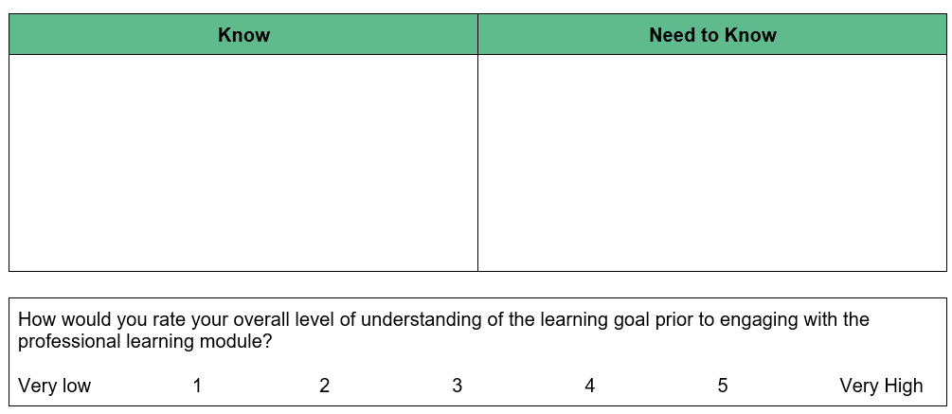
Phase 3 Self-Assessment
Notes:
We will use a Know/Need-to-Know approach for activating background knowledge. First, note things you may already “Know” about our learning goal, perhaps using the title and steps of phase one for added insight. As we are beginning, this can certainly include hunches you may have as well. Next, infer things it may be important for you to find out based on the learning goal, things you may “Need to Know.” Both what you may know and what you may need to know here at the beginning can be recorded in the table on p. 1 of your participant handout. As the module unfolds, hold these lists in mind. You will be invited to update them during midpoint and closing reflections. After capturing what you may know and need to know, please synthesize your sense of overall understanding using the 1-5 scale provided. This too will be revisited during the closing reflection.
Pause the video and restart after completing the self-assessment.

Slide 5
Phase 3 Module Purpose
Learning Goal: We are learning about the importance of HQIRs and key curricular elements to consider when developing the local curriculum template.
Success Criteria:
Examine the importance of HQIRs in supporting implementation of a locally developed curriculum.
Identify key actions and products of Phase 3 of the Curriculum Development Process.
Access resources to support implementation of Phase 3 of the Curriculum Development Process.
Develop an action plan for implementing Phase 3 at the local level.
Notes:
Now that you have a preliminary sense of where you might be relative to our learning goal, let’s move into success criteria for Module 3. By the end of this session, we want you to be able to:
Examine the importance of HQIRs in supporting implementation of a locally developed curriculum.
Identify key actions and products of Phase 3 of the Curriculum Development Process.
Access resources to support implementation of Phase 3.
Develop an action plan for implementing Phase 3 at the local level.
Let’s start with our first succession criterion (CLICK) where we want to examine the importance of HQIRs in supporting implementation of a locally developed curriculum

Slide 6
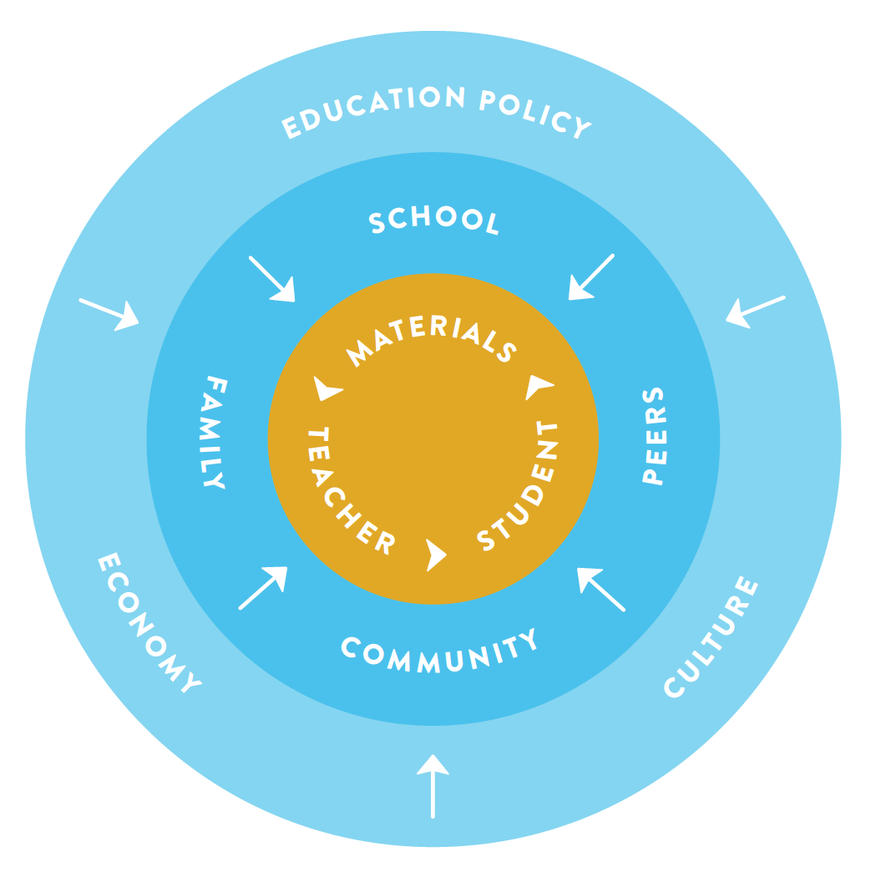
Teachers and instructional resources are centrol to student learning
Teachers and instructional resources are central to student learning
“
That instructional materials exercise their influence on learning directly as well as by influencing teachers’ instructional choices and behavior, makes them all the more important.
Choosing Blindly,
Chingos and Whitehurst 2012
”
Notes:
Why are instructional resources so critical to addressing gaps in learning? This slide shows how many factors influence what happens in the classroom. Instructional materials exert their influence both directly on student learning and indirectly on teachers’ choices as they prepare and facilitate the learning.
Reference: Chingos and G. Whitehurst. Choosing Blindly: Instructional Materials, Teacher Effectiveness and the Common Core. Washington, DC: Brown Center on Education Policy at Brookings. (April 2012).

Slide 7
Resources are one of teachers’ top priorities
Resources are one of teachers’ top priorities
Top Five Funding Priorities Identified by Teachers
55% High-quality instructional materials and textbooks
55% Additional staff
47% Digital resources
47% Higher salaries
46% Intervention programs
High-quality instructional resources are cited as a TOP FUNDING PRIORITY for teachers, equally rated with
additional staff.
Teacher and Principal School Report, Scholastic 2016
Notes:
A Scholastic report from 2016 found these to be top funding priorities identified by teachers. The gaps in current materials are not just noticed by researchers and district leads. Teachers, those using the instructional resources everyday with their students, are clear their resources are not yet aligned, and they would prioritize funding for HQIRs if given the choice.
Reference: Teacher and Principal School Report, Scholastic 2016. https://www.scholastic.com/teacherprincipalreport/

Slide 8
Teachers spend 7-12 hours per week searching for and creating resources
A 2017 RAND analysis found that
96%
OF TEACHERS
use Google to find lessons and materials.
Nearly 75%
OF TEACHERS
Use Pinterest to find lessons and materials.
This leads to inconsistent quality that IMPACTS LOW-INCOME STUDENTS AND STUDENTS OF COLOR THE MOST.
Notes:
When teachers do not have access to HQIRs they often resort to searching websites like Google and Pinterest that offer unvetted resources piecemealed together. The consumes valuable time for a yield that is uneven at best.
Reference: Goldberg, M. (2016). Classroom Trends: Teachers as Buyers of Instructional Materials and Users of Technology. K-12 Market Advisors. Retrieved from: https://mdreducation.com/reports/classroom-trends-teachersbuyers-instructional-materials-users-technology/
Opfer, V., Kaufman, J., Thompson, L. (2016). Implementation of K-12 State Standards for Mathematics and English Language Arts and Literacy. Santa Monica, CA: RAND Corporation. Retrieved from: https://www.rand.org/pubs/research_reports/RR1529-1.html

Slide 9
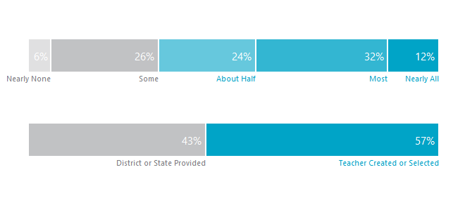
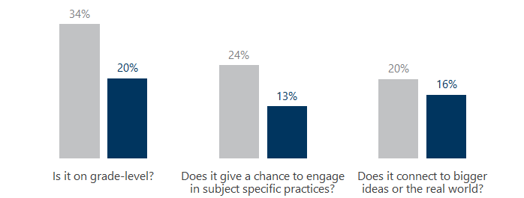
Teachers spent a significant amount of their time creating or selecting their own assignments, but not often with good results.
What percent of materials did teachers say they typically create or find on their own?
Teachers reported spending 7 hours per week or 250 hours per year developing or selecting instructional materials (resources).
What percent of assignments collected did teachers actually create or select?
Assignments Provided by District or State Teacher Created/Selected Assignments
But the assignments teachers created or selected tended to be lower quality than what the district or state provided.
Notes:
This slide from The New Teacher Project (TNTP) again underscores how much of teachers’ time is consumed by seeking or creating resources. It also illustrates how these resources, found or made, fall short in grade-level alignment, subject specific practices, and helping students make connections to their own ideas and to the world around them.

Slide 10
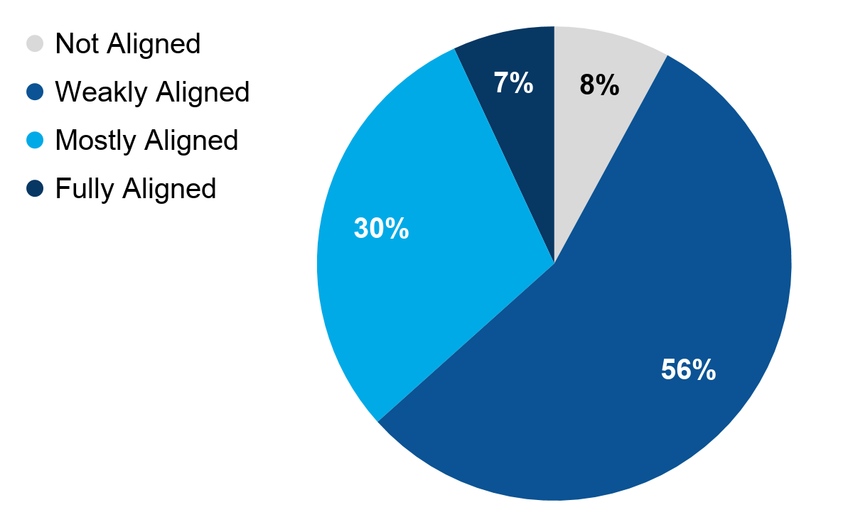
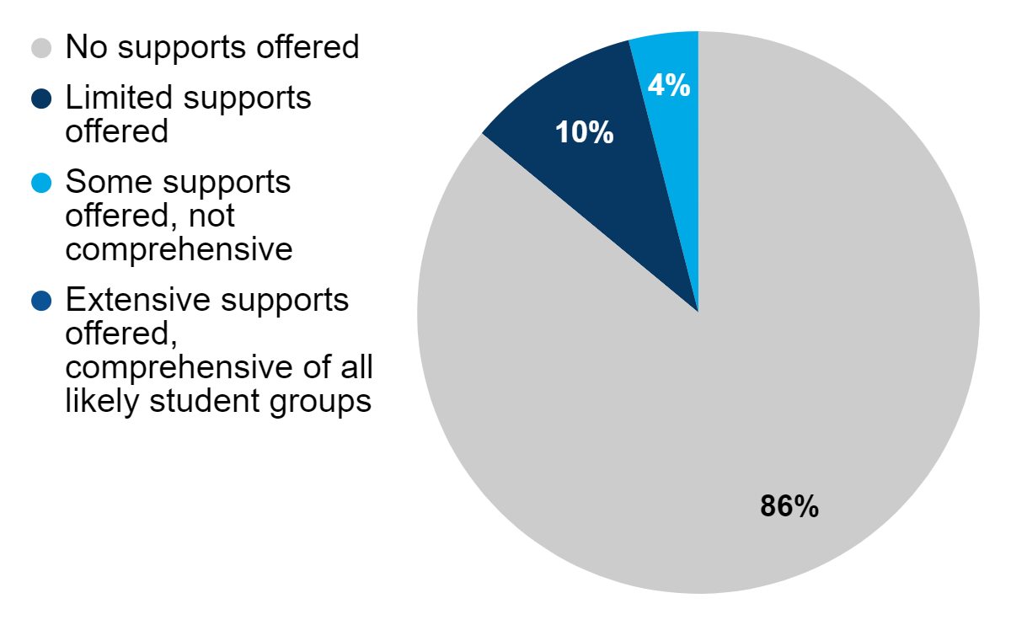
Supplemental online resources show weak alignment and limited student supports
A 2019 study, The Supplemental-Curriculum Bazaar: Is What's Online Any Good? examined over three hundred of the most downloaded materials across three of the most popular supplemental websites
Notes:
The Supplemental-Curriculum Bazaar: Is What's Online Any Good, a 2019 study, examined over 300 of the most downloaded materials across three of the most popular supplemental websites, looking for:
Alignment to standards
Coherence of materials
Materials for students needing additional support
The report shows that while lessons may be somewhat aligned to the intent of the standards, most provide little to no support for differentiation, which was identified as one of the primary reasons teachers search for supplements.
Vital supports for increasing equity or for fostering SEL would also be largely absent from most resources found online.
Reference: The Supplemental Curriculum Bazaar: Is What’s Online Any Good? Polikoff & Dean 2019

Slide 11
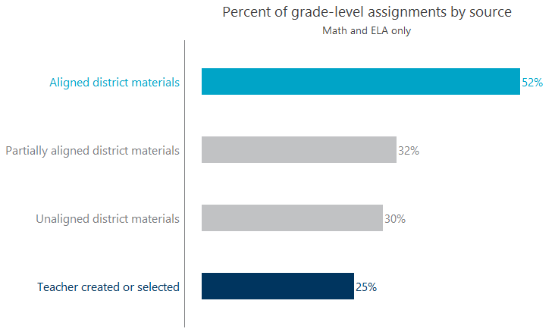
Aligned district materials (resources) were more likely to provide students grade-level opportunities.
Assignments based on district materials from an aligned curriculum were more likely to be at grade-level.
Assignments created or found by teachers were least likely to be at grade-level.
Source: Student work samples
Note: Ns for aligned , partially aligned, unaligned, and teacher created assignments are 328, 199, 719, and 2044 respectively
Notes:
Again from TNTP, here we see that while resources created or curated by a district may offer somewhat higher quality and a degree of coherence, they remain unaligned 48% of the time to grade-level standards; teacher created or selected resources come in as aligned 25% of the time.

Slide 12
Student success on assignments vs master of grade level standards
Notes:
Overall outcomes demonstrate that even when students are successful on classroom assignments, if those assignments are not properly aligned to grade-level standards, students are not prepared for the rigors of future, college-level coursework. The research also shows students of color and from low-income backgrounds are most impacted and least likely to have access to grade-level instruction.

Slide 13
What can we do?
Students need four key resources: grade-appropriate assignments, strong instruction, deep engagement, and teachers who hold high expectations.
Grade-level content must be at the heart of instruction.
Research-based high-quality curriculum and instructional resources makes this task easier.
Notes:
In summary, to ensure equitable opportunity for students to learn and to become ready for future learning we need:
the four key resources of grade-appropriate assignments, strong instruction, deep engagement and teachers who hold high expectations to be present
Grade-level content to be the core of classroom instruction.
Research-based, high-quality curriculum and instructional resources support making equitable opportunity a reality.

Slide 14
Benefits of High-Quality Curriculum and Instructional Resources
Teachers can spend more time on supporting students.
Spend Less Time On… | Spend More Time on…
Figuring out which KAS to teach at which point in the year | Focusing on understanding the KAS for instruction
Building lessons and activities from scratch | Differentiating lessons for specific student needs
Searching for instructional resources | Analyzing and responding to student data
Notes:
To reiterate the benefits of HQIRs for teachers and students, teachers can spend more time supporting students and their learning needs when they are not parsing and bundling standards, building lessons from scratch and searching for instructional resources to drive those lessons.

Slide 15
KDE’s General Definition of HQIRs
Aligned with the Kentucky Academic Standards (KAS);
Research-based and/or externally validated;
Comprehensive to include engaging texts (books, multimedia, etc.), problems and assessments;
Culturally relevant, free from bias; and
Accessible for all students.
Notes:
Since we have reached a focus on the essential role of HQIRs, let’s reset KDE’s General Definition of HQIRs. Please take a moment to read it.
To clarify briefly some important terms, by “comprehensive” we mean resources address the full depth of standards for each grade-level and include pedagogical and instructional supports to meet the diverse needs of students.
“Culturally relevant, free from bias” in this context is thinking about acknowledging students’ ethnic, racial and linguistic identities within the context of their grade-level work in ways that do not create barriers to obstruct student learning;
and materials that are “Accessible for all students” looks to ensure equitable opportunity regardless of unique experiences and qualities, so students can engage meaningfully in the learning process and have an opportunity to fully demonstrate their understandings and skills.

Slide 16
Selecting HQIRs
Primary HQIR: “the print, nonprint or electronic medium designed to assist student learning and support implementation of a high-quality curriculum.”
“Selecting a primary HQIR enables districts and schools to make a marked shift toward equitable, vibrant learning experiences for all students.
Supplemental Resources: “Where gaps are found (in the primary HQIR), selecting supplemental resources, rated as high-quality by an evaluator like EdReports when possible, can be a way of addressing them.
* Quotes taken from the CDP document.
Notes:
When selecting primary and then supplemental instructional resources, it is important to be clear about the construct, about the parts and their relationship to the whole and to its purpose. Within the Curriculum Development Process, the primary HQIR is like ‘the backbone’ of a local curriculum. It is the central instructional resource that supports most of what the curriculum intends to do with its arrangement of standards, texts, tasks, assessments and related pedagogical supports. That said, no single HQIR will ultimately be able to provide everything. Supplemental resources may be added as gaps emerge from the primary resource and need to be filled in order to fully realize the instructional vision.

Slide 17
Processing Time
Team Discussion:
How could intentional use of high-quality instructional resources, primary and supplementary, improve the implementation of a local curriculum?
Thinking can be held in space provided under Success Criterion 1 on your handout.
Notes:
We want to give you an opportunity to process these slides with your team. Please discuss the prompt, “How could intentional use of high-quality instructional resources, primary and supplemental, improve the implementation of a local curriculum.” Make sure ‘talk time’ is shared equitably as you ask each other clarifying questions and make connections.
Also, you can capture any new or additional ideas in the space provided on your participant handout
Pause the video and restart after the team discussion.

Slide 18
Whole Group Share-out
What thoughts, ideas, connections or questions do you have regarding the potential positive impacts of using HQIRs in your local context?
Notes:
If you have more than one team, you may want to have a whole group share out to hear from everyone. What thoughts, ideas, connections or questions do you have regarding the potential positive impacts of using HQIRs in your local context?
Pause the video and restart after the whole group share-out.

Slide 19
Phase 3 Module Purpose
Learning Goal: We are learning about a systematic process for developing a high-quality local curriculum that supports standards implementation and promotes student equity.
Success Criteria:
Examine the importance of HQIRs in supporting implementation of a locally developed curriculum.
Identify key actions and products of Phase 3 of the Curriculum Development Process.
Access resources to support implementation of Phase 3 of the Curriculum Development Process.
Develop an action plan for implementing Phase 3 at the local level.
Notes:
Let’s move into the 2nd success criterion - that you can identify key actions and products of Phase 3 of the Curriculum Development Process.

Slide 20
Phase 3
Notes:
Phase 3 is where the curriculum team you have formed builds out from an instructional vision for teaching and learning in the content area toward adopting a primary HQIR. This includes:
Synthesizing the instructional vision into succinct selection criteria
Using those criteria to identify and evaluate potential HQIRs
Creating a curriculum document to support effective implementation of the selected HQIR
Phase 3 arrives at a developed curriculum ready for implementation planning.

Slide 21
Curriculum Development process, Phase 3: Develop the Curriculum
Success criterion: Identify key actions and products of Phase 3 of the Curriculum Development Process.
As you read Phase 3, focus on the following information for each step:
What are the key actions?
What are the end products?
Space provided under Success Criterion 2 can be used to hold your thinking.
Notes:
We want to pause and give you a chance to read through Phase 3. As you read, focus on the key actions and products of each step of the phase.
Feel free to annotate directly on the text and space is provided under Success Criterion 2 on the participant handout to capture your thinking.
Right now, we want you to focus on the text and the key questions. We will take a closer look at the key tools a little later in the session.
Pause the video and restart after you have read Phase 3 and captured your thinking on the participant handout.

Slide 22
Processing Time
Team Discussion:
Discuss each step in order, focusing on key actions and products​
Make connections to how you currently develop the local curriculum document and select instructional resources.
Add any new/additional ideas in the space provided on your participant handout.
Notes:
We want to give you an opportunity to process what you read with your team. Discuss each step in order focusing on the key actions and products. Make sure ‘talk time’ is shared equitably as you ask each other clarifying questions and make connections regarding how you currently develop the local curriculum document and select instructional resources.
Also, you can capture any new or additional ideas in the space provided on your participant handout.
Pause the video and restart after your team discussion.

Slide 23
Whole Group Share-out
What thoughts, ideas, connections or questions do you have regarding Phase 3 of the Curriculum Development Process?
Notes:
If you have more than one team, you may want to have a whole group share out to hear from everyone. What thoughts, ideas, connections or questions do you have regarding Phase 3 of the Curriculum Development Process?
Pause the video and restart after your whole group share-out.

Slide 24
A Closer Look at Phase 3
HQIRs and the Local Curriculum Document
Notes:
Because Phase 3 is where so much critical action is taken toward having a curriculum ready for implementation, we want to spend some time taking a closer look at what goes into creating a curriculum document that can guide implementation.

Slide 25
Supplemental Instructional Resources
What are some things that might lead to a need for supplemental resources?
Potential Gap | Potential Adjustment in the Curriculum
Primary resource does not meet the depth of a specific KAS | Addition of high-quality instructional resource to meet the depth of the standard in the curriculum
Local needs are not sufficiently addressed | Incorporation of valued initiatives or inclusion of additional texts/context to suit unique needs
Some units do not fully reflect equity and lack“ mirrors and windows” | Addition of on-grade-level, high-quality texts/sources added to the unit to be paired with the anchor text
Additional foundational skills are needed to support deeper work | Addition of high-quality foundational skills lessons or resources to supplement the HQIR
Notes:
On the left side of your screen, you see potential or common reasons why a school/system might add supplemental resources into their curriculum. And on the right, you see examples of adjustments to address the gaps. Please take a moment to read them.
A few things to note:
anything pulled in needs to be vetted and of the highest possible quality.
there are specific reasons for resources—resources aren’t pulled in because they have been used in the past or because they are ‘liked’ or might be comfortable. You are using your primary resource, the HQIR you selected, as that: as primary and as the guide. Additional resources or supplements are strategically pulled in with a specific purpose.

Slide 26
Develop the Curriculum Template
The document should be designed to:
Establish the curricular elements aligned to the instructional vision that must be present in every classroom;
Highlight within the HQIR where key curricular elements are addressed for each unit/module;
Locate where supplemental resources might be required to address depths and dimensions unique to the KAS or to a local context; and
Provide broad-based access and ease of use to support navigation.
Notes:
Once resources, primary and supplemental, have been selected, developing a curriculum template creates a ‘map’ to support communication and access. Four key features to consider when developing a curriculum template are
Establish the curricular elements aligned to the instructional vision that must be present in every classroom;
Highlight within the HQIR where key curricular elements are addressed for each unit/module;
Locate where supplemental resources might be required to address depths and dimensions unique to the KAS or to a local context; and
Provide broad-based access and ease of use to support navigation.
Again, we need to understand how a HQIR accounts for these features and where needs for elaboration and/or further support might be.

Slide 27
Develop the Curriculum Template
Curricular elements to consider include:
KAS alignment
Grade-level tasks/assignments
Pedagogical/Instructional support
Assessment, formative and summative
Supports/Scaffolds for differentiation and diverse learners
Notes:
Following from the first bullet on the previous slide, consider curricular elements aligned to the instructional vision that must be present in every classroom. The five here represent elements you may choose to consider as ‘tight’ or ‘nonnegotiable.’ Please take a moment to read them.
HQIRs should support each of these elements. That said, it’s important to understand how they do so to support planning for and facilitation of learning. And it is important to note on your curriculum document which aspects might need further elaboration and/or additional support, what those supporting or supplemental resources are, if needed, and where they can be found.

Slide 28
Closing Considerations
Flexibility
Can implementing a primary HQIR with fidelity leave educators room to ‘maneuver’?
Autonomy
Where does an educator’s sense of autonomy reside when implementing a primary HQIR?
Notes:
Two big concepts to comment on as this segment closes, concepts that surface during this work, are “flexibility” and “autonomy.”
For “flexibility,” implementing a HQIR as the primary resource does not need to mean sticking ‘lockstep’ to an external script. Time to respond to student needs, those that arise within the course of learning and those in the local context identified prior to adoption, must be included. The ability to linger when learning is esp. rich or to extend a unit into a project, for example, should be present, and once educators are familiar with the resource it can be as long as expectations for what is ‘tight’ and what can be more ‘loose’ are clear.
For “autonomy,” educators must be empowered to examine the HQIR at the course, unit, and lesson levels to determine precisely how what’s provided meets student needs and interests within the local context, and to make adjustments that don’t compromise the overall integrity of the learning design when needed. Likewise, as educators gain experience with the resource over time, they will see more openings for stylistic preferences to be inflected in the learning while still leveraging essential strengths of the HQIR.

Slide 29
Mid-Point Reflection
Based on your learning so far, what might you now add to your “Know/Need to Know” table?
*Hold your thinking in the table at the top of page 1 in your participant handout.
Notes:
Now that we are at the midpoint of the module, we want to pause and give you a chance to reflect. Based on your learning so far in this module, what might you add to your “Know/Need to Know” table on page 1 of your participant handout. This can include transferring items from your Need to Know to your Know list when appropriate.
Pause the video and restart after you capture your thinking on your Know/Need to Know table.

Slide 30
Phase 3 Module Purpose
Learning Goal: We are learning about a systematic process for developing a high-quality local curriculum that supports standards implementation and promotes student equity.
Success Criteria:
Examine the importance of HQIRs in supporting implementation of a locally developed curriculum.
Identify key actions and products of Phase 3 of the Curriculum Development Process.
Access resources to support implementation of Phase 3 of the Curriculum Development Process.
Develop an action plan for implementing Phase 3 at the local level.
Notes:
Let’s move into the 3rd success criterion - that you can access resources to support implementation of Phase 3. While there are several tools included in the CDP, we want to take a little time to highlight a few of those key tools that may be most useful in supporting the work.

Slide 31
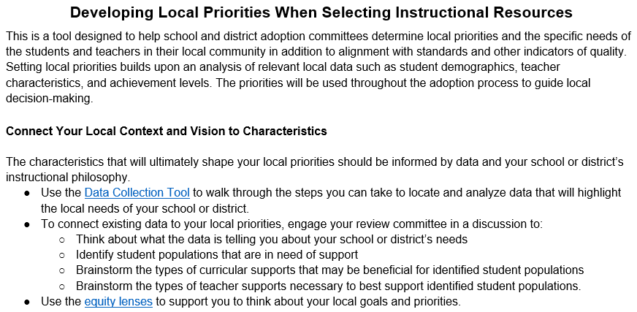
Phase 3: Step 1 (Determine Selection Criteria)
Developing Selection Criteria and Data Collection Tool:
Supports synthesis of an instructional vision and local context into clear selection criteria to inform resource identification and evaluation.
Sample Stakeholder Questions:
Provides possible questions to gather input from different stakeholder groups to inform selection criteria
Notes:
At its best, a successful adoption process begins with identifying clear selection criteria. The Developing Local Selection Criteria and Data Collection tools work together to help the team ground the selection criteria in their instructional vision to guide the selection process.
Another useful tool for developing the selection criteria is the Sample Stakeholder Questions which offers a range of possible questions for three key groups–teachers, families/communities, and students--to ensure that multiple perspectives are taken into account to help inform the selection criteria.

Slide 32
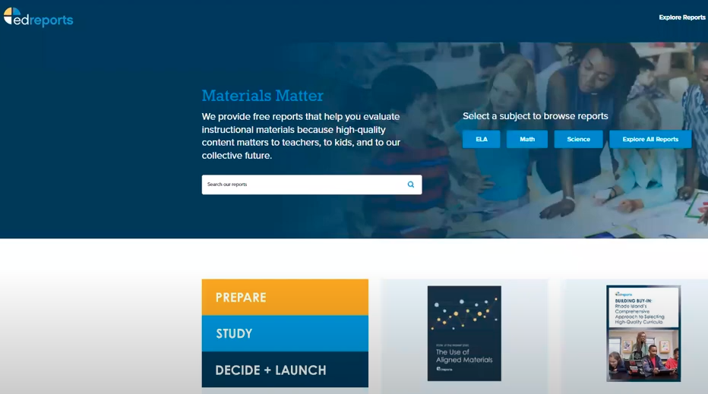
Phase 3: Step 1 (Identify Potential HQIRs)
EdReports Website:
Provides resources identification and evaluation for Reading and Writing and Mathematics.
How to Read an EdReports Review and Video Tutorial:
Briefly walks users through navigating the site and overviews important information contained in the reviews
Notes:
Once the team has determined its selection criteria, the next step is to identify potential HQIRs for further evaluation. For Reading and Writing and Mathematics, EdReports should be the place to begin. EdReports is an independent, educator-led nonprofit that reviews instructional resources to better inform district and school resource adoption processes. The site has quality ratings for most resources currently available. The Video Tutorial offers a quick walk-through to support navigating the site. The How to Read an EdReports review provides guidance on understanding the information contained in their reviews.

Slide 33
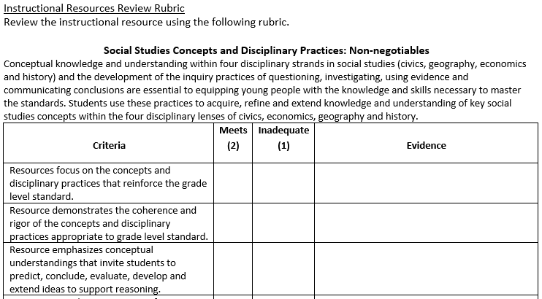
Phase 3: Step 1 (Evaluate Potential HQIRs)
Instructional Resource Alignment Rubrics:
Guide districts in purchasing instructional resources and in determining what revisions may be needed to ensure alignment to the Kentucky Academic Standards (KAS)
Sample Vendor Questions:
Includes possible questions to guide conversations with vendors to ensure resources meet local needs
Notes:
Once the team has identified some potential HQIRs, the next step is resource evaluation. The instructional resource alignment rubrics from the KDE offer guidance for multiple content areas. While the rubrics are important to consult for all content areas, they are especially valuable for those areas not currently reviewed by outside organizations such as EdReports. These tools help teams evaluate resources for alignment to the Kentucky Academic Standards and to determine strengths and possible gaps in potential resources.
The sample vendor questions provides possible questions teams can use to guide conversations with vendors to ensure resources meet their selection criteria and instructional vision.

Slide 34
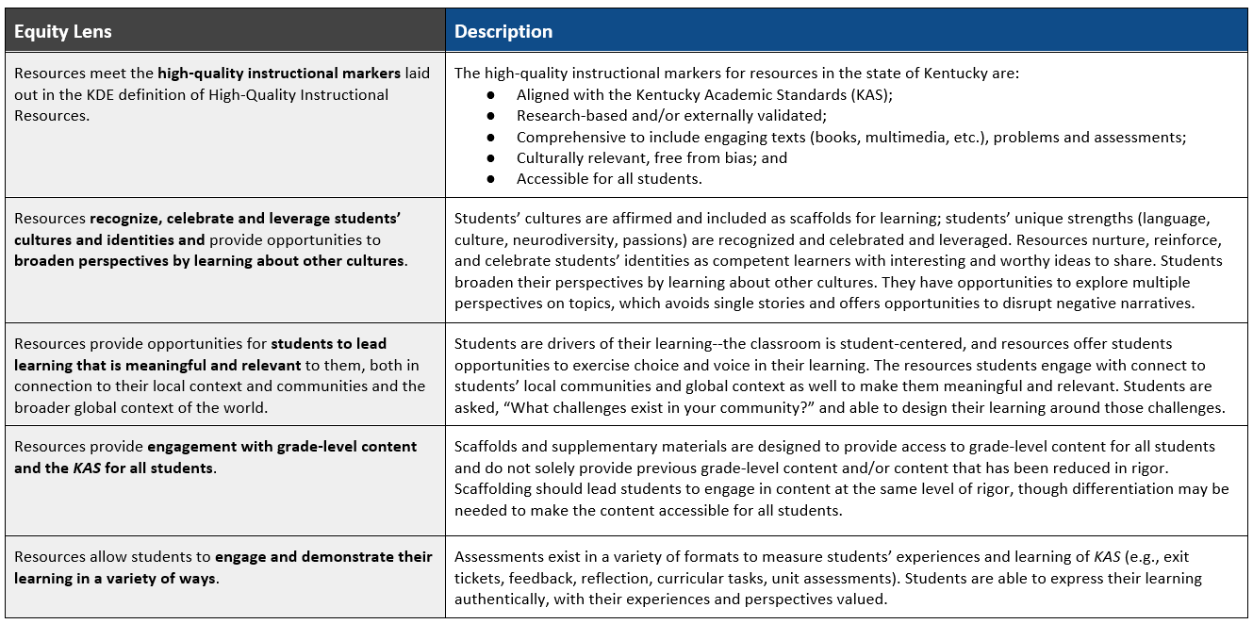
Phase 3: Step 1 (Evaluate Potential HQIRs)
Equity Lenses:
Provides guidance for 5 equity lenses for consideration to help promote equitable learning environments for all students
Notes:
The Equity Lenses, created in Partnership with Leading Educations, describes 5 equity lenses and provides guidance on how to use the lenses when evaluating resources to ensure equitable learning environments for all students across the district or school.

Slide 35
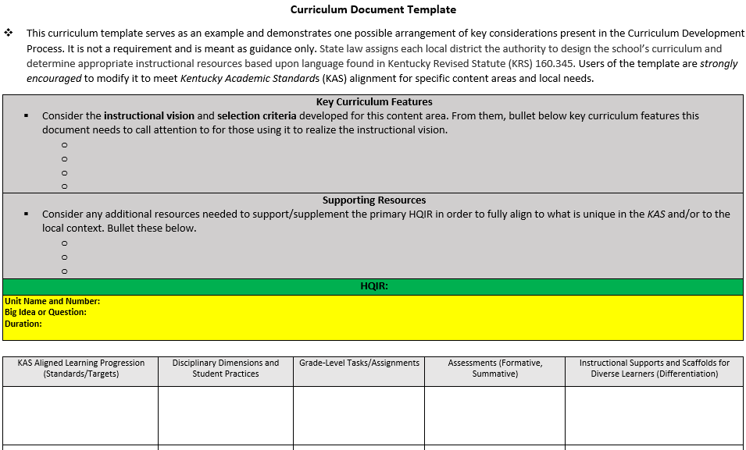
Phase 3: Step 2 (Create Curriculum Document Template)
Curriculum Document Template:
Demonstrate one possible way districts can arrange key considerations in the CDP to help educators engage the curriculum and HQIR effectively.
Notes:
Phase 3, Step 2 focuses on the creation of a curriculum document template that plans a coherent instructional experience within and across grade levels that systematically builds student understanding of the KAS and reflects the beliefs of the instructional vision. The curriculum template tool serves as an example of one possible arrangement of key considerations present in the Curriculum Development Process. It is not a requirement and is meant as guidance only.
The template helps frame how the primary HQIR should be used according to the local instructional vision for it. It should also identify when supplemental resources might be needed and articulate how they fit into the overall vision.

Slide 36
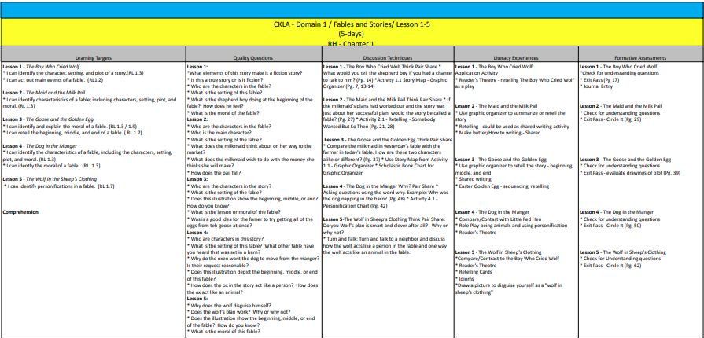
Phase 3: Step 3 (Develop Curriculum Supports)
Sample Local Curriculum Document:
Shows how one KY district has mapped they have prioritized in their curriculum to the selected HQIR.
Notes:
Step 3 is to develop the supports within the local curriculum template aligned to each essential element which helps ensure schools and districts are providing a curriculum with meaningful guidance. This key tool is a sample from Wayne County that illustrates one way of developing the supports within a locally developed curriculum that establishes the expectations for the student experience.

Slide 37
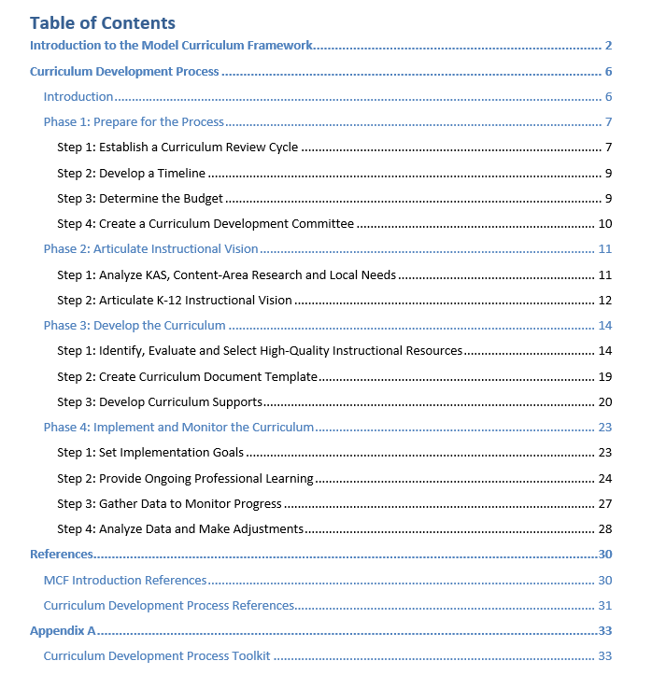
Appendix A
Notes:
In addition to the key tools, the CDP also contains an appendix that provides more support for implementing each phase.

Slide 38
Phase 3 Appendix
Notes:
The Phase 3 toolkit includes the professional learning module and associated resources, sample artifacts from districts around the state and video clips from districts sharing their experiences as they worked through the process.
In the last column of additional resources, the toolkit contains a link to the Reading and Writing Instructional Resources Consumer Guide that supports Phase 3, Step 1. The guide includes specific makers to look for when selecting high-quality reading and writing resources that align with the Kentucky Academic Standards, as well as some R/W specific versions of the key tools from Phase 3 in the CDP. There is also a short video that walks you through the purpose and structure of the R/W consumer guide. Consumer guides for other content areas will be added in the future as they become available.
Another resource to highlight for Phase 3 is the Rivet Professional Learning Partner Guide. RIVET is a nonprofit organization that evaluates and recommends professional learning partners who provide curriculum-aligned services to schools and districts, including support with a local adoption process.
We want to highlight two of the sample artifacts included in the toolkit for Phase 3.

Slide 39
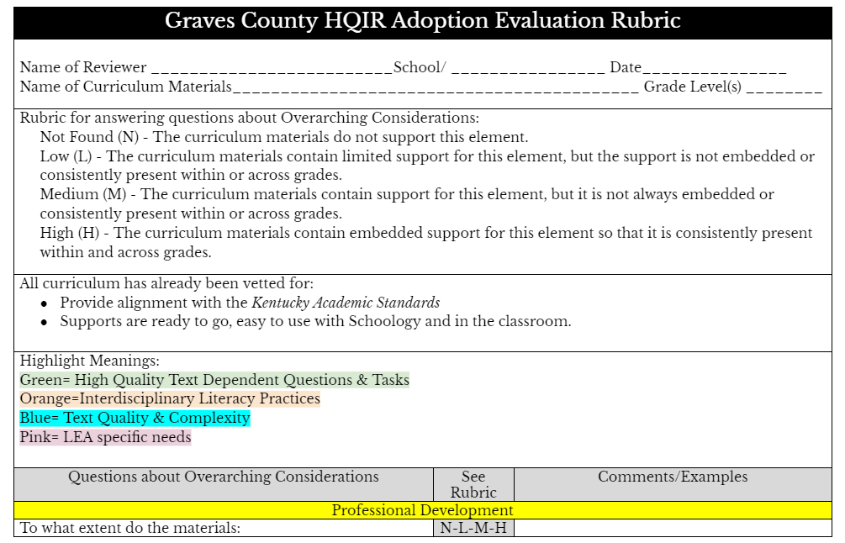
HQIR Evaluation Rubric Example
HQIR Evaluation Rubric Example
Notes:
The first artifact is from Graves County and highlights the document they created to gather input from the curriculum team as they evaluated their top HQIR choices for reading and writing. Using clear structures and documents to organize the notes for the team as the evaluate each resource is critical to the selection process and can help streamline decision-making.

Slide 40
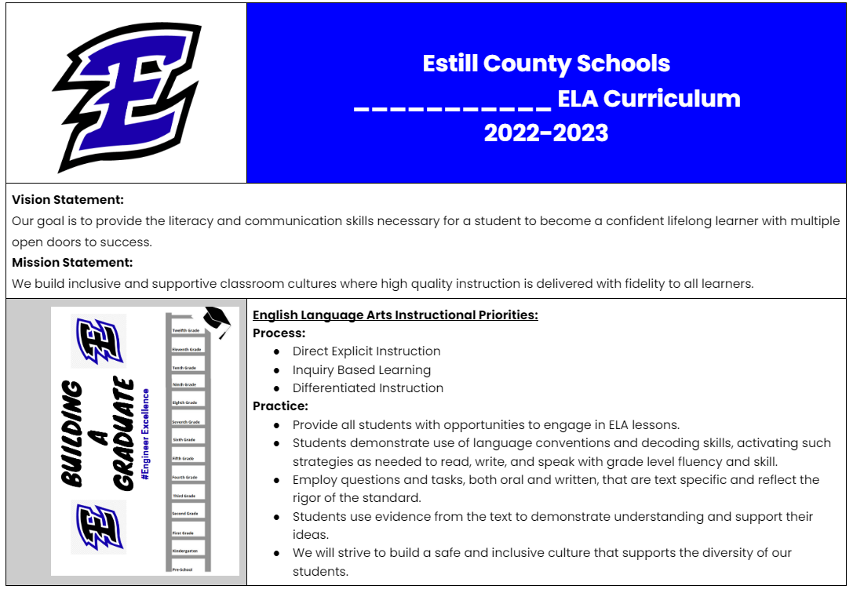
Curriculum Document Template Example
Curriculum Document Template Example
Notes:
This is an example of a local curriculum template created by Estill County Schools that reflects the essential elements in their instructional vision and places to clearly document where the primary and supplemental resources will be used to help students reach grade-level expectations.

Slide 41
Phase 3 Tools and Resources Exploration
Success criterion: Access resources to support implementation of Phase 3.
As you explore, focus on the following information:
Which tools and resources may be most beneficial to supporting the work of Phase 3?
What tools and/or resources may still be needed to support Phase 3?
*Space provided under Success Criterion 3 on your participant handout to hold your thinking
Notes:
We want to give you an opportunity to explore Phase 3 tools and resources. You may want to spend some time exploring individually or with your team. As you explore, focus on:
Which tools and resources may be most beneficial to supporting the work of Phase 3?
What tools and/or resources may still be needed to support Phase 3?
You can hold your thinking in the space provided under Success Criterion 3 on your participant handout.
Pause the video and restart after exploring the resources and capturing your thinking on your handout.

Slide 42
Whole Group Share Out
Resource Feedback
Which tools and resources may be most beneficial to supporting the work of that phase?
What tools and/or resources may still be needed to support the work of that phase?
Notes:
If you explored individually or as a team but have more than one team in your group, take time to have a whole group share out to hear from other teams.
During your exploration, which tools and resources did you feel will be most beneficial?
What were some tools and resources you noted may still be needed to support Phase 3?
Pause the video now and restart after the whole group share-out.

Slide 43
Phase 3 Module Purpose
Learning Goal: We are learning about a systematic process for developing a high-quality local curriculum that supports standards implementation and promotes student equity.
Success Criteria:
Examine the importance of HQIRs in supporting implementation of a locally developed curriculum.
Identify key actions and products of Phase 3 of the Curriculum Development Process.
Access resources to support implementation of Phase 3 of the Curriculum Development Process.
Develop an action plan for implementing Phase 3 at the local level.
Notes:
We are moving into our last success criterion where we want to provide you time to begin to develop an action plan for implementing Phase 3 at the local level.

Slide 44
Phase 3 Module Reflection (A)
Reflection Goal: To anchor learning from the session for application.
Review items on your “Know” list. Update as needed. Of all you now understand about Phase 3, which item seems most important?
Review items on your “Need to Know” list. Update as needed. Which item seems most important to address in supporting implementation of Phase 3 in your district?
Record both items in the space provided under success criterion 4 on your participant handout.
Notes:
Before thinking though your action plan, we want to pause for a final reflection to anchor your learning from the session so that you can move it forward into application. Go back to your “Know/Need to Know” table on page 1 of your participant handout.
Review the items on your “Know” list and update as needed. When you look back over the list, which item seems most important for you to remember?
Then review the items on your “Need to Know” list and again, update as needed. Determine which item seems most important to address in supporting implementation of Phase 3 in your district.
Record both of those items in the space provided under success criterion 4 on your participant handout.
Pause the video and restart after completing this portion of the final reflection.

Slide 45
Phase 3 Module Reflection (B)
Learning Goal: We are learning about the importance of HQIRs and key curricular elements to consider when developing the local curriculum template.
Use the scale under success criterion 4 to reassess your overall level of understanding after engaging the module.
After engaging in the learning experience, how would you rate your overall level of understanding of Phase 3? Very low 1 2 3 4 5 Very High
Notes:
Lastly, we want you to reassess your overall level of understanding of our learning goal after engaging in the module on that scale of 1-5. Determine your rating now in the space provided under success criterion 4.
Pause the video and restart after completing this second portion of the final reflection.

Slide 46
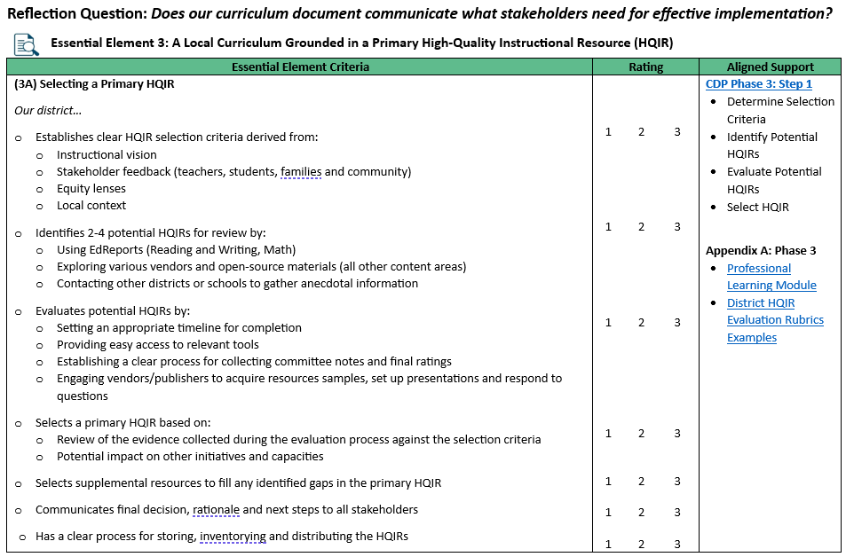
Reflection Question
Notes:
To help you determine possible next steps, we recommend that you complete the section from the CDP Self-Assessment Tool focused on Essential Element 3: A Local Curriculum Grounded in a Primary High-Quality Instructional Resource. The element is broken down into two indicators: 3A focused on selecting a primary HQIR and 3B focused on developing the local curriculum document with support from the HQIR.
Each indicator is broken down into specific criteria necessary for supporting that element with a place for you to give a rating on a scale of 1 being not present in our district to 3 being fully present and systematic in our district. Again, this may help you pinpoint specific aspects of phase 3 that you want to prioritize as a part of your action plan.

Slide 47
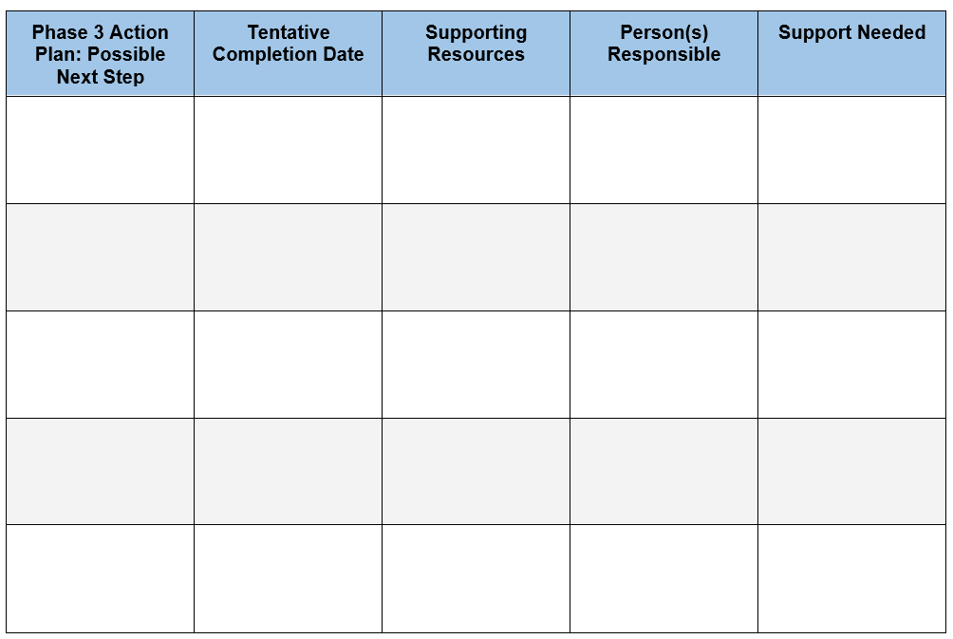
Time to Plan
Based on your learning today, develop an action plan for implementing Phase 3.
Planning template is provided under Success Criterion 4 on the participant handout
Notes:
With your district teams, we want you to begin thinking about possible next steps, completion dates, supporting resources, responsibilities, and support you’ll need for implementing Phase 3 back in your district. The planning template is located under success criterion 4 on your participant handout.

Slide 48
Module Wrap-Up
Please complete the Module 3 Professional Learning Survey.
Questions for OTL?
Fox DeMoisey
fox.demoisey@ducation.ky.gov
Misty Higgins
misty.higgins@education.ky.gov
Notes:
Finally, we ask that you take time to complete the short PL survey to provide feedback on Module 3. An EILA certificate is available and can be accessed at the end of the survey.
Please feel free to reach out to me or Fox with any questions you may have. Thank you for participating in Module 3 of the Curriculum Development Process professional learning series.

