Slide 1
Performance Assessments in Social Studies
Module Four:
How do I design performance assessments to meet the depth and rigor of the KAS for Social Studies?
Notes:
Module Series Overview:
The Performance Assessments in Social Studies module series is a set of five of modules designed to support teachers in implementing performance assessments to determine student mastery of the Kentucky Academic Standards (KAS) for Social Studies.
The Performance Assessments in Social Studies module series is intended to support the successful implementation of the KAS for Social Studies in classrooms across the state. The duration of the module sections may be customized to accommodate local needs and conditions; however, it is important to engage with this module linearly as the first sections support educators in understanding the purpose of performance assessments in the bigger picture of assessing learning. The sections are designed to provide flexibility for districts and schools and, as such, can be viewed as stand-alone lessons or within the progression of the module as written. You are supported in engaging with this module individually, if desired.
Materials:
The following materials are needed for this section:
Notetaking Guide: https://www.education.ky.gov/_layouts/download.aspx?SourceUrl=/curriculum/standards/kyacadstand/Documents/Module_Four_Notecatcher.docx
Additional materials, such as but not limited to, discussion strategies, etc. are provided within the notes section of applicable slides throughout the module.
Guiding Notes
Guiding notes are provided in the Notes section of the PowerPoint to support your learning. The information provided in the Notes section includes additional information, directions for the activities on the slide, and citations of used resources, where appropriate. It is critical that you read the material presented in the Notes section to ensure that you are acquiring the important knowledge, skills and understanding required when engaging with this module.
Virtual Training Note:
If you plan to engage with this module virtually as a group, consider directing participants to the Social Studies Professional Learning Modules page so that you may access the resources used directly from the links provided in the PowerPoint: https://kystandards.org/standards-resources/ss-resources/ss-pl-modules/
Additionally, you may consider downloading the resources contained within each section of the module and placing them into a Google folder for you or your colleagues to access.
Module Four Compelling and Supporting Questions with Learning Goals and Success Criteria
•Compelling Question: How do I implement performance assessments to assess student mastery of the KAS for Social Studies?
•Supporting Questions:
What are the characteristics of high- quality performance assessments that meet the depth and rigor of the KAS for Social Studies?
How do I design performance assessments to meet the depth and rigor of the KAS for Social Studies?
•Learning Target: I can implement performance assessments that evaluate student mastery of the KAS for Social Studies.
•Success Criteria: I will be successful when I can design performance assessments aligned to the KAS for Social Studies.
Intended Audiences:
Participants
Module participants may include, but are not limited to, district leadership, school administrators, instructional specialists/coaches, intervention specialists, department chairs, special educators and classroom teachers.
Facilitators:
This module series may be implemented with by a teacher individually or a group of educators led by a facilitator. If this module is being completed as a group, facilitators may include, but are not limited to, district leaders, school administrators, instructional specialists/coaches, intervention specialists, department chairs, special educators and classroom teachers. Facilitators may need to revise specific tasks in order to meet the needs of the participants or to be respectful of the time planned within the work session.
Helpful Hint for Facilitators:
The learning that will take place in this module may cause Kentucky educators to face changes in instructional practices amidst this transition. It is important to realize that while you are the facilitator of these work sessions, you may not have all the answers to the questions asked by participants, and that is okay. Throughout the module, participants may have questions that will be addressed in future work sessions. When that happens, reflect on this quote from Graham Fletcher, “Every teachable moment doesn’t need to be a teachable moment in that moment.” Use these moments to encourage participants to attend future work sessions where those questions will be addressed. If participants ask questions you are not prepared to answer, offer to follow up on that during the next work session.
Planning Ahead for Facilitators:
●Determine which stakeholders to invite as participants. In the invitation, describe how the work sessions will benefit them.
●A few days before the meeting, you may want to remind participants to be prepared to have their documents available during the meeting. (See below for Participant Documents Needed.)
●Reserve adequate space and equipment. Tables or desks should be set up to support small-group discussion. If conducting this module virtually, ensure that your technology platform can support break out rooms to support small group collaboration.
●Ensure that participants have access to the Internet.
●Consider how you might handle participants who may not be in attendance at all work sessions. It might be worthwhile to consider how those participants might access missed sections of the module between work sessions in order to feel as prepared as the other participants.
Preparation
Participant Documents Needed:
Plan ahead regarding how you will feel most comfortable engaging with the KAS for Social Studies, either:
●A device with access to the KAS for Social Studies, or
●A hard copy of the KAS for Social Studies
Additional documents needed include:
●Notetaking Guide:
Additional materials, such as but not limited to, discussion strategies, etc. are provided within the notes section of applicable slides throughout the module.
Supplies Needed:
• Computer with Module Four: How do I design performance assessments to meet the depth and rigor of the KAS for Social Studies? PowerPoint presentation.
• Technology with projection capability if in person. Technology platform where presenters have sharing ability and breakout room options if virtual.
• Copies of the handouts needed for the session either in hard copy format or available in a folder online. Links to the participant handouts needed for the session also may be built right into the agenda.
• Parking Lot for questions - If completing as a group, you may consider providing a poster on which participants can write or post questions, or you may prefer to have a digital parking lot where participants can access a Google document, for example, to post questions and that you can modify as the participants work through the sections of the module.
• Self-Sticking Notes (optional)
• Poster paper (optional)
• Highlighters and/or colored pens/markers (optional)
Building a Community:
Building a community is important for any group that will work together, especially if participants have not worked together before. The concept is the same as building a safe, respectful, productive classroom climate. Incorporating community-building into each session builds trust, shows participants that they are valuable as individuals and engages them in the learning process. It is also useful for creating a professional learning network where participants can be supported in their work. Community-building can be as simple as allowing participants to introduce themselves and their role in the school/district, developing or refining group norms, allowing for questions, and/or the sharing of answers to reflection questions or individual discovery task items that are included in this module. Again, time allotted for community-building will allow participants to have a voice and be engaged as active contributors and learners in the sessions.
Virtual Training Options: Be sure to conduct continual check-ins throughout the presentation. Build Google documents to continue to collect feedback, such as questions, hopes, and/or concerns to which participants may continually add.

Slide 2
Introduction
Compelling Question: How do I implement performance assessments to assess student mastery of the KAS for Social Studies?
Supporting Questions:
What are the characteristics of high- quality performance assessments that meet the depth and rigor of the KAS for Social Studies?
How do I design performance assessments to meet the depth and rigor of the KAS for Social Studies?
Learning Target: I can implement performance assessments that evaluate student mastery of the KAS for Social Studies.
Success Criteria: I will be successful when I can design performance assessments aligned to the KAS for Social Studies.
Notes:
Guiding Notes:
The Performance Assessments in Social Studies module series has five modules that build on one another to support a participant in answering the compelling question: How do I implement performance assessments to assess student mastery of the KAS for Social Studies? Participants will answer this question after completing the module series. Answering this question will support participants in meeting the Learning Target: I can implement performance assessments that evaluate student mastery of the KAS for Social Studies.
Each module within the module series supports a participant in answering a supporting question. At the conclusion of engaging with Module Four of this series, participants will answer the supporting questions:
What are the characteristics of high- quality performance assessments that meet the depth and rigor of the KAS for Social Studies?
How do I design performance assessments to meet the depth and rigor of the KAS for Social Studies?
Participants will meet the success criteria for Module Four when they can demonstrate the Success Criteria: I will be successful when I can design performance assessments aligned to the KAS for Social Studies.
For more information on compelling questions, visit Section 3B: “What are Compelling Questions and how do students ask them?” from the Inquiry Practices module: https://education.ky.gov/curriculum/standards/kyacadstand/Documents/Inquiry_Practices_of_KAS_for_Social_Studies.pptx
For more information on supporting questions, visit “Section C: What are Supporting Questions, and how do students ask them?” from the Inquiry Practices module: https://education.ky.gov/curriculum/standards/kyacadstand/Documents/Inquiry_Practices_of_KAS_for_Social_Studies.pptx
For more information on Learning Goals and Success Criteria and their alignment to the KAS for Social Studies, visit Learning Goals, Success Criteria and the KAS for Social Studies: https://kystandards.org/standards-resources/ss-resources/learning-goals-success-criteria-and-the-kas-for-social-studies/

Slide 3
Overview of this module
The role of assessments in social studies is a linear process; therefore, it is important to go through the first sections in order to better understand the purpose of performance assessments in the bigger picture of assessing learning.
Module Four is focused on understanding, designing and implementing performance assessments aligned to the KAS for Social Studies.
Notes:
Guiding Notes:
Read the slide. This image shows the different sections of this module. Module Four is focused on designing performance assessments aligned to the KAS for Social Studies. This visual also outlines the processes and steps to better understand the purpose and role of assessment in social studies. It is a linear process – it is important to go through the first sections in order to better understand the purpose of performance assessments in the bigger picture of assessing learning.

Slide 4
Warm Up I Used to Think…
When we began our study of performance assessments, you had some initial ideas about them.
Take a minute to remember what ideas you previously had about performance assessments.
Write a few sentences using the sentence starter, “I used to think…”
This Photo by Unknown Author is licensed under CC BY-SA-NC
Notes:
Guiding Notes:
On your note catcher where is says slide 4, complete the first part of the I Used to Think … Now I think… thinking strategy. Note: you will complete the final portion of this thinking routine at the end of Module Four.
Resource:
Project Zero (2015). I Used to Think… Now I Think… Harvard Graduate School of Education. https://pz.harvard.edu/sites/default/files/I%20Used%20to%20Think%20-%20Now%20I%20Think_2.pdf

Slide 5
What are the characteristics of high- quality performance assessments that meet the depth and rigor of the KAS for Social Studies?
Section A
Notes:
Guiding Notes
This slide begins Section A where you will learn about the characteristics of high-quality performance assessments.

Slide 6
Performance Assessments
What are performance assessments?
Ask students to think and to produce—to demonstrate learning through work that is authentic to the discipline and/or real world.
Yield a tangible product and/or performance that serve as student evidence of learning.
Unlike a selected-response item that asks students to select from given alternatives, a performance assessment presents a situation that calls for learners to apply their learning in context.
Notes:
Guiding Notes:
Read the statements on the slide to begin to understand what performance assessments are. Answer the question “What are performance assessments?” on your note catcher where it says Slide 6.

Slide 7
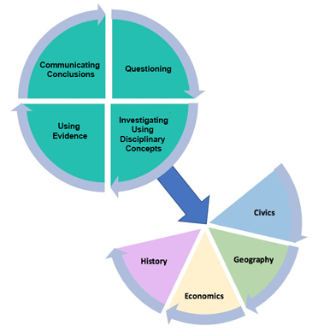
Performance Assessments and the KAS for Social Studies
To determine student mastery of the KAS for Social Studies, student work should be evaluated using performance assessments.
K.I.CC.1 | Construct an explanation about their community’s civic life, history, geography and/or economy.
5.I.CC.4 | Use a range of deliberative and democratic procedures to identify strategies on how to address a current issue.
8.I.CC.2 | Construct arguments by drawing on multiple disciplinary lenses to analyze how multiple perspectives, diversity and conflict and compromise impacted the development of the United States.
HS.C.I.CC.1 | Engage in civil discussion, reach consensus when appropriate and respect diverse opinions relevant to compelling and/or supporting questions in civics.
Notes:
Guiding Notes:
Read the slide. To determine student mastery of the KAS for Social Studies, student work has to be evaluated using performance assessments. Take a moment to review the standards cited on this screen. Use the information on slides 7 and 8 to answer the question “Why are performance assessments required to assess student mastery of the KAS for Social Studies?” on your note catcher where it says slides 7 and 8.

Slide 8
Performance Assessments and the KAS for Social Studies (2)
Why are performance assessments required to assess student mastery of the KAS for Social Studies?
K.I.CC.1 | Construct an explanation about their community’s civic life, history, geography and/or economy.
5.I.CC.4 | Use a range of deliberative and democratic procedures to identify strategies on how to address a current issue.
8.I.CC.2 | Construct arguments by drawing on multiple disciplinary lenses to analyze how multiple perspectives, diversity and conflict and compromise impacted the development of the United States.
HS.C.I.CC.1 | Engage in civil discussion, reach consensus when appropriate and respect diverse opinions relevant to compelling and/or supporting questions in civics.
What are performance assessments?
Performance assessments ask students to think and to produce—to demonstrate learning through work that is authentic to the discipline and/or real world.
Performance assessments yield a tangible product and/or performance that serve as student evidence of learning.
Performance assessments presents a situation that calls for learners to apply their learning in context.
Notes:
Guiding Notes
Use the information on slides 7 and 8 to answer the question “Why are performance assessments required to assess student mastery of the KAS for Social Studies?” on your note catcher where it says slides 7 and 8.
To determine student mastery of the KAS for Social Studies, student work should be evaluated using performance assessments. As you consider this question, think about the characteristics of a performance assessment. Let’s use the characteristics of performance assessments to look at each standard to determine why performance assessments are needed.
Look at K.I.CC.1: students have to produce a tangible product of an explanation that requires them to synthesize their knowledge of the disciplinary strands to demonstrate what they know about their community’s civic life, history, geography and/or economy. It is important to note that students can construct these explanations in a variety of ways: through sharing verbally, a combination of images and text, etc.
5.I.CC.4 asks that students use deliberative and democratic procedures to identify strategies on how to address a current issue. Here, students have to think and produce and apply their learning in a real world context.
8.I.CC.2 is similar to K.I.CC.1 because students have to produce a tangible product of an argument that requires them to draw on multiple disciplinary lenses. In this argument, students have to analyze how multiple perspectives, diversity and conflict and compromise impacted the development of the United States.
HS.C.I.CC.1 is similar to 5.I.CC.4 because it ask that students to engage in civil discussion, reach consensus when appropriate and respect diverse opinions relevant to compelling and/or supporting questions in civics.
Each of these standards provides examples of how the KAS for Social Studies requires students to think and produce work that demonstrates their learning in real world and disciplinary authentic ways. They have to yield a tanigble product and apply their learning in context.

Slide 9
Advantages of Performance Assessments
Are more authentic to the teaching and learning environment
Allow students to demonstrate knowledge and skills that are otherwise very difficult to measure on traditional tests
Provide opportunity for higher depth of knowledge
Provide the opportunity for detailed feedback about performance
Performance assessments are versatile:
Informal or formal
Minutes or months
Formative, interim or summative
A single item or an entire assessment
Notes:
Guiding Notes:
Read the information provided on the slide. Note:
Performance assessments can be used for formative, interim or summative purposes.
A performance assessment could be included as an item within an assessment, or a single performance task can make up the entire assessment.
Performance assessments can be so informal that students don’t even realize that they are happening. Or, they can be highly structured and standardized. Or, performance assessments can fall somewhere in between: they can last only a few minutes or take place over the course of a month.

Slide 10
Basic Characteristics of Performance Assessments
Target skills and knowledge that are required
Link curriculum, instruction and assessment
Focus on learning by doing
Establish novel and authentic contexts for performance
Provide evidence of understanding via transfer
Are multifaceted
Integrate two or more subjects, as well as 21st century skills
Are evaluated with established criteria and rubrics
Notes:
Guiding Notes:
Read the information provided in the slide. Note:
Performance assessments establish novel and authentic contexts for performance.
These assessments present realistic conditions and constraints for students to navigate. For example, an authentic assessment would present students with a never-before-seen problem that cannot be solved by simply “plugging in” disconnected disciplinary content into a project that requires little to no application. In an authentic assessment, students need to consider goals, audience, obstacles and options to achieve a successful product or performance. Authentic assessments have a side benefit — they convey purpose and relevance to students, helping learners see a reason for putting forth effort in preparing for them.
Performance assessments provide evidence of understanding via transfer. Understanding is revealed when students can transfer their learning to new and “messy” situations.
Note that not all performances require transfer. Rich performance assessments are open-ended and call “higher-order thinking” and the thoughtful application of knowledge and skills in context, rather than a scripted or formulaic performance.
Performance assessments are multi-faceted.
Unlike traditional test “items” that typically assess a single skill or fact, performance tasks are more complex. They involve multiple steps and thus can be used to assess several standards or outcomes.
Performance assessments can integrate two or more subjects as well as 21st century skills.
In the wider world beyond the school, most issues and problems do not present themselves neatly within subject area “silos.” While performance assessments can certainly be content-specific (e.g., mathematics, science, social studies), they also provide a vehicle for integrating two or more subjects (civics, economics, geogrpahy and history, as an example) and/or weaving in 21st century skills and Habits of Mind. One natural way of integrating subjects is to include a reading, research, and/or communication component (e.g., writing, graphics, oral or technology presentation) to tasks in content areas like social studies, science, health, business, health/physical education. Such tasks encourage students to see meaningful learning as integrated, rather than something that occurs in isolated subjects and segments.
Performances on open-ended assessments are evaluated with established criteria and rubrics.
Since these assessments do not yield a single answer, student products and performances should be judged against appropriate criteria aligned to the goals being assessed. Clearly defined and aligned criteria enable defensible, judgment-based evaluation. More detailed scoring rubrics, based on criteria, are used to profile varying levels of understanding and proficiency. Note: guidance for creating rubrics for performance assessments will be provided in Module Five of this series.

Slide 11
Application
Evaluate Performance Assessment Draft One on your Note Catcher by using the following characteristics of a Performance Assessment:
Does this prompt target skills and knowledge that are required?
Does this prompt link curriculum, instruction and assessment?
Does this prompt focus on learning by doing?
Does this prompt establish novel and authentic contexts for performance?
Does this prompt provide evidence of understanding via transfer?
Is this prompt multifaceted?
Does this prompt integrate two or more subjects, as well as 21st century skills?
Notes:
Guiding Notes:
Review Draft One and answer these questions on your note catcher where it says slide 11.
Link to Draft One: https://education.ky.gov/curriculum/standards/kyacadstand/Documents/Original_Performance_Task.pdf

Slide 12
Application (2)
Review draft two of the performance assessment task.
How did the performance assessment prompt change from draft one to draft two to better align with the characteristics of a performance assessment? To answer this question, consider how did draft one and draft two differ:
In what the prompt asked students to think and produce?
In their authenticity or connection to the real world?
In the products students produced?
In how students apply their learning in context?
Notes:
Guiding Notes:
Review Draft Two and consider the questions on the slide. Respond to these questions in your Note Catcher.

Slide 13
Application (3)
Choose one of the following examples based on the grade level you teach:
Read the performance assessment example and determine its alignment to the KAS for Social Studies.
Use the Performance Assessment Audit tool to evaluate the assessment you chose.
Record the strengths in the “Successful” column.
Record the gaps in the “Opportunities for Growth” column and propose actions to improve the assessment.
Elementary | Middle | High
example 1 | example 1 | example 1
example 2 | example 2 | example 2
Notes:
Guiding Notes:
Use the audit to reflect on one of the assessments provided on the slide.

Slide 14
Section A Reflection
Five words:
What five words would you use to describe a high-quality performance assessment in social studies?
Why did you choose those words?
Notes:
Guiding Notes:
On your note catcher where is says slide 14, answer the questions on the slide.

Slide 15
How do I design performance assessments to meet the depth and rigor of the KAS for Social Studies?
Section B
Notes:
Guiding Notes
This slide begins Section B where you will design a performance assessment.

Slide 16
Where to Start?
You will now start developing performance assessments aligned to the KAS for Social Studies.
Notes:
Guiding Notes
You will now engage in a process to begin to understand how to develop performance assessments in social studies.

Slide 17
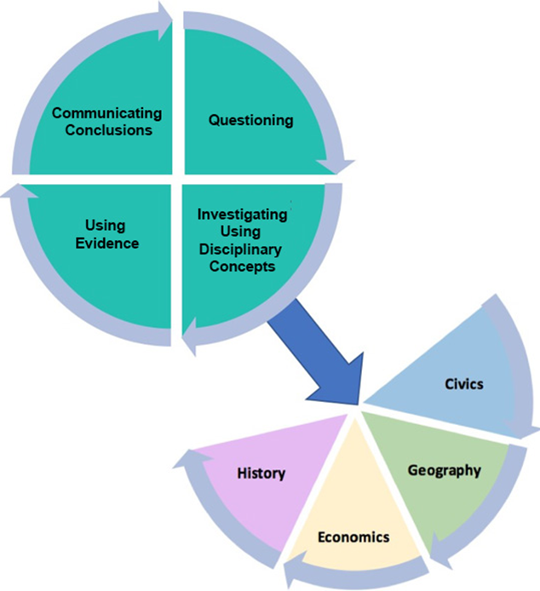
The KAS for Social Studies Require Performance
The inquiry portion of the standards provides a pathway to performance assessments.
The KAS for Social Studies focus on developing transferable processes (e.g., problem solving, argumentation, research, and critical thinking), not simply presenting a body of factual knowledge for students to remember. A fundamental goal reflected in these standards is the preparation of learners who can perform with their knowledge.
Performance Assessment
Notes:
Guided Notes
Answer the question, “Why does the KAS for Social Studies require performance? on your note catcher where it says slide 17 and 18.
Note: The inquiry process is critical for effective student understanding of civics, economics, geography and history. Inquiry instruction requires teachers and students to ask questions that drive student investigation of the subject matter and eliminates the “skills vs. content” dilemma in social studies as both are needed to successfully engage in inquiry. Students will engage in inquiry using the tools, conceptual understandings and the language of political scientists, economists, geographers and historians at a developmentally appropriate level. Students will craft arguments, apply reasoning, make comparisons, corroborate their sources and interpret and synthesize evidence as political scientists, economists, geographers and historians.

Slide 18
What are the benefits of Performance Assessments?
Performance assessments place student demonstration of ability at the center of assessment.
Performance assessments approximate real-world application of complex skills.
Performance assessments allow students to actively demonstrate their learning and skills
Performance assessments can measure abilities beyond academic knowledge and skills
Performance assessments are typically more engaging for students
Notes:
Guided Notes
Answer the question, “Why does the KAS for Social Studies require performance? on your note catcher where it says slide 17 and 18 using the information on this slide.

Slide 19
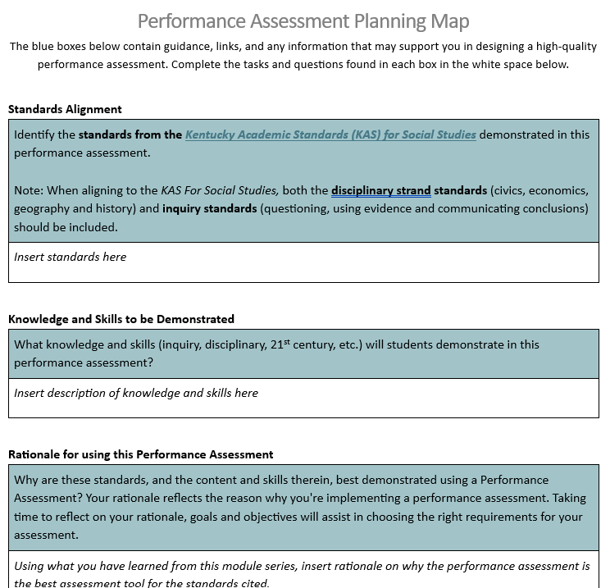
Steps to Designing Performance Assessments
Use the Performance Assessment Planning Map to design a performance assessment aligned to the KAS for Social Studies.
Notes:
Guided Notes
To design a performance assessment. Complete the Performance Assessment Planning Map. The Planning Map is linked below and the following slides will go though each step of completing this map. The purpose of this map is to help frame performance assessments for a particular unit of instruction aligned to the KAS for Social Studies.
Planning Map: : https://www.education.ky.gov/_layouts/download.aspx?SourceUrl=/curriculum/standards/kyacadstand/Documents/Performance_Assessment_Planning_Map.docx

Slide 20
Steps to Designing Performance Assessments (1)
1. Identify a unit/topic that has the most authentic opportunity to create a performance assessment.
2. Identify the standards from the KAS for Social Studies that are being assessed (from step 1 of the tool). In particular, pay attention to the Communicating Conclusion standards, but both disciplinary strand and inquiry standards should be included.
3. Content Required- This correlates to what knowledge, concepts and vocabulary students will need to master the standards. The disciplinary clarifications are useful here as they offer suggestions teachers can use to more clearly determine the knowledge, concepts and vocabulary.
4. Skills required- This outlines the skills students will need to engage in to master the standards for this assessment. This is usually determined by the verb at the start of the standards statement.
Notes:
Guided Notes
Follow the steps on the screen to complete your Performance Assessment Planning Map.

Slide 21
Steps to Designing Performance Assessments (2)
5. Levels of Demonstration Required – This connects directly to the level of proficiency students are required to be at for a particular grade. Most often this can be identified using Bloom’s taxonomy and/or Webbs Depth of Knowledge.
6. Rationale for Using a Performance Assessment - Why are these standards, and the content and skills therein, best demonstrated using a Performance Assessment? Your rationale reflects the reason why you're implementing a performance assessment. Taking time to reflect on your rationale, goals and objectives will assist in choosing the right requirements for your assessment.
7. Authentic Context - This section asks students to think and to produce—to demonstrate learning through work that is authentic to the discipline and/or real world.
Notes:
Guided Notes
Follow the steps on the screen to complete your Performance Assessment Planning Map.

Slide 22
8. Task
Write the prompt that students will answer to complete a Performance Assessment.
Notes:
Guided Notes
Now, reflect on everything you have filled in on your Performance Assessment Planning Map and begin to develop the actual task for the performance assessment. Use the following slides with performance assessment examples to get you started.

Slide 23
Sample
Task Aligned to the Compelling Question: Part One: Construct an explanation, using reasoning, correct sequence, examples and details with relevant information and data to answer the following question: “How can technology transform civilization?” In your explanation, be sure to include examples and details from multiple sources while acknowledging the strengths and weaknesses of the explanations. Part Two: Using your knowledge of how technology can transform civilization, evaluate how individuals and groups addressed local, regional and global problems throughout the growth and expansion of civilizations. Part Three: Based on your evaluation of how individuals and groups addressed local, regional and global problems throughout the growth and expansion of civilization, use historical thinking skills to confront today’s problems. Draw on what you have learned about how technology can transform civilization to discuss current local, regional and global issues. Be prepared to share your thinking through deliberative and democratic procedures.
Notes:
Guided Notes:
Read the example on the slide. This is only one way to frame a performance assessment task.
This is a performance assessment from Grade 7. In this learning experience, students will explain how growing interdependence and advances in technology improved standards of living during the growth and expansion of civilizations from 600-1600. Students examine the ways in which one culture can both positively and negatively influence another through trade relationships of the Silk Road, Mediterranean, the Trans-Saharan and the Indian Ocean network. Additionally, students explore the high costs of luxury goods to understand how a new period of exploration was stimulated among Europeans, who built on and refined technologies originating in Asia, such as the compass, astrolabe and gunpowder. This supports students in answering the supporting question, “How did the technology of advanced civilizations influence Europeans as they attempted to enter world economic markets during the period of exploration?”
This performance assessment requires students use historical thinking skills to confront today’s problems by drawing on what they have learned about how technology can transform civilization to discuss current local, regional and global issues.

Slide 24
Samples (2)
Grade 1 Task Aligned to the Compelling Question: Part One: Create a poster to respond to the compelling question: What makes a community healthy? On your poster, include how different jobs, public and private institutions, and Kentucky laws help make the community healthy. Part Two: Construct an argument, with reasons, on how to improve the local community and Kentucky based on your understanding of what makes a community healthy. In your response, provide at least TWO examples.
Grade 8 Task Aligned to the Compelling Question Based on your explanation for the supporting question, consider the following video entitled, “This 60-second animation shows how divided Congress has become over the last 60 years.” Construct an argument to the following question: In light of the modern division within Congress, how does a government compromise amidst polarization? Draw on what you learned about Henry Clay’s civic action and additional compromises in American history to evaluate how individuals or groups might address a local, regional and/or global problem in modern society. Be prepared to share your thinking through deliberative and democratic procedures and support your argument with evidence from multiple sources.
Notes:
Read the examples on the slide. This is only one way to frame a performance assessment task.
Grade 1:
This is a performance assessment from Grade 1. In this learning experience, students will describe and investigate the purpose of rules and laws in Kentucky. Students will describe how different jobs, as well as public and private institutions, help people in the community. Students will use this knowledge to construct an argument with reasons to address how to improve the local community and Kentucky. In this assignment, students engage with the KAS for Social Studies to build knowledge that will enable them to construct an argument to answer the compelling question: “What makes a community healthy?”
This performance assessment requires students to examine their local community to determine what keeps their community healthy. This is directly related to their lives because they are examining how jobs, public and private institutions and Kentucky laws benefit their community. Students will engage with this topic in their daily lives as they engage with their local community. Next, students are required to consider how to improve their local community.
Grade 8:
This is a performance assessment from Grade 1. In this learning experience, students construct an argument to answer the question “How does a government compromise amidst polarization?” using what they learned about Henry Clay’s civic action and additional compromises in American history to evaluate how individuals or groups might address a local, regional and/or global problem in modern society. Additionally, they have to share their thinking through deliberative and democratic procedures (like a debate or a discussion).
This performance assessment requires students to use historical thinking skills to confront today’s problems by drawing on what you have learned about compromises in American history to consider how individuals or groups might address a local, regional and global problem.

Slide 25
Additional Task Frames
Setting and Role | You are ___________________________________________ You have been asked to _______________________________ Your job is __________________________________________
Goal/Challenge | Your task is _________________________________________ The goal is to ________________________________________ The problem/challenge is______________________________ The obstacle(s) to overcome is(are) ______________________
Product/ Performance | Your client(s) is(are) __________________________________ The target audience is _________________________________ You need to convince __________________________________
Audience | Your client(s) is(are) __________________________________ The target audience is __________________________________ You need to convince _________________________________
Criteria | Your performance needs to ___________________________ Your work will be judged by ____________________________ Your product must meet the following standards ___________ A successful result will ________________________________
Notes:
Guided notes:
You can use this as a tool to build performance assessment tasks as well. You can choose one prompt from each row to build the task. Go back to your Performance Assessment Planning Map and brainstorm a task built off of what you already mapped out. Remember, the task should allow students to demonstrate their learning of the KAS for Social Studies that have been identified.

Slide 26
Steps to Designing Performance Assessments (3)
9. Strategies to Demonstrate Learning- List and describe the strategies that students can use to demonstrate their learning (using a combination of writing and drawing, engaging in civil discussion, etc.)? Brainstorm strategies to demonstrate learning that directly connect to the content and skills of the standards identified:
Provide students the option to identify the authentic product and audience
Create a poster and hang it in a public place about a topic
Create a community education pamphlet
Initiate an informed conversation with members of your community (cafeteria manager, etc.)
Bring stakeholders together for a classroom forum
Organize a community service
Write a newspaper editorial
Create short public service announcements
Present to another class
Engage in civil discourse (dialogue, debate, discussion)
Work collaboratively to write a resolution
Create and publish a class position statement
Notes:
Guided Notes
Follow the steps on the screen to complete your Performance Assessment Planning Map. The examples listed here are some possible product options to consider when determining strategies to demonstrate learning. However, this is not a comprehensive list. It is important to note that many of the Communicating Conclusion standards of the KAS for Social Studies require that students identify strategies to address local, regional or global problems, as an example. When meeting these standards, it is important to provide students with the opportunity to determine the product that best addresses the problem they have identified.

Slide 27
Steps to Designing Performance Assessments (4)
For guidance on how to do this with assignments aligned to the KAS for Social Studies, please see the examples below:
High School Example- Performance Assessment Planning Map
Middle School Example- Performance Assessment Planning Map
Grade 5 Example- Performance Assessment Planning Map
Grade 3 Example- Performance Assessment Planning Map
Kindergarten Example- Performance Assessment Planning Map
Notes:
Guided Notes
Read the slide and reference the example Performance Assessment Planning Maps as needed to complete your own Performance Assessment Planning Map.

Slide 28
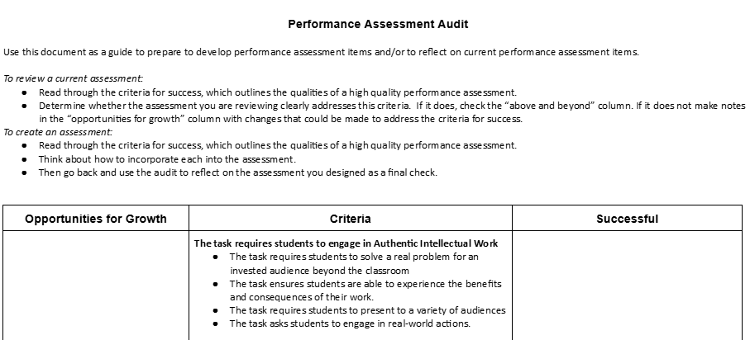
Performance Assessment Audit
Use the Performance Assessment Audit tool to review the Performance Assessment Map you created.
Make any adjustments to your Performance Assessments as needed.
Notes:
Guided Notes
Review your maps using the Performance Based Assessment Audit Tool and revise your Performance Assessment, as needed.

Slide 29
Reflection I Used to Think… Now I Think…
Complete Step Two of “I Used to Think… Now I Think… to capture your shifts in thinking about performance assessments:
On your note catcher, complete the following prompt:
“Now, think about how your ideas about performance assessments have changed because of designing your own assessment.
Again, in just a few sentences, write down what you now think about performance assessments. Start your sentences with, ‘Now, I think…’”
This Photo by Unknown Author is licensed under CC BY-SA-NC
Notes:
Guiding Notes:
On your note catcher where is says slide 29, complete the second part of the I Used to Think … Now I think… thinking strategy.
Resource:
Project Zero (2015). I Used to Think… Now I Think… Harvard Graduate School of Education. https://pz.harvard.edu/sites/default/files/I%20Used%20to%20Think%20-%20Now%20I%20Think_2.pdf

Slide 30
Performance Assessments in Social Studies2
Module Four:
How do I design performance assessments to meet the depth and rigor of the KAS for Social Studies?
Notes:
Thank you for completing Module Four.
The KDE needs your feedback on the effectiveness of this module, the learning platform and how the consultants may best support you as you take the next steps in the implementation process. We are going to complete a short survey to share our thinking and provide them with feedback on how the KDE can best meet our needs. Feedback from our surveys will be used by the KDE to plan and prepare future professional learning.
Post-survey: https://docs.google.com/forms/d/e/1FAIpQLSd5pVVdKiDLKxM4wKq46V2JcO7UTMtFk8ELVR31du6HTO2Szg/viewform

