Slide 1
What do the Kentucky Academic Standards (KAS) for Social Studies look like in practice?
A webinar designed to deepen social studies content knowledge and pedagogy.
Topic Focus: High School Economics

Slide 2
Webinar Goals
Learning Goal
I am learning about how to design instructional experiences aligned to the KAS for Social Studies by engaging in a demonstration about economics.
Success Criteria
I can analyze HS.E.IC.1 to understand what this standard requires students to know and be able to do.
I can improve my content knowledge and pedagogical skills after exploring a grade level sample.

Slide 3
What are Standards?
Standards define what students should know, understand and be able to do at the end of a grade level.
 | Definition
Know | Refers to facts, dates, places, people, definitions, rules or information
Understand | Refers to theories, generalizations or “big ideas”
Do | Refers to skills such as communication, reading, computation, application and transfer to new situations

Slide 4
What Does it Mean to Unpack a Standard?
Breaking a standard into smaller, more explicit chunks for the purposes of curriculum development and/or unit and lesson planning.
For example, analyze the verb in the following standard to determine its meaning in terms of instruction and assessment.
“...understand the development of important community traditions and events.”
What does understand mean in this standard?
Does it mean “make meaning of” or “transfer”?
Does it mean to “accurately state and explain”? Or, does it simply mean to “know”?
What does the verb demand in terms of student learning?

Slide 5
Tool to Unpack Standards
Step 2
Step 4
Step 1
Unpacking the Standard
Standard | What Knowledge/Concepts/ Vocabulary do students need to know to reach this standard? | What skills do students need to be able to do to reach this standard? | What level of proficiency do students need to be at in order to reach this standard?
Step 3

Slide 6
Step 1: List the Standard
Cut and paste the standards, including the inquiry practices, into the furthest left column of the spreadsheet
Unpacking the Standard
Standard | What Knowledge/Concepts/ Vocabulary do students need to know to reach this standard? | What skills do students need to be able to do to reach this standard? | What level of proficiency do students need to be at in order to reach this standard?
HS.E.IC.1 Predict the way scarcity causes individuals, organizations and governments to evaluate tradeoffs, make choices and incur opportunity costs.

Slide 7
Step 2: What Knowledge, Concepts, Vocabulary will they need to Master? (1)
Closely look at each standard and identify the Knowledge/Concepts/Vocabulary
The “what” that students should learn
Unpacking the Standard
Standard | What Knowledge/Concepts/ Vocabulary do students need to know to reach this standard? | What skills do students need to be able to do to reach this standard? | What level of proficiency do students need to be at in order to reach this standard?
HS.E.IC.1 Predict the way scarcity causes individuals, organizations and governments to evaluate tradeoffs, make choices and incur opportunity costs. | Scarcity Individuals Organizations Governments Tradeoffs Choices Opportunity costs

Slide 8
Step 2: What Knowledge, Concepts, Vocabulary will they need to Master? (3)
Teachers can use the disciplinary clarifications to determine the Knowledge/Concepts/Vocabulary.
The disciplinary clarifications for High School Economics begin on page 151 of the KAS for Social Studies.
Concepts and Practices | Standard | Disciplinary Clarifications
E: Incentives, Choices and Decision Making | HS.E.IC.1 Predict the way scarcity causes individuals, organizations and governments to evaluate tradeoffs, make choices and incur opportunity costs. | Individuals, organizations and governments have scarce resources to trade and purchase goods and services. As a result, they make decisions according to their priorities. Individuals might prioritize purchasing food over buying new clothes. The tradeoff they made was eating rather than being fashionable. Being less fashionable was the opportunity cost incurred by purchasing food. Governments also have to prioritize their spending with a limited budget. Every dollar spent on a government priority, such as military or education, has an opportunity cost, as the money could have been spent on something else.

Slide 9
Step 2: What Knowledge, Concepts, Vocabulary will they need to Master? (4)
Unpacking the Standard
Standard | What Knowledge/Concepts/ Vocabulary do students need to know to reach this standard? | What skills do students need to be able to do to reach this standard? | What level of proficiency do students need to be at in order to reach this standard?
HS.E.IC.1 Predict the way scarcity causes individuals, organizations and governments to evaluate tradeoffs, make choices and incur opportunity costs. | Scarcity Individuals Organizations Governments Tradeoffs Choices Opportunity costs Goods and services Priorities Budget

Slide 10
Step 3: What Skills will they need to Master?
Closely look at the standard and identify the skills
Skills include the thinking skills and mental processes that require skillful application of the knowledge to solve problems, make a decision, etc.
Unpacking the Standard
Standard | What Knowledge/Concepts/ Vocabulary do students need to know to reach this standard? | What skills do students need to be able to do to reach this standard? | What level of proficiency do students need to be at in order to reach this standard?
HS.E.IC.1 Predict the way scarcity causes individuals, organizations and governments to evaluate tradeoffs, make choices and incur opportunity costs. | Scarcity Individuals Organizations Governments Tradeoffs Choices Opportunity costs Goods and services Priorities Budget | Predict

Slide 11
Step 4: What Level of Proficiency do Students need to be in order to Reach this Standard?
Look at the standard and identify what level of proficiency students will need to be in order to reach this standard.
One way to determine answers to this question is to look at the Depth of Knowledge.
Unpacking the Standard
Standard | What Knowledge/Concepts/ Vocabulary do students need to know to reach this standard? | What skills do students need to be able to do to reach this standard? | What level of proficiency do students need to be at in order to reach this standard?
HS.E.IC.1 Predict the way scarcity causes individuals, organizations and governments to evaluate tradeoffs, make choices and incur opportunity costs. | Scarcity Individuals Organizations Governments Tradeoffs Choices Opportunity costs Goods and services Priorities Budget | Predict | 2
Notes:
It is important to note that when determining the DOK of a standard, the verb, such as analyze, should not be separated from the rest of the standard as the content and skills outlined in the standard impact the level of rigor students need to engage in order to demonstrate mastery of the standards. For example, in the DOK handout provided, “analyze similarities and differences in issues and problems” is a DOK 3 while “analyzing and synthesizing information from multiple sources” is a DOK 4.

Slide 12
What do the KAS for Social Studies look like in practice?
Topic Focus: High School Economics

Slide 13
Jacob Lawrence’s The Great Migration
Amanda Geiger
Senior Economic Education Specialist
Amanda.Geiger@stls.frb.org

Slide 14
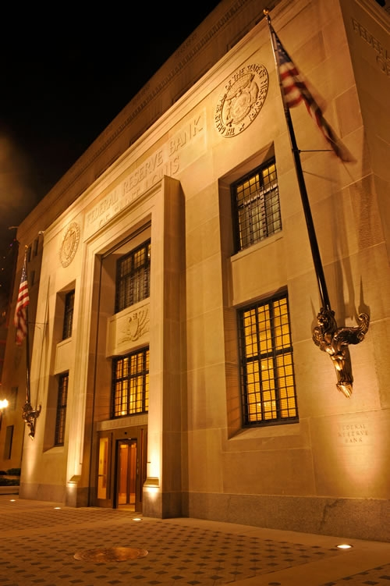
Disclaimer
The views expressed in the presentation are mine and not the views of the Federal Reserve Bank of St. Louis or the Federal Reserve System.

Slide 15
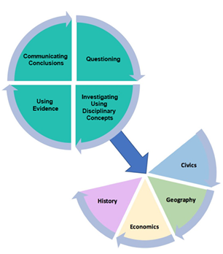
KAS for Social Studies inquiry and history alignment

Slide 16
How do art and economics describe struggles of migrants during the Great Migration?

Slide 17
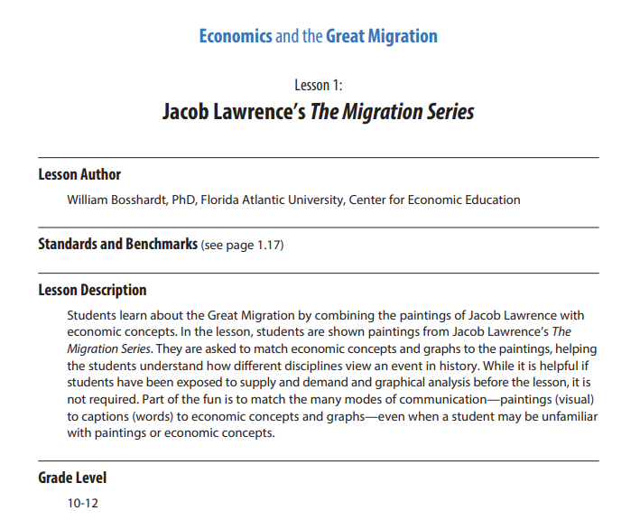
Jacob Lawrence’s The Migration Series
Students learn about the Great Migration by combining the paintings of Jacob Lawrence with economic concepts.
In the lesson, students are asked to match economic concepts and graphs the paintings, helping the students understand how different disciplines view an event in history.

Slide 18
Economics and the Great Migration Lesson 1: Jacob Lawrence’s The Migration Series
Brief Artist Biography and Series Description
SOURCE: Smithgall, Elsa. “One Series, Two Places,” in Dickerman, Leah and Smithgall, Elsa, eds. Jacob Lawrence: The Migration Series. New York: The Museum of Modern Art and Washington, DC: The Phillips Collection, 2017.

Slide 19
Great Migration: Today’s Description
“Historians would come to call it the Great Migration. It would become perhaps the biggest unreported story of the twentieth century. It was vast. It was leaderless. It crept along so many thousands of currents over so long a stretch of time as to be difficult for the press to capture while it was underway.
Over the course of six decades, some six million black southerners left the land of their forefathers and fanned out across the country for an uncertain existence in nearly every other corner of America. The Great Migration would become a turning point in history.”
Wilkerson, Isabel. The Warmth of Other Suns: The Epic Story of America’s Great Migration. New York: Random House, 2010, p. 20.

Slide 20
Causes of the Great Migration: Perception at the Time
“That the lack of labor at the North, due mainly to the ceasing of immigration from Europe, was the occasion of the migration all agree. The causes assigned at the southern end are numerous: General dissatisfaction with conditions, ravages of boll weevil, floods, change of crop system, low wages, poor houses on plantations, poor school facilities, unsatisfactory crop settlements, rough treatment, cruelty of the law officers, unfairness in courts, lynching, desire for travel, labor agents, the Negro press, letters from friends in the North, and finally advice of white friends in the South where crops had failed.”
U.S. Department of Labor, Division of Negro Economics. Dillard, J.H. and Leavell, R.H. Negro Migration in 1916-17: Reports. Washington, DC: Government Printing Office, 1919, pp. 11-12; https://fraser.stlouisfed.org/files/docs/publications/dne/dne_migration1916-1917.pdf.

Slide 21
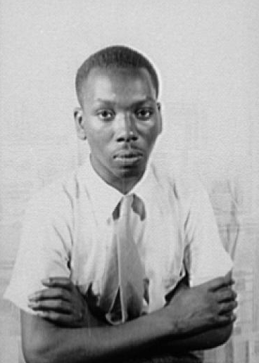
Jacob Lawrence (early life)
Born September 7, 1917, in Atlantic City, New Jersey
Jacob’s parents had come to the North in the Great Migration.
His parents divorced in 1924, and Jacob lived in settlement houses and foster homes in Philadelphia.
He rejoined his mother in New York in 1930.
He dropped out of school at age 16.
Notes:
Library of Congress, Prints & Photographs Division, Carl Van Vechten Collection, [reproduction number, e.g., LC-USZ62-54231 http://loc.gov/pictures/resource/van.5a52278/

Slide 22
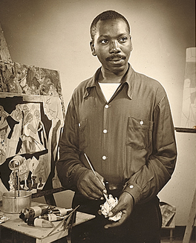
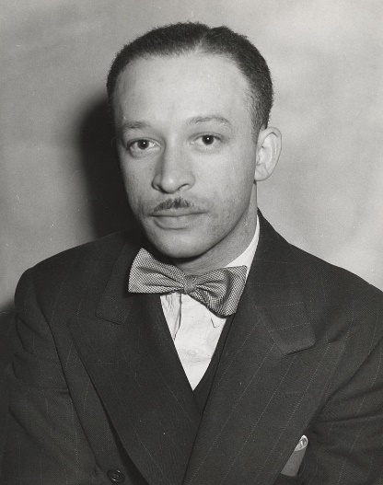
Jacob Lawrence
He worked with Black American artist Charles Alston (right), who was active in the Harlem Renaissance.
Jacob studied at the Harlem Art Workshop in 1932.
He continued his work at the “306 Group” in 1934.
Notes:
Sid Bernstein. Jacob Lawrence, 195-?. Jacob Lawrence and Gwendolyn Knight papers, 1816. Archives of American Art, Smithsonian Institution https://www.aaa.si.edu/collections/items/detail/jacob-lawrence-9132
Andrew Herman. Charles Alston, 1939. Federal Art Project, Photographic Division collection, circa 1920-1965. Archives of American Art, Smithsonian Institution. https://www.aaa.si.edu/collections/items/detail/charles-alston-2465

Slide 23
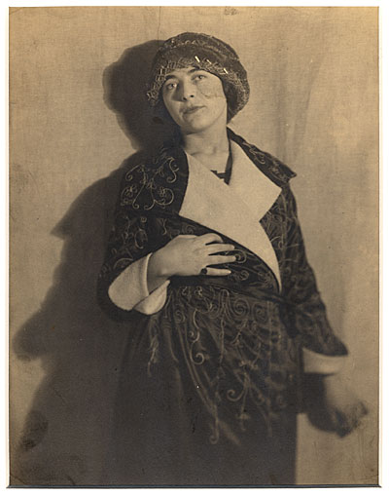
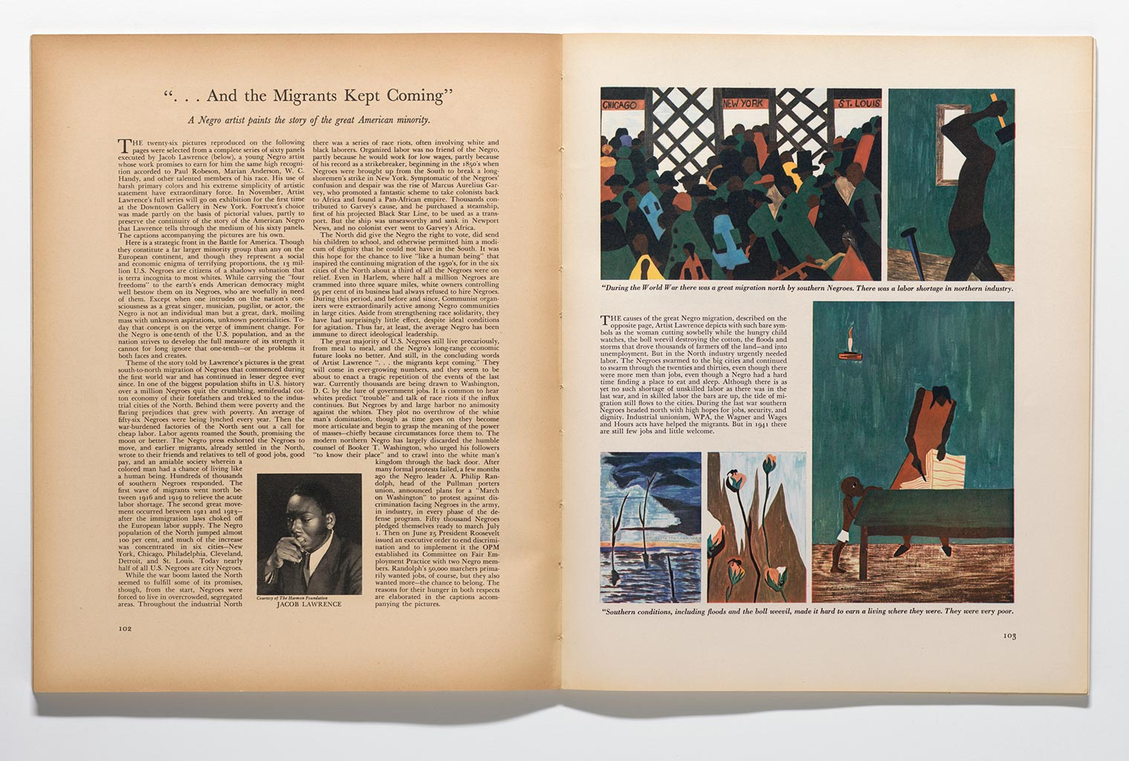
The Migration Series
Influential art dealer Edith Halpert includes The Migration Series in an exhibition.
Twenty-six panels were featured in Fortune Magazine in November 1941.
Jacob Lawrence wanted the panels to remain together.
The Museum of Modern Art (MoMA) and The Phillips Collection acquired the series. They split the even panels (MoMA) and odd panels (Phillips). (They had considered splitting them by panels 1-30 and 31-60.)
Notes:
Man Ray. Edith Halpert, circa 1930. Downtown Gallery records, 1824-1974. Archives of American Art, Smithsonian Institution https://www.aaa.si.edu/collections/items/detail/edith-halpert-3975
Spread from the November 1941 issue of Fortune, featuring twenty-six panels from Lawrence’s Migration Series, with portrait of Lawrence by Kenneth F. Space. © 2015 Jacob and Gwendolyn Knight Lawrence Foundation, Seattle/Artists Rights Society (ARS), New York https://www.moma.org/interactives/exhibitions/2015/onewayticket/jacob-lawrence/15/

Slide 24
Let’s View The Migration Series
Instructions: You will view a set of paintings (panels) and work through the following using Handout 1-1:
First, examine each painting and decide which caption from List I describes each painting. Jacob Lawrence wrote the captions in 1993 for his Migration Series, as the language of the original captions was outdated.
Second, choose an economic description from List II that might match each painting and caption.
Third, if doing the graphical part of the lesson (Handout 1-1a), choose an economic graphical (or diagram) model from List III that might match each painting and caption.

Slide 25
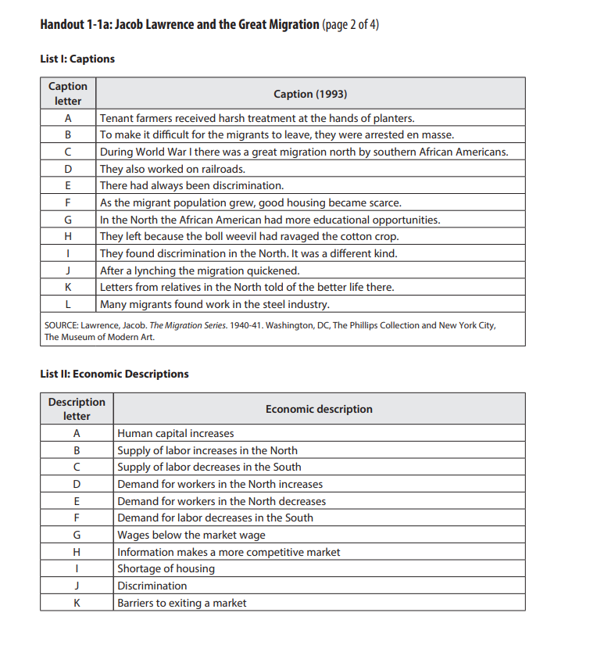
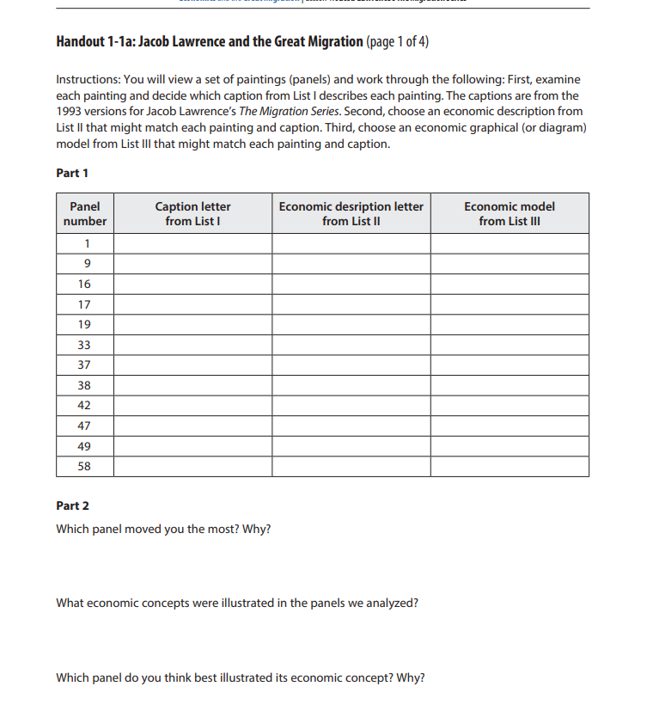
Worksheets

Slide 26
© 2021 The Jacob and Gwendolyn Knight Lawrence Foundation, Seattle/ Artists Rights Society (ARS), New York
Notes:
Jacob Lawrence, “The Migration Series (Panel 1),” © 2021 The Jacob and Gwendolyn Knight Lawrence Foundation, Seattle/ Artists Rights Society (ARS), New York

Slide 27
© 2021 The Jacob and Gwendolyn Knight Lawrence Foundation, Seattle/ Artists Rights Society (ARS), New York 1
Notes:
Jacob Lawrence, “The Migration Series (Panel 1),” © 2021 The Jacob and Gwendolyn Knight Lawrence Foundation, Seattle/ Artists Rights Society (ARS), New York

Slide 28
© 2021 The Jacob and Gwendolyn Knight Lawrence Foundation, Seattle/ Artists Rights Society (ARS), New York
Notes:
Jacob Lawrence, “The Migration Series (Panel 58),” © 2021 The Jacob and Gwendolyn Knight Lawrence Foundation, Seattle/ Artists Rights Society (ARS), New York

Slide 29
© 2021 The Jacob and Gwendolyn Knight Lawrence Foundation, Seattle/ Artists Rights Society (ARS), New York 3
Notes:
Jacob Lawrence, “The Migration Series (Panel 58),” © 2021 The Jacob and Gwendolyn Knight Lawrence Foundation, Seattle/ Artists Rights Society (ARS), New York

Slide 30
© 2021 The Jacob and Gwendolyn Knight Lawrence Foundation, Seattle/ Artists Rights Society (ARS), New York 3
Notes:
Jacob Lawrence, “The Migration Series (Panel 9),” © 2021 The Jacob and Gwendolyn Knight Lawrence Foundation, Seattle/ Artists Rights Society (ARS), New York

Slide 31
© 2021 The Jacob and Gwendolyn Knight Lawrence Foundation, Seattle/ Artists Rights Society (ARS), New York 34
Notes:
Jacob Lawrence, “The Migration Series (Panel 9),” © 2021 The Jacob and Gwendolyn Knight Lawrence Foundation, Seattle/ Artists Rights Society (ARS), New York

Slide 32
© 2021 The Jacob and Gwendolyn Knight Lawrence Foundation, Seattle/ Artists Rights Society (ARS), New York 35
Notes:
Jacob Lawrence, “The Migration Series (Panel 49),” © 2021 The Jacob and Gwendolyn Knight Lawrence Foundation, Seattle/ Artists Rights Society (ARS), New York

Slide 33
© 2021 The Jacob and Gwendolyn Knight Lawrence Foundation, Seattle/ Artists Rights Society (ARS), New York 36
Notes:
Jacob Lawrence, “The Migration Series (Panel 58),” © 2021 The Jacob and Gwendolyn Knight Lawrence Foundation, Seattle/ Artists Rights Society (ARS), New York

Slide 34
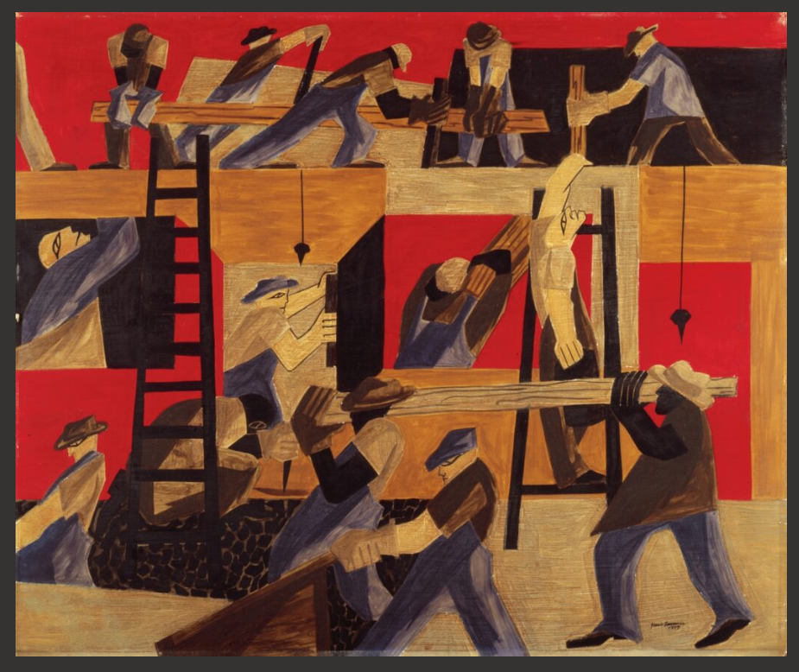
Assessment
What were some of the underlying economic reasons for the Great Migration?
What economic concepts might this painting illustrate? Explain.
https://www.whitehousehistory.org/photos/thebuilders-by-jacob-lawrence

Slide 35
How do art and economics describe struggles of migrants during the Great Migration? (2)

Slide 36
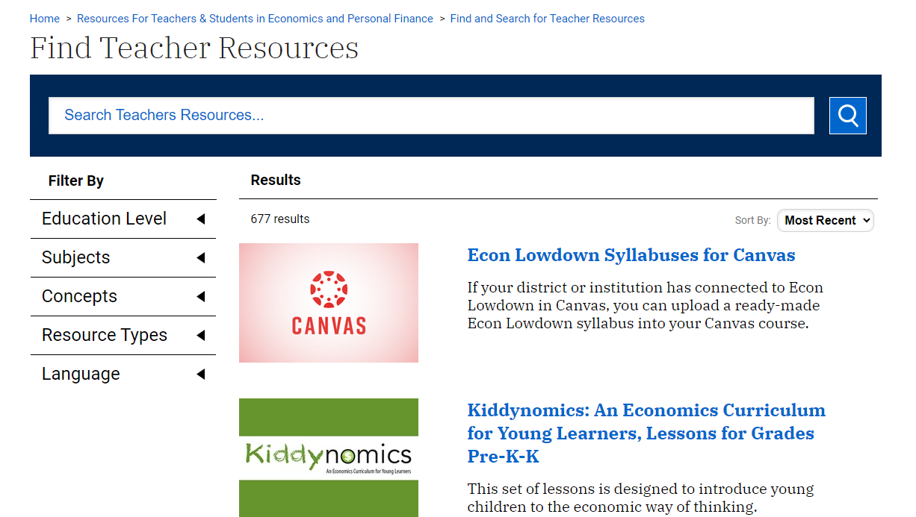
Where can you find more?
Stlouisfed.org/education

Slide 37
Sign up for our newsletter!
Thank you!
Amanda Geiger
Senior Economic Education Specialist
Federal Reserve Bank of St. Louis
Amanda.geiger@stls.frb.org
Notes:
Good morning and-Welcome! Thank you for joining me today. Please type in the chat your name and what grade level and subjects you teach to your students.

