Slide 1
No Bake Playdough Introduction
Kentucky Family Math Night Game
No-Bake Playdough
Recommended for Grades 3-5
This game will help your student build up the right amount of ingredients for a playdough recipe by using smaller measuring tools and generating equivalent fractions.
Kentucky Academic Standards for Mathematics Connections:
Third Grade Measurement and Data
KY.3.MD.2 Measure and solve problems involving mass and liquid volume. a. Measure and estimate masses and liquid volumes of objects using standard units of grams (g), kilograms (kg) and liters (L). b. Add, subtract, multiply, or divide to solve one-step word problems involving masses or volumes that are given in the same units.
Fourth Grade Measurement and Data
KY.4.MD.2 Use the four operations to solve word problems involving distances, intervals of time, liquid volumes, masses of objects and money.
a. Solve measurement problems involving whole number, simple fractions or decimals.
b. Solve problems that require converting a given measurement from a larger unit to a smaller unit within a common measurement system, such as 2 km = 2,000 m.
c. Visually display measurement quantities using representations such as number lines that feature measurement scale.
Standards for Mathematical Practice
MP.1 Make sense of problems and persevere in solving them.
MP.5 Use appropriate tools strategically. MP.6 Attend to precision.
MP.8 Look for and express regularity in repeated reasoning
Fifth Grade Measurement and Data
KY.5.MD.1 Convert among different size measurement units (mass, weight, liquid volume, length, time) within one system of units (metric system, U.S. standard system and time).

Slide 2
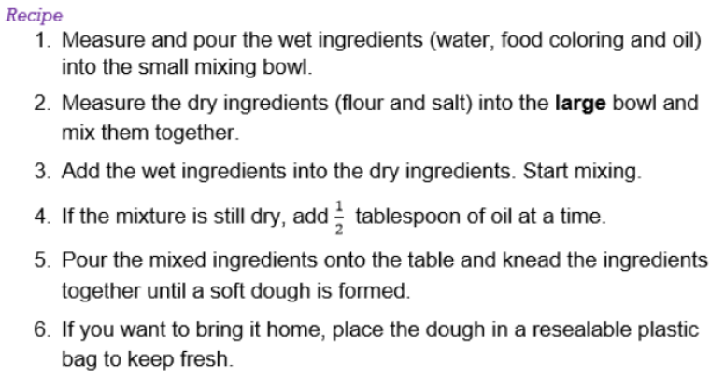
No-Bake Playdough - Instructions
No-Bake Playdough – Instructions
Players: Two or more players
Goal: Use the correct ingredients for their playdough recipes, by using smaller measuring tools
(i.e., they will need to use ¼ cups to build up 1 cup of flour).

Slide 3
No-Bake Playdough – Family Prompts
No-Bake Playdough – Family Prompts
Ask any of the following questions as you play the game.

Slide 4
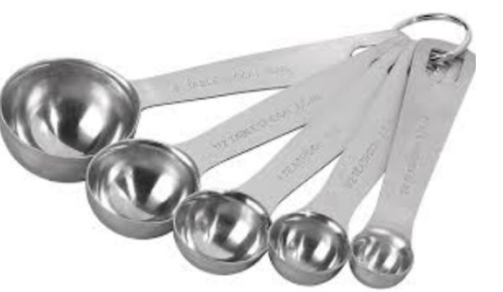
No-Bake Playdough – Measuring Spoons
No-Bake Playdough – Measuring Spoons
Family Prompts
As you read the instructions and make the recipe together:
Examine the tools you have.
Notice that you don’t have tools that are the exact size of the recipe.
Order the measuring tools by size (smallest to largest or the other way around).
Discuss how you can make 1 cup of flour with the tools you have.
Discuss the difference between 1 cup and 1 tablespoon. Which is bigger? How do you know?

Slide 5
No-Bake Playdough – Measuring
No-Bake Playdough – Measuring
Family Prompts
Let your children do the scooping and measuring. Show them how to level off their measurements for accuracy.
What other things could we do together that would let you practice things like this?
What would happen if we didn’t use the correct measurements?
What if you could only use ___?

Slide 6
No-Bake Playdough – Closing Slide
Kentucky Family Math Night Games
No-Bake Playdough
Thank you for playing!
Access more digital family math games at: https://www.education.ky.gov/curriculum/conpro/Pages/summer_support_math_resources.aspx

