Slide 1
Introduction to the Modeling Cycle
Section 1

Slide 2
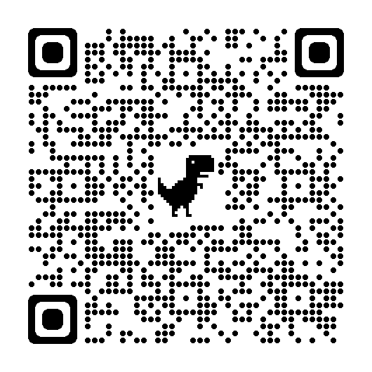
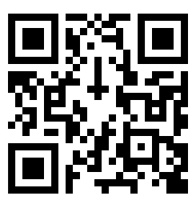
Session Launch:
Access the video launch.
Once everyone is ready, share your initial thinking with your table.
We will refine our thinking around these tasks together later in the session.
K-8 Educators:
High School Educators:
Notes:
Facilitator Notes:
As an launch to our learning, participants will view a short video determined by grade band and tailored to the sample modeling task participants will be engaging in later during the session:
Primary, Intermediate and Middle will watch the video found at: https://www.cbsnews.com/video/students-raise-funds-to-make-playground-inclusive-for-those-with-disabilities/
High School will watch the video found at: https://youtu.be/2ij6SKDCQaA.
Encourage participants to consider their reaction to the video and what the reaction of their students might be to the video. Remind participants we will be revisiting these prompts later in the session; however, at that time we will be looking from a teacher’s perspective.
Materials needed:
Handout 1 Page 1 https://education.ky.gov/curriculum/standards/kyacadstand/Documents/Introduction_to_Modeling_Handout_1.pdf

Slide 3
“In the course of a student’s mathematics education, the word “model” is used in a variety of ways. Modeling with Mathematics might include utilizing manipulatives, demonstration, role modeling and conceptual models of mathematics, all valuable tools for teaching and learning; however, these examples are different from participating in The Modeling Cycle.”
GUIDELINES FOR ASSESSMENT & INSTRUCTION IN
MATHEMATICAL MODELING EDUCATION
(GAIMME, 2016)
Notes:
Facilitator Notes:
This amplifies a critical distinction between modeling with mathematics and participating in The Modeling Cycle.
Throughout the session there will be opportunities to support making this distinction.
Opportunity for Extended Exploration:
One strategic educator practice shown to improve the quality of day-to-day classroom instruction and significantly impact overall student achievement is explicit teaching and modeling, but that is different from students engaging in The Modeling Cycle. While this experience will focus on The Modeling Cycle, participants might also benefit from exploring Explicit Teaching and Modeling and the KAS for Mathematics. Using explicit teaching and modeling strategies to create these learning experiences contributes to supporting and sustaining a culture of equity and access across Kentucky.
Source: GAIMME: Guidelines for Assessment and Instruction in Mathematical Modeling Education, Sol Garfunkel and Michelle Montgomery, editors, COMAP and SIAM, Philadelphia, 2016. View the entire report, available freely online, at https://siam.org/Publications/Reports/Detail/Guidelines-for-Assessment-and-Instruction-in-Mathematical-Modeling-Education.

Slide 4
During our session together, we will:
Use the Kentucky Academic Standards (KAS) for Mathematics and the GAIMME Report to:
Explore the components of the modeling cycle.
Engage in a modeling task through the lens of a student and a teacher.
Look for opportunities to incorporate components of the modeling cycle within available instructional resources.
Notes:
Facilitator Notes:
As a foundational resource for the Kentucky Academic Standards (KAS) for Mathematics, the Guidelines for Assessment and Instruction in Mathematical Modeling Education (GAIMME) helped inform The Modeling Process. Throughout this professional learning we will draw upon the standards and the GAIMME report as we:
Explore the components of the modeling cycle.
Engage in a modeling task through the lens of a student and a teacher.
Look for opportunities to incorporate components of the modeling cycle within available instructional resources.
Materials Needed:
Handout 1 Page 1 https://education.ky.gov/curriculum/standards/kyacadstand/Documents/Introduction_to_Modeling_Handout_1.pdf
Source: GAIMME: Guidelines for Assessment and Instruction in Mathematical Modeling Education, Second Edition, Sol Garfunkel and Michelle Montgomery, editors, COMAP and SIAM, Philadelphia, 2019. https://education.ky.gov/curriculum/standards/kyacadstand/Documents/Kentucky_Academic_Standards_Mathematics.pdf#page=8

Slide 5
The Modeling Cycle in the KAS for Mathematics
Exploring the components of the modeling cycle
Notes:
Facilitator Notes:
This is The Modeling Cycle as defined on pages 8-9 in the KAS for Mathematics. Mathematical modeling often is pictured as a cycle, with a need to come back frequently to the beginning and make new assumptions to get closer to a usable result. Mathematical modeling is an iterative problem-solving process and therefore is not referenced by individual steps in a specific order. The representation on the slide reflects that a modeler often bounces back and forth through the various stages. Throughout the session participants will get to know the modeling process through an exploration of each component; however, participants should keep in mind the interconnectedness of each component within the process.

Slide 6
Capturing Initial Thinking
Through a STUDENT lens:
What might it look like and sound like when students are engaging in vibrant learning experiences in mathematics?
Through a TEACHER lens:
What might you consider when you are planning vibrant learning experiences in mathematics?
Notes:
Facilitator Notes:
The United We Learn vision builds around three big ideas: creating a more vibrant experience for every student, encouraging innovation in our schools – especially when it comes to assessment, and creating a bold new future for Kentucky’s schools through collaboration with our communities. ​​​Let’s take a moment to think about vibrant student learning experiences in mathematics.
THINK - PAIR - SHARE (5 Minutes)
THINK: Give participants 1-2 minutes of independent think time to brainstorm ideas
PAIR: Then invite participants to work as a table to chart some of their ideas (sticky notes, chart paper, etc.). (About 3 minutes)
SHARE: Invite each table to share a key theme from their conversation.
Materials needed:
Handout 1 Page 1 https://education.ky.gov/curriculum/standards/kyacadstand/Documents/Introduction_to_Modeling_Handout_1.pdf
Chart Paper
Markers

Slide 7
“Learning that matters to students, in partnership with families and communities, students are agents of their own learning, engaged in relevant, authentic and joyful learning opportunities. Vibrant learning honors students’ cultural wealth, gifts and interests. Vibrant learning culminates in the application of knowledge and skills demonstrated through personalized products.”
~Kentucky United We Learn Council
Notes:
Facilitator Notes:
While educators can brainstorm around the guiding questions without exploring the United We Learn initiative more deeply, participants who might like additional context can visit https://education.ky.gov/UnitedWeLearn/Pages/default.aspx.
Take this opportunity to draw connections between what the participants shared and vibrant learning experiences as identified by the Kentucky United We Learn Council.
Opportunity for Extended Exploration:
In considering the impact engaging in the modeling process can have on student learning, it becomes clear that Establishing a Learning Environment that embraces intellectual risk-taking and encourages mistakes as a part of the learning process is critical. Participants might benefit from exploring Establishing the Learning Environment and the Kentucky Academic Standards for Mathematics.

Slide 8
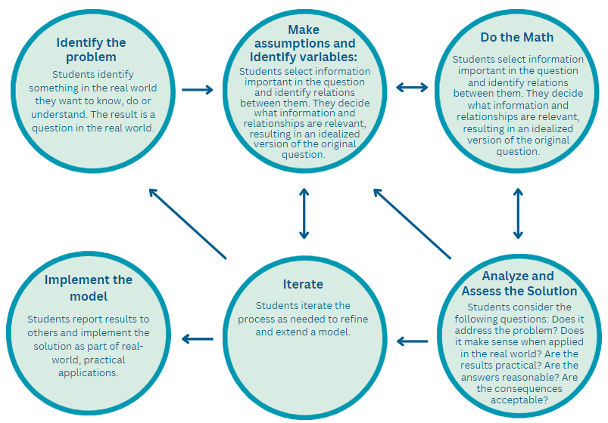
The Modeling Cycle
Notes:
Facilitator Notes:
Read about the components of the modeling cycle on page 2 of your brochure and identify ways in which the modeling process connects to your ideas about vibrant learning experiences in mathematics. During the grade banded task exploration later in the session, each component of the process will be considered more in depth. At this time we are making high level connections to our earlier brainstorm.
Materials needed:
Handout 1 Page 2 https://education.ky.gov/curriculum/standards/kyacadstand/Documents/Introduction_to_Modeling_Handout_1.pdf

Slide 9
What connections do you notice between The Modeling Cycle and vibrant student learning experiences?
Notes:
Facilitator Notes:
Invite participants to share out the connections between the modeling cycle and vibrant student learning experiences based upon an initial review of the components of The Modeling Cycle. These connections can be revisited throughout the session.

Slide 10
Connecting with the
KAS for Mathematics
Notes:
Facilitator Notes:
While modeling standards are only identified at the high school level, students at every grade level deserve opportunities to engage in the Modeling Cycle. In this section we will talk about how modeling is related to the KAS for Mathematics at every grade level by considering the connections to conceptual understanding, procedural skill/fluency and application.

Slide 11
The Modeling Cycle and the KAS for Mathematics
The standards emphasize procedural skill and fluency, building from conceptual understanding to application and modeling with mathematics, in order to solve real world problems.
Conceptual Procedural skill/ Application
understanding fluency
Notes:
Facilitator Notes:
The KAS for Mathematics reflect a balance of the three targets, with every grade level containing some conceptual understanding standards, some procedural skill/fluency standards and some application standards. Within the KAS for Mathematics, the standards emphasize procedural skill and fluency building from conceptual understanding to application and modeling with mathematics, in order to solve real world problems.
Let’s explore the ways in which these three targets support students in engaging with modeling.

Slide 12
Target of the Standard: Conceptual Understanding
The Standards for Mathematical Content are a balanced combination of conceptual understanding, procedural skill/fluency and application.
Conceptual understanding refers to understanding mathematical concepts, operations and relations. Conceptual understanding is more than knowing isolated facts and methods; students should be able to make sense of why a mathematical idea is important and the kinds of contexts in which it is useful. Conceptual understanding allows students to connect prior knowledge to new ideas and concepts.
Notes:
Facilitator Notes:
As we take a look at each of the three types of targets, we will follow a similar structure in our review. First let’s look at conceptual understanding. Take a moment to read and consider, “How does ‘conceptual understanding’ support students engaging in the modeling process? What might be some connections to conceptual understanding you saw within the task you explored earlier in the session?” After you’ve had a moment to read and think, we will share whole group.”
Listen fors might include:
Make sense of “why” mathematical ideas are important - this keeps us from focusing too heavily on “what” is the right answer, instead supporting thinking around “why” is this the right answer and “how” do you know
Connect prior knowledge to new ideas and concepts - this keeps us from approaching mathematics in silos, building those connections among the ideas in mathematics allows us to support student thinking in a holistic way

Slide 13
Target of the Standard: Procedural Skill/Fluency
The Standards for Mathematical Content are a balanced combination of conceptual understanding, procedural skill/fluency and application.
Procedural skill/fluency is the ability to apply procedures accurately, efficiently, flexibly and appropriately. It requires speed and accuracy in calculation while giving students opportunities to practice basic skills. Students’ ability to solve more complex application and modeling tasks is dependent on procedural skill and fluency.
Notes:
Facilitator Notes:
Next, let’s take a look at procedural skill/fluency. Take a moment to read and consider, “How does ‘procedural skill/fluency’ support students engaging in the modeling process? What might be some connections to procedural skill and fluency you saw within the task you explored earlier in the session?” After you’ve had a moment to read and think, we will share whole group.
Listen fors might include:
Accuracy, efficiency, flexibly and appropriately - too often “fluency” is only viewed through the lens of accuracy and efficiency - you got it right and you got it right fast. (See page 8 of the KAS for Mathematics for descriptions of each element.)
Procedural skill/fluency supports further complex exploration of mathematics

Slide 14
Target of the Standard: Application
The Standards for Mathematical Content are a balanced combination of conceptual understanding, procedural skill/fluency and application.
Application provides a valuable context for learning and the opportunity to solve problems in a relevant and a meaningful way. It is through real-world application that students learn to select an efficient method to find a solution, determine whether the solution(s) makes sense by reasoning and develop critical thinking skills.
Notes:
Facilitator Notes:
Last, let’s look at application. After you’ve had a moment to read, consider, “How does “application” support students engaging in the modeling process? What might be some connections to application you saw within the task you explored earlier in the session?” After you’ve had a moment to read and think, we will share whole group.
Listen fors might include:
Valuable context/relevant/meaningful - what is authentically relevant to one student may not be for another across the state/district/sometimes within the same classroom, but this is really about providing opportunities for personal meaning to be developed through exploring mathematics in the world around them.
Selecting an efficient method - connection to procedural skill/fluency
Reasoning and critical thinking - students engage in the content (engagement was also one of the commitments we discussed at the beginning of the session)

Slide 15
Modeling Standards
Specific modeling standards appear throughout the high school standards indicated by a star symbol (★).
The star symbol sometimes appears on the heading for a group of standards; in that case, it should be understood to apply to all standards in that group.
Notes:
Facilitator Notes:
The Modeling Cycle is essential in providing opportunities for students to reason and problem solve. In the course of a student’s mathematics education, the word “model” is used in a variety of ways. Several of these, such as manipulatives, demonstration, role modeling and conceptual models of mathematics, are valuable tools for teaching and learning; however, these examples are different from the practice of mathematical modeling. Mathematical modeling, both in the workplace and in school, uses mathematics to answer questions using real-world context. Within the standards document, the mathematical modeling process could also be used with standards that include the phrase “solve real-world problems.

Slide 16
Task Exploration
Engaging in a modeling task through the lens of a student and a teacher
Notes:
Facilitator Notes:
Set up stations around the meeting space allowing for participants to have conversations within common grade-banded groups. Each group needs access to the printed slides for the grade band along with one piece of chart paper to capture thinking from the group around the guiding questions from the slide. Participants will move throughout the task in a way similar to a gallery walk, exploring the task through each component of the modeling cycle and capturing thinking around the guiding questions on their chart paper.
Materials (for participants):
Handout 1 Page 2 https://education.ky.gov/curriculum/standards/kyacadstand/Documents/Introduction_to_Modeling_Handout_1.pdf
Materials At Each Station:
Printed copies of the slides for available for the grade band to hang on the wall.
Chart Paper
Markers

Slide 17
Grade Band Exploration
As you explore, consider:
How might each component of the modeling cycle provide students with opportunities to engage in the Standards for Mathematical Practice?
How might each component of the modeling cycle equip teachers to implement the Effective Mathematics Teaching Practices?
Notes:
Facilitator Notes:
Building a useful mathematical model does not necessarily require advanced mathematics, but it does require a willingness to do some research, brainstorm, and jump right in and try something that may be out of your comfort zone. To envision what this might look like, sound like, feel like in a math classroom we will explore a sample modeling experience.
You’ll capture your thinking on chart paper about:
How might this component of the modeling cycle provide students with opportunities to engage in the Standards for Mathematical Practice?
How might this component of the modeling cycle equip teachers to implement the Effective Mathematics Teaching Practices?
It is important to note that the sample tasks explored in this section come from the GAIMME report, which is cited within the KAS for Mathematics. As you explore these tasks, keep in mind that educators in schools/districts with adopted High-Quality Instructional Resources (HQIRs) should look to that HQIR as a starting point for support engaging students in the Modeling Cycle as the HQIR likely provides guidance around facilitating the learning experience. These facilitation supports will be explored more in depth in Section 2 of the module.
Source: https://m3challenge.siam.org/wp-content/uploads/siam-guidebook-final-press.pdf (page 3)

Slide 18
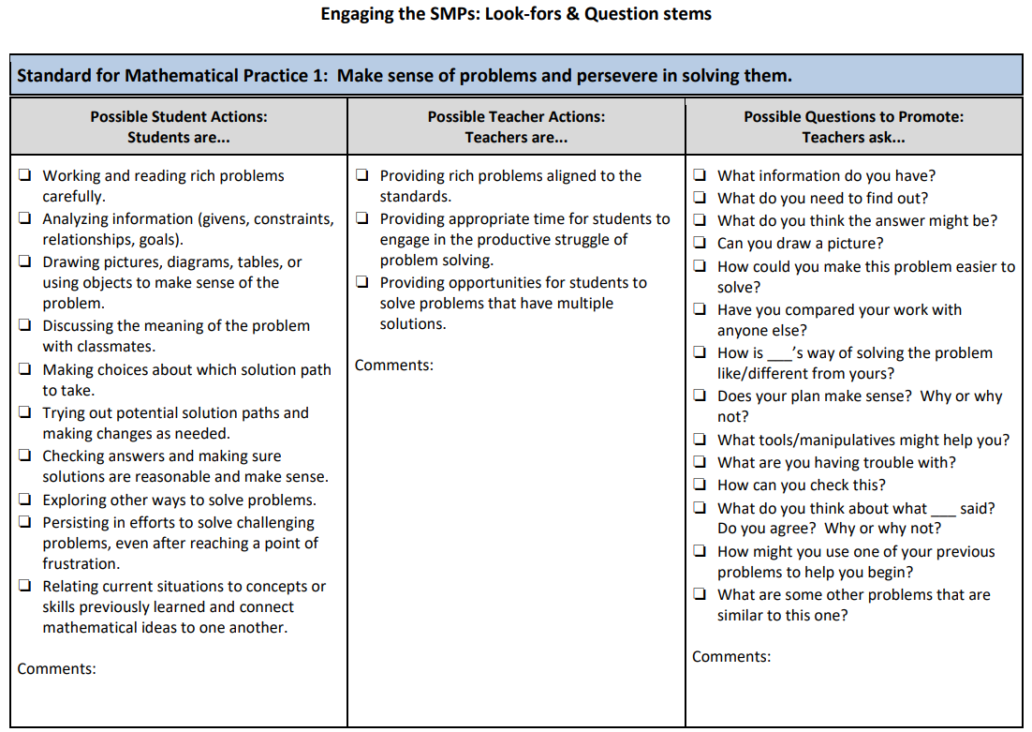
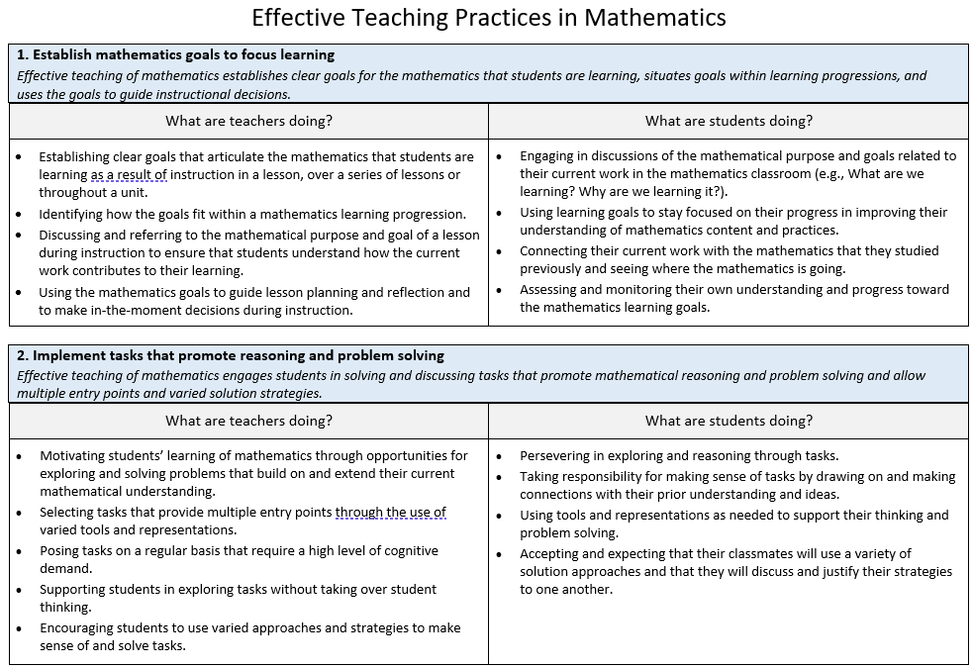
Modeling to Support Teaching and Learning
Standards for Mathematical Practice (SMPs)
Effective Mathematics Teaching Practices (EMTPs)
Notes:
Facilitator Notes:
Educators across the state have varying levels of familiarity with the Standards for Mathematical Practice (from the KAS for Mathematics) and the Effective Mathematics Teaching Practices (from the National Council of Teachers of Mathematics (NCTM)).
As such, it will be important to consider the needs of the audience when planning how much time might need to be devoted to exploring these resources prior to looking at the grade-band task. Options you might consider based upon the needs of your participants:
Allocating time to exploring the resources during the session
Sharing these resources prior to the session to allow participants to familiarize themselves prior to the session
Splitting groups up so that half will look at the modeling task through the lens of student practices and half will look through the lens of teacher practices
Materials needed:
Engaging the SMPs: Look fors and Question Stems
Effective Mathematics Teaching Practices (NCTM)

Slide 19
Primary Sample Task
Notes:
Facilitator Notes:
It is critical to note that these example problems are NOT intended to be used as a template for all modeling problems. Real-world problems do not all come packaged the same way, so the best thing to do is to focus on the process, and not on the specific content presented here. In the following section of the module, we will look at sample modeling tasks within high-quality instructional resources.
As a reminder, the focus of our discussion here is on developing familiarity with the components of the modeling cycle and answering the questions:
How might this component of the modeling cycle provide students with opportunities to engage in the Standards for Mathematical Practice?
How might this component of the modeling cycle equip teachers to implement the Effective Mathematics Teaching Practices?
In the following section of the module, we will look at sample modeling tasks within high-quality instructional resources.
Source: GAIMME: Guidelines for Assessment and Instruction in Mathematical Modeling Education, Second Edition, Sol Garfunkel and Michelle Montgomery, editors, COMAP and SIAM, Philadelphia, 2019. http://www.siam.org/Portals/0/Publications/Reports/gaimme-full_color_for_online_viewing.pdf?ver=2018-03-19-115454-057#page=139

Slide 20
Sample Launch:
Students will watch the clip about a class raising funds to make a playground inclusive for those with disabilities.
Glen Lake Elementary School in Hopkins, Minnesota, has a lot of students with physical disabilities, but it didn't have a playground that was accessible to them. That bothered a fifth-grade class, which stepped in to raise $300,000 to make it accessible.
Notes:
Facilitator Notes:
The slide references the launch from earlier within the session.
Video Launch:
Primary, Intermediate and Middle will watch the video found at: https://www.cbsnews.com/video/students-raise-funds-to-make-playground-inclusive-for-those-with-disabilities/

Slide 21
Identifying the Problem Statement
Modeling problems are often open-ended, which makes defining a clear and concise problem statement especially important.
Using subjective words can support open-endedness (best, efficient, optimal).
Brainstorming should be approached as if you had access to any data you need, knowing you can refine ideas later.
Notes:
Facilitator Notes:
Participants will think about:
How might this component of the modeling cycle provide students with opportunities to engage in the Standards for Mathematical Practice?
How might this component of the modeling cycle equip teachers to implement the Effective Mathematics Teaching Practices?
Adapted from: https://m3challenge.siam.org/wp-content/uploads/siam-guidebook-final-press.pdf

Slide 22
In this sample…
Once students have watched the video, have them consider:
What do they notice?
What do they wonder?
Ultimately, the hope is for students to explore the prompt:
You have been put in charge of designing a playground and need to make a presentation to the class about your design.
Notes:
Facilitator Notes:
From the National Council of Teachers of Mathematics (NCTM), What is Notice and Wonder?
When students become active doers of mathematics, the greatest gains of their mathematical thinking can be realized. The process of sense making begins when we create classrooms full of curious students' thoughts and ideas.
By asking "What do you notice? What do you wonder?" we help our students see problems in big-picture ways.
Self-confidence, reflective skills, and engagement soar, and students discover that the goal is not to be "over and done," but to discover multiple strategies for tackling a problem.
Source: https://www.nctm.org/noticeandwonder/
Participants should consider:
How might this component of the modeling cycle provide students with opportunities to engage in the Standards for Mathematical Practice?
How might this component of the modeling cycle equip teachers to implement the Effective Mathematics Teaching Practices?

Slide 23
Making Assumptions and Identifying Variables
Assumptions often arise from the process of brainstorming and defining the problem statement.
Different assumptions can lead to different, equally valid models.
Keep track of:
assumptions made to include in the discussion of the model.
units because they can reveal relationships between variables.
Notes:
Facilitator Notes:
Participants will think about what it might look like for students to make assumptions and identify variables in general. Then consider what it might look like to have students form the problem statement within this task.
Adapted from: https://m3challenge.siam.org/wp-content/uploads/siam-guidebook-final-press.pdf

Slide 24
In this sample…
You should create a display that communicates data/information about your choices; (Data Analysis and Probability)
You should estimate what you think the cost of the equipment might be; Weigh the options of adding different equipment or taking some pieces away; (Number and Operation)
You should estimate how much space you might
need for your playground; (Geometry)
Notes:
Facilitator Notes:
Teachers might begin by giving the students a list of possible options and have them analyze and discuss them. While it might feel like this limits their ability to be creative, it gives students suggestions for possible solution paths and helps them become comfortable with increasingly open-ended problems, opening the door to more creative modeling later. Don’t be afraid to scaffold the early work in this manner, but don’t continue the scaffolding forever. Scaffolding is an aid to modeling, particularly at the beginning, but the true modeling comes only after the scaffolding is removed. When looking at modeling tasks from your instructional resource, look for embedded supports with scaffolding in the teacher materials.
Participants should consider:
How might this component of the modeling cycle provide students with opportunities to engage in the Standards for Mathematical Practice?
How might this component of the modeling cycle equip teachers to implement the Effective Mathematics Teaching Practices?

Slide 25
In this sample…
You should choose appropriate shapes or a few
shapes that you put together to represent the space that might be taken up by your equipment; (Geometry)
You should lay out the playground on a grid using the input from your classmates making sure to say how you chose where to place the equipment; (Geometry)
You should determine the number of each type of shape used and sort them according to similar attributes…number of sides, symmetries, etc.; (Number and Operation, Data Analysis and Probability)
Notes:
Facilitator Notes:
Teachers might begin by giving the students a list of possible options and have them analyze and discuss them. While it might feel like this limits their ability to be creative, it gives students suggestions for possible solution paths and helps them become comfortable with increasingly open-ended problems, opening the door to more creative modeling later. Don’t be afraid to scaffold the early work in this manner, but don’t continue the scaffolding forever. Scaffolding is an aid to modeling, particularly at the beginning, but the true modeling comes only after the scaffolding is removed. When looking at modeling tasks from your instructional resource, look for embedded supports with scaffolding in the teacher materials.
Participants should consider:
How might this component of the modeling cycle provide students with opportunities to engage in the Standards for Mathematical Practice?
How might this component of the modeling cycle equip teachers to implement the Effective Mathematics Teaching Practices?

Slide 26
In this sample…
You should write a brief description that describes
how your equipment was placed; This description
should include appropriate measurements; (Geometry, Measurement, Data Analysis and Probability)
If you could only choose one new piece of equipment, how will you decide which piece of equipment to use; (Data Analysis and Probability)
What assumptions and/or variables might students need to identify when thinking about this task?
Notes:
Facilitator Notes:
Teachers might begin by giving the students a list of possible options and have them analyze and discuss them. While it might feel like this limits their ability to be creative, it gives students suggestions for possible solution paths and helps them become comfortable with increasingly open-ended problems, opening the door to more creative modeling later. Don’t be afraid to scaffold the early work in this manner, but don’t continue the scaffolding forever. Scaffolding is an aid to modeling, particularly at the beginning, but the true modeling comes only after the scaffolding is removed. When looking at modeling tasks from your instructional resource, look for embedded supports with scaffolding in the teacher materials.
Participants should consider:
How might this component of the modeling cycle provide students with opportunities to engage in the Standards for Mathematical Practice?
How might this component of the modeling cycle equip teachers to implement the Effective Mathematics Teaching Practices?

Slide 27
Doing the Math
Sample Questions:
Have I seen this type of problem before?
If so, how did I solve it?
If not, how is this problem different?
Would a graph or visual representation help provide insight?
Consider that how students build a solution may depend on what mathematical tools are available.
If you don’t know how to solve the problem at hand, what questions might help you get started?
Notes:
Facilitator Notes:
Participants will think about what it might look like for students to engage with mathematics content and practices within this task.
Adapted from: https://m3challenge.siam.org/wp-content/uploads/siam-guidebook-final-press.pdf

Slide 28
In this sample…
The representations of the equipment evolves from
two-dimensional shapes in prekindergarten–2, to three-dimensional representations in grades 3-5, to three-dimensional representations that are to scale in grades 6-8.
Similarly, the cost or budget for the equipment evolves from an estimate of the cost of the equipment using whole numbers in prekindergarten–2 to a formal budget with constraints that also includes fences etc. in grades 6–8.
Notes:
Facilitator Notes:
Participants should consider:
How might this component of the modeling cycle provide students with opportunities to engage in the Standards for Mathematical Practice?
How might this component of the modeling cycle equip teachers to implement the Effective Mathematics Teaching Practices?

Slide 29
Analyze and Assess the Solution:
Students consider the following questions:
Does it address the problem?
Does it make sense when applied in the real world?
Are the results practical?
Are the answers reasonable?
Are the consequences acceptable?
Notes:
Facilitator Notes:
Participants will think about what it might look like for students to analyze and assess their solution in general before considering what that might look like specifically for this task.

Slide 30
In this sample…
What might it look like for students to consider these questions with the playground task?
Does it address the problem?
Does it make sense when applied in the real world?
Are the results practical?
Are the answers reasonable?
Are the consequences acceptable?
Notes:
Facilitator Notes:
Participants should consider:
How might this component of the modeling cycle provide students with opportunities to engage in the Standards for Mathematical Practice?
How might this component of the modeling cycle equip teachers to implement the Effective Mathematics Teaching Practices?

Slide 31
Iterating in this sample…
This problem has some characteristics of mathematical modeling and is something of a middle ground between an open-ended problem and a standard assignment.
Students iterate the process as needed to refine and extend a model.
Notes:
Facilitator Notes:
As this problem had some “guardrails” and guidelines for students to follow, this task is the “middle ground” as mentioned on the slide.

Slide 32
Implementing the Model
Students report results to others and implement the solution as part of real-world, practical applications.
List strengths and weaknesses of the model, including specific improvements that might have been made if more time were available.
Notes:
Facilitator Notes:
Participants might consider creative ways for students to showcase their model
Opportunity for Extended Exploration:
Depending on time and opportunities, students could also share their recommendations with school leaders and/or local elected officials. For support in thinking about what that might look like, access the Writing for Publication in Mathematics resource: https://www.education.ky.gov/curriculum/standards/kyacadstand/Documents/Writing_for_Publication_Mathematics.pdf
Writing for Publication allows students to become subject matter experts who communicate their learning to the world, requiring them to make considerations for the needs of their audience in an authentic context beyond the school community.
Adapted from: https://m3challenge.siam.org/wp-content/uploads/siam-guidebook-final-press.pdf

Slide 33
In this sample…
Finally, have students create and share their playground design.
Notes:
Facilitator Notes:
Participants should consider:
How might this component of the modeling cycle provide students with opportunities to engage in the Standards for Mathematical Practice?
How might this component of the modeling cycle equip teachers to implement the Effective Mathematics Teaching Practices?

Slide 34
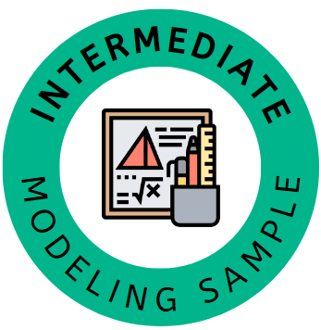
Sample Launch:
Students will watch the clip about a class raising funds to make a playground inclusive for those with disabilities.
Glen Lake Elementary School in Hopkins, Minnesota, has a lot of students with physical disabilities, but it didn't have a playground that was accessible to them. That bothered a fifth-grade class, which stepped in to raise $300,000 to make it accessible.
Notes:
Facilitator Notes:
The slide references the launch from earlier within the session.
Video Launch:
Primary, Intermediate and Middle will watch the video found at: https://www.cbsnews.com/video/students-raise-funds-to-make-playground-inclusive-for-those-with-disabilities/

Slide 35
Identifying the Problem Statement
Modeling problems are often open-ended, which makes defining a clear and concise problem statement especially important.
Using subjective words can support open-endedness (best, efficient, optimal).
Brainstorming should be approached as if you had access to any data you need, knowing you can refine ideas later.
Notes:
Facilitator Notes:
Participants will think about:
How might this component of the modeling cycle provide students with opportunities to engage in the Standards for Mathematical Practice?
How might this component of the modeling cycle equip teachers to implement the Effective Mathematics Teaching Practices?
Adapted from: https://m3challenge.siam.org/wp-content/uploads/siam-guidebook-final-press.pdf

Slide 36
In this sample…
Once students have watched the video, have them
consider:
What do they notice?
What do they wonder?
Ultimately, the hope is for students to explore the prompt:
You have been put in charge of designing a playground and sharing your recommendations with your school leaders and/or local elected officials.
Notes:
Facilitator Notes:
From the National Council of Teachers of Mathematics (NCTM), What is Notice and Wonder?
When students become active doers of mathematics, the greatest gains of their mathematical thinking can be realized. The process of sense making begins when we create classrooms full of curious students' thoughts and ideas.
By asking "What do you notice? What do you wonder?" we help our students see problems in big-picture ways.
Self-confidence, reflective skills, and engagement soar, and students discover that the goal is not to be "over and done," but to discover multiple strategies for tackling a problem.
Source: https://www.nctm.org/noticeandwonder/
Participants should consider:
How might this component of the modeling cycle provide students with opportunities to engage in the Standards for Mathematical Practice?
How might this component of the modeling cycle equip teachers to implement the Effective Mathematics Teaching Practices?

Slide 37
Making Assumptions and Identifying Variables
Assumptions often arise from the process of brainstorming and defining the problem statement.
Different assumptions can lead to different, equally valid models.
Keep track of:
assumptions made to include in the discussion of the model.
units because they can reveal relationships between variables.
Notes:
Facilitator Notes:
Participants will think about what it might look like for students to make assumptions and identify variables in general, then consider what it might look like to have students for the problem statement within this task.
Adapted from: https://m3challenge.siam.org/wp-content/uploads/siam-guidebook-final-press.pdf

Slide 38
In this sample…
You should select and include at least six pieces of equipment (slides, swings, sand boxes, etc.) one of which is a basketball court;
You should design a survey for classmates about which equipment to purchase; The results should be included in the report and be involved in the purchase and placement of the equipment in the playground;
You should include some form of graph or table; (Data Analysis and Probability)
Notes:
Facilitator Notes:
Teachers might begin by giving the students a list of possible options and have them analyze and discuss them. While it might feel like this limits their ability to be creative, it gives students suggestions for possible solution paths and helps them become comfortable with increasingly open-ended problems, opening the door to more creative modeling later. Don’t be afraid to scaffold the early work in this manner, but don’t continue the scaffolding forever. Scaffolding is an aid to modeling, particularly at the beginning, but the true modeling comes only after the scaffolding is removed. When looking at modeling tasks from your instructional resource, look for embedded supports with scaffolding in the teacher materials.
Participants should consider:
How might this component of the modeling cycle provide students with opportunities to engage in the Standards for Mathematical Practice?
How might this component of the modeling cycle equip teachers to implement the Effective Mathematics Teaching Practices?

Slide 39
In this sample…
You should determine what the cost should be for
the playground and include comparisons for
different equipment; (Number and Operation, Algebra)
You should use two-dimensional geometric shapes to layout the playground; Larger shapes should be used for larger pieces of equipment while smaller shapes should be used for smaller pieces of equipment; (Geometry)
You should lay out your playground using the first quadrant of the coordinate plane;
Notes:
Facilitator Notes:
Teachers might begin by giving the students a list of possible options and have them analyze and discuss them. While it might feel like this limits their ability to be creative, it gives students suggestions for possible solution paths and helps them become comfortable with increasingly open-ended problems, opening the door to more creative modeling later. Don’t be afraid to scaffold the early work in this manner, but don’t continue the scaffolding forever. Scaffolding is an aid to modeling, particularly at the beginning, but the true modeling comes only after the scaffolding is removed. When looking at modeling tasks from your instructional resource, look for embedded supports with scaffolding in the teacher materials.
Participants should consider:
How might this component of the modeling cycle provide students with opportunities to engage in the Standards for Mathematical Practice?
How might this component of the modeling cycle equip teachers to implement the Effective Mathematics Teaching Practices?

Slide 40
In this sample…
You should identify how your playground is laid out using the coordinate plane; You should name the positions of the corners of the shapes used to represent the equipment using with ordered pairs; (Geometry, Measurement)
You should describe the layout of the playground including distances between the objects; (Geometry, Measurement)
Notes:
Facilitator Notes:
Teachers might begin by giving the students a list of possible options and have them analyze and discuss them. While it might feel like this limits their ability to be creative, it gives students suggestions for possible solution paths and helps them become comfortable with increasingly open-ended problems, opening the door to more creative modeling later. Don’t be afraid to scaffold the early work in this manner, but don’t continue the scaffolding forever. Scaffolding is an aid to modeling, particularly at the beginning, but the true modeling comes only after the scaffolding is removed. When looking at modeling tasks from your instructional resource, look for embedded supports with scaffolding in the teacher materials.
Participants should consider:
How might this component of the modeling cycle provide students with opportunities to engage in the Standards for Mathematical Practice?
How might this component of the modeling cycle equip teachers to implement the Effective Mathematics Teaching Practices?

Slide 41
In this sample…
You should create scaled three-dimensional models of the playground equipment using geometric solids; (Geometry) – You should include a fence around the playground and incorporate the cost of the fence into the budget; (Number and Operation, Measurement)
You should minimize the space for the rectangular playground; (Algebra, Geometry, Measurement)
Notes:
Facilitator Notes:
Teachers might begin by giving the students a list of possible options and have them analyze and discuss them. While it might feel like this limits their ability to be creative, it gives students suggestions for possible solution paths and helps them become comfortable with increasingly open-ended problems, opening the door to more creative modeling later. Don’t be afraid to scaffold the early work in this manner, but don’t continue the scaffolding forever. Scaffolding is an aid to modeling, particularly at the beginning, but the true modeling comes only after the scaffolding is removed. When looking at modeling tasks from your instructional resource, look for embedded supports with scaffolding in the teacher materials.
Participants should consider:
How might this component of the modeling cycle provide students with opportunities to engage in the Standards for Mathematical Practice?
How might this component of the modeling cycle equip teachers to implement the Effective Mathematics Teaching Practices?

Slide 42
In this sample…
You should include a description of how the shapes might be rotated and still fit in the same space; (Geometry)
You should include a written report to accompany your presentation to the class.
What assumptions and/or variables might students need to identify when thinking about this task?
Notes:
Facilitator Notes:
Teachers might begin by giving the students a list of possible options and have them analyze and discuss them. While it might feel like this limits their ability to be creative, it gives students suggestions for possible solution paths and helps them become comfortable with increasingly open-ended problems, opening the door to more creative modeling later. Don’t be afraid to scaffold the early work in this manner, but don’t continue the scaffolding forever. Scaffolding is an aid to modeling, particularly at the beginning, but the true modeling comes only after the scaffolding is removed. When looking at modeling tasks from your instructional resource, look for embedded supports with scaffolding in the teacher materials.
Participants should consider:
How might this component of the modeling cycle provide students with opportunities to engage in the Standards for Mathematical Practice?
How might this component of the modeling cycle equip teachers to implement the Effective Mathematics Teaching Practices?

Slide 43
Doing the Math
Sample Questions:
Have I seen this type of problem before?
If so, how did I solve it?
If not, how is this problem different?
Would a graph or visual representation help provide insight?
Consider that how students build a solution may depend on what mathematical tools are available.
If you don’t know how to solve the problem at hand, what questions might help you get started?
Notes:
Facilitator Notes:
Participants will think about what it might look like for students to engage with mathematics content and practices within this task.
Adapted from: https://m3challenge.siam.org/wp-content/uploads/siam-guidebook-final-press.pdf

Slide 44
In this sample…
The representations of the equipment evolves from two-
dimensional shapes in prekindergarten–2, to three-dimensional representations in grades 3-5, to three-dimensional representations that are to scale in grades 6-8.
Similarly, the cost or budget for the equipment evolves from an estimate of the cost of the equipment using whole numbers in prekindergarten–2 to a formal budget with constraints that also includes fences etc. in grades 6–8.
Notes:
Facilitator Notes:
Participants should consider:
How might this component of the modeling cycle provide students with opportunities to engage in the Standards for Mathematical Practice?
How might this component of the modeling cycle equip teachers to implement the Effective Mathematics Teaching Practices?

Slide 45
Analyze and Assess the Solution:
Students consider the following questions:
Does it address the problem?
Does it make sense when applied in the real world?
Are the results practical?
Are the answers reasonable?
Are the consequences acceptable?
Notes:
Facilitator Notes:
Participants will think about what it might look like for students to analyze and assess their solution in general before considering what that might look like specifically for this task.

Slide 46
In this sample…
What might it look like for students to consider
these questions with the playground task?
Does it address the problem?
Does it make sense when applied in the real world?
Are the results practical?
Are the answers reasonable?
Are the consequences acceptable?
Notes:
Facilitator Notes:
Participants should consider:
How might this component of the modeling cycle provide students with opportunities to engage in the Standards for Mathematical Practice?
How might this component of the modeling cycle equip teachers to implement the Effective Mathematics Teaching Practices?

Slide 47
Iterating in this sample…
This problem has some characteristics of mathematical modeling and is something of a middle ground between an open-ended problem and a standard assignment.
Students iterate the process as needed to refine and extend a model.
Notes:
Facilitator Notes:
As this problem had some “guardrails” and guidelines for students to follow, this task is the “middle ground” as mentioned on the slide.

Slide 48
Implementing the Model
Students report results to others and implement the solution as part of real-world, practical applications.
List strengths and weaknesses of the model, including specific improvements that might have been made if more time were available.
Notes:
Facilitator Notes:
Participants might consider creative ways for students to showcase their model
Opportunity for Extended Exploration:
Depending on time and opportunities, students could also share their recommendations with school leaders and/or local elected officials. For support in thinking about what that might look like, access the Writing for Publication in Mathematics resource: https://www.education.ky.gov/curriculum/standards/kyacadstand/Documents/Writing_for_Publication_Mathematics.pdf
Writing for Publication allows students to become subject matter experts who communicate their learning to the world, requiring them to make considerations for the needs of their audience in an authentic context beyond the school community.
Adapted from: https://m3challenge.siam.org/wp-content/uploads/siam-guidebook-final-press.pdf

Slide 49
In this sample…
Finally, have students create and share their playground design.
Notes:
Facilitator Notes:
Participants should consider how a task like this might best be used with students based on their local context. In thinking about the task:
What considerations might you prioritize when deciding how to implement this task with students?
What elements would you prioritize being a part of the students’ models?

Slide 50
Middle School
Sample Task
Notes:
Facilitator Notes:
It is critical to note that these example problems are NOT intended to be used as a template for all modeling problems. Real-world problems do not all come packaged the same way, so the best thing to do is to focus on the process, and not on the specific content presented here. In the following section of the module, we will look at sample modeling tasks within high-quality instructional resources.
As a reminder, the focus of our discussion here is on developing familiarity with the components of the modeling cycle and answering the questions:
How might this component of the modeling cycle provide students with opportunities to engage in the Standards for Mathematical Practice?
How might this component of the modeling cycle equip teachers to implement the Effective Mathematics Teaching Practices?
In the following section of the module, we will look at sample modeling tasks within high-quality instructional resources.
Source: GAIMME: Guidelines for Assessment and Instruction in Mathematical Modeling Education, Second Edition, Sol Garfunkel and Michelle Montgomery, editors, COMAP and SIAM, Philadelphia, 2019. http://www.siam.org/Portals/0/Publications/Reports/gaimme-full_color_for_online_viewing.pdf?ver=2018-03-19-115454-057#page=140

Slide 51
Sample Launch:
Students will watch the clip about a class raising funds to make a playground inclusive for those with disabilities.
Glen Lake Elementary School in Hopkins, Minnesota, has a lot of students with physical disabilities, but it didn't have a playground that was accessible to them. That bothered a fifth-grade class, which stepped in to raise $300,000 to make it accessible.
Notes:
Facilitator Notes:
The slide references the launch from earlier within the session.
Video Launch:
Primary, Intermediate and Middle will watch the video found at: https://www.cbsnews.com/video/students-raise-funds-to-make-playground-inclusive-for-those-with-disabilities/

Slide 52
Identifying the Problem Statement
Modeling problems are often open-ended, which makes defining a clear and concise problem statement especially important.
Using subjective words can support open-endedness (best, efficient, optimal).
Brainstorming should be approached as if you had access to any data you need, knowing you can refine ideas later.
Notes:
Facilitator Notes:
Participants will think about:
How might this component of the modeling cycle provide students with opportunities to engage in the Standards for Mathematical Practice?
How might this component of the modeling cycle equip teachers to implement the Effective Mathematics Teaching Practices?
Adapted from: https://m3challenge.siam.org/wp-content/uploads/siam-guidebook-final-press.pdf

Slide 53
In this sample…
Once students have watched the video, have them
consider:
What do they notice?
What do they wonder?
Ultimately, the hope is for students to explore the prompt:
You have been put in charge of designing a playground and sharing your recommendations with your school leaders and/or local elected officials.
Notes:
Facilitator Notes:
From the National Council of Teachers of Mathematics (NCTM), What is Notice and Wonder?
When students become active doers of mathematics, the greatest gains of their mathematical thinking can be realized. The process of sense making begins when we create classrooms full of curious students' thoughts and ideas.
By asking "What do you notice? What do you wonder?" we help our students see problems in big-picture ways.
Self-confidence, reflective skills, and engagement soar, and students discover that the goal is not to be "over and done," but to discover multiple strategies for tackling a problem.
Source: https://www.nctm.org/noticeandwonder/
Participants should consider:
How might this component of the modeling cycle provide students with opportunities to engage in the Standards for Mathematical Practice?
How might this component of the modeling cycle equip teachers to implement the Effective Mathematics Teaching Practices?

Slide 54
Making Assumptions and Identifying Variables
Assumptions often arise from the process of brainstorming and defining the problem statement.
Different assumptions can lead to different, equally valid models.
Keep track of:
assumptions made to include in the discussion of the model.
units because they can reveal relationships between variables.
Notes:
Facilitator Notes:
Participants will think about what it might look like for students to make assumptions and identify variables in general, then consider what it might look like to have students for the problem statement within this task.
Adapted from: https://m3challenge.siam.org/wp-content/uploads/siam-guidebook-final-press.pdf

Slide 55
In this sample…
You should include at least six pieces of equipment
(slides, swings, sand boxes, etc.) in the playground and it should fit into space with a fence on all four sides that is roughly 50 feet by 100 feet; (Measurement)
You should complete a survey of classmates about which equipment to purchase; The results should be included in the report and be involved in the purchase and placement of the equipment in the playground; An appropriate graph should be included; (Data Analysis and Probability)
Notes:
Facilitator Notes:
Teachers might begin by giving the students a list of possible options and have them analyze and discuss them. While it might feel like this limits their ability to be creative, it gives students suggestions for possible solution paths and helps them become comfortable with increasingly open-ended problems, opening the door to more creative modeling later. Don’t be afraid to scaffold the early work in this manner, but don’t continue the scaffolding forever. Scaffolding is an aid to modeling, particularly at the beginning, but the true modeling comes only after the scaffolding is removed. When looking at modeling tasks from your instructional resource, look for embedded supports with scaffolding in the teacher materials.
Participants should consider:
How might this component of the modeling cycle provide students with opportunities to engage in the Standards for Mathematical Practice?
How might this component of the modeling cycle equip teachers to implement the Effective Mathematics Teaching Practices?

Slide 56
In this sample…
You should include a budget that does not exceed
$100,000 and that includes the cost of constructing a fence on all four sides; (Number and Operation)
You should include a scale model of the equipment that uses 3 dimensional geometric shapes, perhaps constructed from cubes appropriately fused together to create objects that represent the equipment; (Number and Operation, Geometry, Measurement)
You should lay out the objects created in sub task 5 on a coordinate plane so that the area that each will take up can be determined; (Geometry, Measurement)
Notes:
Facilitator Notes:
Teachers might begin by giving the students a list of possible options and have them analyze and discuss them. While it might feel like this limits their ability to be creative, it gives students suggestions for possible solution paths and helps them become comfortable with increasingly open-ended problems, opening the door to more creative modeling later. Don’t be afraid to scaffold the early work in this manner, but don’t continue the scaffolding forever. Scaffolding is an aid to modeling, particularly at the beginning, but the true modeling comes only after the scaffolding is removed. When looking at modeling tasks from your instructional resource, look for embedded supports with scaffolding in the teacher materials.
Participants should consider:
How might this component of the modeling cycle provide students with opportunities to engage in the Standards for Mathematical Practice?
How might this component of the modeling cycle equip teachers to implement the Effective Mathematics Teaching Practices?

Slide 57
In this sample…
You should mention what may happen if the
equipment is rotated in some way; (Geometry)
You should include least two feet for a walkway around all of the equipment; The walkways should be represented on the scale model; The total square footage of the material needed to construct the walkways should be included as well; (Number and Operation, Geometry, Measurement)
You should construct the model to scale; (Number and Operation, Geometry, Measurement)
Notes:
Facilitator Notes:
Teachers might begin by giving the students a list of possible options and having them analyze and discuss them. While it might feel like this limits their ability to be creative, it gives students suggestions for possible solution paths and helps them become comfortable with increasingly open-ended problems, opening the door to more creative modeling later. Don’t be afraid to scaffold the early work in this manner, but don’t continue the scaffolding forever. Scaffolding is an aid to modeling, particularly at the beginning, but the true modeling comes only after the scaffolding is removed. When looking at modeling tasks from your instructional resource, look for embedded supports with scaffolding in the teacher materials.
Participants should consider:
How might this component of the modeling cycle provide students with opportunities to engage in the Standards for Mathematical Practice?
How might this component of the modeling cycle equip teachers to implement the Effective Mathematics Teaching Practices?

Slide 58
In this sample…
You should include the surface area of the structures as well as the volume (as appropriate); These will be needed to determine the amount of paint needed and the amount of liquid or sand needed to stabilize certain playground equipment; (Measurement);
You should include a report to accompany the presentation.
What assumptions and/or variables might students need to identify when thinking about this task?
Notes:
Facilitator Notes:
Teachers might begin by giving the students a list of possible options and having them analyze and discuss them. While it might feel like this limits their ability to be creative, it gives students suggestions for possible solution paths and helps them become comfortable with increasingly open-ended problems, opening the door to more creative modeling later. Don’t be afraid to scaffold the early work in this manner, but don’t continue the scaffolding forever. Scaffolding is an aid to modeling, particularly at the beginning, but the true modeling comes only after the scaffolding is removed. When looking at modeling tasks from your instructional resource, look for embedded supports with scaffolding in the teacher materials.
Participants should consider:
How might this component of the modeling cycle provide students with opportunities to engage in the Standards for Mathematical Practice?
How might this component of the modeling cycle equip teachers to implement the Effective Mathematics Teaching Practices?

Slide 59
Doing the Math
Sample Questions:
Have I seen this type of problem before?
If so, how did I solve it?
If not, how is this problem different?
Would a graph or visual representation help provide insight?
Consider that how students build a solution may depend on what mathematical tools are available.
If you don’t know how to solve the problem at hand, what questions might help you get started?
Notes:
Facilitator Notes:
Participants will think about what it might look like for students to engage with mathematics content and practices within this task.
Adapted from: https://m3challenge.siam.org/wp-content/uploads/siam-guidebook-final-press.pdf

Slide 60
In this sample…
The representations of the equipment evolves from
two-dimensional shapes in prekindergarten–2, to three-dimensional representations in grades 3-5, to three-dimensional representations that are to scale in grades 6-8.
Similarly, the cost or budget for the equipment evolves from an estimate of the cost of the equipment using whole numbers in prekindergarten–2 to a formal budget with constraints that also includes fences etc. in grades 6–8.
Notes:
Facilitator Notes:
Participants should consider:
How might this component of the modeling cycle provide students with opportunities to engage in the Standards for Mathematical Practice?
How might this component of the modeling cycle equip teachers to implement the Effective Mathematics Teaching Practices?

Slide 61
Analyze and Assess the Solution:
Students consider the following questions:
Does it address the problem?
Does it make sense when applied in the real world?
Are the results practical?
Are the answers reasonable?
Are the consequences acceptable?
Notes:
Facilitator Notes:
Participants will think about what it might look like for students to analyze and assess their solution in general before considering what that might look like specifically for this task.

Slide 62
In this sample…
What might it look like for students to consider
these questions with the playground task?
Does it address the problem?
Does it make sense when applied in the real world?
Are the results practical?
Are the answers reasonable?
Are the consequences acceptable?
Notes:
Facilitator Notes:
Participants should consider:
How might this component of the modeling cycle provide students with opportunities to engage in the Standards for Mathematical Practice?
How might this component of the modeling cycle equip teachers to implement the Effective Mathematics Teaching Practices?

Slide 63
Iterating in this sample…
This problem has some characteristics of mathematical modeling and is something of a middle ground between an open-ended problem and a typical assignment.
Students need to try several methods based on different definitions and assumptions
Notes:
Facilitator Notes:
As this problem had some “guardrails” and guidelines for students to follow, this task is the “middle ground” as mentioned on the slide.

Slide 64
Implementing the Model
Students report results to others and implement the solution as part of real-world, practical applications.
List strengths and weaknesses of the model, including specific improvements that might have been made if more time were available.
Notes:
Facilitator Notes:
Participants might consider creative ways for students to showcase their model
Opportunity for Extended Exploration:
Depending on time and opportunities, students could also share their recommendations with school leaders and/or local elected officials. For support in thinking about what that might look like, access the Writing for Publication in Mathematics resource: https://www.education.ky.gov/curriculum/standards/kyacadstand/Documents/Writing_for_Publication_Mathematics.pdf
Writing for Publication allows students to become subject matter experts who communicate their learning to the world, requiring them to make considerations for the needs of their audience in an authentic context beyond the school community.
Adapted from: https://m3challenge.siam.org/wp-content/uploads/siam-guidebook-final-press.pdf

Slide 65
In this sample…
Finally, have students create and share their playground design.
Notes:
Facilitator Notes:
Participants should consider how a task like this might best be used with students based on their local context. In thinking about the task:
What considerations might you prioritize when deciding how to implement this task with students?
What elements would you prioritize being a part of the students’ models?

Slide 66
High School Sample Task:
Notes:
Facilitator Notes:
It is critical to note that these example problems are NOT intended to be used as a template for all modeling problems. Real-world problems do not all come packaged the same way, so the best thing to do is to focus on the process, and not on the specific content presented here. In the following section of the module, we will look at sample modeling tasks within high-quality instructional resources.
As a reminder, the focus of our discussion here is on developing familiarity with the components of the modeling cycle and answering the questions:
How might this component of the modeling cycle provide students with opportunities to engage in the Standards for Mathematical Practice?
How might this component of the modeling cycle equip teachers to implement the Effective Mathematics Teaching Practices?
In the following section of the module, we will look at sample modeling tasks within high-quality instructional resources.
Source: GAIMME: Guidelines for Assessment and Instruction in Mathematical Modeling Education, Second Edition, Sol Garfunkel and Michelle Montgomery, editors, COMAP and SIAM, Philadelphia, 2019. http://www.siam.org/Portals/0/Publications/Reports/gaimme-full_color_for_online_viewing.pdf?ver=2018-03-19-115454-057#page=62

Slide 67
Sample Launch:
Hurricanes, earthquakes, floods, tornados, industrial accidents, plane crashes and other similar disasters
occur with distressing regularity and cause the loss of property, personal suffering and sometimes the loss of lives. In the wake of a natural disaster, local or national governments (or private organizations) may set aside a dedicated “pot” of money (or clothing, tents, food, etc.) to help the people or communities affected by the storm with rebuilding or dealing with losses. Unfortunately, the size of the fund is often not large enough to cover all of the legitimate claims that are made against the sum of money allotted to try to relieve suffering.
Notes:
Facilitator Notes:
The slide references the launch from earlier within the session.
Video Launch:
High School will watch the video found at: https://youtu.be/2ij6SKDCQaA.

Slide 68
Identifying the Problem Statement
Modeling problems are often open-ended, which makes defining a clear and concise problem statement especially important.
Using subjective words can support open-endedness (best, efficient, optimal).
Brainstorming should be approached as if you had access to any data you need, knowing you can refine ideas later.
Notes:
Facilitator Notes:
Participants will think about:
How might this component of the modeling cycle provide students with opportunities to engage in the Standards for Mathematical Practice?
How might this component of the modeling cycle equip teachers to implement the Effective Mathematics Teaching Practices?
Adapted from: https://m3challenge.siam.org/wp-content/uploads/siam-guidebook-final-press.pdf

Slide 69
In this sample…
Once students have watched the video and read the
prompt, have them consider:
What do they notice?
What do they wonder?
Ultimately, the hope is for students to explore the prompt:
Devise a fair system for the fund administrator to distribute a total amount of E dollars to the claimants.
Notes:
Facilitator Notes:
From the National Council of Teachers of Mathematics (NCTM), What is Notice and Wonder?
When students become active doers of mathematics, the greatest gains of their mathematical thinking can be realized. The process of sense making begins when we create classrooms full of curious students' thoughts and ideas.
By asking "What do you notice? What do you wonder?" we help our students see problems in big-picture ways.
Self-confidence, reflective skills, and engagement soar, and students discover that the goal is not to be "over and done," but to discover multiple strategies for tackling a problem.
Source: https://www.nctm.org/noticeandwonder/
Participants should consider:
How might this component of the modeling cycle provide students with opportunities to engage in the Standards for Mathematical Practice?
How might this component of the modeling cycle equip teachers to implement the Effective Mathematics Teaching Practices?
Note: Sample responses are provided on the next slide.

Slide 70
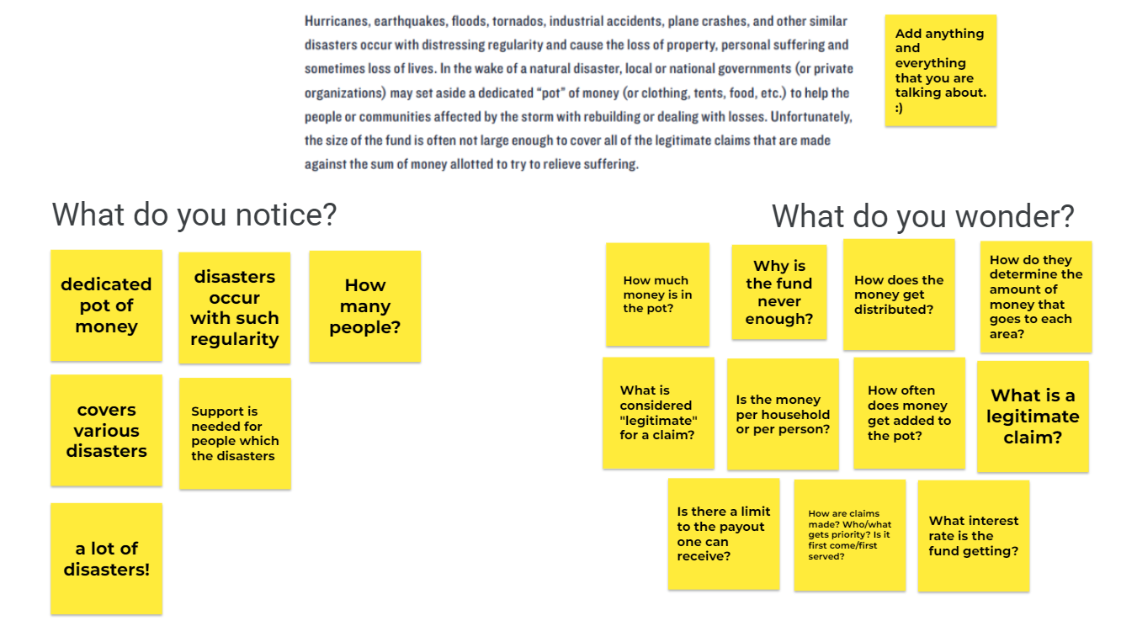
Sample responses: Notice & Wonder
Notes:
Facilitator Notes:
The slide provides a sample of what a notice/wonder brainstorm might look like. Honoring every idea shared is an important part of this routine. It might be helpful to point out that several of the sample wonderings coalesce around the central idea of “What is a fair way to distribute the funds?”
Other questions not being explored at this time can be held for future explorations or included as extension opportunities.

Slide 71
Making Assumptions and Identifying Variables
Assumptions often arise from the process of brainstorming and defining the problem statement.
Different assumptions can lead to different, equally valid models.
Keep track of:
assumptions made to include in the discussion of the model.
units because they can reveal relationships between variables.
Notes:
Facilitator Notes:
Participants will think about what it might look like for students to make assumptions and identify variables in general, then consider what it might look like to have students for the problem statement within this task.
Adapted from: https://m3challenge.siam.org/wp-content/uploads/siam-guidebook-final-press.pdf

Slide 72
In this sample…
Students select information important in the question and identify relations between them. They decide what information and relationships are relevant, resulting in an idealized version of the original question.
For us today, what are some methods that might be used to distribute the funds?
Notes:
Facilitator Notes:
Teachers might begin by giving the students a list of possible options and having them analyze and discuss them. While it might feel like this limits their ability to be creative, it gives students suggestions for possible solution paths and helps them become comfortable with increasingly open-ended problems, opening the door to more creative modeling later. Don’t be afraid to scaffold the early work in this manner, but don’t continue the scaffolding forever. Scaffolding is an aid to modeling, particularly at the beginning, but the true modeling comes only after the scaffolding is removed. When looking at modeling tasks from your instructional resource, look for embedded supports with scaffolding in the teacher materials.
Participants should consider:
How might this component of the modeling cycle provide students with opportunities to engage in the Standards for Mathematical Practice?
How might this component of the modeling cycle equip teachers to implement the Effective Mathematics Teaching Practices?
Note: Sample responses are provided on the next slide.

Slide 73
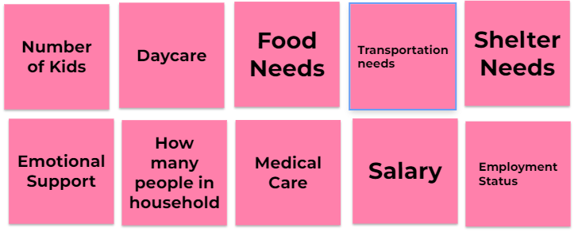
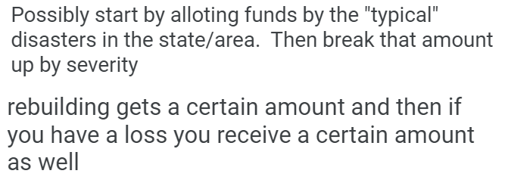
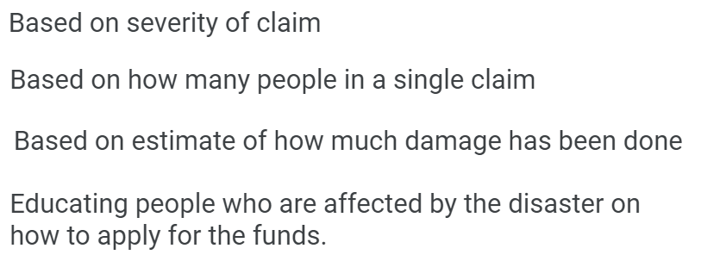
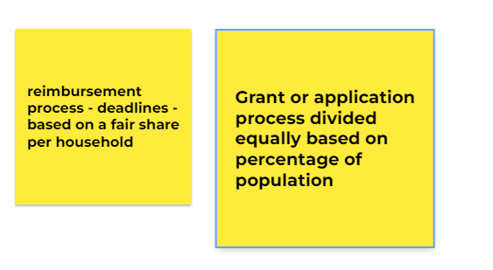
Sample Jamboard Responses to “What are some methods that might be used to distribute the funds?”
Notes:
Facilitator Notes:
The slide provides a sample brainstorm might look like.
Other questions not being explored at this time can be held for future explorations or included as extension opportunities.

Slide 74
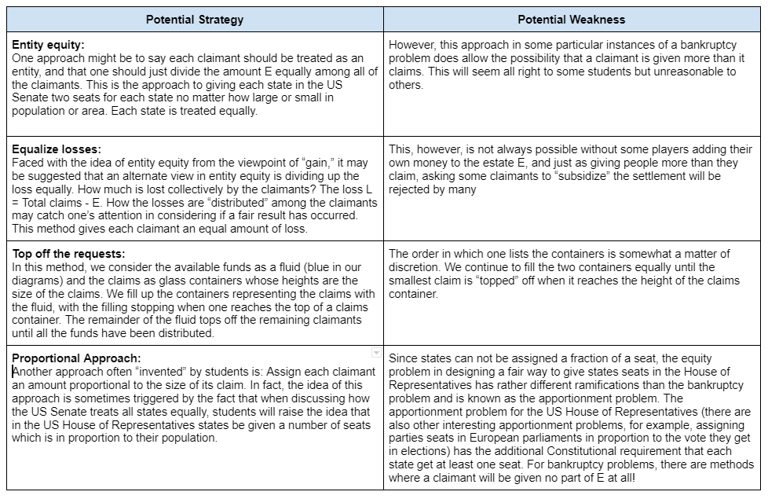
From the GAIMME Report
Notes:
Facilitator Notes:
These are four sample strategies included in the GAIMME report.

Slide 75
Doing the Math
Sample Questions:
Have I seen this type of problem before? If so, how did I solve it? If not, how is this problem different?
Is the model linear or nonlinear?
Would a graph or visual representation help provide insight?
Consider that how students build a solution may depend on what mathematical tools are available.
If you don’t know how to solve the problem at hand, what questions might help you get started?
Notes:
Facilitator Notes:
Participants will think about what it might look like for students to engage with mathematics content and practices within this task.
Adapted from: https://m3challenge.siam.org/wp-content/uploads/siam-guidebook-final-press.pdf

Slide 76
In this sample…
Consider the fairness of your model:
Suppose the pot of money is E = $210 and Claimant A has verified claims of $160 and Claimant B has verified claims of $100.
How would your model distribute the funds?
Notes:
Facilitator Notes:
Participants should consider:
How might this component of the modeling cycle provide students with opportunities to engage in the Standards for Mathematical Practice?
How might this component of the modeling cycle equip teachers to implement the Effective Mathematics Teaching Practices?

Slide 77
Analyze and Assess the Solution:
Students consider the following questions:
Does it address the problem?
Does it make sense when applied in the real world?
Are the results practical?
Are the answers reasonable?
Are the consequences acceptable?
Notes:
Facilitator Notes:
Participants will think about what it might look like for students to analyze and assess their solution in general before considering what that might look like specifically for this task.

Slide 78
In this sample…
What might it look like for students to consider
these questions in the context of the “fairness” task?
Does it address the problem?
Does it make sense when applied in the real world?
Are the results practical?
Are the answers reasonable?
Are the consequences acceptable?
Notes:
Facilitator Notes:
Participants should consider:
How might this component of the modeling cycle provide students with opportunities to engage in the Standards for Mathematical Practice?
How might this component of the modeling cycle equip teachers to implement the Effective Mathematics Teaching Practices?

Slide 79
Iterating in this sample…
This problem, as presented here, has some characteristics of mathematical modeling and is something of a middle ground between an open-ended problem and a standard assignment.
Students need to try several methods based on different definitions of and assumptions about fairness. Small steps taken consistently can lead to large gains.
Notes:
Facilitator Notes:
As this problem had some “guardrails” and guidelines for students to follow, this task is the “middle ground” as mentioned on the slide.
The following slides provide sample iterations.

Slide 80
Iterations for this sample…
How would your method handle the following instances?
$1000 is available with claims of
A: 200 B: 400 C: 600
$1000 is available with claims of
A: 1000 B: 1200 C: 1600
$1000 is available with claims of
A: 800 B: 1000 C: 1200
Notes:
Facilitator Notes:
Sample iterations from the GAIMME report.

Slide 81
Iterations for this sample…
Instance 1: Estate E = 210 with two claims:
A claims 60, B claims 210
Suppose, instead, E=40 and the claims remain the same.
Instance 2: Estate E = 100 with four claims:
A claims 40, B claims 40, C claims 60, D claims 160
Suppose, instead, E = 150; E = 210; and E - 280 and the claims remain the same in each instance.
Instance 3: Estate E = 300 with four claims:
A claims 10, B claims 20, C claims 30, D claims 440
Suppose, instead, E = 40; and E = 400, with the claims remaining the same.
Notes:
Facilitator Notes:
Sample iterations from the GAIMME report.

Slide 82
Implementing the Model
Students report results to others and implement the solution as part of real-world, practical applications.
List strengths and weaknesses of the model, including specific improvements that might have been made if more time were available.
Notes:
Facilitator Notes:
Participants might consider creative ways for students to showcase their model
Opportunity for Extended Exploration:
Depending on time and opportunities, students could also share their recommendations with school leaders and/or local elected officials. For support in thinking about what that might look like, access the Writing for Publication in Mathematics resource: https://www.education.ky.gov/curriculum/standards/kyacadstand/Documents/Writing_for_Publication_Mathematics.pdf
Writing for Publication allows students to become subject matter experts who communicate their learning to the world, requiring them to make considerations for the needs of their audience in an authentic context beyond the school community.
Adapted from: https://m3challenge.siam.org/wp-content/uploads/siam-guidebook-final-press.pdf

Slide 83
Implementing the Model
Finally, have students create and defend their own method for “fairly” distributing the funds.
Notes:
Facilitator Notes:
Participants should consider how a task like this might best be used with students based on their local context. In thinking about the task:
What considerations might you prioritize when deciding how to implement this task with students?
What elements would you prioritize being a part of the students’ models?

Slide 84
Reflection
Draw a card from the deck. Based on the suit, share your reflection based on Session 1.
Hearts: What might be some ways in which this learning stretched you?
Diamonds: What might be some resources you found most helpful? How so?
Spades: What might be some reasons this learning is important to your work?
Clubs: How were the session conversations helpful to you?
Notes:
Facilitator Notes:
Before looking ahead to where we are going in Session 2, there is value in looking at where we have been.
● Hearts: What is something you tried in your classroom this year for the first time? How did it go?
● Diamonds: What is one way you grew professionally this year?
● Spades: Who amongst your colleagues was helpful to you? Why?
● Clubs: In what ways were you helpful to your colleagues this year? We will discuss in a round-robin style, allowing each participant about 1 minute to share.” Set a timer to allow for about 1 minute of sharing per person within each group.
Facilitators might pass out cards once participants have returned to their seats after the gallery walk or have decks available at each table.
THINK - PAIR - SHARE (5 Minutes)
THINK: Give participants 1-2 minutes of independent think time to reflect
PAIR: Then invite participants to share with partners or in table groups
SHARE: Invite each table to share a key theme from their conversation.
Materials:
Deck of cards (optional)

Slide 85
Introduction to the Modeling Cycle
Section 2

Slide 86
During our session together, we will:
use the Kentucky Academic Standards (KAS) for Mathematics and the GAIMME Report to:
Explore the components of the modeling cycle.
Engage in a modeling task through the lens of a student and a teacher.
Look for opportunities to incorporate components of the modeling cycle within available instructional resources.
Notes:
Facilitator Notes:
As a foundational resource for the Kentucky Academic Standards (KAS) for Mathematics, the Guidelines for Assessment and Instruction in Mathematical Modeling Education (GAIMME) helped inform The Modeling Process. Throughout this professional learning we will draw upon the standards and the GAIMME report as we:
Explore the components of the modeling cycle.
Engage in a modeling task through the lens of a student and a teacher.
Look for opportunities to incorporate components of the modeling cycle within available instructional resources.

Slide 87
Existing State → → → Desired State
A focus on the PRESENT:
How would you (or your students) describe math teaching and learning in your school right now?
A focus on the POSSIBILITIES:
How would you (or your students) describe ideal math teaching and learning in your school?
Notes:
Facilitator Notes:
As we prepare to continue our learning relating to the modeling cycle, consider:
To focus on the present: How would you (or your students) describe math teaching and learning in your school right now?
To focus on the possibilities: How would you (or your students) describe ideal math teaching and learning in your school?
You’ll have one minute to capture your thinking on sticky notes, one word per sticky note. Then, as a table (or with a partner) you’ll share some of your sticky notes and sort them into groups - Present and Possibilities - on your table.
THINK - PAIR - SHARE (5 Minutes)
THINK: Give participants 1 minute of independent think time to brainstorm ideas
PAIR: Then invite participants to work as table to share and sort their sticky notes (About 3 minutes)
SHARE: Invite each table to share a key theme from their conversation. (About 1 minute)
Materials Needed:
Sticky Notes
Markers

Slide 88
Getting Started with
The Modeling Cycle
Notes:
Facilitator Notes:
Once participants have informally explored a modeling task that might be used with their grade band and they have a better understanding of what the components of the modeling cycle might look like, it’s important to consider what it might look like to “get started” with The Modeling Cycle.

Slide 89
Tips for Getting Started
Start small
Scaffold initial experiences with leading questions and class discussion
Use common, everyday experiences to motivate the use of mathematics
Use bite-sized modeling scenarios that require only one or two components of a full modeling cycle
Share your goals and instructional practices with parents and administrators
Notes:
Facilitator Notes:
The GAIMME Report mentions, “For experienced modelers, the statements above might be all they need to get started. But for beginners, that would be totally overwhelming. So, we start small with some probing questions for students to consider. We make the problem similar to exercises students have done in the past, but with some open-ended questions at the end.”
Educators in schools/districts with adopted High-Quality Instructional Resources (HQIRs) should look to that HQIR as a starting point for support engaging students in the Modeling Cycle as the HQIR likely provides guidance around facilitating the learning experience.

Slide 90
An Excerpt From the GAIMME Report
Access GAIMME Report excerpt for your grade band.
As you read, consider:
In what ways might engaging in the modeling process support teachers in implementing effective mathematics teaching practices?
In what ways might engaging in the modeling process support student engagement in the standards for mathematical practice?
What aspects of this example of the modeling process are similar to or different from your own teaching of mathematics?
Notes:
Facilitator Notes:
This short excerpt from the GAIMME report is designed to show how contexts that might feel more “typical” or “traditional” can develop into tasks that engage students in the modeling process.
Once participants have had time to read, invite whole group discussion around the questions on the slide.
Materials Needed:
Excerpt from the GAIMME Report: Elementary: https://education.ky.gov/curriculum/standards/kyacadstand/Documents/GAIMME_Excerpt_Elementary.pdf
Excerpt from the GAIMME Report: Secondary: https://education.ky.gov/curriculum/standards/kyacadstand/Documents/GAIMME_Excerpt_Secondary.pdf

Slide 91
Whole-Group Discussion:
In what ways might engaging in the modeling process support teachers in implementing effective mathematics teaching practices?
In what ways might engaging in the modeling process support student engagement in the standards for mathematical practice?
What aspects of this example of the modeling process are similar to or different from your own teaching of mathematics?
Notes:
Facilitator Notes:
Invite participants to share thinking around the guiding questions.

Slide 92
The Modeling Cycle and Instructional Resources
Looking for opportunities to incorporate components of the modeling cycle within available instructional resources
Notes:
Facilitator Notes:
Participants will explore the modeling tasks (including instructional supports) within available instructional resources.
Educators in schools/districts with adopted High-Quality Instructional Resources (HQIRs) should look to that HQIR as a starting point for support engaging students in the Modeling Cycle as the HQIR likely provides guidance around facilitating the learning experience.

Slide 93
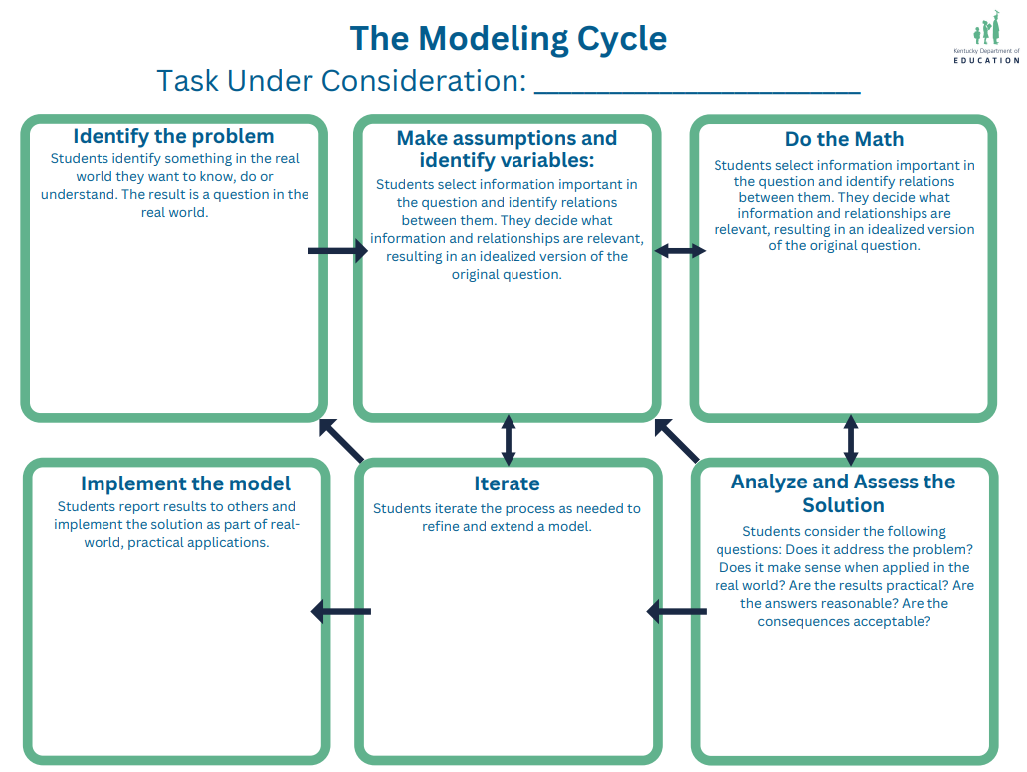
What might the modeling cycle look like using available instructional resources?
Part 1: Task Consideration
Part 2: SWOT Analysis
Notes:
Facilitator Notes:
As we explore what modeling supports are within your available instructional resources, you’ll need access to the Task Consideration and the SWOT Analysis documents.
Materials Needed:
Modeling Task Consideration SWOT Analysis Template
https://education-edit.ky.gov/curriculum/standards/kyacadstand/Documents/Modeling_Task_Consideration_SWOT_Analysis.pdf

Slide 94
Part 1: Task Consideration
What you’ll need:
A copy of the task you envision engaging students in the modeling cycle.
A task labeled “modeling” within your instructional resource
A task with modeling “potential” based on your understanding of the modeling cycle
What you’ll do:
Identify where the components of the modeling cycle shows up in the task as written.
Capture your thoughts and questions about what teaching and learning might look like during each component.
Notes:
Facilitator Notes:
You’re going to be examining your modeling task to identify where the components of the modeling cycle show up in the task as written. As you examine the task, also consider what ideas and questions you have related to what teaching and learning might look like during each component.
Educators in schools/districts with adopted High-Quality Instructional Resources (HQIRs) should look to that HQIR as a starting point for support engaging students in the Modeling Cycle as the HQIR likely provides guidance around facilitating the learning experience.
Materials Needed:
Modeling Task Consideration SWOT Analysis Template
https://education-edit.ky.gov/curriculum/standards/kyacadstand/Documents/Modeling_Task_Consideration_SWOT_Analysis.pdf

Slide 95
Part 2: SWOT Analysis
As you review a modeling task from your instructional resource, consider the following questions:
What might you consider STRENGTHS related to how the task engages students with the modeling cycle?
What might you consider WEAKNESSES related to how the task engages students with the modeling cycle?
What OPPORTUNITIES might you see?
How might you TAKE ACTION?
Notes:
Facilitator Notes:
Now that you’ve examined your task, complete the SWOT analysis to identify:
What might you consider STRENGTHS related to how the task engages students with the modeling cycle?
What might you consider WEAKNESSES related to how the task engages students with the modeling cycle?
What OPPORTUNITIES might you see?
How might you TAKE ACTION?
Educators in schools/districts with adopted High-Quality Instructional Resources (HQIRs) should look to that HQIR as a starting point for support engaging students in the Modeling Cycle as the HQIR likely provides guidance around facilitating the learning experience.
Materials Needed:
Modeling Task Consideration SWOT Analysis Template
https://education-edit.ky.gov/curriculum/standards/kyacadstand/Documents/Modeling_Task_Consideration_SWOT_Analysis.pdf

Slide 96
Choose Your Own Adventure
From Your HQIR:
KDE Samples:
Complete the graphic organizers based on:
A task labeled “modeling” within your instructional resource
A task with modeling “potential” based on your understanding of the modeling cycle
Complete the graphic organizers based on:
Elementary Mathematics:
enVision Mathematics: Piled Up
Annotated Sample Graphic Organizer
Secondary Mathematics:
Illustrative Mathematics: Planning a Vacation
Annotated Sample Graphic Organizers
Notes:
Facilitator Notes:
Facilitators may want to adjust this section based on the needs of the audience. For schools/districts who have adopted an HQIR, exploring that HQIR more in-depth through this process may support successful implementation. For schools/districts who have not adopted HQIRs, there may be a benefit to exploring the KDE provided samples as participants will see firsthand the benefits of the facilitator supports evident within an HQIR. Depending on the timing and/or the needs of the participants, facilitators may find benefits in completing the graphic organizers together first using common KDE samples and then invite participants to work in small groups exploring another modeling task of their choosing from their instructional resource. Much of this decision-making will be based on time available and the needs of the specific audience.

Slide 97
Existing State → → → Desired State
A focus on the PRESENT:
A focus on POSSIBILITIES:
How might engaging in the modeling cycle support mathematics teaching and learning in your school?
What assets did you notice from your instructional resource to support this shift?
Notes:
Facilitator Notes:
Let’s revisit our thinking from the beginning of the session. Having now explored another modeling task, this time from your instructional resource, what reflections might you have that relate to your original sticky note brainstorming and table sort:
How might engaging in the modeling cycle support mathematics teaching and learning in your school?
What assets did you notice from your instructional resource to support this shift?

Slide 98
Reflection

Slide 99
Stoplight Chat
PURPOSE AND INTENTIONS
Reflect on content and connect to current work..
Take a moment to consider:
What might be one thing you’ll START based on today’s session?
What might be one thing you’ll CONTINUE based on today’s session?
What might be one thing you’ll STOP based on today’s session?
Notes:
Facilitator Notes:
Allow participants a few minutes to reflect on the content of the session and consider connections to current work. Once participants have had a few moments to reflect, consider offering participants the opportunity to share whole group or facilitating a shift into pairs (such as Stand up, Hand up, Pair up) to share reflections in a smaller setting.
Once participants have completed the reflection, thank them for attending, share the KDE Feedback survey information.
The KDE needs your feedback on the effectiveness of this module, the learning platform and how the consultants may best support you as you take the next steps. Feedback from your surveys will be used by the KDE to plan and prepare future professional learning opportunities.
Materials Needed:
Handout 1 Page 1 https://education.ky.gov/curriculum/standards/kyacadstand/Documents/Introduction_to_Modeling_Handout_1.pdf
Kentucky Department of Education Professional Learning Modules Feedback Survey
https://forms.office.com/Pages/ResponsePage.aspx?id=H8Fgk-aQBketACX83J4u0R502Mh4cJZPnd5bIKZJykxUMlRYS09SNjNCOFpWNVVZWVpINUxYSUQyUy4u
Be sure to thank participants for their work throughout this module as it has provided a foundation for future knowledge. To you, the facilitator, thank you for providing participants with knowledge and support throughout this process. The KDE greatly values your role in leading the Introduction to the Modeling Cycle module. We appreciate your time and effort in leading your school/district in the successful implementation of the modeling cycle within mathematics classrooms. Thank you!
Source: https://4deefe9b-2cd7-4227-9bfc-3ed4b9a356ea.filesusr.com/ugd/6a5cc9_ed28b325ab6a4362b834f4bbf295d408.pdf#page=265

